Slide 1
Lecture 1

Slide 2
What is computer networking?
Computer Network is a group of computers connected with each other through wires, optical fibers or optical links so that various devices can interact with each other through a network.
The aim of the computer network is the sharing of resources among various devices.
In the case of computer network technology, there are several types of networks that vary from simple to complex level.

Slide 3
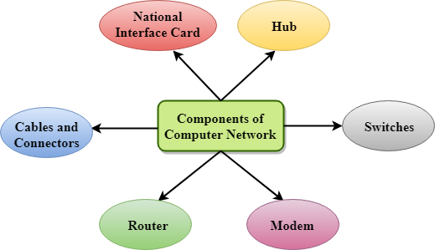
Components Of Computer Network

Slide 4
Major components of a computer network are
NIC(National interface card)
Hub
Switches
Cables and connectors
Router
Modem

Slide 5
NIC(National interface card)
NIC is a device that helps the computer to communicate with another device. The network interface card contains the hardware addresses, the data-link layer protocol use this address to identify the system on the network so that it transfers the data to the correct destination.

Slide 6
Two types of NIC
Wireless NIC: All the modern laptops use the wireless NIC. In Wireless NIC, a connection is made using the antenna that employs the radio wave technology.
Wired NIC: Cables use the wired NIC to transfer the data over the medium.

Slide 7
Hub
Hub is a central device that splits the network connection into multiple devices. When computer requests for information from a computer, it sends the request to the Hub. Hub distributes this request to all the interconnected computers.

Slide 8
Switches
Switch is a networking device that groups all the devices over the network to transfer the data to another device. A switch is better than Hub as it does not broadcast the message over the network, i.e., it sends the message to the device for which it belongs to. Therefore, we can say that switch sends the message directly from source to the destination.

Slide 9
Cables and connectors
Cable is a transmission media that transmits the communication signals. There are three types of cables:
Twisted pair cable: It is a high-speed cable that transmits the data over 1Gbps or more.
Coaxial cable: Coaxial cable resembles like a TV installation cable. Coaxial cable is more expensive than twisted pair cable, but it provides the high data transmission speed.
Fiber optic cable: Fiber optic cable is a high-speed cable that transmits the data using light beams. It provides high data transmission speed as compared to other cables. It is more expensive as compared to other cables, so it is installed at the government level.

Slide 10
Router
Router is a device that connects the LAN to the internet. The router is mainly used to connect the distinct networks or connect the internet to multiple computers.

Slide 11
Modem
Modem connects the computer to the internet over the existing telephone line. A modem is not integrated with the computer motherboard. A modem is a separate part on the PC slot found on the motherboard.

Slide 12
Uses Of Computer Network
Resource sharing: Resource sharing is the sharing of resources such as programs, printers, and data among the users on the network without the requirement of the physical location of the resource and user.
Server-Client model: Computer networking is used in the server-client model. A server is a central computer used to store the information and maintained by the system administrator. Clients are the machines used to access the information stored in the server remotely.
Communication medium: Computer network behaves as a communication medium among the users. For example, a company contains more than one computer has an email system which the employees use for daily communication.
E-commerce: Computer network is also important in businesses. We can do the business over the internet. For example, amazon.com is doing their business over the internet, i.e., they are doing their business over the internet.

Slide 13
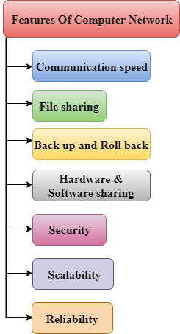
Features Of Computer network

Slide 14
Communication speed
Network provides us to communicate over the network in a fast and efficient manner. For example, we can do video conferencing, email messaging, etc. over the internet. Therefore, the computer network is a great way to share our knowledge and ideas.

Slide 15
File sharing
File sharing is one of the major advantage of the computer network. Computer network provides us to share the files with each other.

Slide 16
Back up and Roll back is easy
Since the files are stored in the main server which is centrally located. Therefore, it is easy to take the back up from the main server.

Slide 17
Software and Hardware sharing
We can install the applications on the main server, therefore, the user can access the applications centrally. So, we do not need to install the software on every machine. Similarly, hardware can also be shared.

Slide 18
Security
Network allows the security by ensuring that the user has the right to access the certain files and applications.

Slide 19
Scalability
Scalability means that we can add the new components on the network. Network must be scalable so that we can extend the network by adding new devices. But, it decreases the speed of the connection and data of the transmission speed also decreases, this increases the chances of error occurring. This problem can be overcome by using the routing or switching devices.

Slide 20
Reliability
Computer network can use the alternative source for the data communication in case of any hardware failure.

Slide 21
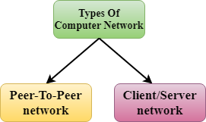
Computer Network Architecture

Slide 22
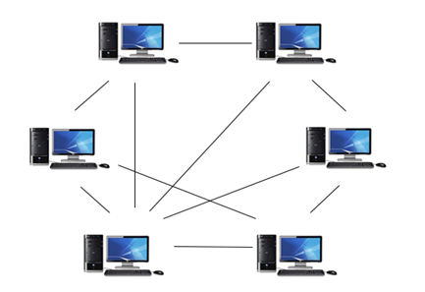
Peer-To-Peer network

Slide 23
Details
Peer-To-Peer network is a network in which all the computers are linked together with equal privilege and responsibilities for processing the data.
Peer-To-Peer network is useful for small environments, usually up to 10 computers.
Peer-To-Peer network has no dedicated server.
Special permissions are assigned to each computer for sharing the resources, but this can lead to a problem if the computer with the resource is down.

Slide 24
Advantages Of Peer-To-Peer Network
It is less costly as it does not contain any dedicated server.
If one computer stops working but, other computers will not stop working.
It is easy to set up and maintain as each computer manages itself

Slide 25
Disadvantages Of Peer-To-Peer Network
In the case of Peer-To-Peer network, it does not contain the centralized system . Therefore, it cannot back up the data as the data is different in different locations.
It has a security issue as the device is managed itself.

Slide 26
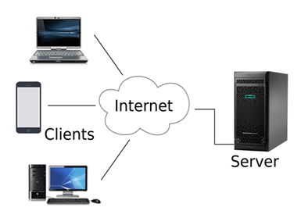
Client/Server Network

Slide 27
Details
Client/Server network is a network model designed for the end users called clients, to access the resources such as songs, video, etc. from a central computer known as Server.
The central controller is known as a server while all other computers in the network are called clients.
A server performs all the major operations such as security and network management.
A server is responsible for managing all the resources such as files, directories, printer, etc.
All the clients communicate with each other through a server. For example, if client1 wants to send some data to client 2, then it first sends the request to

Slide 28
Advantages Of Client/Server network:
A Client/Server network contains the centralized system. Therefore we can back up the data easily.
A Client/Server network has a dedicated server that improves the overall performance of the whole system.
Security is better in Client/Server network as a single server administers the shared resources.
It also increases the speed of the sharing resources.

Slide 29
Disadvantages Of Client/Server network:
Client/Server network is expensive as it requires the server with large memory.
A server has a Network Operating System(NOS) to provide the resources to the clients, but the cost of NOS is very high.
It requires a dedicated network administrator to manage all the resources.

Slide 30


