Slide 1
Software Development Life Cycle

Slide 2
What is software development life cycle?
Software Development Life Cycle (SDLC) is a process used by the software industry to design, develop and test high quality software's.

Slide 3
Software Development Life cycle Models
Waterfall Model
Agile Model
RAD Model
Spiral Model
V-Model
Incremental Model
Iterative Model

Slide 4
Waterfall Model
The waterfall model is a classical model used in system development life cycle to create a system with a linear and sequential approach. It is termed as waterfall because the model develops systematically from one phase to another in a downward fashion.

Slide 5

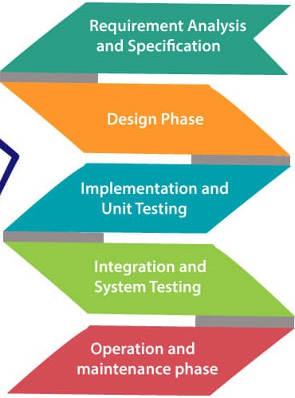
Waterfall Model Phases
Requirement Phase:Requirement are collected from clients and stalkholders
Design Phase: UI design, Database Design are done in these phase.
Implementation and Unit Testing: Coding phase is done, and unit testing is done in these phase
Integration and System Testing: All the code that was divided and modules are integrated, and system testing done.
Operation and Maintenance: After deployment these phases is performed.

Slide 6
When waterfall should be used
Short Project
Requirement fixed
Consistent Tools and Technology
Resources are well prepared

Slide 7
Advantages of Waterfall
This model is simple to implement also the number of resources that are required for it is minimal.
The requirements are simple and explicitly declared; they remain unchanged during the entire project development.
The start and end points for each phase is fixed, which makes it easy to cover progress.
The release date for the complete product, as well as its final cost, can be determined before development.
It gives easy to control and clarity for the customer due to a strict reporting system.

Slide 8
Disadvantages of Waterfall
In this model, the risk factor is higher, so this model is not suitable for more significant and complex projects.
This model cannot accept the changes in requirements during development.
It becomes tough to go back to the phase. For example, if the application has now shifted to the coding phase, and there is a change in requirement, It becomes tough to go back and change it.
Since the testing done at a later stage, it does not allow identifying the challenges and risks in the earlier phase, so the risk reduction strategy is difficult to prepare.

Slide 9
Agile Model
"Agile process model" refers to a software development approach based on iterative development

Slide 10
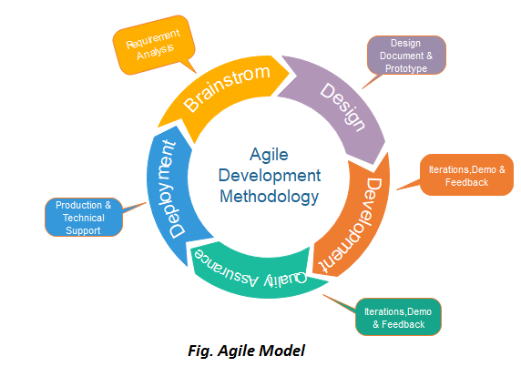
Agile Model Phases
Requirement Gathering: Requirement are gathered from the stakeholders.
Design And Requirement:High level diagrams and flowcharts are designed in these phase.
Development: Coding is done in these phase.
Quality Assurance: Different types of testing are done in these phase.
Deployment: Developed project is deployed.
Feedback and Maintenance: Feedback is received from users and maintenance is done.

Slide 11
Popular Agile Frameworks
Scrum
Kanban
Extreme Programming

Slide 12
When to use Agile Method
When frequent changes are required.
When a highly qualified and experienced team is available.
When a customer is ready to have a meeting with a software team all the time.

Slide 13
Advantage of Agile Methodology
Frequent Delivery
Face-to-Face Communication with clients.
Efficient design and fulfils the business requirement.
Anytime changes are acceptable.
It reduces total development time.

Slide 14
Disadvantages of Agile Methodology
Due to the shortage of formal documents, it creates confusion and crucial decisions taken throughout various phases can be misinterpreted at any time by different team members.
Due to the lack of proper documentation, once the project completes and the developers allotted to another project, maintenance of the finished project can become a difficult

Slide 15
RAD Model
The Rapid Application Development (or RAD) model is based on prototyping and iterative model with no (or less) specific planning. AD approach to software development means putting lesser emphasis on planning tasks and more emphasis on development and coming up with a prototype.

Slide 16
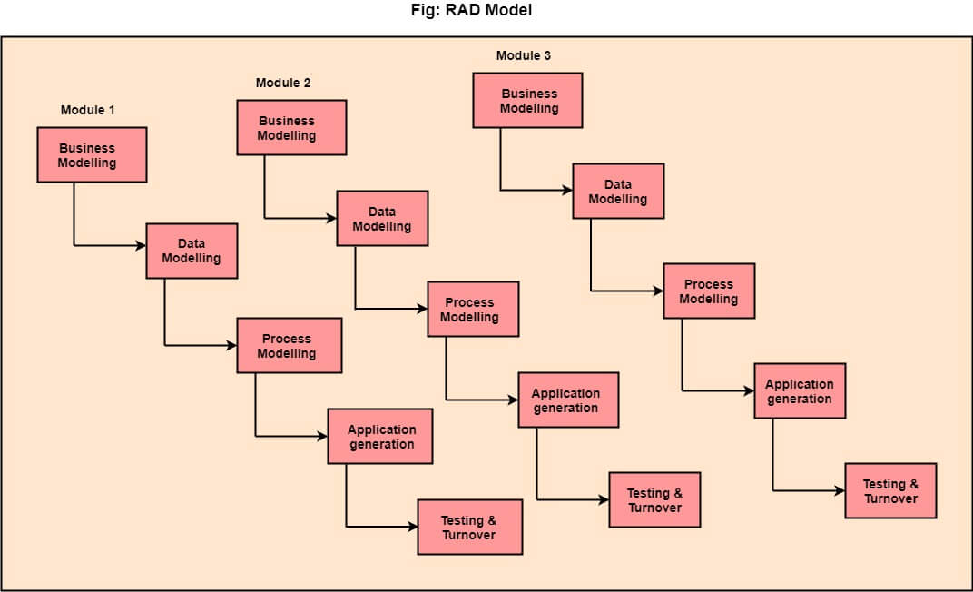
Phases of Rad model
Business Model: By gathering requirements from stakeholderrs a business model is prepared.
Data Modeling: Data gathered from the previous phase are identified and data model is prepared.
Process Modeling: Processing descriptions are created for adding, modifying, deleting, or retrieving a data object.
Application Generation: Automated tools are used to facilitate construction of the software; even they use the 4th GL techniques.
Testing and Turnover: Many of the programming components have already been tested since RAD emphasis reuse. This reduces the overall testing time. But the new part must be tested, and all interfaces must be fully exercised.

Slide 17
When to use RAD Model
When the system should need to create the project that modularizes in a short span time (2-3 months).
When the requirements are well-known.
When the technical risk is limited.
When there's a necessity to make a system, which modularized in 2-3 months of period.
It should be used only if the budget allows the use of automatic code generating tools.

Slide 18
Advantages of RAD Model
This model is flexible for change.
In this model, changes are adoptable.
Each phase in RAD brings highest priority functionality to the customer.
It reduced development time.
It increases the reusability of features.

Slide 19
Disadvantages of RAD Model
It required highly skilled designers.
All application is not compatible with RAD.
For smaller projects, we cannot use the RAD model.
On the high technical risk, it's not suitable.
Required user involvement.

Slide 20
Spiral Model
The spiral model is similar a incremental development for a system, with more emphasis placed on risk analysis.

Slide 21
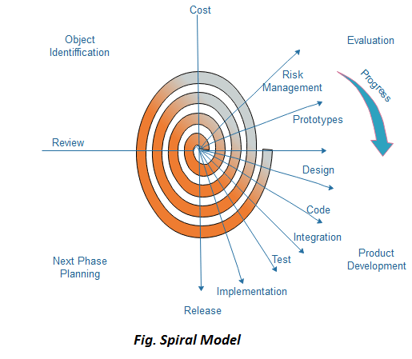
Phases or cycle of spiral model
Objective setting: Each cycle in the spiral starts with the identification of purpose for that cycle, the various alternatives that are possible for achieving the targets, and the constraints that exists.
Risk Assessment and reduction: The next phase in the cycle is to calculate these various alternatives based on the goals and constraints. The focus of evaluation in this stage is located on the risk perception for the project.
Development and validation: The next phase is to develop strategies that resolve uncertainties and risks. This process may include activities such as benchmarking, simulation, and prototyping.
Planning: Finally, the next step is planned. The project is reviewed, and a choice made whether to continue with a further period of the spiral. If it is determined to keep, plans are drawn up for the next step of the project.

Slide 22
When to use Spiral Model
When deliverance is required to be frequent.
When the project is large
When requirements are unclear and complex
When changes may require at any time
Large and high budget projects

Slide 23
Advantage of Spiral Model
High amount of risk analysis
Useful for large and mission-critical projects.

Slide 24
Disadvantage of Spiral Model
Can be a costly model to use.
Risk analysis needed highly particular expertise
Doesn't work well for smaller projects.

Slide 25
V-Model
V-Model also referred to as the Verification and Validation Model. In this, each phase of SDLC must complete before the next phase starts. It follows a sequential design process same as the waterfall model. Testing of the device is planned in parallel with a corresponding stage of development.

Slide 26
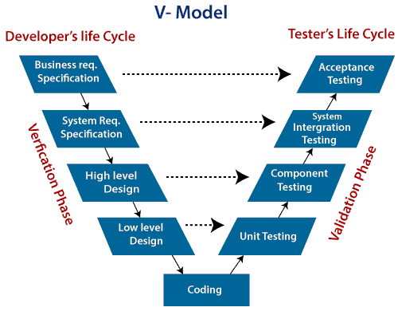
Phases of V-model
Verification: It involves a static analysis method (review) done without executing code. It is the process of evaluation of the product development process to find whether specified requirements meet.
Validation: It involves dynamic analysis method (functional, non-functional), testing is done by executing code. Validation is the process to classify the software after the completion of the development process to determine whether the software meets the customer expectations and requirements.

Slide 27
Phases of Verification Phase
Business requirement analysis
System Design
Architecture Design
Module Design
Coding Phase

Slide 28
Phases of validation phases
Unit Testing
Integration Testing
System Testing
Acceptance Testing

Slide 29
When to use v-model
When the requirement is well defined and not ambiguous.
The V-shaped model should be used for small to medium-sized projects where requirements are clearly defined and fixed.
The V-shaped model should be chosen when sample technical resources are available with essential technical expertise.

Slide 30
Advantage of v-model
Easy to Understand.
Testing Methods like planning, test designing happens well before coding.
This saves a lot of time. Hence a higher chance of success over the waterfall model.
Avoids the downward flow of the defects.
Works well for small plans where requirements are easily understood.

Slide 31
Disadvantage of v-model
Very rigid and least flexible.
Not a good for a complex project.
Software is developed during the implementation stage, so no early prototypes of the software are produced.
If any changes happen in the midway, then the test documents along with the required documents, has to be updated.

Slide 32
Incremental Model
Incremental Model is a process of software development where requirements divided into multiple standalone modules of the software development cycle. In this model, each module goes through the requirements, design, implementation and testing phases. Every subsequent release of the module adds function to the previous release. The process continues until the complete system achieved.

Slide 33
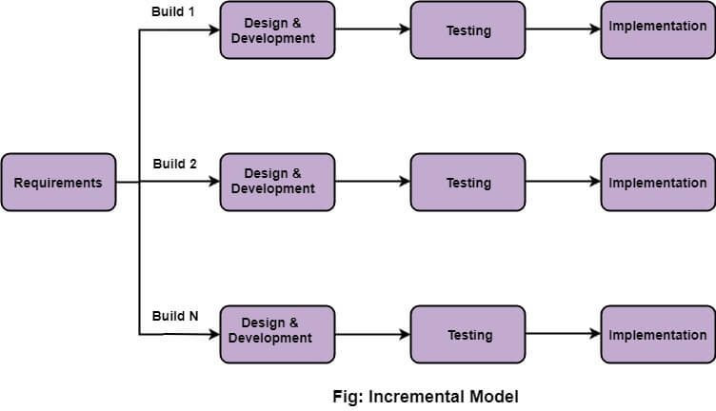
Phases of incremental model
Requirement analysis: In the first phase of the incremental model, the product analysis expertise identifies the requirements.
Design & Development: In this phase of the Incremental model of SDLC, the design of the system functionality and the development method are finished with success.
Testing: In the incremental model, the testing phase checks the performance of each existing function as well as additional functionality
Implementation: Implementation phase enables the coding phase of the development system. It involves the final coding that design in the designing and development phase and tests the functionality in the testing phase.

Slide 34
When we use the Incremental Model?
When the requirements are superior.
A project has a lengthy development schedule.
When Software team are not very well skilled or trained.
When the customer demands a quick release of the product.
You can develop prioritized requirements first.

Slide 35
Advantages of incremental model
Errors are easy to be recognized.
Easier to test and debug
More flexible.
Simple to manage risk because it handled during its iteration.
The Client gets important functionality early.

Slide 36
Disadvantages of incremental model
Need for good planning
Total Cost is high.
Well defined module interfaces are needed.

Slide 37
Iterative Model
In this Model, you can start with some of the software specifications and develop the first version of the software. After the first version if there is a need to change the software, then a new version of the software is created with a new iteration. Every release of the Iterative Model finishes in an exact and fixed period that is called iteration.

Slide 38
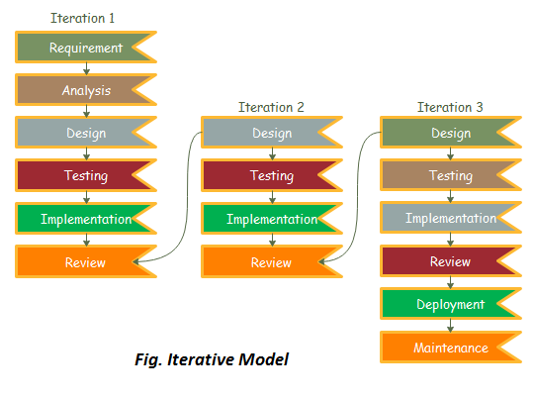
Phases of iterative model
Requirement gathering & analysis: In this phase, requirements are gathered from customers and check by an analyst whether requirements will fulfil or not. Analyst checks that need will achieve within budget or not.
Design: In the design phase, team design the software by the different diagrams like Data Flow diagram, activity diagram, class diagram, state transition diagram, etc.
Implementation: In the implementation, requirements are written in the coding language and transformed into computer programmes which are called Software.
Testing: After completing the coding phase, software testing starts using different test methods. There are many test methods, but the most common are white box, black box, and grey box test methods.
Deployment: After completing all the phases, software is deployed to its work environment.
Review: In this phase, after the product deployment, review phase is performed to check the behaviour and validity of the developed product.
Maintenance: In the maintenance phase, after deployment of the software in the working environment there may be some bugs, some errors or new updates are required. Maintenance involves debugging and new addition options.

Slide 39
When to use iterative model
When requirements are defined clearly and easy to understand.
When the software application is large.
When there is a requirement of changes in future.

Slide 40
Advantages of iterative model
Testing and debugging during smaller iteration is easy.
A Parallel development can plan.
It is easily acceptable to ever-changing needs of the project.
Risks are identified and resolved during iteration.
Limited time spent on documentation and extra time on designing

Slide 41
Disadvantages of iterative model
It is not suitable for smaller projects.
More Resources may be required.
Design can be changed again and again because of imperfect requirements.
Requirement changes can cause over budget.
Project completion date not confirmed because of changing requirements.

Slide 42

Questions from the topics discussed in class.
Any suggestions or observations

Slide 43

For Contacting
Email:esraq26552@gmail.com
Phone:01770137655
Address:4/703 Nam Garden Mirpur 13 Dhaka Bangladesh

