Slide 1
Welcome to our presentation Group-02
Submitted To – Prof. Dr. Md. Mozammel Huq Azad Khan
Submitted By –
1. Md. Shafiur Alam ID : 2023-3-60-400
2. Sadia Afrin ID : 2023-03-60-064
3. Esrat Jahan Jerin ID : 2023-3-60-271
Course code : CSE 106
Sec: 04

Slide 2
Introduction
Using C program, randomly generate an undirected graph represented by adjacency matrix with n = 1000 vertices.
Determine number of edges in the graph. Determine degrees of all vertices. Show that Handshaking logic holds. Determine computational time in this step (except printing time) in ms.

Slide 3
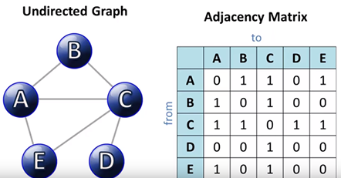
UNDIRECTED GRAPH
C Program
Adjacency Matrix
Edges
Vertices
Handshaking Logic
Computational Time

Slide 4





THE OUTPUTS OF THE PROGRAM
When n= 1000
The computational time is 25.000000 ms
When n= 2000
The computational time is 72.000000 ms
When time is n=3000 The computational time is 165.000000 ms
When n= 4000 The computational time is 242.000000 ms
When n= 5000
The computational time is 435.000000 ms

Slide 5
Computational Time (ms)vs Number of Vertices
Computational Time (ms) | Number of Vertices
25 | 1000
72 | 2000
165 | 3000
242 | 4000
435 | 5000

Slide 6
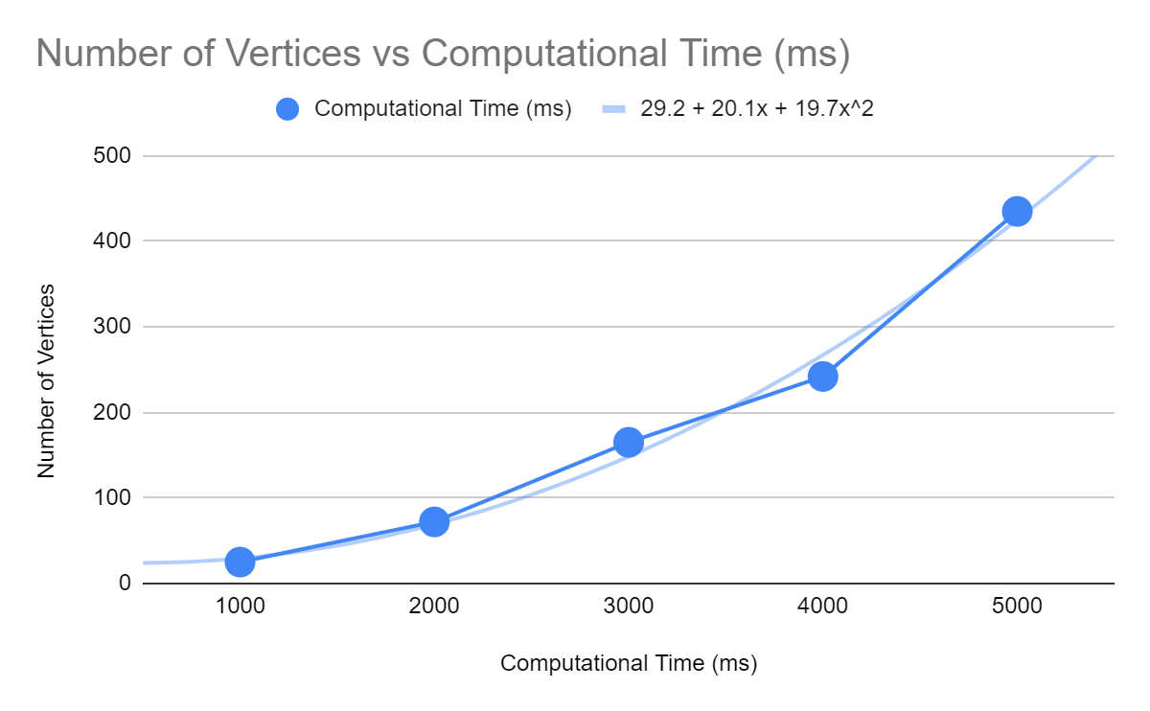
Ideal Graph

Slide 7
Derived equation from the graph
Equation: 19.7x^2+20.1x+29.2
g(n)=19.7n^2+20.1n+29.2
Now,19.7n^2+20.1n+29.2<=19.7n^2+20.1n^2+29.2n^2
[n^2>=n,n^2>=1]
19.7n^2+20.1n+29.2<=69n^2
[k=1,c=69]
g(n)=19.7n^2+20.1n+29.2=O(n^2)

Slide 8







