Slide 1
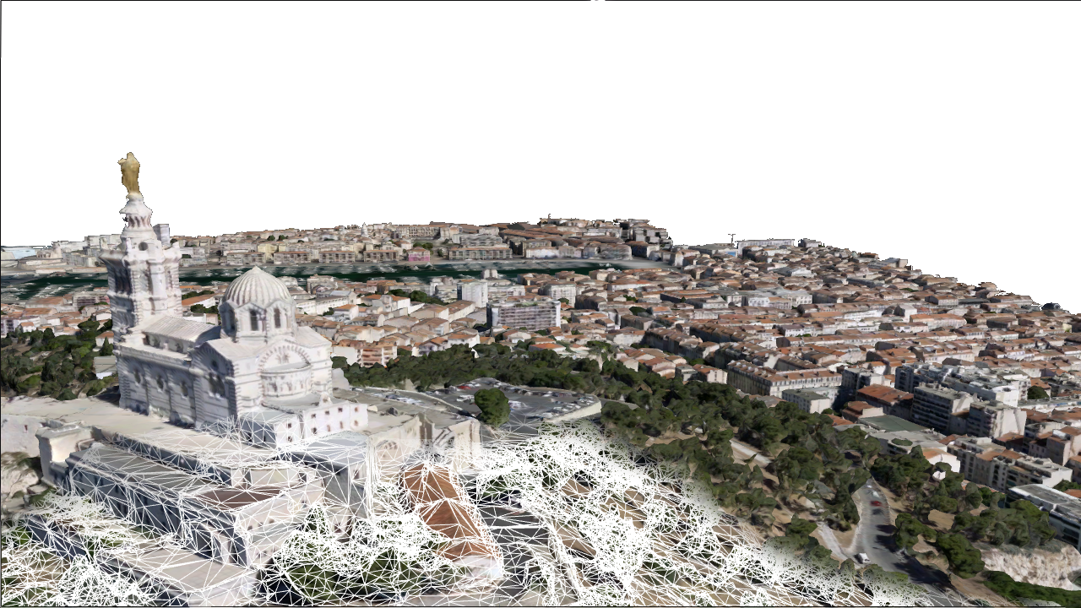
High performance I3S Meshes
Ronald Poirrier - rpoirrier@esri.com

Slide 2
Deliver high performance 3D meshes to customers
Upgrade I3S specs to reduce latency & bandwidth usage
Upgrade 3D clients
Provide tooling to content providers:
Optimize existing content ( v1.6 -> v2.0 upgrade tool)
I3S SDK to help with generating I3S content

Slide 3
Integrated Mesh: Test datasets from 3rd party data providers
Common Issues:
Not specs compliant (won’t draw)
Invalid LOD metrics
Too many “null geometries”
Nodes are too large
Missing LOD
Poor lower LOD texture quality
Visible tile seams at lower LOD
Vendor | # of functional datasets | # datasets with perf./drawing issues
Agisoft | 1 | 1
Bentley/Aerometrex | 4 | 2
Geo_Jobe | 2 | 1
GroundVu | 2 | 0
NearMap | 0 | 1
Skyline | 2 | 1
Vexcel | 0 | 2
Vricon | 13 | 2
FME I3S exporter | 0 | 1
HERE | - | -
Contributing factors:
Creating I3S data from specs is difficult (ambiguities, unsupported patterns, etc.)
Limited tooling/doc/examples

Slide 4
SDK for I3S content
{SDK}
Benefits
Better control over Scene Layer performance
Encourages I3S adoption and brings more content to the platform
Helps with compatibility issues and specs upgrades
Minimal shippable product
Closed-source SDK with C++ API (win32/64).
Self-contained, released on GitHub. No ArcGIS11 dependencies.
Support for writing Integrated meshes (but no LOD generation)
Support for “optimizing” SLPK from v1.6 to v2.0
paged-access, forward-compatibility, texture/geometry compression
Validation tool for SLPK including stats and performance warnings

Slide 5
SDK for I3S content
{SDK}
Features considered for following releases:
Support more SL types: 3DObject, Point and Point Cloud
Support for LOD generation
Support for “splitting” large nodes
Bindings for Python
Utilities: AOI to SLPK
Importers: OBJ, OSGB, TIN to I3S
Support more platforms (Linux?)
Challenge:
LOD generation requires textured-mesh simplification

Slide 6
I3S Specs Upgrade: Design goals
Forward-compatibility with v1.6
Reduce latency due to dependent requests
Remove superfluous requests (i.e. sharedResource, featureData)
Reduce bandwidth (compression)
Feature improvements:
Multi-mesh nodes
Instancing
Advanced material (with transparency meta-data)
Texture sharing
Mixed topology (triangle, point, line)
Multi-texturing (textured attributes)
Highly implementable specs

Slide 7
Forward compatibility
Benefits:
“Opt-in” approach to new specs
Progressive roll-out on the platform
Transparent to end-users
Drawbacks:
Increased storage size (mostly from geometry duplication)
More complex to create and edit (SDK would help here)
Legacy
Server
Service 1.6
Clients
1.6
SLPK 2.0
Server
Service 2.0
Clients
2.0

Slide 8
Overview
unchanged
added to specs v2.0
deprecated
Node pages meta-data (nodes per page, lod metric)
Texture-set definitions (replaces sharedResources)
Multi-texturing
Simpler definition of available compressed formats
Material definitions (replaces sharedResources)
glTF equivalency (metallic-roughness material model)
Mesh definitions ( replaces defaultGeometrySchema )
Multi-mesh, multi-schema
Mixed topology
Instance buffer definition
+--3DSceneLayer.json (with added fields)
+--nodes
| +--0
| | +--3dNodeIndexDocument
| | +--features
| | +--attributes
| | | +--0
| | | +--(...)
| | +--geometries
| | | +--0
| | | +--1
| | +--shared
| | | +--sharedResource
| | +--textures
| | | +--0 (e.g. "jpeg")
| | | +--1 (e.g. "dds")
| | | +--(...)
| | +--instances (optional)
| | | +--0
| | | +--(...)
| +--(...)
+--nodepages
| +--0
| +--1
| +--(...)
+--shared (optional)
| +--textures
| | +--0
| | +--(...)
+-- statistics
Compress geometry buffer (Draco)
Geometry instancing
Paged-nodes (with multi-mesh per node support)
Shared textures (e.g. for advanced materials)

Slide 9
Performance: Paged-access
Speed-up BVH traversal by paging multiple nodes per request
Implications:
Switch from “discoverable” URL schema to “by-convention” URL
page = node_index / node_page
“IDs” to replace “href” ( convention vs. discoverable)
More nodes per document, so node must be compact => remove redundant information

Slide 10
Performance: Paged-access Example
page_id = floor( node_id / node_per_page)
node_id_in_page = modulo( node_id, node_per_page)
{
"index": 1024,
"lodThreshold": 50.43,
"obb": {
"center": [20.82,41.988,76.56],
"halfSize": [64.93,11.4,70.315],
"quaternion": [-0.0,0.03,-0.20569,0.9]
},
"children": [2025,2036],
"meshes": [
{
"materialId": 0,
"meshDefinitionId": 0,
"resourceId": 478,
"vertexCount": 526,
"featureCount": 26
}]
}
This node index (page_id = 1024/64 = 16)
url: /layers/0/nodepages/16
Index of the children in the node array ( on page 31)
url: /layers/0/nodepages/31
Index material definition for this node (see 3dSceneLayer.json)
Mesh definition (geometry/attribute buffers) (see 3dSceneLayer.json)
Resource locator:
Geometry: /layers/0/nodes/478/geometries/0
Geometry(Draco): /layers/0/nodes/478/geometries/{geo_def}
Attributes: /layers/0/nodes/478/attributes/{attrb_id}
Textures: /layers/0/nodes/478/textures/{material_def}

Slide 11
Performance: remove “sharedResource”
Factor out information that is actually shared across multiple nodes:
Material
TextureSetDefinition (see “Texture definition example” slide)
Remove obsolete node-specific meta-data
Move tile-specific meta-data to node document (texture_id)

Slide 12
Performance: reduce bandwidth usage
Texture compression:
Each mesh (or group of mesh) cleanly declares which compressed formats are available
Remove redundant/contradictory texture information from 3dLayer, 3dNodeIndexDocument and sharedResource
Texture Sharing:
Multiple materials/meshes may reference shared textures in /shared/textures/

Slide 13
Texture definition example
{"textureSetDefinitions": [
{
"formats": [
{
"index": 4,
"format": "jpg"
},{
"index": 1,
"format": "dds"
},{
"index": 2,
"format": "ktx"
}
],
"binding": "per-node"
},
{
"formats": [
{
"index": 10,
"format": "jpg"
}
],
"binding": "per-layer"
}
]}
Per-node texture definition 0 with support for jpg, dxt and etc2 compression:
url: /layers/0/nodes/{resource_id}/textures/4.jpg
url: /layers/0/nodes/{resource_id}/textures/1.dds
url: /layers/0/nodes/{resource_id}/textures/2.ktx
Per-layer (i.e. shared) texture definition 1 with support for jpg only:
url: /layers/0/shared/textures/10.jpg

Slide 14
Performance: reduce bandwidth usage
Geometry Compression:
Support for Draco compressed attributed mesh/point cloud
… but “legacy” I3S geometry buffers must be duplicated for forward-compatibility.
{
"geometryBuffers": [
{
"id": 1,
"featureId": {
"type": "UInt32",
"component": 1,
"binding": "per-feature"
},
"compressedAttributes": {
"encoding": "draco",
"attributes":["position","normal","uv0","featureIndex"]
}
}
]}

Slide 15
Feature: Multiple meshes per node
I3S 1.6: 3dObjects are broken up in into co-trees based on “material” properties (repeated-textures, transparency, etc.)
Challenges:
More nodes to load/display. These nodes are usually collocated, so no view-culling advantage
Loss of load consistency ( i.e. transparent balconies appears/disappears before the rest of the building)
One-to-one mapping between materials and nodes => more nodes than necessary
I3S 2.0: Multi-mesh
Similar to glTF: Multi-materials objects (e.g. car body+wheel+windshield ) are still represented as a single node with multiple meshes
BIM could be one layer (instead of 27)

Slide 16
Feature: Instancing
Very large bandwidth/memory saving for instance scene (BIM)
Support for per-instance transformation:
Translation, Rotation, Scale
Color
FeatureId
Limitations:
One feature_id per instance
For forward-compatibility, un-instanced geometry buffers must available too
Lower LOD must be built with instancing in mind (simplify each instance first, cluster instances second)
Notes:
The Nashville 05 model contains a total of 1,117 features. Of those, 825 are instances. There are 9 unique instance symbols.
The Nashville 08 model contains a total of 25,183 features. 20,209 are instanced. There are 4,105 unique symbols.
The Kentucky Champion Court contains 21,048. 11,830 are instanced. There are 2,119 unique symbols.

Slide 17
Feature: Advanced material
Physically-based rendering (pbr) metal roughness model
Equivalency with glTF
Material textures (shadow map, normal map, etc.) may be shared

Slide 18
Feature: Multi-texturing Support
Enable support for Textured attributes (Integrated mesh)
Advantages:
High resolution
Independent from geometric complexity
Better consistency between LOD
Disadvantages:
“Blurry edges” when zoomed-in
Lossy GPU Texture compression may not be acceptable => high VRAM usage
Limited attribute type support (8/16 bit attribute only?. No float texture support?)

