Slide 1
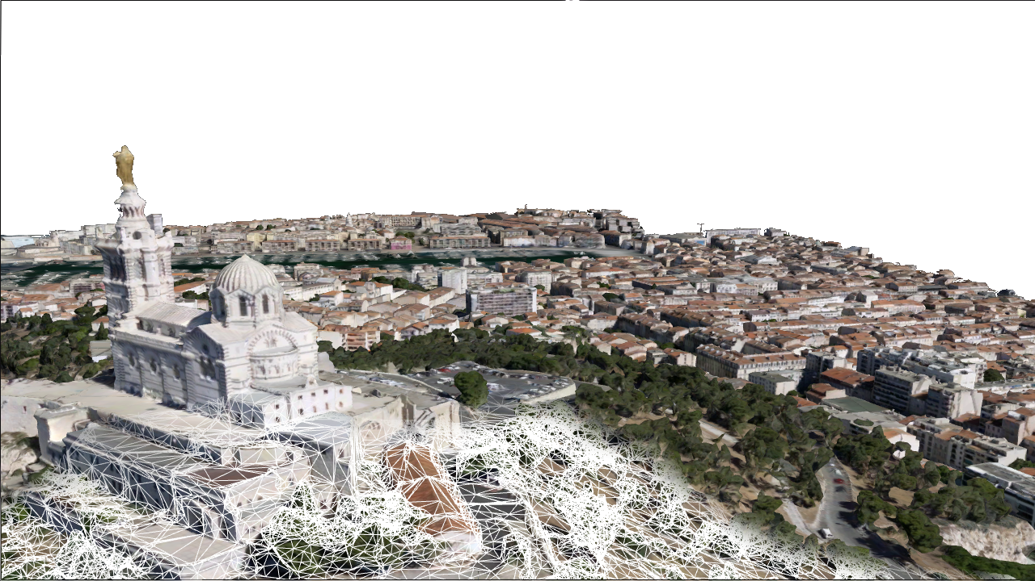
I3S version 1.7
Ronald Poirrier - rpoirrier@esri.com

Slide 2
Deliver high performance 3D meshes to customers
Upgrade I3S specs to reduce latency & bandwidth usage
Upgrade 3D clients
Provide tooling to content providers:
Optimize existing content ( v1.6 -> v1.7 upgrade tool)
I3S SDK to help with generating I3S content

Slide 3
Design goals
Forward-compatibility with v1.6
Reduce latency due to dependent requests
Remove superfluous requests (i.e. sharedResource, featureData)
Reduce bandwidth (compression)

Slide 4
Forward compatibility
Benefits:
“Opt-in” approach to new specs
Progressive roll-out on the platform
Transparent to end-users
Drawbacks:
Increased storage size (mostly from geometry duplication, possibly DDS duplication (to avoid loss of alpha channel in WSV )
More complex to create and edit (SDK would help here)
Legacy
Server
Service 1.7
Clients
1.6
SLPK 1.7
Server
Service 1.7
Clients
1.7

Slide 5
Overview
Node pages meta-data:
nodes per page, lod metric.
Texture-set definitions
Replaces sharedResources
Simpler definition of available compressed formats
Material definitions
Replaces sharedResources
glTF equivalency (metallic-roughness material model)
Mesh definitions
replaces defaultGeometrySchema
replaces sharedResources.
Describes compressed geometry
unchanged
added to specs v1.7
deprecated
+--3DSceneLayer.json (with added fields)
+--nodes
| +--0
| | +--3dNodeIndexDocument
| | +--features
| | +--attributes
| | | +--0
| | | +--(...)
| | +--geometries
| | | +--0
| | | +--1
| | +--shared
| | | +--sharedResource
| | +--textures
| | | +--0 (e.g. "jpeg")
| | | +--1 (e.g. "dds")
| | | +--(...)
+--nodepages
| +--0
| +--1
| +--(...)
+-- statistics
Compress geometry buffer (Draco)
Paged-nodes.

Slide 6
Performance: Paged-index example
page_id = floor( node_id / node_per_page)
node_id_in_page = modulo( node_id, node_per_page)
{
"index": 1024,
"lodThreshold": 50.43,
"obb": {
"center": [20.82,41.988,76.56],
"halfSize": [64.93,11.4,70.315],
"quaternion": [-0.0,0.03,-0.20569,0.9]
},
"children": [2025,2036],
"meshes": [
{
"material": {
"definition": 0,
"resource": 1000
},
"geometry": {
"definition": 1,
"resource": 1000,
"vertexCount": 14587,
"featureCount": 1
},
"attribute": {
"resource": 500
}}]
}
This node index (page_id = 1024/64 = 16)
url: /layers/0/nodepages/16
Index of the children in the node array ( both on page 31)
url: /layers/0/nodepages/31
Index material definition for this node (see 3dSceneLayer.json)
Mat. Texture: /layers/0/nodes/1000/textures/…
Mesh definition (geometry/attribute buffers) (see 3dSceneLayer.json)
Geometry: /layers/0/nodes/1000/geometries/…
Attributes: /layers/0/nodes/500/attributes/…
Notes:
Resource ID for each facilitate:
Editing
Shared resources across nodes.

Slide 7
Performance: remove “sharedResource”
shared.material: moved to layer.materialDefinitions
shared.texture: moved to layer.textureSetDefinitions
Resources are implicitly shared (texture, attributes, geometries) using indirection ID:
node.geometry.resource
node.material.resource
node.attributes.resource

Slide 8
Performance: remove “sharedResource”
{"textureSetDefinitions": [
{
"formats": [
{
"index": 0,
"format": "jpg"
},{
"index": 2,
"format": "dds"
},{
"index": 4,
"format": "ktx-etc2"
}
],
}]}
Per-node texture definition 0 with support for jpg, dxt and etc2 compression:
url: /layers/0/nodes/{resource_id}/textures/4.jpg
url: /layers/0/nodes/{resource_id}/textures/1.dds
url: /layers/0/nodes/{resource_id}/textures/2.ktx
"materialDefinitions":
{
"alphaCutoff": 0.25,
"doubleSided": true,
"atlas": false,
"pbrMetallicRoughness": {
"baseColorTexture": {
"textureSetDefinitionId": 0,
"texCoord": 0
}
}
},
Material definition:
- Physically-based rendering (pbr) metal roughness model
- Equivalency with glTF

Slide 9
Performance: Geometry compression
Legacy geometry buffer is left unchanged, but benefits from simpler layer.geometryDefinition
Additional Draco compressed mesh resource:
Typical saving: 40-60%
Vertex attribute indexing may be retained
Extended to embed FeatureID and UV_regions
Future proof: additional vertex attributes may be added (uv[n]), multiple encoding may be supported, etc.

Slide 10
Performance: Geometry Definition example:
"geometryBuffers": [
{
"offset": 8,
"position": {
"type": "float32",
"component": 3
},
"normal": {
"type": "float32",
"component": 3
},
"uv0": {
"type": "float32",
"component": 2
},
"color": {
"type": "uint8",
"component": 4
},
"featureId": {
"type": "uint64",
"component": 1,
"binding": "per-feature"
}
},
{
"compressedAttributes": {
"encoding": "draco",
"attributes": ["position","uv0","color","feature-index"]
}}]
Legacy mesh definition ( on index 0)
url: /layers/0/nodes/{resource_id}/geometries/0
Draco mesh definition ( on index 1)
url: /layers/0/nodes/{resource_id}/geometries/1

Slide 11
Release Schedule
Jan
Feb
March
April
May
June
July
I3S
Specification
1.6 public spec
1.7 internal spec
spec presented
1.7 public spec
I3S SDK
Earth
1.9
CityEngine
2019.0
CityEngine
2019.1
Earth
1.10
Apps
2.3
2.3.1
2.4
Pro
10.7
10.7.1
ArcGIS 10.x
7.1
7.2
AGOL
Scene Viewer
100.5
Run Time
Dev Summit
UC

Slide 12
Promote I3S adoption:
Comprehensive documentation generated from schema, including examples and implementation guidelines.
JSON Schema validation of all profiles and all versions starting from 1.6
Tools to convert 1.6 to 1.7 Integrated Meshes and 3D objects
I3S SDK to help create (v1.7) and read (1.6+) I3S Scene Layers

Slide 13
SDK for I3S content
{SDK}
Benefits
Refined control over Scene Layer performance
Encourages I3S adoption and brings more content to the platform
Helps with compatibility issues and specs upgrades
Minimal shippable product
Closed-source SDK with C++ API (win32/64).
Self-contained, released on Esri GitHub. No ArcGIS11 dependencies.
Support for writing Integrated meshes (no LOD generation)
Support for “optimizing” SLPK from v1.6 to v1.7
Validation tool for SLPK including stats and performance warnings

