Slide 1
PROJECT
Rock-Paper-Scissors 15! by Elisha Morse
CMSC 1513
University of Central Oklahoma

Slide 2
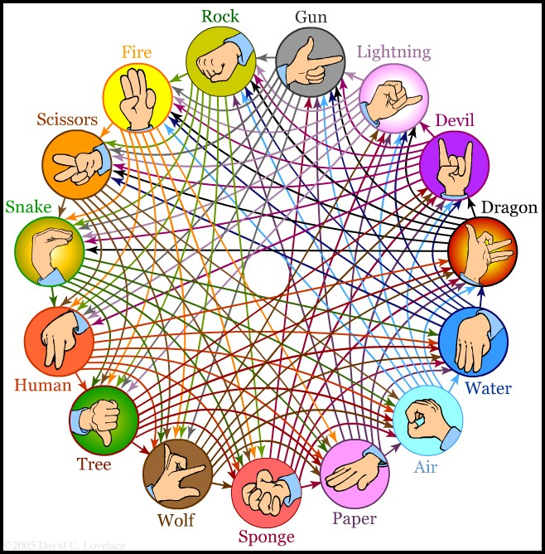
A More Advanced R.P.S. Game
In this version, every gesture beats the following 7 (when arranged in this order), ties with itself, and is beaten by the previous 7. This creates a whopping 105 possible outcomes.

Slide 3
Design
I implimented a system that allowed the user to enter the number of rounds that the game could go for.
I made an array that contained all of the different gestures for the game.
This is the backbone of the program – the ordering is used to determine the winner in each instance.
A random gesture is generated and compared to the users.
There is a “who beats whom” section to determine the winner.
A point is awarded to the winner each round.
A seperate method contains a two dimentional array with all of the possible verbs. Ex: “paper covers rock”
Lastly, there are debugging and error message sections added throughout to make the experience more user friendly

Slide 4
Implementation
The largest challenge was making sure to use the smallest amount of code possible; I didn’t want to rewrite things I could use in later sections.
Arrays and indexing ultimately was the best tool for the job.
Some of the debugging and error messages were added at the end; they also proved relatively difficult to condense.

Slide 5
Demo
Welcome to Rock-Paper-Scissors-15! Your choices are:
Rock Fire Scissors Snake Human Tree Wolf Sponge Paper Air Water Dragon Devil Lightning Gun.
How many rounds would you like to go? The number must be odd: 3
Enter a gesture: fire
The computer got Devil.
Devil breaths Fire. You lose.
Enter a gesture: water
The computer got Human.
Human drinks Water. You lose.
The computer won 2-out-of-3...

Slide 6
Conclusion
I learned some more out of the box applications to the methods and statements we covered in the semester as well as some new ones along the way.
It was altogether a fun and engaging experience to create something new.

