Slide 1
Company Food Ordering App
Essa D Bah 22016002
Muhammed Ndong 22011047
Sirra Kebbeh 22011051

Slide 2
Introduction
Ordering food is difficult for companies
Especially when employees are many
Anch aims to lift the weight of asking every employee what to order everyday.
Just register your company and connect to our partnering restaurants.

Slide 3
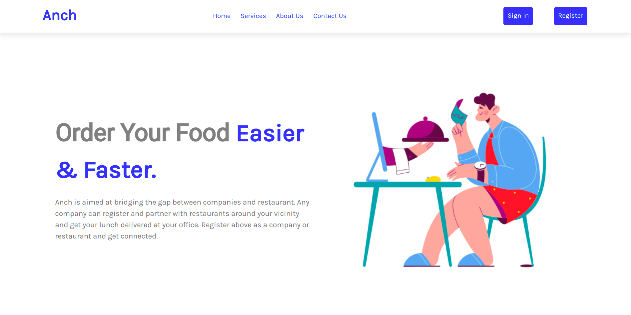
Homepage
Visit our page and register

Slide 4
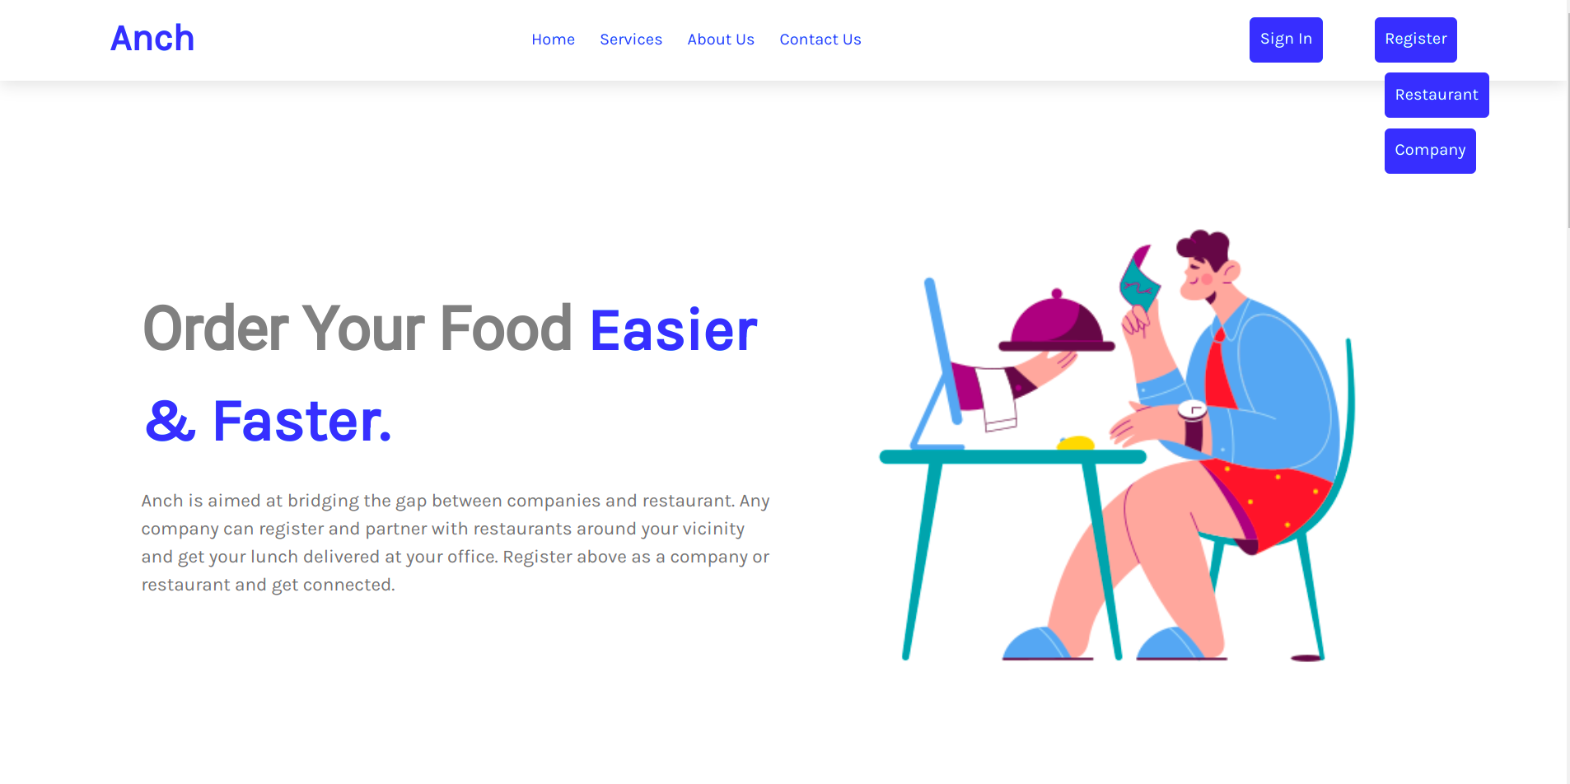
Registration
Register Either as Restaurant or Company
Click Register button

Slide 5
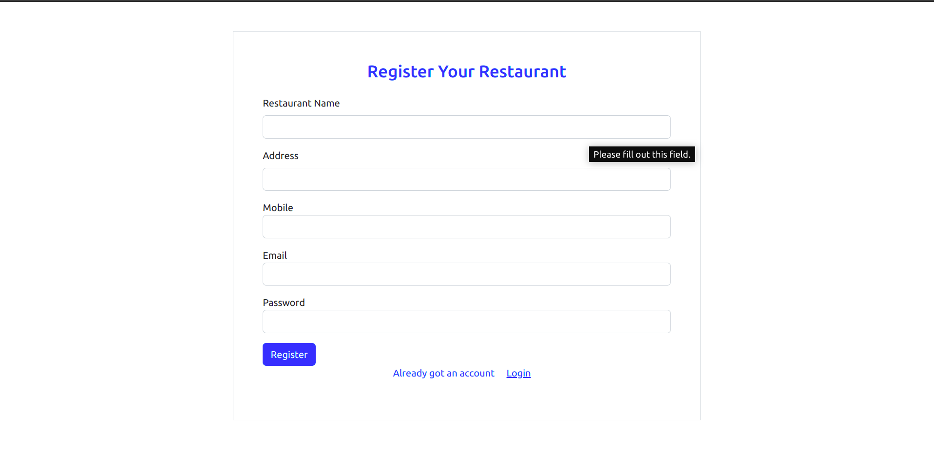
Register Restaurant
Click Restaurant button on the homepage

Slide 6
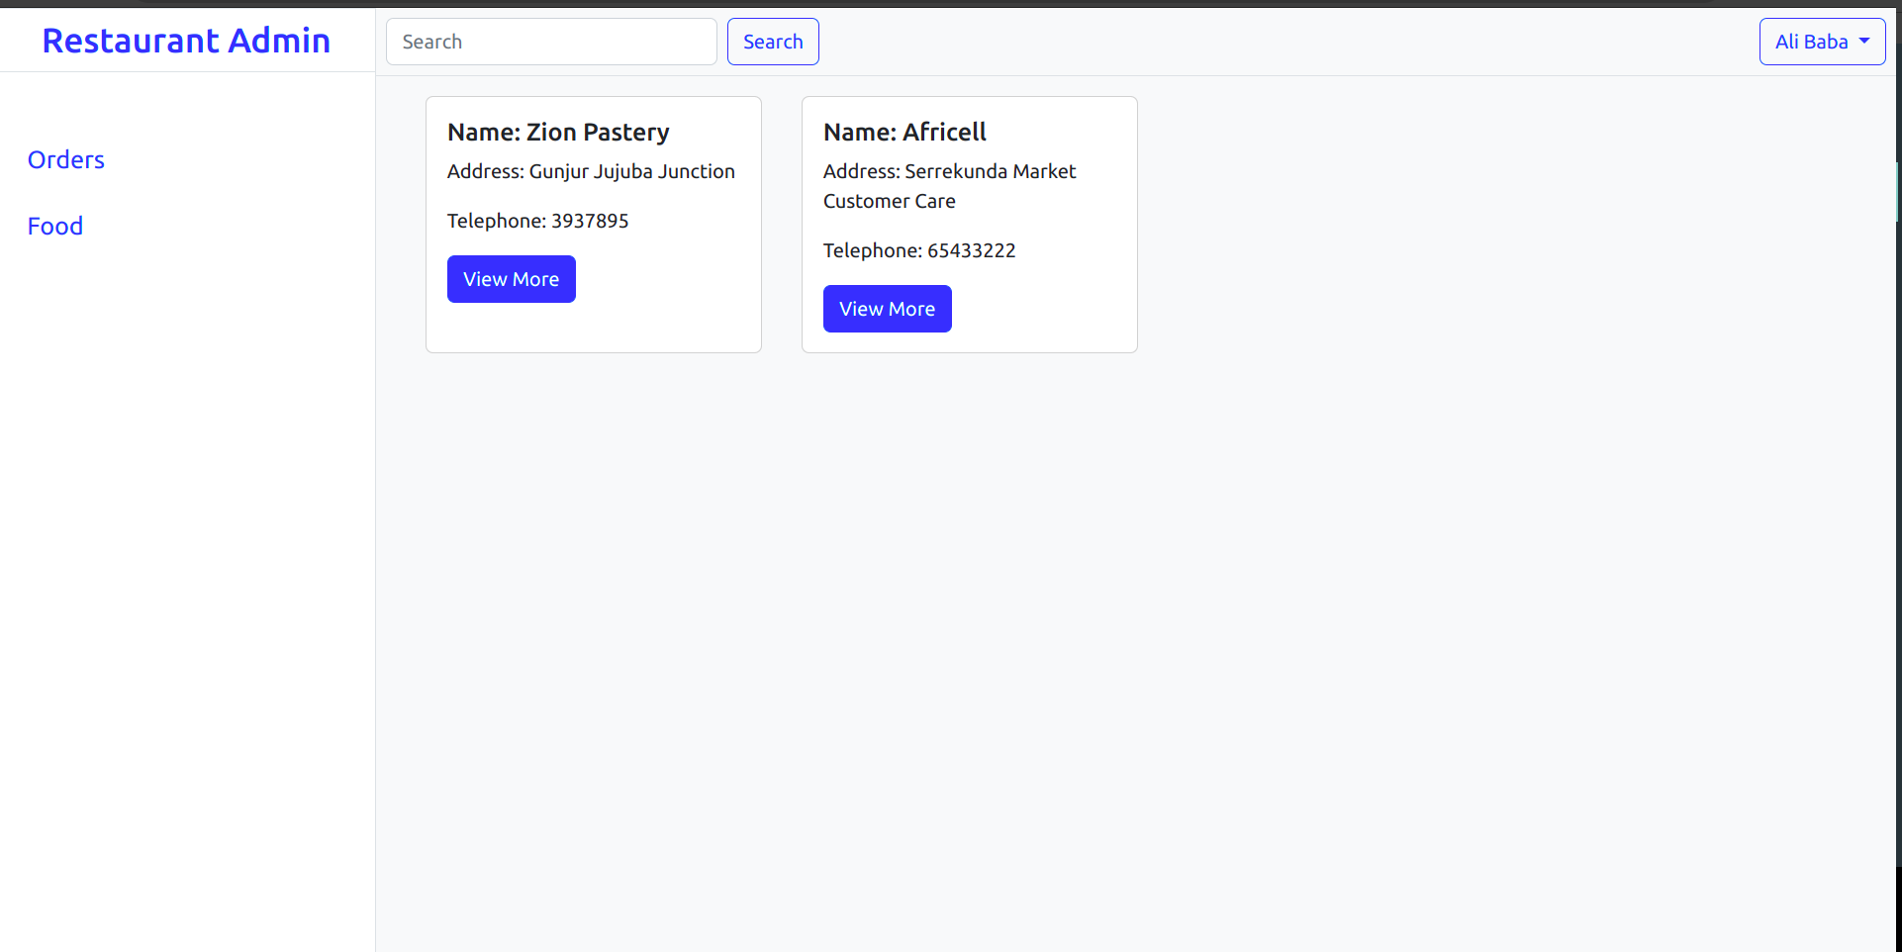
Restaurant Dashboard
Here the restaurant dashboard contains the orders from the different companies.

Slide 7
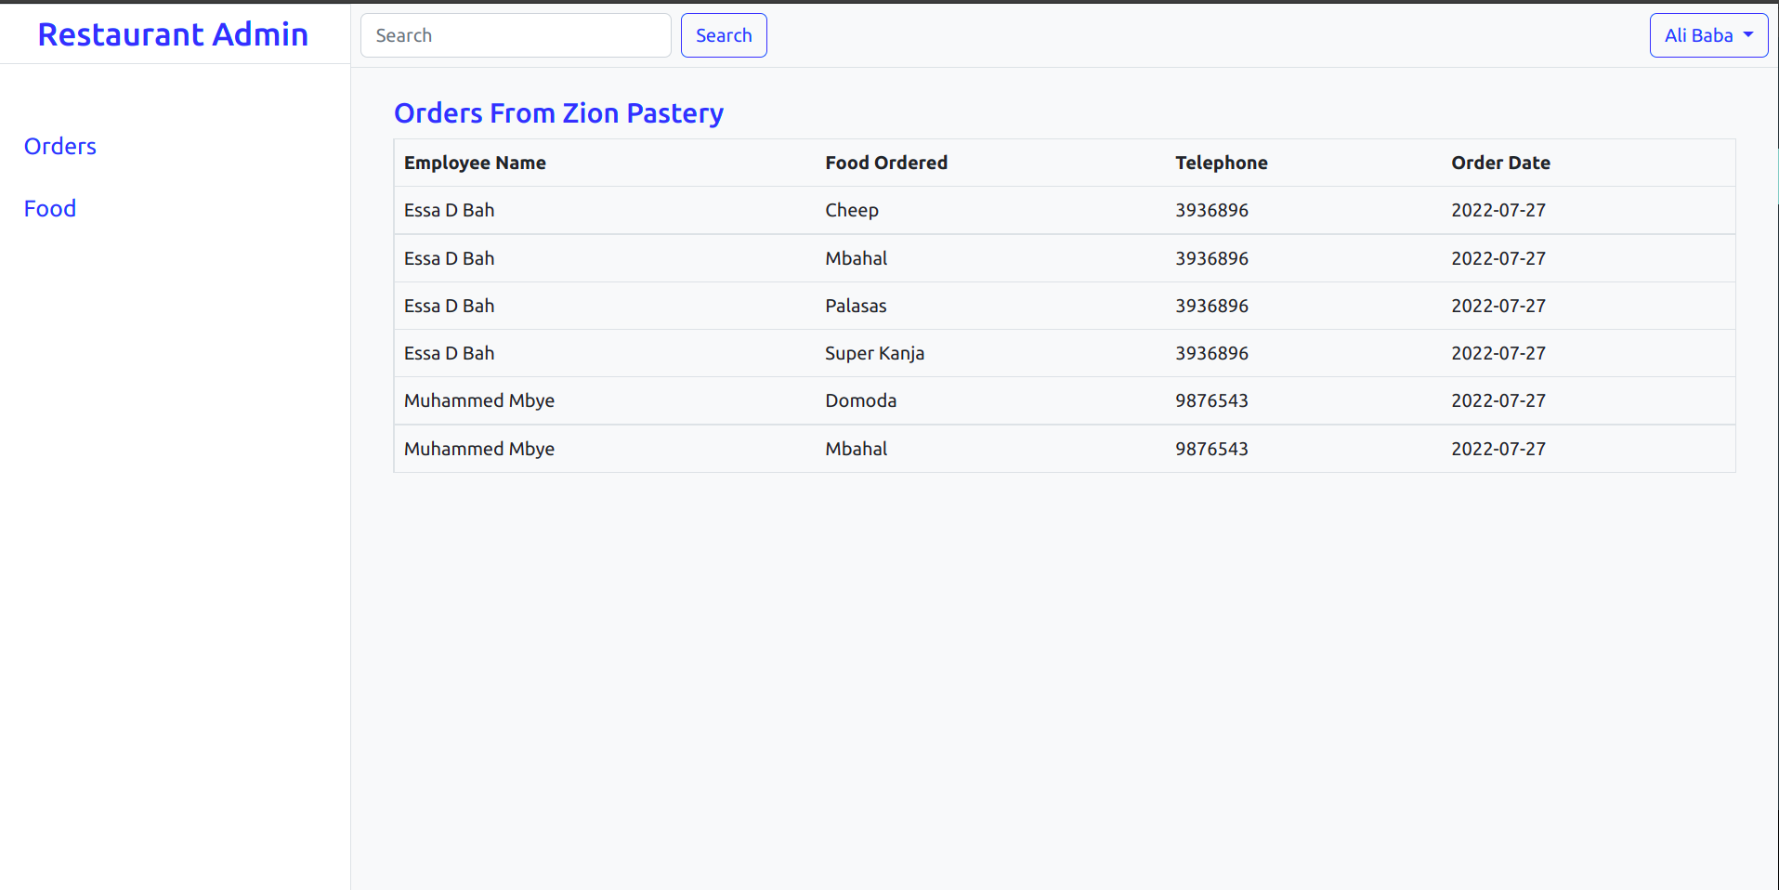
View Orders of Companies
List of orders from all employees of a particular company

Slide 8
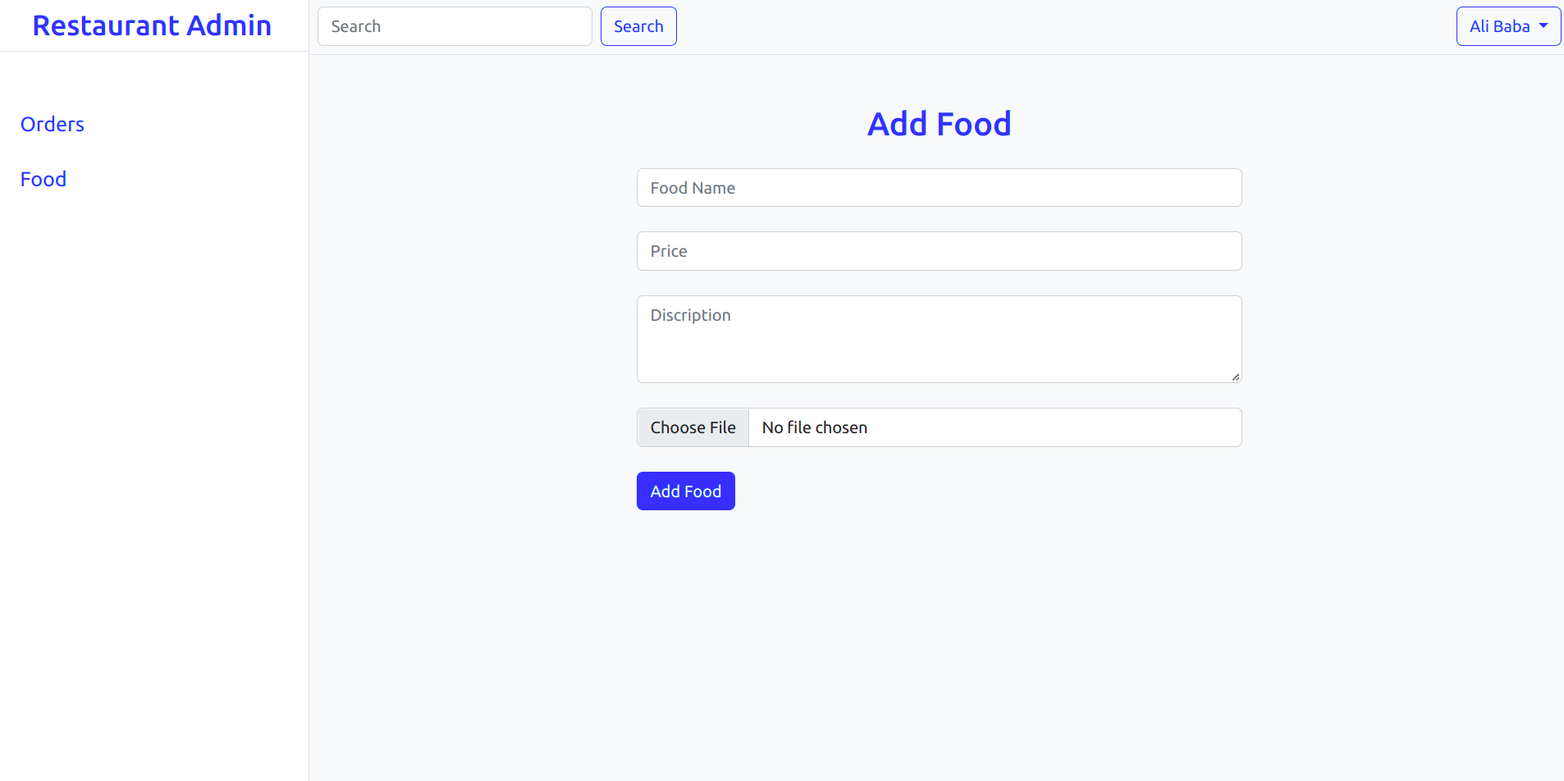
Add Food
Restaurant can Add Food

Slide 9
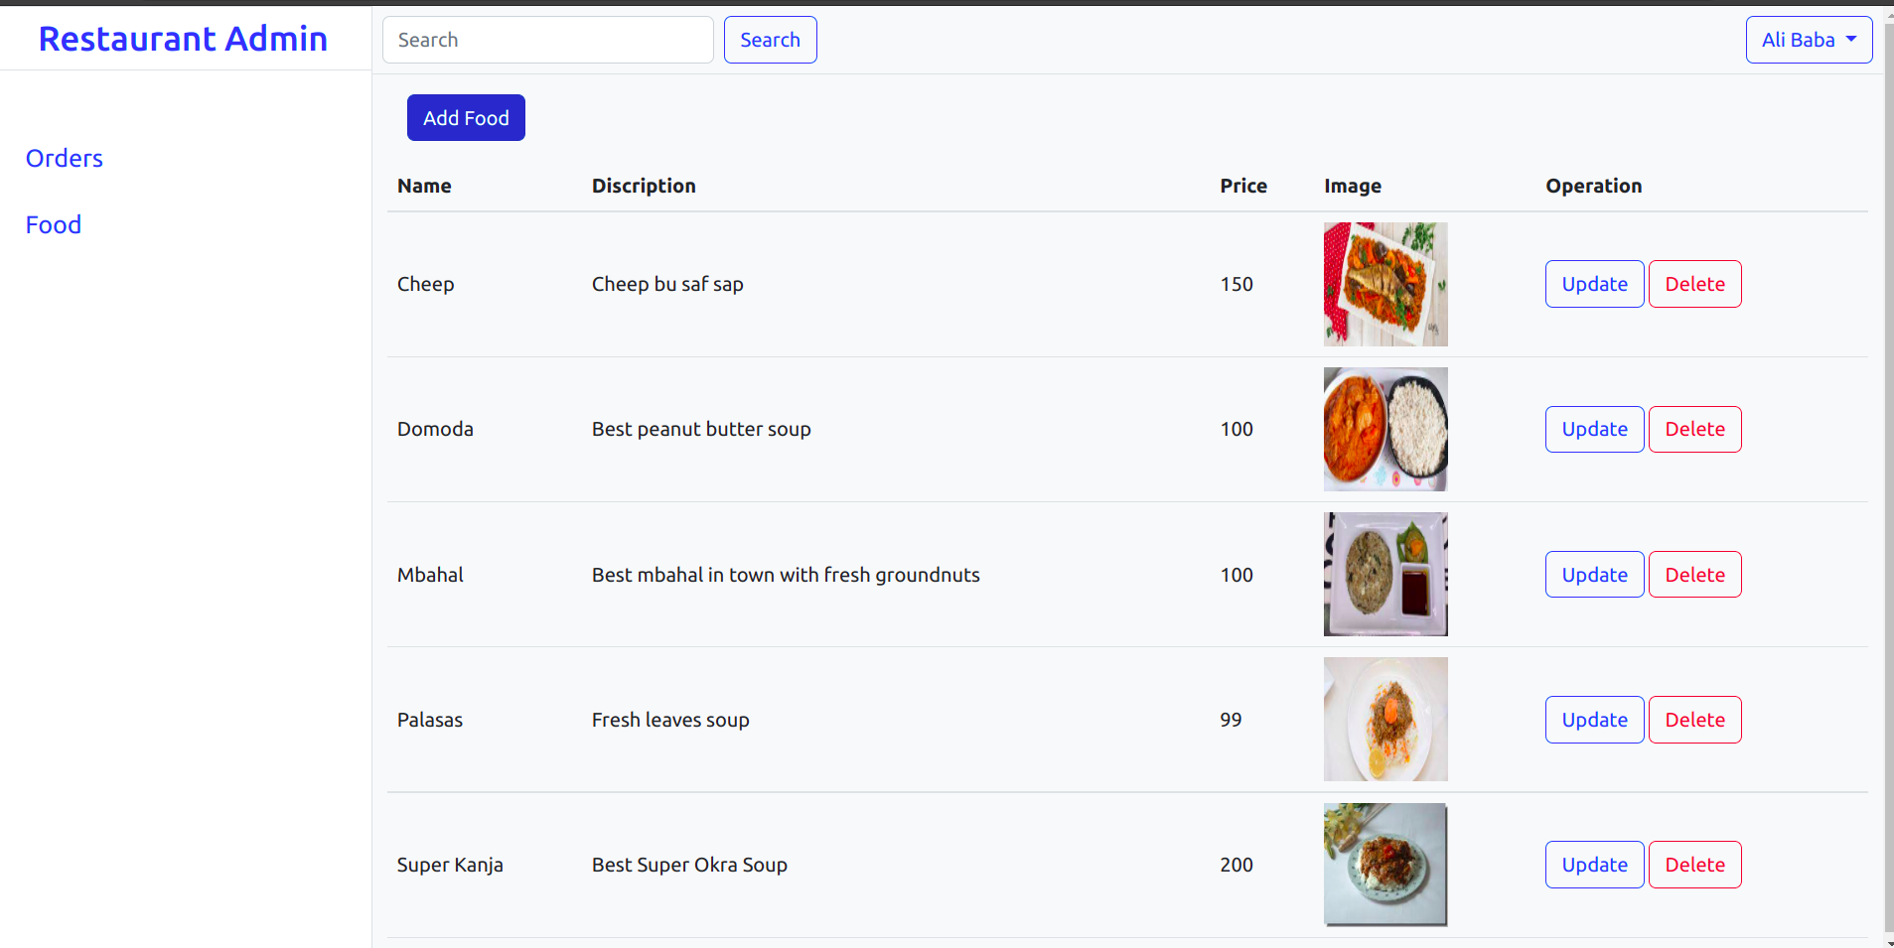
Food
List of all foods the restaurant have
Can edit can delete food

Slide 10
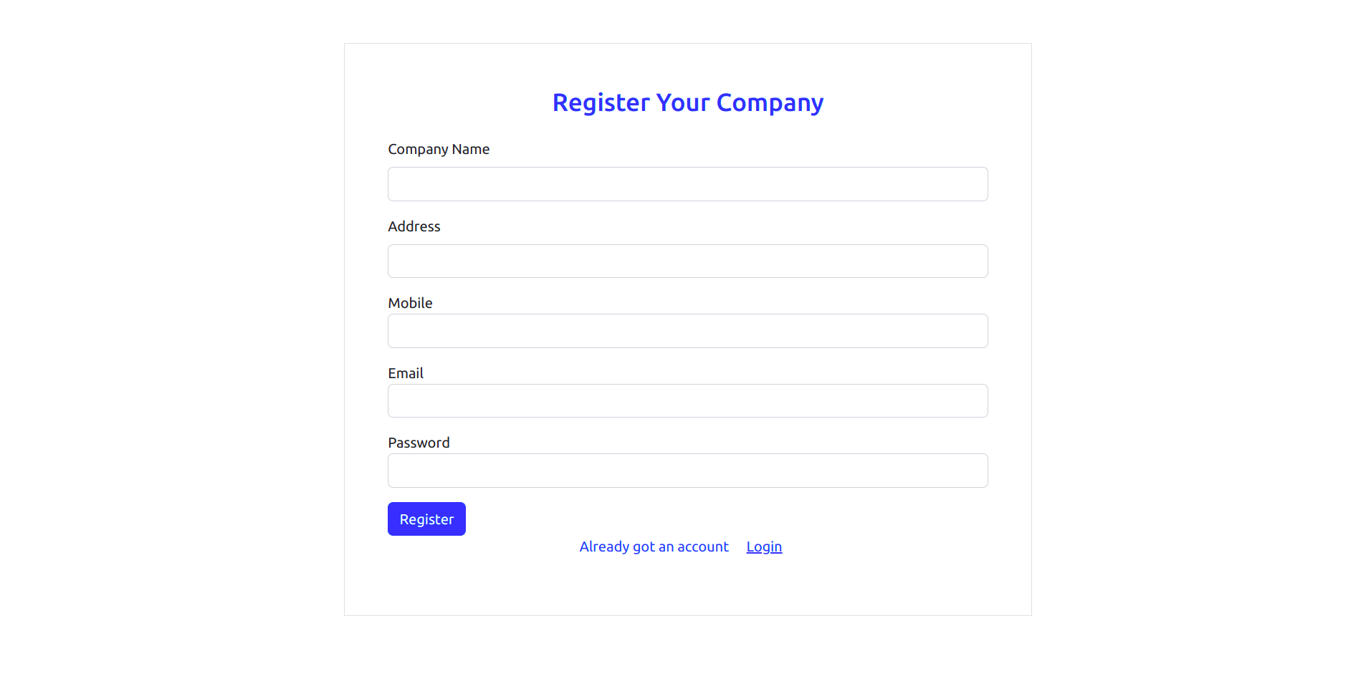
Register Company
Click the Company link on the homepage

Slide 11
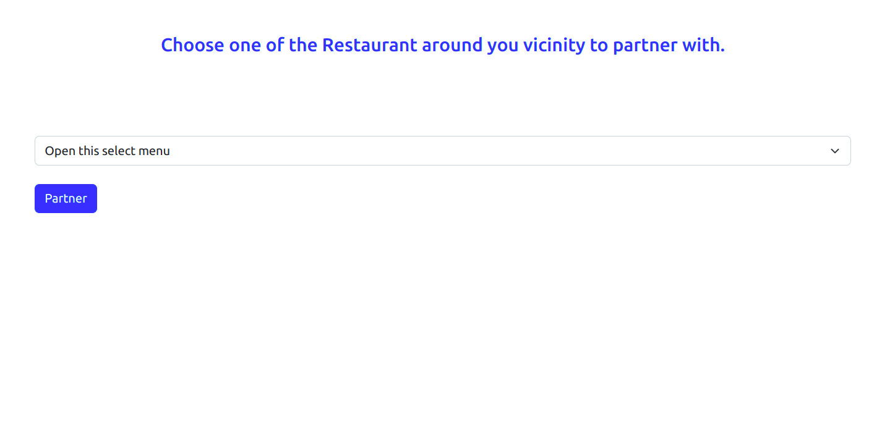
Partner Restaurant
On first login company is forced to partner with restaurant of its choice

Slide 12
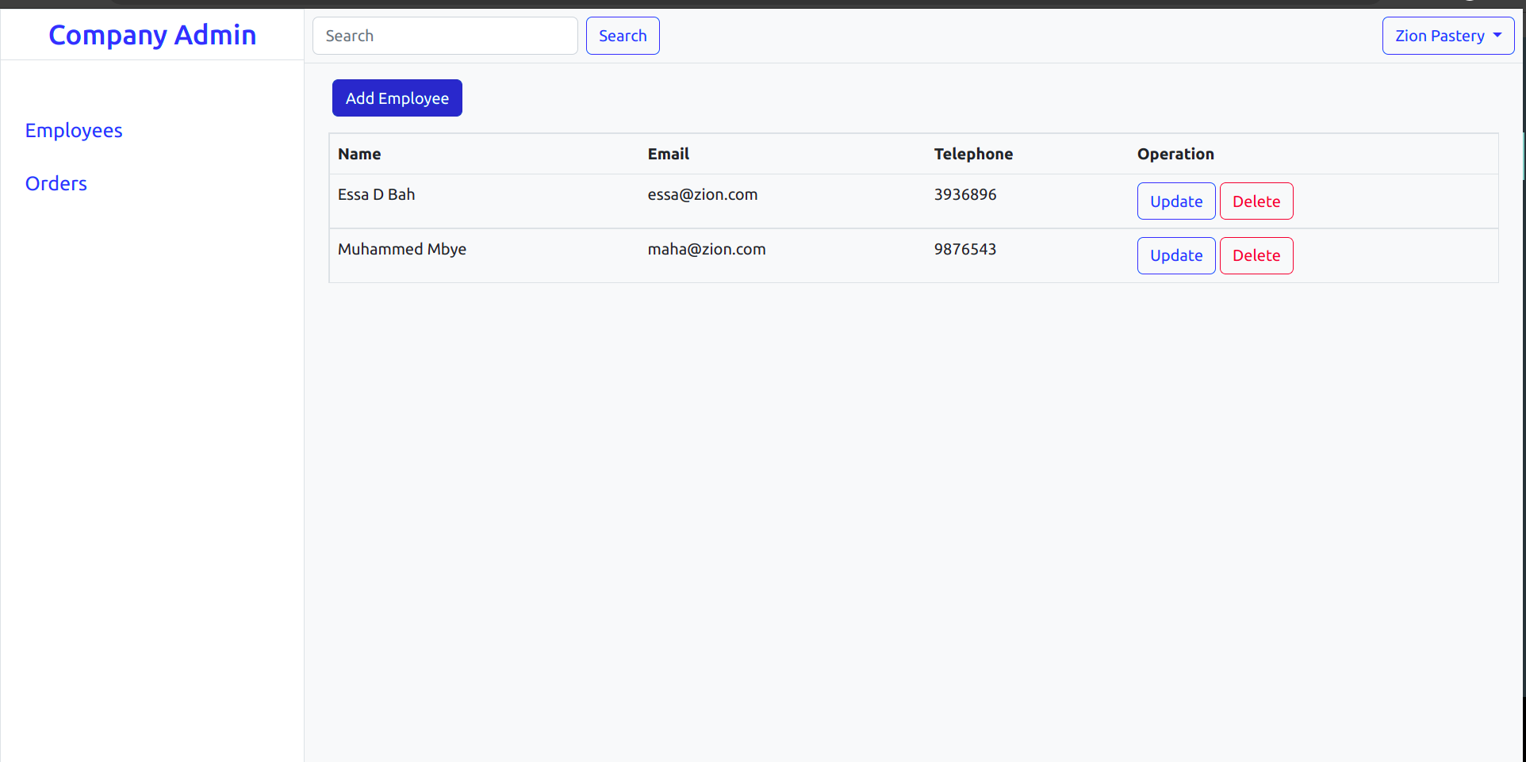
Company Dashboard
List of all Employees and button to add employee

Slide 13
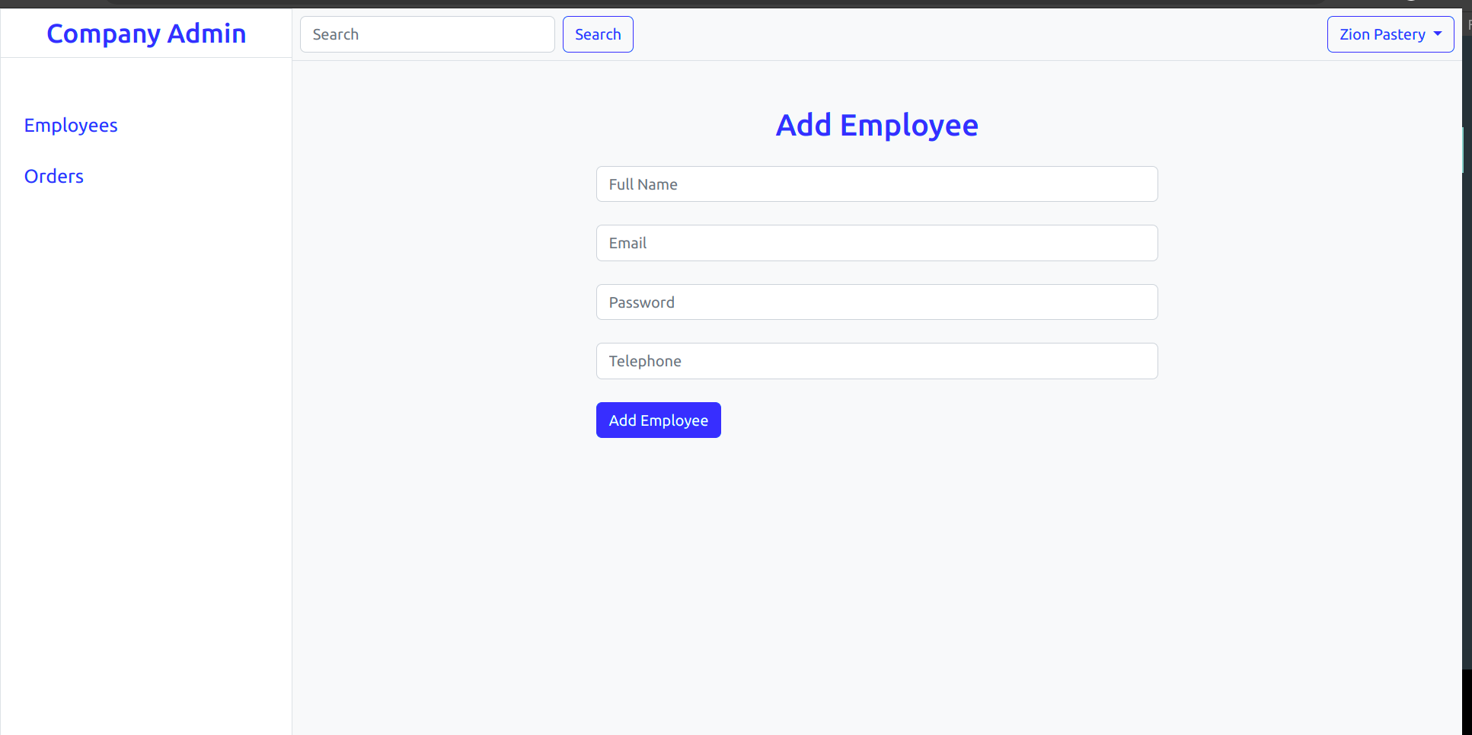
Add Employee
Add employees to company

Slide 14
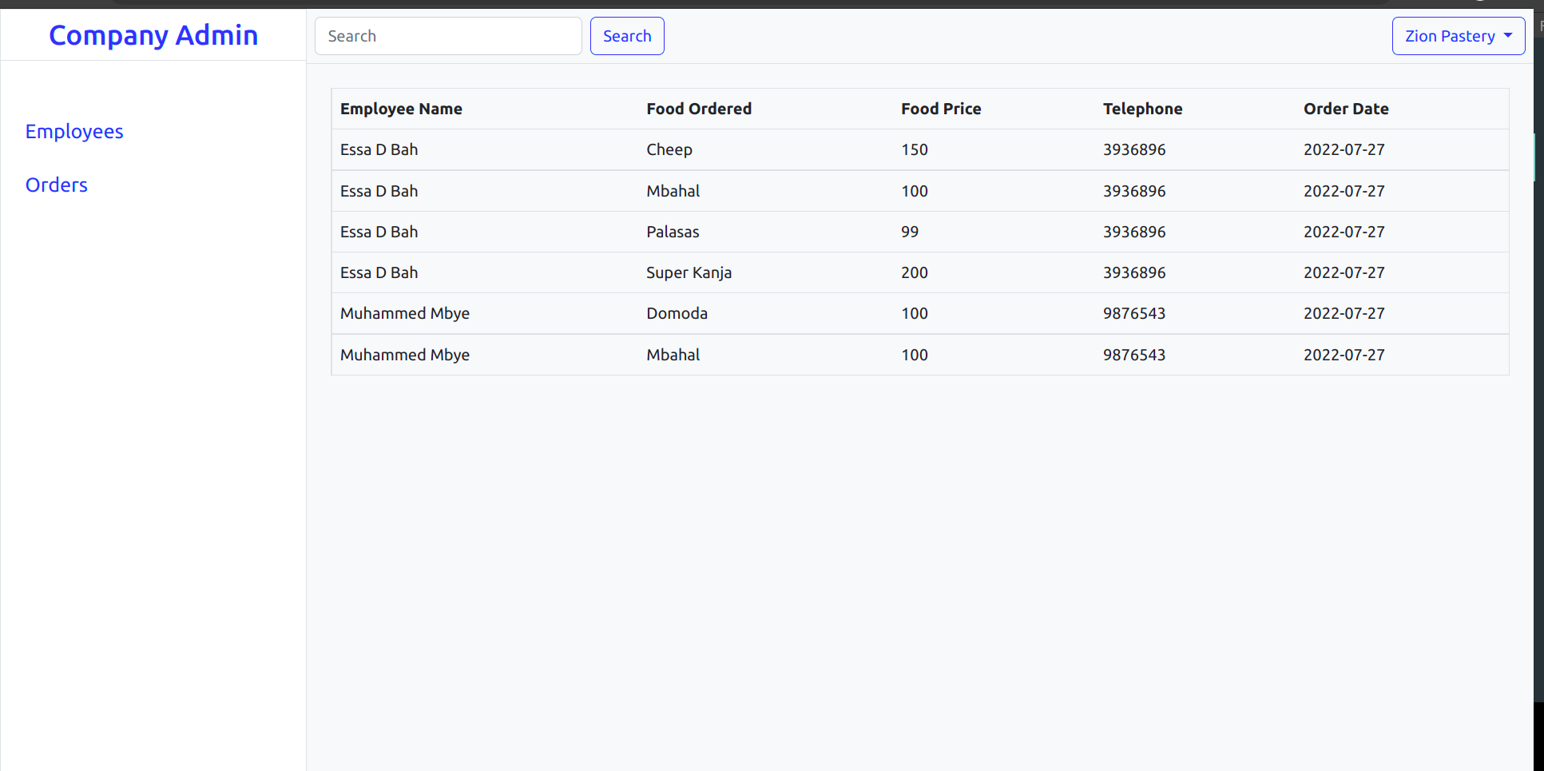
Company Orders
All orders made by employee of a particular company are listed here

Slide 15
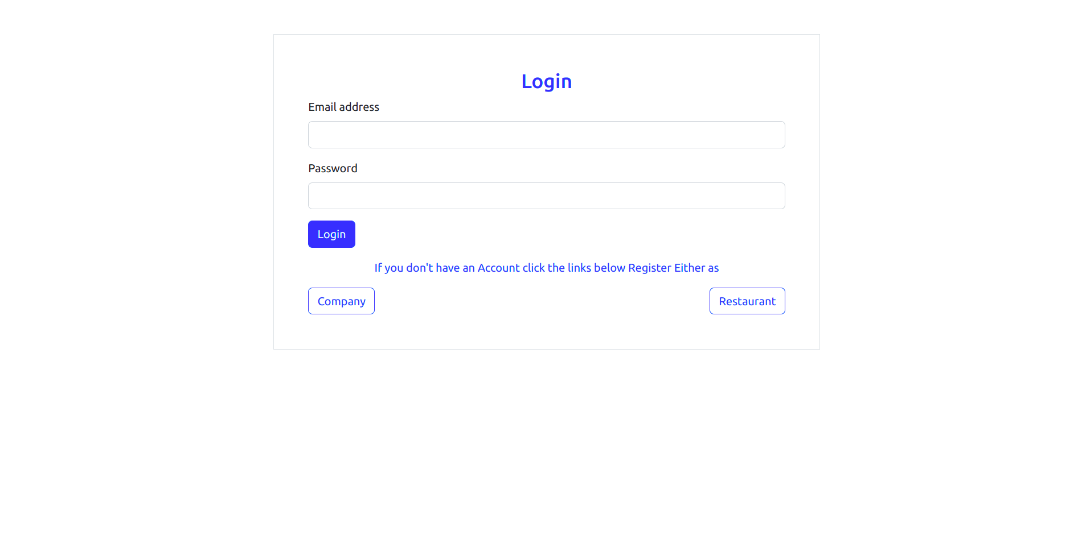
Login
Login into the app and you will be redirected to your page.

Slide 16
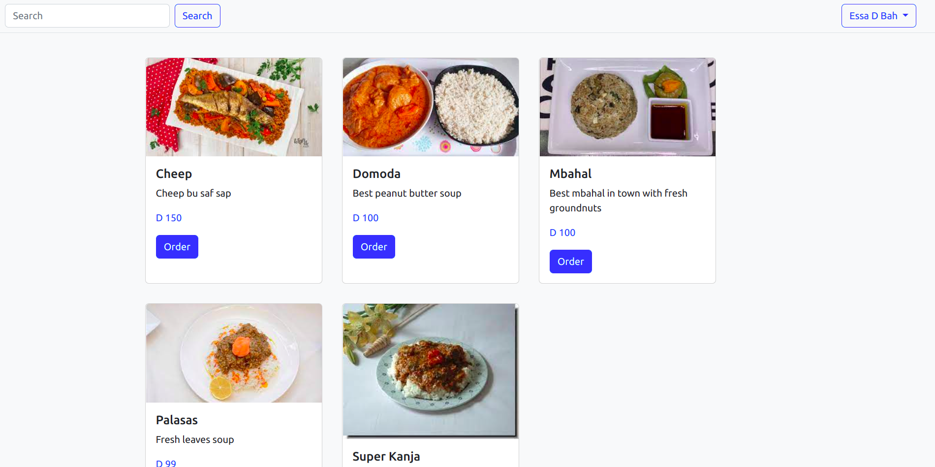
Employee Dashboard
After a company adds an employee they can login with the credentials provided by the admin of the company.
Order food by clicking order

Slide 17
cont
Partnering Restaurant will see the order
The order will be send to the company.

Slide 18
Conclusion
Anch will remove the hustle of going around asking employees of what to order.
Just Register and let us handle the heavy lifting.

