Slide 1
WEB SERVICES
DISTRIBUTED INFORMATION SYSTEM

Slide 2
WEB SERVICES
SUMMARY
1 – What are Web services ?
2 – How does a Web service work?
3 – Different types of Web services.
4 – Examples
5 – Conclusion

Slide 3
1 – WHAT ARE WEB SERVICES ?
Application Programming Interfaces (API)
Request services
REST architecture
SOA architecture
OASIS
World Wide Web Consortium (W3C)

Slide 4
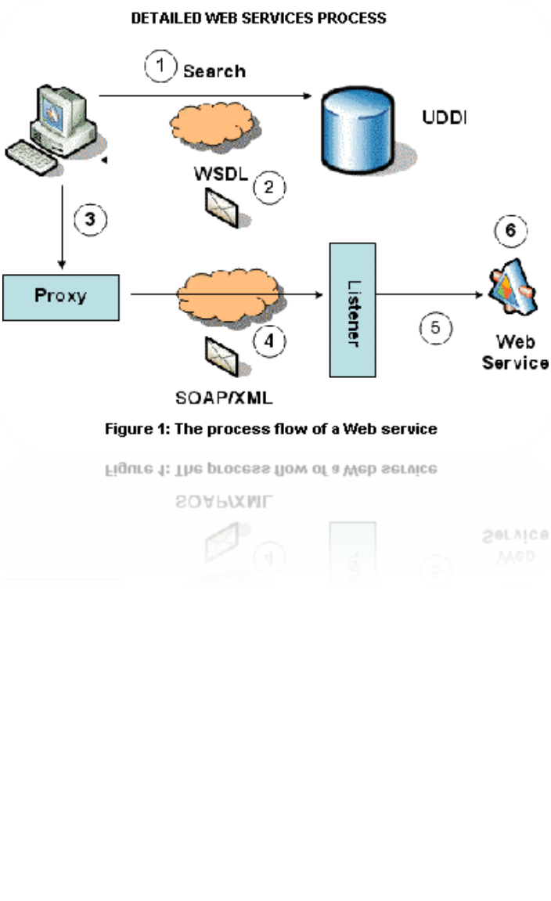
2 – HOW DOES A WEB SERVICE WORK?
The client sends a request
Request encoded in XML
Function (GET, POST…) in the file
The server decodes the file
The function is executed
A new XML file is encoded
and re-send to the client
=> Clients and servers communicate over the HyperText Transfer Protocol (HTTP).

Slide 5
3 – DIFFERENT TYPES OF WEB SERVICES
=> Service-oriented architecture (SOA):
SOA defines WS-* Web Services
Communication protocol: SOAP
Web Service Description Language (WSDL)
for description
UDDI (Universal Description Discovery and Integration) directory

Slide 6
3 – DIFFERENT TYPES OF WEB SERVICES
=> Service-oriented architecture (SOA):
Advantages :
- Interoperability between applications on many platforms
Use open protocols
Data and protocols are in plain text
Thanks to HTTP protocol, Web services can run through firewalls
- Easy to implement

Slide 7
3 – DIFFERENT TYPES OF WEB SERVICES
=> Service-oriented architecture (SOA):
Disadvantages :
- Norms are sometimes recent
Low performances
HTTP protocol: Web services can circle security measures implemented by firewalls

Slide 8
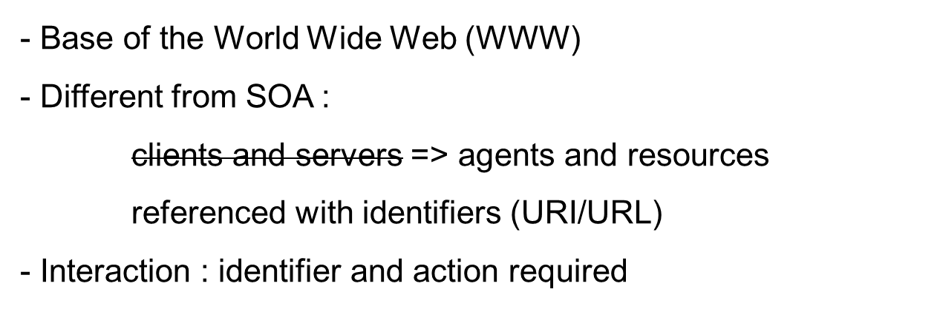
3 – DIFFERENT TYPES OF WEB SERVICES
=> Representational state transfer (REST):

Slide 9
3 – DIFFERENT TYPES OF WEB SERVICES
=> Representational state transfer (REST):
Advantages :
Easy to maintain
- No state client administration: Less memory used, simplicity, simultaneous requests, several servers …
- Using URI: setting up cache servers

Slide 10
3 – DIFFERENT TYPES OF WEB SERVICES
=> Representational state transfer (REST):
Disadvantages :
- The client has to keep locally all necessary data for a request: High consuming network bandwidth

Slide 11
4 – EXAMPLES
Social Networking (Facebook, Twitter…)
Travel agency (Ryanair, EasyJet…)
Video sharing (Youtube …)
Blogging (MySpace, Blogger…)
E-Commerce (Amazon, Ebay…)
Maps (Google maps, Mappy…)

Slide 12
5 – CONCLUSION
Growing since 2000
Security problems (HTTP)
REST architecture more and more common
. . . QUESTIONS ? . . .

