Slide 1
OLFACTORY
MAHMOUD ELSAED SERAG
202201762

Slide 2
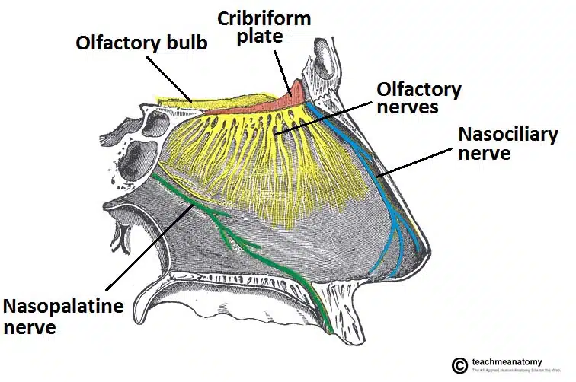
The olfactory nerve
The olfactory nerve (CN I) is the first and shortest cranial nerve. It is a special visceral afferent nerve, which transmits information relating to smell.
Embryologicallly, the olfactory nerve is derived from the olfactory placode (a thickening of the ectoderm layer), which also give rise to the glial cells which support the nerve.
In this article, we shall look at the anatomy of the olfactory nerve – its structure, anatomical course and clinical relevance.

Slide 3
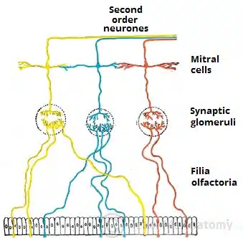
Anatomical Course
The anatomical course of the olfactory nerve describes the transmission of special sensory information from the nasal epithelium to the primary olfactory cortex of the brain.
Nasal Epithelium
The sense of smell is detected by olfactory receptors located within the nasal epithelium. Their axons (fila olfactoria) assemble into small bundles of true olfactory nerves, which penetrate the small foramina in the cribriform plate of the ethmoid bone and enter the cranial cavity.
Olfactory Bulb
Once in the cranial cavity, the fibres enter the olfactory bulb, which lies in the olfactory groove within the anterior cranial fossa.
The olfactory bulb is an ovoid structure which contains specialised neurones, called mitral cells. The olfactory nerve fibres synapse with the mitral cells, forming collections known as synaptic glomeruli. From the glomeruli, second order nerves then pass posteriorly into the olfactory tract.

Slide 4
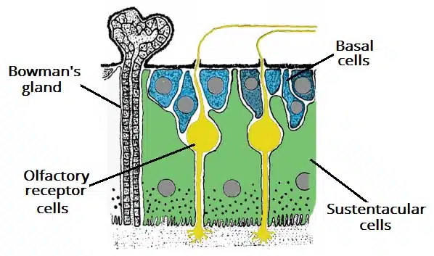
Sensory Function
The sensory function of the olfactory nerve is achieved via the olfactory mucosa. This mucosal layer not only senses smell, but it also detects the more advanced aspects of taste.
It is located in the roof of the nasal cavity and is composed of pseudostratified columnar epithelium which contains a number of cells:
Basal cells – form the new stem cells from which the new olfactory cells can develop.
Sustentacular cells – tall cells for structural support. These are analogous to the glial cells located in the CNS.
Olfactory receptor cells – bipolar neurons which consist of two processes:
Dendritic process projects to the surface of the epithelium, where they project a number of short cilia, the olfactory hairs, into the mucous membrane. These cilia react to odors in the air and stimulate the olfactory cells.
Central process (also known as the axon) projects in the opposite direction through the basement membrane.
In addition to the epithelium, there are Bowman’s glands present in the mucosa, which secrete mucus.

Slide 5
reference
https://teachmeanatomy.info/head/cranial-nerves/olfactory-cni/

Slide 6
THANK YOU

