Slide 1

Notes:
Benvenuto. Giornata in due parti: prima capiamo il panorama e il metodo, poi entriamo a fondo in Claude e in come impostarlo. Chiedere chi usa già un'AI e quale.

Slide 2

AI at Work
October 2026
Intro and setting
AI training for Marketing
Notes:
Benvenuto. Giornata in due parti: prima capiamo il panorama e il metodo, poi entriamo a fondo in Claude e in come impostarlo. Chiedere chi usa già un'AI e quale.

Slide 3
Why we're here today
In marketing, time goes in two ways: creating content and handling repetitive operations.
AI can help on both fronts, without betraying the brand and without becoming yet another job to manage.
Goals for the day:
understand which AI to use for what
get to know Claude in depth and set it up well from day one
learn a method to automate repetitive work on your own
Notes:
Gancio: chiedere all'aula qual è il lavoro più noioso che rifanno ogni settimana. Annotare 3 o 4 risposte: torneranno nella sezione automazioni.

Slide 4
What we'll cover today
01 The landscape: ChatGPT, Claude, Gemini, Perplexity, Leonardo AI
02 The prompt: how you talk to an AI
03 ChatGPT, Claude and Gemini compared
04 Inside Claude: surfaces, modes, workspace, models and tokens
05 Working well: projects, folder, artifacts and files
06 Skills and agents: skills, agents, connectors, scheduled tasks, Code
07 The ideal setup
08 Automating the repetitive
09 Trust and the first step
10 An events office with Claude
11 Leonardo AI in detail
Notes:
Le slide «Pipeline» sono percorsi consigliati da replicare in ufficio: non facciamo prove in aula, mostriamo il metodo.

Slide 5
AI empowers those who use it
Notes:
Messaggio chiave da ripetere in chiusura: l'AI non sostituisce il giudizio, il gusto e la conoscenza del brand. Li moltiplica.

Slide 6
The AI landscape
Section 01 · Five tools, five jobs

Slide 7
How fast the AI world moves
Seven months have passed since our first training in March. In the meantime:
Claude has gone from Opus 4.6 to Opus 5.5 and Sonnet 5.5
ChatGPT has moved to the GPT-6 family: Astra, Sol, Luna
Gemini works with the 3.x models; Gemini 4 has been announced
Claude Design was born (April), today inside Claude
in the Claude app, chat and Cowork are no longer separate: one single conversation
scheduled tasks run in the cloud, even with your PC switched off
Important: learn the method, not the buttons. Buttons change, the method stays.
Notes:
Dati verificati a inizio ottobre 2026 su anthropic.com, help.openai.com e fonti Google. Ricontrollare la settimana dell'aula.

Slide 8
How an AI thinks
A generative AI doesn't think and doesn't know: it completes text in the most likely way, based on everything it has read.
Practical consequences:
where information is missing, it fills the gaps with generic or made-up answers
the more context you give it, the more the result is yours and not everyone's
it always needs rereading: a brilliant collaborator, not an oracle
Text AIs and image AIs work with the same logic: the prompt drives everything.
Notes:
Metafora: un collaboratore brillantissimo al primo giorno, che non conosce né l'azienda né i clienti.

Slide 9
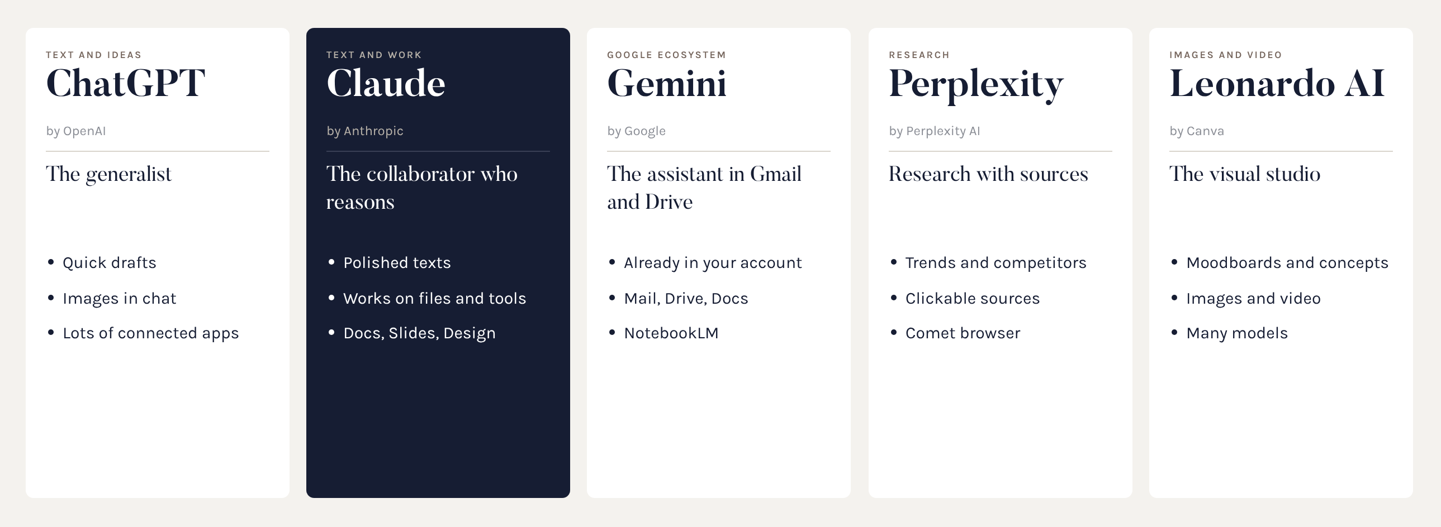
Five jobs
There is no best AI: there's the right one for the task.
Notes:
Un minuto per strumento. Le slide successive li presentano uno per uno.

Slide 10
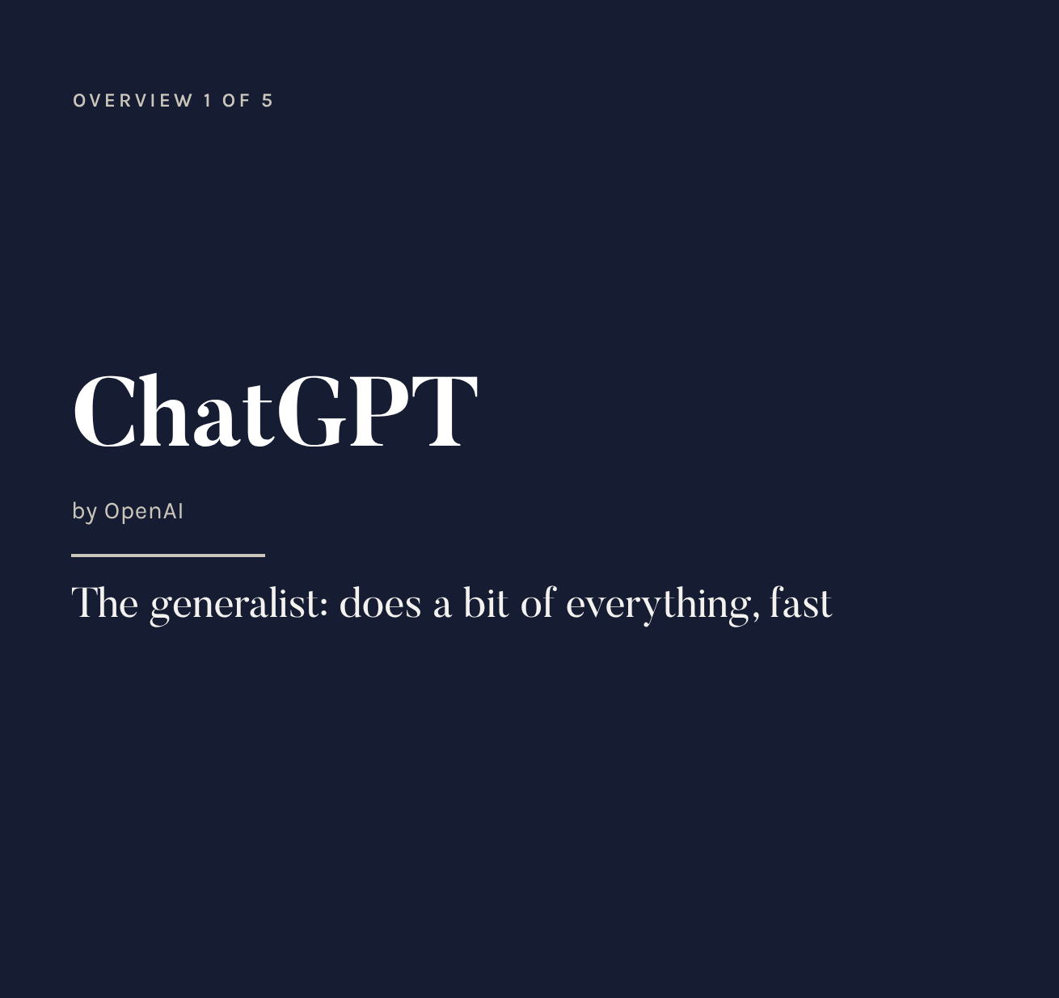
What it is
The most widespread AI assistant, by OpenAI. Current models: the GPT-6 family. Strong on speed, versatility and images generated in chat.
For marketing
brainstorming claims and ideas
first drafts and quick variants
concept images on the fly
careful: check facts and figures
Notes:
Punto di forza: ecosistema enorme di app, agenti e automazioni.

Slide 11
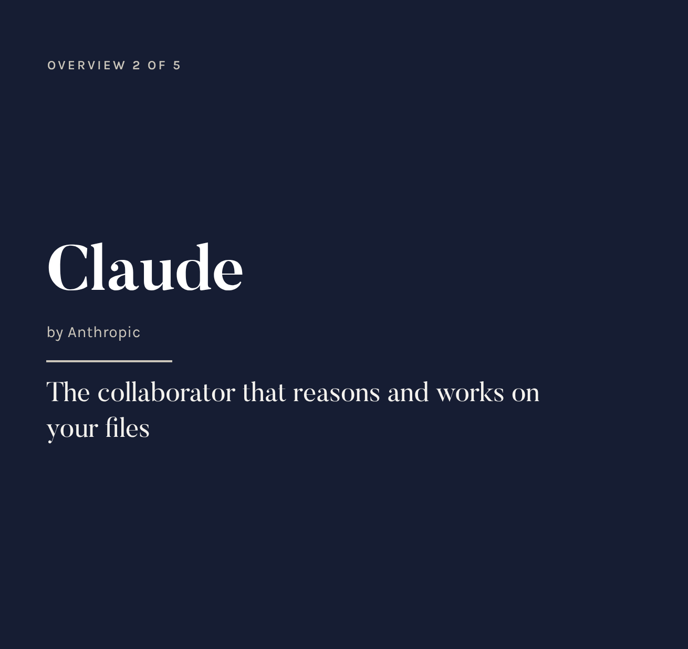
What it is
Anthropic's AI assistant. Current models: Opus 5.5 and Sonnet 5.5. Strong on reasoning, polished writing and working on documents and folders.
For marketing
copy, press releases, on-brand sheets
works on files and tools
creates documents, slides and graphics
automates repetitive work
Notes:
È lo strumento adottato dal gruppo: lo approfondiamo dalla sezione 04.

Slide 12
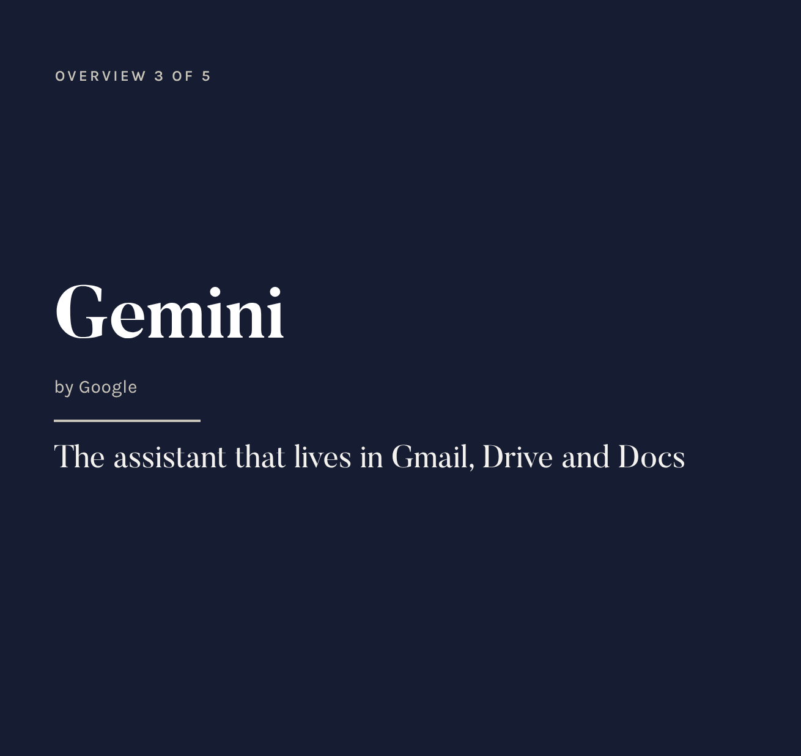
What it is
Google's AI assistant, already in every Gmail account. Models 3.x Flash and Pro. It lives inside Gmail, Drive, Docs, Sheets and Meet.
For marketing
summarising long email threads
finding files and information in Drive
NotebookLM on brand books and catalogues
images (Nano Banana) and video (Veo)
Notes:
Attenzione: dal 9 ottobre il piano gratuito usa solo il modello più leggero (Flash-Lite). Per dati aziendali non usare l'account Gmail personale.

Slide 13
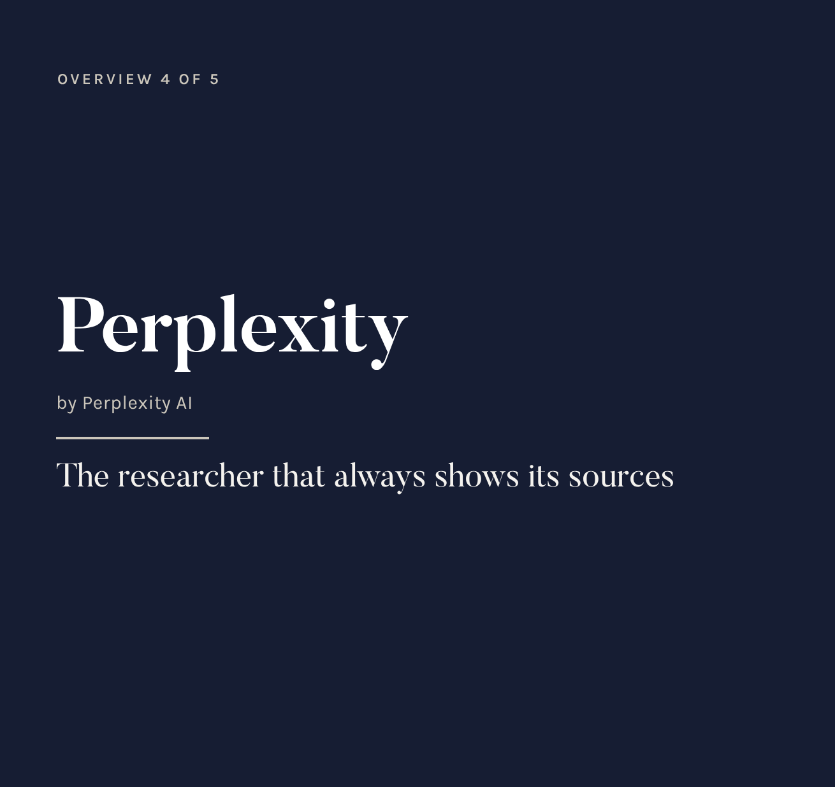
What it is
An answer engine: it searches the web and answers citing clickable sources. It also has Deep Research and the Comet AI browser.
For marketing
industry and design trends
competitor monitoring
market data with sources
preparing for trade fairs and events
Notes:
Il suo valore è la verificabilità: ogni affermazione ha una fonte da aprire.

Slide 14
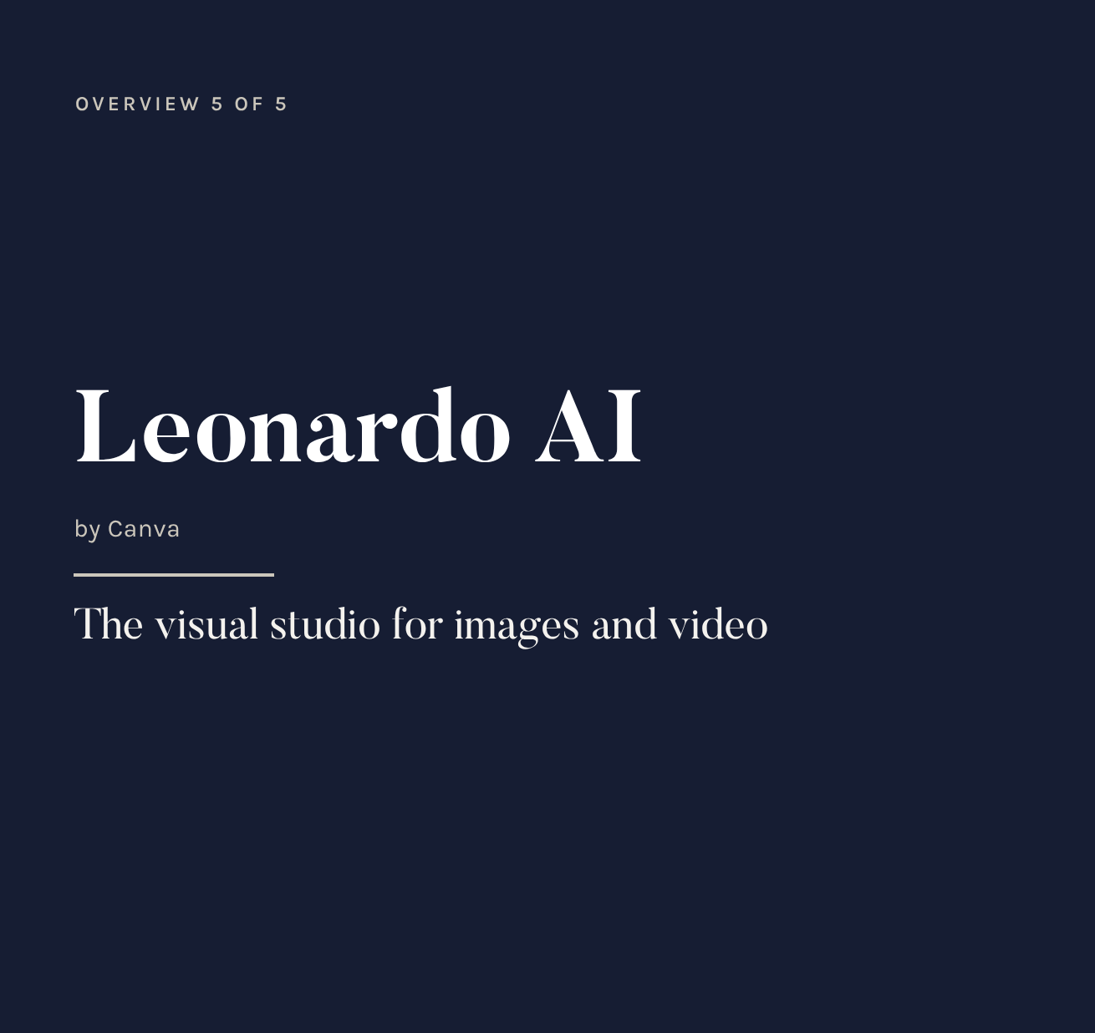
What it is
A platform to generate images and video with many different models in one place. It's part of Canva.
For marketing
moodboards and setting concepts
social visuals and video teasers
deep dive in section 11
Notes:
Qui solo la presentazione: la sezione finale spiega modelli, area di lavoro, token e pipeline.

Slide 15
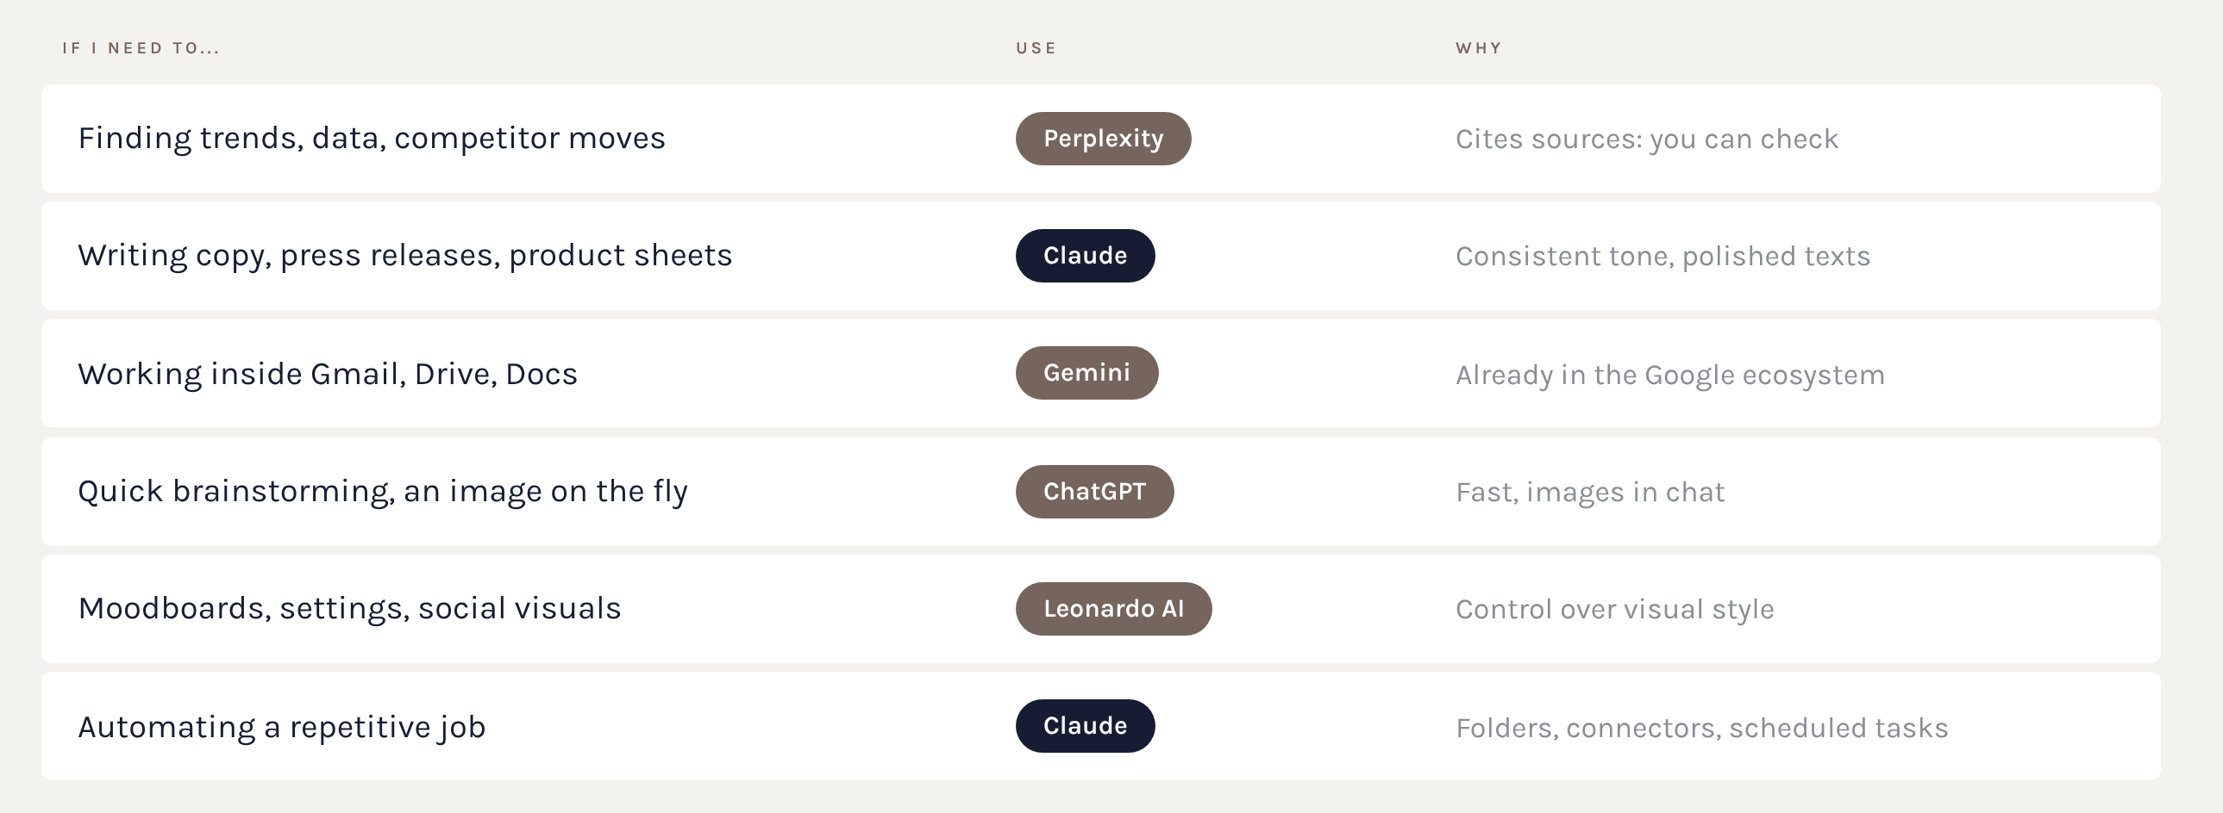
Which AI for what
They work together: each one where it's strongest.
Notes:
Chiedere all'aula un compito reale della settimana e decidere insieme quale strumento usare.

Slide 16
The prompt
Section 02 · How you talk to an AI

Slide 17
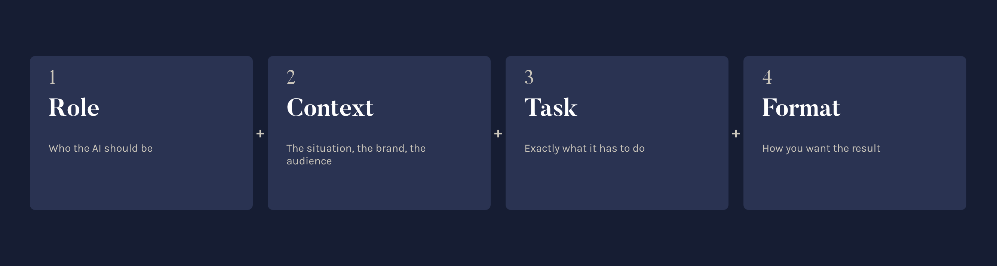
Before and after
VAGUE PROMPT
“Write an Instagram post for the new kitchen.”
Result: generic, fits any brand.
COMPLETE PROMPT
“You are the social media manager of a high-end kitchen brand. Write 3 caption variants for the launch of a new model, for an audience of architects and families. Elegant tone, max 300 characters, 3 hashtags.”
Notes:
Far notare i 4 ingredienti: ruolo, contesto, compito, formato.

Slide 18
Three tricks that work
1. Give it a role: “You are our brand's copywriter”. It changes register and depth.
2. Show examples: paste 2 or 3 approved texts and ask for the same style.
3. Iterate in the same chat: “shorter”, “fewer adjectives”, “add a call to action”.
Bonus: ask the AI to ask you questions before it answers. “Before you write, ask me what you need to know.”
Notes:
Il trucco 2 (esempi) è il più potente per il tono di voce di un brand.

Slide 19
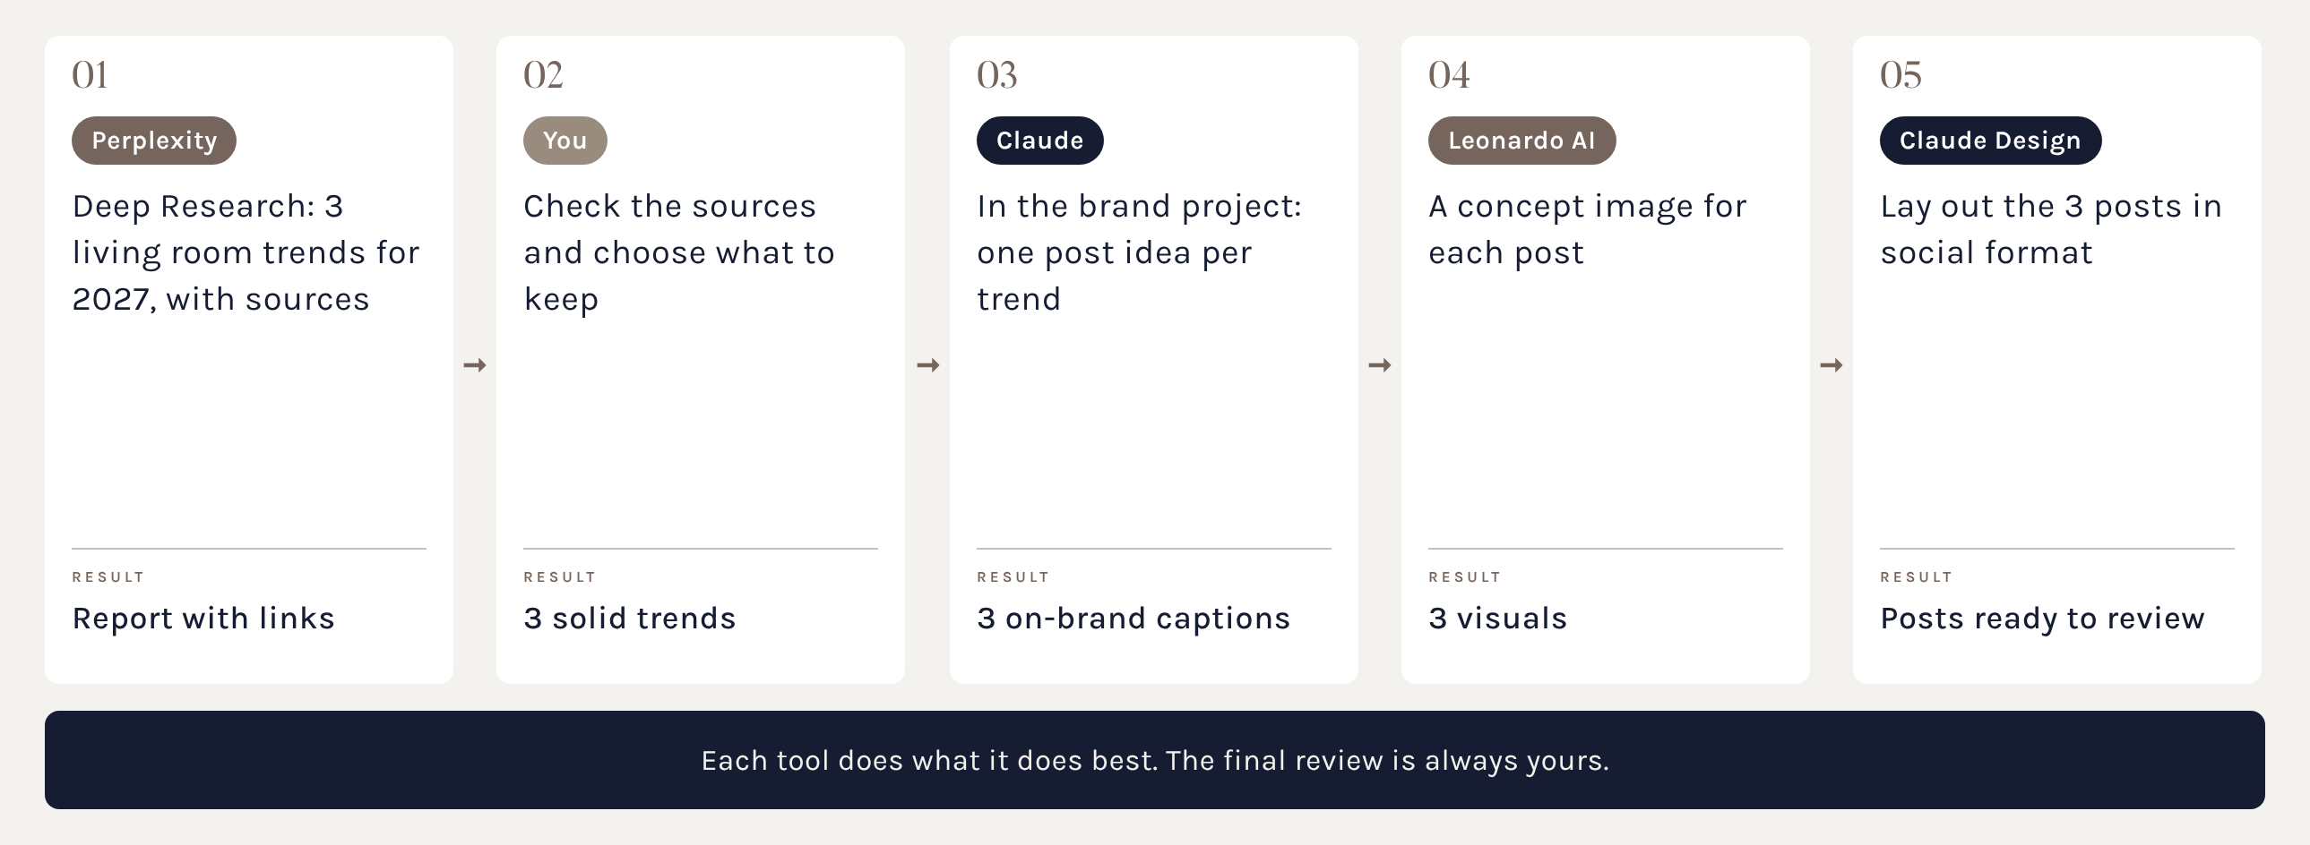
Pipeline: 3 trends for 2027
Suggested path: three 2027 living room trends, one post for each.
Notes:
Non è una prova in aula: è il percorso ideale da replicare in ufficio. Spiegare perché ogni passo usa quello strumento.

Slide 20
The pipeline prompts
1. Perplexity: “What are the 2027 living room trends? Three trends with industry sources, each with materials, colours and an example.”
2. You: open the sources, drop anything weak.
3. Claude, in the brand project: “For each of these 3 trends, suggest an Instagram post with a caption in our tone of voice.”
4. Leonardo AI: one image prompt per trend (see section 11).
5. Claude Design: “Lay out the 3 posts in 4:5 format in the brand colours.”
Notes:
Distribuire questi prompt come scheda pratica dopo l'aula.

Slide 21
Three side by side
Section 03 · ChatGPT, Claude and Gemini

Slide 22
What they have in common
Today ChatGPT, Claude and Gemini are more alike than they seem:
chat with web search and file uploads
projects or spaces with instructions and documents
memory of conversations
connection to external apps (mail, calendar, drive)
agents that carry out multi-step tasks
individual plan at about 20 dollars a month
The difference is their character and how they work with you.
Notes:
Non è una guerra di tifoserie. Chi sa usare bene uno, impara gli altri in un'ora.

Slide 23
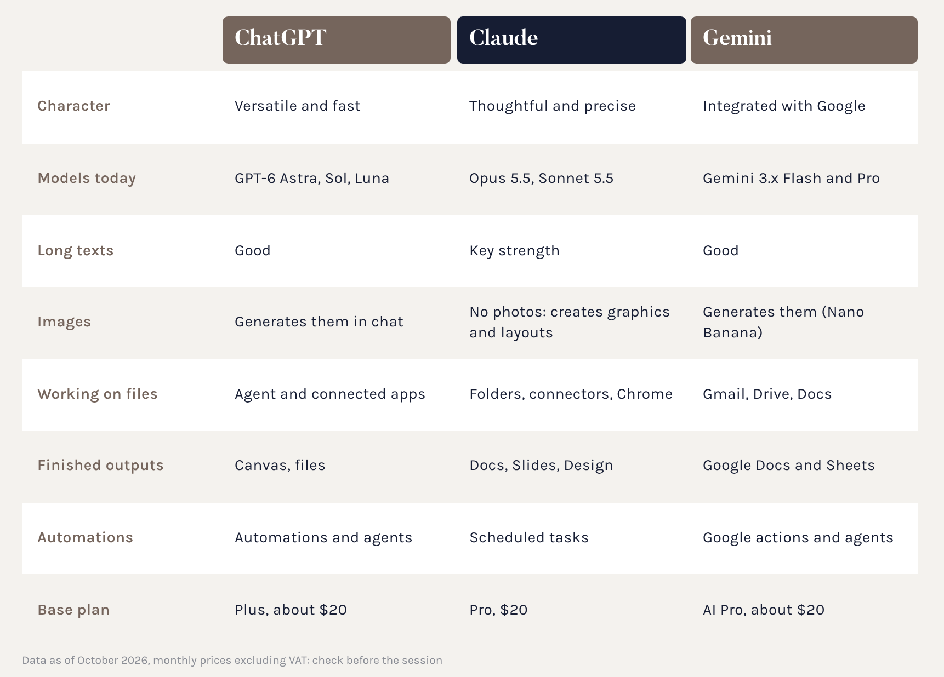
The comparison
ChatGPT is fast and generates images.
Claude reasons, writes with care and works inside files and tools.
Gemini is already inside Gmail and Drive.
Notes:
Dati volatili verificati a ottobre 2026. Prezzi in dollari, IVA esclusa.

Slide 24
When to use what
ChatGPT when you need speed, an image on the fly or an app from its ecosystem.
Gemini when the work is inside Gmail, Drive or Google Docs.
Claude when the text must be polished and on-brand, when you work on long documents or want the AI to act on folders and tools.
If in doubt: try the same request on two tools and compare.
Notes:
Da qui in poi il focus è su Claude, lo strumento adottato dal gruppo.

Slide 25
The method matters more than the tool

Slide 26
Inside Claude
Section 04 · Surfaces, modes, workspace, models

Slide 27
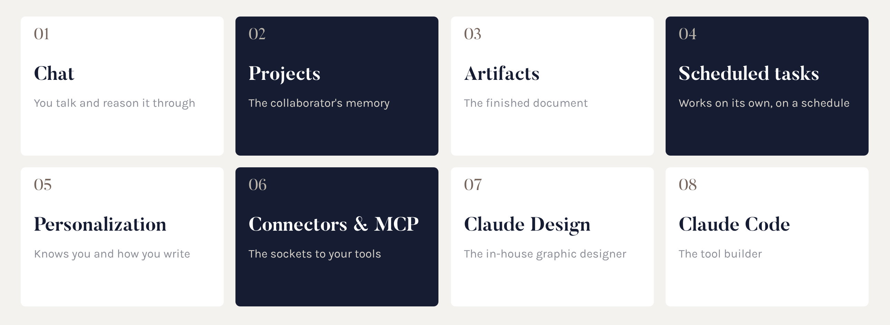
The Claude map
Eight building blocks. Start with chat and projects, add the rest when you need it.
Notes:
Presentare la mappa come indice di tutta la parte su Claude.

Slide 28
Where to use
Claude
The same Claude, in several places:
Desktop app (Mac and Windows): the full version, recommended
Browser, on claude.ai: handy from any computer
Mobile app: to chat, dictate and follow tasks in progress
Claude in Chrome: an extension that browses and acts on websites
Claude in Excel and PowerPoint: works inside Office files
Claude for Google Workspace (beta): in Docs, Sheets and Slides
Account, projects, artifacts and scheduled tasks are the same everywhere.
Notes:
Il messaggio chiave: installate l'app desktop. È lì che Claude può lavorare sulle vostre cartelle.

Slide 29
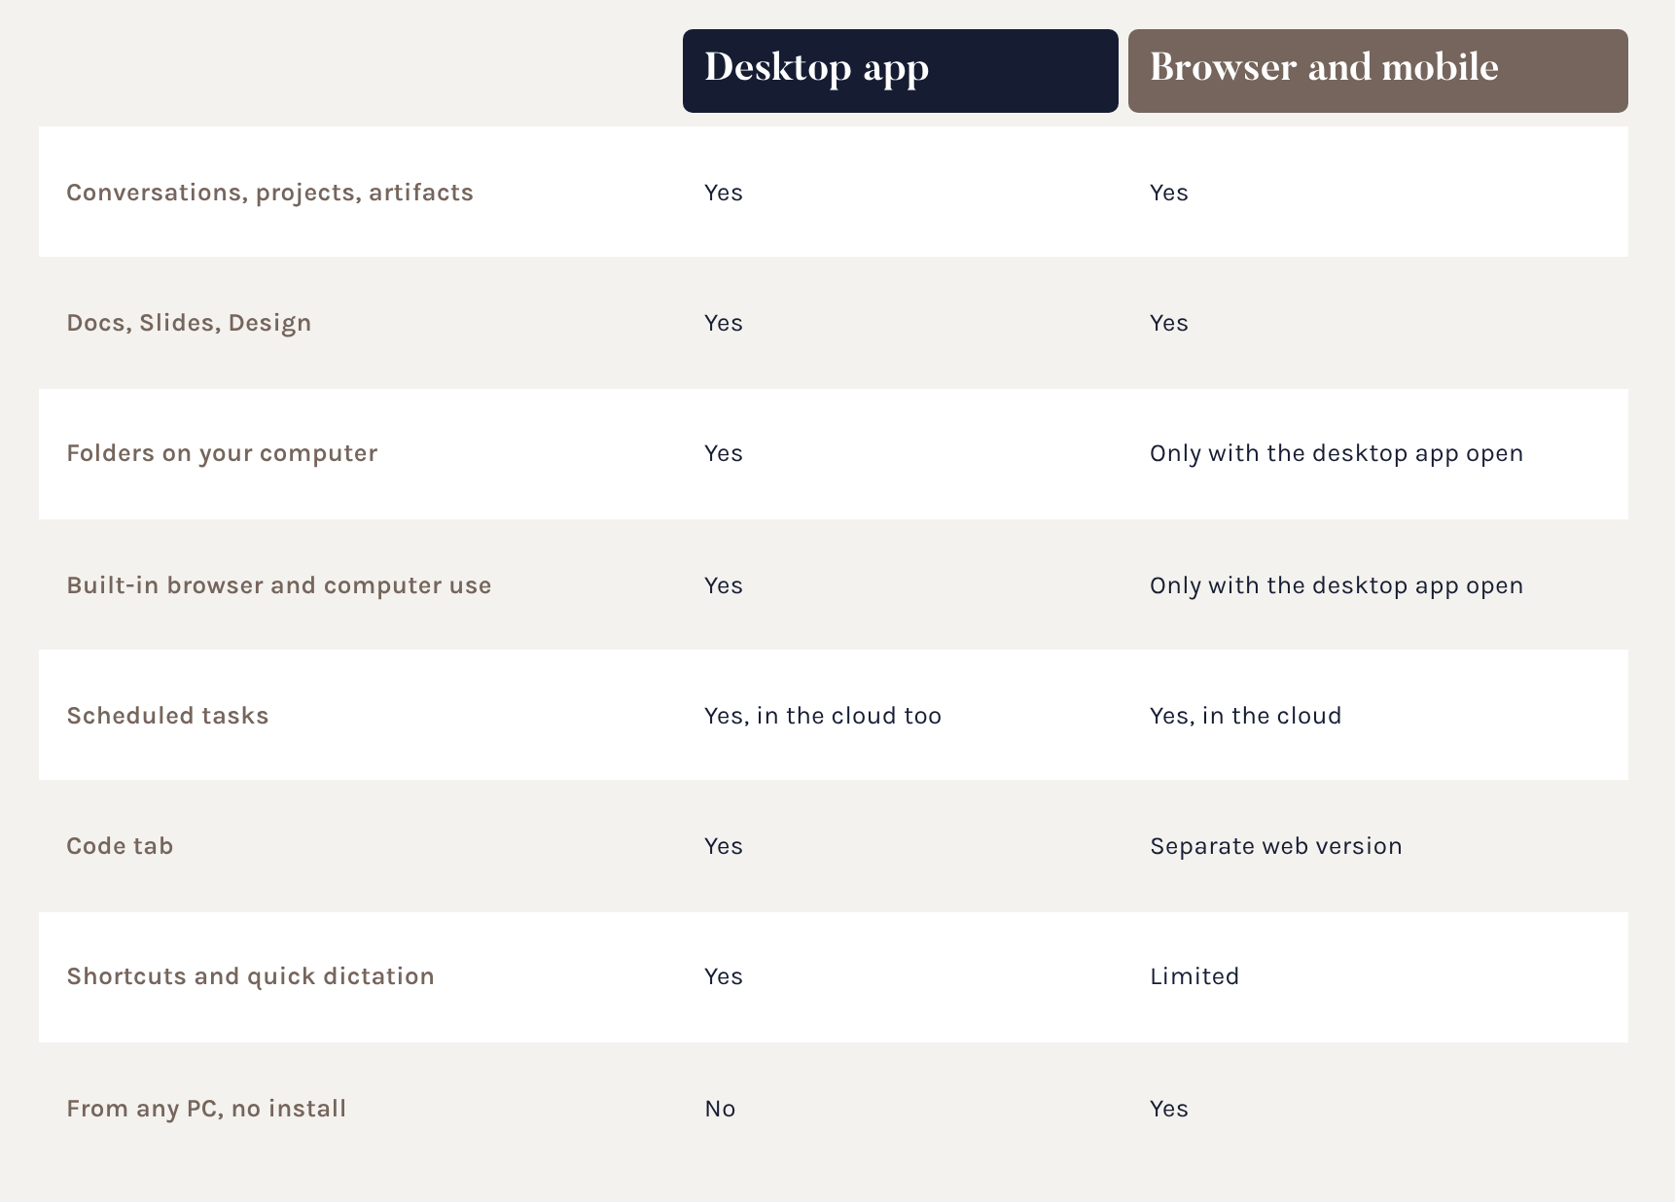
Desktop or browser?
The desktop app is the gateway to your computer: folders, the built-in browser and computer use only work while it's open, even if you're working from the browser or your phone.
Notes:
Dettagli verificati a ottobre 2026; le funzioni si allineano spesso, verificare prima dell'aula.

Slide 30
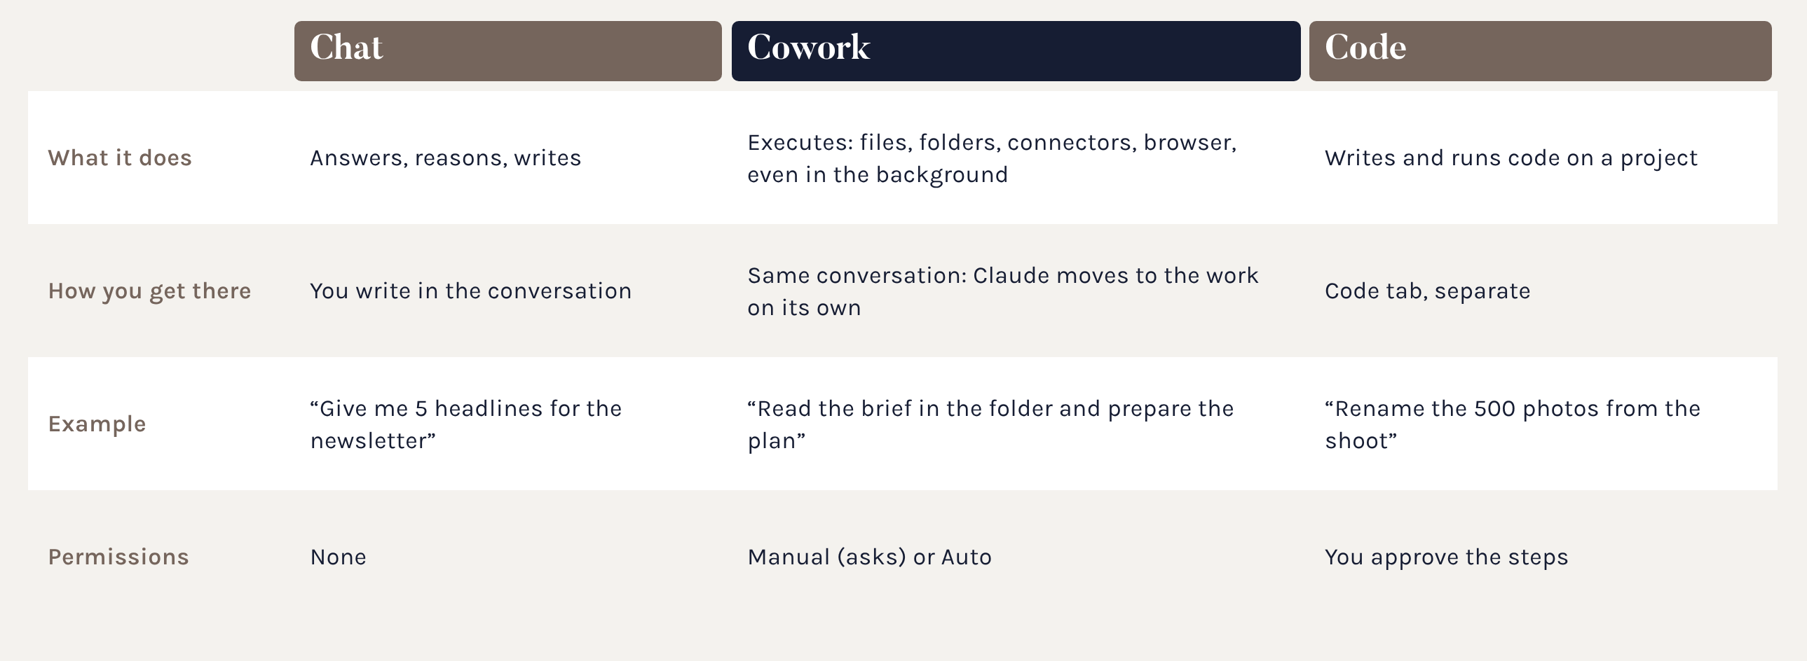
One single conversation
Since the latest update you no longer choose between Chat and Cowork: Claude works out what's needed on its own.
Notes:
Prima esistevano Chat e Cowork separati. Ora è una sola conversazione: se chiedete un'idea risponde, se chiedete un lavoro su file apre le attività. Code resta la modalità per costruire strumenti.

Slide 31
What has changed
The choice between Chat and Cowork is gone: you just write.
Claude answers a quick question or starts a piece of work (research, reports, sheets, presentations) in the same conversation.
Recents brings chats and tasks together.
No web search switch: Claude searches when needed.
In-depth research: /deep-research or + > Research.
Projects work in every conversation.
The Code tab stays separate.
Notes:
Fonte: Centro assistenza Claude, «Claude Cowork and chat are one Claude». Distribuzione graduale: alcuni colleghi potrebbero vedere ancora la vecchia interfaccia.

Slide 32
Where things ended up
Cowork global instructions: now in Settings > General > Instructions for Claude.
Authorised folders: Settings > Trusted folders.
Folder where Cowork saved its work: Settings > Storage folder.
Permissions: in the input box, Manual or Auto.
Old Cowork tasks: in Recents, they reopen as before.
Local files, built-in browser and computer use: only with the desktop app open.
Claude always asks before permanently deleting files.
Notes:
Nomi delle voci tradotti dall'inglese: l'etichetta in italiano nell'app può variare leggermente.

Slide 33
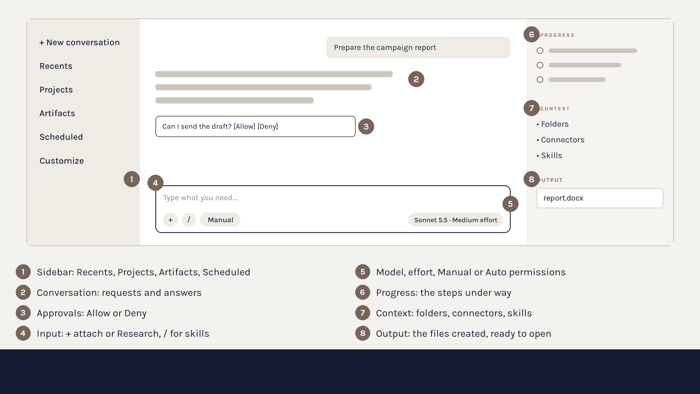
The workspace
Notes:
Schema semplificato: l'interfaccia reale può differire nei dettagli e cambia spesso.

Slide 34
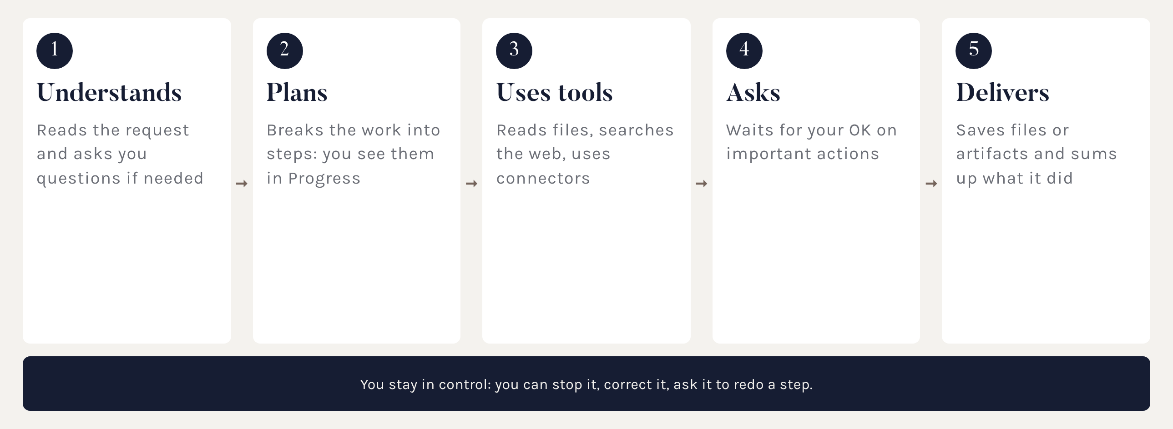
How Claude works
The cycle of every task, from request to delivery.
Notes:
Sottolineare il punto 4: la modalità di approvazione la scegliete voi.

Slide 35
How to set up the work
Three choices before you start:
Permissions: Manual (default) to begin with, Claude asks before acting. Auto: it works on its own with automatic safety checks.
Where it works: a dedicated folder, never the whole disk.
With what: only the connectors and skills that job needs.
While it works you can stop it, correct it or tell it “redo step 3 like this”.
At the end: Claude sums up what it did and where it saved the files.
Notes:
Collegare alla sezione 05 sulla cartella di lavoro.

Slide 36
What is a model
The model is the “brain” that answers. Anthropic offers several, like engines of different power:
Haiku: quick and light, for simple tasks
Sonnet: balanced, the everyday model
Opus: deep reasoning, for serious work
Fable: for long projects carried forward on its own
The number (e.g. 5.5) is the generation: higher means more recent.
Next to the model there's the effort: how much Claude thinks before answering.
Notes:
Disponibilità dei modelli e livelli di effort variano per piano: verificare sugli account aziendali.

Slide 37
What is a token
A token is the unit an AI reads and writes in: a piece of a word, about 3 or 4 characters.
Everything is measured in tokens:
what you write and the attachments
the whole conversation, which Claude rereads with every message
the internal reasoning and the answer
Your plan has a usage limit that resets every 5 hours, plus a weekly cap. The more tokens you use, the sooner you hit it.
Notes:
Fonte: support.claude.com, articolo sull'utilizzo del piano Pro.

Slide 38
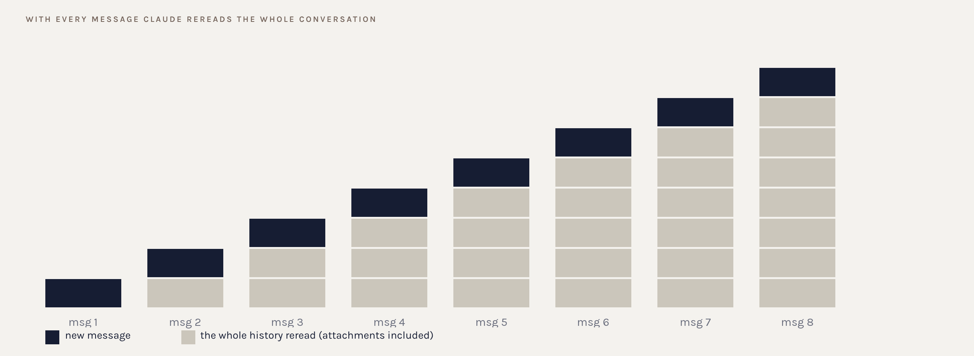
Why long chats weigh more
Message 8 costs as much as all the previous ones put together.
Notes:
È il concetto che cambia le abitudini: una chat infinita consuma sempre di più. Quando cambia argomento, nuova chat.

Slide 39
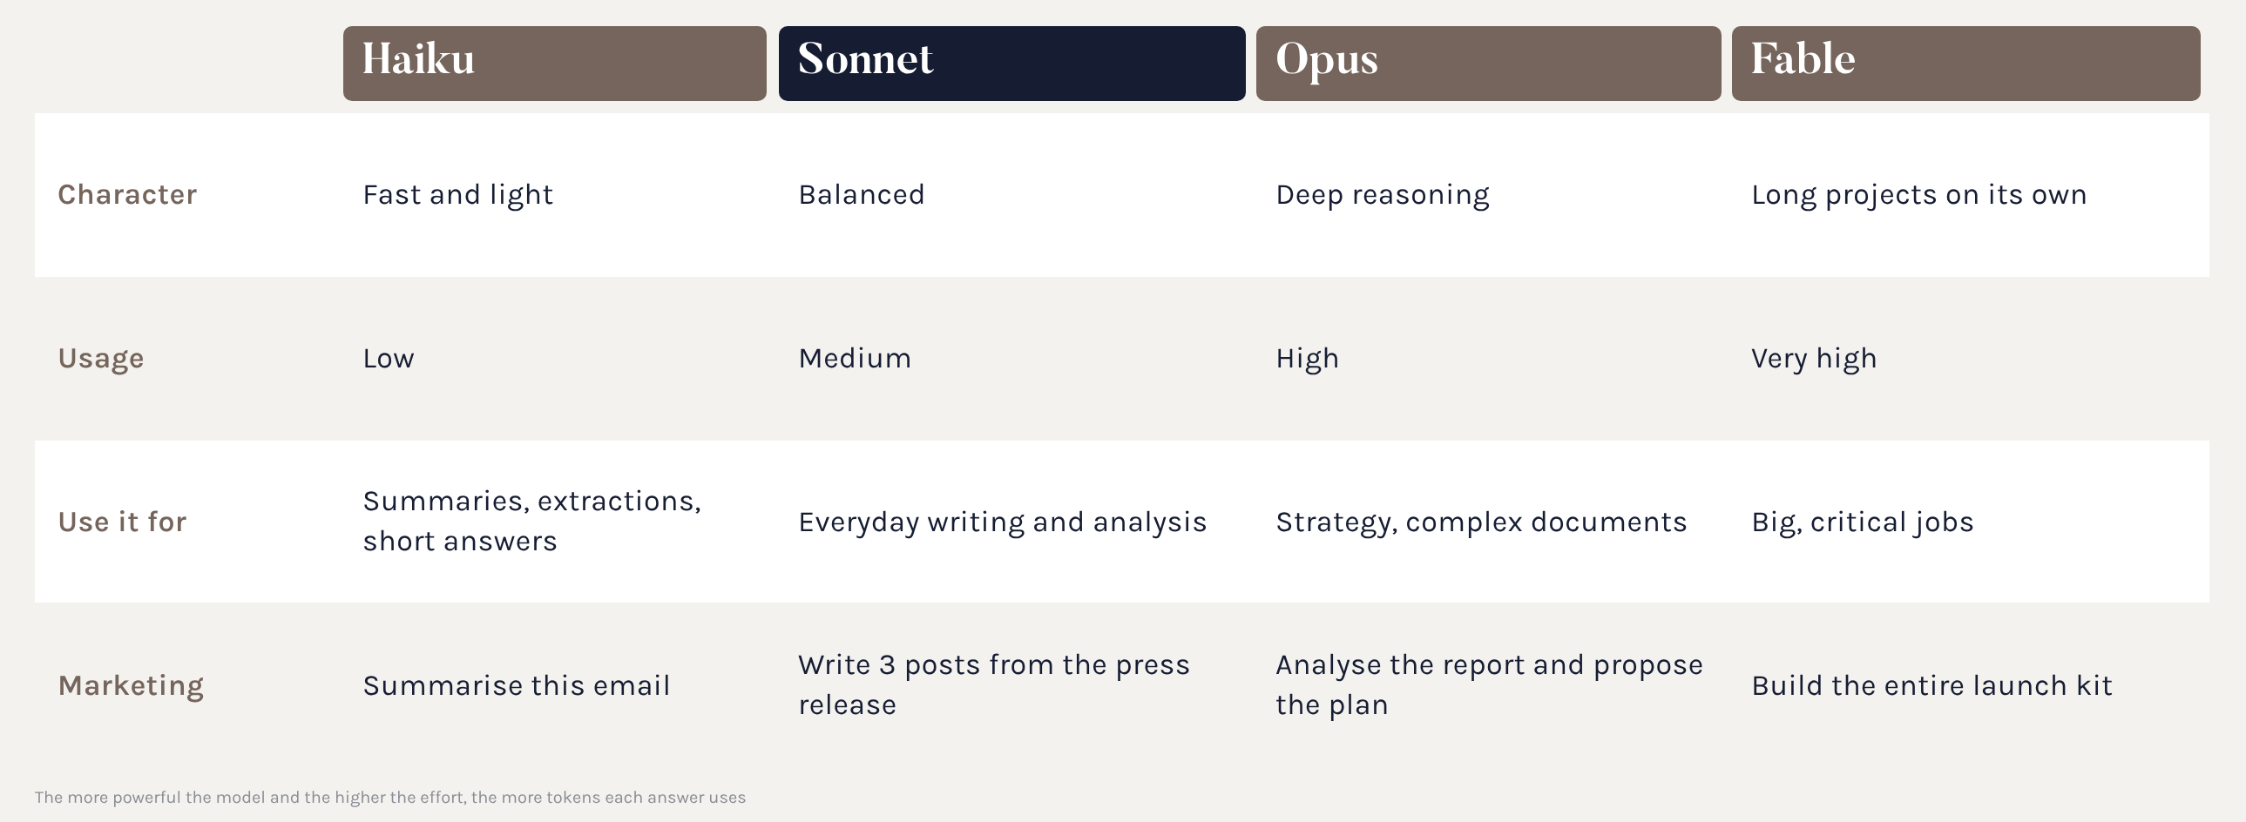
Models and usage
The right model for the right task: not too much, not too little.
Notes:
Haiku è il più efficiente, Fable consuma di più. Usare Opus per riassumere una mail è come andare a fare la spesa in Formula 1.

Slide 40
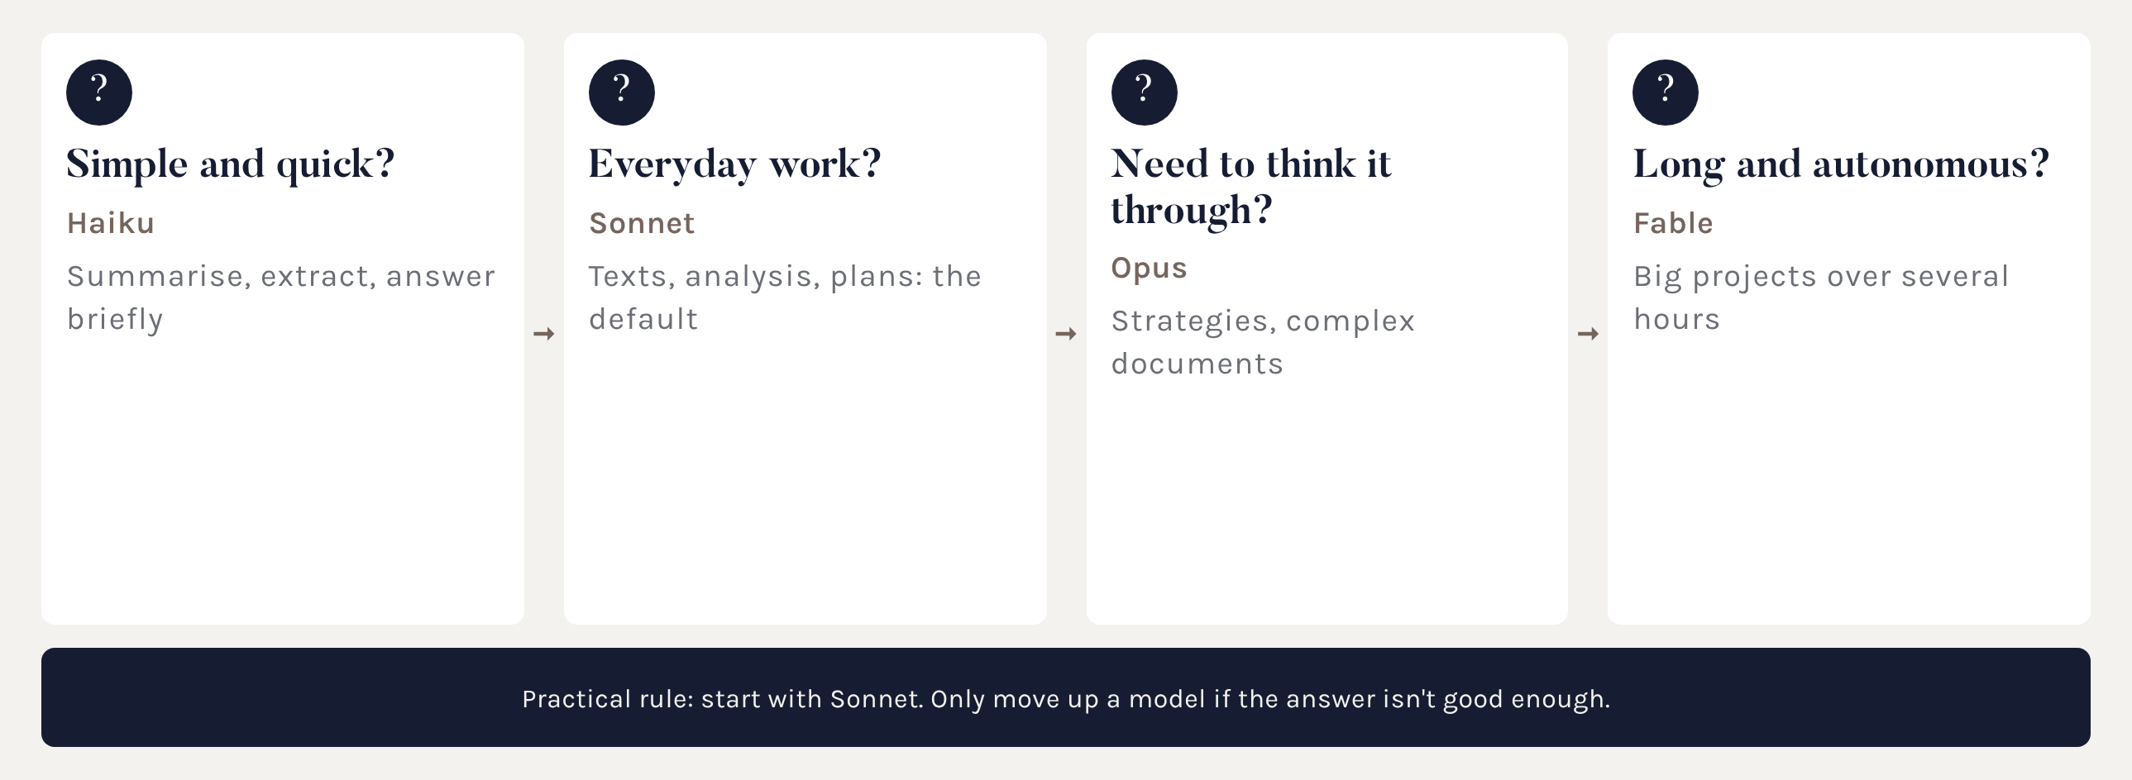
How to choose the model
Four questions, one answer.
Notes:
Lasciare Sonnet con effort medio come impostazione predefinita.

Slide 41
Using it mindfully
1. Choose the model and effort that fit the task.
2. One chat per topic: when you change subject, open a new one.
3. Don't upload the same files again: use projects and folders.
4. Group your questions into a single message.
5. Ask for short answers when a short answer is enough.
6. In-depth research only when you really need it.
7. Check your usage in Settings > Usage.
Notes:
Secondo il supporto Claude, i contenuti dei progetti vengono messi in cache e contano meno sul limite.

Slide 42
Working well
Section 05 · Projects, folder, artifacts and files

Slide 43
The chat, used well
Before you hit enter, three choices change the answer:
the model and the effort
the tools: attachments and Research with +, skills with /
the project you're in
Good habits:
one chat per topic
attach the material instead of summarising it in words
ask for sources when you use web search
rename important chats so you can find them
Notes:
Mostrare selettore modello, effort e allegati.

Slide 44
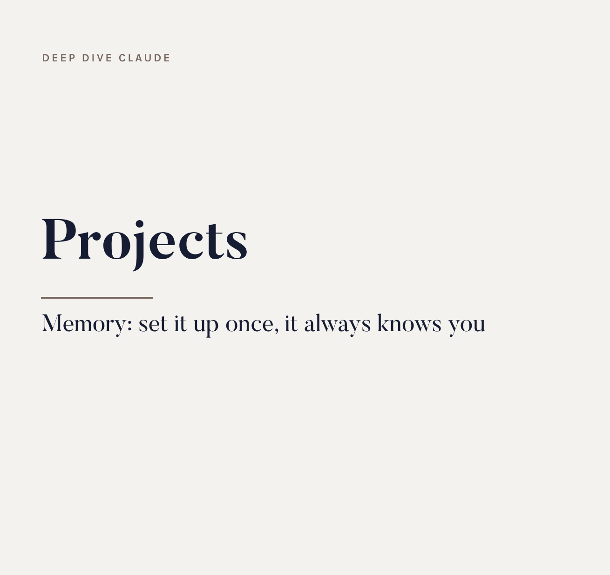
Projects
A space with permanent instructions and materials: every conversation inside it starts already knowing who you are and how you work.
Two kinds
on claude.ai: in the account, shareable with the team
on desktop: with local folders, memory and scheduled tasks
they can be linked to each other
Notes:
Il progetto desktop vive sul computer e non si condivide; il progetto claude.ai vive nell'account. Si può collegare un progetto claude.ai a un progetto desktop per usarne i materiali.

Slide 45
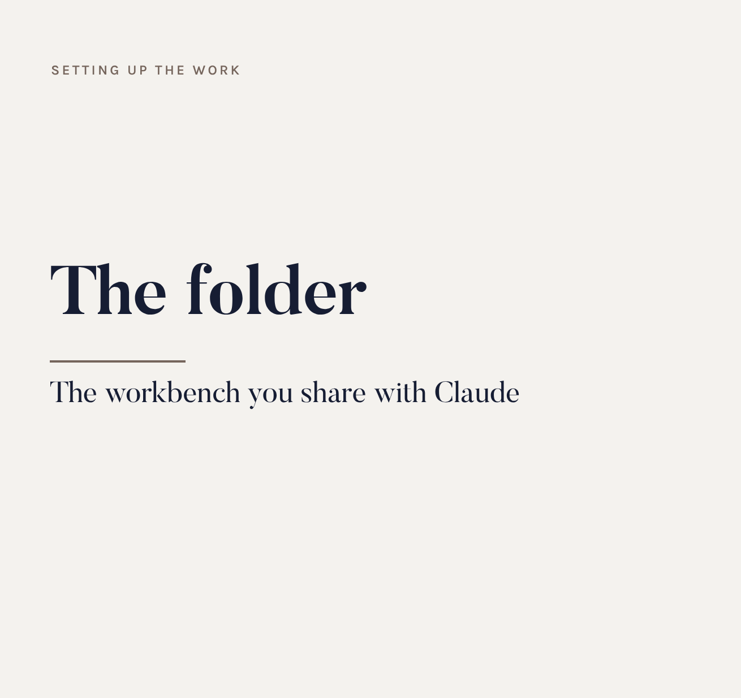
Why a folder
Linking the project to a folder is the move that changes everything: Claude works on your desk, not on copies uploaded to the chat.
What you gain
reads documents without uploading them
always sees the latest version
saves outputs there, no searching
you save tokens and time
Notes:
Esempio: aggiornate il listino nella cartella e Claude, la volta dopo, usa già quello nuovo. Nessun caricamento.

Slide 46
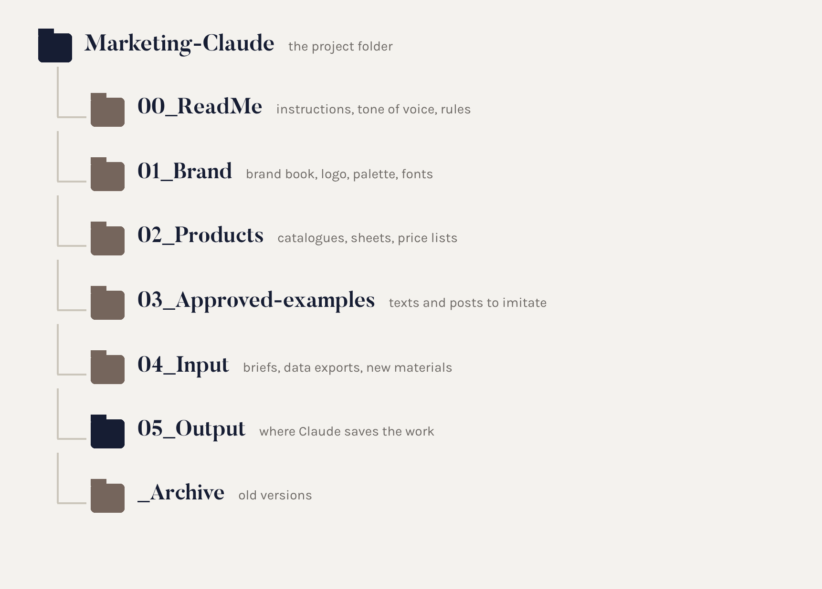
The ideal folder
A simple structure, the same for everyone. Claude knows where to find the rules, where to read the materials and where to save the work.
Notes:
Suggerire una cartella sincronizzata (OneDrive o SharePoint) per averla anche come backup. Mai collegare l'intero disco.

Slide 47
The ideal project, step by step
1. Create the folder with the structure we just saw.
2. Desktop app > Projects > + > Use an existing folder.
3. Give the project a name and description.
4. Write the instructions (example on the next slide).
5. Link the team's claude.ai project, if there is one.
6. Turn on only the connectors and skills you need.
7. First test: “Read 00_Read_me and tell me what you understood about the brand”.
Notes:
Il test finale serve a verificare che Claude abbia capito le regole prima di produrre qualcosa.

Slide 48
Example instructions
“You are the brand's marketing collaborator.
Before every job, read 00_Read_me and 01_Brand.
Only use data found in the folder: if something's missing, ask, don't make it up.
Tone: elegant, warm, short sentences, no superlatives.
Always save work in 05_Output, named date_topic_v1.
Never overwrite a file: create a new version.
At the end, tell me what you did and where you saved it.”
Notes:
Le istruzioni del progetto valgono per ogni conversazione al suo interno.

Slide 49
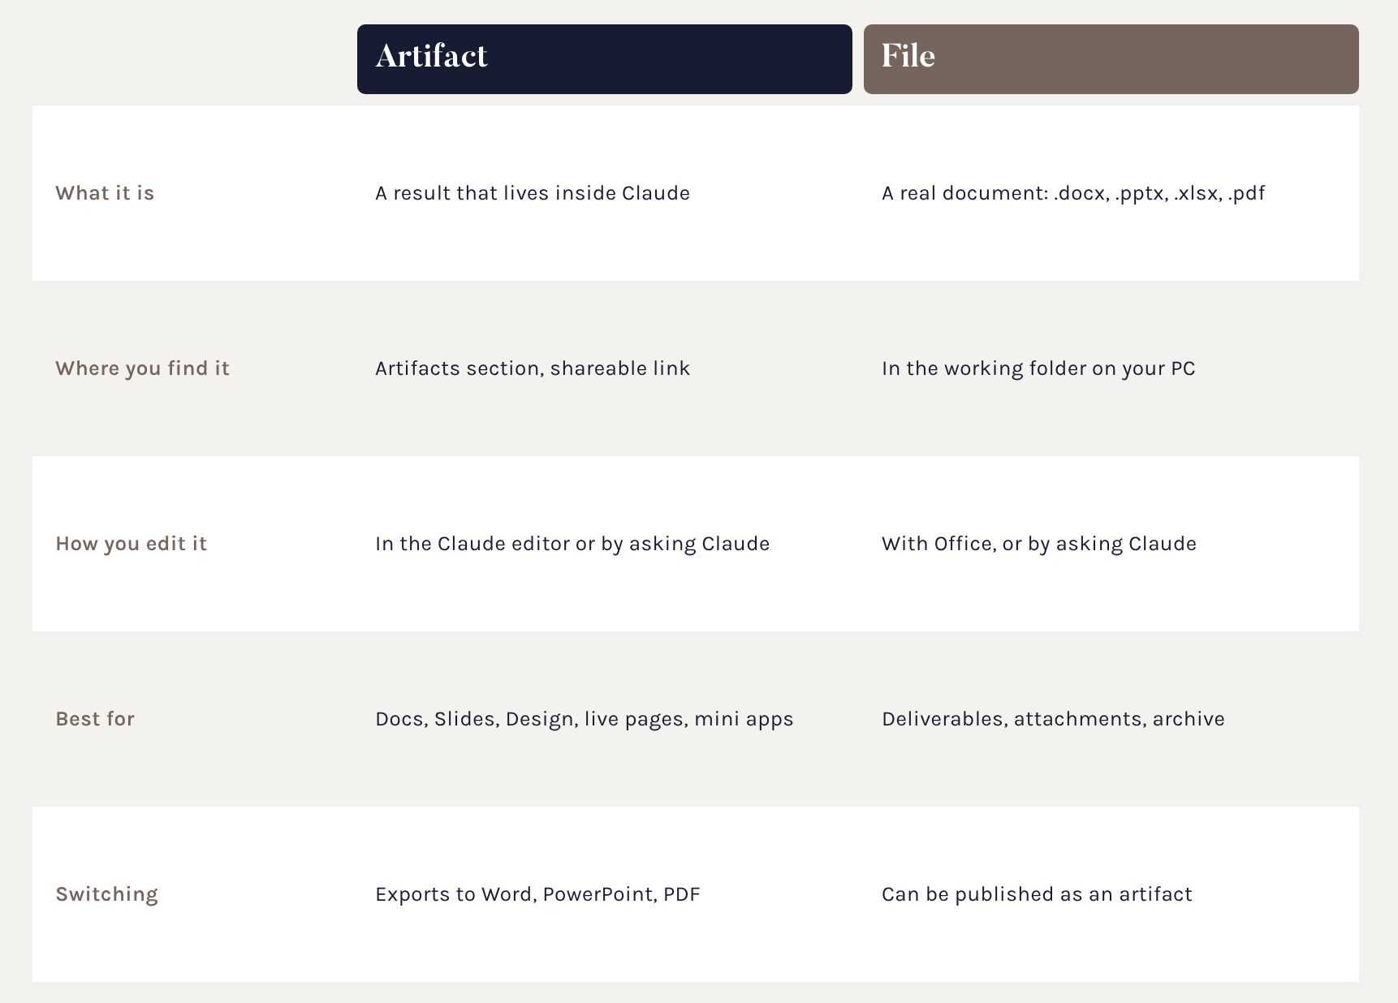
Artifact or file?
They're two different things. An artifact lives inside Claude and is shared with a link. A file is the real document in your folder.
Notes:
Risposta alla domanda ricorrente: il documento nella cartella è un file. L'artifact è la versione che vedi e modifichi dentro Claude. Spesso esistono entrambi.

Slide 50
Artifacts
An artifact is the finished work Claude delivers separately, clean and reusable.
Docs: documents to write together and comment on
Slides: presentations to present or export
Design: graphics, mockups, pages
Live pages and mini apps: trackers, calculators, dashboards
You find them in the Artifacts section, share them with a link and export them to Word, PowerPoint or PDF.
Notes:
Docs e Slides sono in beta sui piani a pagamento da settembre 2026: verificare la disponibilità sugli account aziendali.

Slide 51
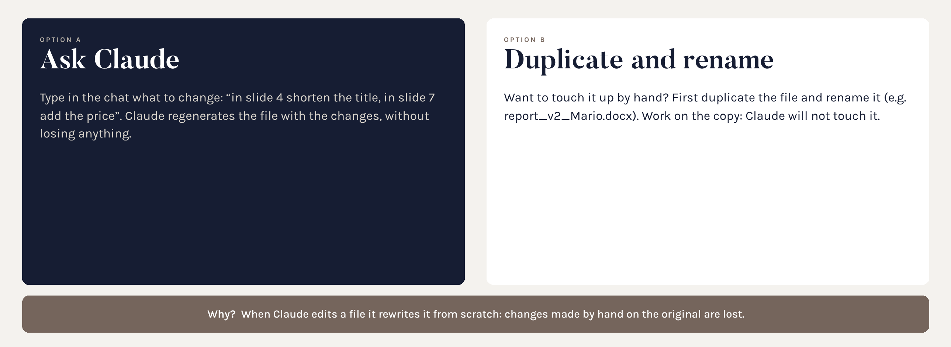
Careful with edits
The golden rule to avoid losing work.
Notes:
Nota importante da dire in aula: quando Claude modifica un file lo riscrive da zero. Se nel frattempo lo avete ritoccato a mano, quelle modifiche si perdono. Quindi o chiedete a Claude, o duplicate e rinominate.

Slide 52
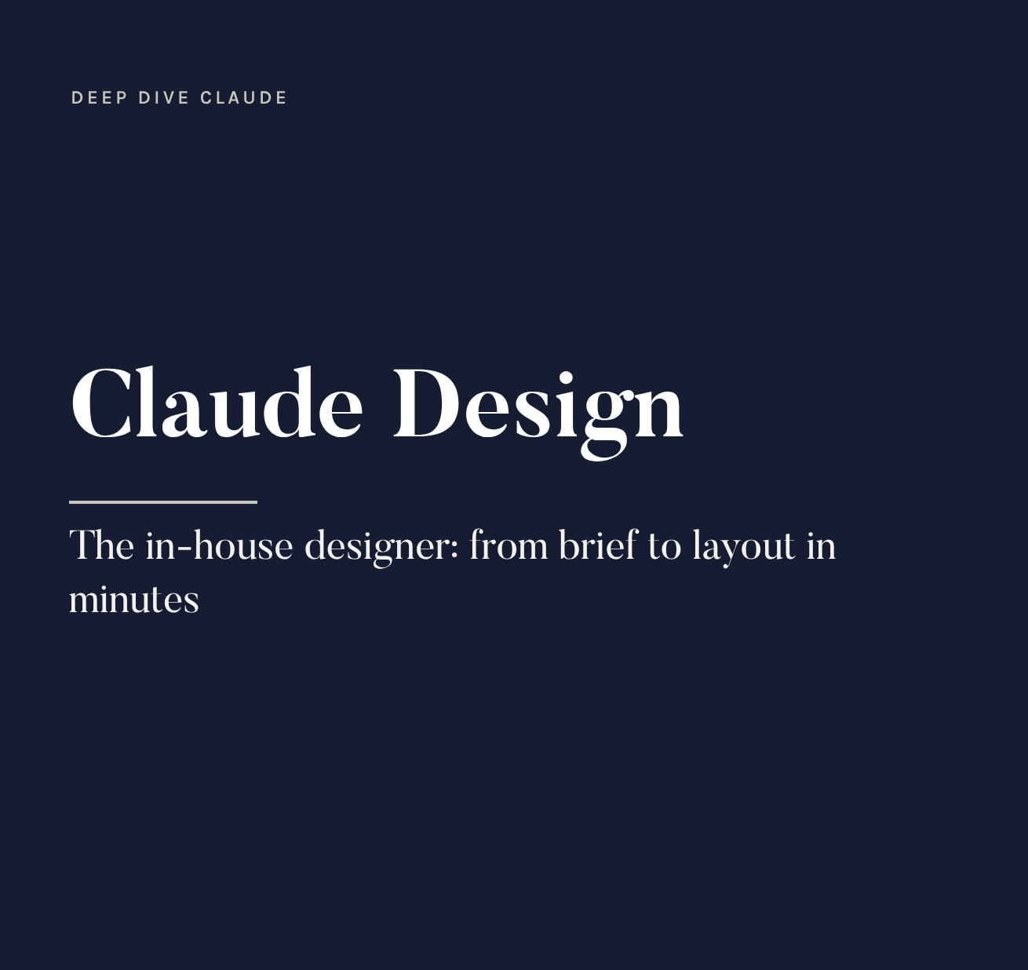
Claude Design
Launched in April as a separate app, since September it's inside Claude. From a brief it produces an editable layout, even with the brand's design system.
For marketing
landing page and newsletter mockups
social posts and event posters
on-brand presentations
for photos, there's still Leonardo AI
Notes:
Non sostituisce il grafico: accelera le prime versioni.

Slide 53
Skills and agents
Section 06 · Agents, connectors, scheduled tasks, Code

Slide 54
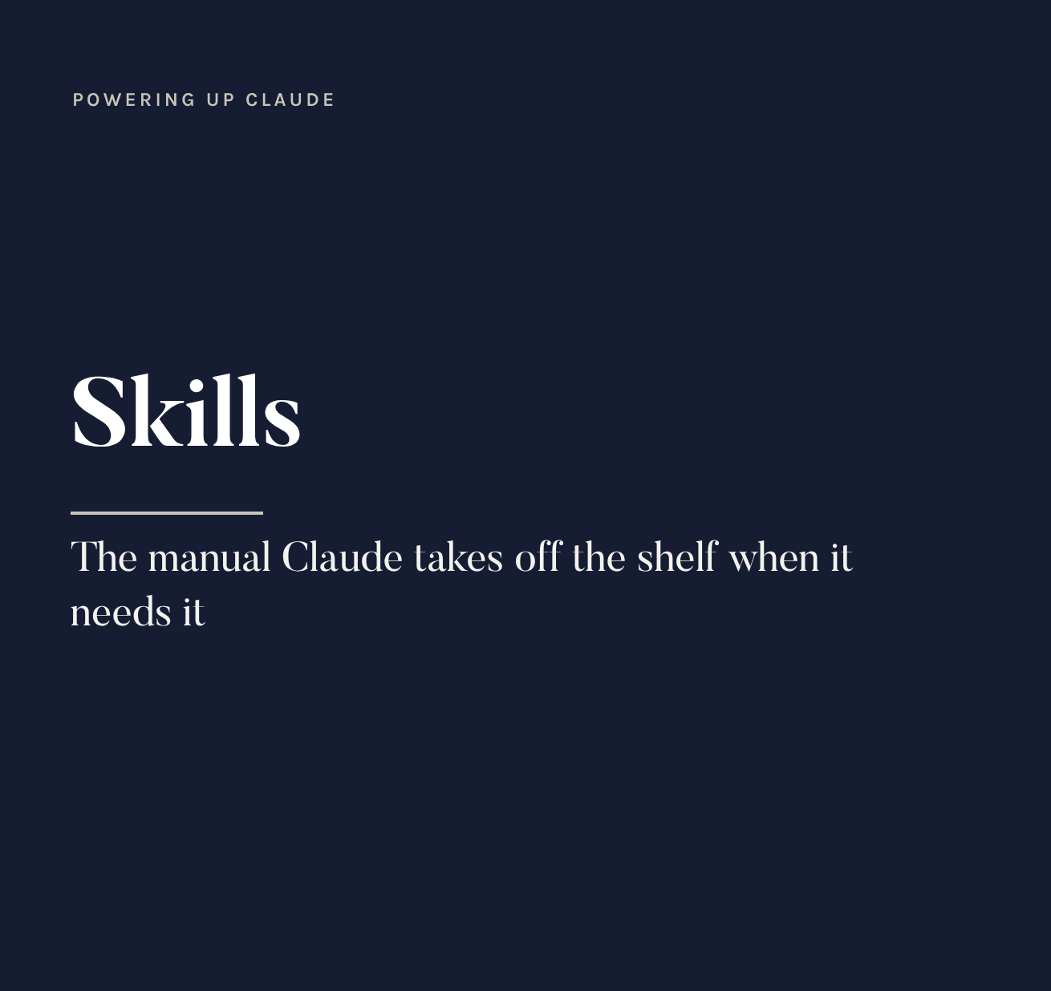
What it is
A folder with an instruction file (SKILL.md) that teaches Claude how to do a task well: a method, a tone, a format.
How it works
switches on by itself when needed
or you call it up with /
works in every project
e.g. “tone of voice”, “press release”
Notes:
Metafora: il manuale sullo scaffale. Claude legge solo la descrizione finché non serve, poi apre il manuale.

Slide 55
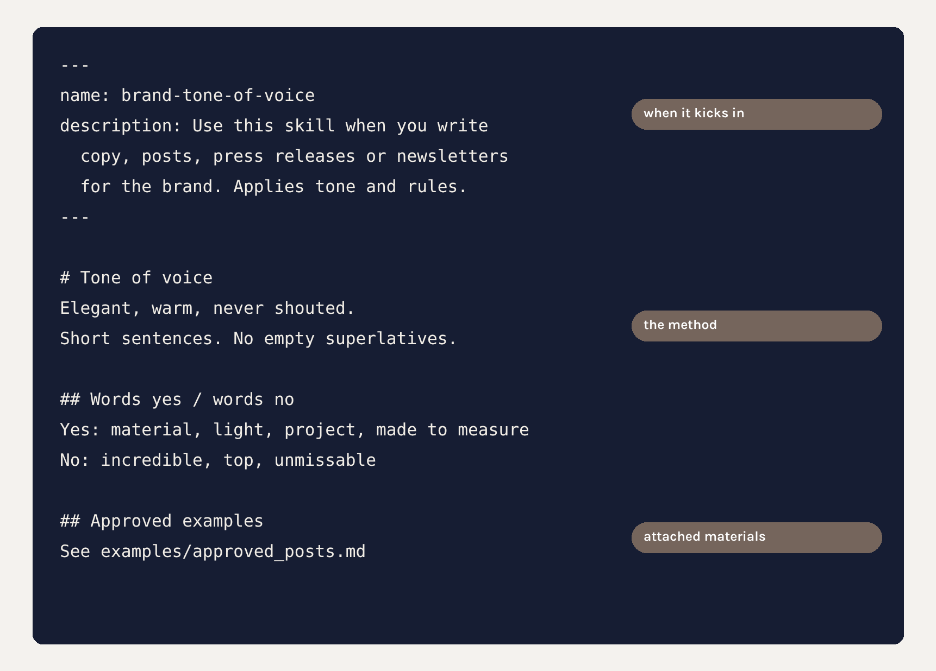
Inside a skill
No code required: it's text. The description at the top decides when the skill kicks in, the body explains the method.
Notes:
Se la skill non scatta quando dovrebbe, quasi sempre è colpa della descrizione troppo vaga.

Slide 56

The marketplace
Claude Marketplace (since September): plugins, connectors, agents and partners in one place. Open it from Customize > Skills, Connectors or Plugins > +.
What you'll find
skills for Word, Excel, PowerPoint, PDF
plugins: bundles of skills and connectors
e.g. the Marketing and Brand Voice plugins
skills shared by the team
Notes:
Le skill della directory si possono scaricare, modificare e ricaricare come proprie. Gli amministratori possono condividere skill con tutta l'organizzazione.

Slide 57
Creating a custom skill
1. Pick a task you repeat often and always do the same way.
2. Ask Claude: “Create a skill that...” and describe the task.
3. Claude asks you questions, then writes the skill.
4. Attach good and bad examples: they make it precise.
5. Save it from the review card, or upload the file in Customize > Skills.
6. Try it on 3 real cases and ask Claude to fix it.
7. Share it with the team.
Notes:
Prima skill consigliata per il marketing: il tono di voce del brand, con parole sì, parole no ed esempi approvati.

Slide 58
Skill ideas for marketing
Tone of voice: rewrites any text in the brand's style
Press release: structure, length, boilerplate
Product sheet: from technical data to emotional copy
Social posts: formats, lengths and hashtags per channel
Campaign report: from the exports to the document for management
Presentation in the group template
Briefs for agencies and photographers
Notes:
Chiedere all'aula quale costruirebbero per prima.

Slide 59
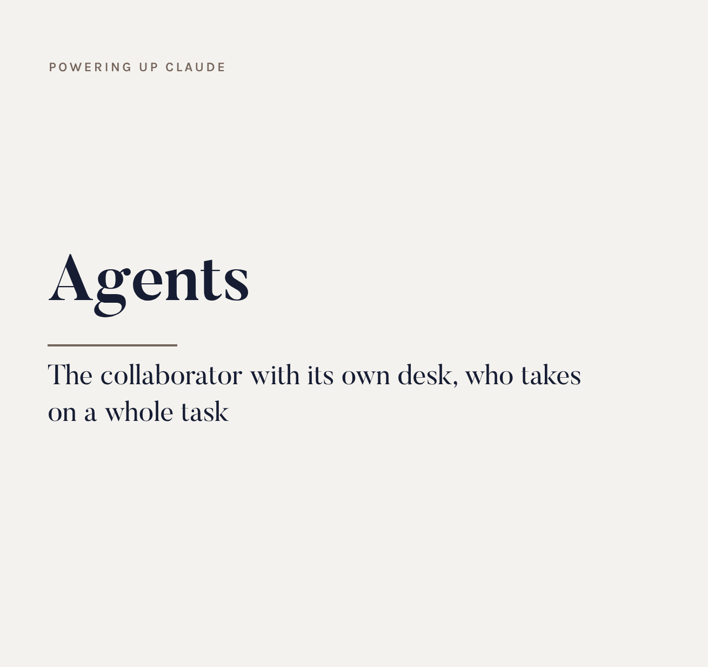
What it is
A collaborator with a separate context: Claude hands it a whole task, it carries it out on its own and reports back only the result.
When you need it
long, multi-step jobs
several analyses in parallel
broad research to summarise
keeping the conversation clean
Notes:
Metafora: il collaboratore con la sua scrivania.

Slide 60
How to create an agent
An agent is a role file with four elements:
name and description: who it is and when to use it
tools: what it can use (files, web, connectors)
model: which brain it works with
instructions: its working method
You create one by asking Claude, inside a plugin or in Claude Code.
A simple way to start: a project with role instructions is already a “lightweight agent”.
Notes:
Per il livello base basta capire il concetto. La creazione vera la facciamo in un modulo avanzato.

Slide 61
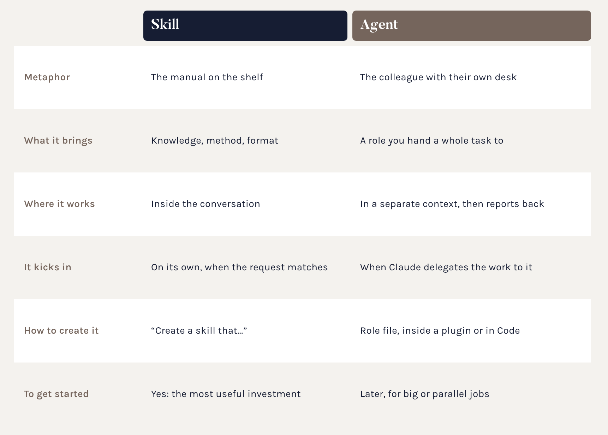
Skill or agent?
It's not a choice: they work together. Skills provide the method, agents do the work.
Notes:
Regola pratica: per una competenza ripetibile, skill. Per delegare un compito ampio o parallelo, agente.

Slide 62
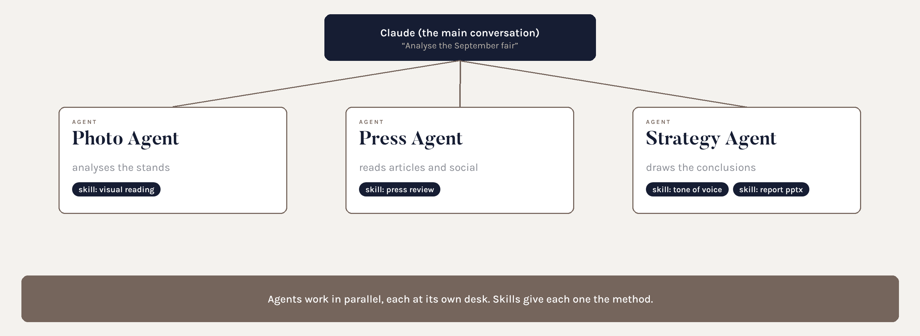
How they work together
An example: analysing a trade fair with three agents and their skills.
Notes:
Claude coordina, gli agenti lavorano in parallelo, le skill garantiscono metodo e formato coerenti.

Slide 63
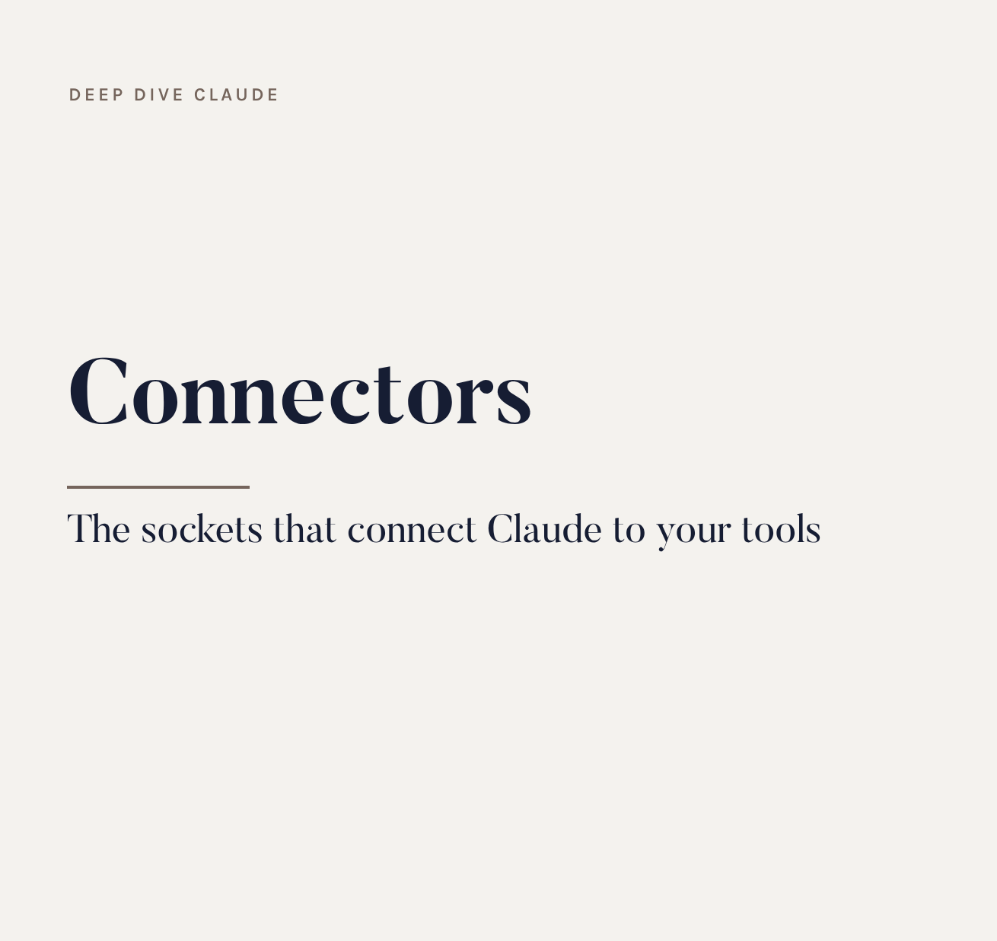
What it is
Connectors link Claude to mail, calendar, Drive, SharePoint, Canva, CRM. MCP is the standard that makes them work: like a USB-C socket.
How to use them
Customize > Connectors
Claude only sees what you authorise
Claude in Chrome browses websites
Notes:
Creare PowerPoint o Excel non richiede un connettore: è una skill. Il connettore serve per leggere e scrivere nei sistemi esterni.

Slide 64
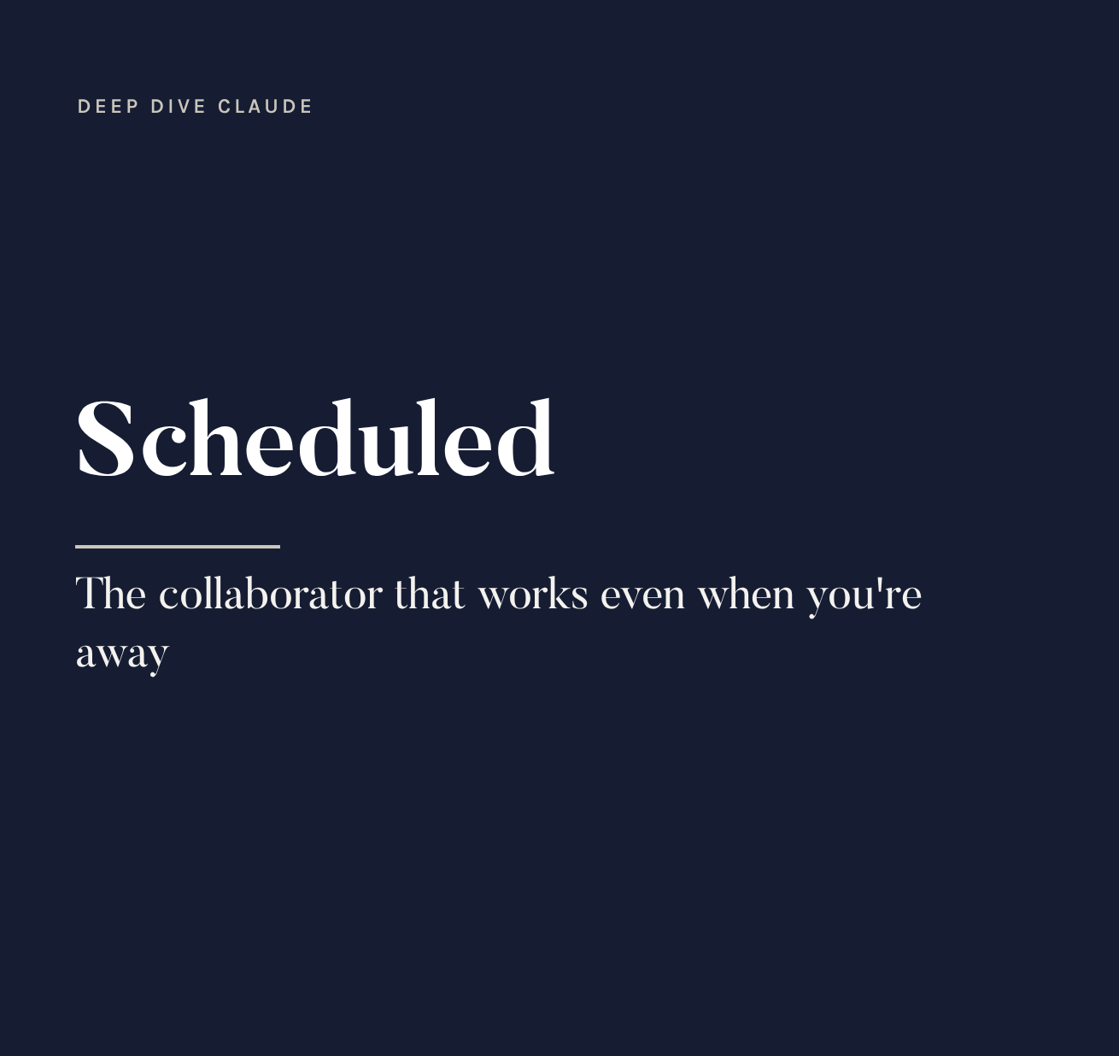
What it is
Describe a job once and Claude repeats it on its own: every hour, every day, every week or on demand. It runs in the cloud, even with your PC off.
How to create one
Scheduled > Create with Claude
describe the job in words
uses connectors and skills already on
basis of automations (section 08)
Notes:
Disponibili sui piani a pagamento.

Slide 65
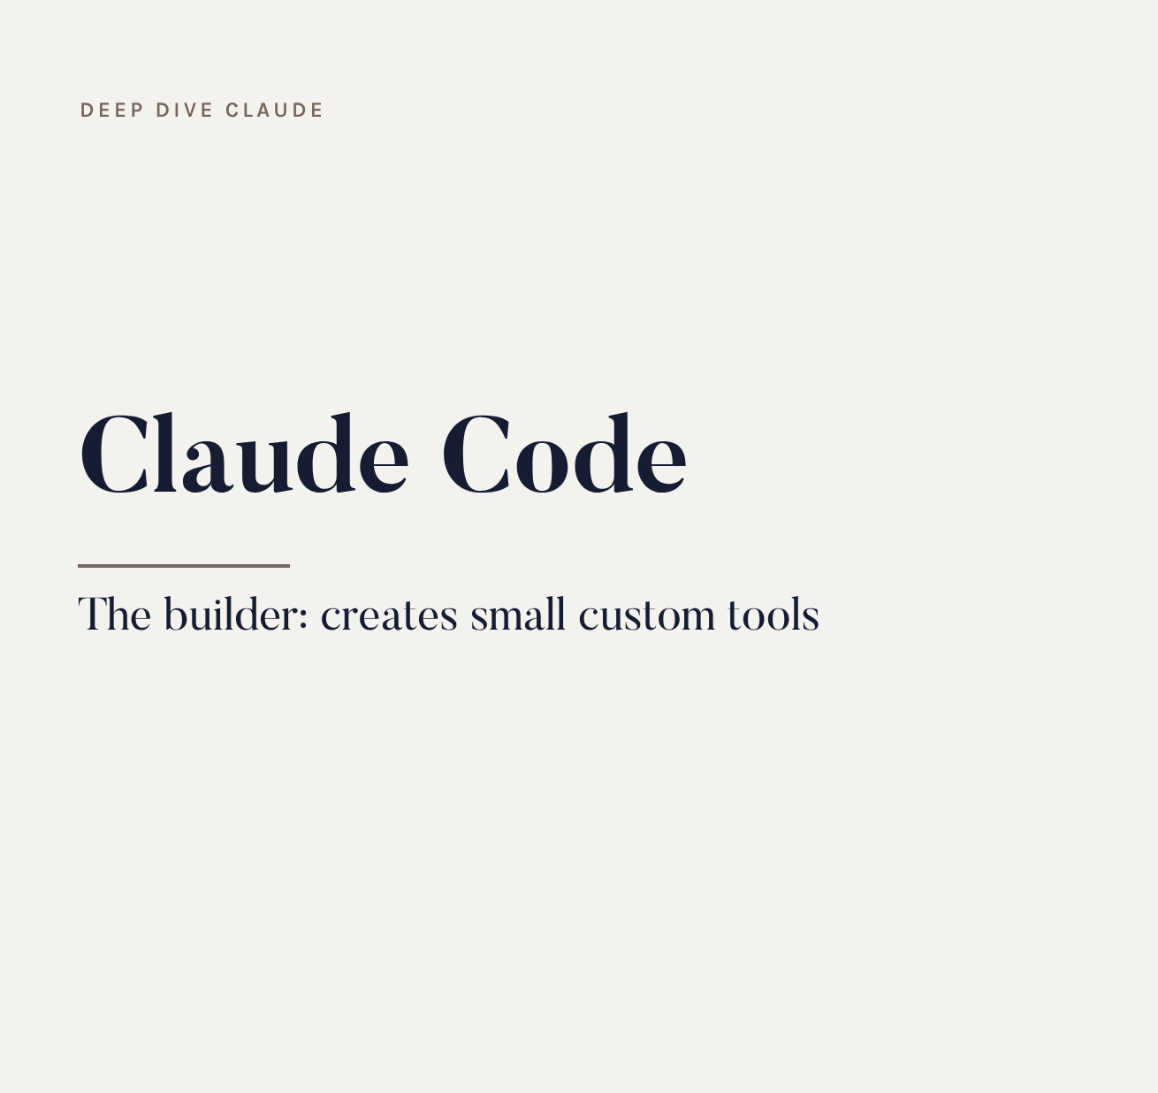
What it is
The mode where Claude writes and runs code. You'll find it in the Code tab of the desktop app, in the terminal and on the web.
For non-programmers
rename 500 photos in one go
a mini site for an event
turn a price list into product sheets
edit and cut a video
small custom tools
Notes:
Non serve saper programmare: si descrive il risultato. Claude Code è lo strumento giusto quando il lavoro è meccanico e ripetuto su tanti file.

Slide 66
Claude Code in practice
When to use it instead of the chat:
the work touches dozens or hundreds of files
you need a tool to reuse, not an answer
you want a “technical” result: web page, script, data file
How to work:
open the Code tab and choose the folder
describe the result, not the code
approve the steps and test the result on a few files
Notes:
Esempio da raccontare: le foto dello shooting rinominate secondo prodotto, finitura e ambiente.

Slide 67
Security:
Manual or Auto
When Claude acts on mail, files and tools, you decide how much autonomy to give it.
Manual (default): Claude asks before acting. It's the starting point.
Auto: works without asking at every step. Only for drafts and research, when the workflow is proven.
Irreversible actions (sending, paying, deleting, publishing) always need approval.
Connect only the folders and accounts you need.
Review active connectors and skills from time to time.
Notes:
Prima si osserva, poi si dà fiducia.

Slide 68
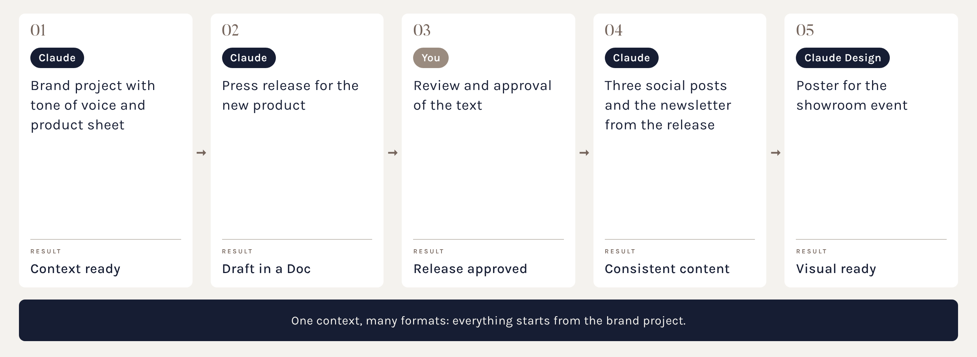
Pipeline: a launch
Suggested path: from a new product to all the content.
Notes:
Percorso ideale da replicare in ufficio, non una prova in aula.

Slide 69
The pipeline prompts
1. Brand project with tone of voice and the new product sheet in the folder.
2. “Write a press release for [new product], max 2,500 characters, with a quote from the marketing director. Create a Doc.”
3. You review and approve.
4. “From the approved release, derive 3 posts for Instagram and LinkedIn and a newsletter.”
5. “With Claude Design, create a poster for the showroom event, A3 format, brand colours.”
Notes:
Distribuire come scheda pratica.

Slide 70
The ideal setup
Section 07 · Ten moves to start well

Slide 71
Ten moves for the setup
1. Install the desktop app and sign in with your company account.
2. Settings > General: write your Instructions for Claude.
3. Set Sonnet with medium effort as the default.
4. Authorise the work folder (Trusted folders).
5. Create the work folder and the linked project.
6. Upload brand book, tone of voice, approved examples.
7. Install the skills for Word, Excel, PowerPoint and the Marketing plugin.
8. Connect only the useful connectors, with IT.
9. Permissions: Manual.
10. Check memory and usage once a month.
Notes:
Questa slide è la checklist da consegnare dopo l'aula.

Slide 72
Personal instructions
Example to adapt, in Settings > General > Instructions for Claude:
“I work in marketing at the Colombini Group, premium furniture sector.
When data is missing, ask me for it, don't make it up.
For long texts, propose an outline first.
Always cite your sources when you search the web.
If a task is ambiguous, ask me a question before you start.”
Notes:
Le istruzioni personali valgono in ogni conversazione, i progetti aggiungono le regole specifiche.

Slide 73
Memory and privacy
Memory: Claude remembers facts and preferences from one conversation to the next.
you can see, correct and delete it in the settings
in projects it's separate: each project has its own
Privacy:
use your company account, not your personal one
don't upload sensitive customer data unless you need to
Notes:
Le policy sui dati cambiano per piano: verificare con l'IT.

Slide 74
Mistakes to avoid
Endless chats on different topics: they waste tokens and cause confusion.
Uploading the same files every time instead of using the folder.
Using the most powerful model for everything.
Touching up a file by hand and then asking Claude to regenerate it.
Giving access to the whole disk or every account.
Trusting numbers and facts without checking them.
Starting with the most complex automation.
Notes:
Ognuno di questi errori l'abbiamo visto accadere: raccontare un esempio reale.

Slide 75
Automations
Section 08 · The method to do it yourself

Slide 76
The work nobody loves
Every marketing department has jobs that repeat the same way:
agency and supplier invoices to forward to whoever approves them
material requests from retailers
weekly social and campaign reports
press reviews and competitor monitoring
photos from shoots to rename and file
They follow rules you could explain to a new colleague. If you can explain them, Claude can carry them out.
Notes:
Riprendere la lista dei lavori noiosi raccolta all'inizio.

Slide 77
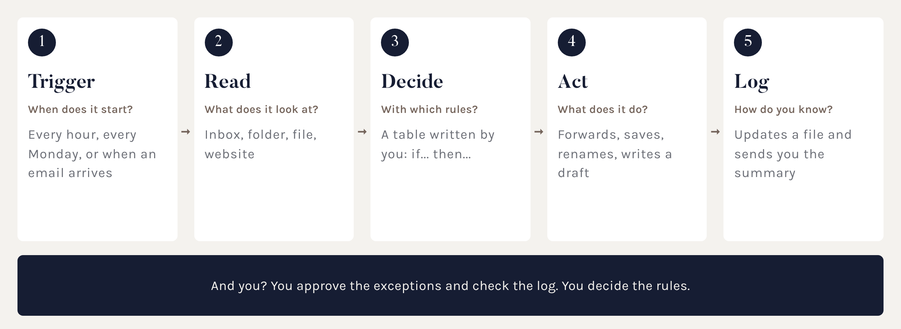
The 5-move pattern
Every automation, simple or complex, is built like this.
Notes:
Il concetto da portare a casa: con questo schema si progetta qualsiasi automazione.

Slide 78
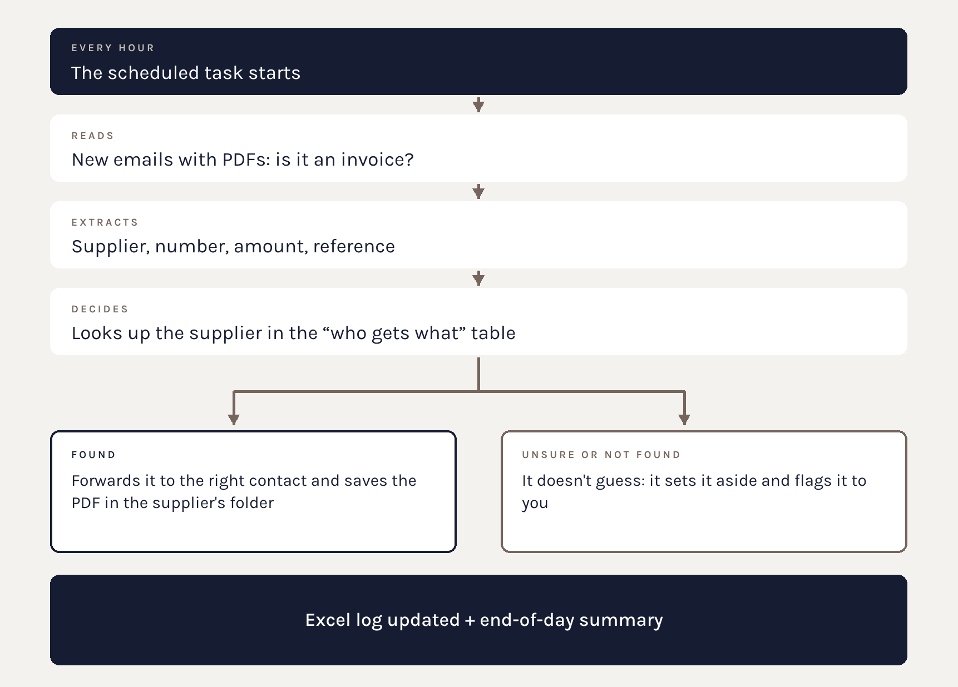
Example: the invoice
An invoice arrives by email. Claude recognises it, reads the supplier, looks up in the table who should receive it and forwards it.
If it's unsure, it doesn't guess: it flags it to you.
Notes:
Raccontare il caso seguendo le 5 mosse.

Slide 79
The rules in a table
The secret is to separate the rules from the instructions. Create a “who gets what” Excel file:
Social Agency → Maria → Invoices/Social
Photo Studio → Luca → Invoices/Shoots
Trade Fair → Anna → Invoices/Events
When a contact person changes, you update the table: the automation stays untouched.
Put it in the project folder.
Notes:
Nomi di esempio. La tabella è anche documentazione: chiunque capisce come funziona.

Slide 80
The task prompt
“Every hour, check the marketing inbox. For every new email with a PDF that looks like an invoice:
1. read supplier, number, date, amount
2. look up the supplier in who_gets_what.xlsx
3. if you find it, forward it to the contact person and save the PDF in their folder
4. if you can't find it or you're unsure, do nothing and add it to the list to check
5. update invoice_log.xlsx
At 6 p.m., send me a summary.”
Notes:
Sono le 5 mosse scritte in italiano. Nessun codice. Partire con i permessi in Manuale.

Slide 81
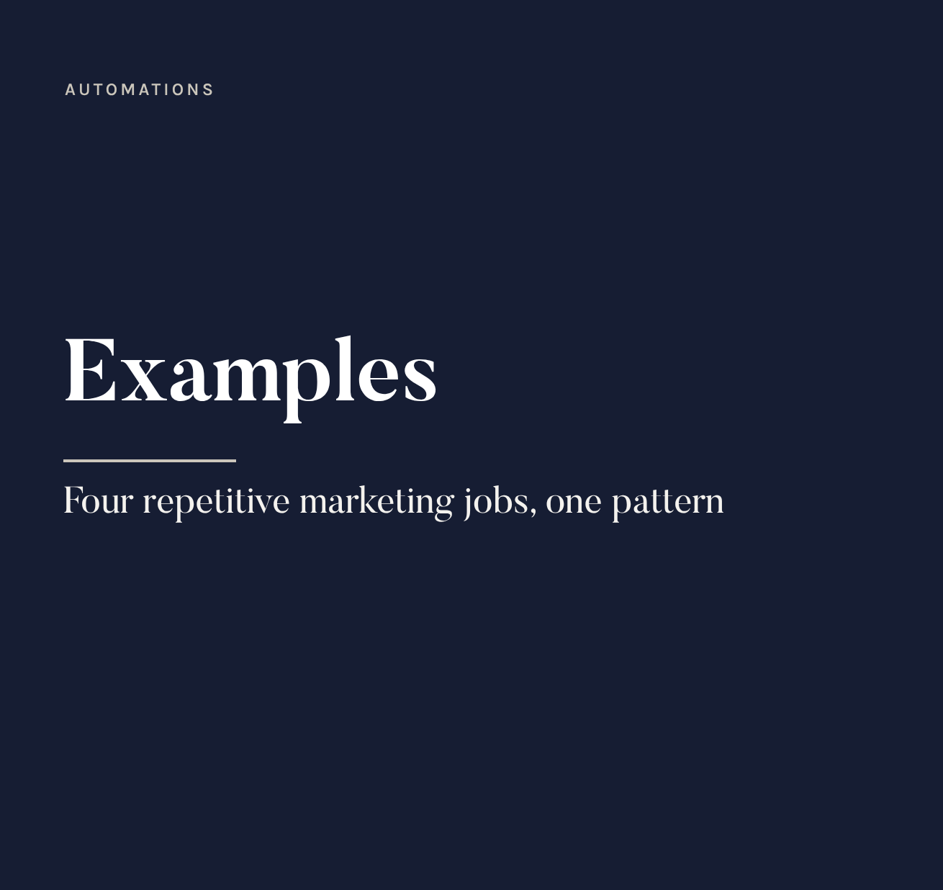
Retailer requests
Trigger: new email. Read: what's being asked. Decide: catalogue, photo or price list? Act: draft reply with the right link. Log: list of requests.
Weekly social report
Trigger: Monday at 8. Read: exports in the folder. Decide: what went up or down. Act: Doc with charts and commentary. Log: archive.
Notes:
L'azione è una BOZZA: la mail al rivenditore la manda la persona.

Slide 82
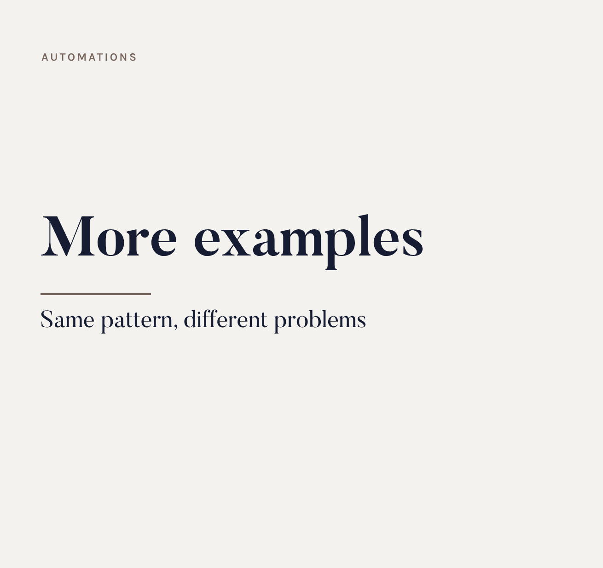
Press review and competitors
Trigger: every Friday. Read: industry sites and competitor pages. Decide: what's relevant. Act: summary with sources. Log: review archive.
Shoot photo archive
Trigger: at the end of a shoot. Read: the photo folder. Decide: product, finish, setting. Act: rename and sort. Log: list of files.
Notes:
Per le foto, Claude Code o il lavoro su cartella sono ideali.

Slide 83
The golden rules
1. Start with a small, frequent job.
2. Write the rules the way you'd explain them to a new colleague.
3. Begin with permissions on Manual: watch for one or two weeks.
4. Always plan for the “I don't know” case: better a flag than a mistake.
5. Keep a log of everything it does.
6. Never automatic sending, payments or deletions at the start.
Notes:
Queste regole evitano la maggior parte dei problemi.

Slide 84
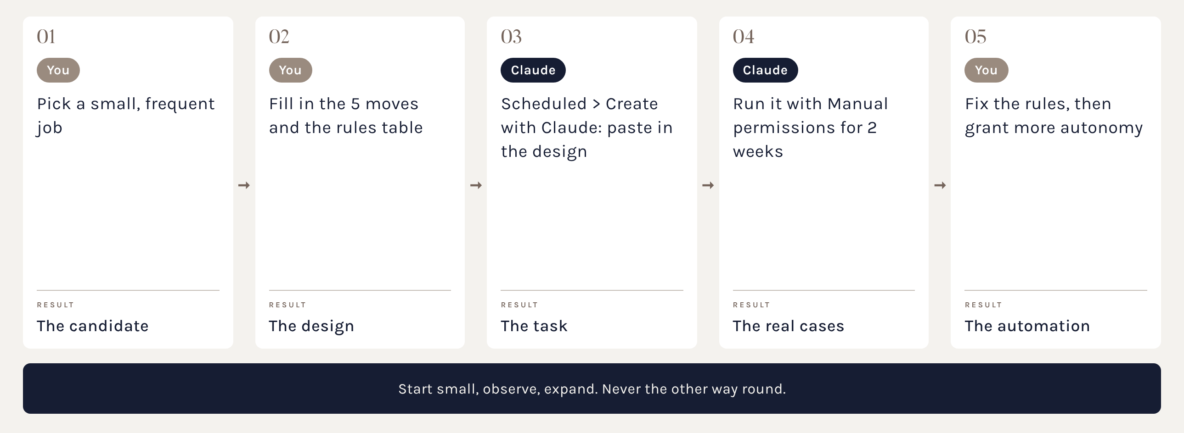
Pipeline: your automation
Suggested path to build your first automation on your own.
Notes:
Distribuire il modello delle 5 mosse da compilare.

Slide 85
The template to fill in
Copy and complete it, then paste it into Scheduled > Create with Claude:
1. Trigger: when does it start? (every hour, every Monday, on demand)
2. Read: what does it look at? (inbox, folder, file, website)
3. Decide: which rules? (attach the table)
4. Act: what does it do? (draft or direct action)
5. Log: where does it record things and when does it tell you?
Doubtful case: “if you're not sure, do nothing and flag it to me”.
Notes:
Questo testo è la scheda da consegnare.

Slide 86
Trust
Section 09 · Checking and the first step

Slide 87
Always check
AI images and texts:
check rights, trademarks and consistency with the guidelines
real products must not be “invented” by AI
numbers and data must always be double-checked
Checking in 4 moves:
1. ask for sources
2. compare with data you know
3. use your expert judgment
4. test small before you publish
Notes:
L'AI potenzia chi la usa, non sostituisce il giudizio.

Slide 88
What to take home
01 Every AI has its job: Perplexity searches, Claude writes and works, Gemini lives in Google, ChatGPT is fast, Leonardo creates images.
02 The prompt is everything: role, context, task, format.
03 Right model, short chats, connected folder: fewer tokens, better quality.
04 Claude rewrites files: ask Claude or work on a copy.
05 Every automation is made of 5 moves. Ask first, then delegate.
Notes:
Chiedere quale punto sembra più utile a ciascuno.

Slide 89
The first step, by tomorrow
Just one action, small and concrete:
create your work folder and the linked project
put tone of voice and two approved texts in 00_Read_me
ask for a variant of a real piece of content
judge the result: what's missing? Add it to the instructions
At our next meeting we'll start from your projects and your automations.
Notes:
Proporre un follow-up a 4 o 6 settimane.

Slide 90
Events office
Section 10 · A digital team for events

Slide 91
The idea: an office of agents
Picture the events office as a digital team:
each agent has a role: research, communication, logistics, reporting
each has its own hours: some work every morning, some every Monday, some once the event is over
they all work in the same folder and leave a trace of what they do
you are the director: you assign, approve, correct
Claude is the engine: project, skills, agents and scheduled tasks.
Notes:
Il modello è quello degli uffici digitali fatti di agenti con compiti e orari. Lo costruiamo con gli strumenti già visti, tenendo il controllo.

Slide 92
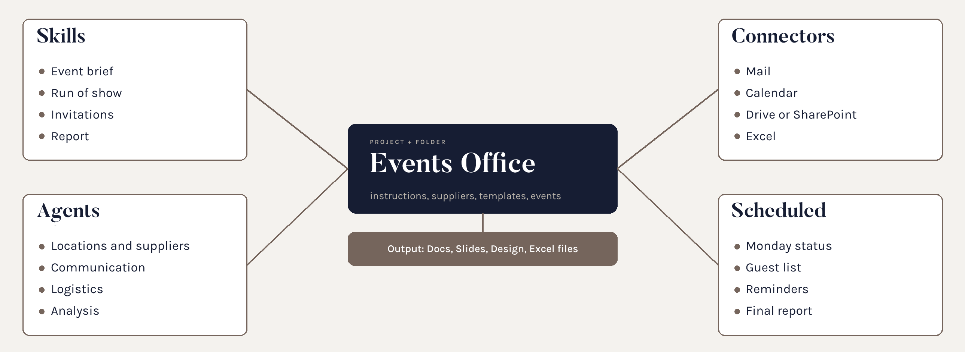
An events office in Claude
Project, folder, skills, agents, connectors and scheduled tasks: the building blocks we already know.
Notes:
Ogni mattone è stato spiegato nelle sezioni precedenti: qui li montiamo insieme su un caso reale.

Slide 93
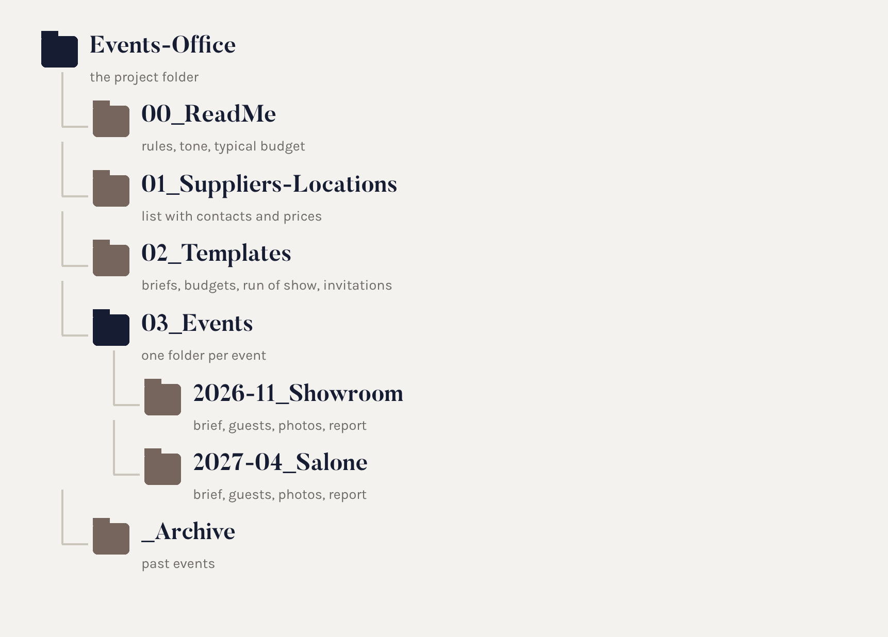
The events folder
One folder for the office, one subfolder for each event. Claude finds rules, suppliers and templates, and saves everything in the right place.
Notes:
Il file fornitori e location è il patrimonio dell'ufficio: Claude lo legge e lo aggiorna.

Slide 94

Skills to create
Event brief: goals, audience, budget, KPIs
Run of show: minute-by-minute schedule
Invitations and communication in the brand's tone
Post-event report
Agents
Venue and supplier research
Communication and guests
Logistics and deadlines
Analysis and reporting
Notes:
Le skill danno il metodo, gli agenti si dividono il lavoro. Per iniziare bastano le skill: gli agenti arrivano dopo.

Slide 95
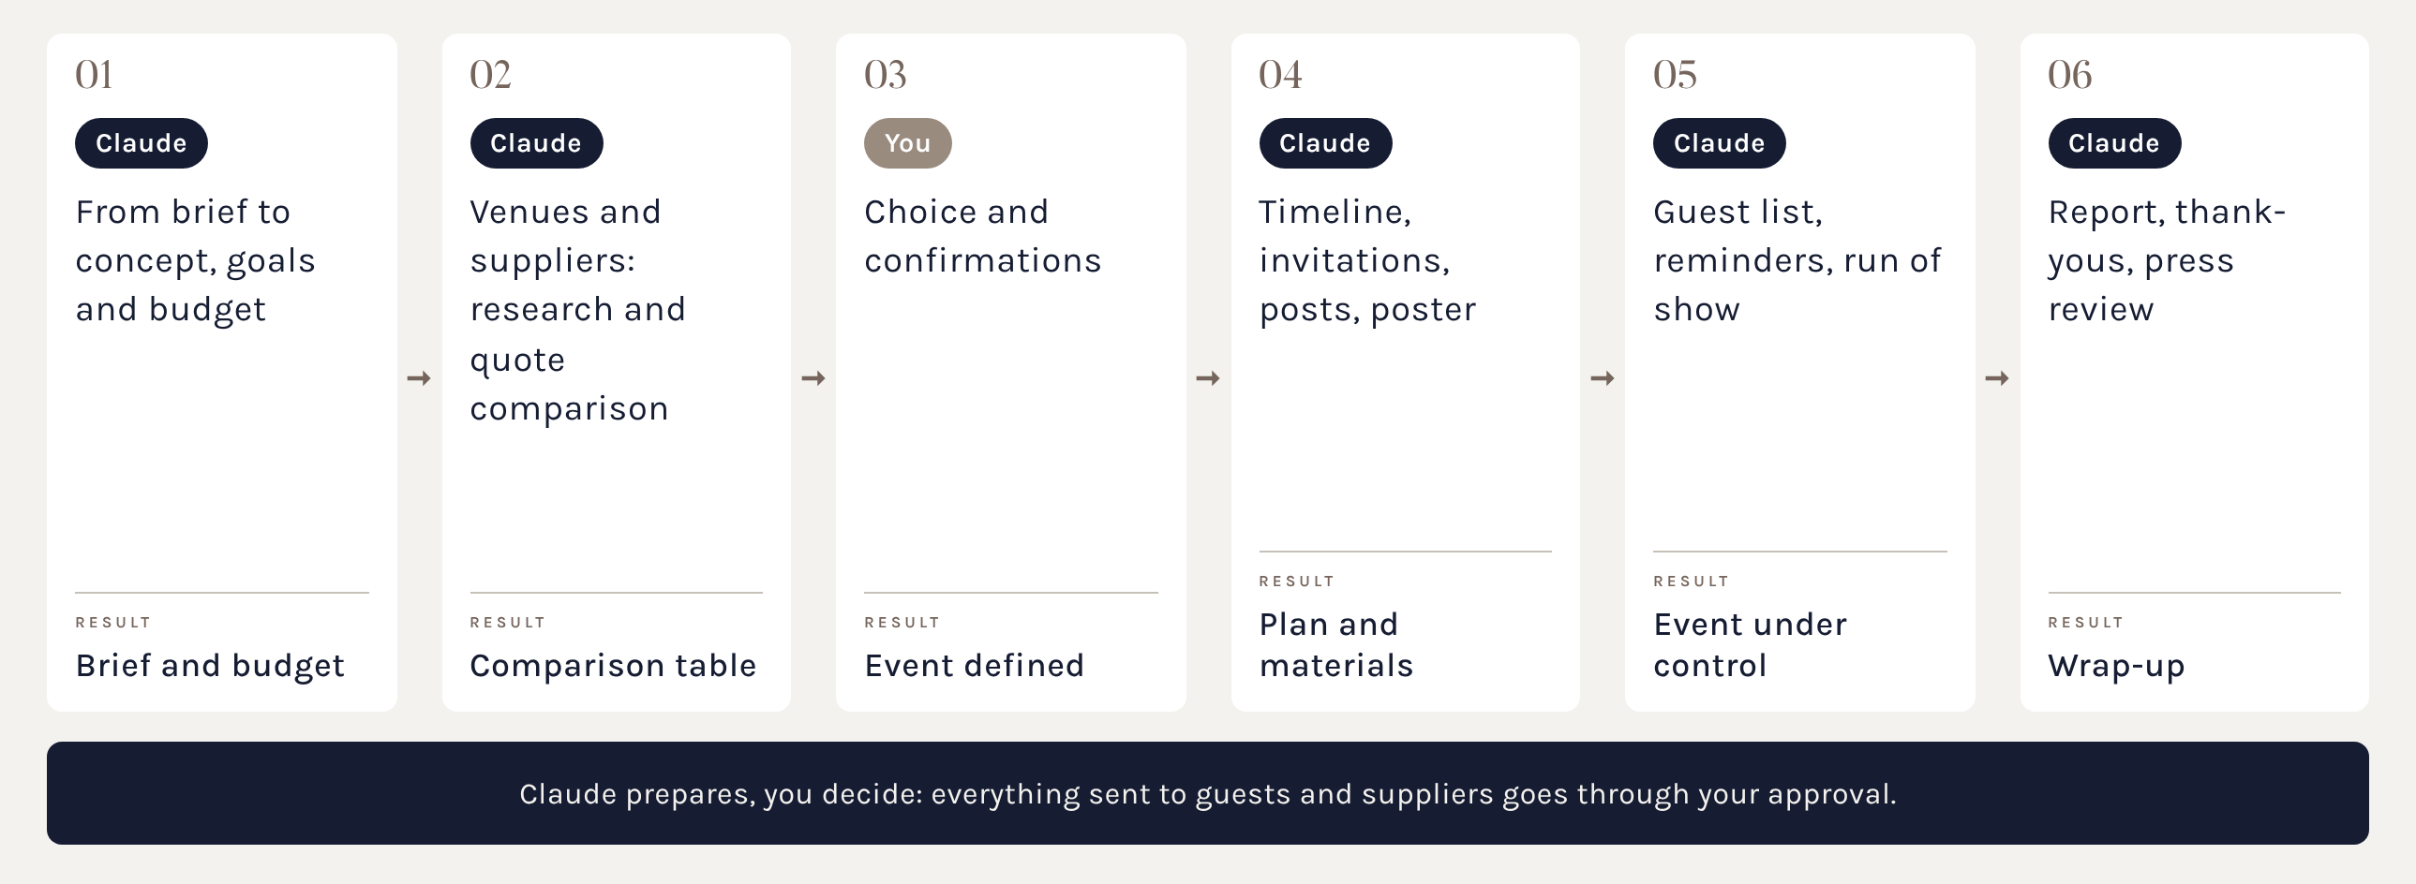
Pipeline: an event
Suggested path, from brief to final report.
Notes:
Ogni passo produce un file nella cartella dell'evento. La persona approva brief, budget, inviti e invii.

Slide 96
Scheduled tasks
The heart of an events office that runs on its own:
Every Monday at 9: status of all events and the week's deadlines.
Every day: reads replies to invitations and updates the guest list.
14, 7 and 1 day before the event: reminders to suppliers, as drafts.
The day after: draft thank-you to guests and photo collection.
A week later: report with attendance, costs and results.
Notes:
Tutte le attività partono in Manuale: le mail verso l'esterno restano bozze finché qualcuno non le approva.

Slide 97
The kick-off prompt
To paste into the Events Office project:
“You are the assistant of the marketing events office. Read 00_Read_me and Suppliers-Venues.xlsx.
For a new event, create the folder Events/YYYY-MM_name with brief, budget and timeline.
Keep the guest list updated from emails and forms.
Prepare invitations, communications and reminders only as drafts: nothing gets sent without my OK.
Every Monday, send me the status of the events.”
Notes:
Le regole permanenti vanno nelle istruzioni del progetto, non ripetute a ogni conversazione.

Slide 98
Setup in eight steps
1. Create the Events-Office folder with the structure shown.
2. Fill in Suppliers-Venues.xlsx and the templates.
3. Create the project and link the folder.
4. Write the instructions (the kick-off prompt).
5. Create the skills: brief, run of show, invitations, report.
6. Connect mail, calendar and Drive or SharePoint, with IT.
7. Create the scheduled tasks, on Manual.
8. Test on a small event, then scale up.
Notes:
Tempo realistico per il setup: mezza giornata, più due settimane di rodaggio.

Slide 99
What's left out
Claude organises, writes, checks and remembers. For some things you need dedicated tools:
online registration and ticketing
QR code check-in at the entrance
payments
attendee apps
If the platform has a connector, Claude can read its data.
Notes:
Messaggio finale della sezione: non serve un'altra AI, serve un ufficio ben impostato.

Slide 100
A well set-up office

Slide 101
Leonardo AI
Section 11 · The visual studio, in detail

Slide 102
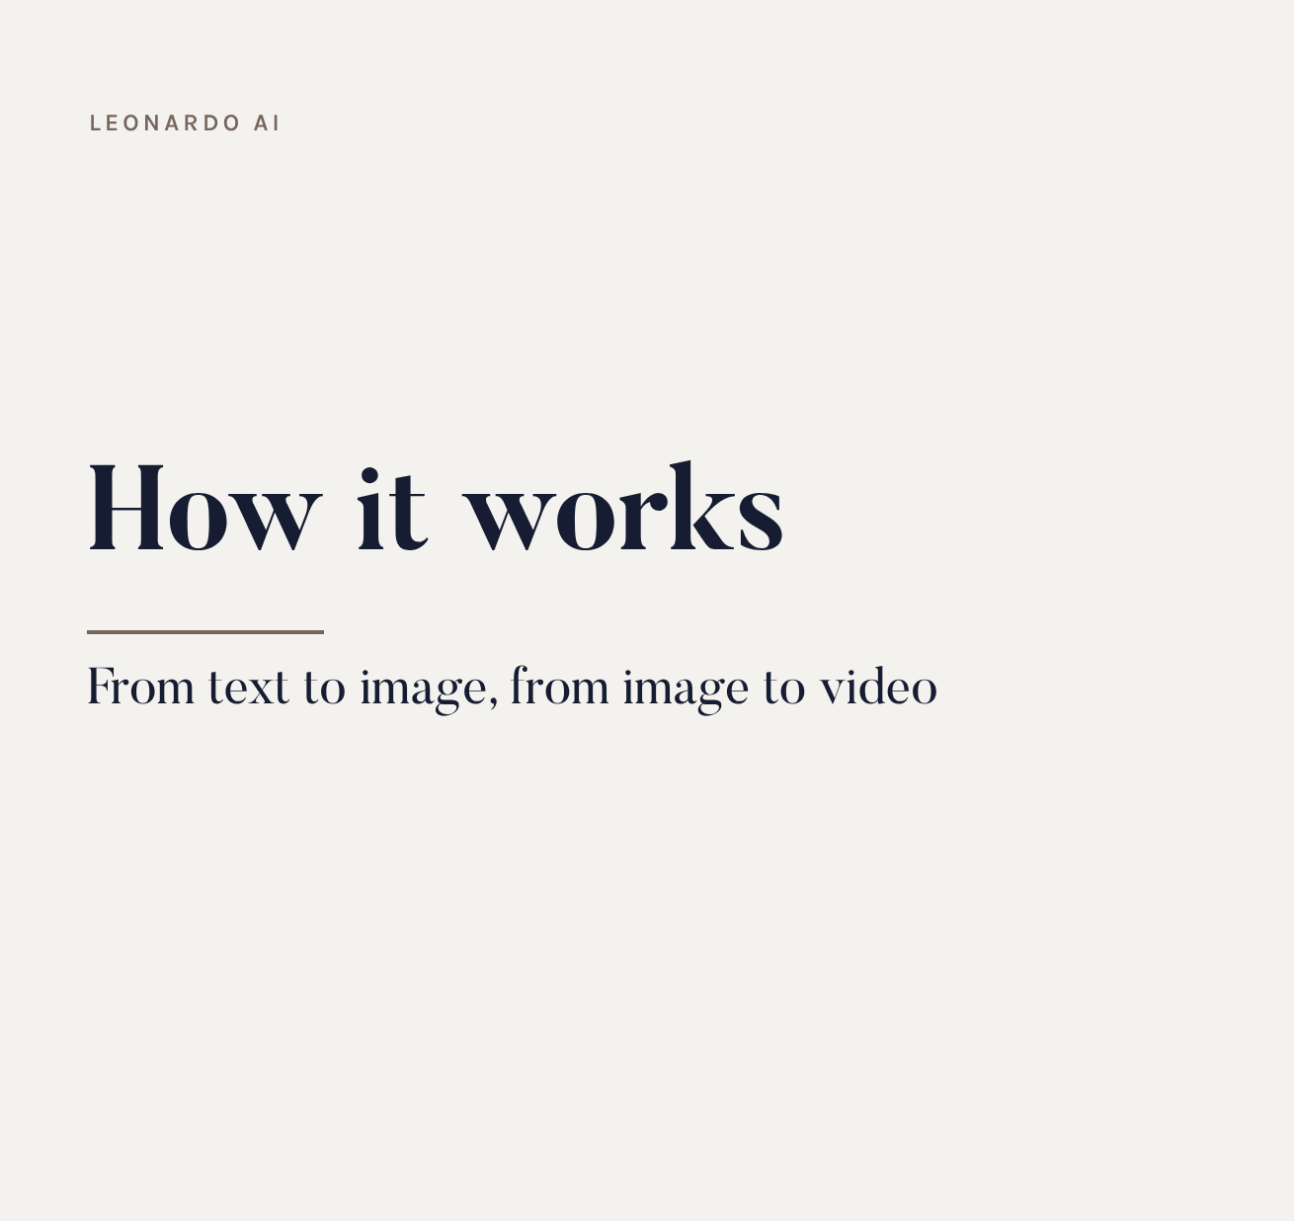
How it works
Describe an image in words, choose a model and a format: Leonardo generates a few variants. Then you retouch, upscale or animate them.
What to know
it's an aggregator: many different models
every generation costs tokens
private images on paid plans
Notes:
A differenza di ChatGPT o Gemini, Leonardo non è una chat: è uno studio con controlli precisi su modello, formato e riferimenti.

Slide 103
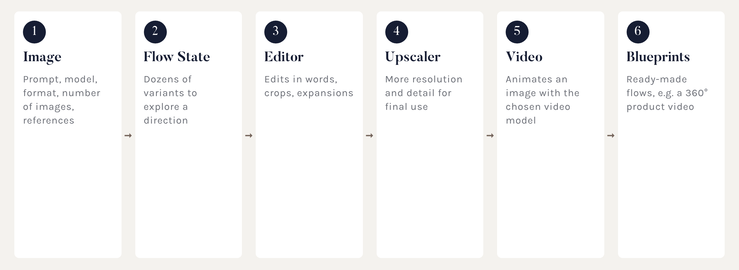
The workspace
Six tools, from first concept to video.
Notes:
Mostrare l'interfaccia se c'è tempo: barra del prompt in alto, selettore del modello a sinistra.

Slide 104
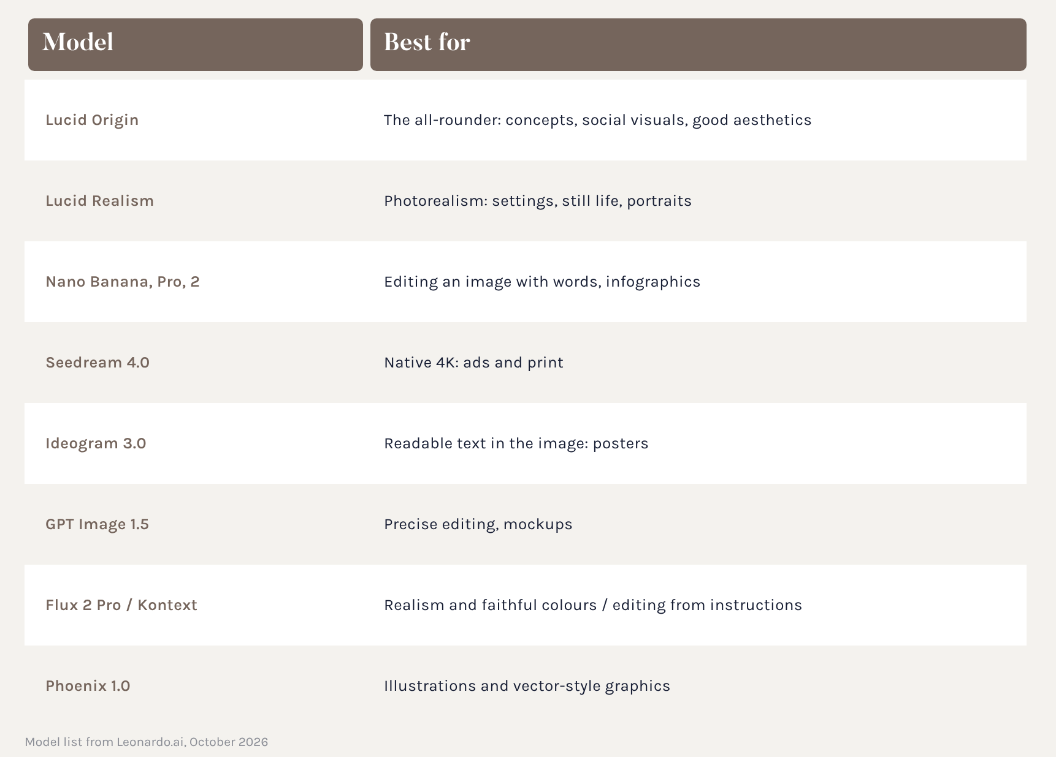
Image models
There's no single best model: each has its speciality. Leonardo can also choose on its own based on the prompt.
Notes:
Per iniziare: Lucid Origin per i concept, Lucid Realism per il fotorealismo, Nano Banana per le modifiche.

Slide 105
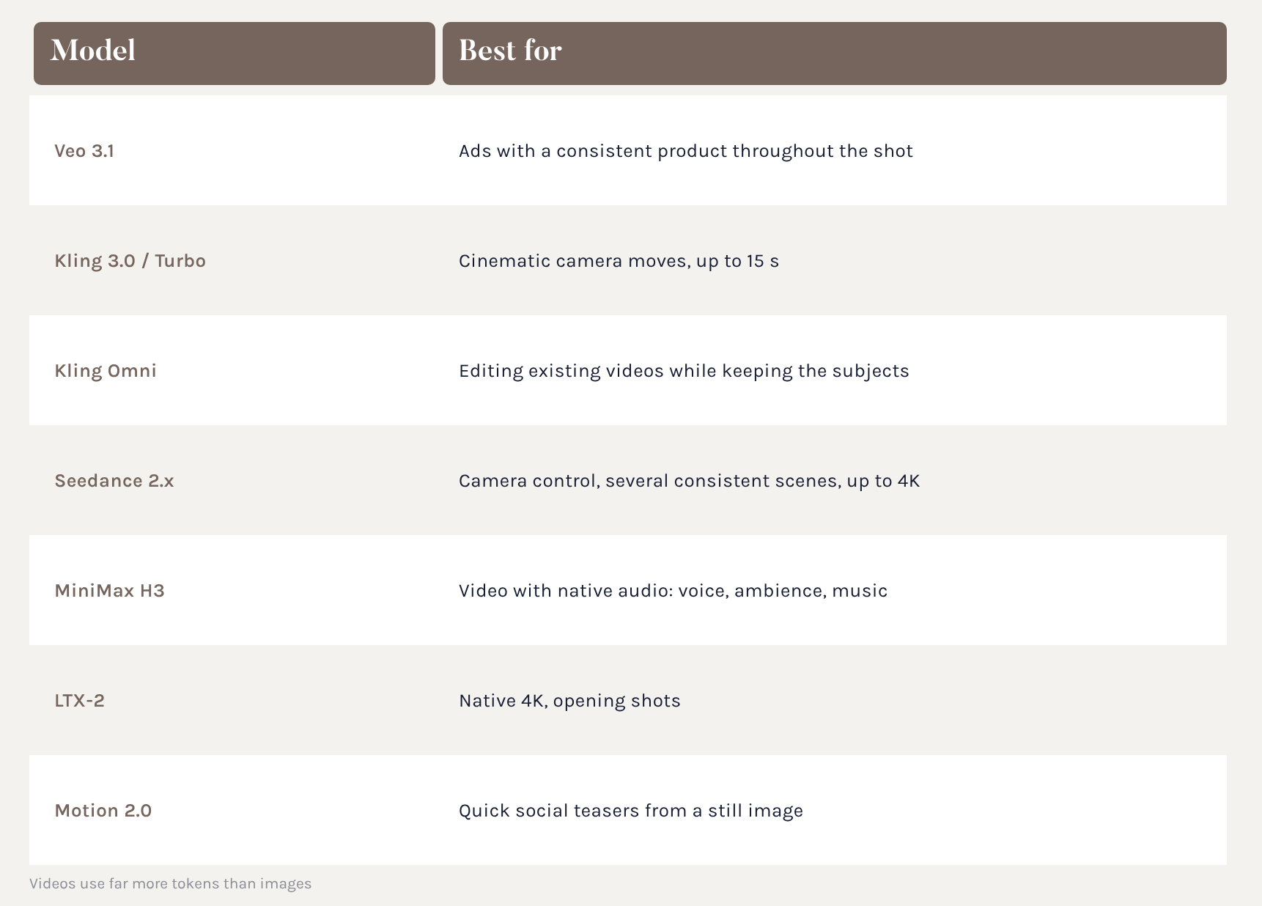
Video models
Video almost always starts from an image: it becomes the first frame, and the prompt describes the movement.
Notes:
Kling è un buon equilibrio tra qualità e velocità; Veo quando il prodotto deve restare coerente.

Slide 106
How to choose the model
Concepts and moodboards: Lucid Origin, then Flow State for variants
Photorealistic setting: Lucid Realism or Flux 2 Pro
Fixing a detail: Nano Banana, with words, no masks
Poster with text: Ideogram 3.0
Print and ad visuals: Seedream 4.0 in 4K
Social teaser: Motion 2.0
Ad video with the product: Veo 3.1 or Kling 3.0
Notes:
Elenco basato sulla guida ufficiale di Leonardo, ottobre 2026.

Slide 107
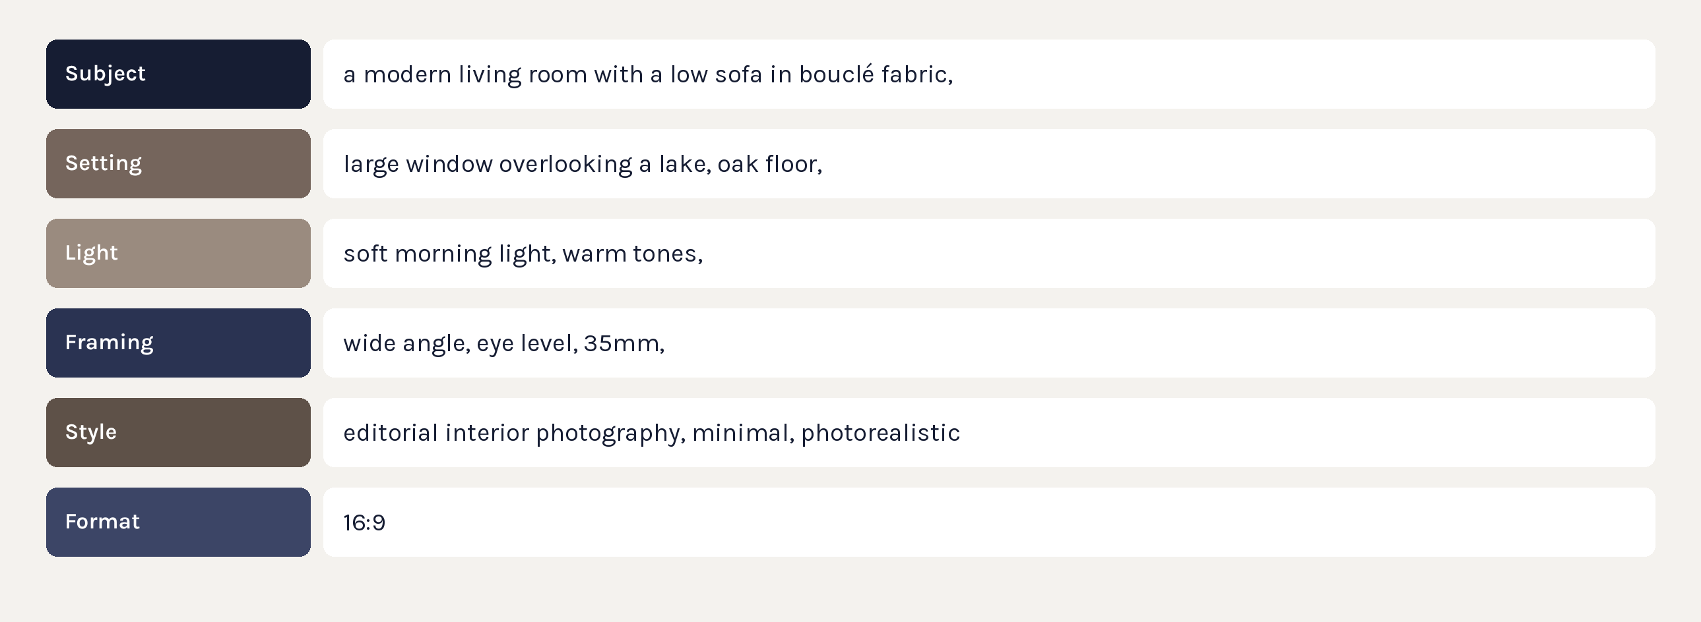
Anatomy of a prompt
Six blocks. Models perform best in English.
Notes:
Si può chiedere a Claude di scrivere il prompt in inglese partendo da una descrizione in italiano.

Slide 108
References and touch-ups
Text alone isn't enough for consistency. Leonardo accepts reference images:
style: “make it like this photo”
content: a starting shape and composition
character: the same subject across several images
Then the touch-ups:
edits in words with Nano Banana
upscale for the final resolution
format expansion, from square to landscape
Notes:
Le foto prodotto reali vanno usate come riferimento: l'AI da sola non le riproduce fedelmente.

Slide 109
Tokens and plans
Every generation costs tokens: it depends on model, resolution and number of images. Videos cost much more.
Free: 150 tokens a day
Essential: about $12 a month
Premium: about $30 a month
Ultimate: about $60 a month
Tips: generate 1 or 2 images at a time, explore at low resolution, only upscale the best ones, only animate the images you've chosen.
Notes:
Prezzi indicativi da fonti 2026: verificare su leonardo.ai prima dell'aula.

Slide 110
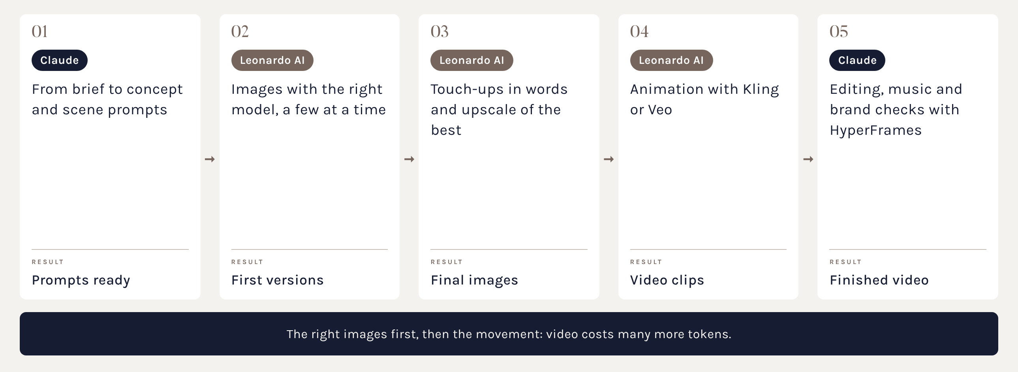
Pipeline: from idea to video
Suggested path for a social teaser or a video for the stand.
Notes:
Collegare all'esperienza del gruppo con i video AI per le fiere.

Slide 111
Things to watch
Real products don't come out accurately: use them as a reference or do compositing.
Text in images is often wrong: add it afterwards, or put it in with Claude Design (as vector or in InDesign) or with ChatGPT.
Commercial use and private images: check the plan's terms.
Brand consistency: palette, light and materials need guiding.
Transparency: declare AI-generated content when required.
Notes:
Chiudere ricordando che l'AI accelera, ma la direzione artistica resta umana.

Slide 112
Thank you for your attention
slatte@colombinigroup.com

