Slide 1


SESSION · SPRING 2026
INTERNAL TRAINING · 45 MINUTES · 2026
Agentic AI in 2026.
A working tour of Claude in 2026 — the capabilities, the surfaces, and how to pick the right one for the work in front of you.
Agentic · Automations
BEGINNER → INTERMEDIATE 13 TOPICS · 30 SLIDES

Slide 2
Agentic
·
Automations
TODAY'S SESSION
What we'll cover.
01
02
Foundations
Intermediate
What Claude can do well
Where Claude shows up — products + surfaces
Cowork · Claude Code · Chat · Projects
Skills · Connectors · Enterprise Search · Research
When to reach for which surface
Practical exercises & Q&A
02 / 30

Slide 3
Agentic
·
Automations
01
PART ONE
Foundations.
Five things Claude does well · Where Claude lives · The four main surfaces you'll use day-to-day.
03 / 30

Slide 4
Agentic
·
Automations
TOPIC 01 · CAPABILITIES
Five things Claude does well.
01
02
03
Writing & content
Research & analysis
Coding assistance
Social posts, emails, reports. Iterates on tone, voice and structure with you until it sounds like you.
Upload documents and Claude makes sense of them. 200K+ token context — up to 1M on Pro / Max / Team / Enterprise with Opus 4.7.
Opus 4.7 is our most powerful coding model. Write, debug, and explain code across multiple languages.
04
05
REMEMBER
Problem-solving & reasoning
Learning new things
The right surface matters as much as the right ask.
Hybrid models — near-instant answers or extended thinking for step-by-step analysis on complex problems.
Adapts to your pace. Learning mode guides your reasoning process rather than handing over answers.
04 / 30

Slide 5
Agentic
·
Automations
BY THE NUMBERS
Why context window matters.
1M
200K+
500+
ON PRO / MAX / TEAM / ENTERPRISE · OPUS 4.7
TOKENS · STANDARD
PAGES IN A SINGLE CONVERSATION
Big context means Claude can hold an entire codebase, a quarter of meeting notes, or a stack of contracts in mind at once — and reason across all of it without losing the thread.
05 / 30

Slide 6
Agentic
·
Automations
TOPIC 02 · SURFACES
Where Claude lives.
WEB
WEB
WORKSPACE
WORKSPACE
Claude.ai
claude.ai/design
Slack
Excel · PowerPoint
Browser-based chat — best for conversations, writing, research, file creation.
Full design framework for marketing material and web pages.
@Claude in any thread. Searches your workspace's channels, DMs and shared files.
Sidebar in Microsoft Office. Reads, analyzes, modifies, creates workbooks & decks.
DESKTOP
DESKTOP
DESKTOP
DEVELOPER
Cowork
Claude Code
Chat
Managed agents & API
For accessing & manipulating documents on your desktop. The day-to-day work driver.
Agentic coding tool. Reads your codebase, writes & modifies code, runs commands.
Lightweight conversational surface — like claude.ai, but native to your machine.
Build your own — programmatic access to Claude for production systems.
06 / 30

Slide 7
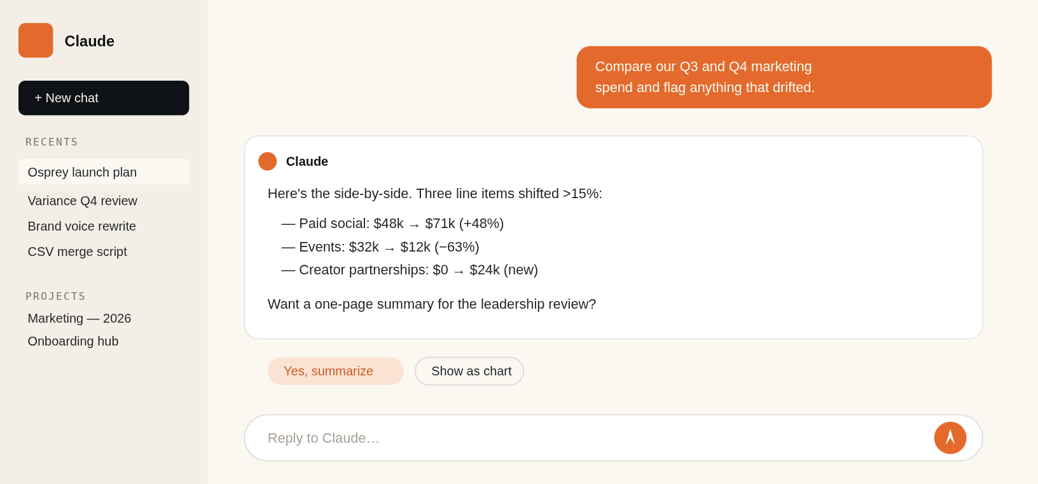
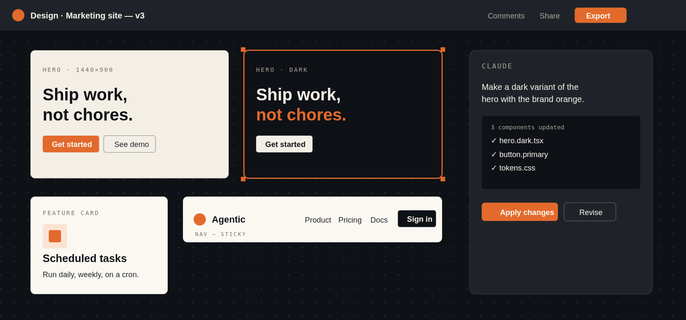
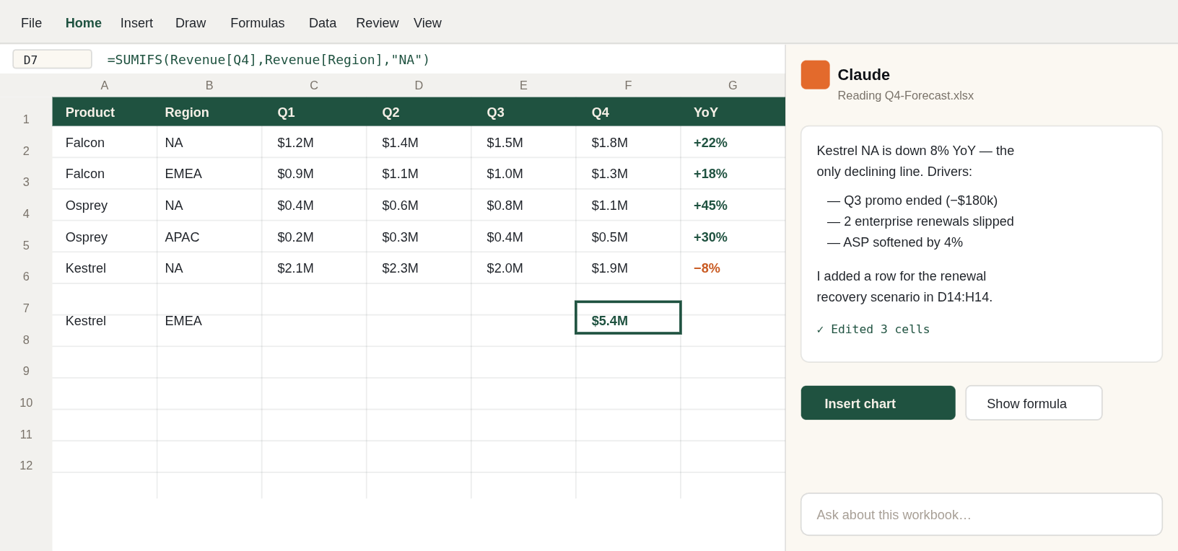
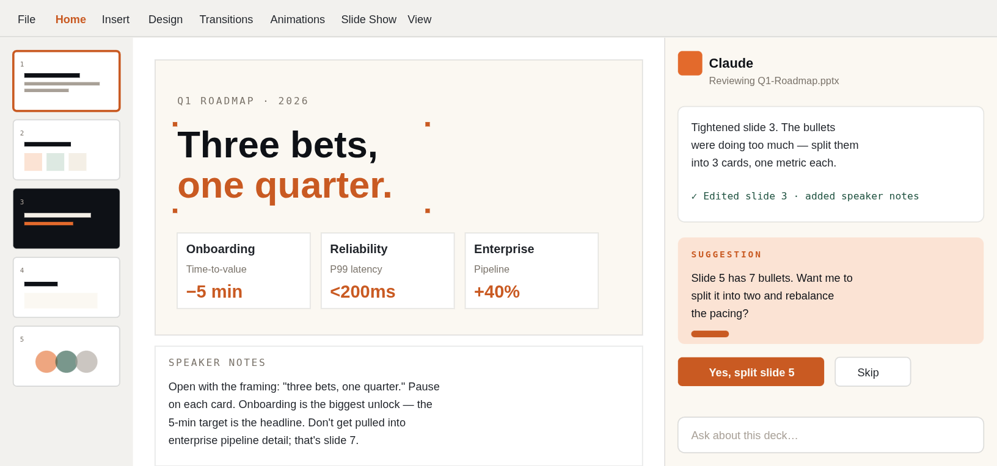
Agentic
·
Automations
TOPIC 02 · THE FOUR SURFACES
What it looks like.
Same Claude — four very different rooms.
WEB
Claude.ai
claude.ai
WEB
Claude.ai · Design
claude.ai/design
claude.ai
claude.ai/design
WORKSPACE
Excel · Claude sidebar
Microsoft 365
WORKSPACE
PowerPoint · Claude sidebar
Microsoft 365
X
Q4-Forecast.xlsx — Excel
P
Q1-Roadmap.pptx — PowerPoint
07 / 31

Slide 8
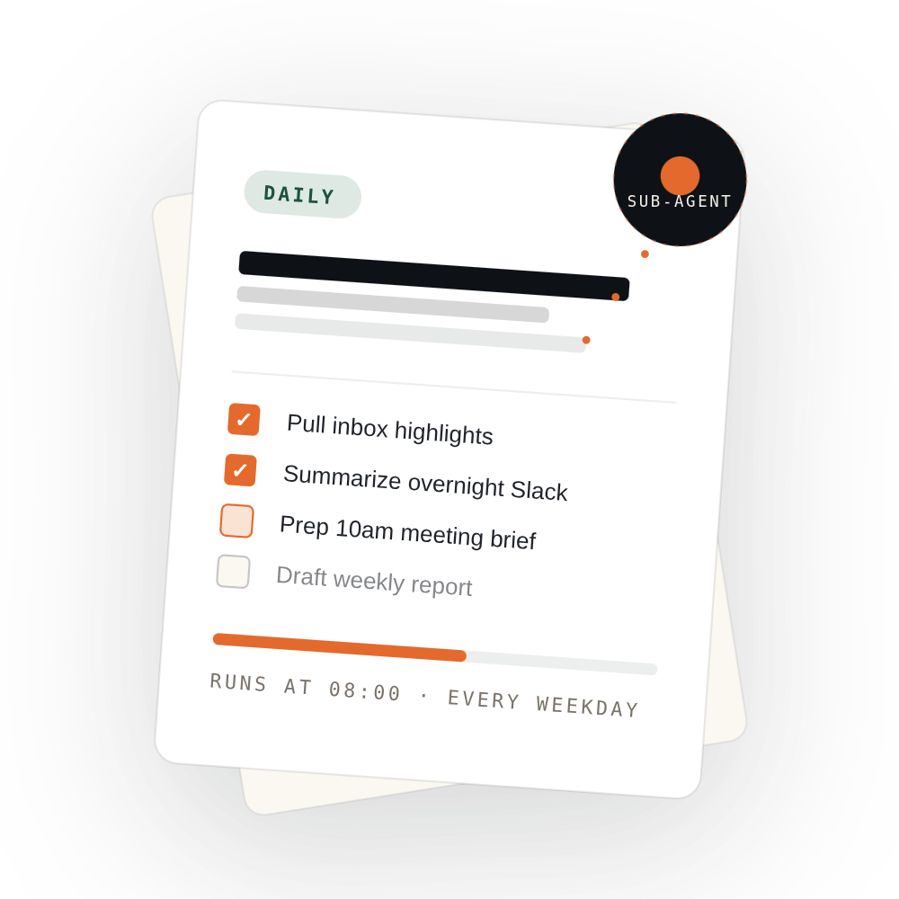
Agentic
·
Automations
TOPIC 03 · DEEP DIVE
Claude Cowork.
Cowork is what most people end up using daily. It runs on your machine, sees your files, runs in the background, and lets you hand it work the same way you'd hand it to a colleague.
DO THIS
"You keep doing the same work every morning — checking messages, prepping for meetings. Set it up once as a scheduled task and Claude handles it on repeat."
07 / 30

Slide 9
Agentic
·
Automations
COWORK · WHAT IT CAN DO
Eight moves you'll use.
01
02
03
04
Folder access
Scheduled tasks
Subagents
Dispatch
Point Claude at a folder; it reads, figures out what's relevant, saves work back to the same place.
Daily briefings, weekly roundups — recurring work that just runs.
Background workers that handle parts of a task in parallel.
Continue Cowork threads from your phone — hand off tasks that use everything on your computer.
05
06
07
08
Projects
Browser use
Computer use
Plugins
Group related tasks into workspaces with their own files, context, instructions and memory.
Connect Claude in Chrome — navigate websites, interact with pages, pull what it finds back in.
No connector? Claude navigates your computer directly — clicks, types, opens apps.
Specialized capabilities — live financial data, internal knowledge bases, compliance frameworks.
08 / 30

Slide 10
Agentic
·
Automations
TOPIC 04 · CLAUDE CODE
Claude works in your codebase.
Reads what's there, writes and modifies code, runs commands. Two places it can run from — and three working modes that control how much rope it gets.
LOCAL
REMOTE
On your machine
In a cloud env
Select a folder; Claude works directly with those files. Reads your project, accesses local tools, runs a dev server you can preview in your browser.
Connect a GitHub repo; sessions continue even if you close the app. Good for larger codebases or keeping dev off your local machine.
09 / 30

Slide 11
Agentic
·
Automations
CLAUDE CODE · MODES
How much rope to give it.
01
02
03
Ask
Code
Plan
Claude proposes every change and waits for your approval. Review a visual diff; accept or reject before anything is modified.
Claude applies file changes automatically but checks with you before running terminal commands.
Claude outlines its full approach before touching anything. A dedicated plan viewer lets you review and revisit as work progresses.
MOST CAUTIOUS
DEFAULT
FOR BIG WORK
10 / 30

Slide 12
Agentic
·
Automations
TOPIC 05 · CHAT
When you just need to ask.
Chat excels for questions, brainstorming, drafting, and working through problems back-and-forth. The quick-entry surface.
Quick entry.
Double-tap Option (Mac) to pull Claude up over whatever you're working on — stays on top as you switch apps.
DO THIS
Screenshots & window sharing.
Show Claude what you're looking at. Faster than describing. (Mac)
You've been jotting product-launch ideas in Apple Notes for weeks. Add the Notes connector and ask: "Pull together everything about the Osprey launch, figure out where I left things half-finished, and check my other connected tools for anything that fills in the gaps."
Dictation.
Talk through a problem when speaking is faster than typing. (Mac)
Desktop connectors.
Connect local tools so Claude can work with the rest of your machine.
11 / 30

Slide 13
Agentic
·
Automations
TOPIC 06 · PROJECTS
Projects = persistent context.
Use a project when you're working on something ongoing — not a one-off question. Reference materials you'll use repeatedly. Consistent rules for how Claude should respond. Teammates who need the same foundation.
Reference materials
Consistent requirements
Team collaboration
Meeting notes · survey results · historical data — things you'll come back to.
"Always use formal language." "Always cite sources." "Always follow our template."
Multiple people working from the same shared foundation, same shared instructions.
12 / 30

Slide 14
Agentic
·
Automations
PROJECTS · SETUP FOR FINANCE TEAMS
Three steps to set one up.
Walking through a real example: a Quarterly Close project the FP&A team uses every month-end.
01
Set up your project
Sidebar → Projects → + New Project. Name it FP&A — Quarterly Close . Mark it shared so your controller and analysts work from the same context.
02
Add instructions
Tell Claude the rules: "Always reconcile to the GL. Flag variances >5% with commentary. Use US GAAP terminology. Never invent figures — cite the source workbook and tab."
03
Build your knowledge base
Upload the chart of accounts, the close calendar, last quarter's variance memo, and your reporting template. Link the Drive folder where TB exports land monthly.
13 / 30

Slide 15
Agentic
·
Automations
PROJECTS · IN PRACTICE
Make them earn their keep.
Best practices
DO THIS
Australian tax reform briefing. Load the latest ATO rulings, draft Treasury legislation, your client's group structure, and prior advisory memos. Claude drafts plain-English impact notes.
Start focused, then expand.
One use case at a time.
Keep your knowledge base current.
Stale docs = stale answers.
Write clear instructions.
Vague in, vague out.
Name files descriptively.
Q4-2025-Variance-Memo.pdf
, not
memo.pdf
.
Reference by name in prompts.
"Per the Q3 variance memo…" focuses the search.
PRO TIP
When project knowledge approaches the context-window limit, Claude seamlessly enables RAG mode — you don't have to do anything.
14 / 30

Slide 16
Agentic
·
Automations
02
PART TWO · FOR FINANCE
Intermediate.
Skills · Connectors · Enterprise Search · Research. The four capabilities that turn Claude into a real finance partner — reconciling, modelling, drafting commentary, and pulling answers out of the systems where your numbers actually live (ERP, BI, close folders, board archives).
15 / 30

Slide 17
Agentic
·
Automations
TOPIC 06 · SKILLS
Skills are expertise packages.
Folders of instructions, scripts and resources that Claude loads dynamically. They teach Claude how to complete specific tasks in a repeatable way.
What a Skill encodes
Turning Skills on
A quarterly variance analysis methodology
A brand voice review process
A compliance checklist
Any repeatable workflow you want Claude to run the same way every time
01
Settings → Capabilities
02
Toggle
Code execution and file creation
on
03
Scroll to Skills section, toggle individual skills on
04
Ask normally — Claude picks the right skill automatically
"Generate a PDF report summarizing this data" → Claude picks the PDF skill.
16 / 30

Slide 18
Agentic
·
Automations
SKILLS
VS
PROJECTS
The what and the how.
PROJECTS
SKILLS
Knowledge hubs
Procedural machines
Hold the reference materials Claude needs to understand your work — specs, notes, research, documents. Claude draws on them across every conversation.
Encode how Claude should execute a task — the specific steps, order of operations and methodology you want run consistently every time.
= The how
= The what
A skill can reference knowledge stored in a project — your "customer call prep" skill might pull from customer profiles in a project's knowledge base.
17 / 30

Slide 19
Agentic
·
Automations
TOPIC 07 · CONNECTORS
From assistant to collaborator.
Connectors give Claude access to the same tools, data and context you use every day. Search files, retrieve documents, analyze data, create content, update records — across your connected apps.
WEB CONNECTORS
DESKTOP EXTENSIONS
Cloud services
Local apps & files
Google Drive · Notion · Slack · Asana · Stripe · Salesforce. Visit claude.ai/directory or click + → Connectors in any chat.
Run locally through Claude Desktop. Local file access, browser control, native app integration (e.g. Figma for design work).
MCP —the Model Context Protocol — is "USB-C for AI": one standard, any tool. That's why the connector library keeps growing.
18 / 30

Slide 20
Agentic
·
Automations
CONNECTORS · IN PRACTICE
What you can ask.
PM TOOLS
COMMS
DOCS
BUSINESS
Asana · Linear · Jira
Slack · Gmail
Notion · Drive · Confluence
Stripe · Salesforce
"Highest-priority tasks due this week?"
"Create a task for the Q4 budget review."
"Find the thread on the vendor contract."
"Draft a reply to yesterday's #marketing message."
"Search docs for our brand voice guide."
"Summarize last week's product review notes."
"Revenue trends for the past quarter?"
"Status of the Acme Corp opportunity?"
SECURITY
Claude sees what you see. Scoped access · revocable anytime · permissions toggle per app.
19 / 30

Slide 21
Agentic
·
Automations
TOPIC 08 · ENTERPRISE SEARCH
"Ask {Your Org}" in your sidebar.
A dedicated entry point for finding and synthesizing knowledge buried across your company's tools. Think of it as a pre-built Project for the entire organization.
01
02
03
Getting up to speed
Policy & process
Onboarding & research
"What happened yesterday while I was out?"
"Key updates from the last week."
"Current blockers on the Platform project."
"Our remote work policy?"
"How do I submit an expense report?"
"Process for requesting time off?"
"How does our auth system work?"
"Why do customers choose competitors?"
"Summarize Q4 product roadmap discussions."
Enterprise Search only shows what you already have permission to access in the source tool. Conversations stay private; connected data isn't indexed separately.
SAFE
20 / 30

Slide 22
Agentic
·
Automations
ENTERPRISE SEARCH · SETUP
Two-step setup.
STEP 01 · ADMIN
STEP 02 · USERS
Owners set it up once
Everyone authenticates
→
Click "Ask Your Org" in left sidebar
→
Click the "Ask {Org Name}" project in your sidebar
→
"Set up for your org"
→
Follow the guided onboarding
→
Pick connectors for Documents + Chat (Email optional)
→
Authenticate each service (Slack, Google, M365…)
→
Name the project, add description, finish
→
Ask away — more connectors = richer answers
21 / 30

Slide 23
Agentic
·
Automations
TOPIC 09 · RESEARCH
Claude as a systematic investigator.
Research transforms Claude from a conversational assistant into a researcher. Multi-step exploration that pursues leads, cross-references sources and synthesizes findings — hours of manual work done in minutes.
01
02
03
04
Plan the approach
Run many searches
Synthesize findings
Cite everything
Extended thinking activates automatically. Claude breaks down the request and plans how to investigate.
Searches build on each other. Claude pursues promising leads, fills in gaps.
Compile information from web + your connected integrations into a structured report.
Every claim links to its source. Verify, dig deeper, trust the output.
22 / 30

Slide 24
Agentic
·
Automations
RESEARCH · DECISION MATRIX
When to reach for which.
Multi-source synthesis. Market analysis, competitive research, comprehensive reports with citations.
"Compare top 5 vendors for AI orchestration; pull internal notes about each."
RESEARCH
Quick fact. One or two sources, answer in a sentence, speed over depth.
"What's the current Fed funds rate?"
WEB SEARCH
Deep reasoning. No external info needed — math, debugging, logical analysis.
"Find the bug in this 200-line function."
EXTENDED THINKING
Internal-only knowledge. Your docs, Slack threads, meeting notes — questions specific to your company.
"How does our auth system work?"
ENTERPRISE SEARCH
23 / 30

Slide 25
Agentic
·
Automations
03
PART THREE · 5 MINUTES
Pick the right tool.
Five short reference cards — Code · Slack · Excel · PowerPoint · Chrome. When you reach for each and what to expect.
24 / 30

Slide 26
Agentic
·
Automations
TOPIC 09
Use Claude Code when…
You want to build features by describing them in plain English — let Claude write the code, run tests, create commits
You need to debug — paste error messages and have Claude analyze the codebase to fix the problem
You're navigating an unfamiliar codebase and want to ask how different parts work together
You want to automate tedious tasks: lint errors, merge conflicts, release notes
You prefer working in your terminal alongside your existing IDE
25 / 30

Slide 27
Agentic
·
Automations
TOPIC 10
Use Claude in Slack when…
You want to draft responses, summarize threads, or break down complex discussions without leaving Slack
You need to prep for meetings — pull together related conversations and shared docs from your workspace
You're onboarding to a new team and want help understanding ongoing projects via channel history
DEMO
26 / 30

Slide 28
Agentic
·
Automations
TOPIC 11
Use Claude for Excel when…
You're working with a complex multi-tab workbook and want to understand how formulas flow across sheets
You need to update assumptions across a model while preserving formula dependencies
You're debugging
#REF!
,
#VALUE!
or circular references — Claude traces them to source
You want to create new spreadsheets or populate templates with data while keeping formula structure intact
You need to quickly build pivot tables or charts to visualize data
DEMO
27 / 30

Slide 29
Agentic
·
Automations
TOPICS 12 + 13
PowerPoint & Chrome.
POWERPOINT
CHROME
Use it when…
Use it when…
You want to turn an outline or doc into a first-draft deck without building each slide by hand
You want to summarize articles, research papers, or web pages while browsing
You need to rewrite or tighten slide copy — shorter bullets, speaker notes, tone adjustments
You need help drafting email responses or managing your inbox
You're filling out repetitive forms and want to automate the process
You're restructuring a deck — reordering sections, splitting dense slides, merging overlapping ones
You need a browsing assistant that maintains context across tabs — great for niche internal tools, CRMs, dashboards
You want consistent formatting applied across the deck without manually fixing each slide
DEMO
DEMO
28 / 30

Slide 30
Agentic
·
Automations
RECAP
Cheat sheet.
IF YOU NEED TO…
Brainstorm or ask a quick question
Chat or Claude.ai
IF YOU NEED TO…
Work with files on your machine
Cowork · folder access + scheduled tasks + subagents
IF YOU NEED TO…
Write, debug or refactor code
Claude Code · pick Ask / Code / Plan based on appetite
IF YOU NEED TO…
Reference materials across many chats
Projects · the persistent knowledge hub
IF YOU NEED TO…
Run the same workflow consistently
Skills · turn it into a repeatable procedure
IF YOU NEED TO…
Find a fact buried inside your company
Enterprise Search · "Ask {Your Org}"
Investigate a topic comprehensively
29 / 30
IF YOU NEED TO…
Research · multi-source, cited, structured report

Slide 31

THANKS FOR SITTING THROUGH IT
Now go automate something.
Questions? We'll stick around for 10 minutes. Otherwise.
Agentic · Automations
30 / 30 · END

