Slide 1
Applied Machine Learning
Population
Estimation
Using CNNs, Transformers & Clustering to determine
population counts on small-scale orthophotos

Slide 2
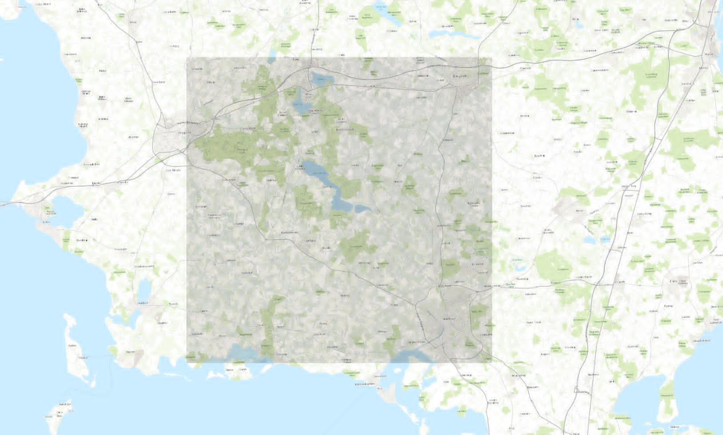
Background & Data
What Are Orthophotos?
Aerial photographs corrected for perspective distortion
Projected onto maps with geospatial logging
Squarenet (Kvadratnet) from DST
[ Orthophoto / Squarenet Example ]
Standardised spatial grid by Statistics Denmark (DST).
Linked to official population counts
Available in different resolutions

Slide 3
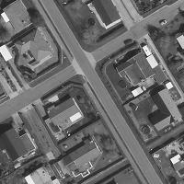
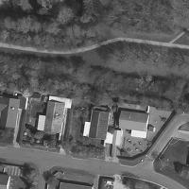
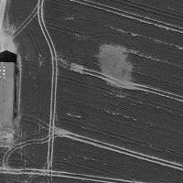
What the Data Looks Like
IMAGE RESOLUTION
Image SIZE
DATA REGION
DATA SIZE
1 px = 0.5 m
[200×200] px
[30×30] km
88 869 images

Slide 4
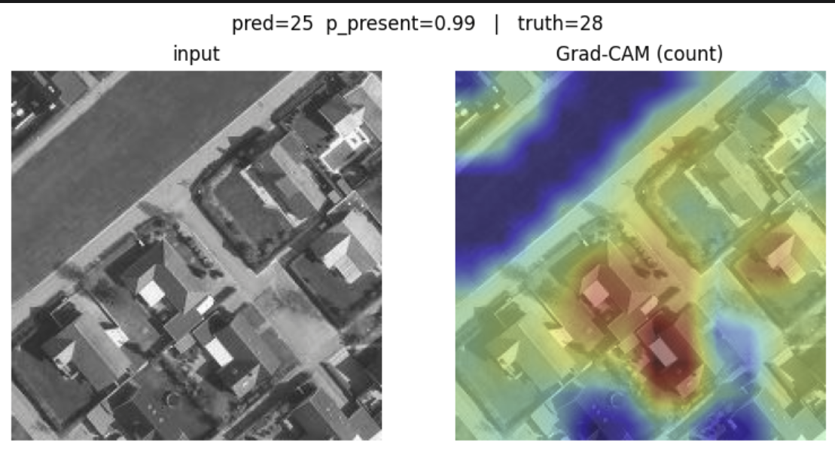
Methods: The Naïve Approach
Mangler R^2 plot her

Slide 5
Methods: Problems Identified
Where Did It Go Wrong?
The model struggled most on populated cells, producing large prediction errors in those cases.
[ Population Distribution Plot ]
Zero-Inflated Distribution
The majority of Squarenet cells have zero or near-zero population, creating a severe class imbalance.
Regression Bias
[ Predicted vs True Values ]
Trained on imbalanced data, the model defaulted to predicting near-zero values for all inputs.

Slide 6
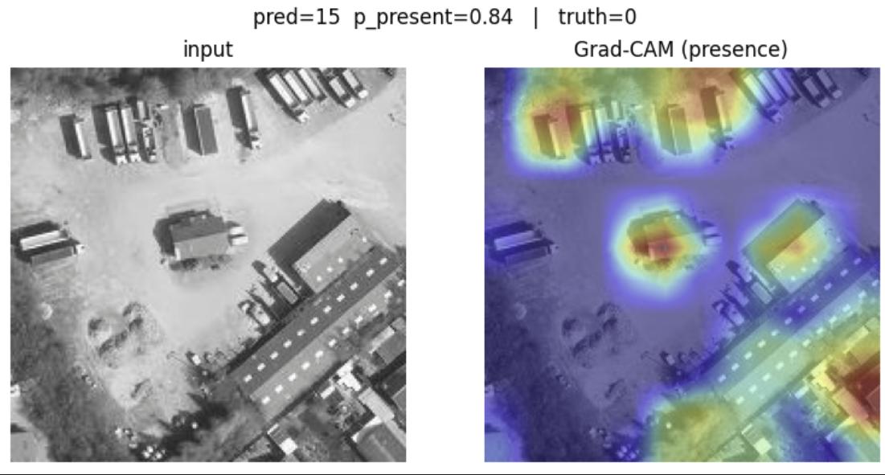
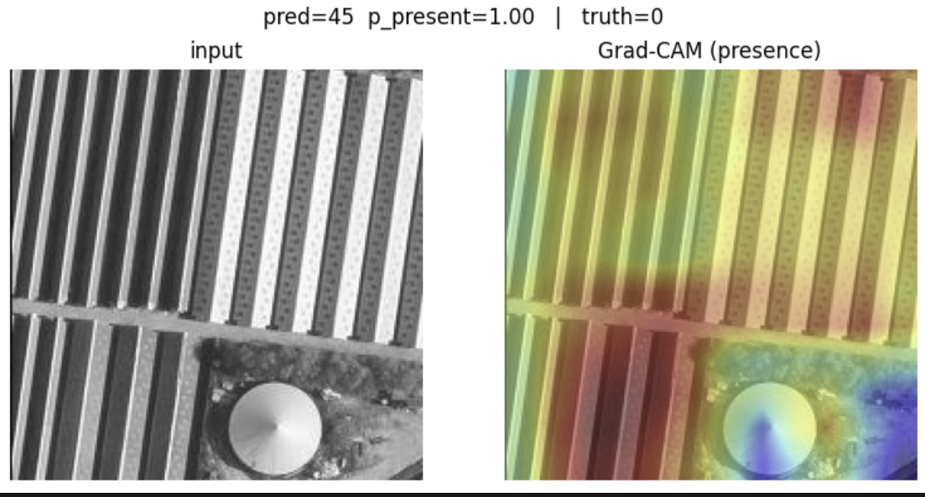
Failure Cases: GradCAM Analysis
GradCAM highlights which image regions
drove the model's incorrect predictions.

Slide 7
New Methods
Classification → Regression
Transformer Models
First classify each cell as populated vs. empty; apply regression only to populated cells, addressing class imbalance.
Attention-based architectures that capture long-range spatial dependencies across the full image.
Clustering
Context — 300×300m Squares
Group images by visual similarity (urban, suburban, rural) and train separate models per cluster.
Expand the receptive field to capture surrounding neighbourhood context for improved spatial awareness.
Model effectiveness verified via GradCAM — confirming attention on actual building structures.

Slide 8
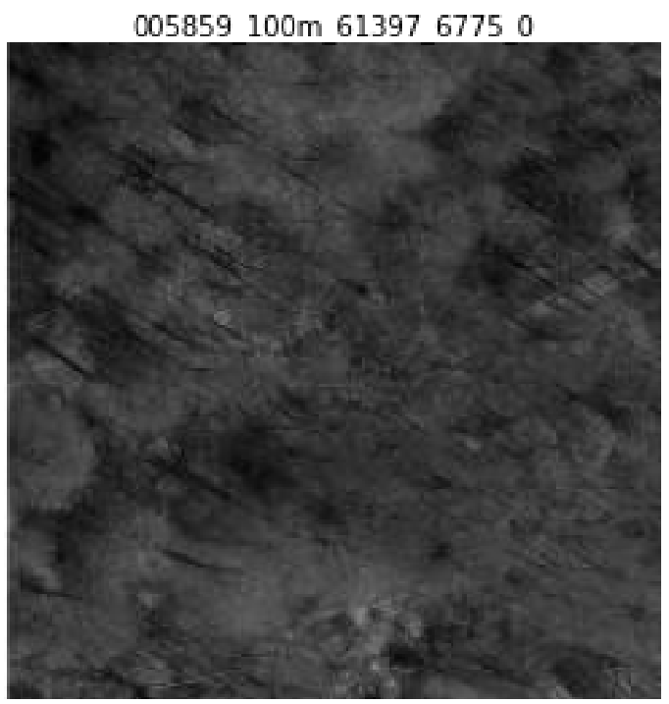
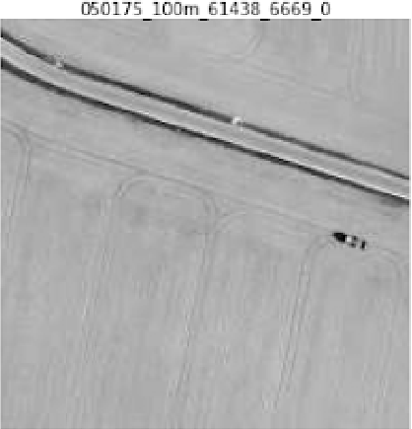
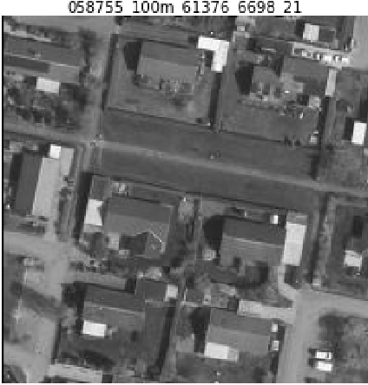
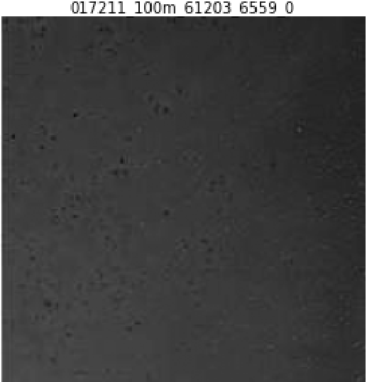
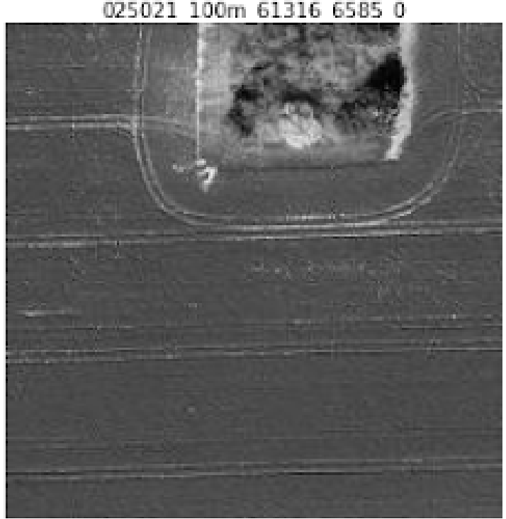
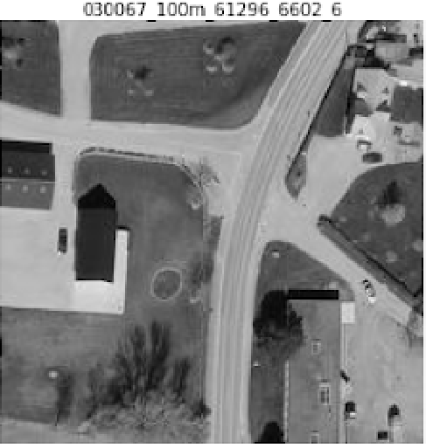
Clustering Effects

Slide 9
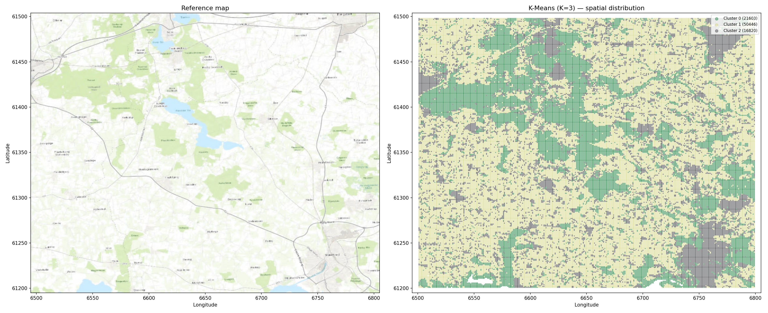
Clustering Effects

Slide 10
Results: Classification-First Regression
[ True vs Predicted — R² ]
[ ROC Curve ]
Regression Performance
Classification Performance

Slide 11
Results: Transformer Model
[ True vs Predicted — Transformer ]
[ R² / Model Metrics ]
Scatter Plot
Performance Metrics

Slide 12
Model Comparison
Model | R² | MAD | Notes
Naive CNN Regression | [ — ] | [ — ] | Baseline
CNN + Population Filter | [ — ] | [ — ] | Zero-inflated handling
Classification + Regression | [ — ] | [ — ] | Two-stage pipeline
Transformer | [ — ] | [ — ] | Attention-based model
Clustering + CNN | [ — ] | [ — ] | Per-cluster training

Slide 13
Out of Training Sample
What We Hope to See
Ideally, the model generalises beyond its training data — accurately predicting population counts for previously unseen geographic areas.
[ Out-of-Sample Prediction Map ]
Good generalisation means the model has learned meaningful features of human settlement patterns — not just memorised the training set.

