Slide 1
Introduction to
Boundary Integral Equations
Suvranu De
Acknowledgements: Prof K H Lee of NUS and Jacob White, MIT

Slide 2
Boundary Integral Equations
What are Integral Equations?
Green’s Functions and Integral Equations
Green’s Functions for Laplace
Exterior Dirichlet problem
Discretization Techniques

Slide 3
In a Nutshell
domain discretization
(finite elements)
boundary discretization
(boundary elements)

Slide 4
References
Gipson, G.S., Boundary Element Fundamentals, CMP (1987)
Banerjee, P.K. and Butterfield, R., Boundary Element Methods in Engineering Science, McGraw-Hill (1981)
Brebbia, C.A. and Dominguez, J., Boundary Elements: An Introductory Course, CMP & McGraw-Hill (1989)

Slide 5
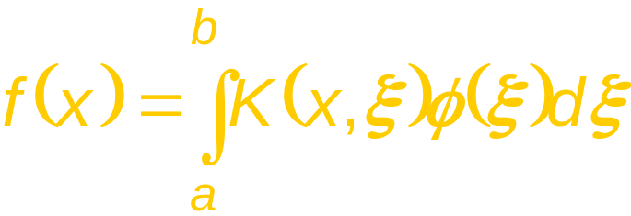
What are Integral Equations?
They are equations which contain the unknown function under the integral sign.
For example,
known
(function)
known
(kernel)
unknown
(function)

Slide 6







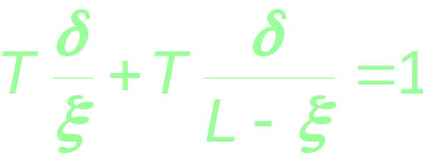
An Example: Taut String with Load
unit load
For small deflection, force equilibrium gives

Slide 7
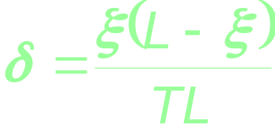
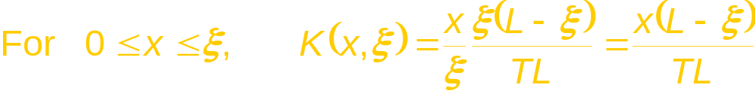
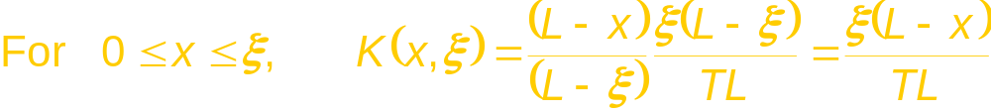
An Example: Taut String with Load
From
we have

Slide 8
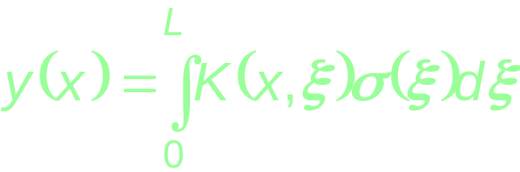
An Example: Taut String with Load
For small deflection, the Principle of Superposition holds, and for an arbitrary load density σ(x),
the deflection y(x) at any point is given by
If we specify the deflection function y(x), then this is an Integral Equation for the unknown load density function σ(x).

Slide 9
What are Integral Equations?
This is an Integral Equation of the First Kind.
The limits a and b are fixed. The equation is then called a Fredholm Equation.
If one of the limits is variable, then the equation is called a Volterra Equation.
Are there Integral Equations of the Second Kind? Yes!

Slide 10
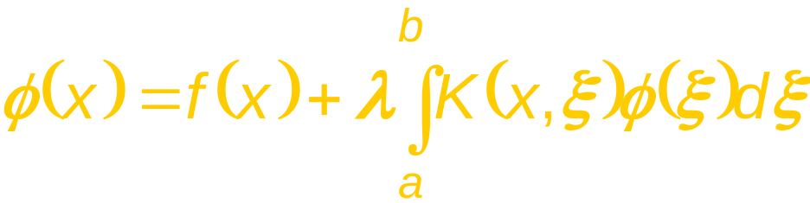
What are Integral Equations?
An Integral Equation of the Second Kind has the unknown function also appearing outside the integral.
It is usually written as (Fredholm Equation)
unknown
(function)
known
(function)
known
(kernel)
unknown
(function)

Slide 11


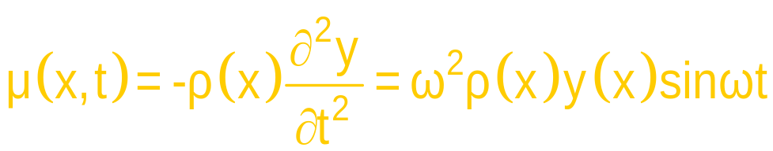
An Example: Vibrating Taut String
Let the string have a linear mass density ρ(x).
The string undergoes vibration given by
The inertia force density μ(x) is then

Slide 12
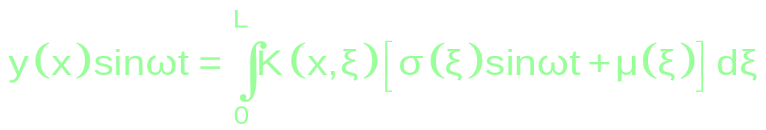
An Example: Vibrating Taut String
With the additional inertia force, the equation
now becomes

Slide 13
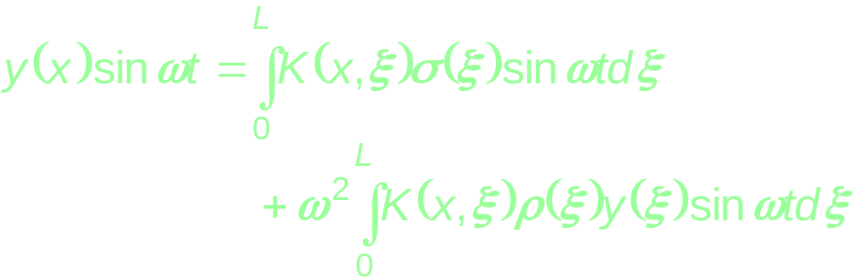
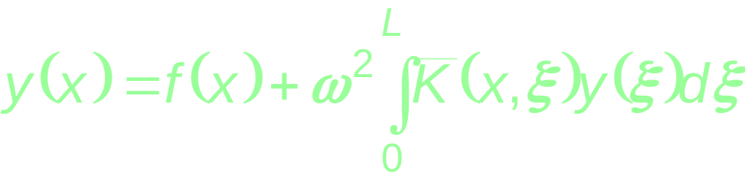
An Example: Vibrating Taut String
Substituting for μ(x) gives
Dropping the t terms, and for given σ(x),

Slide 14
So what?
Everything seems so ad hoc.
What’s it got to do with differential equations?
What’s it got to do with Green’s functions?
What is the advantage of integral equations?
What about other physical phenomena?
So far, it is only 1D.
What about 2D and 3D problems?

Slide 15


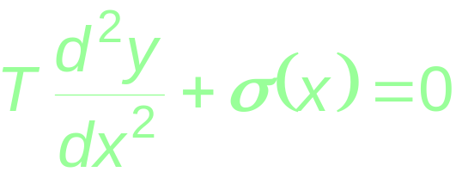
Taut String with Load Revisited
The governing differential equation is
with boundary conditions y(0)=y(L)=0.
Can we transform this into an integral equation?

Slide 16
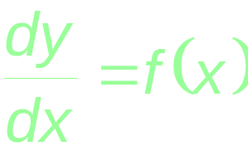
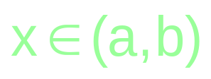

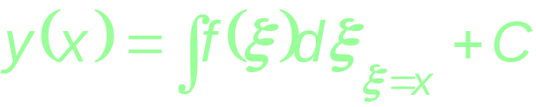
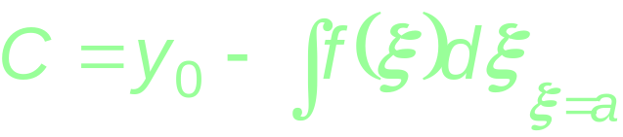
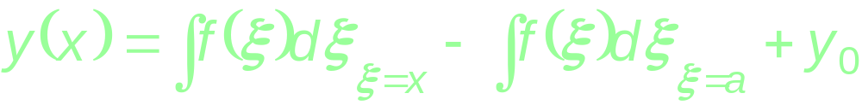
Elementary Differential Equation
Example 1: Solve
subject to
Integrating gives
Applying the boundary condition gives
Thus

Slide 17
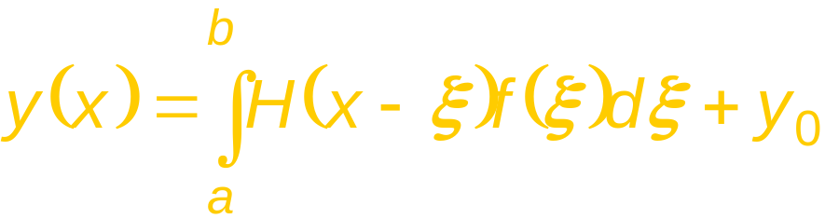
Elementary Differential Equation
Using the Heaviside step function, rewrite
as
H(x-ξ )
1
Green’s function for d.e. with b.c.
ξ
a
x
b
Does the equation above look familiar to you?

Slide 18
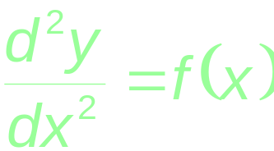



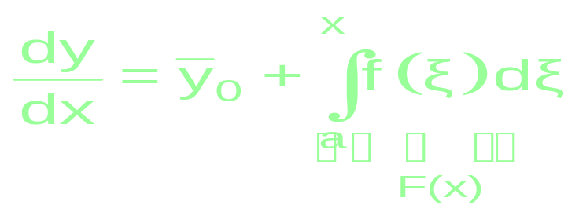
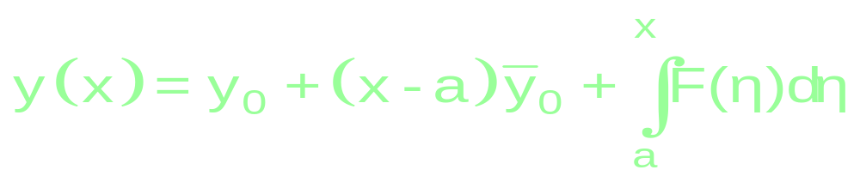
Another Elementary Equation
Example 2: Solve
Subject to
Integrating once and applying give
Integrating again and applying give

Slide 19
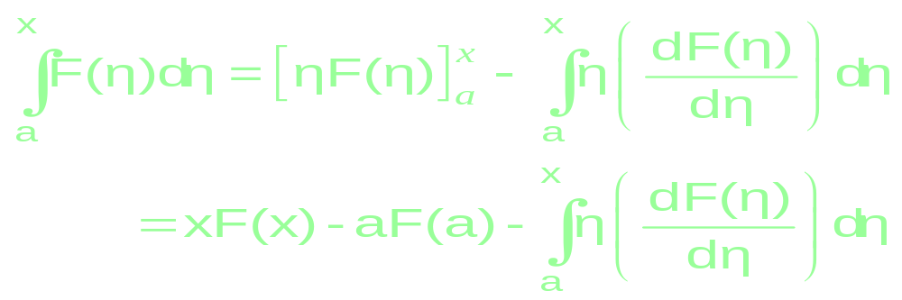
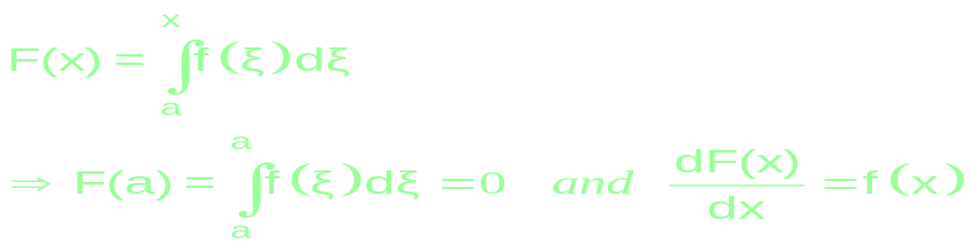
Another Elementary Equation
Integrating by parts the last term
But

Slide 20
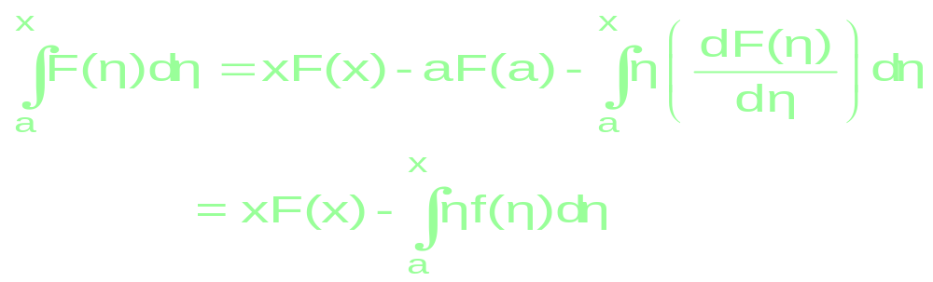
Another Elementary Equation
Hence

Slide 21
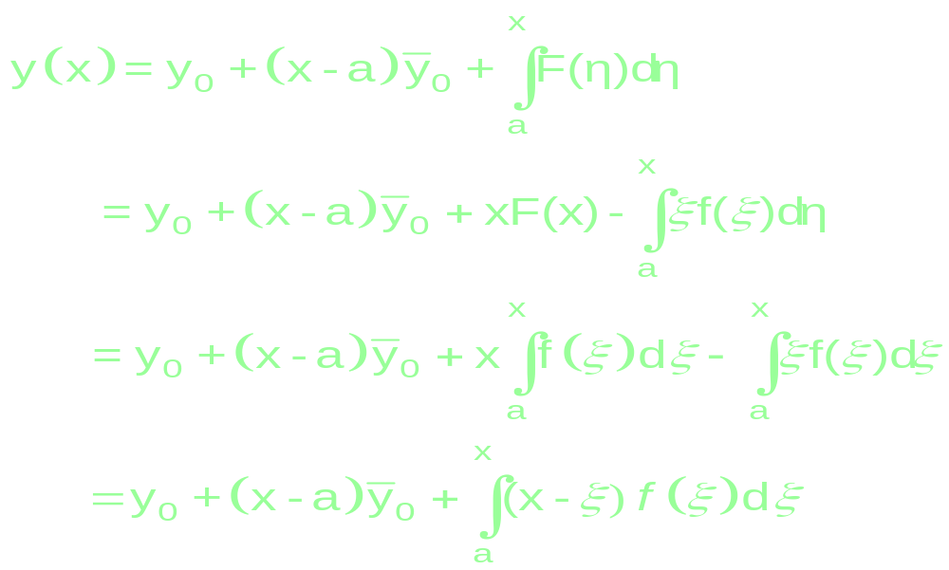
Another Elementary Equation
Therefore

Slide 22
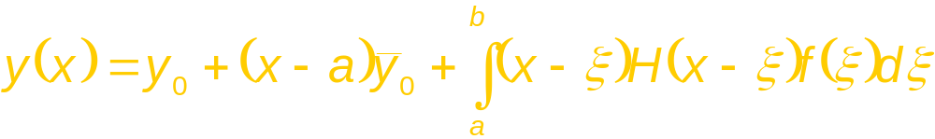

Another Elementary Equation
Green’s function for d.e. with b.c.
Problem #1
What is the Green’s function for
subject to
and ?

Slide 23
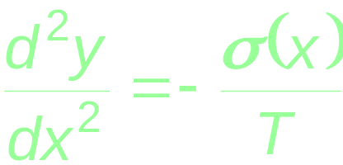
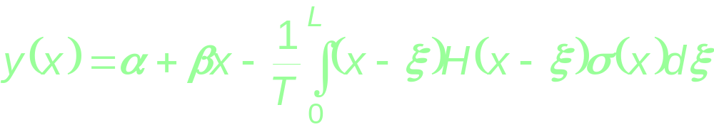
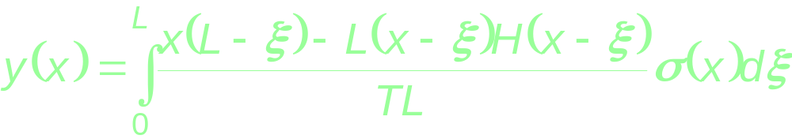
Taut String with Load Revisited
Now, back to or .
Integrating twice gives
Applying the boundary conditions gives
Green’s function for d.e. with b.c.

Slide 24
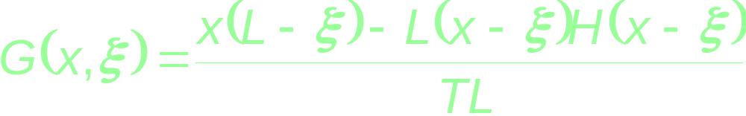
Taut String with Load Revisited
Does the Green’s function
agree with the earlier result? Let us check - Yes!
The Green’s function is thus the solution to the original differential equation for a unit point load (or point source) under the boundary conditions.
It is also called an influence function or a fundamental solution.

Slide 25
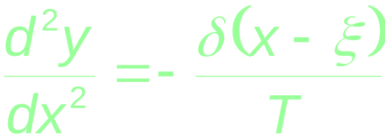
Taut String with Load Revisited
Is there a physical interpretation of G(x,ξ) ?
Instead of applying a load density σ(x), suppose
a unit concentrated load is applied at x=ξ.
Then, instead of ,
using the Dirac delta function gives

Slide 26

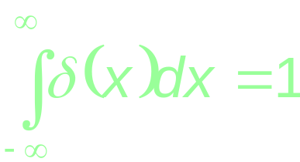
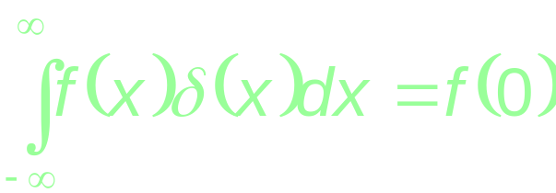
Aside on Dirac Delta Function
The Dirac delta function in I-D is defined by
δ(x)
x
0

Slide 27
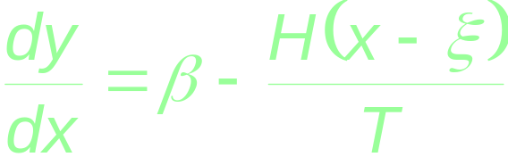
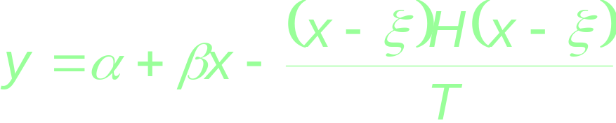
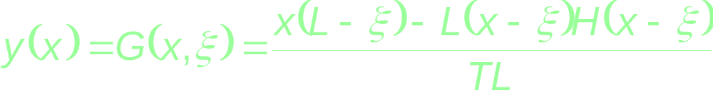
Taut String with Load Revisited
Integrating once gives
Integrating again gives
Applying the boundary conditions gives G(x,ξ)

Slide 28
Two Questions
QUESTION 1: How to compute Green’s functions for a given problem?
QUESTION 2: How to generate a “boundary integral equation” using the Green’s function?
Notes:
A ‘boundary integral equation” is an equation where all terms of interest reside on the boundary.

Slide 29
How to get Green’s Function?
Given
Differential equation of the form Ly = f.
Boundary conditions to make y unique.
Recipe
Apply unit concentrated form of f, at x( source point) and compute the solution of the differential equation at y (field point)
LG(x,y) = δ(x-y)
y (field point)
x (source)

Slide 30
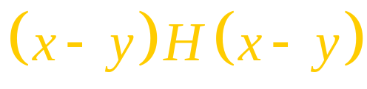
Types of Green’s Function
The “particular solution” of this equation (that does not account for the boundary conditions) is known as the “Free Space Green’s function”
e.g., in Example 2
The homogeneous solution G_{H} (x, y) satisfies
LG_{H}(x, y) = 0
and may be used to satisfy the boundary conditions.
The “Region Dependent Green’s function” G_{R} (x, y) is defined as
G_{R}(x, y) =G_{H}(x, y)+ G(x, y)
Even though we have derived the region dependent Green’s functions in the previous examples, henceforth we will use the “Free space Green’s function” to generate the boundary integral equations unless otherwise stated

Slide 31
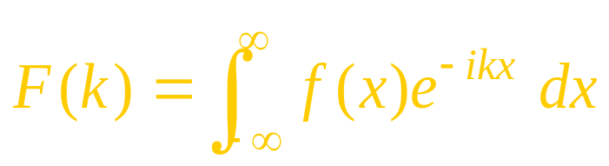
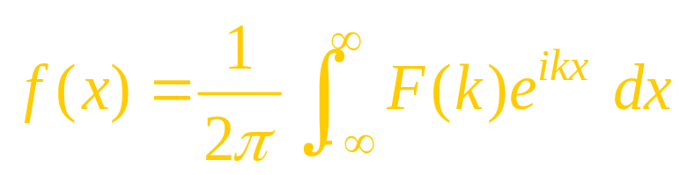
How to compute the free space GF?
Solve the differential equation directly
Or, take the Fourier transform of the equation and then use the inverse transform.
The Fourier transform of a function f(x)
And its inverse

Slide 32
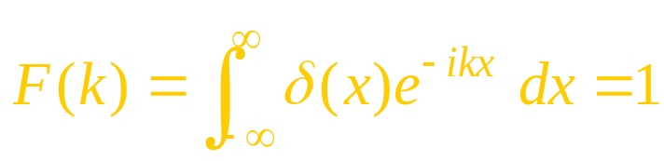
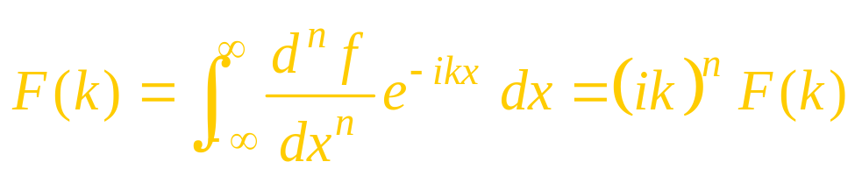
Important Fourier transforms
For a delta function
For the derivative
See standard tables on Fourier Transforms and inverse transforms

Slide 33
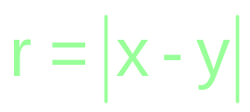
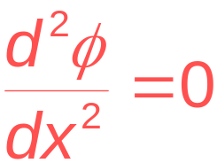
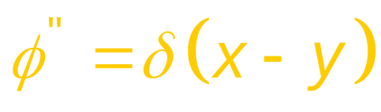

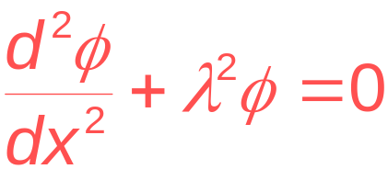
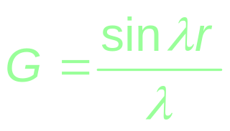
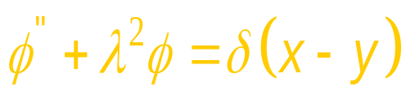
Free Space Green’s Functions (1D)
Note that
Original d.e. d.e. for G G(x,y)

Slide 34
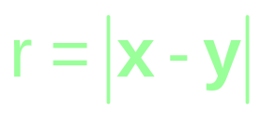
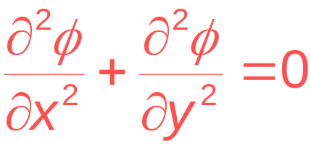
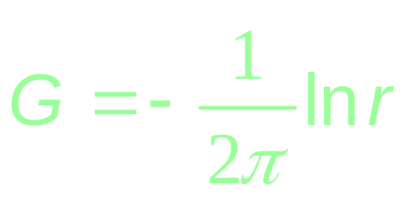


Free Space Green’s Functions (2D)
For unbounded space, noting that ,
p.d.e. G(x,y)

Slide 35






Free Space Green’s Functions (3D)
For unbounded space, noting that ,
p.d.e. G(x,y)

Slide 36


3D Example: Laplace Equation
The Green’s function corresponding to the equation
is
How? Start with

Slide 37


3D Example: Laplace Equation
Integrate on the volume of a sphere Ω centered at x and of radius
Divergence theorem
Due to symmetry

Slide 38


3D Example: Laplace Equation
Hence
But G(r) is constant at a given r,
hence

Slide 39


3D Example: Laplace Equation
Integrate once more
Using the condition that the Green’s function vanish at infinity

Slide 40

Interior Versus Exterior Problems
Interior
Exterior
outside
inside
Temperature known on surface
Temperature known on surface
“Temperature in a Tank”
“Ice Cube in a Bath”
What is the heat flow?
Thermal
conductivity

Slide 41



Exterior Problem in Electrostatics
potential
+
v
-
What is the capacitance?
Dielectric
Permitivity

Slide 42

Example: A bracket
Example: A bracket
Exterior problems
Example: VLSI circuit analysis
Notes:
This is an example of a very large scale integrated circuit. The interest here is to find out how long it takes for a signal to go from one point to the other through all these interconnect. The difficulty is to predict the capacitance which determines the speed of the wire. Such large scale capacitance extractions are also done using fast boundary element methods.

Slide 43


Why not use Finite-Difference or FEM methods
Exterior Problems
2-D Heat Flow Example
Surface
But, must truncate the mesh

Slide 44

Exterior problem: Laplace equation
“Electrostatics problem”
outside
Potential known on surface
Aim is to find a potential ‘u’ that satisfies the Laplace eqn in the exterior and the “known” potential on the domain boundary.

Slide 45


Poisson’s equation: Interior problem
GUSWF I
Pure Dirichlet problem
n
Γ
Poisson’s equation
Ω
Global Unsymmetric Weak Form I : Use ‘v’ as weight function

Slide 46

Poisson’s equation: Interior problem
Using Green’s Theorem twice
GUSWF II
This is the starting point of the boundary integral equation method
We choose v=G (the Green’s function) with the source point (x) located within Ω
What happens if the source is outside Ω?

Slide 47


Poisson’s equation: Interior problem
Hence
Now, from the definition of G,
For x ∈Ω

Slide 48

Poisson’s equation: Interior problem
n
Γ
Y (field point)
When the field point is on
the boundary we will
represent it as ‘Y’
Note that the source point cannot be
on the boundary.
Ω
x (source)
Unknown boundary flux
Known from b.c

Slide 49



Indirect from Direct Formulation
Domain Ω’= R³- Ω
Domain Ω
Y
n’
r
x
Boundary Γ
n

Slide 50


Indirect from Direct Formulation
Consider simultaneously a bounded domain Ω and its
unbounded counterpart Ω’=R³- Ω, and let u and u’ be the
solutions to Laplace equation over Ω and Ω’, respectively
with u=u’ =u^{sp} on Γ
For any source point ‘x’ interior to Ω
for the interior problem
for the exterior problem
Notice the n’ points into Ω , hence

Slide 51



Indirect from Direct Formulation
Rewrite the exterior solution as
Now add the two solutions to obtain
Where, the discontinuity of normal derivative is

Slide 52


Taking x to X
Is the integral equation
of the ‘boundary’-type?
Domain Ω
Y
r
X
x
Boundary Γ
n
No! We must ‘take’ x to the boundary (to X).

Slide 53


3D Example: Laplace Equation
When we take x to X, we have to make sure that the integrals are convergent.
It may be proved that
This is a Fredholm Integral equation of the First kind and
will be used extensively in the following discussions as

Slide 54

Basis Function Approach
Laplace’s Equation in 2-D
Basic Idea
Example Basis
Represent circle with straight lines
The basis functions are “on” the surface
Can be used to approximate the density
May also approximate the geometry

Slide 55

Basis Function Approach
Laplace’s Equation in 2-D
Geometric Approximation is not new.
Piecewise Straight surface basis functions approximate the circle
Triangles for 2-D FEM approximate the circle too!

Slide 56










Basis Function Approach
Laplace’s Equation in 2-D
Piecewise Constant Straight Sections Example.
1) Pick a set of n Points on the surface
2) Define a new surface by connecting points with n lines.

Slide 57


Basis Function Approach
Laplace’s Equation in 2-D
Residual Definition and minimization

Slide 58

Basis Function Approach
Laplace’s Equation in 2-D
Residual minimization using test functions

Slide 59



Basis Function Approach
Laplace’s Equation in 2-D
Collocation

Slide 60



Basis Function Approach
Laplace’s Equation in 2-D
Centroid Collocation for Piecewise Constant Bases
Collocation point in line center

Slide 61



Basis Function Approach
Laplace’s Equation in 2-D
Centroid Collocation Generates a nonsymmetric A

Slide 62





Basis Function Approach
Laplace’s Equation in 2-D
Galerkin
A is symmetric

Slide 63


Basis Function Approach
Laplace’s Equation in 2-D
Galerkin for Piecewise Constant Bases

Slide 64




Electrostatics Example
Laplace’s Equation in 3-D
Piecewise Constant Basis
Integral Equation:
Discretize Surface into Panels
Panel j

Slide 65



Basis Function Approach
Laplace’s Equation in 3-D
Centroid Collocation
Put collocation points at
panel centroids
Collocation
point

Slide 66



Basis Function Approach
3-D Laplace’s Equation
Calculating Matrix Elements
z
Collocation
point
y
x
Panel j
One point quadrature Approximation
Four point quadrature Approximation

Slide 67



Basis Function Approach
3-D Laplace’s Equation
Calculating “Self-Term”
z
Collocation
point
y
x
Panel i
One point quadrature Approximation

Slide 68


Basis Function Approach
3-D Laplace’s Equation
Calculating “Self-Term” Tricks of the trade
z
Collocation
point
y
x
Panel i
Disk of radius R surrounding collocation point
Integrate in two pieces
Disk Integral has singularity but has analytic formula

Slide 69

Basis Function Approach
3-D Laplace’s Equation
Calculating “Self-Term” Other Tricks of the trade
z
Collocation
point
y
x
Panel i
1) If panel is a flat polygon, analytical formulas exist
2) Curved panels can be handled with projection

Slide 70
Summary
Integral Equation Methods
Exterior versus interior problems
Standard Solution Methods
Collocation Method
Galerkin Method
Integrals for 3-Dimensional Problems
Singular Integrals
We will examine computing integrals next time, and then examine integral equation convergence theory

