Slide 1
MACHINE LEARNING
XGBOOST ALGORITHM

Slide 2
XGBOOST ALGORITHM
XGBoost stands for eXtreme Gradient Boosting
It is an open-sourced tool
A variant of the gradient boosting machine
Tree-based model
Use for structure data(table data)
Use for both regression and classification problems
Notes:
* The winning model for several kaggle competitions

Slide 3
Why is XGBoost so popular?
Speed and performance – faster than other ensemble classifiers.
Core algorithm is parallelizable – Can harness the power of multi-core computers.
Consistently outperforms other algorithm methods
Wide variety of tuning parameters- e.g Cross-validation, regularization, user-defined objective functions, missing values, tree parameters, scikit-learn compatible API etc
Notes:
The primary author of the model and the c++ implementation is Tianqi Chen.
The author for the R-package is Tong He.

Slide 4
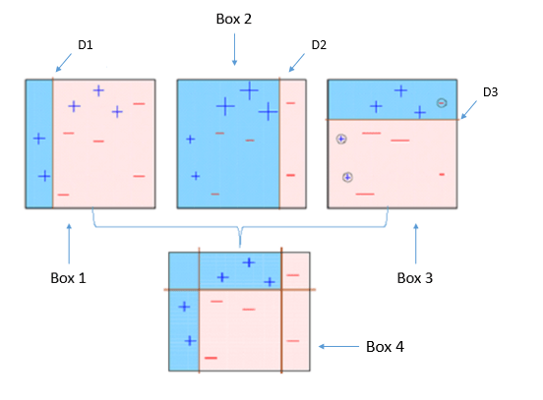
Basic Idea about Boosting Algorithm
Notes:
Four classifiers (in 4 boxes), shown above, are trying to classify + and - classes as homogeneously as possible.

Slide 5
Box 1: The first classifier (usually a decision stump) creates a vertical line (split) at D1. It says anything to the left of D1 is + and anything to the right of D1 is -. However, this classifier misclassifies three + points.
Box 2: The second classifier gives more weight to the three + misclassified points (see the bigger size of +) and creates a vertical line at D2. Again it says, anything to the right of D2 is - and left is +. Still, it makes mistakes by incorrectly classifying three - points.
Box 3: Again, the third classifier gives more weight to the three - misclassified points and creates a horizontal line at D3. Still, this classifier fails to classify the points (in the circles) correctly.
Box 4: This is a weighted combination of the weak classifiers (Box 1,2 and 3). As you can see, it does a good job at classifying all the points correctly.
Notes:
Note a Decision Stump is a Decision Tree model that only splits off at one level, therefore the final prediction is based on only one feature

Slide 6
The basic idea behind boosting algorithms is building a weak model, making conclusions about the various feature importance and parameters, and then using those conclusions to build a new, stronger model and capitalize on the misclassification error of the previous model and try to reduce it.
XGBoost uses the default base learners tree ensembles. The tree ensemble model is a set of classification and regression trees (CART).
Trees are grown one after another ,and attempts to reduce the misclassification rate are made in subsequent iterations.

