Slide 1
Forest Cover Type

Slide 2
Problem Description
Prediction of Forest Cover type based on Cartographic Variables.
Multiclass Problem with 7 classes.
The data set contains 5,81,102*54 observations.
Attributes are both Qualitative and Quantitative data type.
Due to more Computational time , data is sub-sampled to 30% of Original data.

Slide 3
Data Pre Processing
There were no observations with NA value.
Standardized on numeric data.
We have partitioned the data into Train and Test datasets.

Slide 4
Class Imbalance
Checked for class imbalance in the data

Slide 5
Models used
Logistic Regression.
KNN.
SVM.
Decision Trees.
Random Forests.

Slide 6
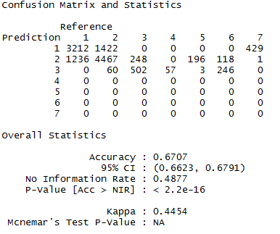
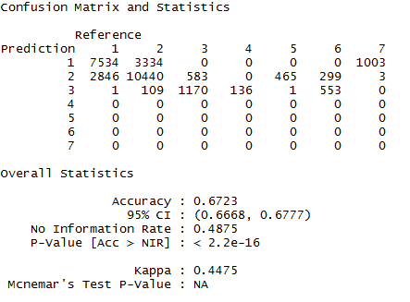
Decision Trees
Sensitivity for class 4 to 7 were zero .
Test & Train

Slide 7
Relations

Slide 8
Data Pre Processing

Slide 9
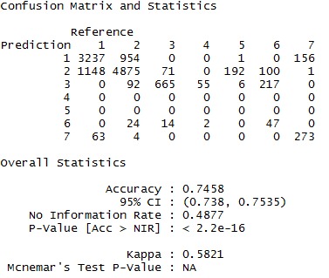
SVM
Applied linear, polynomial, RBF, tanhdot.
As the data was non linear the best results were coming for RBF kernel.
Applied hyper parameter (c, gamma) tuning for the SVM with kernel as RBF.

Slide 10
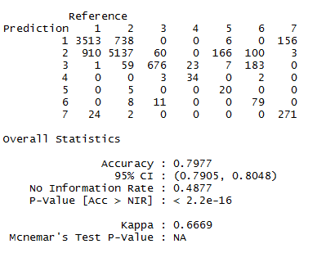
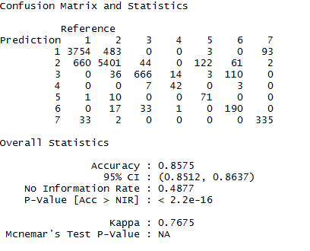
Random Forests
Applied hyper parameter tuning for Random Forests using random search.
Better results than Decision trees.
Tuned parameters are ntree(number of trees), mtry(number of features to be selected), nodesize (depth of the trees).
The best accuracy for ntrees =1000 ,mtry = 10

Slide 11
Further Enhancements
Parameter tuning for Boosting for better accuracy.
Multiple Correspondence Analysis for feature Generation.
We can also work on parts of data for better results.

Slide 12
Thank You

Slide 13
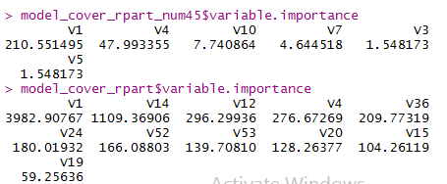
Model on Important Variables.

Slide 14
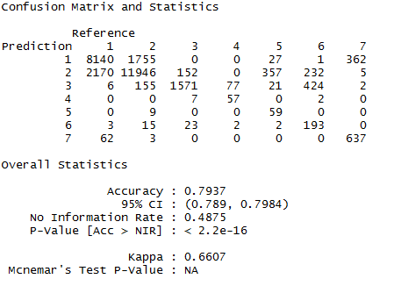
Random Forest On train

