Slide 1
Forest Cover Type Prediction —Classification Problem

Slide 2


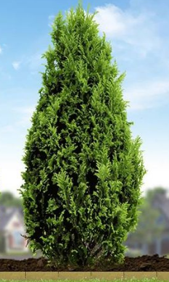

The Problem Statement:

Slide 3
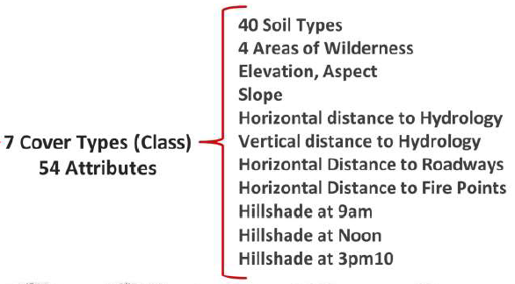
Data Description:
Spruce/Fir
Lodgepole pine
Aspen
Douglas-Fir
Ponderas
Cottonwood

Slide 4
Preprocessing
Data is
Sub Sampled
30%
Standard Normalization
No NA Values
Exploratory Data Analysis
Using Plots

Slide 5
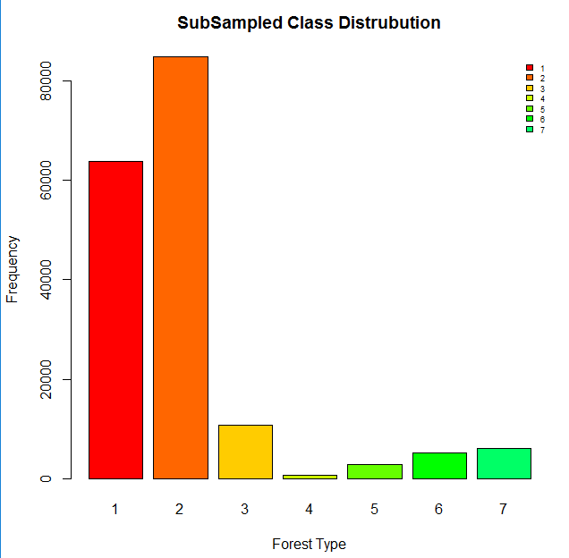
Class Imbalance
Checked for class imbalance in the data

Slide 6
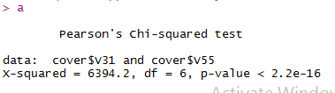
Exploratory Data Analysis:
Correlation Plot
Chi.Sq.Test

Slide 7
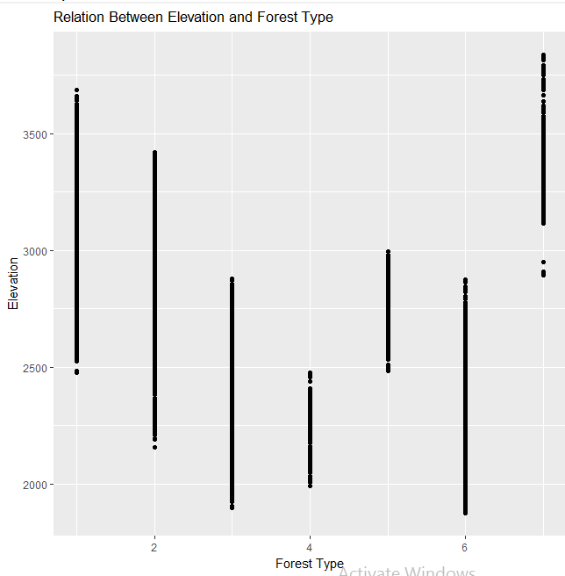
Relations

Slide 8
Relations

Slide 9
Classifiers
Preprocessing
Classifiers Explored
Logistic Regression
SVM
Decision Trees
Random Forest
K-NN
Naïve Bayes
Modelling
Evaluation

Slide 10
Classifiers
Classifiers Explored
Logistic Regression
SVM
Decision Trees
Random Forest
K-NN
Naïve Bayes
Sampled Data
Smote Data
PCA/MCA Data

Slide 11
Accuracy On Train & Test

Slide 12
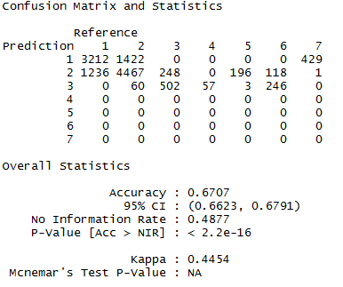
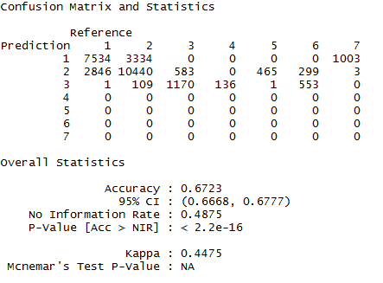
Decision Trees
Sensitivity for class 4 to 7 were zero .
Test & Train

Slide 13
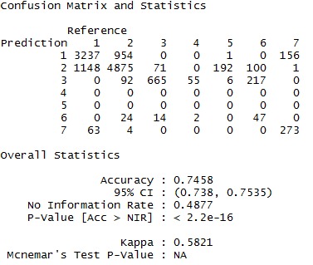
SVM
Applied linear, polynomial, RBF, tanhdot.
As the data was non linear the best results were coming for RBF kernel.
Applied hyper parameter (c, gamma) tuning for the SVM with kernel as RBF.

Slide 14
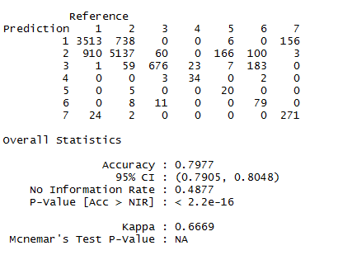
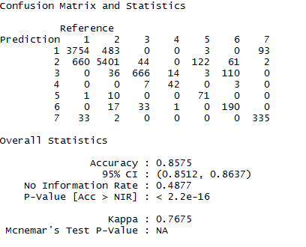
Random Forests
Applied hyper parameter tuning for Random Forests using random search.
Better results than Decision trees.
Tuned parameters are ntree(number of trees), mtry(number of features to be selected), nodesize (depth of the trees).
The best accuracy for ntrees =1000 ,mtry = 10

Slide 15
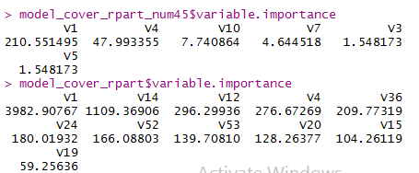
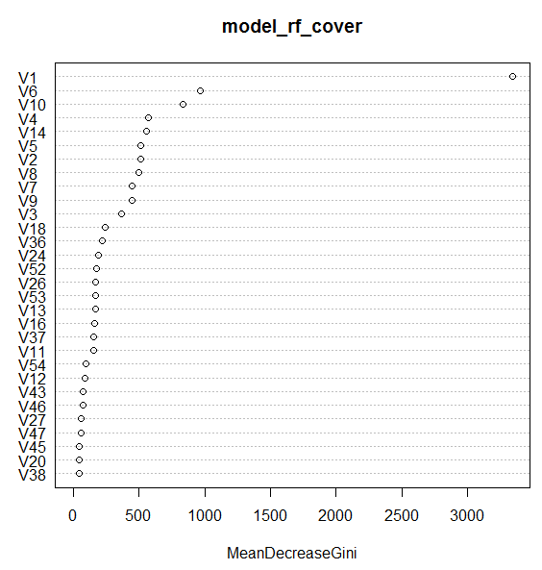


Variable Importance

Slide 16
Further Enhancements
Parameter tuning for Boosting for better accuracy.
We can also work on parts of data for better results.

Slide 17
Thank You

Slide 18
Model on Important Variables.

Slide 19
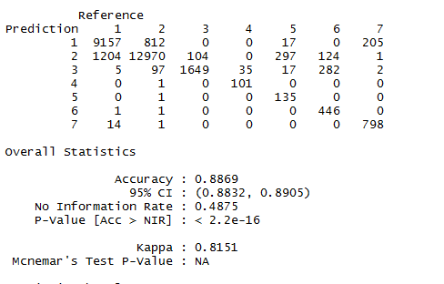
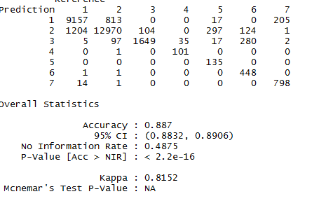
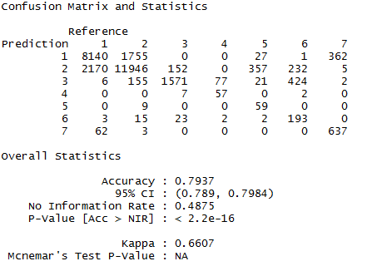
Random Forest On train

