Slide 1
C40 KPI slides
Business Planning and Reporting Team

Slide 2
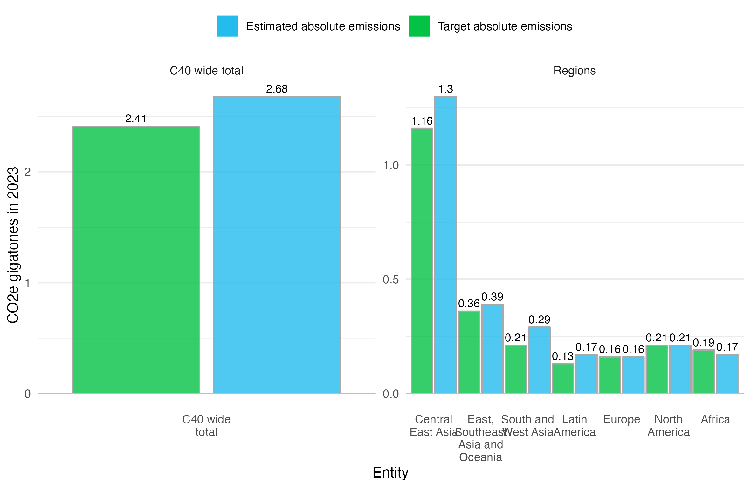
GHG total breakdown by region - GtCO₂e - Absolute: actual vs. target

Slide 3
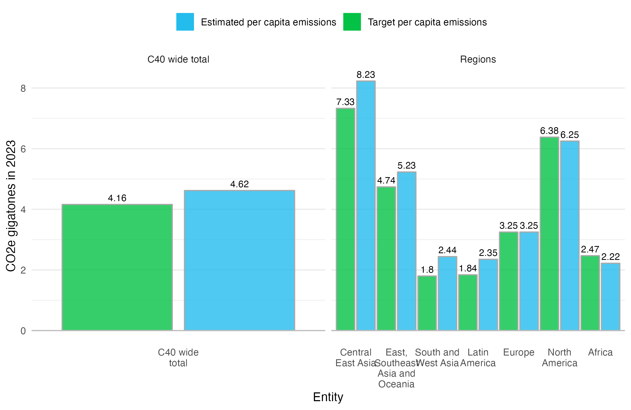
GHG total breakdown by region - GtCO₂e - Per capita: actual vs. target

Slide 4
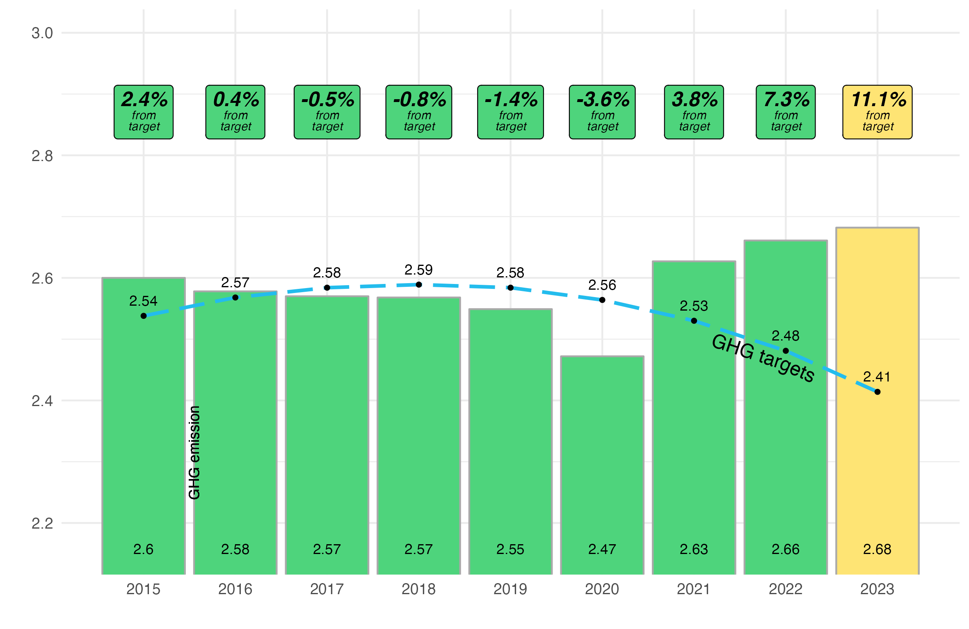
GHG historical by region - GtCO₂e - TOTAL

Slide 5
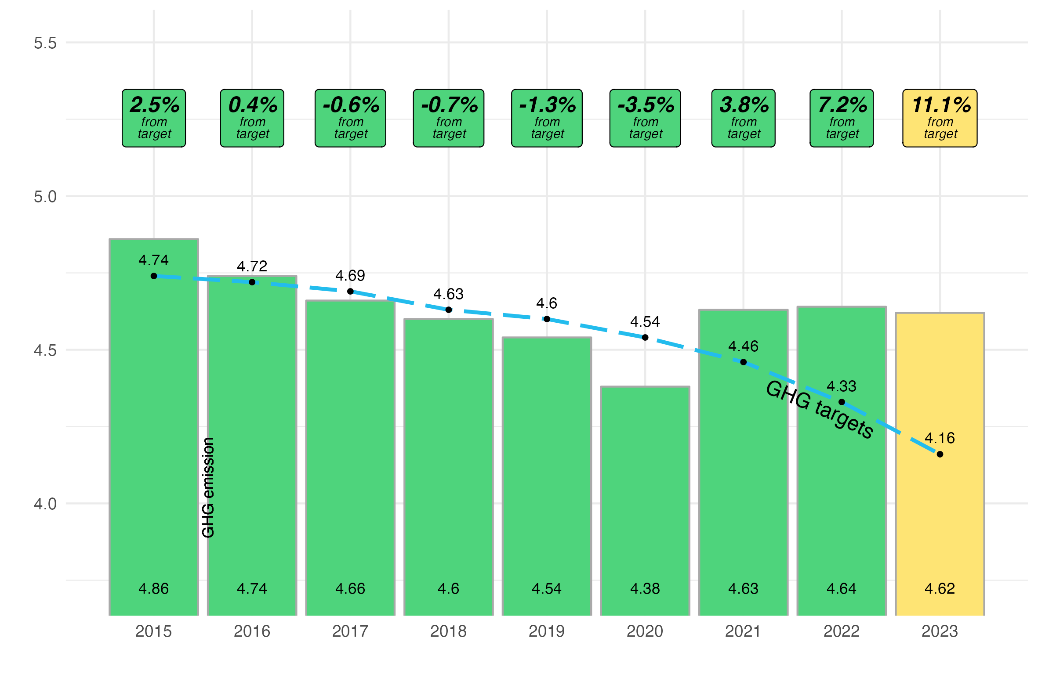
GHG historical by region - tCO₂e - PER CAPITA

Slide 6
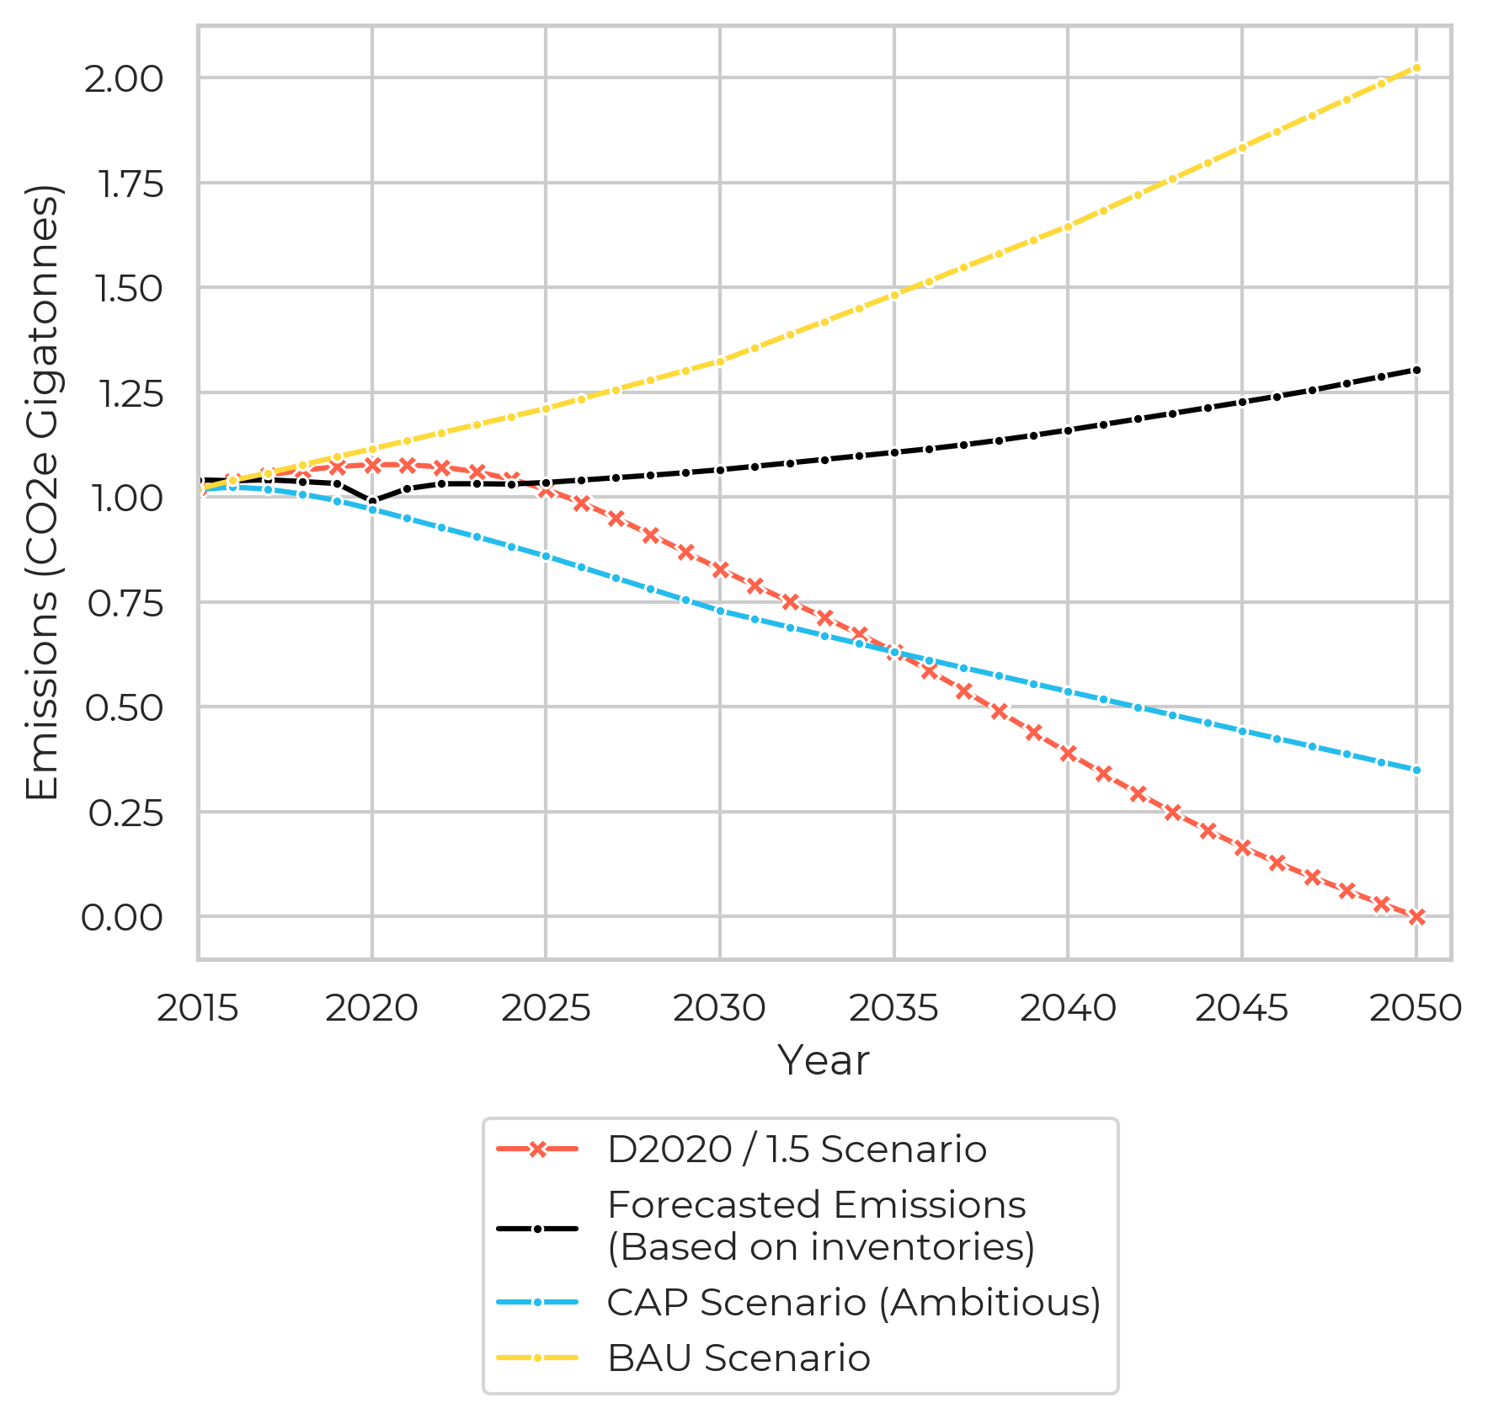
OVERALL GHG TREND

Slide 7
## Mode share

Slide 8
Electric chargers

Slide 9
HIAs

Slide 10
City vs national gov emission reduction

