Slide 1

DevOps Process for Thales
Building a pipeline for CI/CD with Jenkins and OpenShift

Slide 2
DevOps

Slide 3
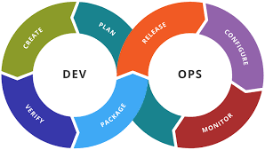
What is DevOps?
“DevOps is a set of practices that combines software development (Dev) and information-technology operations (Ops) which aims to shorten the systems development life cycle and provide continuous delivery with high software quality” [Wikipedia]
Agile methodologies are often part of DevOps
Continuous Integration (CI) and Continuous Delivery (CD) form part of it too
Automation is a key aspect of DevOps
DevOps is often referred to as a culture rather than a particular set of tools

Slide 4





Who does DevOps?
Some companies constantly update their code and it (pretty much) works as expected all of the time
Netflix is famous for releasing software many times in a day
Amazon releases software every few seconds
Uber pushes out releases several times a day
Perfect DevOps is software delivery at scale, with high quality, high velocity, and consistency

Slide 5
So how do they do it?
Deliver Software as Small Independently deployment batches (Microservices)
Using Containers (e.g. Openshift)
Automation
Environments (e.g. Terraform, Ansible, Openshift)
Builds (e.g. Jenkins)
Testing (e.g. Cucumber, JUnit, Selenium, Wiremock)
Propagation (migrating software between environments)
Monitor & Review Releases (e.g. Jaeger, Prometheus)
Continually Optimise Delivery Processes

Slide 6
How far can we go?
True DevOps is hard to achieve especially in disconnected environments
Automation is certainly possible however
Environments (e.g. Terraform, Ansible, Openshift)
Builds (e.g. Jenkins for CI/CD Pipelines)
Testing (e.g. Cucumber, JUnit, Selenium, Wiremock)
Rather than deploying to production tagging and pushing tested images to a registry should be possible
Incorporation of static analysis tools in the build pipeline should be possible
Automation of integration testing might be more difficult to achieve

Slide 7
Stack-in-a-Box

Slide 8
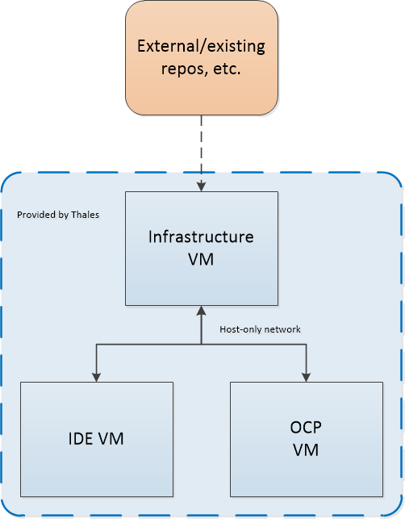
Thales Stack-in-a-Box project

Slide 9
Infrastructure VM
repo.thales.com 10.0.2.3
Red Hat repos
Required images
RHEL 7 VM
2Gb RAM
1 CPU
200Gb hard disk
NAT adapter for internet connection
Host only adapter for connection between VMs
Apache HTTP server
Other software

Slide 10
IDE VM
ide.thales.com 10.0.2.2
Git client
Maven client
RHEL 7 VM
8Gb RAM
1 CPU
20Gb hard disk
Host only adapter
devtoolset
Eclipse

Slide 11
Deployment VM
ocp.thales.com 10.0.2.1
Jenkins server container
Gitea
RHEL 7 VM
24Gb RAM
8 CPU
100Gb hard disk
Host only adapter
All-in-one OpenShift cluster
Sonatype Nexus
Sonarqube server containers
Kafka cluster

Slide 12
Continuous Delivery

Slide 13

CI / CD pipelines using Jenkins
Continuous Integration / Continuous Delivery
Jenkins will build projects based on a Pipeline
The Pipeline is contained in a Jenkinsfile
The Jenkinsfile is checked in alongside code
The Jenkinsfile uses Groovy syntax to define a set of build steps
Automating build and testing steps is key to eliminating human error and preventing outages

Slide 14
Jenkinsfile
pipeline {
agent {
any {}
}
stages {
stage(‘build')
{
steps
{
echo 'building...'
sh “mvn install -DskipTests”
}
}
}

Slide 15





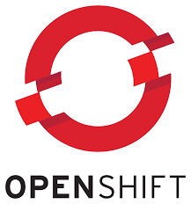
Example project
devops-example
Demonstrates a java spring boot project that sends messages to a Kafka cluster
Included with the Stack-in-a-Box product
Uses a Maven build strategy
Hosted in Gitea SCM tool
Includes a Jenkins pipeline to demonstrate automated build

Slide 16


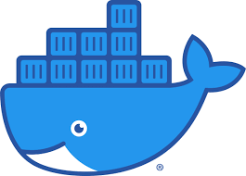
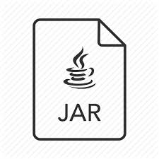
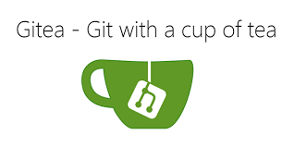

Jenkins Pipeline in devops-example
Checkout
Run automated tests
Sonarqube analysis
Compile
Create build config
Build s2i
Create deployment config
Tag new image
Rollout deployment

Slide 17

Demonstration
The IDE VM
Eclipse development – Spring Boot
Jenkinsfile
The OCP VM
OpenShift console
Jenkins
Gitea
Sonarqube
Checkout
Run automated tests
Sonarqube analysis
Compile
Create build config
Build s2i
Create deployment config
Tag new image
Rollout deployment

Slide 18


Enhancements to Jenkins Pipeline
Checkout
Run automated tests
Sonarqube analysis
Compile
Create build config
Build s2i
Create deployment config
Tag new image
Rollout deployment
Vulnerability scan
Integration testing

