Slide 1


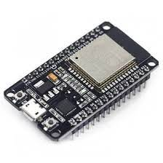

Slide 2
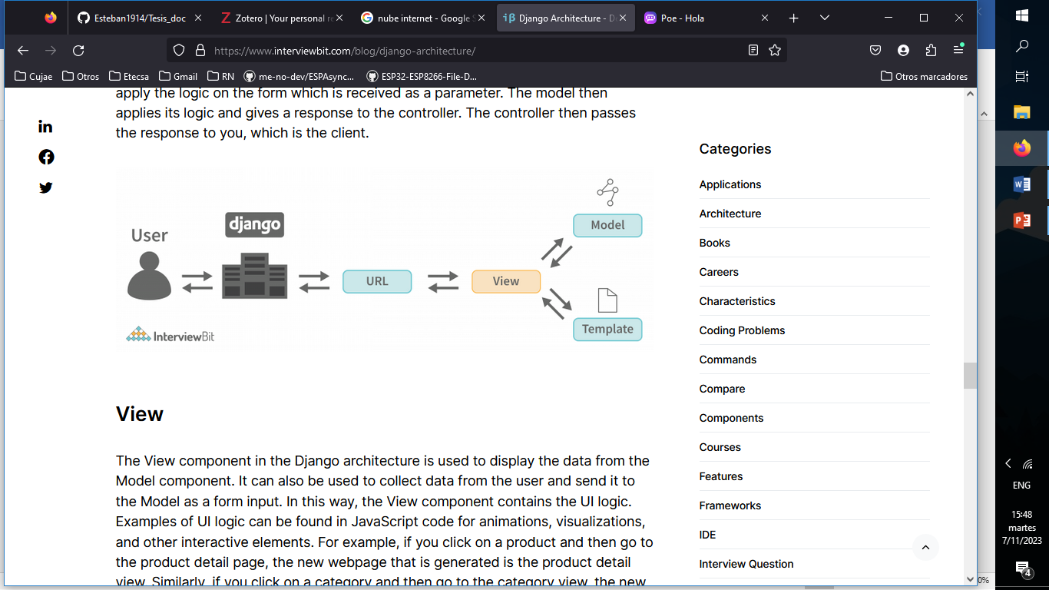

Slide 3
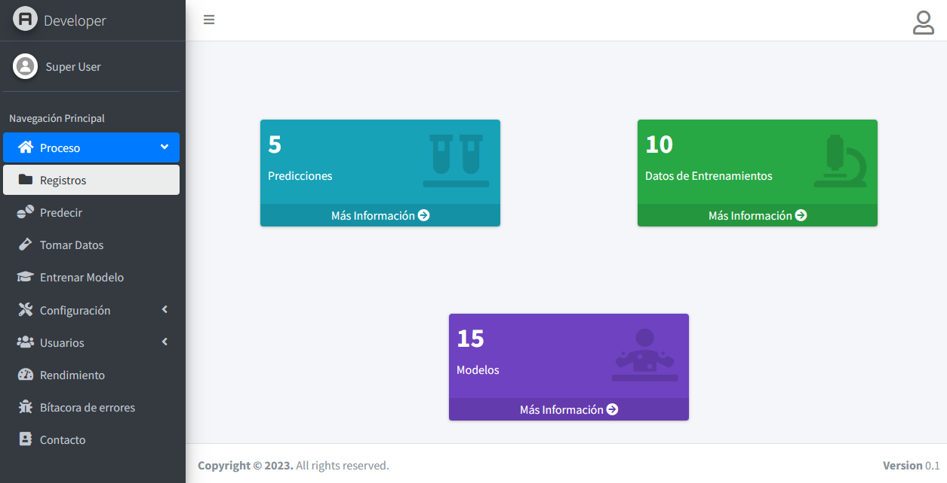

Slide 4
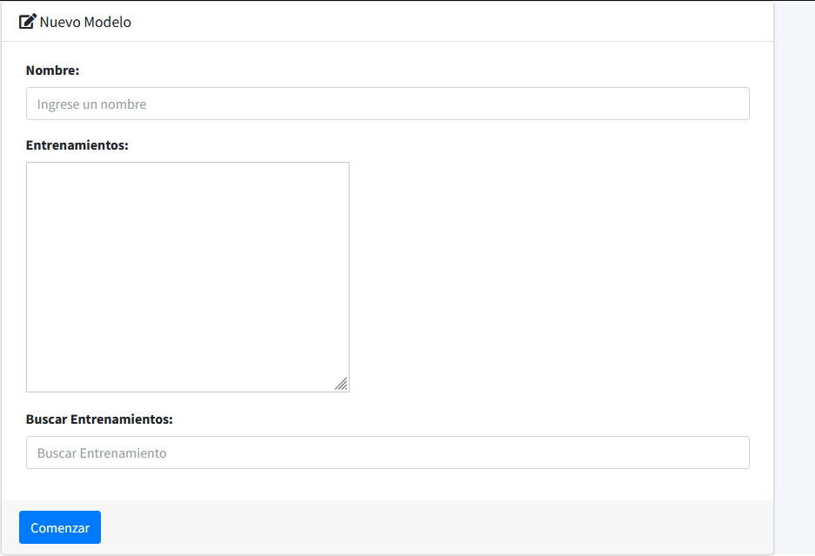
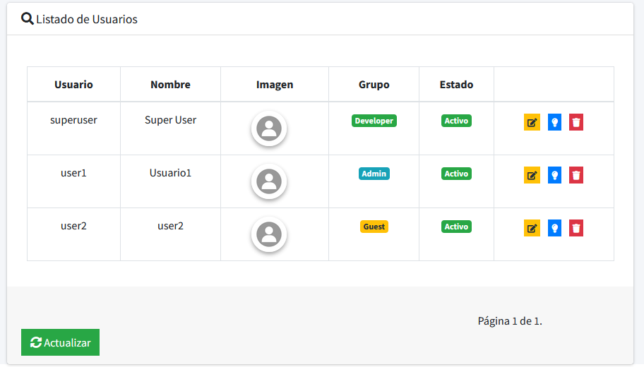
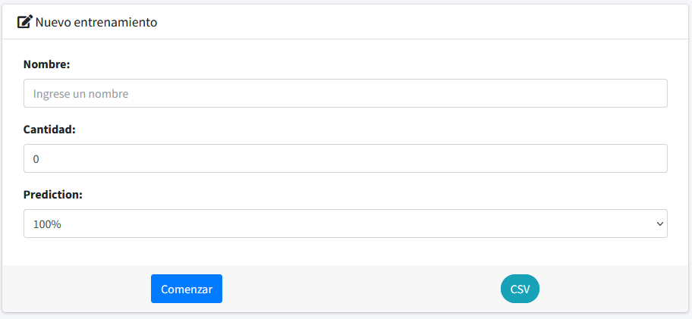
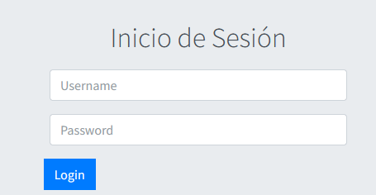

Slide 5








Predicciones
Registros
Muestras
Rendimiento
Modelos
Bitácora
Predecir
Login
Proceso
Tomar Datos
Usuarios
Entrenar
Configuración
Fecha y Hora
Red

Slide 6
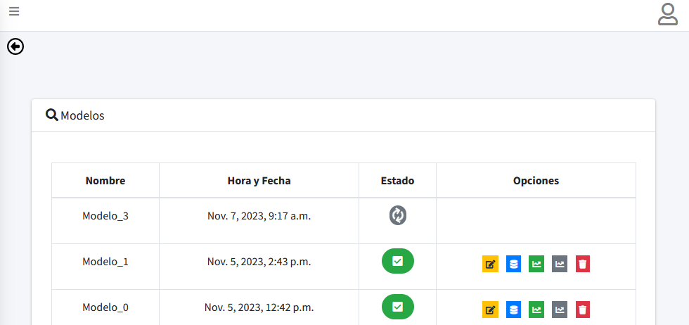

Slide 7
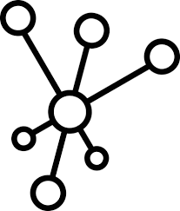





Datos Entrenamiento
Modelo
Data
Muestra
Longitud
Onda
18

Slide 8
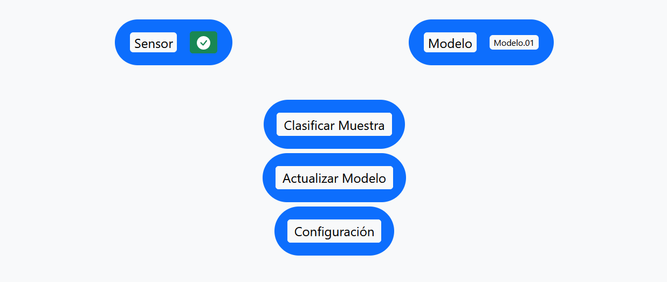
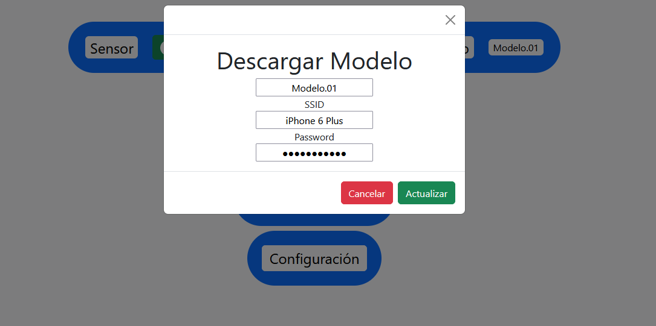
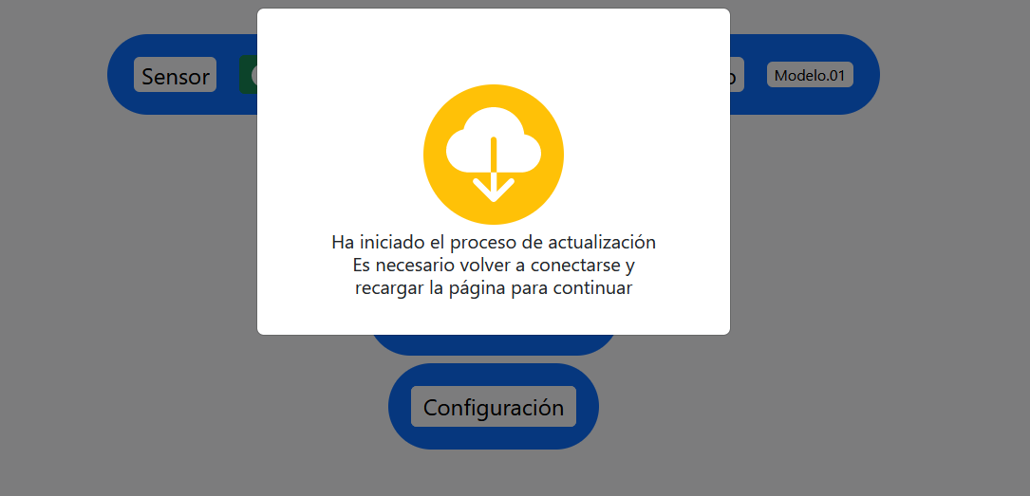
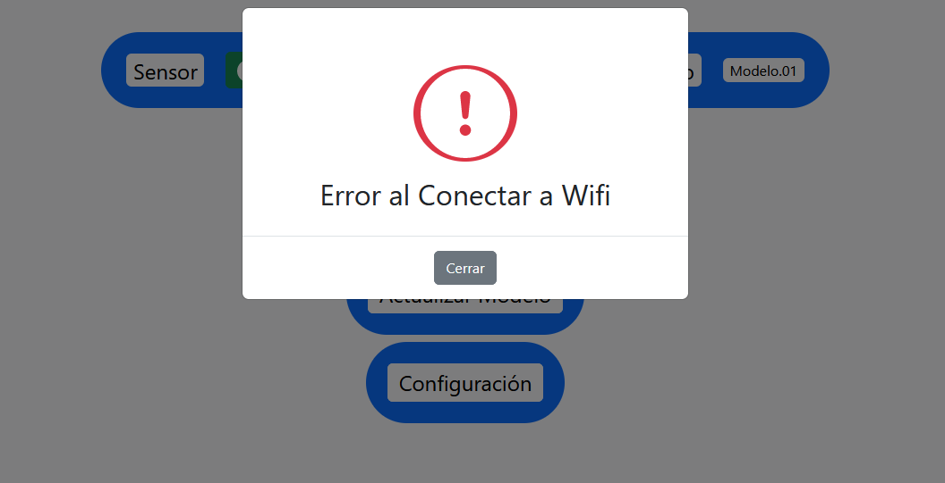

Slide 9
Setup
Loop
Web
No
Bandera
Predicción
Inicializar Variables
Si
Conectar Wifi
Nuevo Modelo
Leer Sensor
Descargar Modelo
No
Si
Cargar modelo
Cargar y Guardar modelo
Calculo Red
Almacenar Modelo
Verificar Errores
Mostrar Resultado
Reiniciar ESP32

Slide 10
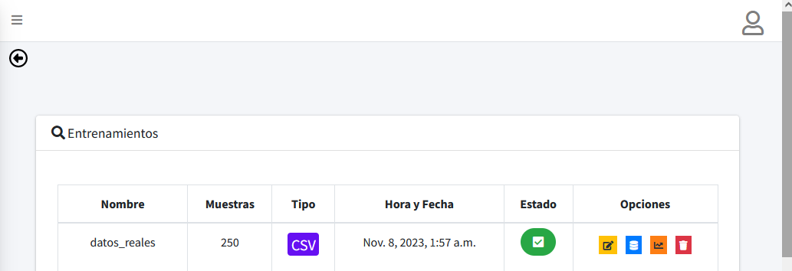

Slide 11
Trial 5 Complete [00h 00m 14s]
val_accuracy: 0.8599999845027924
Best val_accuracy So Far: 0.9900000095367432
Total elapsed time: 00h 01m 05s
Hyperband
{'units_0': 288, 'activation': 'tanh', 'dropout': False, 'learning_rate': 0.01, 'tuner/epochs': 50, 'tuner/initial_epoch': 17, 'tuner/bracket': 3, 'tuner/round': 3, 'tuner/trial_id': '0046'}
Model: "sequential_1"
_________________________________________________________________
Layer (type) Output Shape Param #
=================================================================
dense_2 (Dense) (None, 288) 5472
dense_3 (Dense) (None, 5) 1445
=================================================================
Total params: 6917 (27.02 KB)
Trainable params: 6917 (27.02 KB)
Non-trainable params: 0 (0.00 Byte)
_________________________________________________________________
RandomSearch
{'units_0': 224, 'activation': 'relu', 'dropout': False, 'learning_rate': 0.01}
Model: "sequential_2"
_________________________________________________________________
Layer (type) Output Shape Param #
=================================================================
dense_4 (Dense) (None, 224) 4256
dense_5 (Dense) (None, 5) 1125
=================================================================
Total params: 5381 (21.02 KB)
Trainable params: 5381 (21.02 KB)
Non-trainable params: 0 (0.00 Byte)

Slide 12
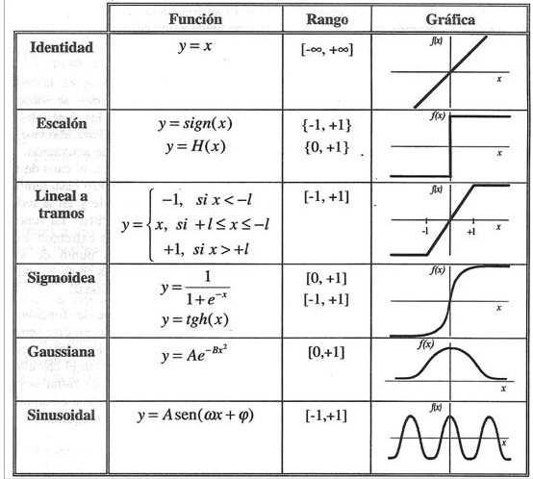
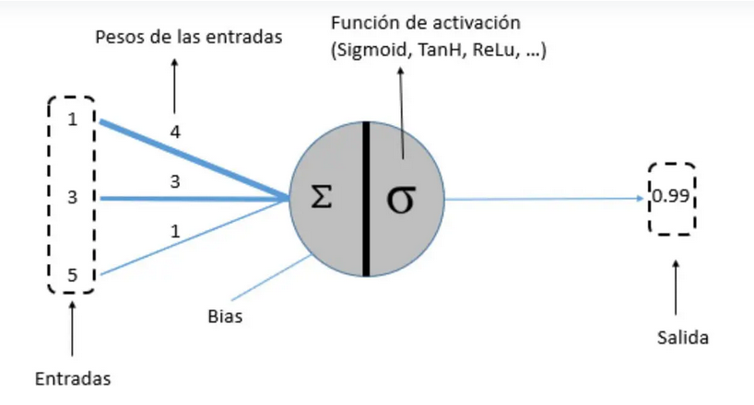
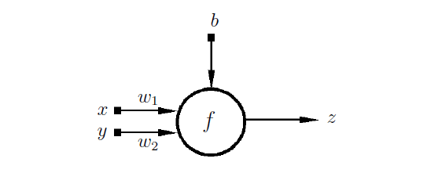
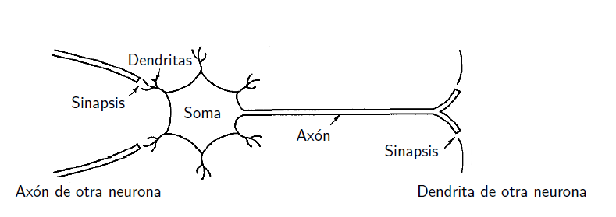

Slide 13
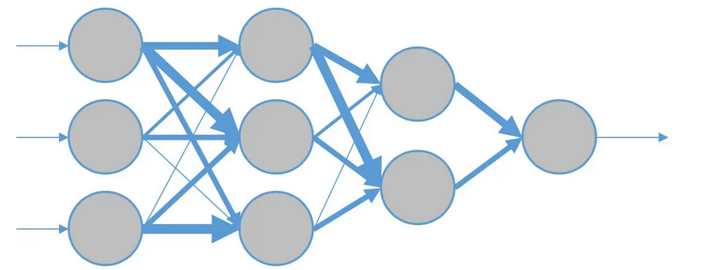
Entradas
Salida

Slide 14
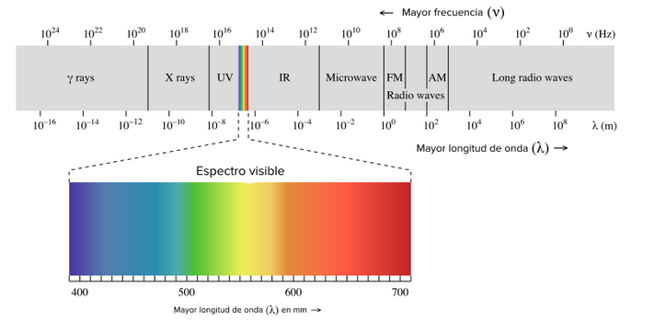

Slide 15
