Slide 1
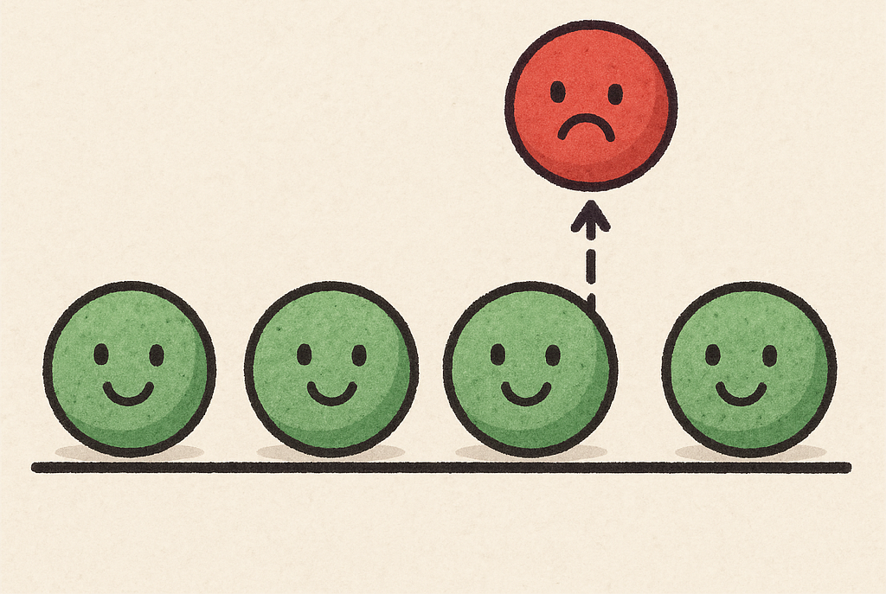
Intelligent Systems
Anomalies Antonio Bahamonde
Departamento de informática

Slide 2

Andrew Ng. Stanford University

Slide 3
Contents
What is an Anomaly?
Definition
Applications
Evaluation
Gaussian Detection Algorithms
Other Methods
Images
Conclusions

Slide 4
Definition anomaly
An anomaly (or outlier) is an observation that significantly deviates from the general pattern of the data.
A data point that is generated by a different process than the one generating the "nominal" points. Also called abnormalities, deviants, or outliers.
The goal of anomaly detection (also known as outlier detection) is to identify all such instances.
Anomalies can be caused by errors in the data but sometimes indicate a new, previously unknown, underlying process (different mechanism).
Notes:
El concurso se convocó con el reto de aprender de un conjunto de datos con estas características.

Slide 5

Types of Anomalies
One-off: A single piece of data that deviates significantly from the rest. For example, a credit card transaction with a very high value.
Contextual: A data that is anomalous in a specific context, but not in another. For example, a temperature of 30°C in winter in Oviedo.
Collective: A group of data that, although in themselves are not anomalous, their joint occurrence is. For example, an unusual sequence of requests to a server.

Slide 6
Applications
Fraud Detection: Unusual transaction patterns.
Cybersecurity: Detection of intrusions and anomalous behavior in networks.
Predictive Maintenance: Identification of anomalous sensor readings that indicate possible failures.
Data Quality: Identification of errors or inconsistencies in data sets.
Time Series Anomaly Detection: Unusual temporal patterns.

Slide 7
Applications
Data cleaning
Novel categories
Agriculture
Fraud Detection
Cyber-Intrusion attacks Detection; Log-Anomaly Detection
Medical Anomaly Detection; Novel diseases
Sensor Networks Anomaly Detection
Internet Of Things (IoT) Big-data Anomaly Detection
Video Surveillance
Industrial Damage Detection

Slide 8
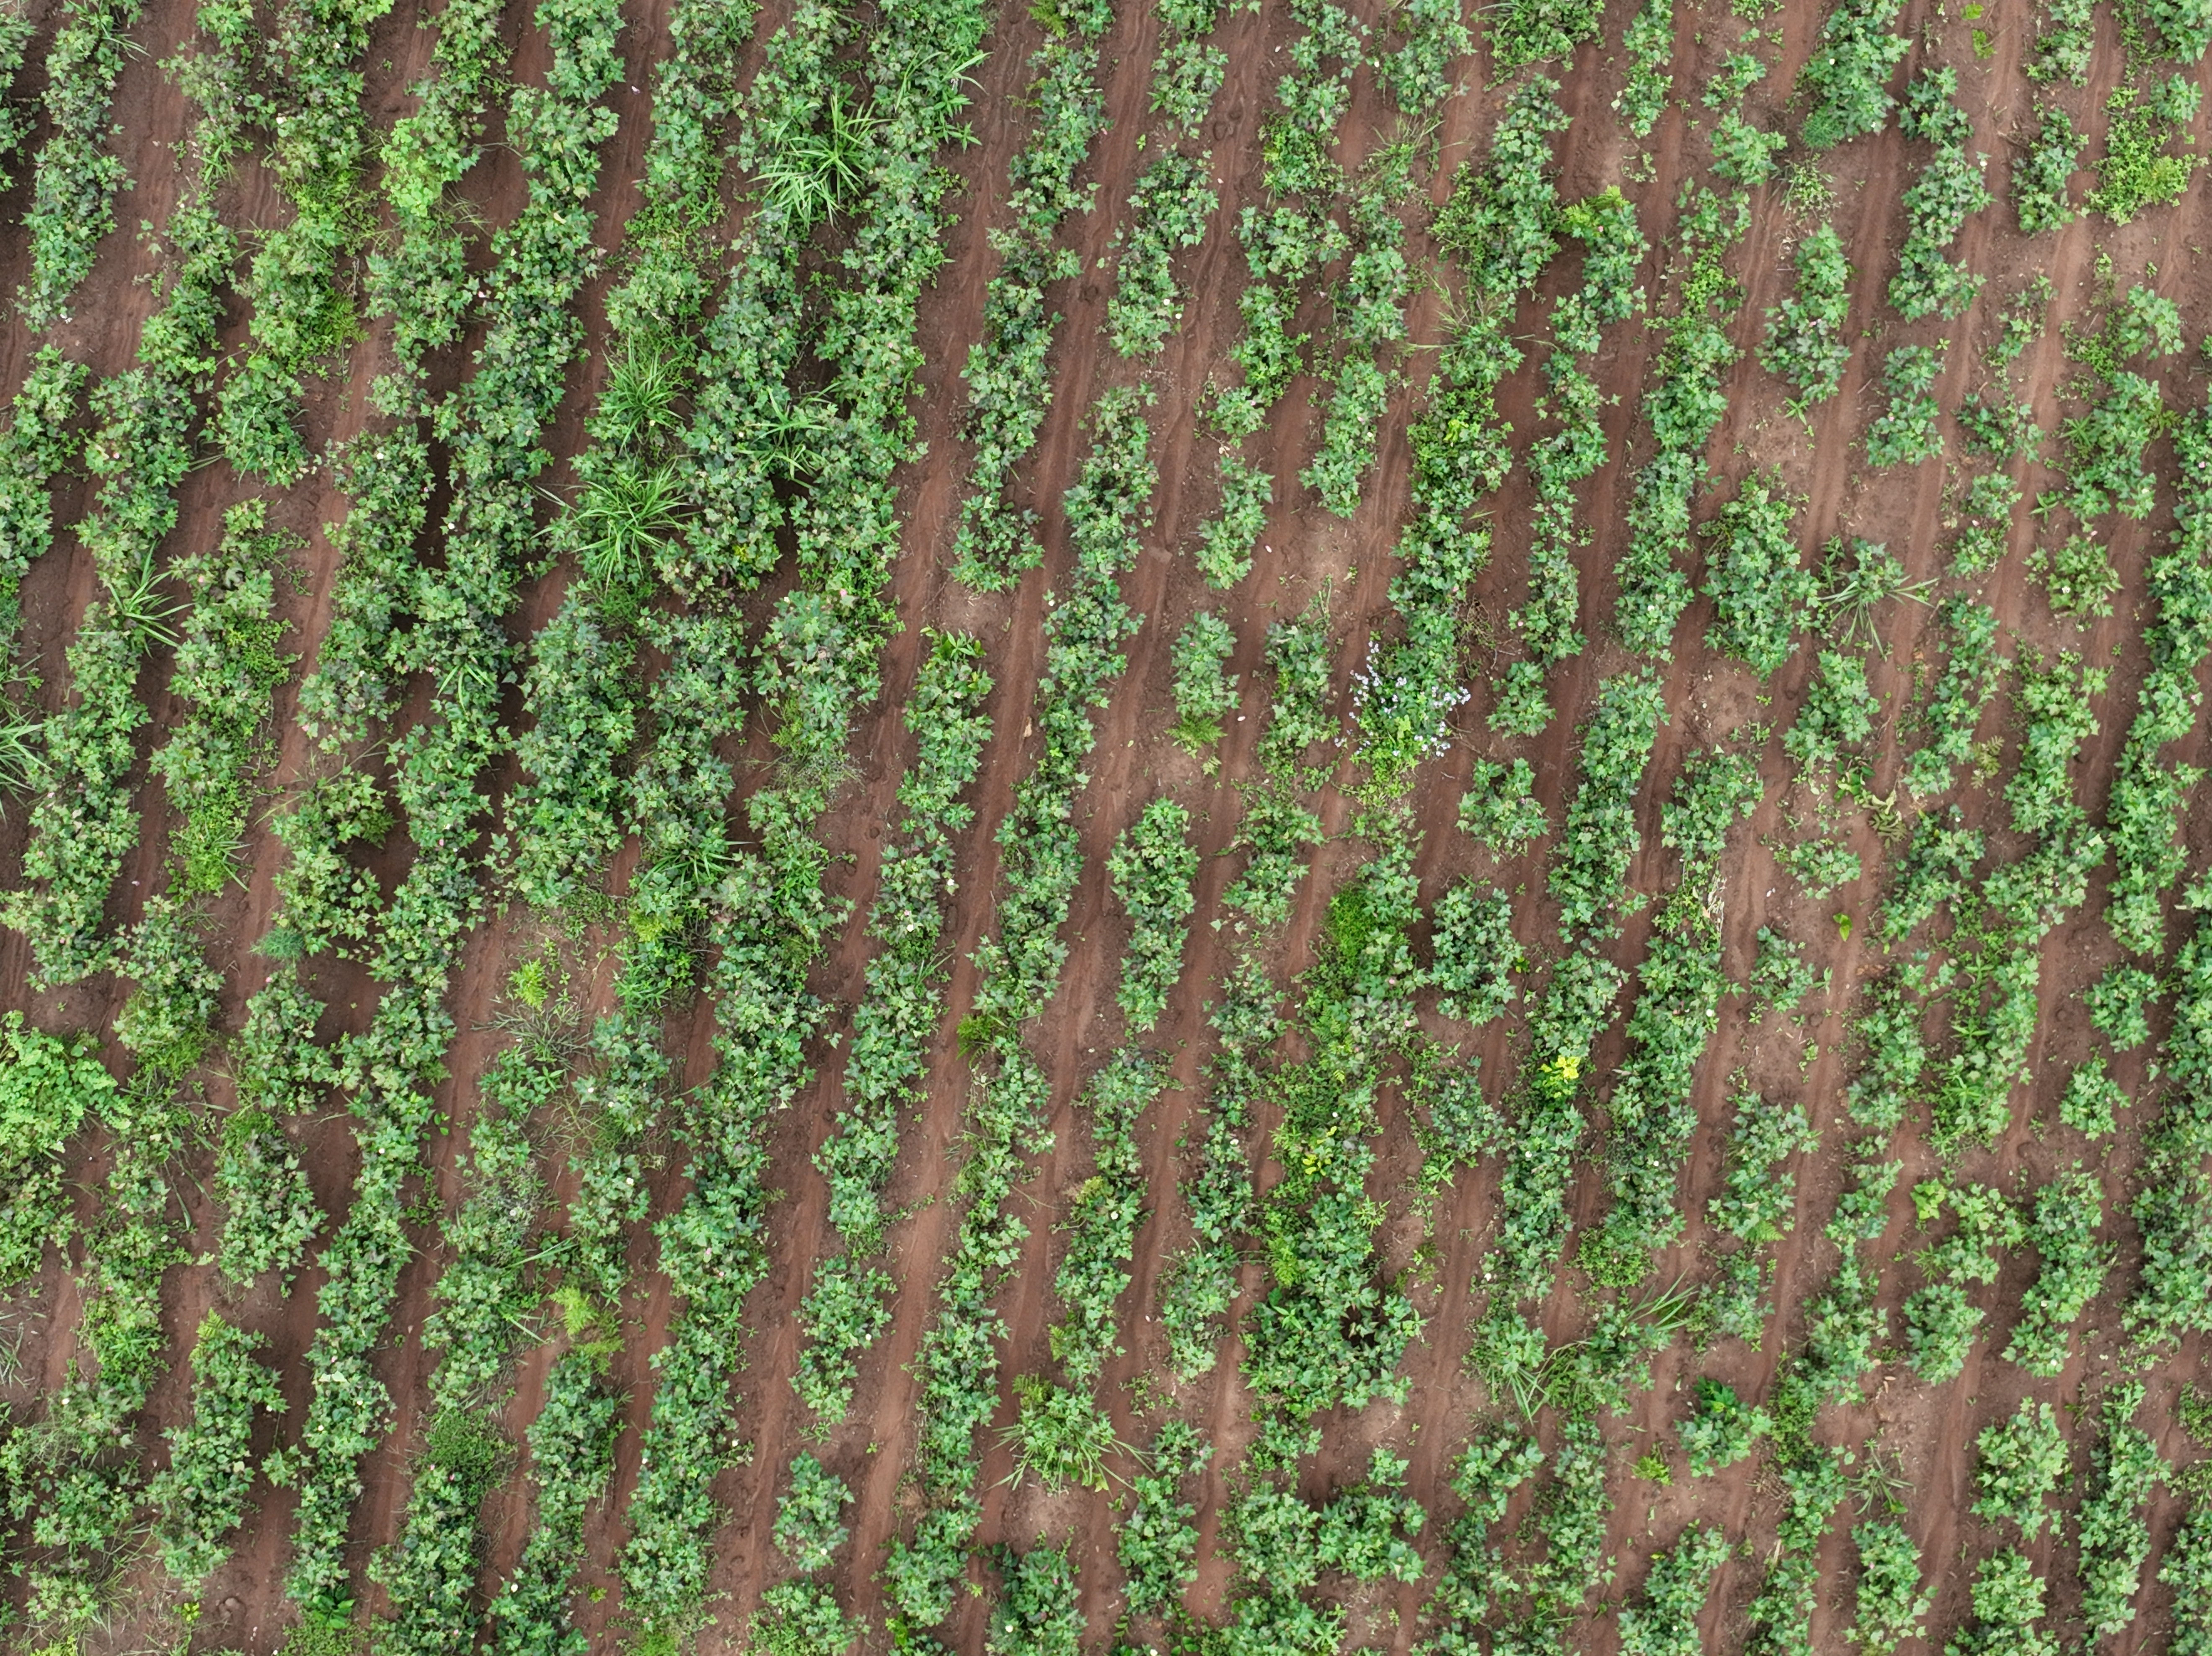
Agriculture

Slide 9
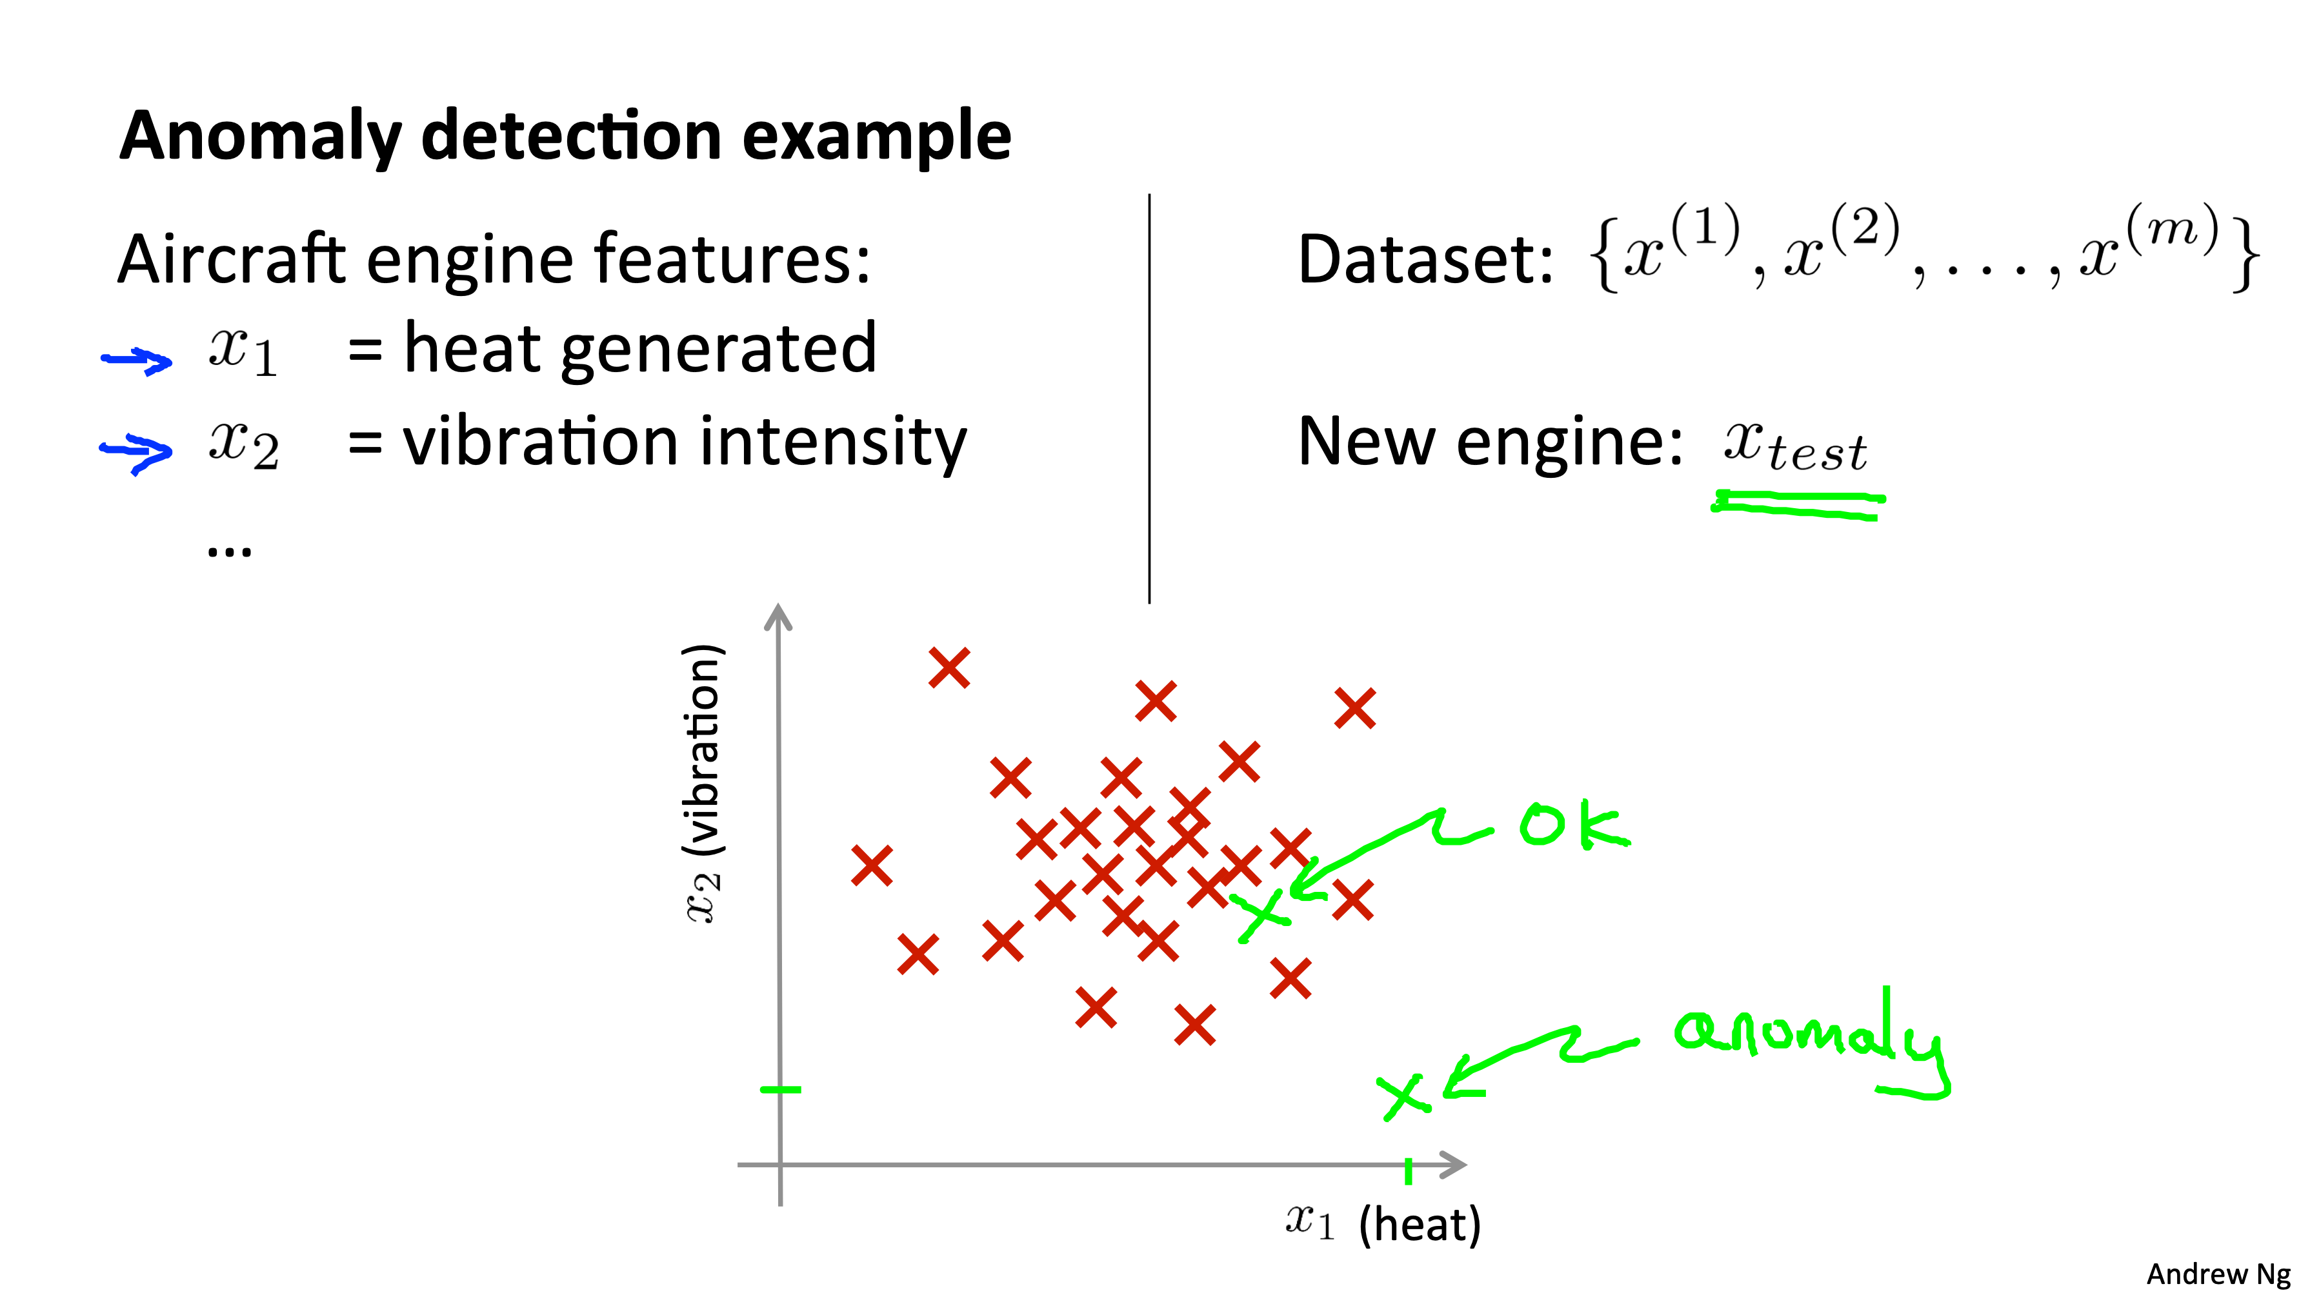

Slide 10
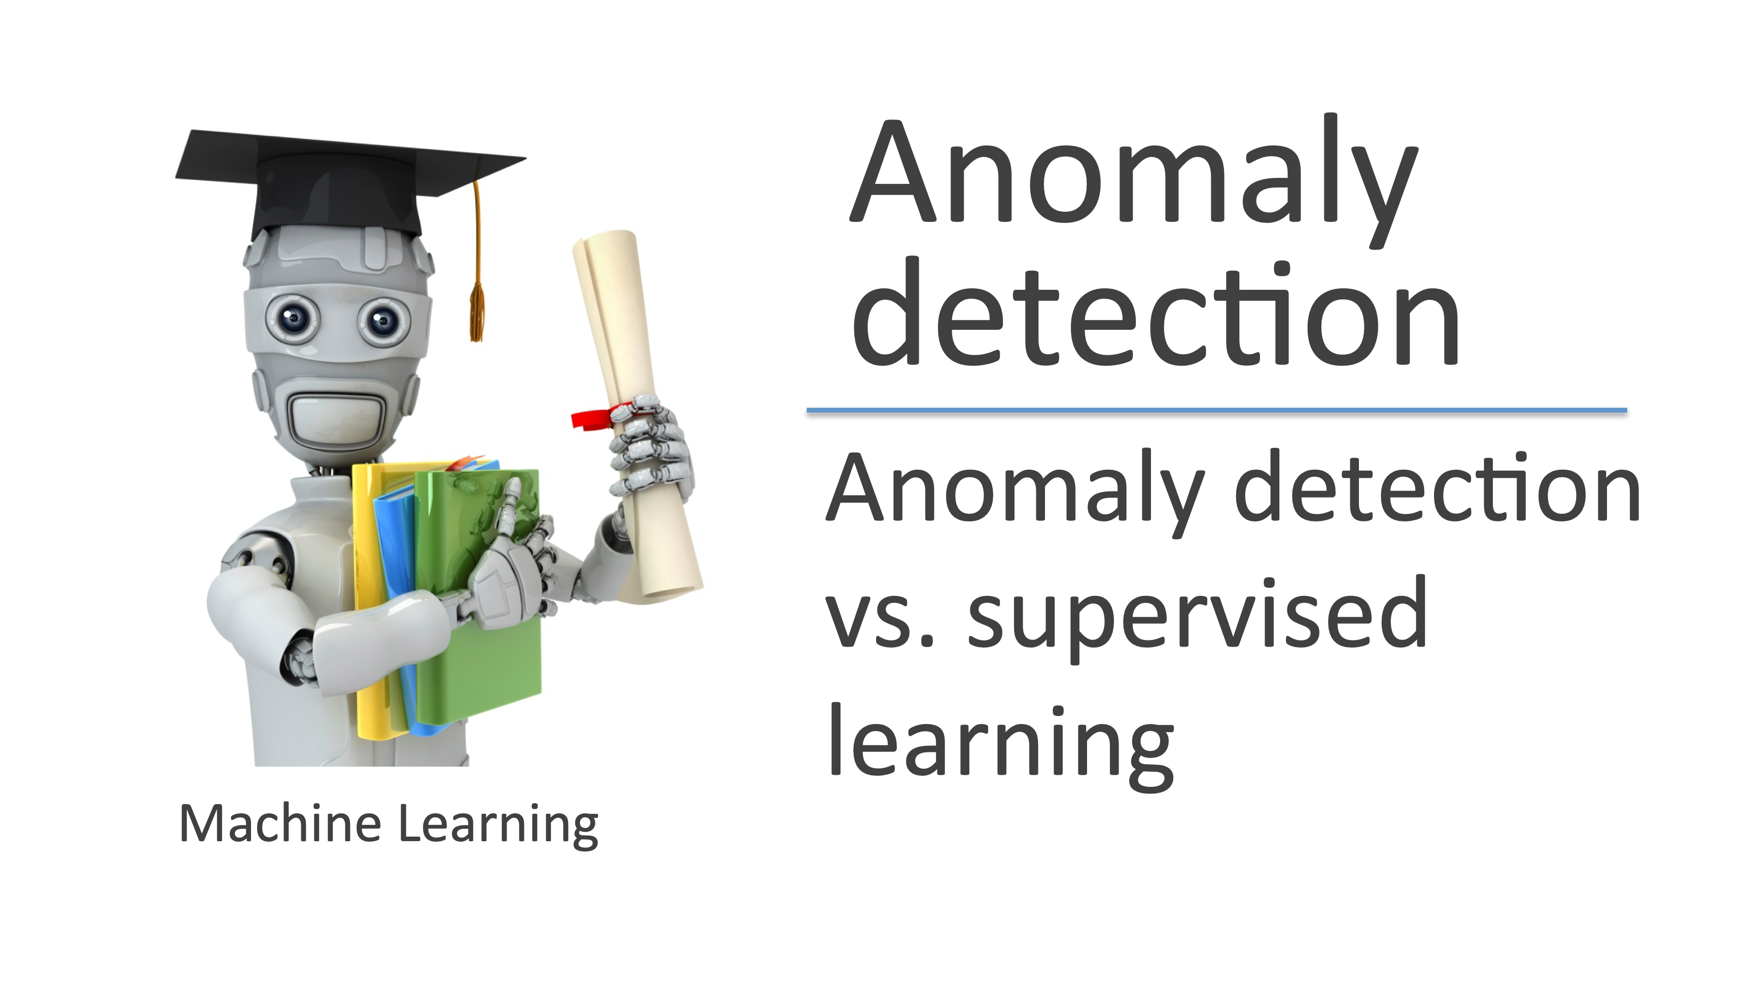

Slide 11
Challenges
Little or no labeled data
Anomalies are rare
Anomalies may not come from a well-defined probability distribution (especially in adversarial settings)
Nuisance Novelty: Not all anomalies are relevant to the task or use-case
Changes in image background or context

Slide 12
Anomaly Detection Challenges
Subjective definition of "normality".
Unbalanced data (scarcity of anomalous examples).
Noise in the data that can be mistaken for anomalies.
Evolution of anomalies over time.

Slide 13
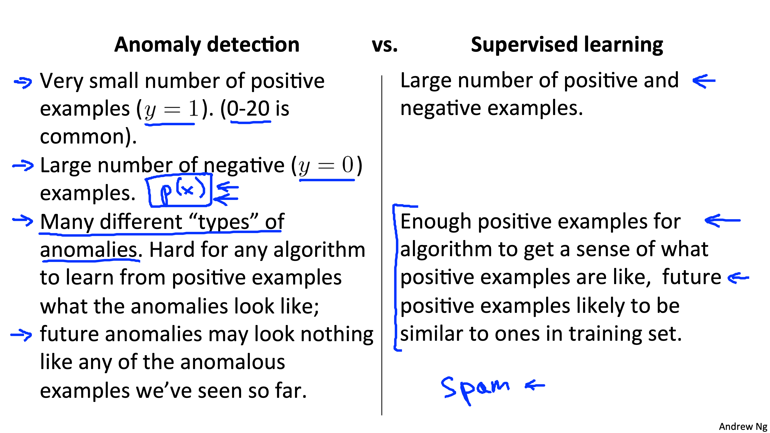

Slide 14
Evaluation
Possible evaluation metrics:
True positive, false positive, false negative, true positive
Precision/Recall
F1-­‐score

Slide 15

Gaussian

Slide 16
1 dimension
Z-score: Detects values that deviate from the mean by more than a certain number of standard deviations. Assumes normal distribution.

Slide 17
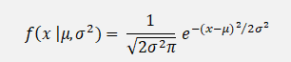
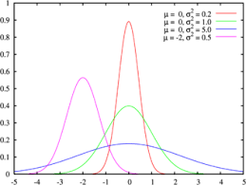
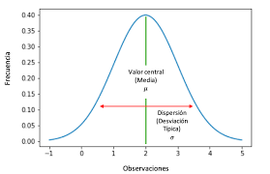
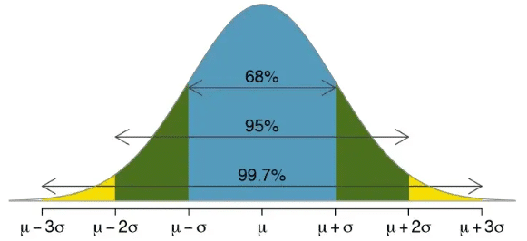
Gaussian distribution

Slide 18
Short table
P(|x| > z) = probability queues
Z | Probability of queues
2.576 | 1 %
2.24 | 2.5%
1.96 | 5 %
1.64 | 10 %

Slide 19
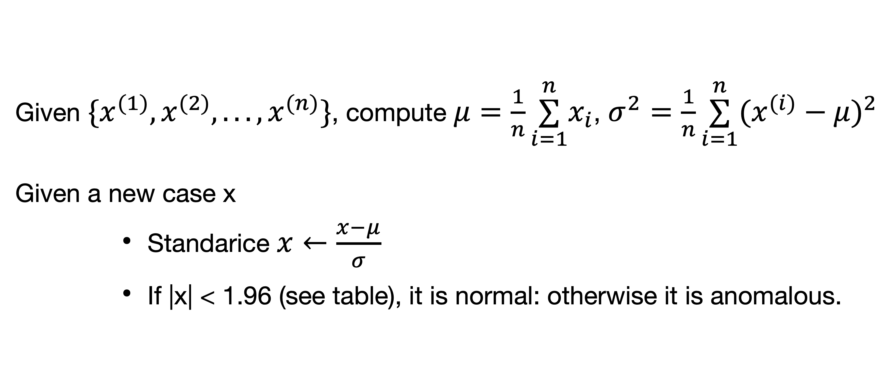
Algorithm 1-dim
Given $\{x^{(1)},x^{(2)},...,x^{(n)}\}$, compute $μ=\frac{1}{n}\overset{n}{\underset{i=1}{∑}}x_{i}$, $σ^{2}=\frac{1}{n}\overset{n}{\underset{i=1}{∑}}(x^{(i)}−μ)^{2}$
Given a new case x
Standarice $x←\frac{x−μ}{σ}$
If |x| < 1.96 (see table), it is normal: otherwise it is anomalous.

Slide 20
Observations Gaussian rule
Advantages: Simplicity and speed.
Disadvantages: Assumption of normality, sensitivity to outliers in calculations.

Slide 21
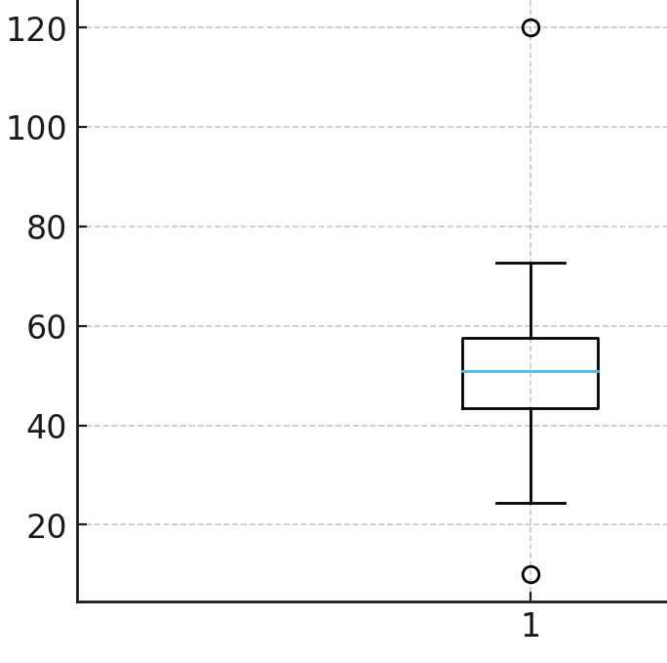
Inter-quartile range method (IQR)
Calculation of the first quartile (Q1), the third quartile (Q3) and the IQR = (Q3 - Q1).
Definition of limits. Outliers are points outside the interval
[Q1 - 1.5 *IQR, Q3 + 1.5 *IQR].
Advantage: Does not assume a normal distribution, more robust to outliers than mean and standard deviation.
Disadvantage: 1.5 *IQR?

Slide 22
Gaussian m-dimension

Slide 23

Density estimation
Given $\{x^{(1)},x^{(2)},...,x^{(n)}\}$, each $x∈ℝ^{m}$
$$x_{i}∼𝒩(μ_{i},σ_{i}),i=1,...,m$$
$$p(x)=p(x_{1};μ_{1},σ_{1})∗...∗p(x_{m};μ_{m},σ_{m})=\underset{i}{∏}p(x_{i};μ_{i},σ_{i})$$

Slide 24
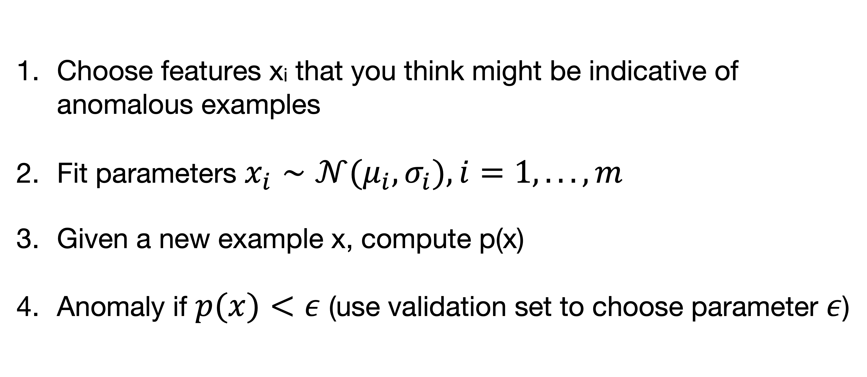
Anomaly detection algorithm
Choose features xi that you think might be indicative of anomalous examples
Fit parameters $x_{i}∼𝒩(μ_{i},σ_{i}),i=1,...,m$
Given a new example x, compute p(x)
Anomaly if $p(x)<ε$ (use validation set to choose parameter $ε$)

Slide 25
Alternative
Standardize all components
Determine, using the basic 1-dimensional algorithm, whether each component is anomalous or not
Compare the obtained results with reality

Slide 26
Limits
Non-Gaussian Components
Relationships Between Components

Slide 27
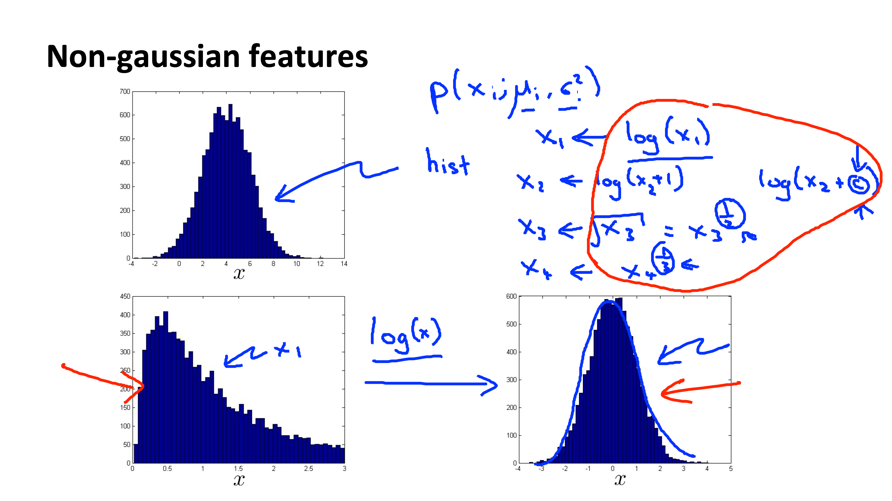

Slide 28
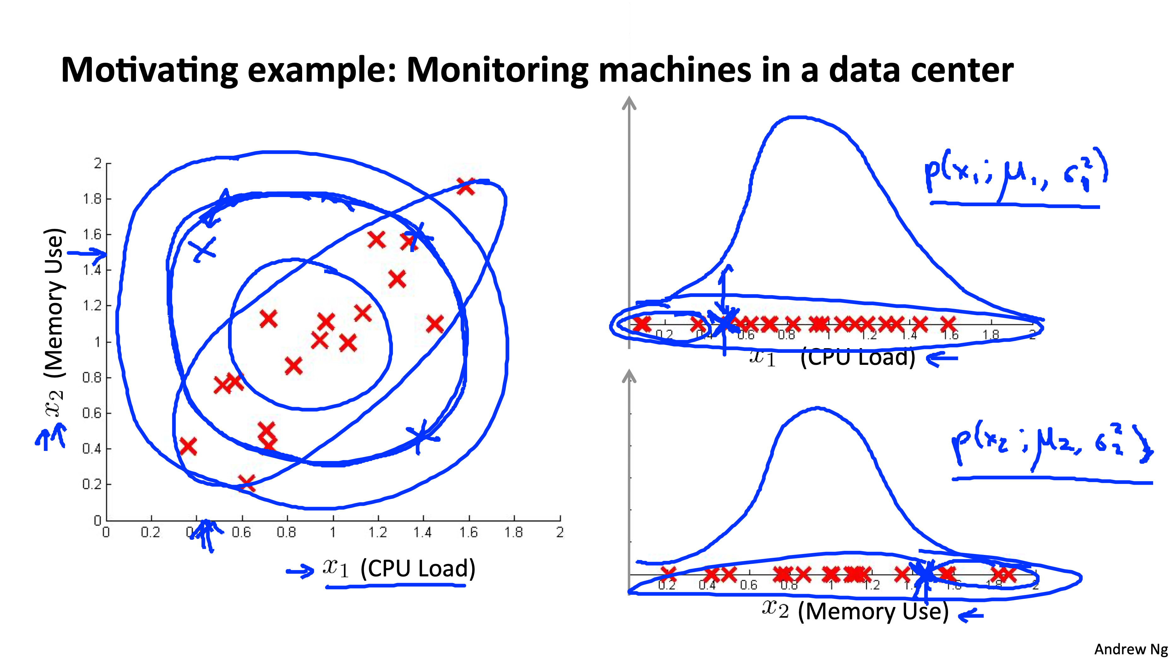

Slide 29
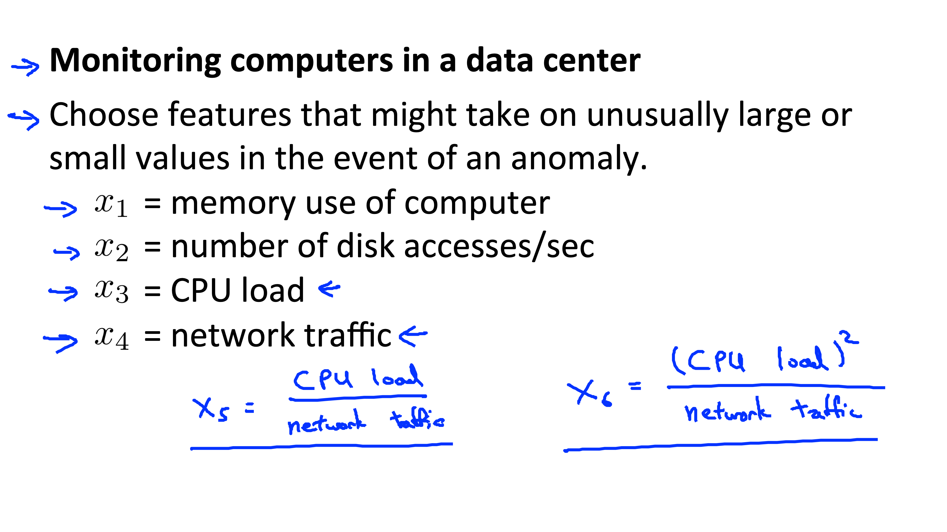

Slide 30
Other algorithms

Slide 31
Local Outlier Factor (LOF)
Other methods seek global outliers, LOF detects anomalous points with respect to its local neighborhood
Idea: Compare the local density of a point with that of its neighbors.
Anomalies have a significantly lower density.
Concept of reachability and local outlier factor.
Advantages: Can detect anomalies with different densities, does not assume a global distribution.
Disadvantages, parameters, complexity

Slide 32
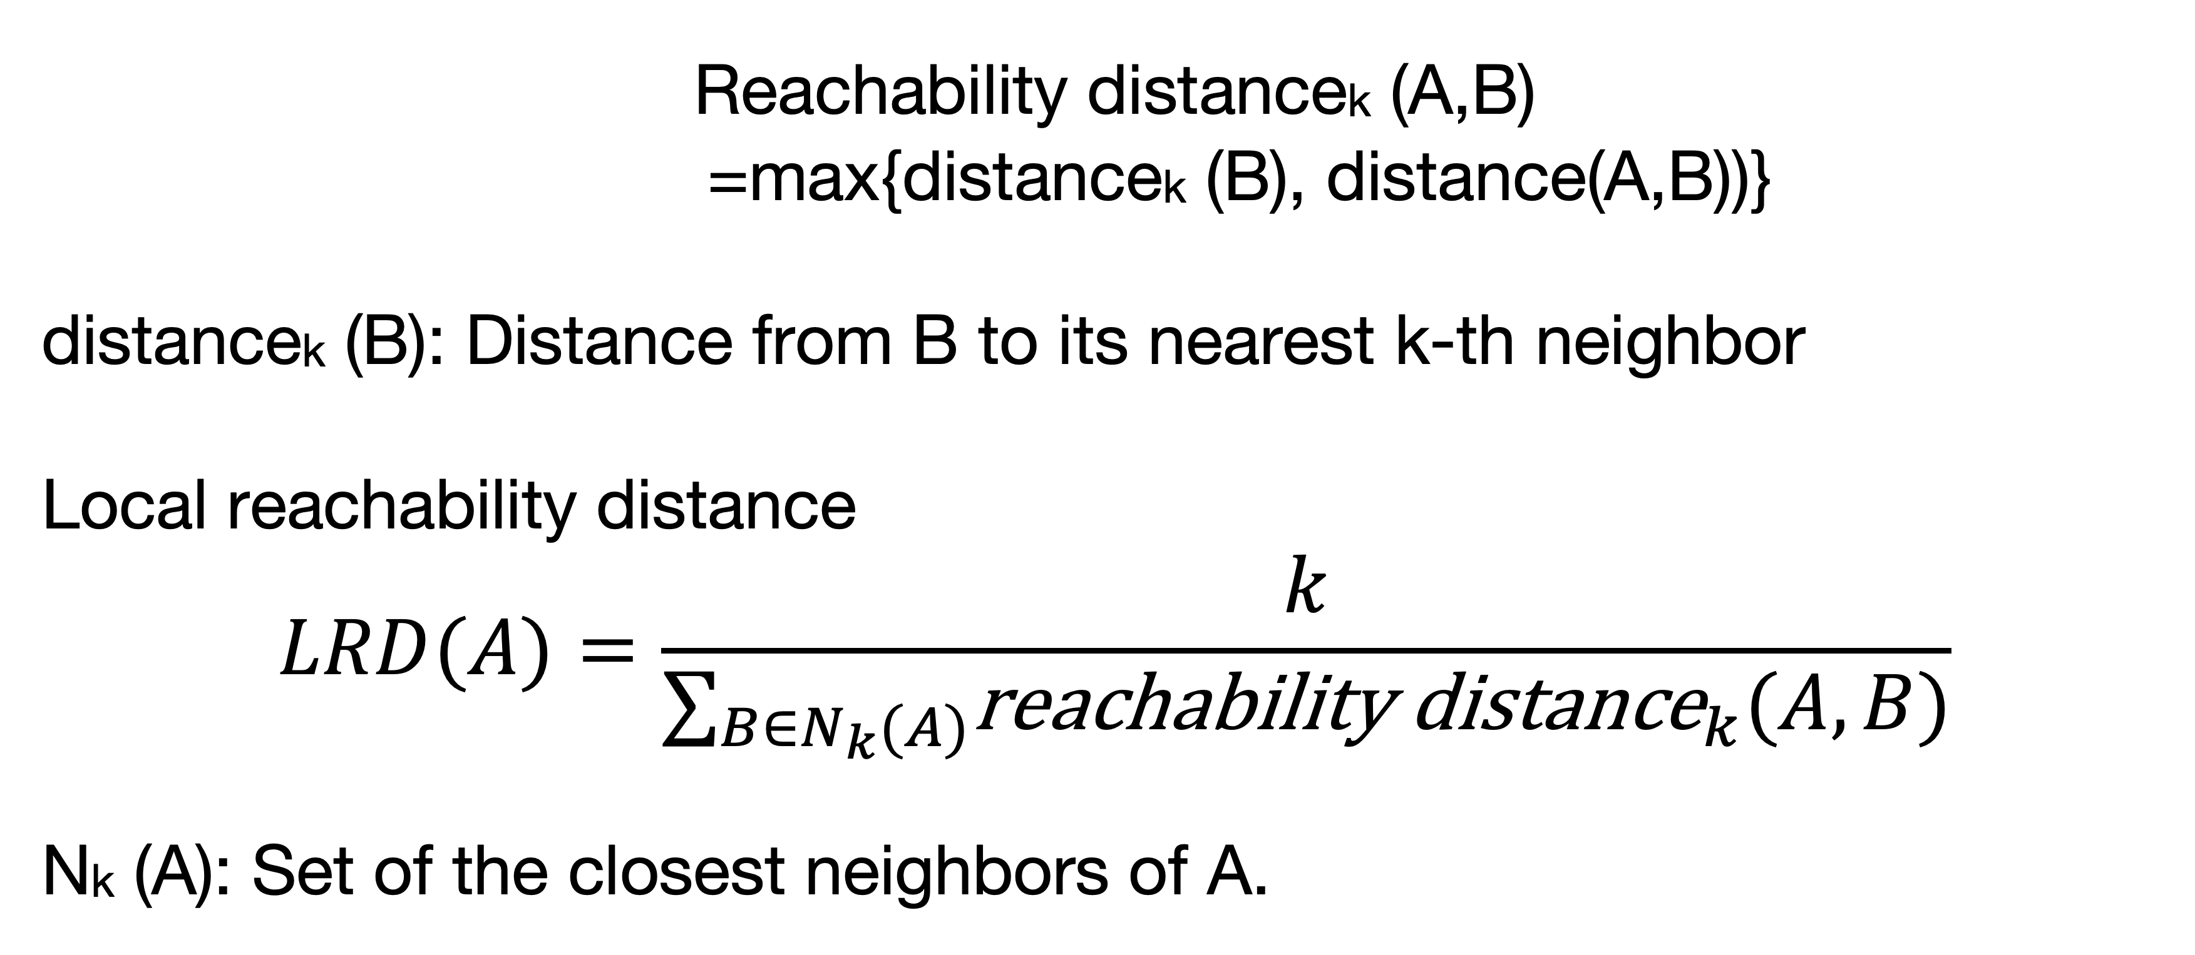
Local Outlier Factor (LOF)
Reachability distancek (A,B)
=max{distancek (B), distance(A,B))}
distancek (B): Distance from B to its nearest k-th neighbor
Local reachability distance
$$LRD(A)=\frac{k}{∑_{B∈N_{k}(A)}{\text{reachability} \text{distance}}_{k}(A,B)}$$
Nk (A): Set of the closest neighbors of A.

Slide 33
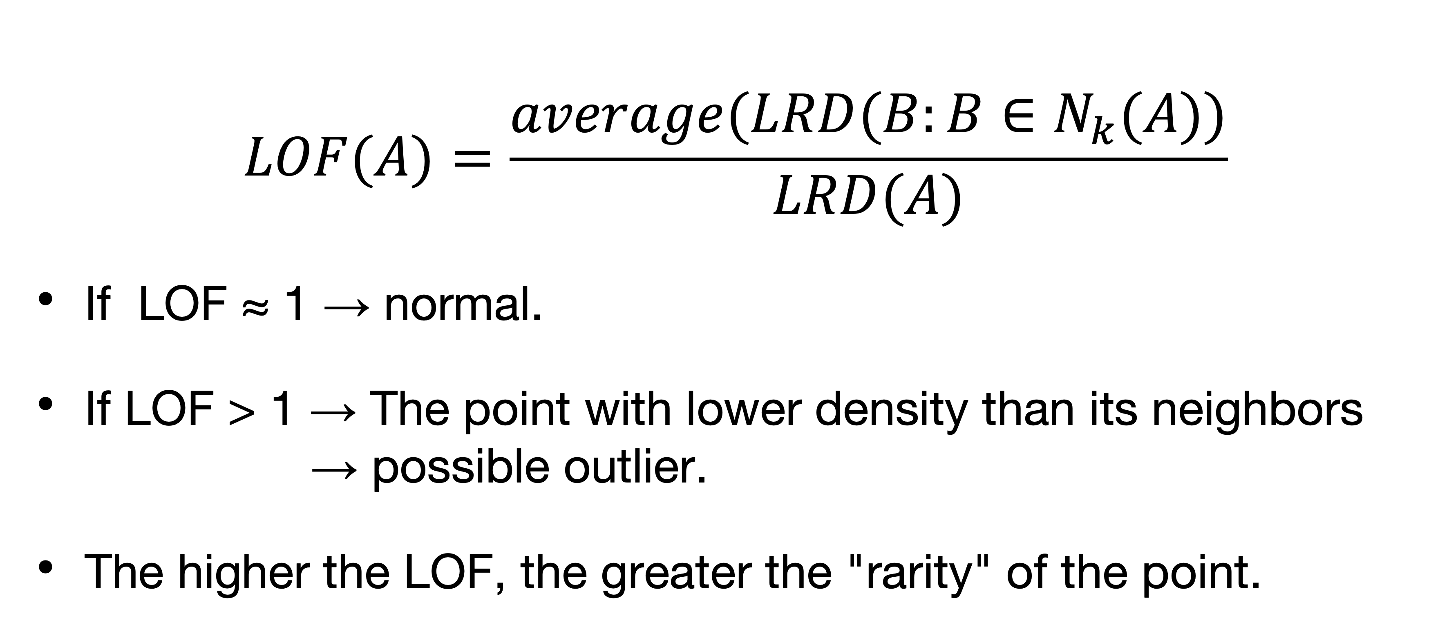
Local Outlier Factor (LOF)
$$LOF(A)=\frac{average(LRD(B:B∈N_{k}(A))}{LRD(A)}$$
If LOF ≈ 1 → normal.
If LOF > 1 → The point with lower density than its neighbors → possible outlier.
The higher the LOF, the greater the "rarity" of the point.

Slide 34
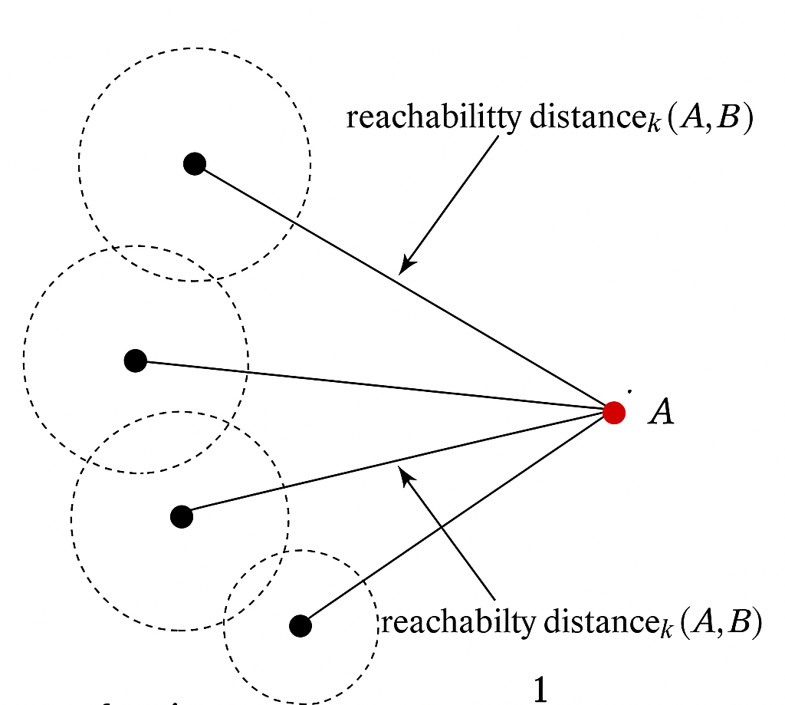
Local Outlier Factor (LOF)

Slide 35
Isolation Forest
Idea: Anomalies are easier to "isolate" in decision tree type structures with fewer splits.
Advantages:
Fast and scalable, even with millions of data.
Works well in high dimension.
No need to assume statistical distributions.
Can be applied to unnormalized numerical data.

Slide 36
Isolation Forest
1. Data Set Subsampling
A small sample of the data is randomly selected (for example, 256 points).
This reduces the computational cost and is enough to detect outliers.
2. Construction of an insulation tree. A binary tree is created for each sample:
Select a random feature (for example, "height").
Choose a random cut-off value between the minimum and maximum of that feature.
Divide the data into two groups: left and right of the cut.
Repeat with each subgroup until:
The node contains only one point (it is "isolated").
A maximum depth is reached.
🔁This process is repeated to build many trees (for example, 100).

Slide 37
Isolation Forest
For each point, the average depth of the point in all trees is calculated.
An outlier will be isolated with fewer cuts → less depth.
A normal stitch will need more cuts → greater depth.

Slide 38
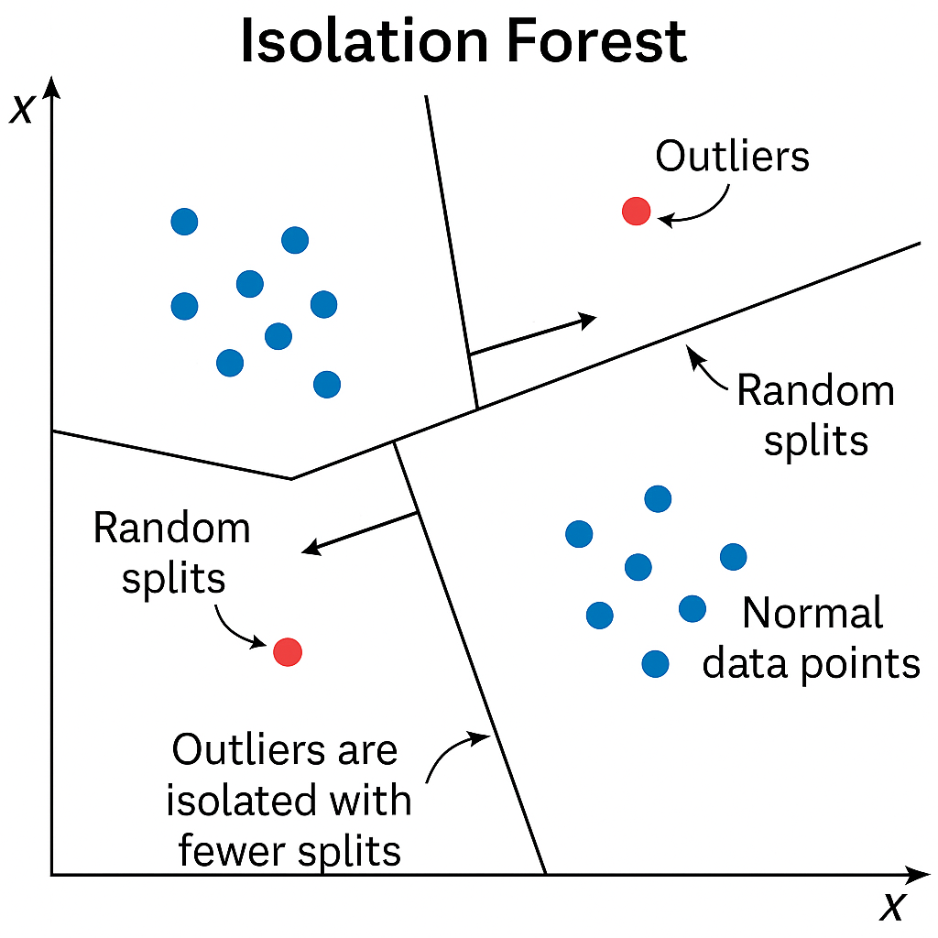

Slide 39
When data are images

Slide 40


Slide 41
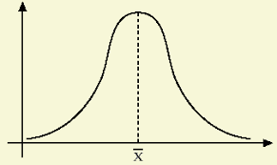
}
Anomalous
…

Slide 42
Autoencoder
Compress images
Two networks, encoder and decoder. The compressed image is in the center and is called "latent representation" or "bottle neck"
Utility:
Dimensionality reduction
Noise removal (Denoising)
Anomaly detection: An autoencoder trained in "normal" data will have difficulty reconstructing "abnormal" data. The difference between input and output (the reconstruction error) will be greater for anomalies, which allows them to be detected.

Slide 43
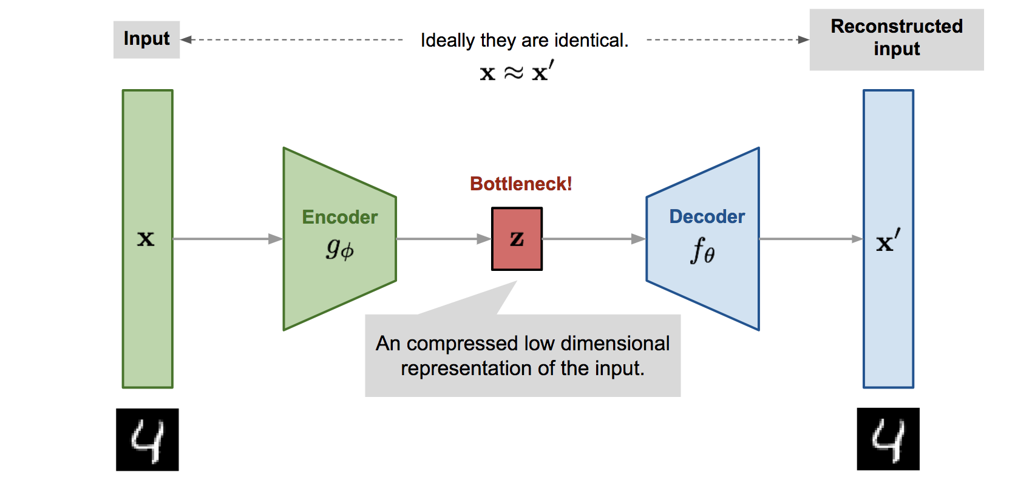

Slide 44
Image encoding + algorithm
Autoencoder
High error (relative, problem 1-dim, IQR)
Gaussian algorithm

Slide 45
Conclusions

Slide 46
Anomaly detection is very useful
Algorithms: need to set thresholds
If there are anomalous validation examples: use them for thresholds
Alternative: Use rules like the 1-dimensional Gaussian or quartile rules
In any case, consult findings with end users

