Slide 1
6. Representaciones Vectoriales
Antonio Bahamonde
Departamento de Informática

Slide 2

Continuous/Discrete
The components of the input vector are the characteristics (features) of the examples (cases)
Continuous
Discrete
Mixed

Slide 3
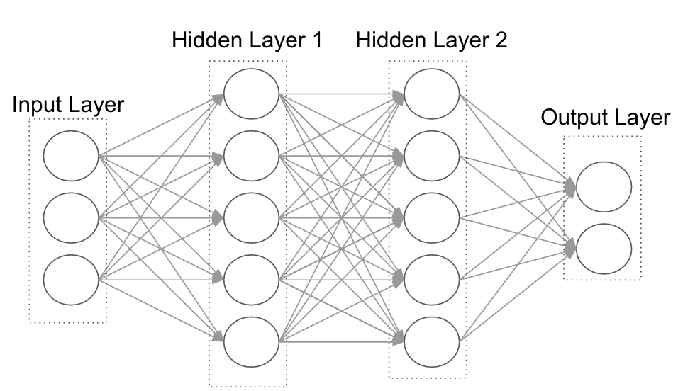
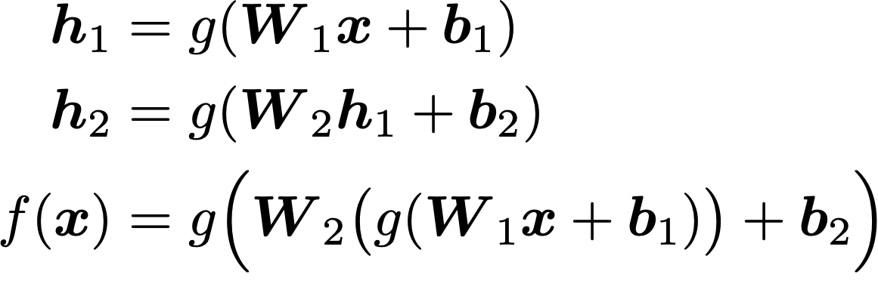
Vectors

Slide 4
Continuous

Slide 5
Consumer preferences of food products
A consumer likes a product better than another
Expert panels
Measurements
Consumer panels
Product description
Preference Judgments
Features that entail consumer acceptance of beef meat from seven Spanish breeds

Slide 6
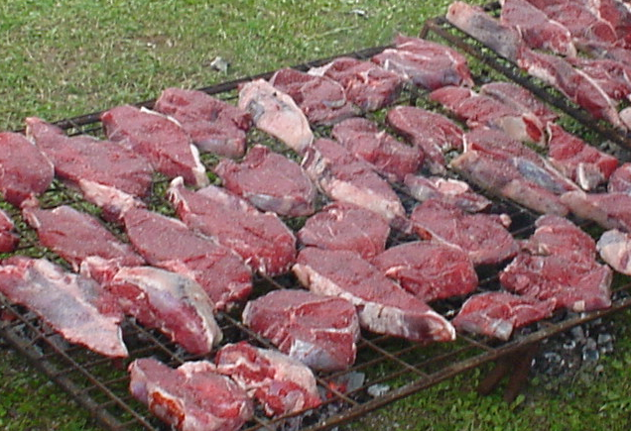
Consumer preferences of food products
101 animals
7 Spanish breeds
slaugther weight:
300–350 Kg. (light)
530–560 Kg. (heavy)
3 ageing periods: 1, 7, 21 days (*)
(*) Sañudo, C.; Macie, E.S.; Olleta, J.L.; Villarroel, M.; Panea, B.; Albertí, P.. The effects of slaughter weight, breed type and ageing time on beef meat quality using two different texture devices. Meat Science, 66 (2004) 925–932
Notes:
Un segundo ámbito en el que aplicamos el análisis de encuestas de calidad sensorial fue el de la carne de vacuno. La encuesta la había realizado un grupo de La Facultad de Veterinaria de Zaragoza (del área de Producción Animal) [Sañudo, 2004]. Para esta experiencia se contaba con 101 animales de 7 razas españolas. Se sacrificaron de tal forma que aproximadamente la mitad dieron lugar a canales ligeras (con un peso en vivo entre 300 y 350 kg) y la otra mitad fueron canales pesadas (animales de entre 530 y 560 kg de peso en vivo). El conjunto de animales fue uniformemente distribuido entre razas y pesos.
Como se sabe que el periodo de maduración de la carne es muy importante, por esta razón las muestras de trozos de chuletas que iban a ser calificadas por los consumidores se prepararon con 3 periodos de maduración diferentes: 1, 7 y 21 días. De esta forma se disponía de 303 muestras de carne de vacuno diferentes.

Slide 7
Consumer preferences of food products
 | % fat |  |  |  | % fat
Breed | inter-muscular | Sub- cutaneous | % Bone | %muscle | Intra-muscular
Asturiana Valles | 5.01 | 0.89 | 15.77 | 78.32 | 1.01
Avileña | 13.30 | 3.55 | 19.30 | 63.84 | 2.48
Morucha | 13.71 | 3.93 | 18.68 | 63.68 | 2.59
Parda Alpina | 10.27 | 2.70 | 20.53 | 66.50 | 1.96
Pirenaica | 10.11 | 3.09 | 17.66 | 69.14 | 1.59
Retinta | 13.76 | 4.52 | 20.40 | 61.33 | 2.12
Rubia Gallega | 5.90 | 1.12 | 16.34 | 76.64 | 1.27
Notes:
Las razas consideradas constituyen una muestra muy variada de carne de vacuno. Se incluyen razas como la Asturiana de los Valles con animales culones muy musculosos. Pero también se incluyen otras razas rústicas de la España seca, como la Avileña, la Morucha o la Retinta; razas con muchas grasas y huesos.

Slide 8
Consumer preferences of food products
Each piece of meat was described by:
the weight of the animal,
ageing time,
breed,
6 physical features describing its texture and
12 sensory characteristics rated by 11 different experts (132 ratings).
The dataset has 307 different items.

Slide 9
Discrete

Slide 10

Discrete, n-hot: Text Representation
Dictionary/Corpus
1 | 2 | 3 | 4 | 5 | 6 | 7 | 8
el | un | caballo | gato | blanco | negro | agua | …
0 | 1 | 0 | 1 | 0 | 1 | 0 | …
“un gato negro”
Bag of Words (BoW) Vector Space Model (VSM)

Slide 11


Document classification
Is this a SPAM email?
Is this a document about economy?
Handmade procedure: keywords
If p is in D then return YES
else return NO

Slide 12



Document classification
Inputs | Class
D-1 | YES
D-2 | No
... | ...
Y
N
N
Y
N
Y
Y
N
Machine Learning
algorithm
D-i = BoW vector
Learned procedure

Slide 13
Dealing with 2 Documents
document
query
Is the document relevant for the query?
Handmade procedure: all words have the same importance
Compute cos and return the documents with the highest value (see next)

Slide 14

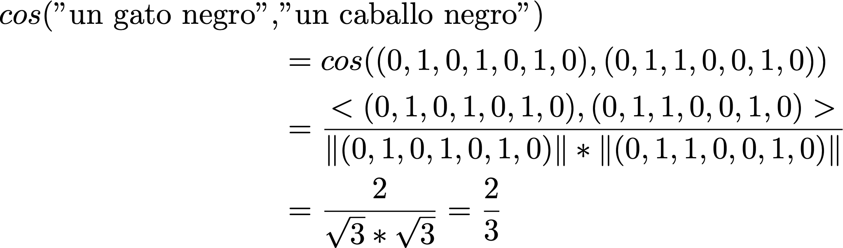
Discrete, n-hot: Text Representation
Bag of words
 | 1 | 2 | 3 | 4 | 5 | 6 | 7 | 8
 | el | un | caballo | gato | blanco | negro | agua | …
“un gato negro” | 0 | 1 | 0 | 1 | 0 | 1 | 0 | …
“el caballo blanco” | 1 | 0 | 1 | 0 | 1 | 0 | 0
“un caballo negro” | 0 | 1 | 1 | 0 | 0 | 1 | 0

Slide 15
Dealing with 2 Documents
D-i, Q-j are BoW vectors
Inputs | Class
D-1, Q-1 | YES
D-1, Q-2 | No
D-2, Q-43 | YES
… | …
All words have the same importance? Compute cos …
Some words are more relevant than others, but I do not know which ones
Machine Learning
algorithm
Learned procedure

Slide 16
Recommender Systems

Slide 17
Recommender Systems
Users,
Movies
The goal is to fill this matrix according to the assessments of users about movies
 | m1 | m2 | m3 | m4
u1 | 👎🏻 | * | * | 👍🏻
u2 | * | 👍🏻 | 👎🏻 | *
u3 | * | * | 👎🏻 | 👍🏻
u4 | 👍🏻 | 👍🏻 | * | *
Notes:
We follow the approach used in Recommender systems. We have a matrix of grades given by some students to the responses of other students. The goal is to fill this matrix according to the assessments of graders.

Slide 18
Recommender Systems: Users and Items representations
Let’s assume that we consider 3 features of movies
Action, Romantic, Science fiction
All of them can be quantified (say 0-100)
This can be used both for users and for movies
Notes:
We follow the approach used in Recommender systems. We have a matrix of grades given by some students to the responses of other students. The goal is to fill this matrix according to the assessments of graders.

Slide 19
1-hot & n-hot examples
Index | 1 | 2 | 3 | 4 | 5 | 6 | 7 | 8
x1 | 1 | 0 | 0 | 0 | 0 | 0 | 0 | 0
x2 | 0 | 1 | 0 | 0 | 0 | 0 | 0 | 0
x3 | 0 | 0 | 1 | 0 | 0 | 0 | 0 | 0
…
x8 | 0 | 0 | 0 | 0 | 0 | 0 | 0 | 1
unknown | Action | Adventure | Animation | Children's | Comedy | Crime | Documentary | Drama | Fantasy | Film-Noir | Horror | Musical | Mystery | Romance | Sci-Fi | Thriller | War | Western |
These are the genres, a 1 indicates the movie is of that genre, a 0 indicates it is not; movies can be in several genres at once.

Slide 20
Recommender Systems: Users and Items representations
Affinity is a typical function to estimate if u is gonna like m-i.
affinity(u,m) = <vec(u), vec(m)>
Affinity | m1 = (0, 100, 0) | m2 = (90,1, 100)
u = (100, 1, 80) | 0*100+100*1+0*80 = 100 | 90*100+1*1+100*80 = 17001
Notes:
We follow the approach used in Recommender systems. We have a matrix of grades given by some students to the responses of other students. The goal is to fill this matrix according to the assessments of graders.

Slide 21
Recommender Systems: Users and Items representations
How can we find out the features of users and movies?
Notes:
We follow the approach used in Recommender systems. We have a matrix of grades given by some students to the responses of other students. The goal is to fill this matrix according to the assessments of graders.

Slide 22
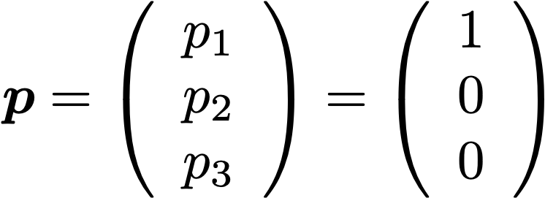
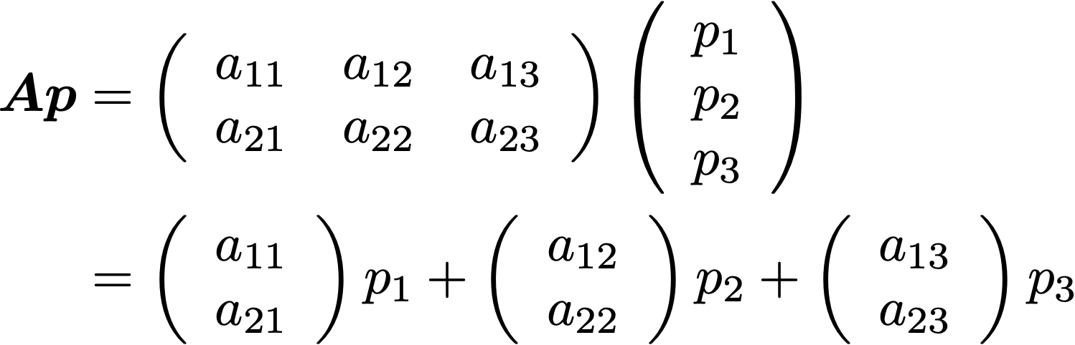
1-hot embedding

Slide 23

Recommender Systems: Users and Items representations
How can we find out the features of users and movies?
affinity(u,m) = <vec(u), vec(m)> = <Wu,Vm>
W = 3 rows, one column for each user
V = 3 rows, one column for each movie
We must learn the matrices W and V
Notes:
We follow the approach used in Recommender systems. We have a matrix of grades given by some students to the responses of other students. The goal is to fill this matrix according to the assessments of graders.

Slide 24
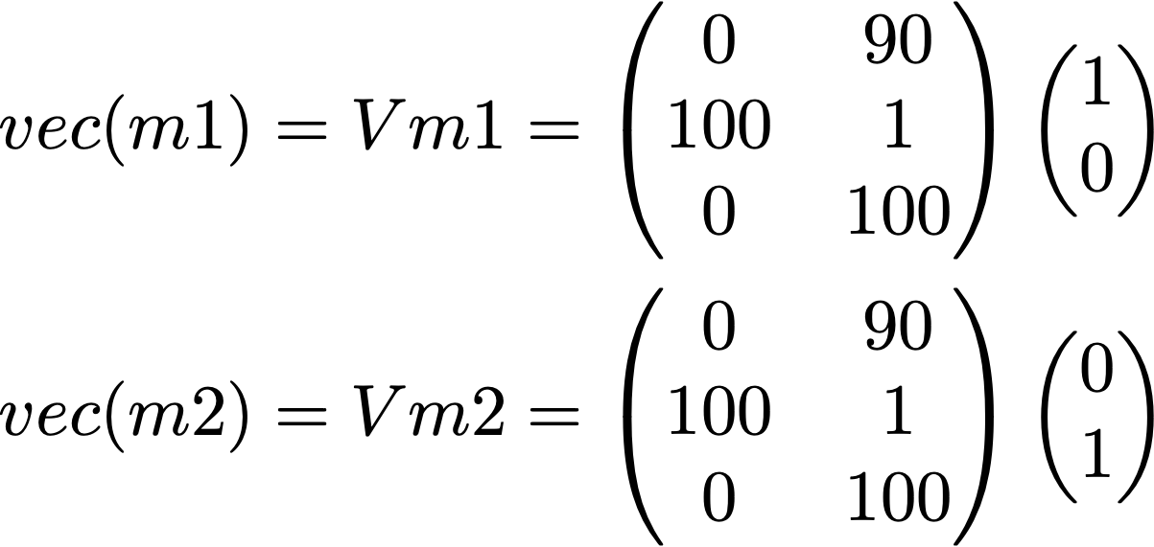
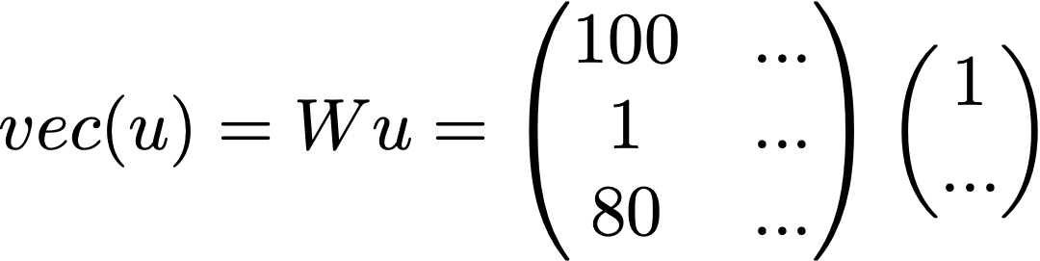
Recommender Systems: Users and Items representations
affinity(u,m) = <vec(u), vec(m)> = <Wu,Vm>
Affinity | m1 = (0, 100, 0) | m2 = (90,1, 100)
u = (100, 1, 80) | 0*100+100*1+0*80 = 100 | 90*100+1*1+100*80 = 17001
Notes:
We follow the approach used in Recommender systems. We have a matrix of grades given by some students to the responses of other students. The goal is to fill this matrix according to the assessments of graders.

Slide 25

Recommender Systems
Users,
Movies
The goal is to fill this matrix according to the assessments of users about movies
 | m1 | m2 | m3 | m4
u1 | 👎🏻 | * | * | 👍🏻
u2 | * | 👍🏻 | 👎🏻 | *
u3 | * | * | 👎🏻 | 👍🏻
u4 | 👍🏻 | 👍🏻 | * | *
sign (affinity(u, m) + b) = sign (<Wu,Vm>+ b)
Notes:
We follow the approach used in Recommender systems. We have a matrix of grades given by some students to the responses of other students. The goal is to fill this matrix according to the assessments of graders.

Slide 26


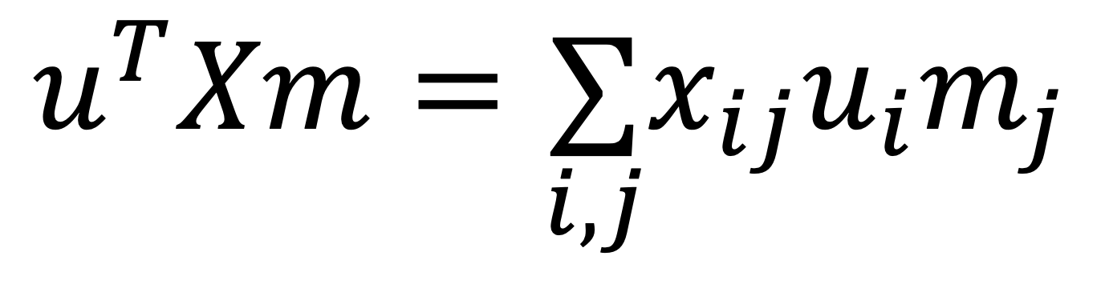
Matrix factorization
$$<Wu,Vm>=(Wu)^{T}(Vm)=u^{T}(W^{T}V)m$$
$$W^{T}V=X$$
$$u^{T}Xm=\underset{i,j}{∑}x_{ij}u_{i}m_{j}$$
Notes:
We follow the approach used in Recommender systems. We have a matrix of grades given by some students to the responses of other students. The goal is to fill this matrix according to the assessments of graders.

Slide 27
Additional examples

Slide 28
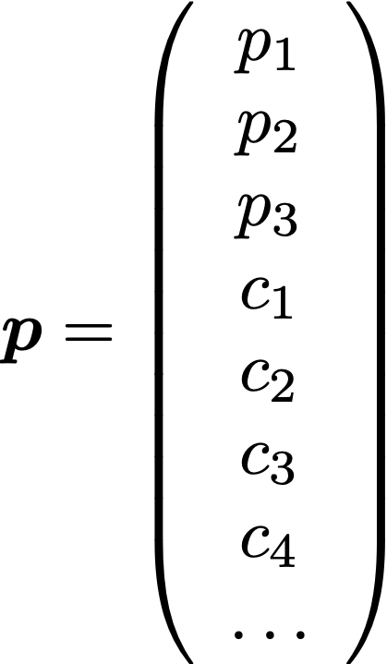
Mixed
1-hot
Continuous

Slide 29
Consumer preferences of food products
In addition to feature descriptions of consumers and items, we added a binary identification each object (consumer or item) includes in its description a vector with all components 0 but the one (index the ordinal of the object) that has value 1.
Example. If we have only 3 consumers,
consumer₁ =(1,0,0,sex₁,age₁,job₁)^{T},
consumer₂ =(0,1,0,sex₂,age₂,job₂)^{T},
consumer₃ =(0,0,1,sex₃,age₃,job₃)^{T}.

Slide 30
Preferencias
Val(p,c) > Val(p’,c)
D = {(p,p’,c): Val(p,c) > Val(p’,c)}
Clasificación binaria

Slide 31



Automatic assessment of open response answers (Peer assessment)
graders,
answers
The goal is to fill this matrix according to the assessments of graders
 | a1 | a2 | a3 | a4
g1 | 4 | * | * | 9
g2 | * | 7 | 4 | *
g3 | * | * | 3 | 8
g4 | 5 | 5 | * | *
Notes:
We follow the approach used in Recommender systems. We have a matrix of grades given by some students to the responses of other students. The goal is to fill this matrix according to the assessments of graders.

Slide 32
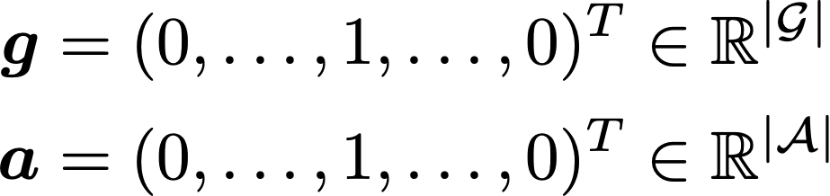
Automatic assessment of open response answers (Peer assessment)
vectorial representation
the simple binary codification
collaborative filter
Notes:
To have a vectorial representation of graders and answers, we may use a simple binary codification. The result (in terms of recommendation system) is a collaborative filter: the content of the answers is not used at all.

Slide 33
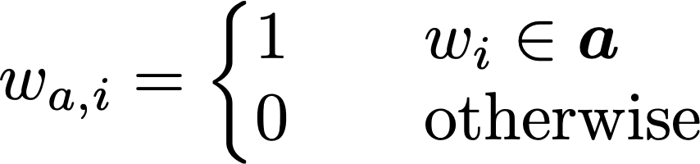


Automatic assessment of open response answers (Peer assessment)
Add content-based codification in answers
where
BoW
1-hot
Notes:
However, we may add content-based codification in answers. In addition to the binary codification we may use the vector space model to represent the answers. Each word of the corpus used by students is then an index, and we simply record if the word is present or not.

