Slide 1
Color based Face Detection

Slide 2
List of Contents
Literature Research
YCbCr Color Space
Blob Analysis
Face Detection in a Video Stream
Algorithm on a Raspberry Pi
Live Presentation
Findings and Results

Slide 3
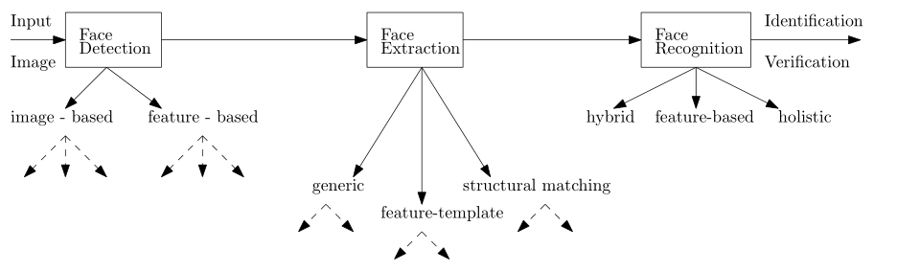
Where – Did we find this topic?
Chosen Topic: Face Recoginition

Slide 4
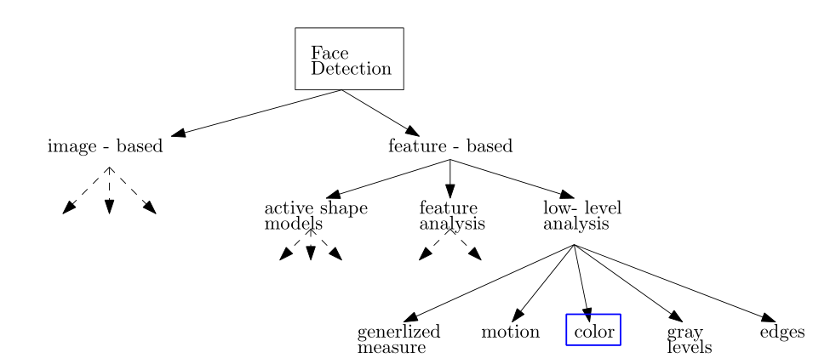
Where – Did we find this topic?
Chosen Part: Face Detection

Slide 5
Where - Is this approach used?
Benefit
Approach is much faster than other facial features
Orientation invariant
Approach
Video conferencing systems, to focus camera on speaker
Goal
Face detection based on skin color, executed by a Raspberry Pi with a Raspberry Pi camera module

Slide 6
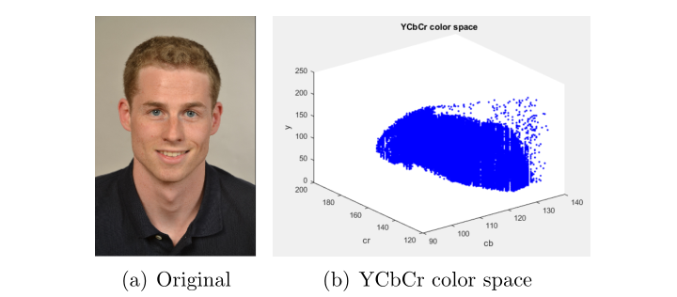
Why – YCbCr Space
YCbCr Space split image into
Luminance information (Y)
Chrominance information (Cb, Cr)

Slide 7
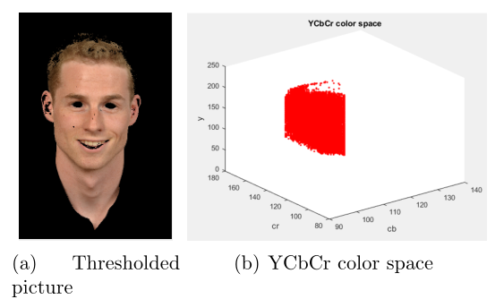
Why – YCbCr Space Thresholding
Thresholding = remove all colors instead of skin colors

Slide 8
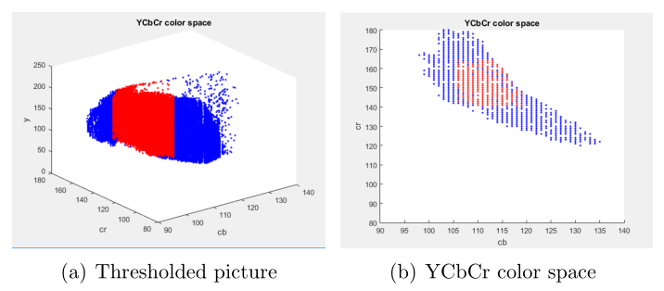
Why – YCbCr space Thresholding

Slide 9
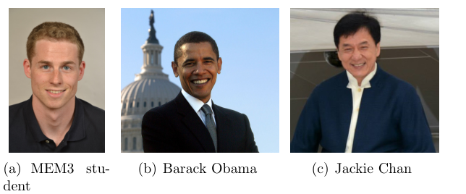
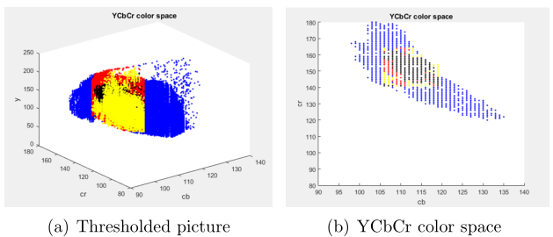
Why – YCbCr Space Thresholding

Slide 10

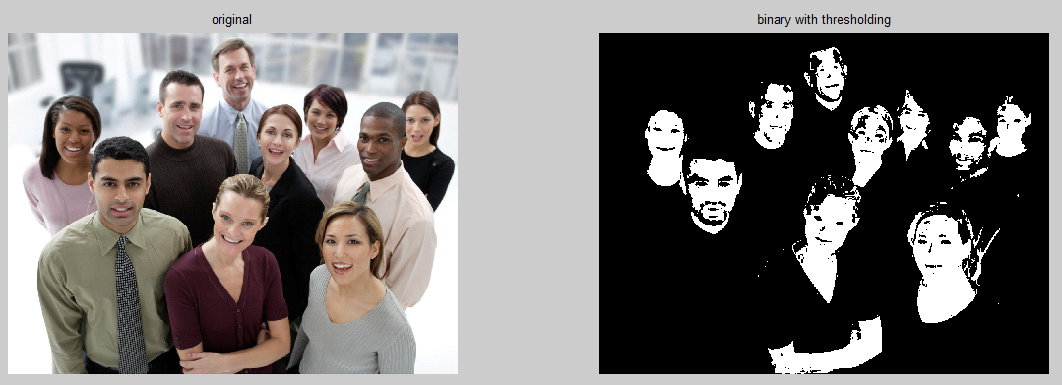
Is it really a Face?
Thresholding

Slide 11
Blob Analysis
Small Area: Blobs with too less pixels are rejected
Euler Number: Blob must contain holes, E = C – H < 0
Eccentricity: Must be smaller than 0.91
Bounding Box Properties: Height to width ratio must be smaller than 0.5

Slide 12
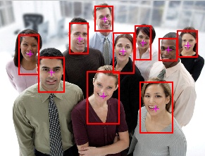
Result
Blob Analysis

Slide 13
Face Detection in a Video Stream
Idea
Take a snapshot of the video stream
Let it run through the face detection algorithm
Plot the snapshot with rectangles around faces
Take a new snapshot when former snapshot is fully processed
Is it fast enough?

Slide 14
Computation Time
Highly depends on the size of the image -> Example image has a size of 1548x2048 pixels -> processing an plotting takes 1.241 seconds
Video resolution is set to 320x240 -> Taking snapshot takes 0.08 – 0.1 seconds -> Processing and plotting takes: 0.04 – 0.09 seconds
Worst case for one snapshot: -> 0.19 seconds → 5.26 fps

Slide 15
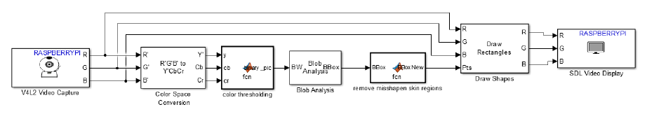
Simulink & Raspberry Pi
The alorithm is modeled with Simulink blocks - ready made function blocks are available
The model is downloaded to the Raspberry Pi
Probably faster when coding the Raspberry Pi in Phyton

Slide 16
Result and Findings
Resolution of the image/video must be predefined → influences blob analysis and computation time
Thresholding values are different for different cameras
Lighting conditions can affect the algorithm – e.g. shadows
Simulink blocks do not support all region properties (e.g. no Euler number) -> in contrast to the MATLAB algorithms morphological operations are used?
The algorithm is probably faster when coding the Raspberry Pi in Phyton (instead of downloading Simulink blocks)
The algorithm gets faster using the Raspberry Pi 3

