Slide 1
Color based face detection

Slide 2
Content
Color based face detection
Where? Stst
Why? Stst
Blob analyis, Ideal Gruppe Buto
Results Buto
Live presentation

Slide 3
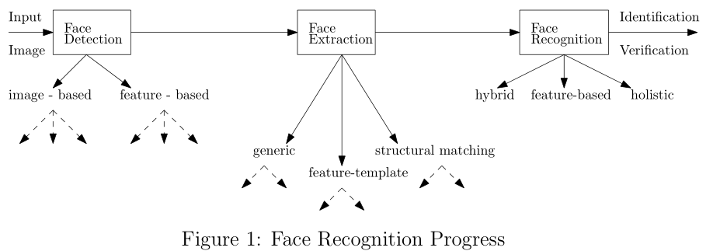
Where – Did we find this topic?
Chosen Topic: Face Recoginition

Slide 4
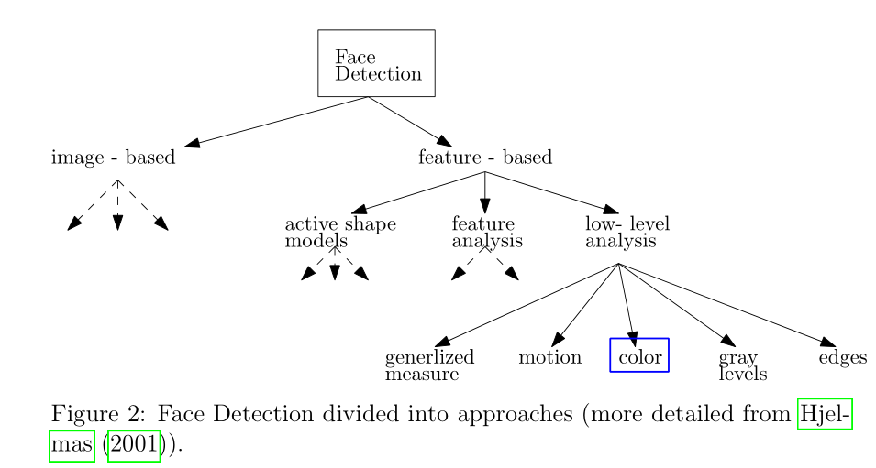
Where – Did we find this topic?
Chosen Part: Face Detection

Slide 5
Where - Is this approach used?
Benefit
Approach is much faster than other facial features
Orientation invariant
Approach
Video conferencing systens, to focus camera on speaker
Goal
Face detection based on skin color, executed by a Raspberry Pi with a Raspberry Pi camera module

Slide 6
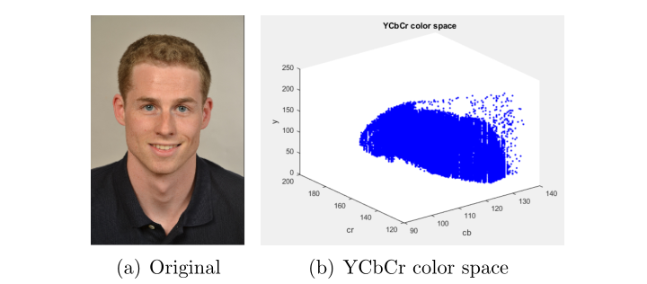
Why – YCbCr Space
YCbCr Space split image into
Luminance informations (Y)
Chrominance informations (Cb, Cr)

Slide 7
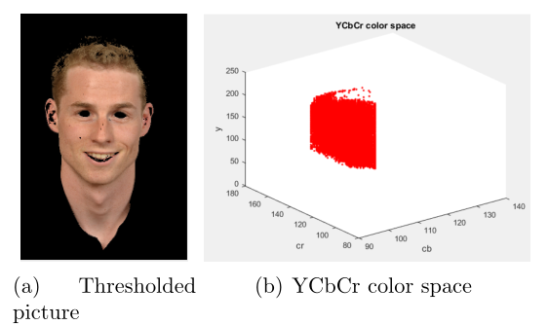
Why – YCbCr space Thresholding
Thresholding = remove all colors instead of skin colors

Slide 8
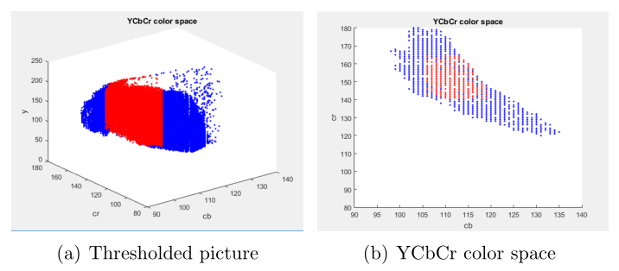
Why – YCbCr space Thresholding

Slide 9
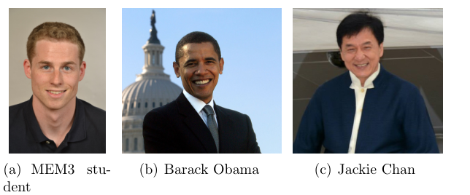
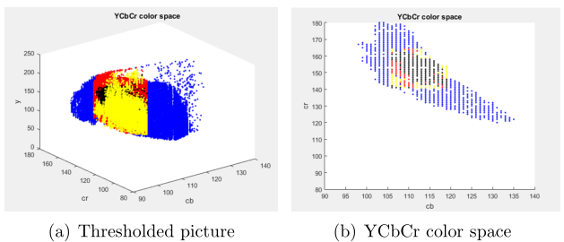
Why – YCbCr space Thresholding

