Slide 1
Clustering with GMM and K-means
Esteban (EJ) Guillen
Computer Science Department
University of New Mexico
Sandia National Labs

Slide 2
Overview
Brief Introduction to Clustering
Theory
K-means (Euclidian)
GMM (EM)
K-means (Mahalanobis)
Experiments
Data
Results
Demo Code
Conclusion
Future Work

Slide 3
Clustering
Data is everywhere and rapidly growing
Most data is unlabeled (no classification assigned to it)
Network traffic data
Log files
Objects in an image
Text in an email (topic)
Clustering is a common approach learn something from unlabeled data (unsupervised learning)
Hierarchical
Partitioning (focus of this work)
K-means
GMM

Slide 4
Partitioning
Construct a partition of n objects into a set of k clusters
X2
X1

Slide 5
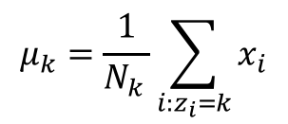
K-means (Euclidian) Algorithm
Input – Number of clusters K, data X
Initialize the K cluster centers (randomly)
Iterate
Assign points to the nearest cluster center (Euclidian distance)
Re-estimate the k cluster centers (mean)
$$μ_{k}=\frac{1}{N_{k }}\sum_{i:z_{i}=k}{x_{i}}$$
Termination – If none of the data are changing membership exit, otherwise go back to step 1.

Slide 6
K-means (Euclidian) Example (K=3)
X
X
X2
X
X1

Slide 7
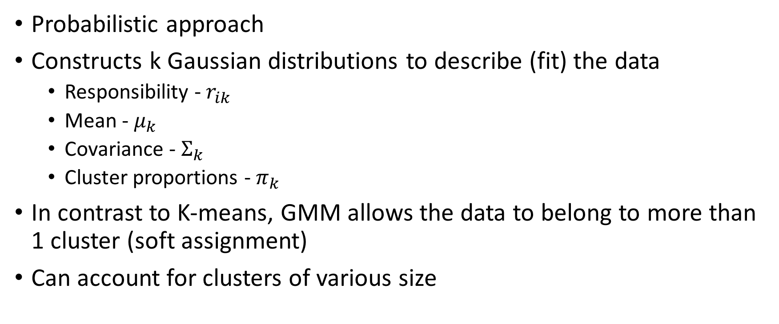
Gaussian Mixture Model (GMM)
Probabilistic approach
Constructs k Gaussian distributions to describe (fit) the data
Responsibility - $r_{ik}$
Mean - $μ_{k}$
Covariance - $Σ_{k}$
Cluster proportions - $π_{k}$
In contrast to K-means, GMM allows the data to belong to more than 1 cluster (soft assignment)
Can account for clusters of various size

Slide 8
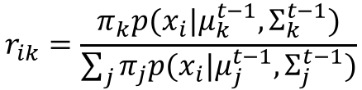




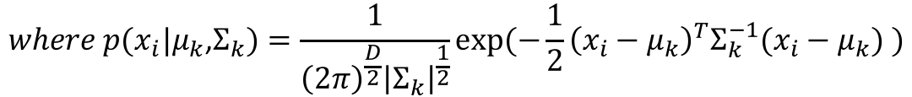
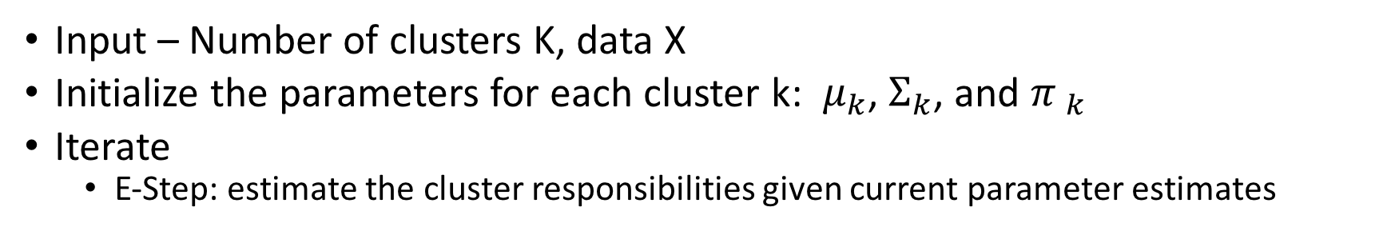
Expectation Maximization (EM) for GMM
Input – Number of clusters K, data X
Initialize the parameters for each cluster k: $μ_{k}$, $Σ_{k}$, and ${π }_{k}$
Iterate
E-Step: estimate the cluster responsibilities given current parameter estimates
$$r_{ik}=\frac{π_{k}p(x_{i}|μ_{k}^{t−1},Σ_{k}^{t−1})}{\sum_{j}{π_{j}p(x_{i}|μ_{j}^{t−1},Σ_{j}^{t−1})}}$$
$$where p(x_{i}|μ_{k}\text{,}Σ_{k})=\frac{1}{{\left(2π\right)}^{\frac{D}{2}}{\left|Σ_{k}\right|}^{\frac{1}{2}}}exp⁡(−\frac{1}{2}{\left(x_{i}−μ_{k}\right)}^{T}Σ_{k}^{−1}(x_{i}−μ_{k}) )$$
M-Step: maximize likelihood over parameters given current responsibilities
$$μ_{k}=\frac{\sum_{i}{r_{ik}x_{i}}}{r_{k}}$$
$$Σ_{k}=\frac{\sum_{i}{r_{ik}(x_{i}−μ_{k}){(x_{i}−μ_{k})}^{T}}}{r_{k}}$$
$$π_{k}=\frac{1}{N}\sum_{i}{r_{ik}}=\frac{r_{k}}{N}$$
$$where r_{k}=\sum_{i}{r_{ik}}$$
Termination - If algorithm has converged exit, else go back to E-Step
Converged when log likelihood for all data is maximized (not improving)

Slide 9
Gaussian Mixture Model (GMM) (K=3)
After learning the responsibility, mean, covariance, cluster proportions
X2
X1

Slide 10
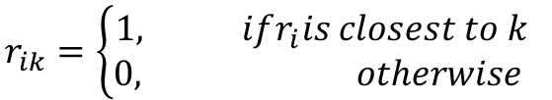


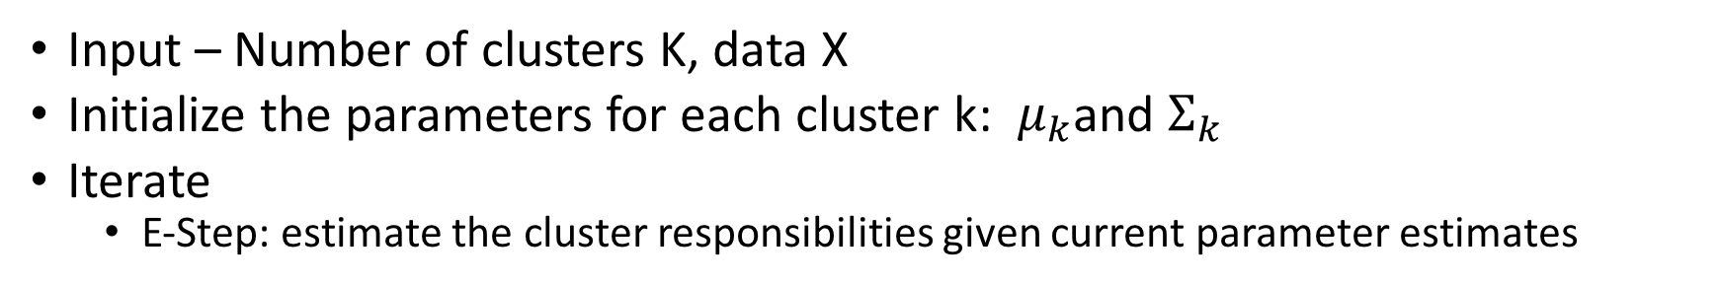
K-means (Mahalanobis) Algorithm
Input – Number of clusters K, data X
Initialize the parameters for each cluster k: $μ_{k}$and $Σ_{k}$
Iterate
E-Step: estimate the cluster responsibilities given current parameter estimates
$$r_{ik}=\left\{\begin{aligned}1, ifr_{i}is closest to k \\ 0, otherwise \end{aligned}\right.$$
M-Step: maximize likelihood over parameters given current responsibilities
$$μ_{k}=\frac{\sum_{i}{r_{ik}x_{i}}}{r_{k}}$$
$$Σ_{k}=\frac{\sum_{i}{r_{ik}(x_{i}−μ_{k}){(x_{i}−μ_{k})}^{T}}}{r_{k}}$$
$$where r_{k}=\sum_{i}{r_{ik}}$$
Termination - If algorithm has converged exit, else go back to E-Step
Converged when data stops changing cluster membership

Slide 11
K-means (Mahalanobis) Algorithm(K=3)
After learning the responsibility, mean, and covariance
X2
X1

Slide 12
Implementation Details
Non convex optimization problems
Algorithms will converge, but only guaranteed to converge to a local optimum
Random restarts are needed to increase odds of finding a global optimum
To prevent the variance from going to zero, I added a small diagonal to the covariance matrix at each iteration
If a cluster had zero points assigned to it I didn’t update the mean or covariance (just left them unchanged)

Slide 13
Experiments
Implemented K-means (Euclidian), GMM using EM, and K-means (Mahalanobis) algorithms from scratch and run them against 3 different data sets
Visualize the algorithms at each iteration step
Perform 4 restarts (same data, but different initialization parameters)
Evaluate alternative stopping criteria for GMM

Slide 14
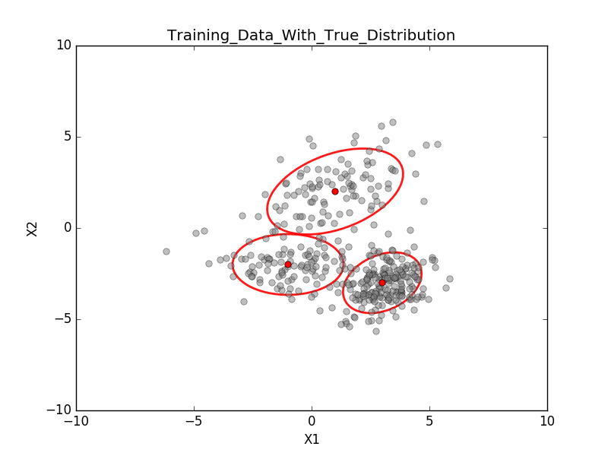
Experiment 1- Data
mu1 = [1,2] sigma1 = [[3,1],[1,2]]
mu2 = [-1,-2] sigma2 = [[2,0],[0,1]]
mu3 = [3,-3] sigma3 = [[1,.3],[.3,1]]

Slide 15
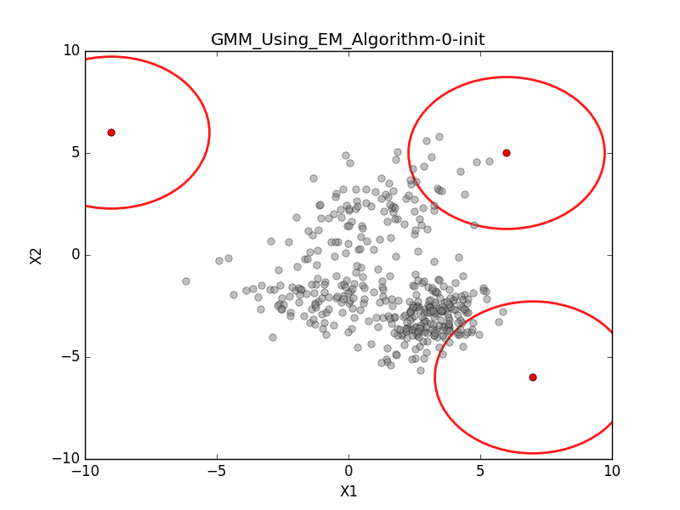

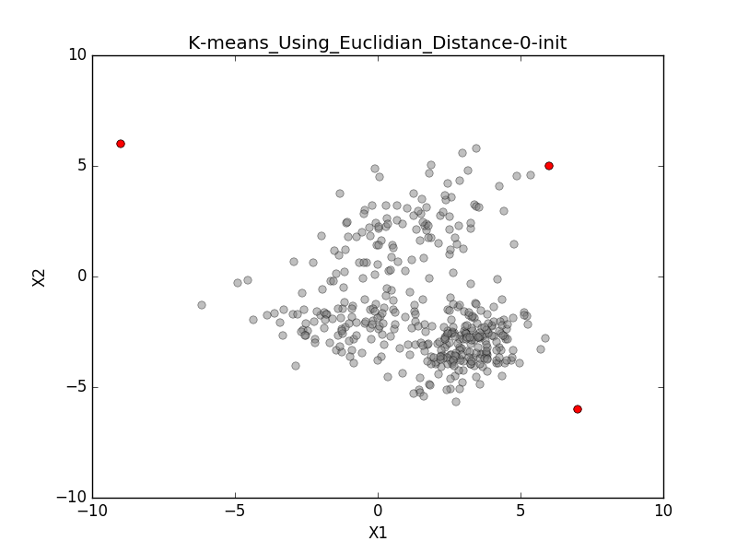
Experiment 1 –Restart 0 – Initialize params

Slide 16
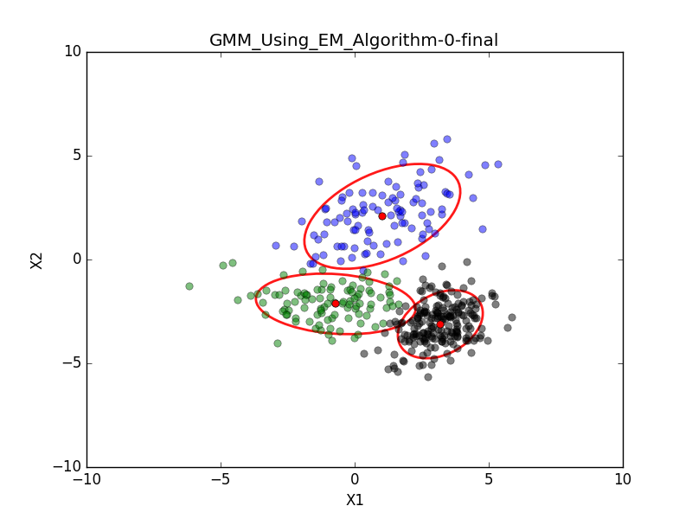
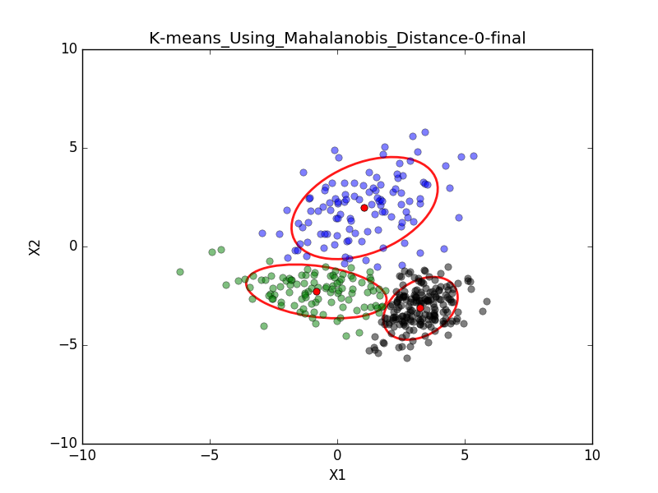
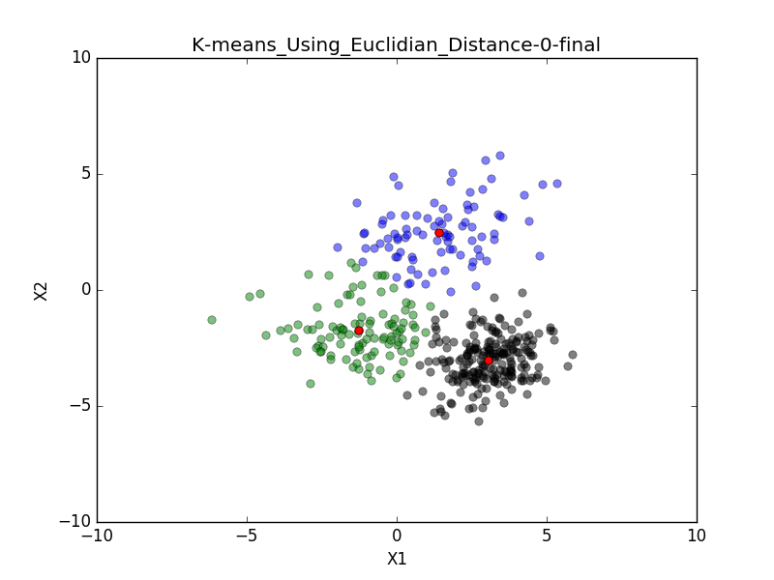
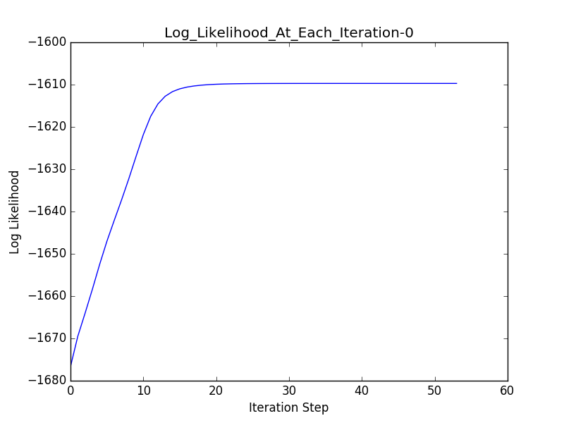
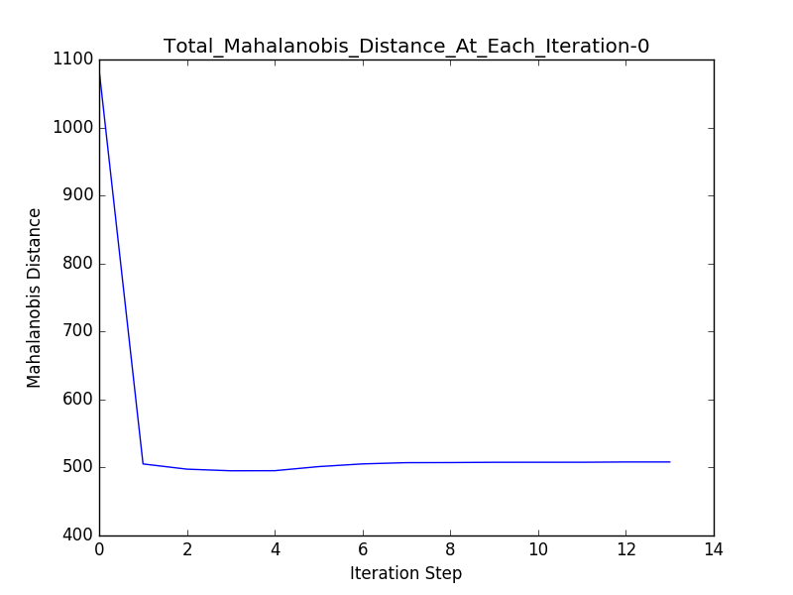
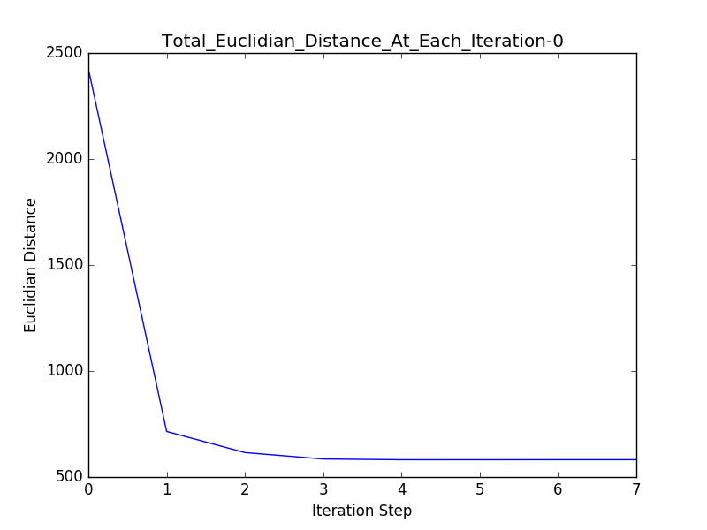
Experiment 1 – Restart 0 - Result

Slide 17
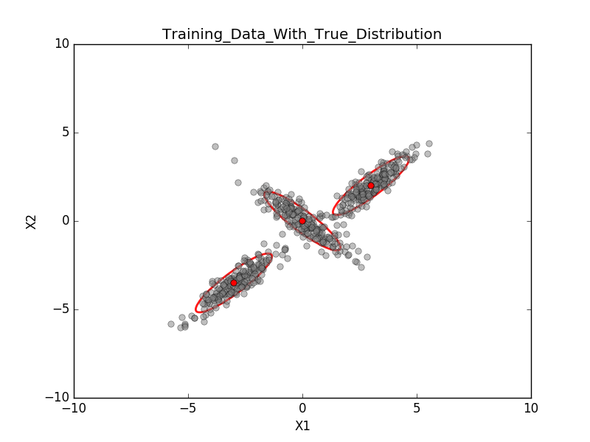
Experiment 2 - Data
mu1 = [0,0] sigma1 = [[1,-.90],[-.90,1]]
mu2 = [-3,-3.5] sigma2 = [[1,.90],[.90,1]]
mu3 = [3,2] sigma3 = [[1,.90],[.90,1]]

Slide 18
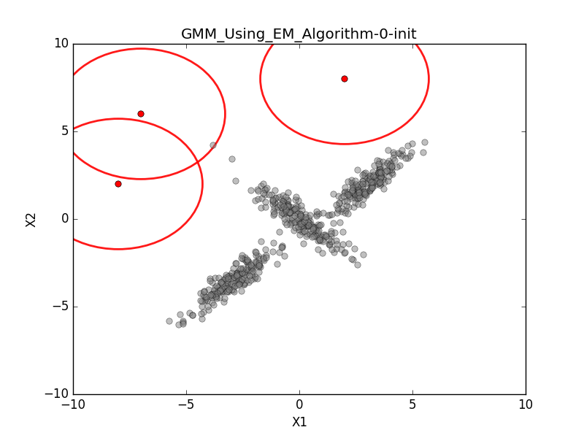

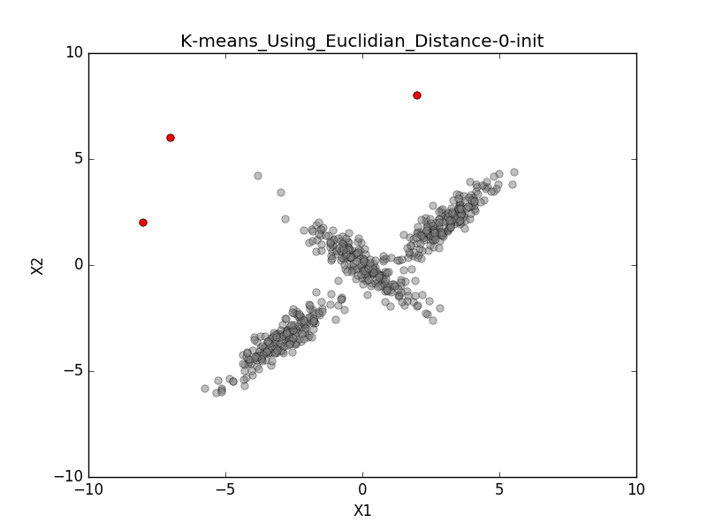
Experiment 2 –Restart 0 – Initialize params

Slide 19
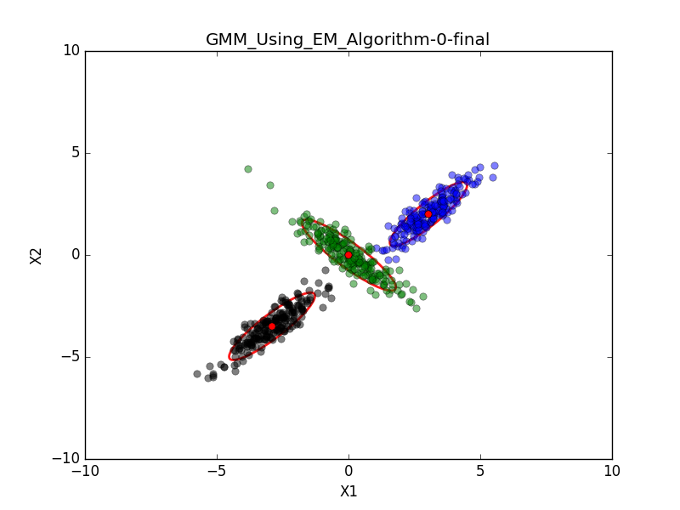

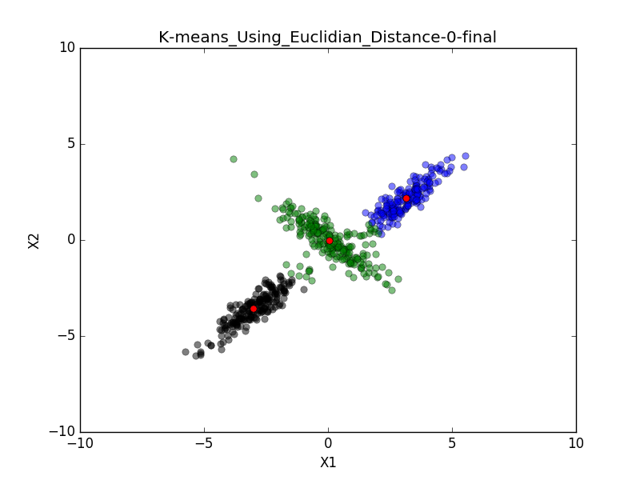
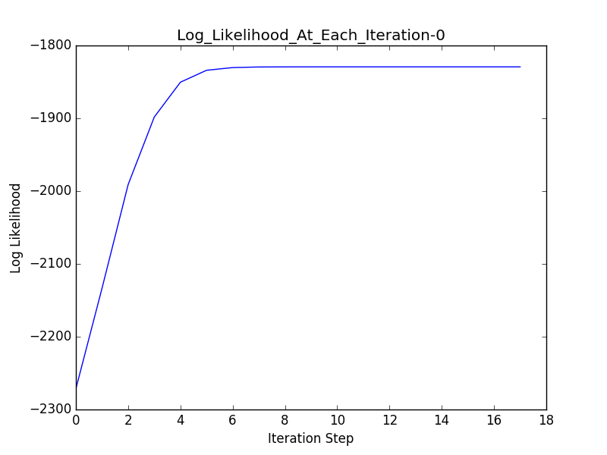
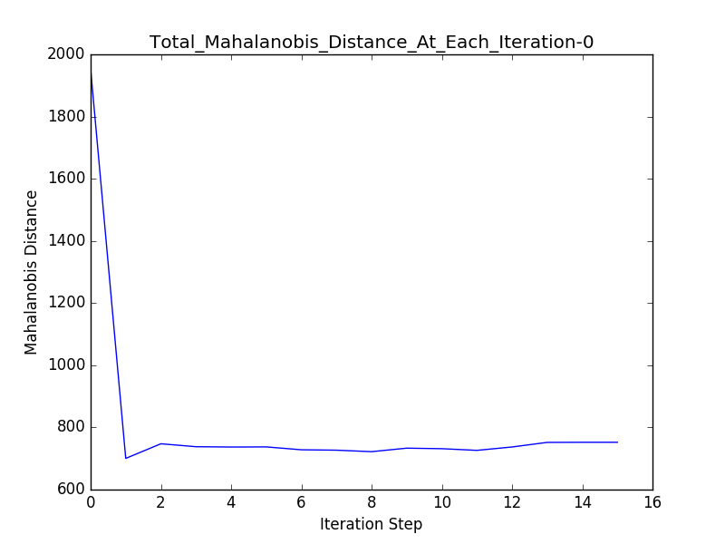
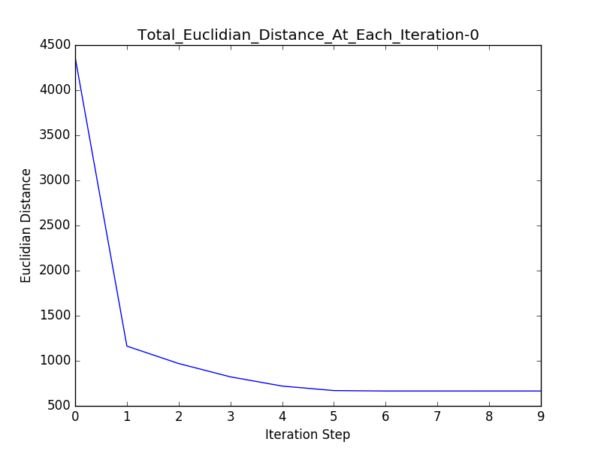
Experiment 2 – Restart 0 - Result

Slide 20
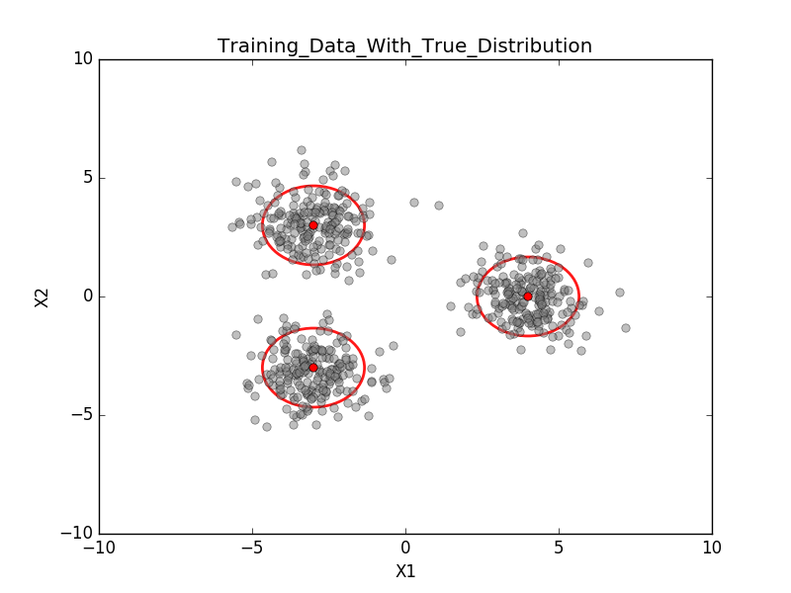
Experiment 3 - Data
mu1 = [-3,3] sigma1 = [[1,0],[0,1]]
mu2 = [-3,-3] sigma2 = [[1,0],[0,1]]
mu3 = [4,0] sigma3 = [[1,0],[0,1]]

Slide 21
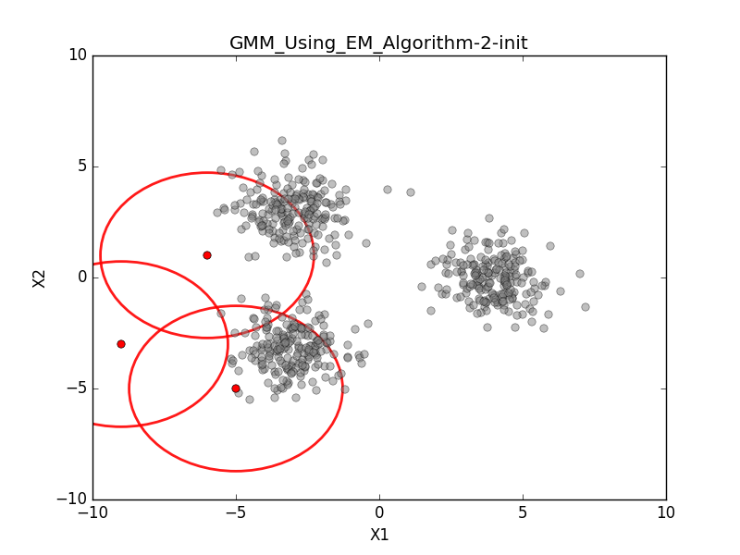

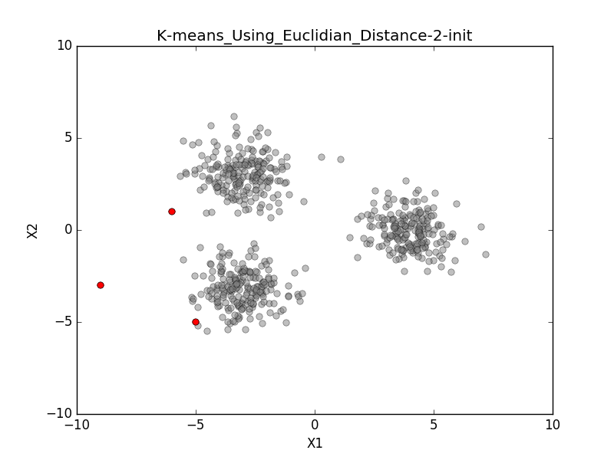
Experiment 3 –Restart 2 – Initialize params

Slide 22
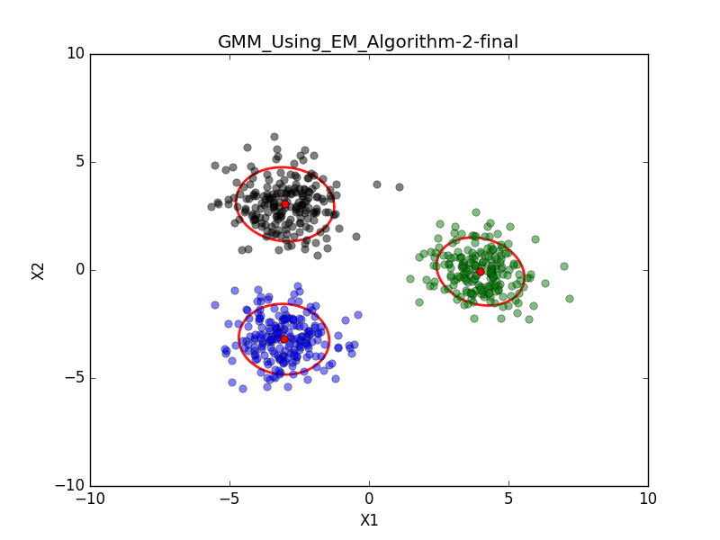
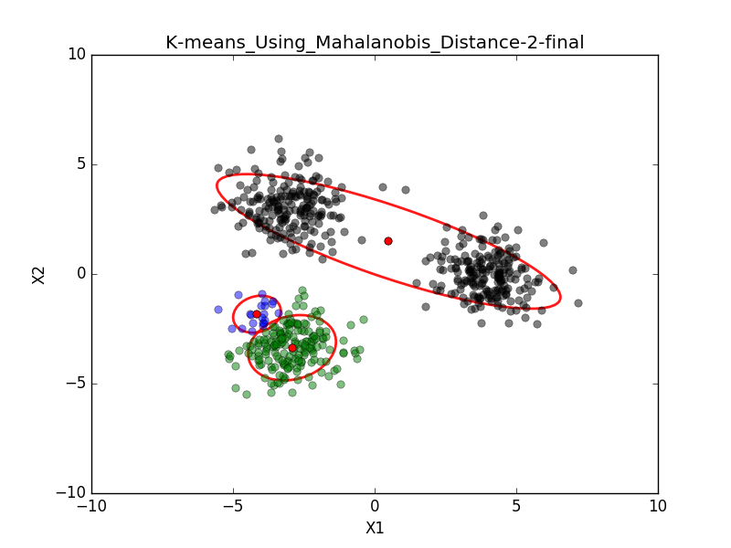
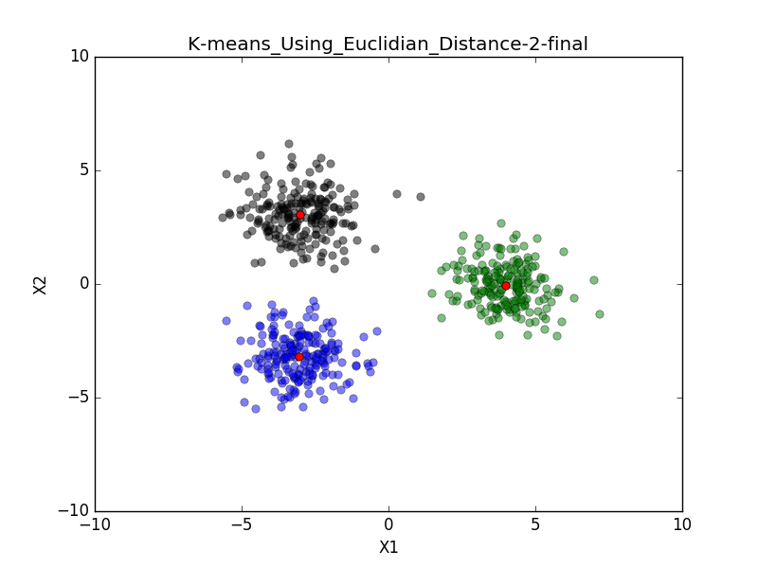
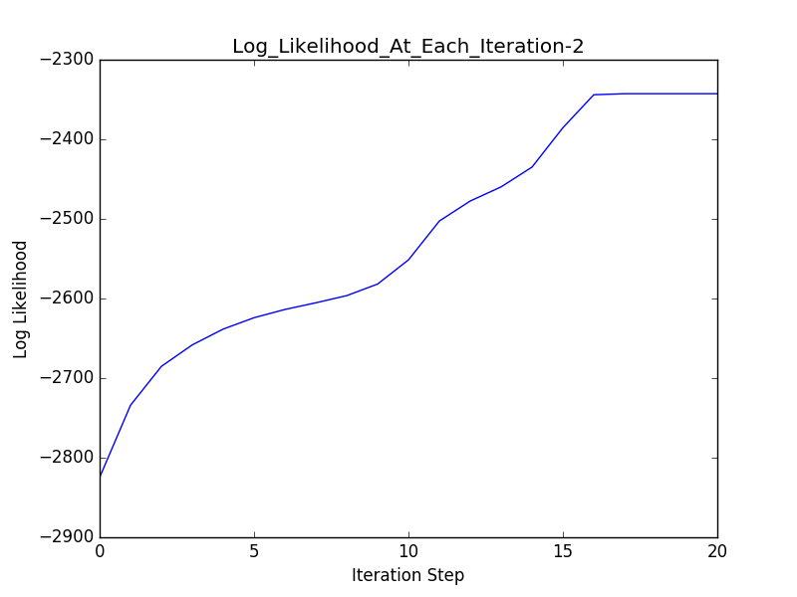
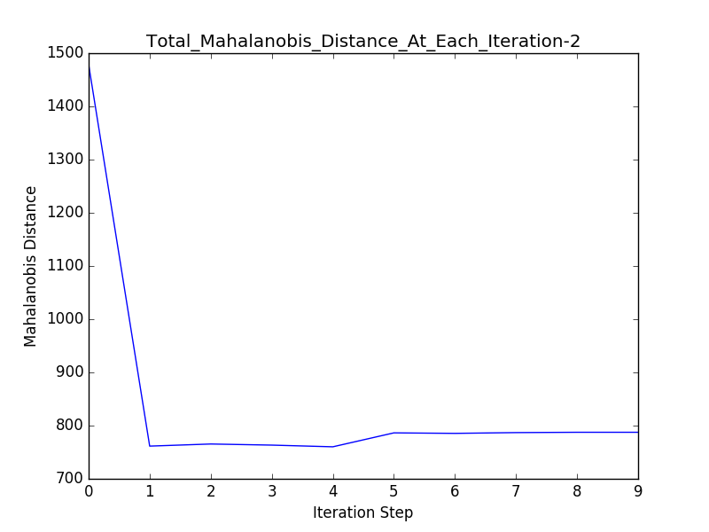
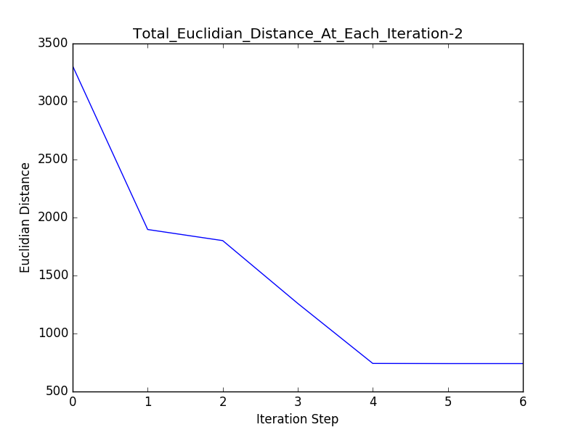
Experiment 3 –Restart 2 – Final

Slide 23
Experiment 4 – Compare Stop Criteria for GMM
For experiments 1,2, and 3 the GMM algorithms stopped when the log likelihood stop increasing (difference between iteration t and t-1 fell with in some tolerance, 1e-9)
For this experiment (using data set 2) I introduced another stopping criteria, “stable mu and Sigma” (difference between mu and Sigma between iteration t and t-1 fell with in some tolerance, 1e-9)
The two stopping criteria were compared on how quickly they stopped the algorithm
4 restarts with random centroids selected at the beginning of each restart

Slide 24
Experiment 4 - Results
Using the same tolerance value (1e-09) the “stable mu and Sigma” version took more iterations to converge
In some cases it only took a few more iterations and other times it took a lot more
The overall quality of the clusters created by the “stable mu and Sigma” version wasn’t any better than the max log likelihood version (final log likelihood values were almost the same)
Changing the tolerance will have big effect on stopping time

Slide 25
Summary of Experiments
GMM consistently took more iterations to converge
Also had the most computational overhead
GMM took more iterations but found more often found the correct clusters
K-means (Euclidean) was fast and took the fewest iterations to converge
K-means (Mahalanobis) had the worst performance, would get stuck in bad local optima
Algorithm needs additional preprocessing in initialization step
Initialization step is important
Using the log likelihood for stopping criteria appears to converge faster than “stable mu and Sigma”

Slide 26
Demo

Slide 27
Conclusion
Successfully implemented 3 clustering algorithms using the Python language and evaluated their perfomance
Happy with the GMM and K-means (Euclidean)
K-means (Mahalanobis) algorithm needs further development
Algorithms were coded from scratch
Numpy was used for matrix operations
Matplotlib was used for graphing
Library for drawing the error ellipse
http://www.nhsilbert.net/source/2014/06/bivariate-normal-ellipse-plotting-in-python/

Slide 28
Future Work
Evaluate different stopping criteria for K-means
Evaluate algorithms using a real life data set
Vectorize code (nested loops are slow)
Run experiments to determine optimal K (number of clusters)
Implement more intelligent initialization (K-means++)

