Slide 1
Bellabeat Case Study
Smart Device Usage Insights
Esteban Segura | 2025

Slide 2
Business Task
Bellabeat wants to unlock growth opportunities using smart device data.
As a junior data analyst, I was tasked with identifying user behavior patterns.
The goal: inform marketing strategies for the Bellabeat Leaf product.

Slide 3
Data Overview
Source: Fitbit Dataset from Kaggle (April 12 – May 12, 2016) – 33 users
4 main files:
Daily activity
Sleep
Heart rate
Minute-level sleep
Limitations:
Small sample size
Short data window
Uneven data availability

Slide 4
Data Cleaning & Preparation
Used PostgreSQL, Python, and R for cleaning and transformation
Steps: column renaming, date parsing, duplicate removal, data validation
Loaded cleaned data into R using the `here()` package for reproducibility

Slide 5
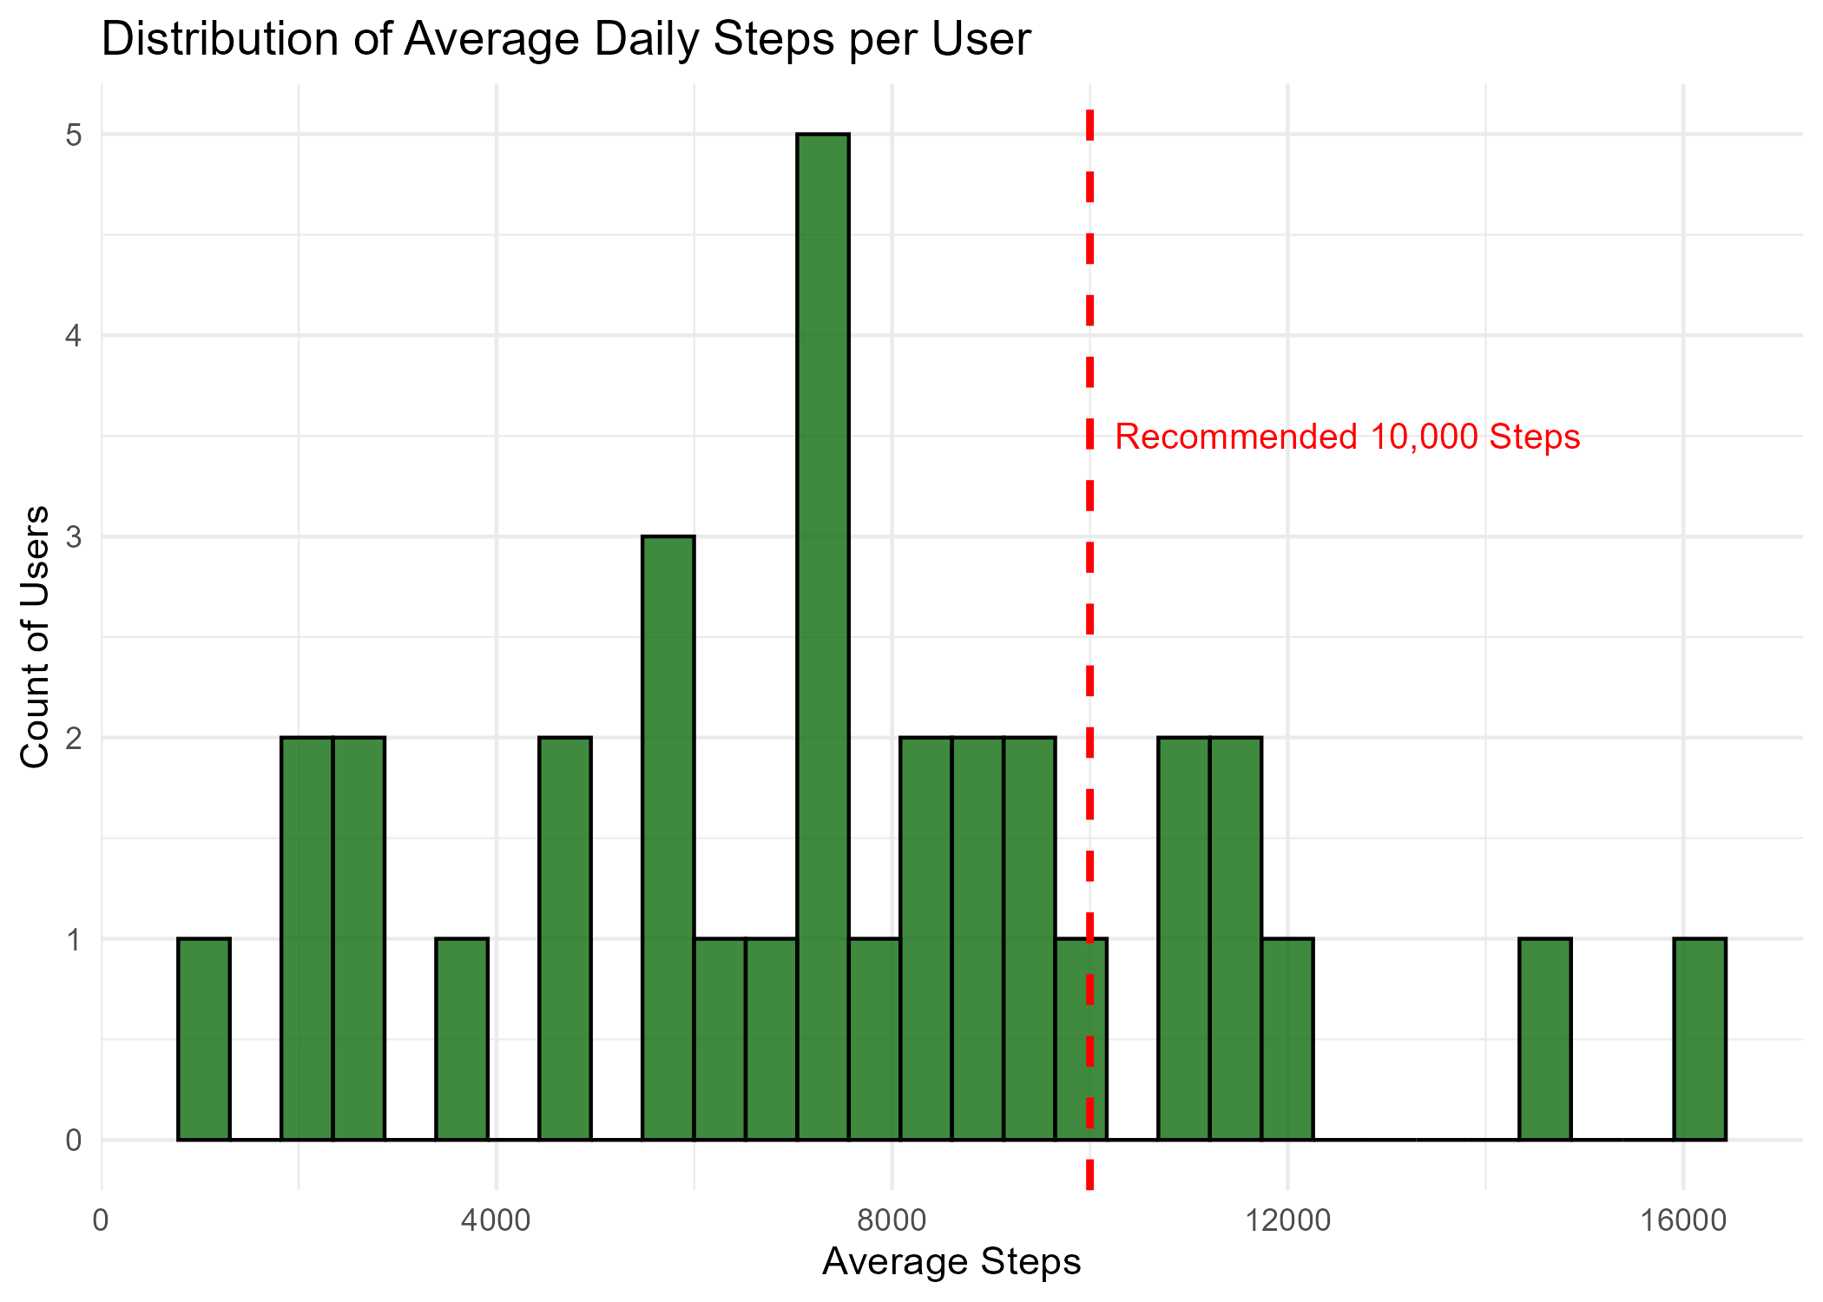
Key Insights: Physical Activity
Most users average <10,000 steps per day, indicating a generally moderate to sedentary user base.

Slide 6
User Segmentation
Activity Level | Number of Users
Highly Active | 7
Moderately Active | 18
Sedentary | 8
Segmented users by avg daily steps:
- Sedentary (<5,000): 24%
- Moderately Active (5,000–9,999): 55%
- Highly Active (10,000+): 21%

Slide 7
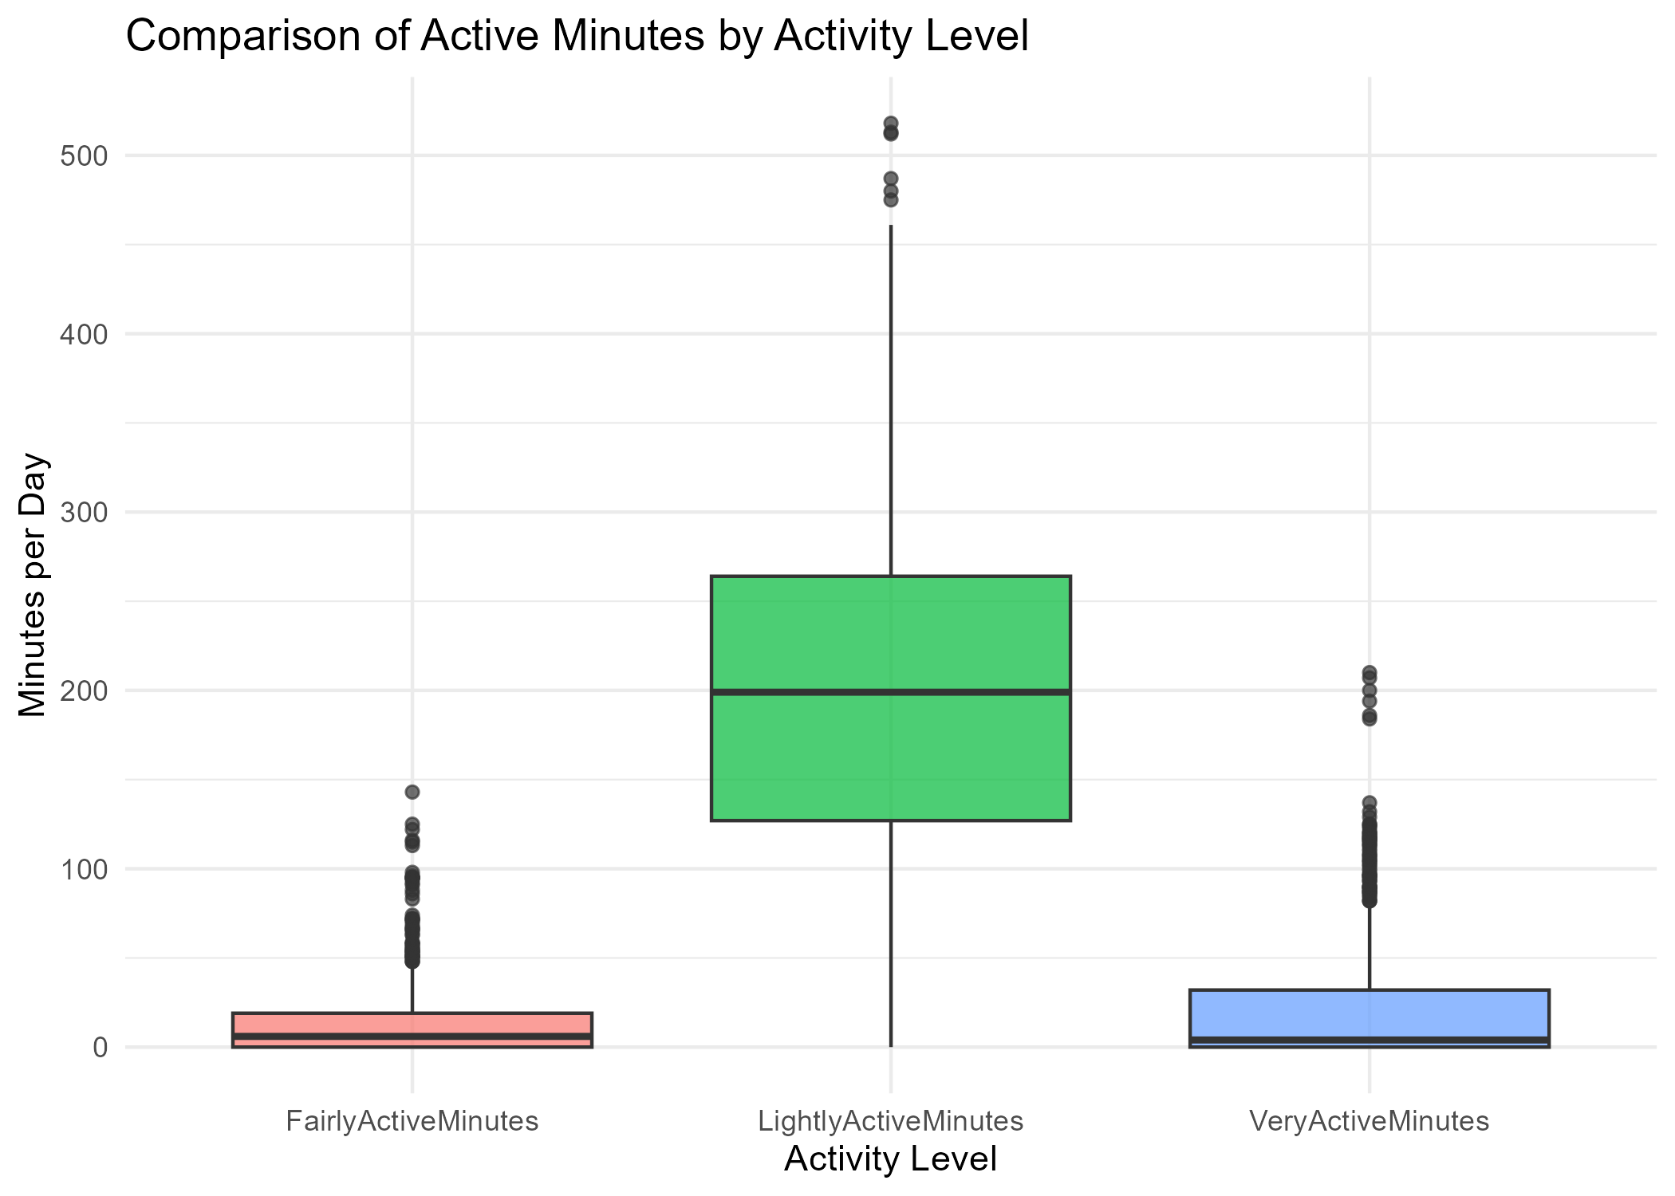
Key Insights: Physical Activity
Light activity dominates daily routines, while very active minutes are limited.

Slide 8
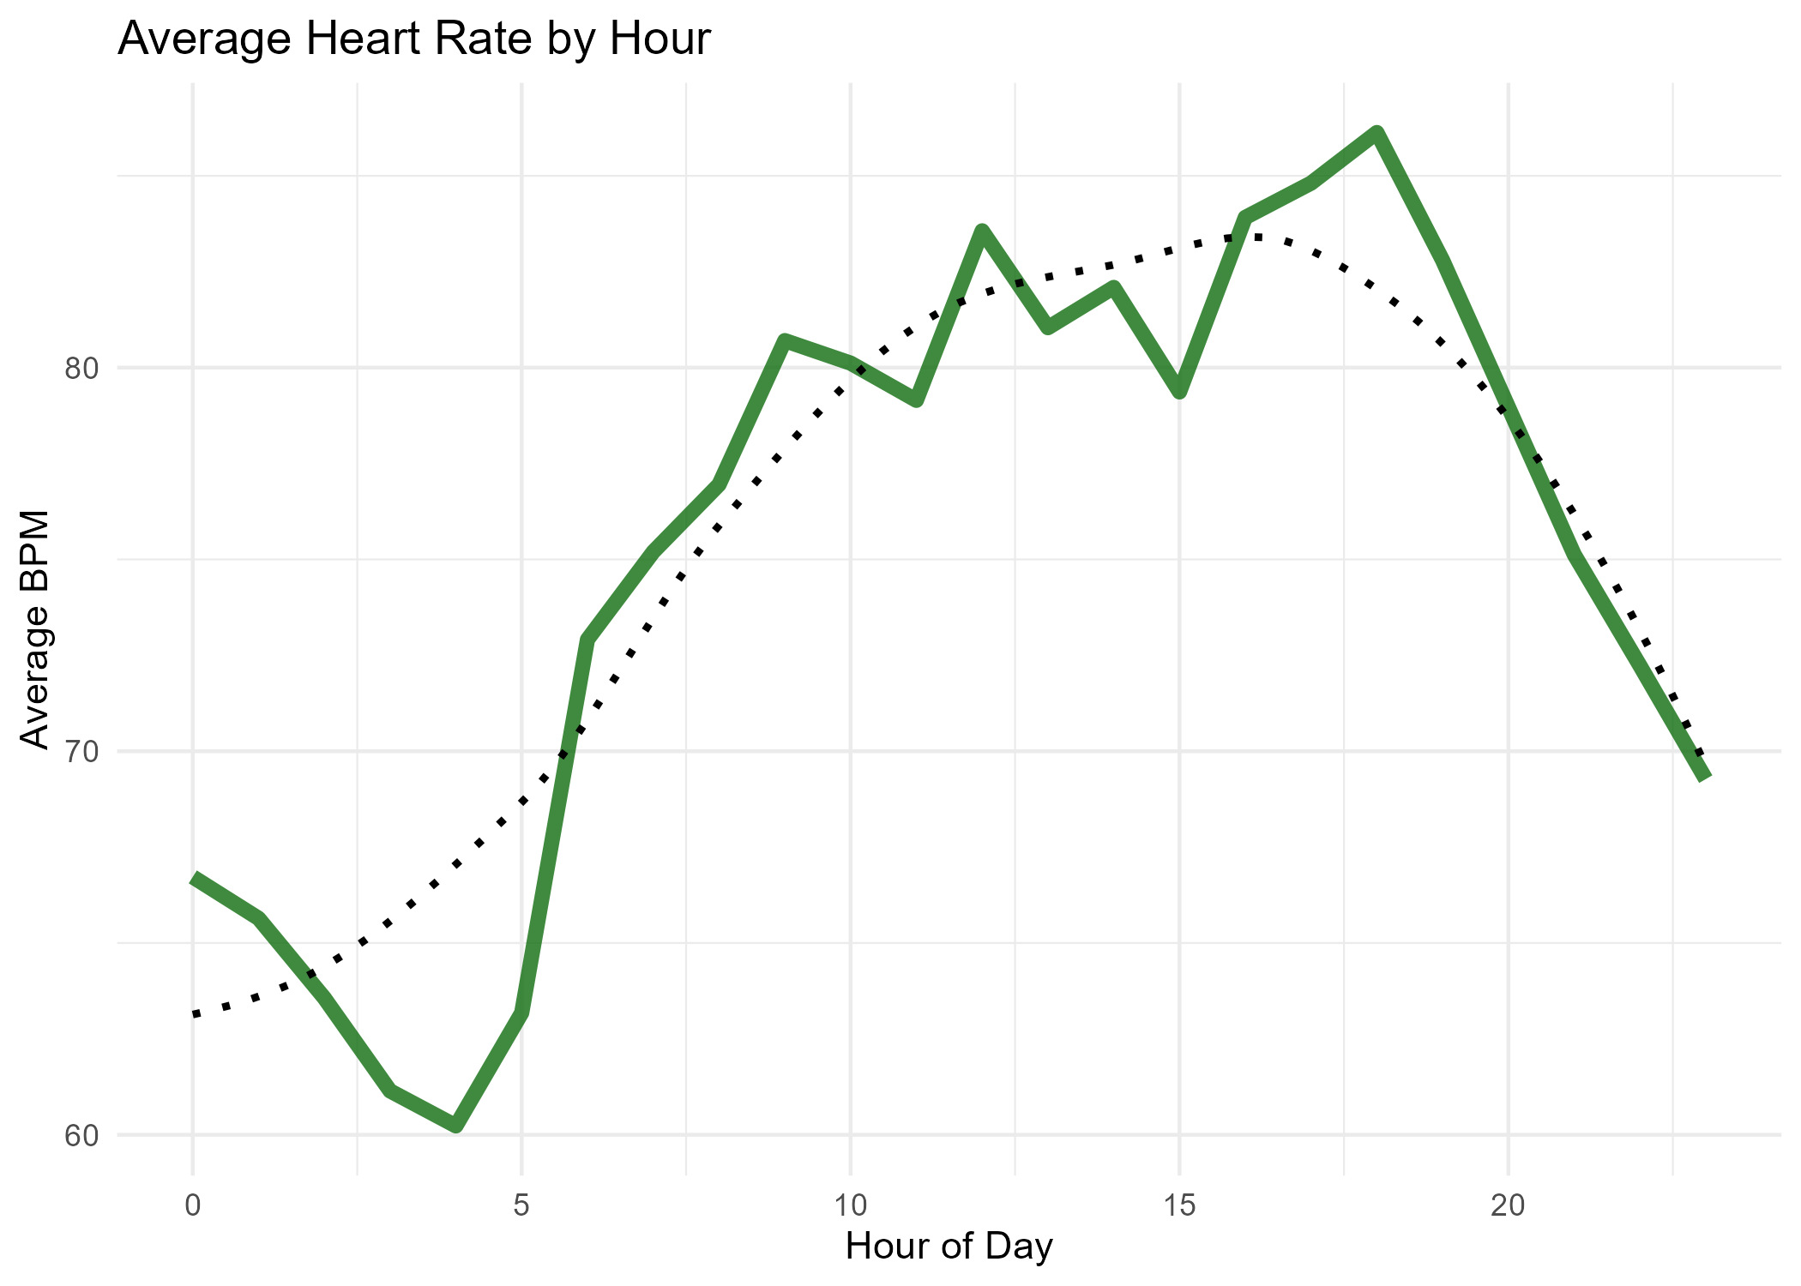
Key Insights: Heart Rate Trends
Heart rate tends to rise in the morning and stabilize in the afternoon/evening.

Slide 9
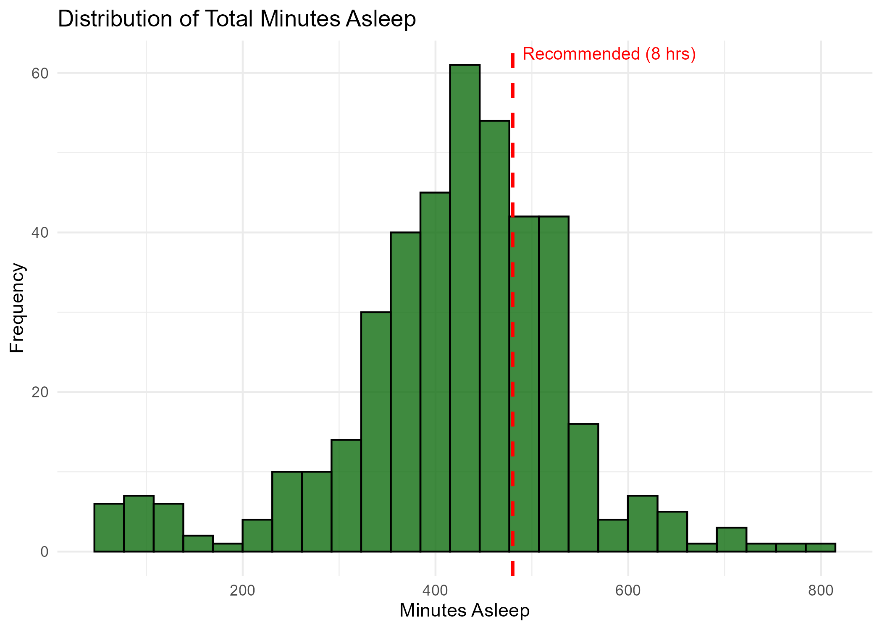
Key Insights: Sleep Behaviors
Most users sleep between 300 and 450 minutes (5–7.5 hours), below the recommended 8 hours.

Slide 10
Strategic Recommendations
1. Promote movement goals via reminders, rewards and challenges
2. Enhance sleep quality with personalized coaching tools
3. Deliver stress-reducing prompts at peak HR times (morning)
4. Tailor messaging and features by user activity level

Slide 11
Next Steps for Stakeholders
Refine campaign messaging based on user tiers
Introduce customizable goals and challenge features
Segment marketing efforts for sedentary vs active users
Explore deeper analysis with larger, more diverse datasets

Slide 12
Thank You!
Questions?
Esteban Segura | Data Analyst
GitHub: https://github.com/EstebanSP23
LinkedIn: linkedin.com/in/estebansegp

