Slide 1





CSE445
Nuclei Image Segmentation using Deep Learning
MD. Esterhaar Ahmed Emon
Md.Shahria Sarker Shuvo
Elma Khanam
Saima Arafin Smrity
FALL 2025

Slide 2
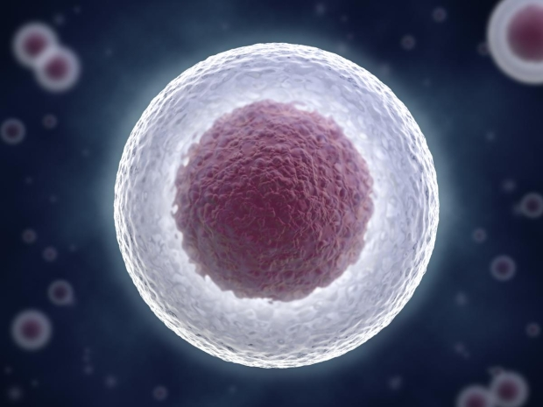

Objective:
Our project task is to take 10 whole slide images of cell nuclei with heterogeneous backgrounds and use a segmentation model to accurately extract the regions.
This supervised learning problem can be resolved with:
Data preparation
Model training
Evaluation and threshold tuning
Medical imaging comes with challenges such as :
  Variable staining
  Low contrast boundaries
  Overlapping nuclei
  Limited long-range dependency capture in CNNs

Slide 3
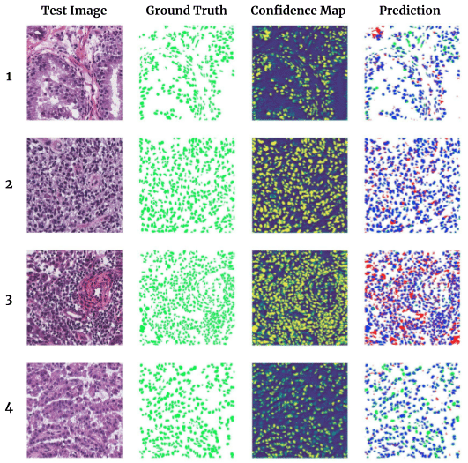
Data Collection
We selected the MoNuSeg 2018 Dataset from Kaggle for the Multi-Organ Nuclei Segmentation Challenge, which features whole-slide histopathology images with various backgrounds.
The dataset is organized into two main folders:
kmms_training
kmms_test
  58 images
  58 images
  Subfolders:
  Subfolders:
  Images
  Masks
  Images (raw histopathology images)
  Masks (ground-truth nuclei segmentation masks)
MonuSeg-2018

Slide 4

Dataset Preparation & Processing
We utilized the KMMS dataset, applying comprehensive data augmentation to address scarcity and ensure robust model training.
1.Data Loading & Balancing
Split into 68.3% train, 15.9% validation, 15.9% test for representative distributions.
3.Image Processing
Resized to 256x256 pixels, normalized, and masks binarized.
2.Augmentation Strategies
Random flips, rotation, brightness/contrast, Gaussian blur, and cropping.

Slide 5
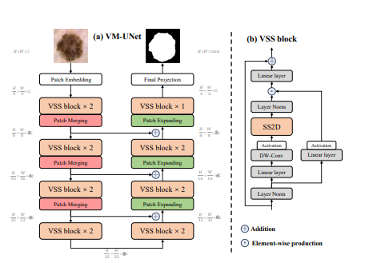




Model Selection: VM-UNet
Our project uses VM-UNet, a novel medical image segmentation architecture. It integrates Vision Mamba blocks within a U-Net framework to improve feature extraction for nuclei segmentation tasks.
VM-UNet combines U-Net's local feature extraction with Vision Mamba's global context understanding, offering linear computational complexity and global receptive fields.
U-Net Framework
Local feature extraction capabilities.
Vision Mamba Blocks
Global context understanding.
VM-UNet
Novel hybrid architecture for superior segmentation.

Slide 6
VM-UNet Architecture: Encoder-Decoder Structure
3 | Encoder | 64 | DoubleConv + VMBlock + M
512 | Bridge | 1024 | DoubleConv + VMBlock + M
128 | Decoder 4 | 64 | UpConv + Skip + DoubleConv + M
64 | output | 1 | 1x1 Conv + Sigmoid

Slide 7
Loss Functions & Optimization
We utilize a weighted combination of Dice Loss and Focal Loss for more stable training, optimized with AdamW and a learning rate scheduler.
Combined Loss:
= ( 0.6 x Dice Loss + 0.4 x Focal Loss)
Optimizer:
AdamW with learning rate (10-4) and weight decay (10-5)
Scheduler:
We used the ReduceLROnPlateau scheduler to automatically reduce the learning rate when the validation performance stopped improving. This helped stabilize training and avoid getting stuck when the loss plateaued ment.

Slide 8
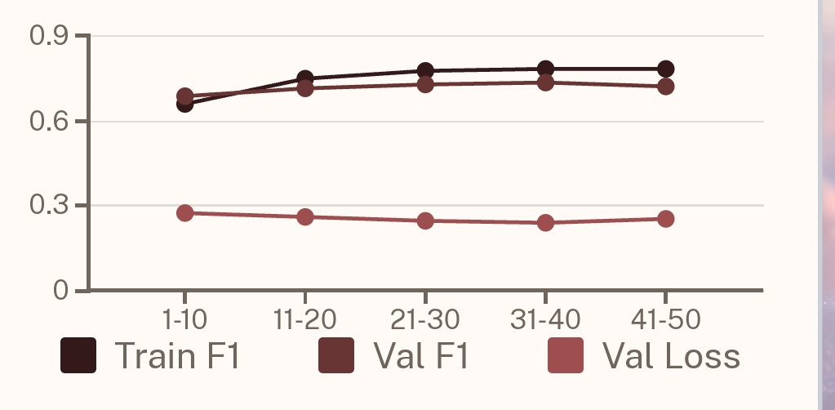
Experimental Results: Training Performance
  Gradual improvement in training and validation F1-score
  Our selected Model achieved Best validation F1 around epoch 40
Even with limited data, our chosen model was able to learn significant features

Slide 9
VM-UNet FINAL TEST RESULTS
OPTIMAL TRESHOLD | 0.3
TEST LOSE | 0.2774
PRECISION | 0.7332
RECALL | 0.6404
ACCURACY | 0.8965
F1-Score | 0.6837
  Thresholds (0.3 – 0.7) were tested
The Monuseg2018 dataset was small, but it achieved good performance despite its limited size.

Slide 10
Conclusion:
Our project successfully applied a complete machine learning pipeline for nuclei segmentation using histopathology images with diverse backgrounds. The VM-UNet approach achieved reliable performance despite a limited dataset, balancing computational efficiency and accuracy compared to more complex models. Key factors included careful dataset preparation, data augmentation, balanced splitting, and appropriate evaluation methods. Performance limitations were due to dataset size and staining variations. Testing the model on larger datasets like MoNuSeg and TNBC could further enhance our understanding of scalability and training behavior.

Slide 11

THANK YOU
Stay tuned with ML

Slide 12
Thank you

