Slide 1


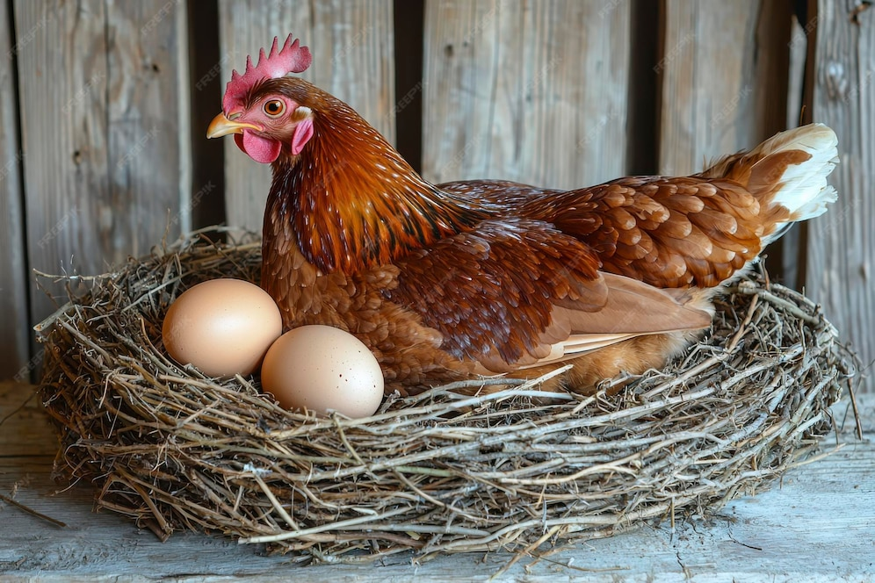
Architecture and Service Platforms
NEST
Next-generation Edge System for Tracking
Group 2 | Alejandro Botas Bárcena
 | Javier Grimaldos Chavarría
 | Estela Mora Barba
Date | 13 February 2026

Slide 2
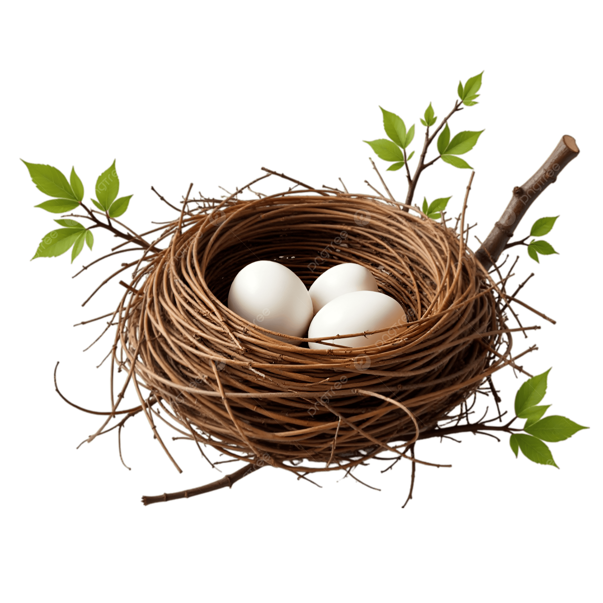
Architecture and Service Platforms
Summary
1
General Overview
2
Requirements
3
Proposal Description
4
Demo
5
Results
6
Conclusions and Future Works
2

Slide 3
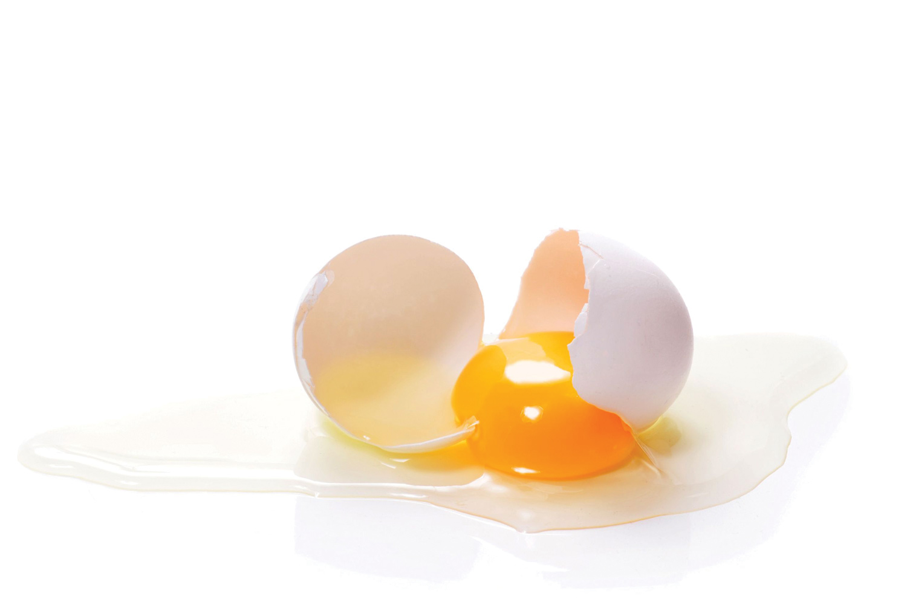
Architecture and Service Platforms
Motivation
1
2
3
4
5
6
General Overview
3

Slide 4
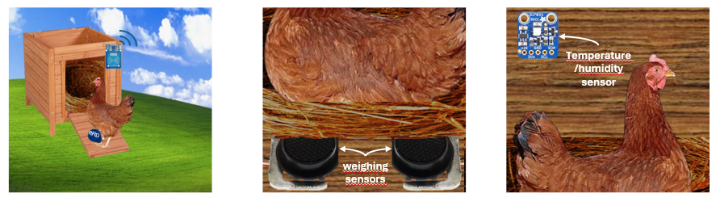
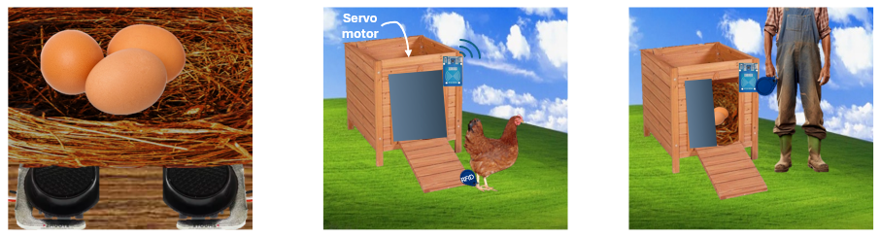
Architecture and Service Platforms
Project Idea
1
2
3
4
5
6
General Overview
4

Slide 5
Architecture and Service Platforms
Requirements and Functionalities
Alarms (Periodic and non-periodic)
Knowledge extraction form the IoT network
The system fuses data by gathering all the telemetry and encapsulating it into a structured JSON every period (10 seconds by default)
Sensing and acting (real and simulated)
The system has several sensor, like a temperature and humidity sensor and a weight sensor; and actuator like a servo motor and a RGB
Periodic Measurements
The system periodically measures the temperature, the humidity, the weight and the UID read by the RFID
Fusion of information
Commanding the IoT network (Server side) and Visualization
Through the use of the ThingsBoard interface and the Telegram bot developed the IoT network can be commanded
The system extracts the state of the nest from the information gathered: If the nest is empty, If the hen is in the nest, If there are eggs in the nest and how many eggs are present.
The system creates alerts when any of the telemetry is out of bounds and when there are eggs present in the nest
1
2
3
4
5
6
Requirements
5

Slide 6
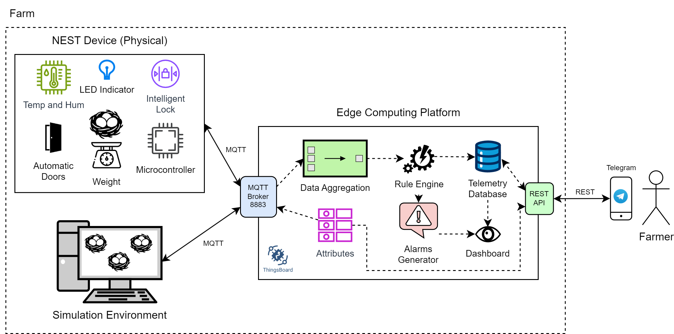
Architecture and Service Platforms
System Architecture
1
2
3
4
5
6
Proposal Description
6

Slide 7





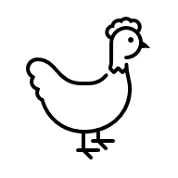
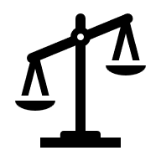

Architecture and Service Platforms
NEST Device - Functions
Periodical Measurement
Non-Periodical Measurement
Commands (Attributes)
Temperature
Humidity
RGB
UID
Door
Weight
UID
Period
1
2
3
4
5
6
Proposal Description
7

Slide 8
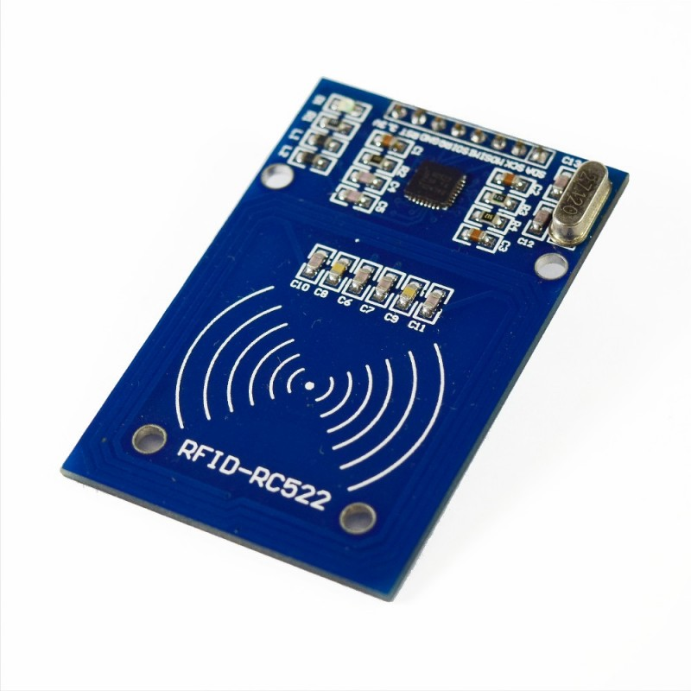
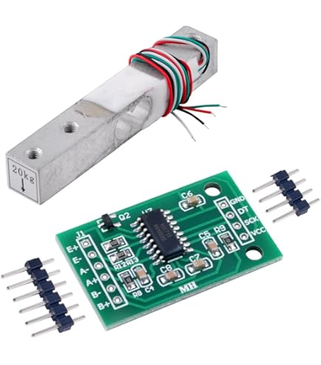
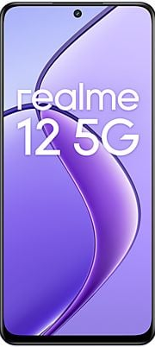
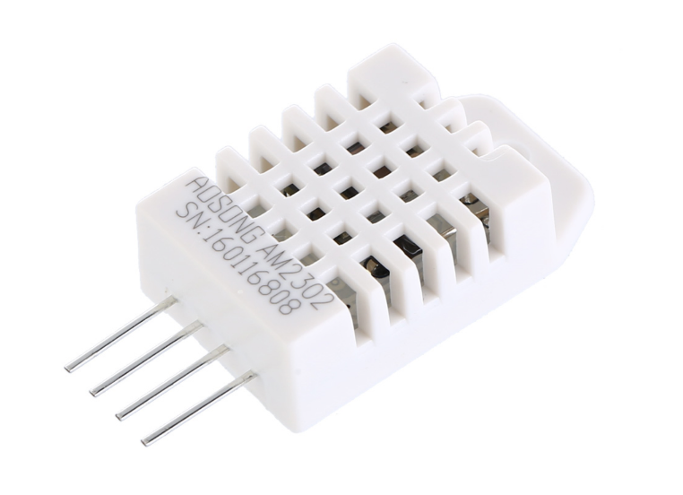
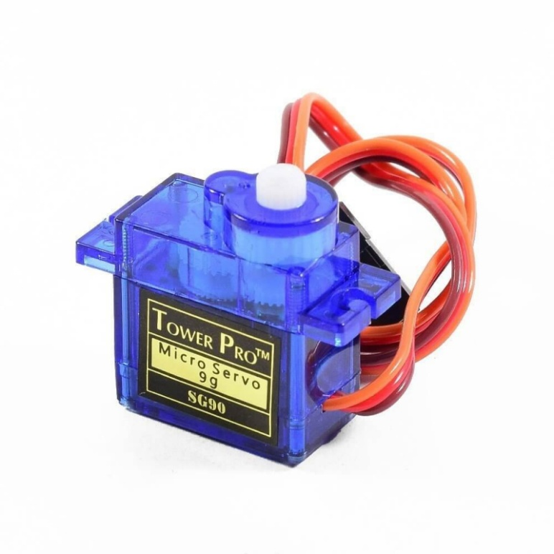
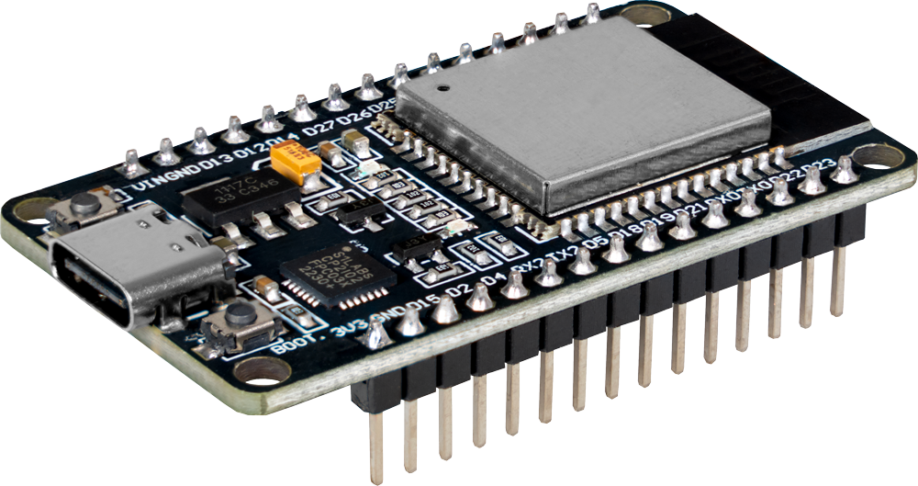
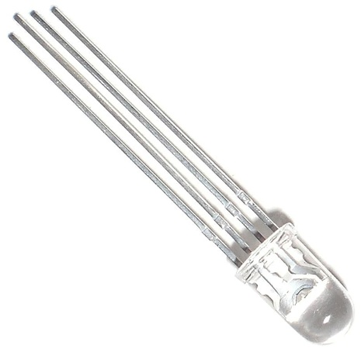
Architecture and Service Platforms
NEST Device - Hardware
DHT22
Load Cell + HX711
MRFC522
Mobile Phone
SG90-180
RGB LED
ESP32
1
2
3
4
5
6
Proposal Description
8

Slide 9
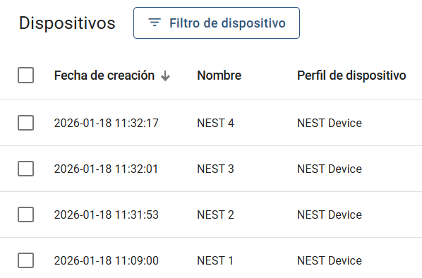
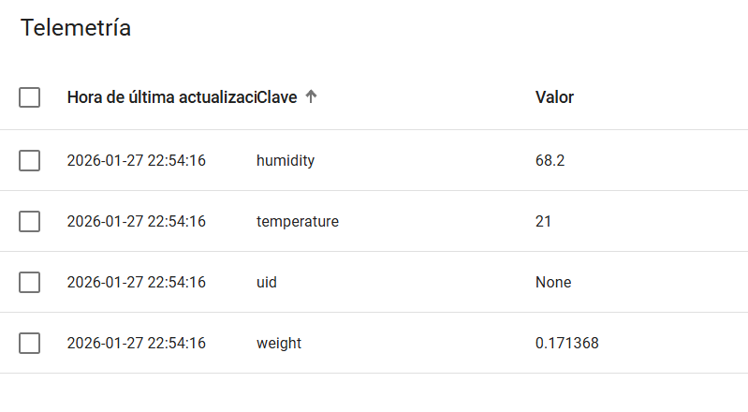
Architecture and Service Platforms
ThingsBoard - Devices
1
2
3
4
5
6
Proposal Description
9

Slide 10
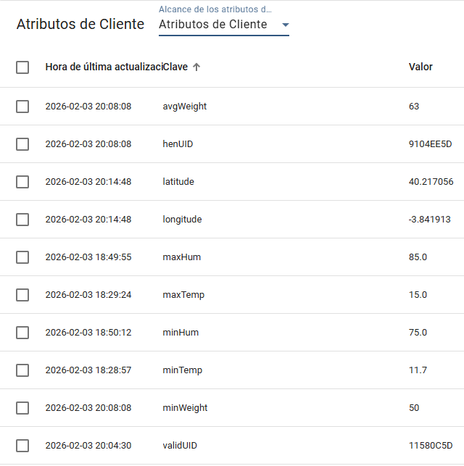
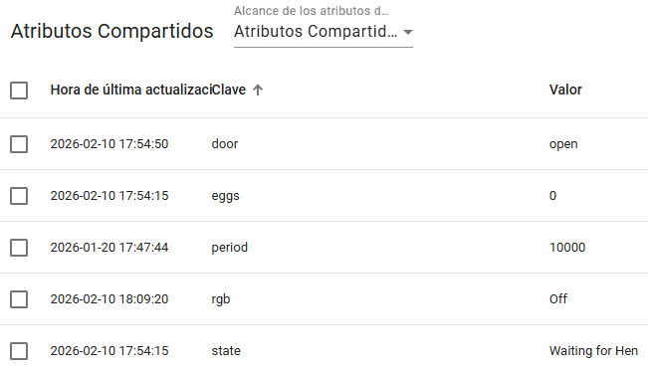
Architecture and Service Platforms
ThingsBoard - Devices
1
2
3
4
5
6
Proposal Description
9

Slide 11
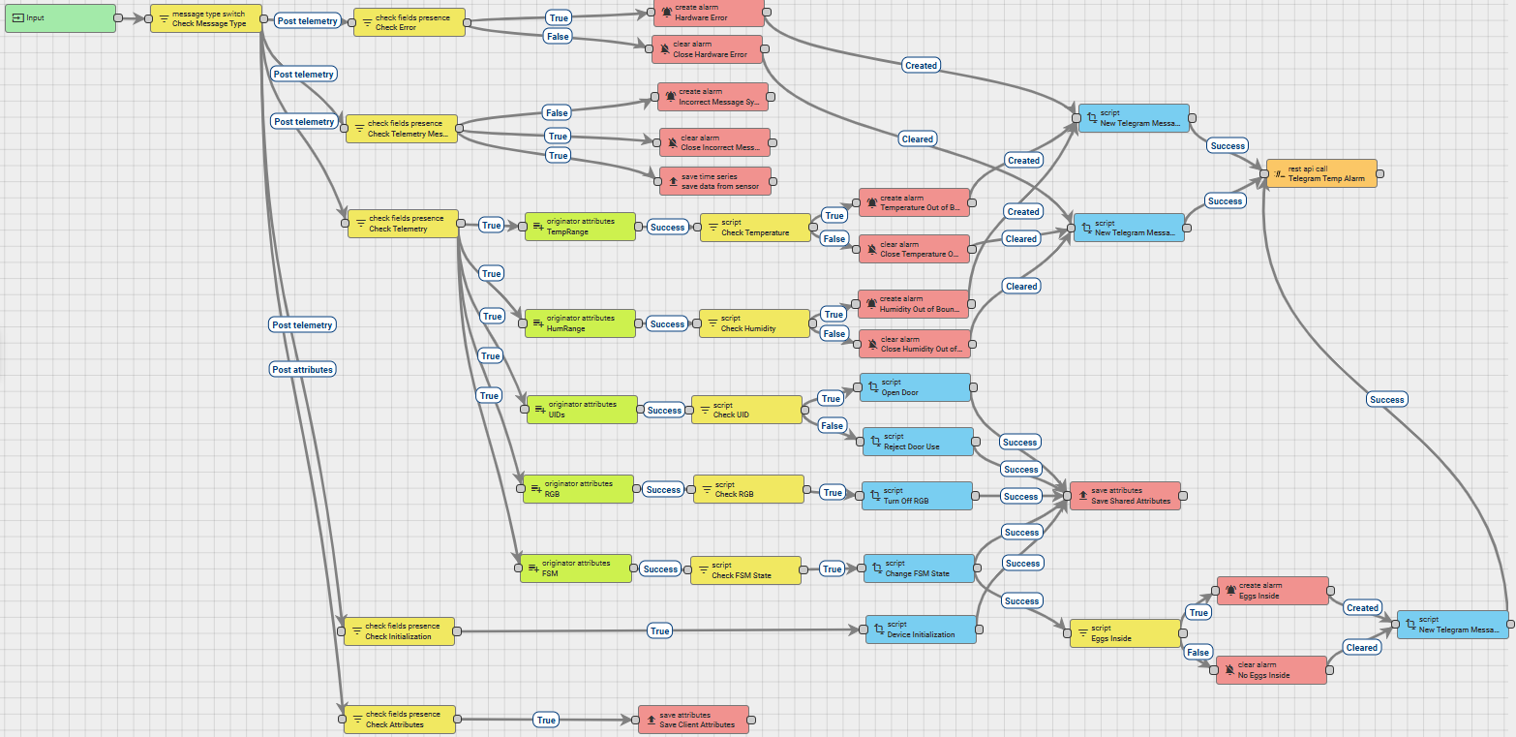
Architecture and Service Platforms
ThingsBoard - Rule Chain
1
2
3
4
5
6
Proposal Description
10

Slide 12
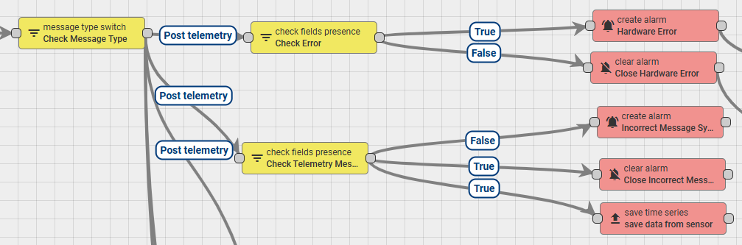
Architecture and Service Platforms
ThingsBoard - Rule Chain
1
2
3
4
5
6
Proposal Description
10

Slide 13
Architecture and Service Platforms
ThingsBoard - Rule Chain
1
2
3
4
5
6
Proposal Description
10

Slide 14
Architecture and Service Platforms
ThingsBoard - Rule Chain
1
2
3
4
5
6
Proposal Description
10

Slide 15
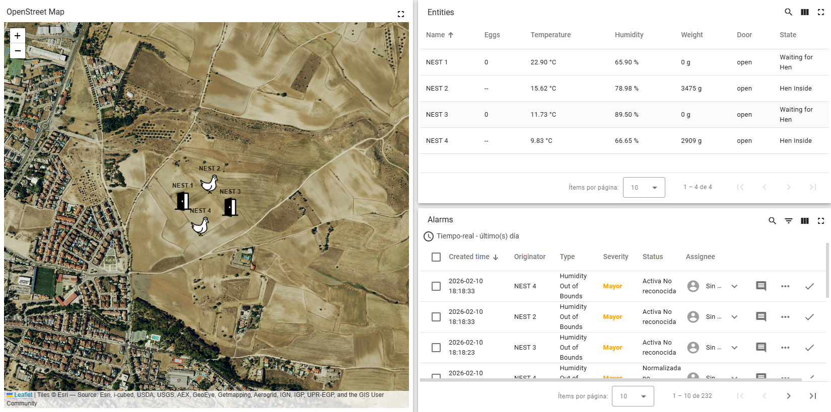
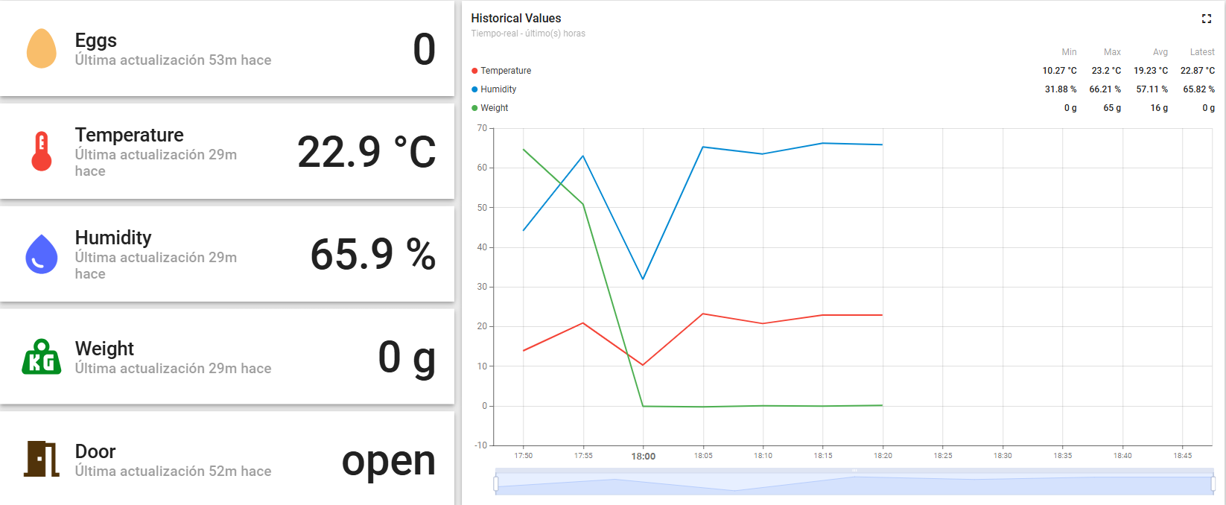
Architecture and Service Platforms
ThingsBoard - Dashboard
1
2
3
4
5
6
Proposal Description
11

Slide 16
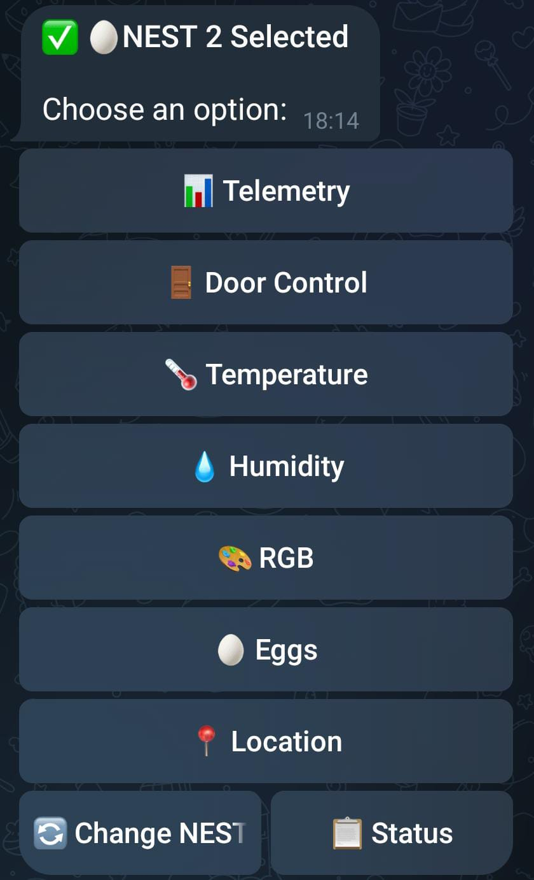
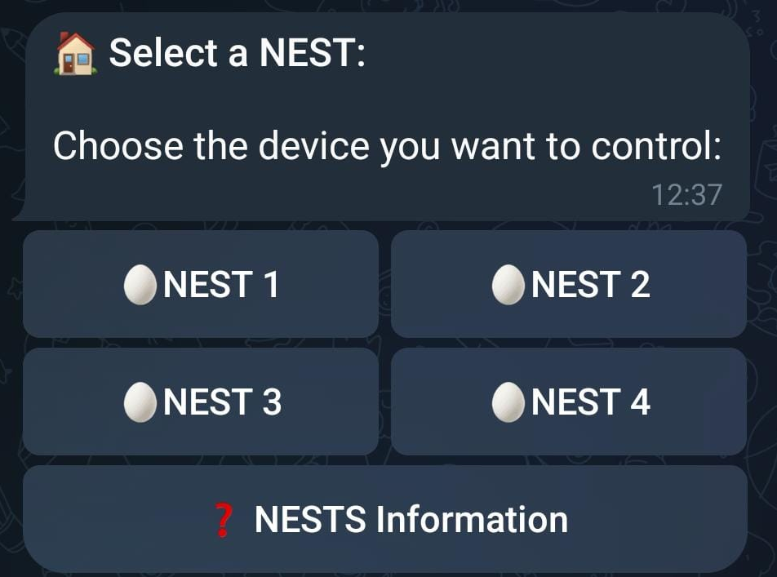
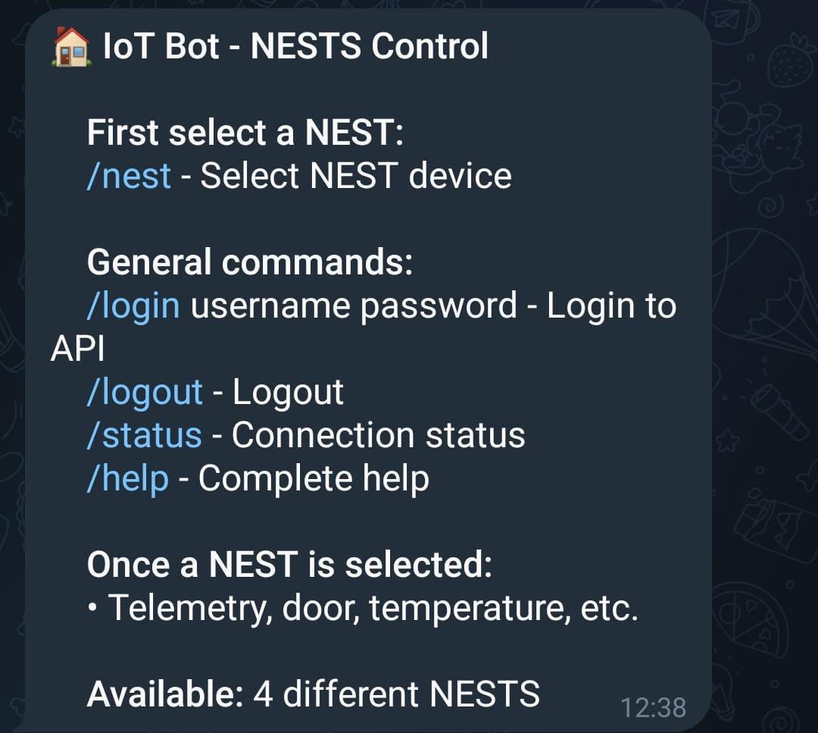
Architecture and Service Platforms
ThingsBoard - Telegram
1
2
3
4
5
6
Proposal Description
11

Slide 17
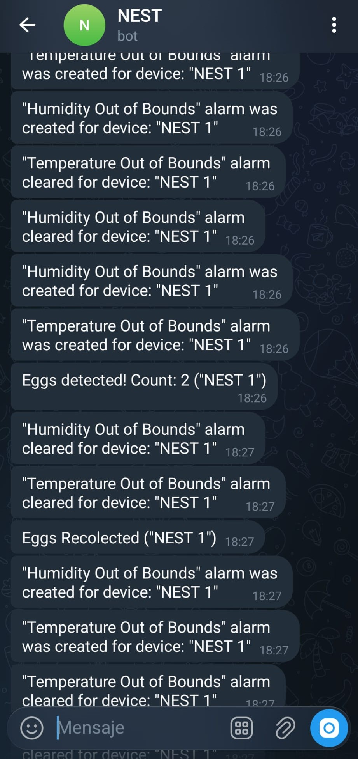
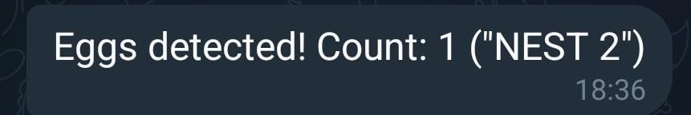
Architecture and Service Platforms
ThingsBoard - Telegram
1
2
3
4
5
6
Proposal Description
11

Slide 18
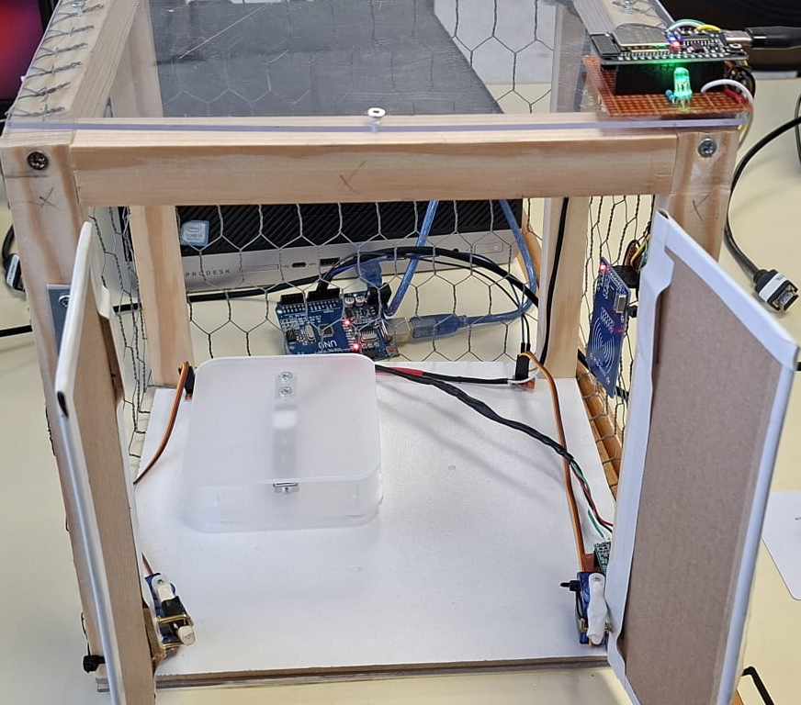
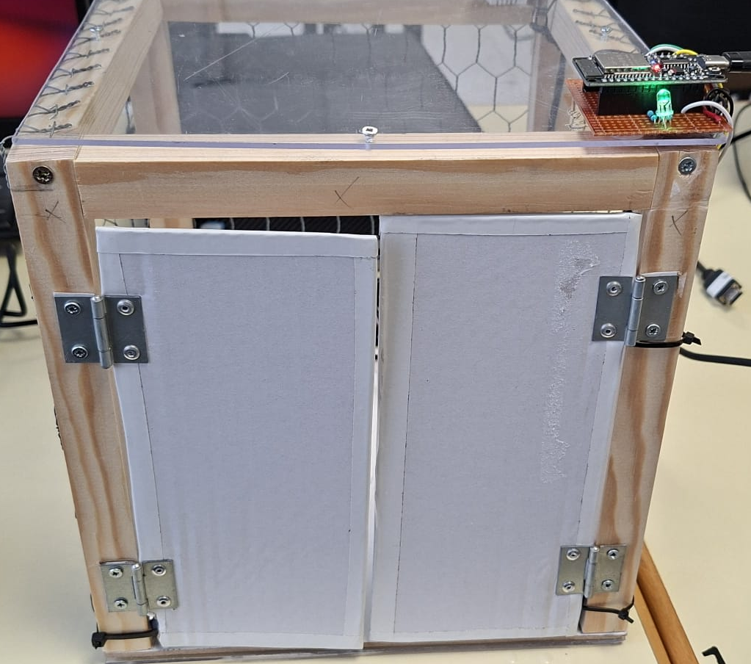
Architecture and Service Platforms
Demo
1
2
3
4
5
6
Demo
12

Slide 19
Architecture and Service Platforms
Test and Results
Test | Description
Unitary Tests | Check each hardware peripheral
Local Test | Verify data acquisition
ThingsBoard | Connection between NEST Devices and ThingsBoard platform
Attributes Changes | Command execution
System Integration | End-to-end
1
2
3
4
5
6
Results
13

Slide 20

Architecture and Service Platforms
Conclusions
Developed an IoT ecosystem for hen farms
Deployed an autonomus Edge decision-making
Low latency and local autonomy system
Unified network capable of handling diverse data streams
1
2
3
4
5
6
Conclusions and Future Work
14

Slide 21
Architecture and Service Platforms
Future Work
Predictive Analytics
Telegram Updates
Enhanced Dashboard
Power Optimization
Sustainability and Energy Harvesting
Multi-Protocol Redundancy
Historical data stored in the ThingsBoard Telemetry Database to implement machine learning models at the Edge for predicting egg-laying patterns and identifying illness based on environmental anomalies.
Better control of the users and actions that are able to be done with the bot, such as creating UIDs for animals and users, controlling the door or implementing more types of birds.
Develop more visualizations and alerting mechanisms on the dashboard, including real-time heatmaps of environmental conditions and predictive maintenance alerts based on sensor data trends.
Deep-sleep modes for the ESP32 to enhance energy efficiency, for future deployments using batteries or solar power in remote farm areas.
Research the integration of solar photovoltaic panels to create a maintenance-free energy cycle for the NEST device, reducing the reliance on external power bridges.
Implement a fallback communication strategy using LoRaWAN to ensure that critical alarms and autonomous edge decisions are transmitted even during Wi-Fi outages, which are common in rural farming environments.
1
2
3
4
5
6
Conclusions and Future Work
15

Slide 22
Architecture and Service Platforms
Thank you
Questions?

