Slide 1


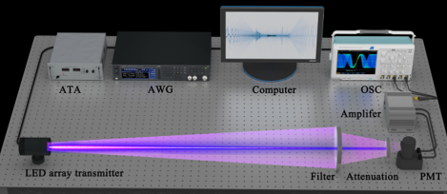
Sensor Networks
UV Wireless Communication
Sensor Networks - Challenge 1
Group Orange | Alejandro Botas Bárcena
 | Javier Grimaldos Chavarría
 | Estela Mora Barba
Date | 09 February 2026
https://ieeexplore.ieee.org/document/10843247

Slide 2
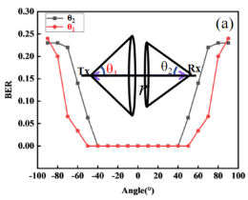
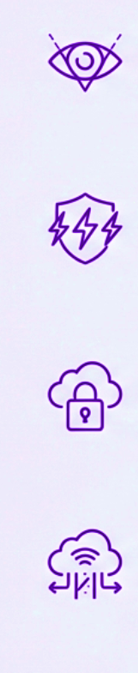
Sensor Networks
About the technology
Large Field of View (FoV)
- Transmitter covers 120⁰ (-60⁰ to +60⁰)
- Receiver captures 100⁰
- No complex alignment required
Interference Immunity
- Immune to EMI and RF jamming
- Ideal for electromagnetically noisy environments
Security
- High atmospheric absorption prevents long-range interception or wall penetration
Resilience
- Atmospheric scattering enables connectivity in obstacle-rich environments
2

Slide 3
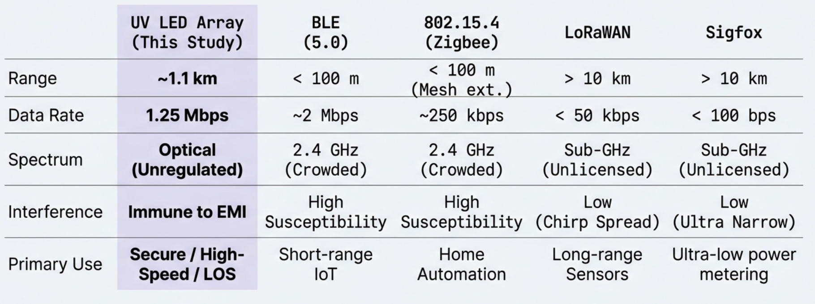
Sensor Networks
Comparison
3

