Slide 1


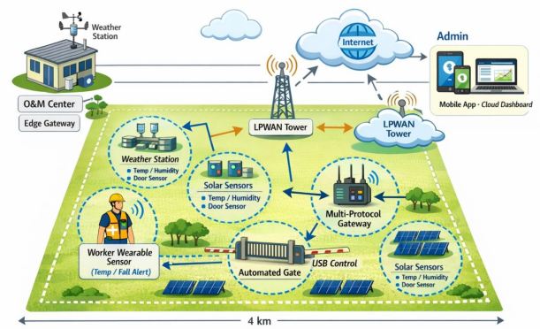
Sensor Networks
The Solar Plant
Sensor Networks - Challenge 2
Group Orange | Alejandro Botas Bárcena
 | Javier Grimaldos Chavarría
 | Estela Mora Barba
Date | 09 February 2026

Slide 2
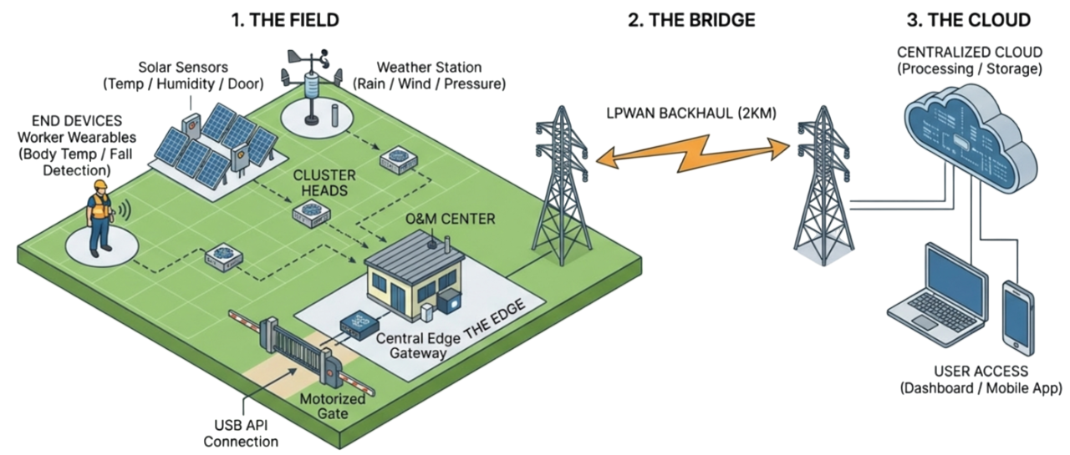
Sensor Networks
System Architecture
LTE-M
ZigBee
2

Slide 3
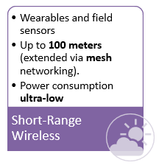
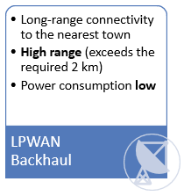
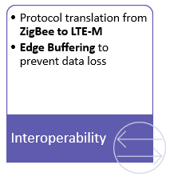
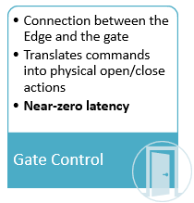
Sensor Networks
Communication Stack
ZigBee (IEEE 802.15.4)
LTE-M
Multi-protocol
Edge Gateway
USB-Accessible API
3
Interoperability
Protocol translation from ZigBee to LTE-M
LPWAN Backhaul
Long-range connectivity to the nearest town
Gate Control
Connection between the Edge and the gate
Edge Buffering to prevent data loss
Short-Range Wireless
Wearables and field sensors
Up to 100 meters (extended via mesh networking).
Power consumption ultra-low
Power consumption low
High range (exceeds the required 2 km)
Translates commands into physical open/close actions
Near-zero latency

Slide 4
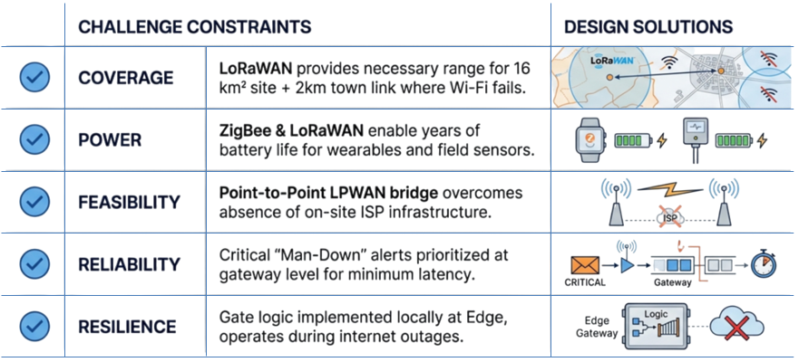
Sensor Networks
Design Justification
CHALLENGE CONSTRAINTS
DESIGN SOLUTIONS
COVERAGE
LTE-M provides necessary range for the communication with the town (2 km)
LTE-M
POWER
ZigBee enables years of battery life for wearables and field sensors
FEASIBILITY
LTE-M eliminates the message-per-day constraints of LoRaWAN
RELIABILITY
LTE-M offers lower latency than LoRaWAN, critical for the fall alerts
RELISIENCE
Gate logic implemented at Edge to operate even during internet outages
4

