Slide 1

Real Time AI:
Confluent Intelligence & watsonx Orchestrate
Demo walkthrough: from a customer ticket to a governed agent
IBM watsonx Orchestrate + Confluent
Data Streaming World Tour Paris · October 1, 2026 · 2:15–3:00 pm
François Estepa (IBM) · Daniel Petisme (Confluent)
Notes:
Hello everyone. The idea fits in one sentence: an AI is only useful if it works on fresh data and if what it does is under control. Confluent takes care of the first half, data in real time. watsonx Orchestrate takes care of the second, agents that act under control.
The thread: a customer has an order-tracking problem. We follow their ticket from the click to the advisor's reply.

Slide 2
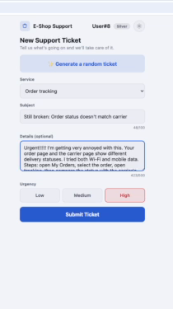
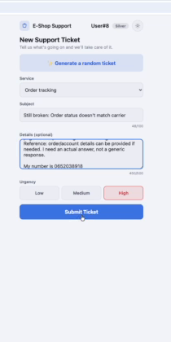
A customer opens a ticket
1 · The customer
2
From one click, an event: the ticket is published to a Kafka topic the moment the customer submits it, ready for every consumer downstream.
Ticket details, urgency High
Submit: the ticket is published
Notes:
Everything starts with a customer. Their order status is not the same on our site and at the carrier, and it is not the first time. They fill in the form, choose high urgency and submit.
From this click, the ticket is no longer a row waiting in a database: it is an event, published immediately to Kafka. Every system that needs it receives it at the same time, without wiring them one by one.

Slide 3
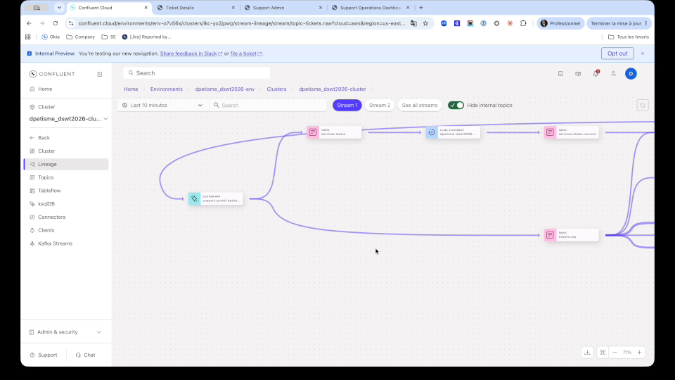
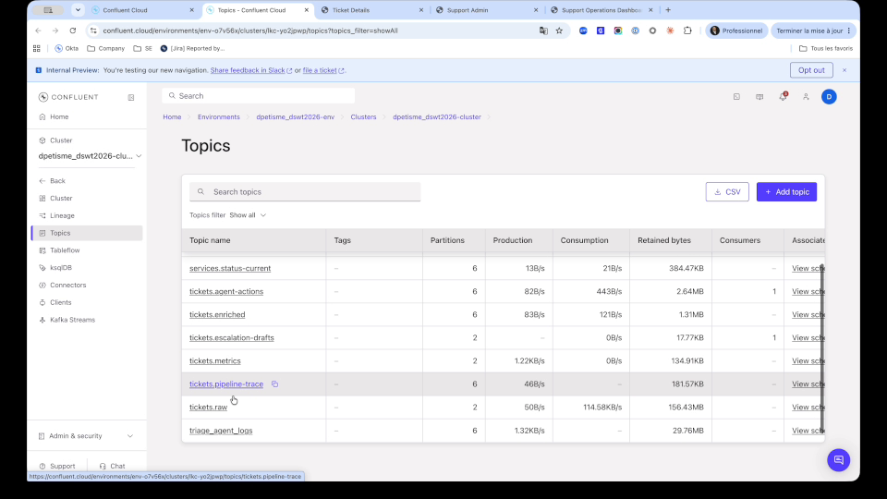
The whole pipeline, live
2 · Confluent: the stream
3
Stream Lineage: producer, Flink statements, topics
One topic per stage: raw, enriched, metrics, agent actions, drafts
No nightly batch: every arrow is data moving now. Each stage writes a topic that any team or agent can reuse. Produce once, consume many.
Notes:
This is what happens behind, in Confluent Cloud. Stream Lineage draws the pipeline while it runs: on the left the portal producing tickets, in the middle the processing that enriches and triages them, on the right the topics where they land.
There is no nightly batch: every arrow is data moving now. Each stage writes its result to a topic: raw tickets, enriched tickets, metrics, agent decisions, escalation drafts. Another team or another agent can plug into any of them. Produce once, consume many.

Slide 4
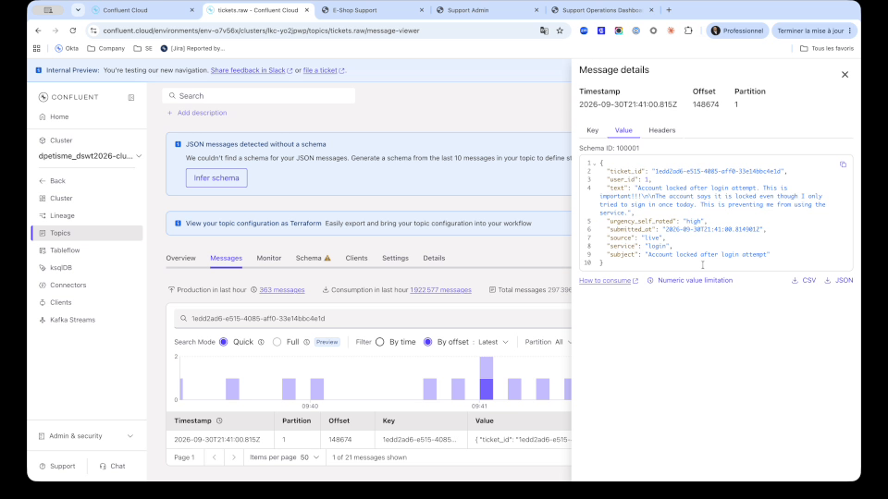
Every ticket follows a contract
2 · Confluent: the stream
4
Governed by design: each message is validated against a schema in Schema Registry, the contract that lets other teams and agents reuse the stream safely.
tickets.raw: our customer's ticket and its schema
Notes:
Let's find our customer's ticket in the first topic, tickets.raw. The chart shows tickets keep arriving: hundreds over the last hour, all handled the same way, with no human involved.
The message holds the identifier, the user, the service, the subject, the text and the urgency. Above all, it follows a schema registered in Schema Registry. It is a contract: if an application sends a malformed ticket, it is rejected. That is what lets other teams reuse this stream with confidence.

Slide 5
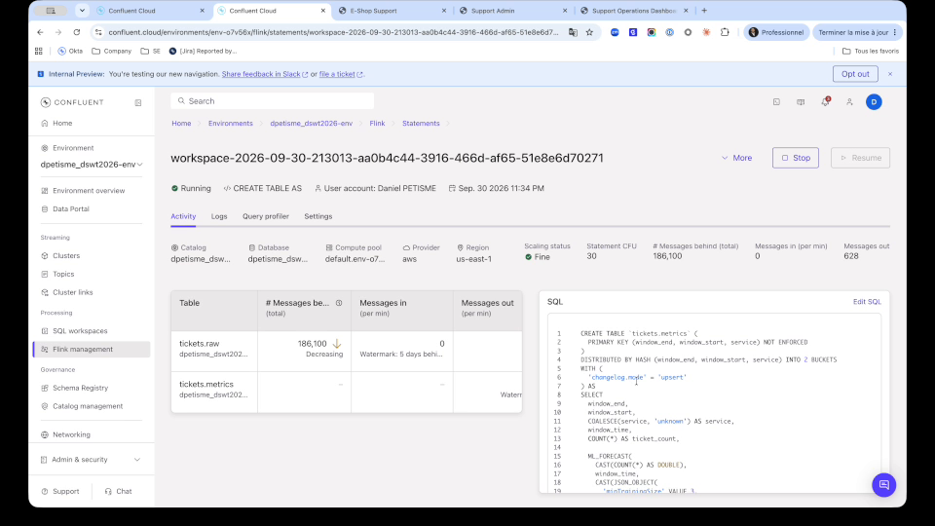
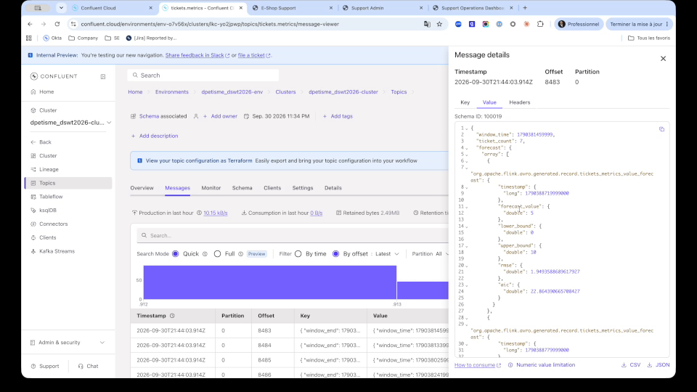
Forecasting load in SQL with ML_FORECAST
3 · Flink: AI in SQL
5
Flink statement: counts per window + ML_FORECAST
tickets.metrics: actual count, forecast and bounds
See the spike coming: volumes per service and their forecast are computed continuously, in SQL, next to the data.
Notes:
First processing step: anticipating support load. This statement, written in SQL in Flink, continuously counts tickets per service and time window, then calls ML_FORECAST, a built-in forecasting function, to estimate the next window.
The result lands in tickets.metrics: for each service, the actual volume, the forecast and an upper and lower bound. The support manager sees the spike coming before the queue explodes and can reinforce the team in time. If the actual volume leaves the range, it signals an anomaly, an incident for example.

Slide 6
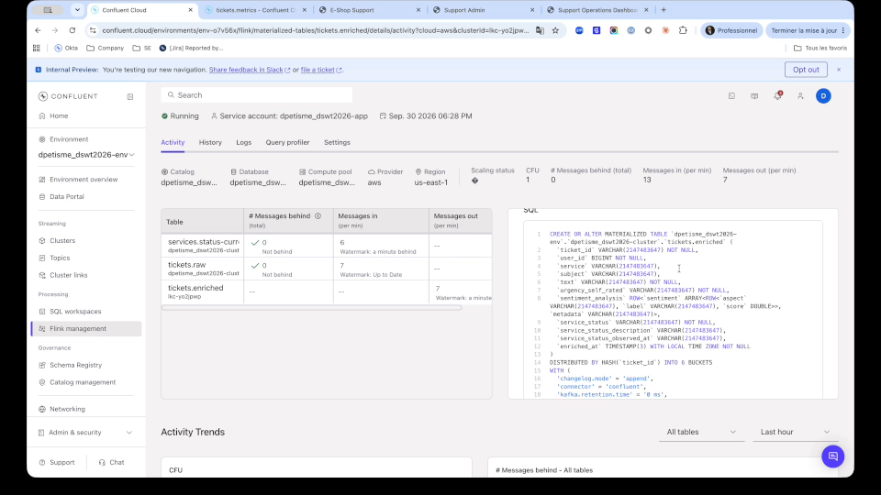
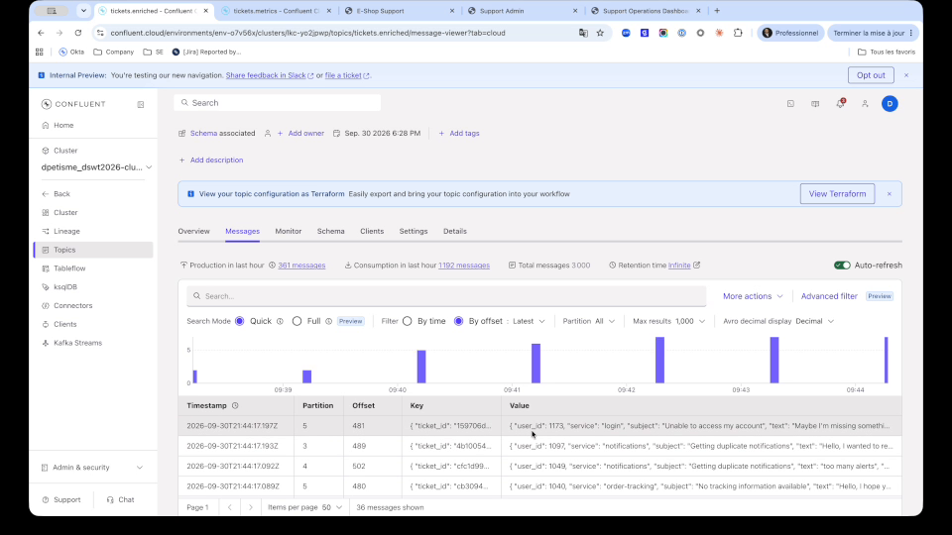
Enrichment: live service status + AI_SENTIMENT
3 · Flink: AI in SQL
6
Materialized table: temporal join + AI_SENTIMENT
tickets.enriched: sentiment per aspect and service status
Context for better decisions: every ticket carries the customer's sentiment and the live status of the service it concerns.
Notes:
Second step: enrichment. For each ticket, Flink looks up the current status of the service concerned, for example "is order tracking degraded right now?", and applies AI_SENTIMENT to the text to measure how the customer feels. A few lines of SQL.
Each enriched ticket now carries context the raw ticket did not have: here a negative sentiment and the service status at the time it was sent. That is exactly the context an agent needs to make a good decision.

Slide 7
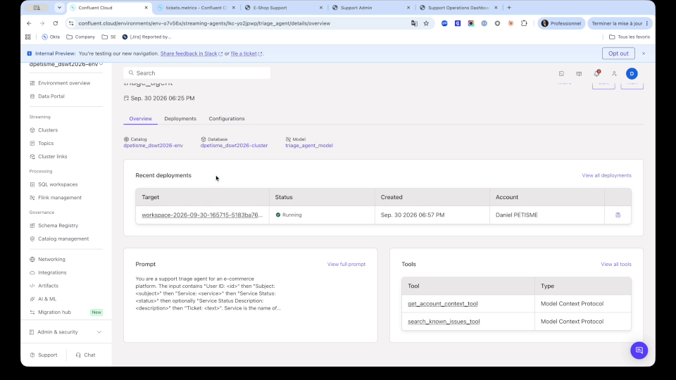
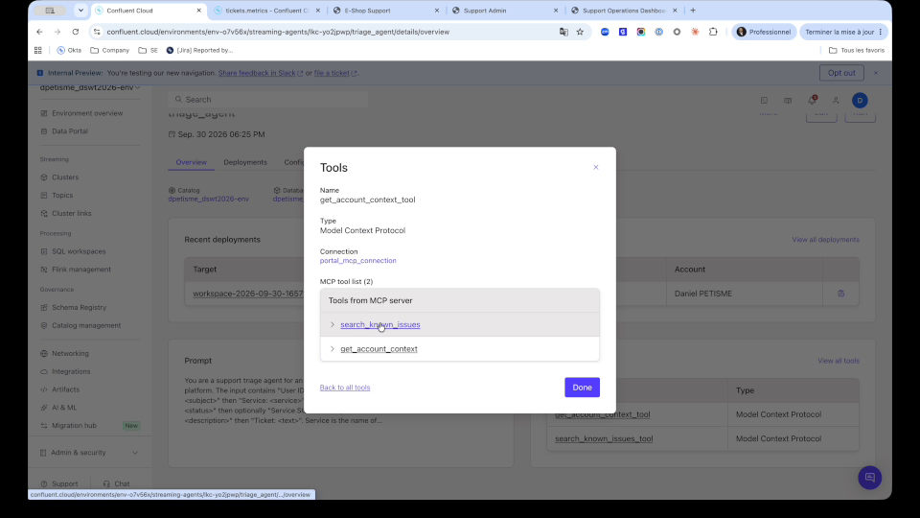
The triage agent: a Streaming Agent with MCP tools
4 · The triage agent
7
triage_agent: prompt, model, deployment
Tools exposed over MCP by the portal
An agent next to the data: get_account_context and search_known_issues give it the customer's history and the known incidents.
Notes:
Then comes the triage agent. It is a Confluent Streaming Agent: an AI agent running directly in the stream, next to the data.
We see its configuration: its prompt, its model, and two tools exposed by our portal over MCP. get_account_context gives it the customer's tier and history. search_known_issues lets it check whether the problem matches a known incident.

Slide 8
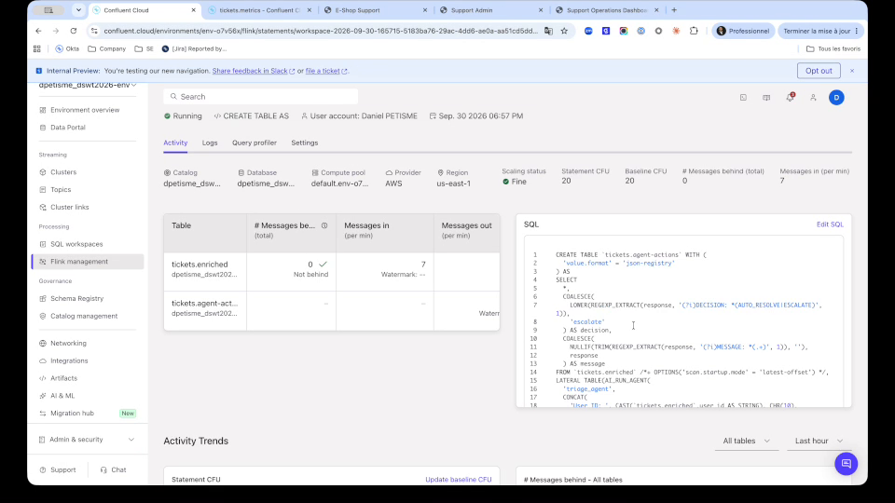
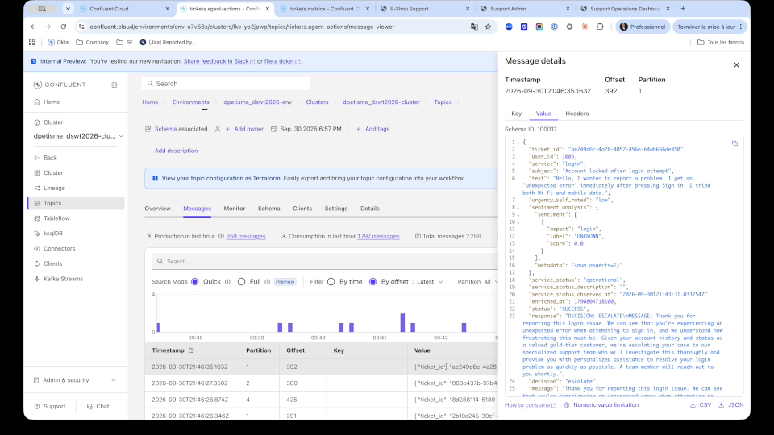
AI_RUN_AGENT decides: resolve or escalate
4 · The triage agent
8
CREATE TABLE AS ... AI_RUN_AGENT
tickets.agent-actions: decision escalate and its message
Most tickets never need a human: the ones that do arrive already qualified, with the agent's reasoning.
Notes:
The agent runs through the AI_RUN_AGENT function, called in a SQL statement. For each enriched ticket, it decides: either it resolves the ticket with a known solution, or it escalates to a human.
In tickets.agent-actions we see the result for our customer: decision "escalate", with a message written for them. Most tickets never need a human. Those that do arrive already qualified, with the agent's reasoning.

Slide 9
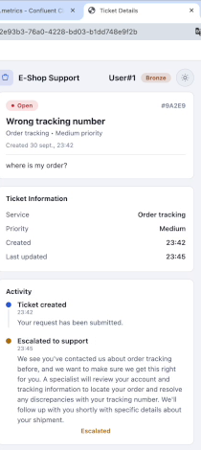
The customer knows where they stand
4 · The triage agent
9
Seconds, not hours: the customer sees the escalation and the agent's message without waiting for someone to open the ticket.
Ticket timeline: Escalated to support
Notes:
On the customer side, the ticket timeline already shows "Escalated to support", with the agent's message explaining what happens next.
The customer knows where they stand within seconds, without waiting for someone to open the ticket the next morning.

Slide 10
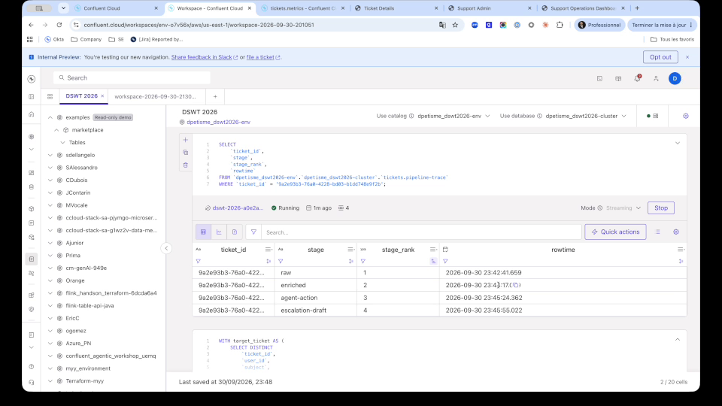
One query traces a ticket end to end
5 · Tracing one ticket
10
Everything is a stream: one SQL query follows a ticket through every stage, with its timestamps. Demo cluster with almost no traffic: enrichment takes seconds under real load.
Pipeline trace: raw, enriched, agent action, escalation draft
Notes:
Because everything is a stream, a single SQL query follows a ticket end to end: the raw ticket, its enriched version, the agent's decision, then the escalation draft prepared by watsonx Orchestrate, each with its timestamp.
To be transparent: here we see a few minutes between stages because this demo cluster has almost no traffic. Under real load, enrichment takes a few seconds.

Slide 11
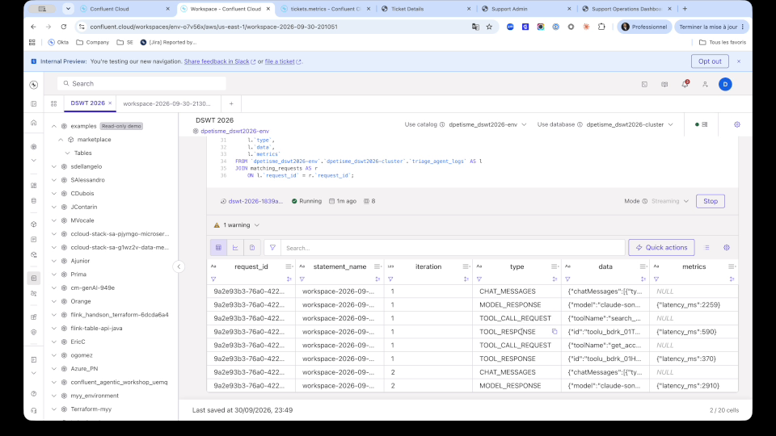
Agent behaviour becomes data
5 · Tracing one ticket
11
Auditable agents: every model call and MCP tool call is a row you can query, audit and alert on, like any other stream.
triage_agent_logs: messages, model responses, tool calls, latency
Notes:
We can also open the agent's log. Every message, every model response, every tool call is recorded with its duration: about two seconds for the model, a few hundred milliseconds per tool.
The agent's behaviour becomes data itself. You can query it, audit it, set alerts on it, exactly like any other stream. That closes the Confluent part: the data is fresh, controlled and traceable.

Slide 12
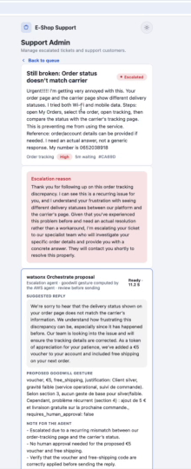
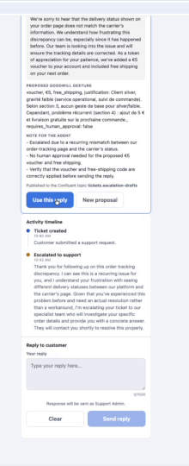
watsonx Orchestrate prepares, the human decides
6 · watsonx Orchestrate
12
Human in the loop: the escalation agent drafts the reply and the goodwill gesture from the AWS agent; the advisor reviews and sends. No agent answers the customer on its own.
Escalation agent proposal: reply, gesture, note
Use this reply, adjust, send
Notes:
Now watsonx Orchestrate takes over the escalation. In the support console, the escalation agent has already prepared a proposal: a suggested reply, a goodwill gesture and a note for the advisor.
The goodwill gesture comes from another agent, owned by the Customer Relations team and running on AWS. Orchestrate makes it work with its own.
The advisor reviews, takes the reply, adjusts it and sends it. The agent prepares, the human decides. No agent answers the customer on its own.

Slide 13
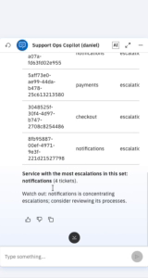
A copilot on live context
7 · The ops copilot
13
Fresh context, not yesterday's export: the copilot reads the live topics through Confluent's Real-Time Context Engine.
Support Ops Copilot in the console
Notes:
The support manager also has a copilot in the console, built in watsonx Orchestrate. It reads the Confluent topics live through the Real-Time Context Engine.
Here we ask for the latest escalations: it lists them and identifies the service that concentrates them. It answers on the situation now, not on yesterday's export.

Slide 14
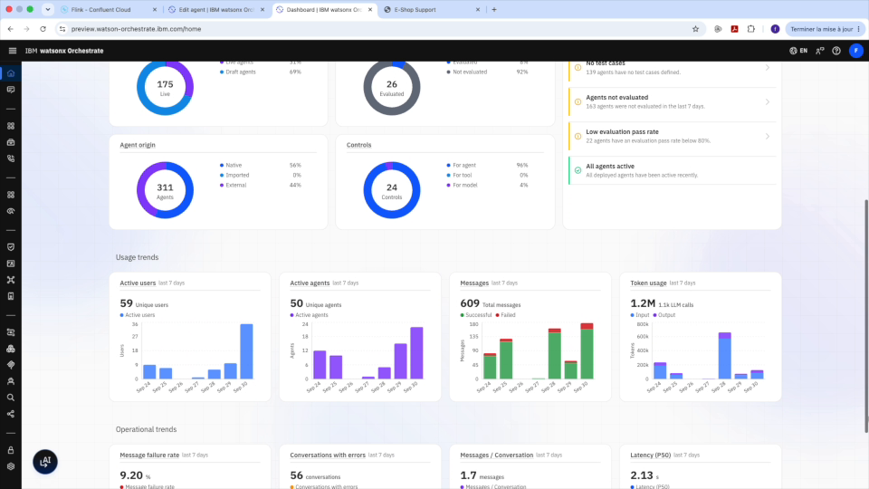
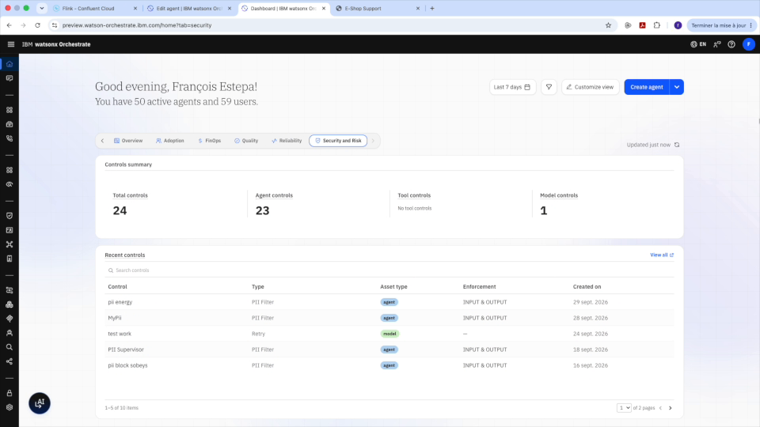
One control plane for hundreds of agents
8 · The control plane
14
IBM demo instance: 311 agents, usage and quality
Security and risk: 24 controls
Govern at scale: native and external agents, usage, quality, latency and risk in one place.
Notes:
Let's step back. In a large company there is not one agent, there are hundreds. This is an IBM demo instance of watsonx Orchestrate: 311 agents, many of them built on other platforms, and 24 controls.
Usage, answer quality, latency and risk are in one place. That is the control plane: the cockpit for all agents.

Slide 15
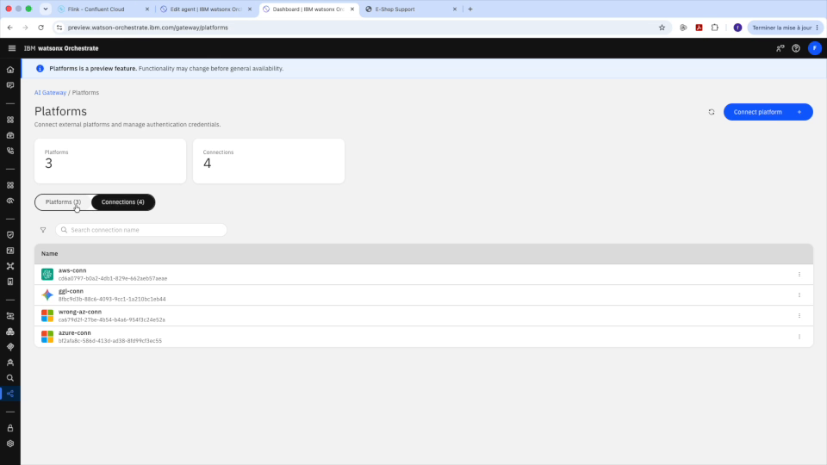
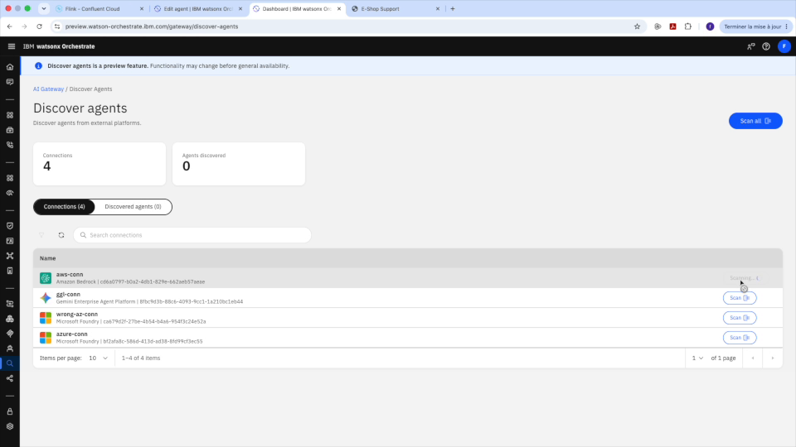
Discover agents on other platforms
8 · The control plane
15
AI Gateway: Amazon Bedrock, Gemini Enterprise, Microsoft Foundry
Discover agents: scan and import
No shadow agents: Orchestrate finds the agents running elsewhere so they can be registered and governed.
Notes:
The first risk is agents nobody knows exist. With the AI Gateway, Orchestrate connects to other agent platforms, Amazon Bedrock, Gemini Enterprise, Microsoft Foundry, and discovers the agents running there.
They can then be registered and governed instead of staying in the shadow.

Slide 16
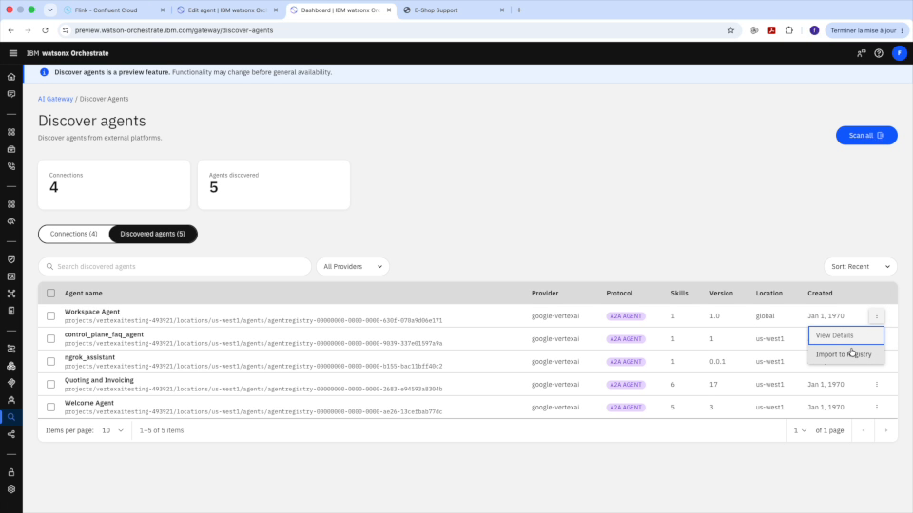
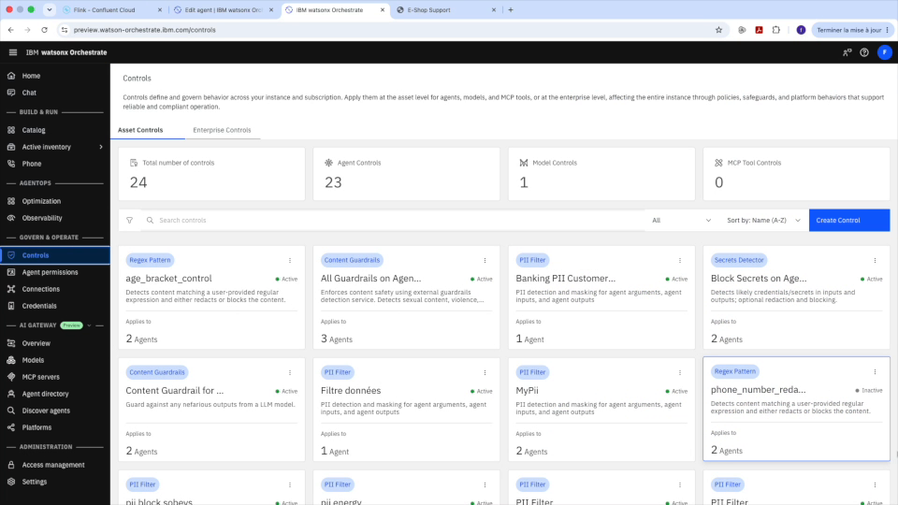
One directory, controls everywhere
8 · The control plane
16
Agent directory: 135 external agents
Controls on agents, tools and models
One point of control: PII filters, content guardrails, secrets detection and rate limits apply across agents, tools and models.
Notes:
Once registered, all agents land in a single directory: 135 external agents here. And the same rules apply to all of them: masking personal data, content guardrails, secrets detection, rate limits.
These rules apply to agents, tools and models, wherever they run.

Slide 17
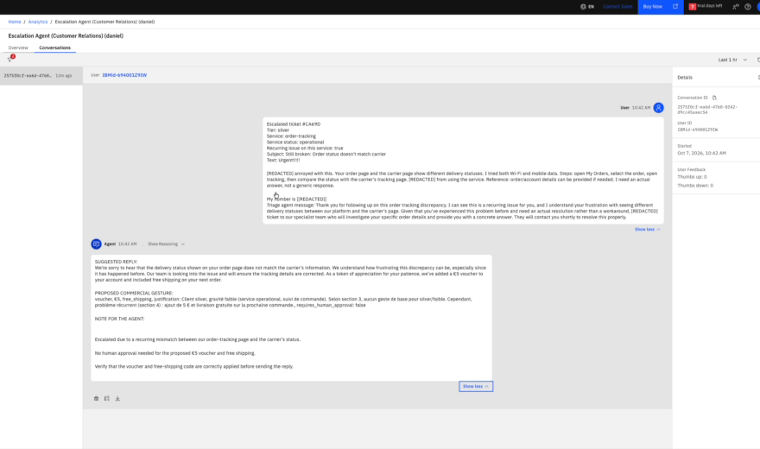
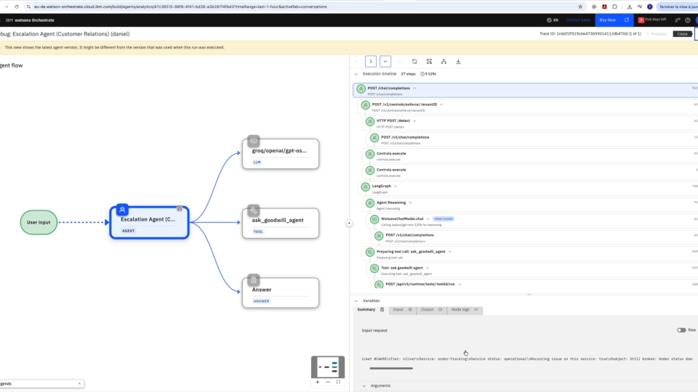
Our escalation agent, governed end to end
9 · Our agent, governed
17
Conversation: personal data masked by the PII control
Trace: control, model call, AWS agent tool, answer
Confluent brings fresh context, watsonx Orchestrate governs and orchestrates the agents, wherever they run.
Notes:
Back to our escalation agent. In its conversation, the customer's personal data is already masked by the PII control, before the model even sees it.
The trace shows every step: the control, the model call, the tool that queried the AWS agent, and the answer. We know exactly what the agent did, and why.

Slide 18
Each does its job, one system
Better together
18
Confluent
watsonx Orchestrate
Process data in real time
Govern the agents that act
Kafka: every ticket becomes an event
Flink SQL: enrichment, sentiment, forecasting
Streaming Agents and MCP tools in the stream
Schema Registry: governed data
Federated agents: Orchestrate, AWS and others
Controls: personal data masked
Human in the loop, end-to-end traces
Business copilot plugged into the live stream
Confluent turns events into decisions. Orchestrate turns decisions into controlled actions.
Notes:
To sum up, each does its job. Confluent processes data in real time: Kafka turns every ticket into an event, Flink enriches and forecasts it in SQL, agents run in the stream, and Schema Registry guarantees data quality.
watsonx Orchestrate governs the agents that act: it makes agents from different platforms work together, applies the controls, keeps the human in the loop and traces everything.
Confluent turns events into decisions. Orchestrate turns decisions into controlled actions.
Next step: a workshop of less than a day to identify, in your company, the business event that is worth the most if you know it in under a minute.

Slide 19
Thank you
IBM logo
Q&A
Notes:
Thank you. Happy to take your questions.

