Slide 1


Customer Behavior foodpanda
Prepared by Ester Siahaan
1

Slide 2

2
Dataset Overview
Income
Total Order
14.343.912.079
6000
The total amount of money received from customer transactions (Gross Revenue).
The total number of customer orders within a specific period of time.
2

Slide 3



3
Dataset Overview
Quantity
Average Order Value
17.950
2.390,65
The total amount of money received from customer transactions (Gross Revenue).
The average transaction value spent by a customer per order within a specific period of time.
3

Slide 4
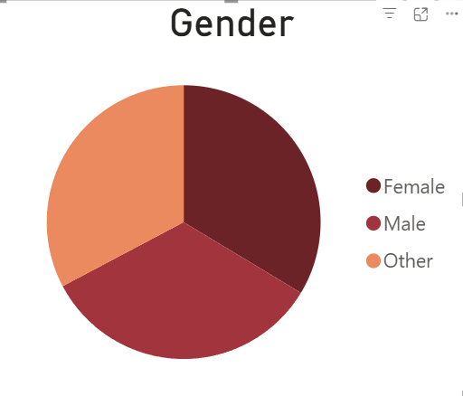
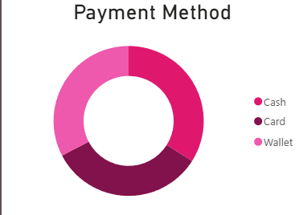
Key Insight
4
Looking at the demographics, the majority of foodpanda users are predominantly female 2018 (33,63%). This suggests that our future marketing strategies and product positioning should lean heavily toward female preferences and trends.
Although Cash remained the most widely used payment method (33.98%), the strong adoption of Card and Wallet presents an opportunity to promote digital payments through cashback programs, loyalty rewards, and exclusive offers.

Slide 5
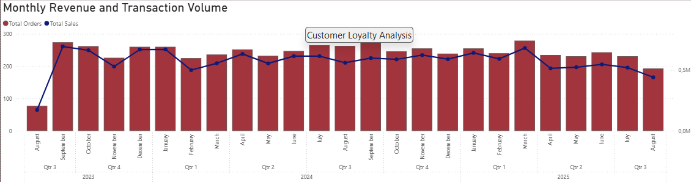
Monthly Revenue & Transaction Volume
5
Based on the Monthly Revenue and Transaction Volume analysis, the highest revenue and transaction volume were recorded in September 2023, reaching $696,622.20. This indicates that customer demand was at its peak during this period, resulting in both increased order activity and higher sales performance.

Slide 6
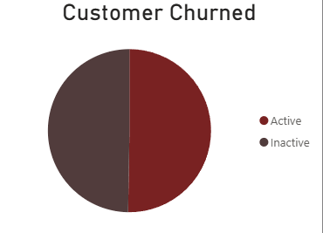
6
Customer Engagement Overview
The analysis shows that approximately 3,016 customers (50.27%) remain active on the platform, while the remaining customers are inactive or have stopped using the application. This indicates that customer retention remains a key challenge for the business. Customer inactivity may be influenced by various factors, including increased competition, changes in customer preferences, pricing concerns, service quality issues, or a lack of engagement and loyalty initiatives.

Slide 7
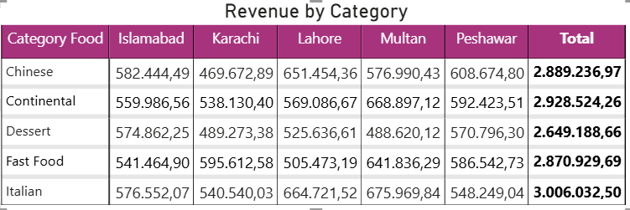
7
Revenue by Category
Multan contributed the highest city-category revenue, generating $668,897.12 from Continental cuisine. Meanwhile, Italian cuisine emerged as the best-performing category overall, generating total revenue of $2.928.524,26 across all cities.

Slide 8
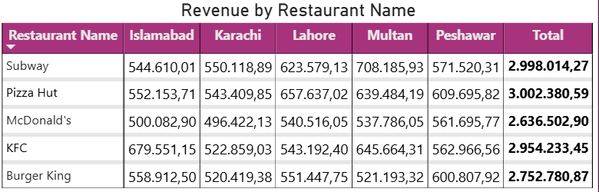
8
Revenue by Restaurant Name
Subway in Multan recorded the highest revenue among restaurant-city combinations, generating $708,185.93. Meanwhile, Pizza Hut ranked as the highest-performing restaurant overall, contributing $3,002,380.59 in revenue across all five cities.

Slide 9
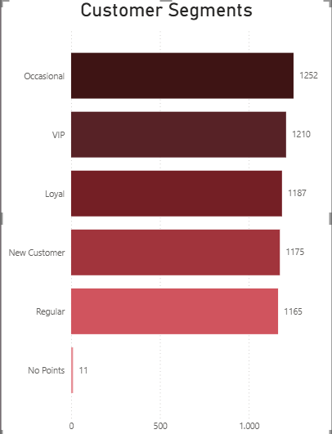

Production
9
Occasional Customers formed the largest customer segment, with 1,252 customers, highlighting the potential to increase customer engagement and retention.

Slide 10




Strategy Recomendations
10
Personalized Food Recommendations
Leverage customers' purchase history and ordering patterns to provide personalized restaurant and menu recommendations based on different meal times (breakfast, lunch, and dinner).
Accelerate Digital Payment Adoption
Offer cashback and exclusive discounts for digital payment users and launch "Cashless Day" campaigns with special promotions.
Improve Delivery Service Reliability
Enhance delivery time estimation accuracy and implement an automatic compensation system for delayed orders to improve customer satisfaction and build long-term trust in the platform.

Slide 11



Strategy Recomendations
11
Optimize User Interface (UI) and User Experience (UX)
Simplify the ordering process by improving the application's interface, allowing customers to quickly reorder their favorite meals with a single click.
Expand Menu Variety
Increase the diversity of restaurants and menu options by partnering with more local merchants
Optimize Pricing & Promotion Strategy
Implement localized promotions and combo meal offers with personalized add-on recommendations to increase sales and average order value.

Slide 12

Thank You
We would love to hear your opinions.
Ester Siahaan
estersiahaan1806@gmail.com
12

