Slide 1



E-COMMERCE SALES
PERFORMANCE DASHBOARD
Oleh: Ester Siahaan

Slide 2

BUSINESS OVERVIEW
This project analyzes a fictional e-commerce company's sales performance using a public sales dataset from Kaggle. The dataset contains transactional information such as products, categories, customer types, payment methods, order dates, quantities, and revenue across multiple regions from 2022 to 2026. Although the dataset is simulated, it represents realistic business operations and is suitable for practicing business intelligence and sales performance analysis.
Source:
https://www.kaggle.com/datasets/ajitjha01/sales-dataset

Slide 3

BUSINESS UNDERSTANDING
Business Objective
The company generates a large volume of sales transaction data from its daily operations. However, the available data has not been fully utilized to provide actionable insights that support strategic decision-making.
As a result, management faces challenges in:
Monitoring overall sales performance effectively.
Identifying products and categories that contribute the most to revenue.
Understanding sales trends over time.
Analyzing customer segments and purchasing behavior.
Identifying customers' preferred payment methods.
Making data-driven decisions to improve business performance and increase revenue.

Slide 4
BUSINESS UNDERSTANDING
Business Problem
Monitor key sales performance indicators, including Revenue, Total Orders, and Quantity Sold.
Identify top-performing products that generate the highest revenue contribution.
Analyze product category performance to understand which categories drive sales growth.
Evaluate sales trends over time to identify growth opportunities and potential declines.
Understand customer distribution based on customer type.
Analyze customer payment preferences across different payment methods.
Apply Pareto Analysis to identify products that contribute the majority of total revenue.
Provide data-driven recommendations to support business decision-making and improve overall sales performance.

Slide 5


DATASETS OVERVIEW
Key Variabels
The dataset includes the following key variables:
Order Date – Transaction date.
Region – Sales region.
Product Name – Purchased product.
Category – Product category.
Customer Type – Customer segment (New, Premium, Returning).
Payment Method – Payment option used by the customer.
Quantity – Number of units sold.
Revenue – Total revenue generated from each transaction.
Datasets Type
Simulated E-Commerce Datasets

Slide 6

EXPLORATORY DATA
Before deep-diving into detailed insights, an initial data exploration was conducted to capture overall sales performance.
Total Revenue
Top Revenue Contributors
$28.220.731
Laptop, Tablet, Watch
Top Products by Sales Volume
Watch (468 pcs), Water Bottle (466 pcs), Mobile (430 pcs)
Analysis Period
Largest Customer Segment
Desember 2023
New

Slide 7





WHAT THE DATA REVEALS?
Strong Overall Sales Performance
The company generated $28.22 million in total revenue during the analysis period, indicating strong overall sales performance across multiple products and regions.
Revenue is Concentrated in a Few Products
Revenue is primarily driven by Laptop, Tablet, and Watch, indicating that a small group of products contributes significantly to the company's overall sales performance.
Sales Volume Does Not Always Reflect Revenue Contribution
New customers represent the largest customer segment, indicating successful customer acquisition while highlighting opportunities to improve customer retention.
Historical Data Supports Trend Analysis
December 2023 achieved the highest monthly revenue of $856,962, making it the strongest sales period in the dataset. This peak may have been influenced by seasonal demand, promotional campaigns, or increased customer purchasing activity.

Slide 8

E-COMMERCE RECOMENDATIONS
Prioritize High-Revenue Products
Focus marketing campaigns and inventory planning on Laptop, Tablet, and Watch, as these products contribute the most to overall revenue. Ensuring product availability and strategic promotions can maximize revenue growth.
Strengthen Customer Retention Strategies
Since New Customers represent the largest customer segment, the company should implement loyalty programs, personalized promotions, and post-purchase engagement strategies to encourage repeat purchases and increase customer lifetime value.
Optimize Inventory Based on Sales Performance
Products with consistently high sales volume should be prioritized in inventory planning to reduce stock-out risks and improve customer satisfaction, especially during high-demand periods.
Enhance Digital Payment Experience
As UPI is the most preferred payment method, the company should continue optimizing digital payment services and consider offering incentives such as cashback or discounts to encourage digital transactions.

Slide 9

BUSINESS IMPACT
1
By prioritizing high-performing products and categories, the company can maximize revenue opportunities and improve overall sales performance.
2
Implementing customer retention strategies can encourage repeat purchases, increase customer lifetime value, and reduce customer acquisition costs.
Understanding which products generate the highest revenue and sales volume enables more effective inventory planning, reducing stock shortages and excess inventory.
3
4
As UPI is the dominant payment method, introducing limited-time discounts for selected products paid via UPI could enhance customer experience, drive incremental sales, and reinforce the company's digital payment strategy.

Slide 10
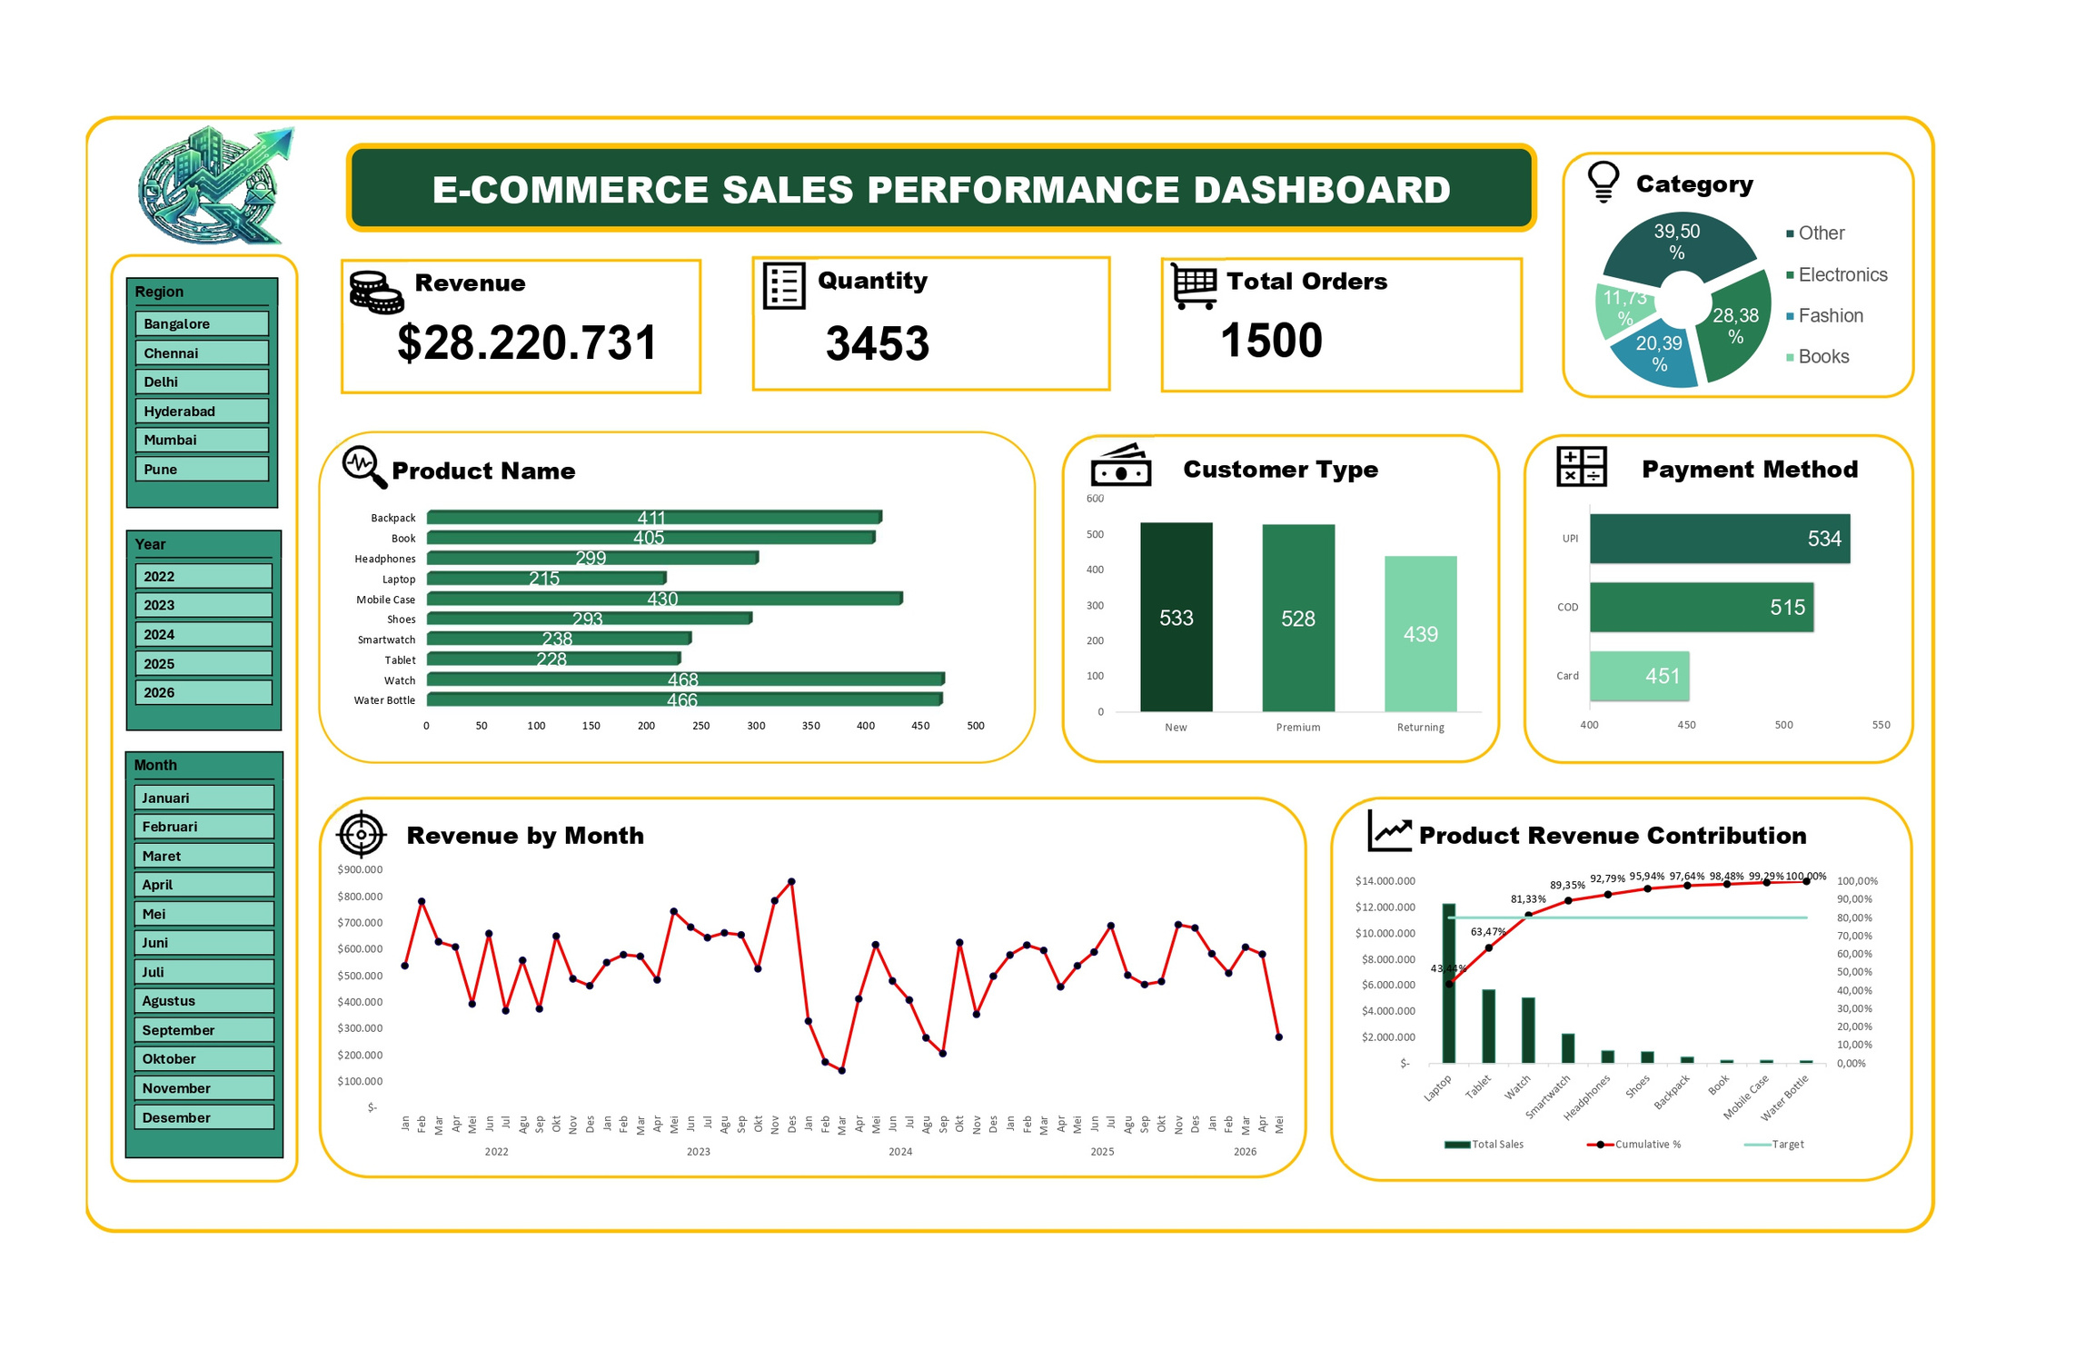

Slide 11

THANK YOU

