Slide 1
A Yang Data Model for Optical Impairment-aware Topology
draft-ietf-ccamp-optical-impairment-topology-yang-02
Co-authors (editors):
Young Lee (SKKU)
Victor Lopez (Telefonica)
Gabriele Galimberti (Cisco)
Jean Luc Auge (Orange)
Dieter Beller (Nokia)
Co-authors/contributors:
Haomian Zheng (Huawei)
Italo Busi (Huawei)
Nicola Sambo (Scuola superior S.Anna)
Julien Meuric (Orange)
Esther Le Rouzic (Orange)
Sergio Belotti (Nokia)
Enrico Griseri (Nokia)
Gert Grammel (Juniper)
Jonas Martenson (RISE)
Aihua Guo (Huawei)

Slide 2
Major Activities since IETF 105
Weekly CCAMP WebEx meetings (Thu, 4-5pm CET)
Topics addressed:
ROADM model:
ROADM architectures discussed – outcome: new sections in version 02
Modeling of optical impairments for ROADMs – starting with simple approach:
Homogenous architecture
3 paths identified: express path (pass-through), add path, and drop path
3R regenerators – discussion started
Two 3R regenerator realizations discussed
Two back-to-back transponders
Two transponders each providing uni-directional 3R regeneration

Slide 3
ROADM modeling: express (through) path, add path, drop path
ROADM
OCX
Line west
Line east
Ingress/egress amplifier modeled as part of TE link
Physical device
OT
OT
OT Client Interfaces

Slide 4
ROADM modeling
Ingress and egress amplifiers modeled as part of the TE link like in-line amplifiers (ILAs)
Agreed express, add, drop path impairment parameters (read-only):
Chromatic dispersion (CD)
Polarization mode dispersion (PMD)
Polarization dependent loss (PDL)
Other impairment parameters still under discussion:
Cross-talk due to imperfect optical isolation of components
Filtering impacts – how to characterize and model filtering impacts

Slide 5
Integrated ROADM architecture with integrated optical transponders (OTs) providing client interfaces
ROADM
OCX
Line west
Line east
OT
OT
OT
OT
OT Client Interfaces

Slide 6
Integrated ROADMs with integrated OTs and single channel add/drop interfaces for remote OTs
ROADM
OCX
Line west
Line east
OT
OT
Colored OT Line Interfaces
OT
OT
OT Client Interfaces

Slide 7
Disaggregated ROADMs that are subdivided into degree, add/drop, and optical transponder subsystems
Degree 1
Degree 2
WSS
WSS
Line 1
Line 2
Add/Drop 1
Add/Drop 2
Colored OT Line Interfaces
Colored OT Line Interfaces
OCX
OT
OT
OT
OT
Abstracted
ROADM
OT Client Interfaces

Slide 8
2 Optical Transponders (OTs) used as 3R regenerator Option 1: bi-directional back-to-back configuration
ROADM
OCX
Line west
Line east
OT
OT
2 OTs can only be used as 3R regenerators
Cable
OT Client Interfaces

Slide 9
2 Optical Transponders used as 3R regenerator Option 2: uni-dir 3R configuration (internal loop)
ROADM
OCX
Line west
Line east
OT
OT
2 OTs can be used as 3R regenerators or as service end-point OT (flexibility!)
Client Interface

Slide 10
Major Changes since IETF 105
Text/figures added describing the ROADM architectures
YANG model remained unchanged – agreements still to be reached how to model optical impairments for ROADMs before the YANG model can be updated (TE topology augmentations for layer 0).

Slide 11
YANG model and draft on GitHub
The authors/contributors are using GitHub:
https://github.com/younglee-ietf/ietf-optical-impairment-yang
This is not a CCAMP WG “organization” GitHub account but it can still be used for the time being.
As suggested by the authors/contributors, the CCAMP chairs agreed to create a CCAMP WG “organization ”account as defined in:
https://tools.ietf.org/html/draft-ietf-git-github-wg-configuration-03

Slide 12
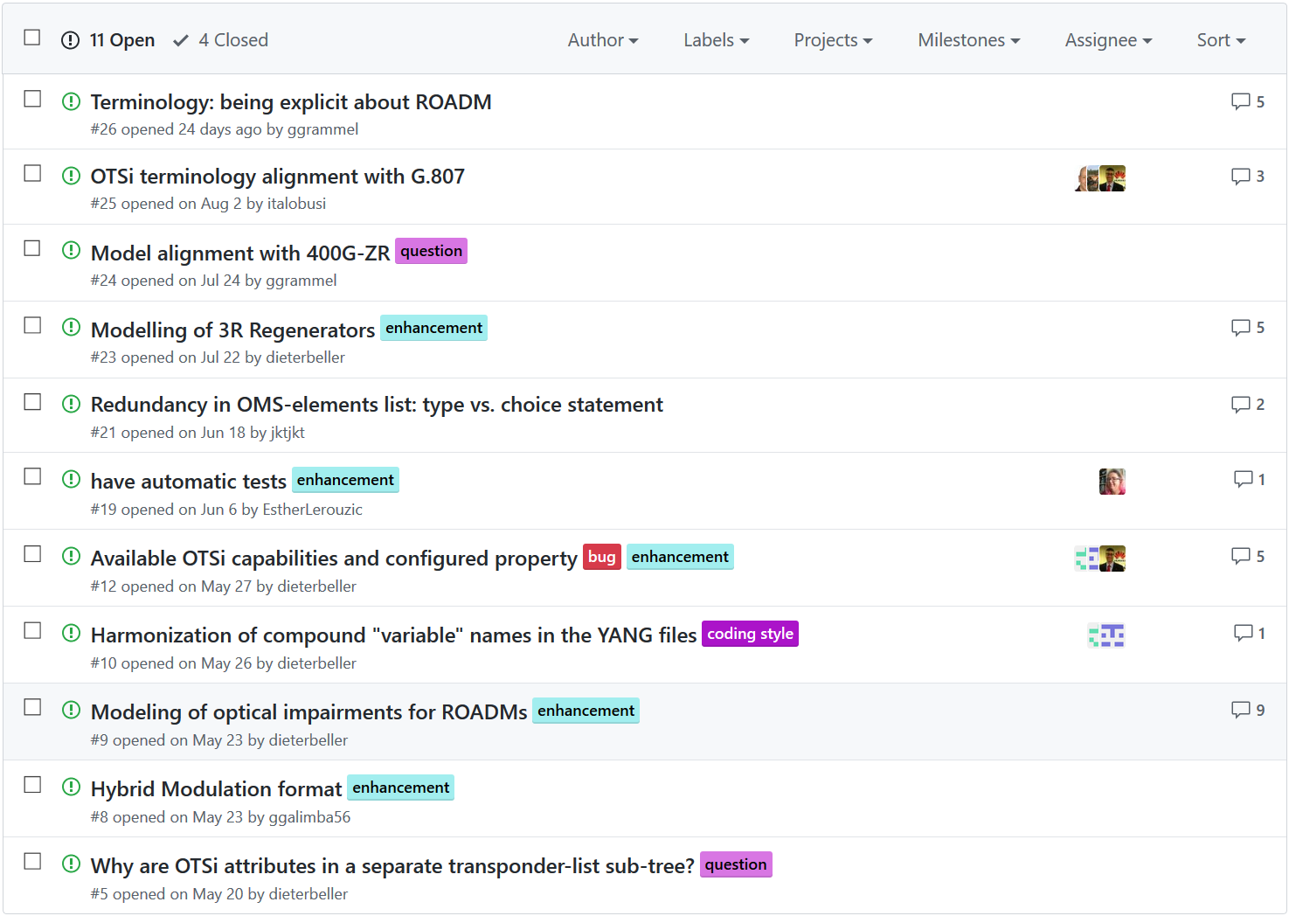
Open Issues - listed on GitHub https://github.com/younglee-ietf/ietf-optical-impairment-yang/issues

Slide 13
Next Steps
Conclude on how to model the optical impairments for ROADMs:
Cross-talk contributions to signal degradation (OSNR degradation)
Identify the TE node entities (containers) in the TE topology YANG suitable for optical impairment augmentations (scalability!)
Define the YANG model augmentations in the YANG module
Study filtering impacts on signal quality and how to model those
Modeling of 3R regenerators
Address the other open issues on GitHub

Slide 14

Thank You!

