Slide 1
A Yang Data Model for Optical Impairment-aware Topology
draft-ietf-ccamp-optical-impairment-topology-yang-03
Co-authors (editors):
Young Lee (SKKU)
Jean Luc Auge (Orange)
Victor Lopez (Telefonica)
Gabriele Galimberti (Cisco)
Dieter Beller (Nokia)
Co-authors/contributors:
Haomian Zheng (Huawei)
Italo Busi (Huawei)
Nicola Sambo (Scuola superior S.Anna)
Julien Meuric (Orange)
Esther Le Rouzic (Orange)
Sergio Belotti (Nokia)
Enrico Griseri (Nokia)
Gert Grammel (Juniper)
Jonas Martenson (RISE)
Aihua Guo (Futurewei)

Slide 2
Major Activities since IETF 106
Weekly CCAMP WebEx meetings (Thu, 4-5pm CEST)
Topics addressed:
ROADM model:
YANG model augmentations for optical impairments imposed by ROADMs added
3 paths identified: express path (pass-through), add path, and drop path
connectivity-matrices and local-link-connectivities of te-topology augmented referencing an roadm-path-impairments list entry
Current focus: revision of optical transponder model (topological layer 0 aspects)
typedefs, identityrefs, and groupings in layer0-types-ext
Modeling 3R regenerators – task parked – task will be resumed when optical transponder model will have been completed

Slide 3
IETF 106 recap: ROADM modeling: express path, add path, drop path
ROADM
OCX
Line west
Line east
Ingress/egress amplifier modeled as part of TE link
Physical device
OT
OT
OT Client Interfaces

Slide 4
Major Changes since IETF 106
New section 2.8.4: Optical Impairments Imposed by ROADM Nodes
New te-node-attributes: roadm-path-impairments:
augment /nw:networks/nw:network/nw:node/tet:te/tet:te-node-attributes:
+--ro roadm-path-impairments* [roadm-path-impairments-id]
+--ro roadm-path-impairments-id uint32
+--ro (impairment-type)?
+--:(roadm-express-path)
| +--ro roadm-express-path
| +--ro roadm-pmd? decimal64
| +--ro …
+--:(roadm-add-path)
| +--ro roadm-add-path
| +--ro roadm-pmd? decimal64
| +--ro …
+--:(roadm-drop-path)
+--ro roadm-drop-path
+--ro roadm-pmd? decimal64
+--ro …

Slide 5
Major Changes since IETF 106
Optical impairments for the 3 paths:
+--:(roadm-express-path)
+--ro roadm-express-path
+--ro roadm-pmd? decimal64
+--ro roadm-cd? decimal64
+--ro roadm-pdl? decimal64
+--ro roadm-inband-crosstalk? decimal64
+--ro roadm-maxloss? decimal64
+--:(roadm-drop-path)
+--ro roadm-drop-path
+--ro roadm-pmd? decimal64
+--ro roadm-cd? decimal64
+--ro roadm-pdl? decimal64
+--ro roadm-inband-crosstalk? decimal64
+--ro roadm-maxloss? decimal64
+--ro roadm-minloss? decimal64
+--ro roadm-typloss? decimal64
+--ro roadm-pmin? decimal64
+--ro roadm-pmax? decimal64
+--ro roadm-ptyp? decimal64
+--ro roadm-osnr? decimal64
+--ro roadm-noise-figure? decimal64
+--:(roadm-add-path)
+--ro roadm-add-path
+--ro roadm-pmd? decimal64
+--ro roadm-cd? decimal64
+--ro roadm-pdl? decimal64
+--ro roadm-inband-crosstalk? decimal64
+--ro roadm-maxloss? decimal64
+--ro roadm-pmax? decimal64
+--ro roadm-osnr? decimal64
+--ro roadm-noise-figure? decimal64

Slide 6
Major Changes since IETF 106
connectivity-matrices augmented:
table entries referencing corresponding roadm-path-impairments table entry
Example:
augment /nw:networks/nw:network/nw:node/tet:te/tet:information-source-ntry/tet:connectivity-matrices:
+--ro roadm-path-impairments? -> ../../../tet:te-node-attributes/roadm-path-impairments/roadm-path-impairments-id
local-link-connectivities augmented (same approach as above):
table entries referencing corresponding roadm-path-impairments table entry
Example:
augment /nw:networks/nw:network/nw:node/tet:te/tet:tunnel-termination-point/tet:local-link-connectivities:
+--ro add-path-impairments? -> ../../../tet:te-node-attributes/roadm-path-impairments/roadm-path-impairments-id
+--ro drop-path-impairments? -> ../../../tet:te-node-attributes/roadm-path-impairments/roadm-path-impairments-id

Slide 7
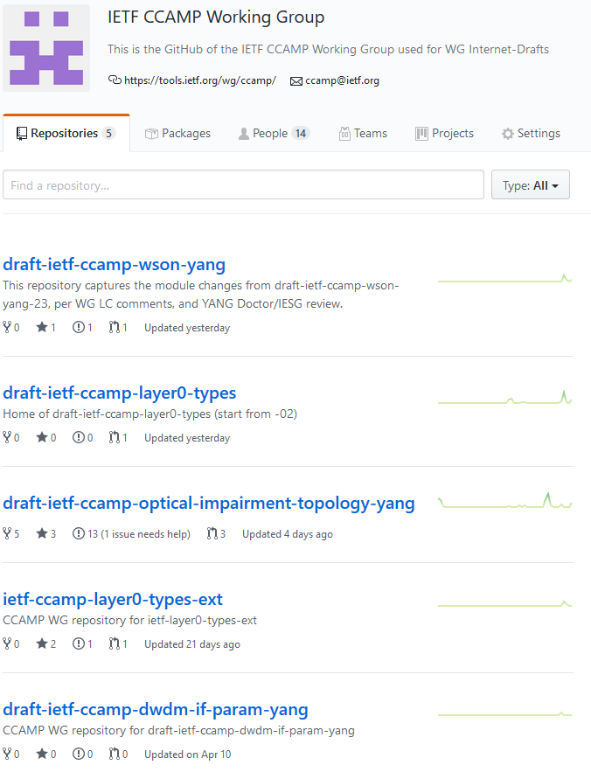
New CCAMP WG GitHub https://github.com/ietf-ccamp-wg
New organizational GitHub account created for the CCAMP WG:
14 members – open to everyone who wants to contribute
5 repositories for CCAMP WG drafts:
draft-ietf-ccamp-wson-yang
draft-ietf-ccamp-layer0-types
draft-ietf-ccamp-optical-impairment-topology-yang
ietf-ccamp-layer0-types-ext
draft-ietf-ccamp-dwdm-if-param-yang

Slide 8
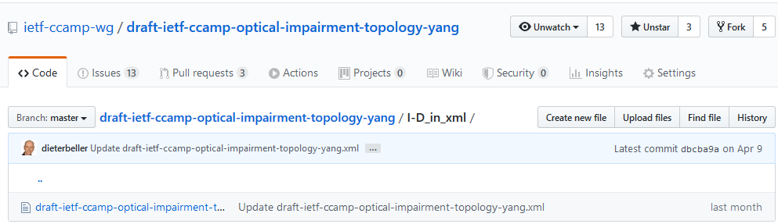
Major Changes since IETF 106 https://github.com/ietf-ccamp-wg/draft-ietf-ccamp-optical-impairment-topology-yang
YANG model on GitHub: optical impairments imposed by ROADMs added
Draft converted to xml and uploaded on GitHub before -03 was submitted
GitHub link can be used to convert the draft into a txt file using xml2rfc https://raw.githubusercontent.com/ietf-ccamp-wg/draft-ietf-ccamp-optical-impairment-topology-yang/master/I-D_in_xml/draft-ietf-ccamp-optical-impairment-topology-yang.xml
Latest xml file on GitHub is revision -04, which has not been submitted yet
File history → History button

Slide 9
Open Issues https://github.com/ietf-ccamp-wg/draft-ietf-ccamp-optical-impairment-topology-yang/issues
Alignment with ITU-T terminology and definitions for the data plane
ITU-T Recommendation G.807 approved and published (02/20)
Issues raised during AAP will be addressed in a new amendment to G.807
Sub-sections in section 2.3 will have to be updated
Open issue on GitHub: #25
Other issues: see GitHub link above

Slide 10
Next Steps
Completion of layer0-types-ext for transponders
Joint effort with authors of draft-ietf-ccamp-dwdm-if-param-yang
Completion of optical transponder modeling revision based on layer0-types-ext
Modeling of 3R regenerators based on optical transponder model
Address the other open issues on GitHub

Slide 11

Thank You!

