Slide 1
Design and plan
session, course, materials

Slide 2
Outline of the session
Design of a minitraining
Select LO
ID target audience
Draw a concept map
Select content
Deliver
Provide and receive targeted feedback
From lesson to session: session plan
From session to course planning

Slide 3
Practice a minitraining (three-minute training)
Prepare and plan for delivering training
Revise feedback
Adjust/improve/modify (according to feedback) for a 3 minute presentation

Slide 4
Challenge - define the audience, goal and outcomes (7 min)
Choose a topic
Define learning objectives (describe the goals and intentions of the instructor )
Write learning outcomes (think about what learners will be able to do by the end of instruction/session/workshop)
Identify the target audience and prerequisites
Identify the learning experiences
Select the content
https://www.clinton.edu/curriculumcommittee/listofmeasurableverbs.cxml
Notes:
LO should be appropriate to the level of the target audience according to Bloom’s taxonomy. When you pick actionable verbs to what to expect – chose approriate level!

Slide 5
Choose a topic for a three-minute training
Choose a topic to demonstrate your training in three minutes.
how to make an origami bird
introduction to biochemistry
how bats recognise the presence of obstacles
the second law of Newton
how to draw a comic strip

Slide 6
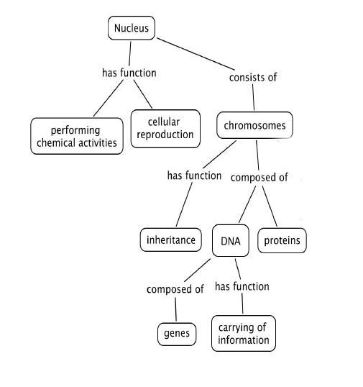
Concept map
Notes:
Concept maps begin with a main idea (or concept) and then branch out to show how that main idea can be broken down into specific topics.

Slide 7
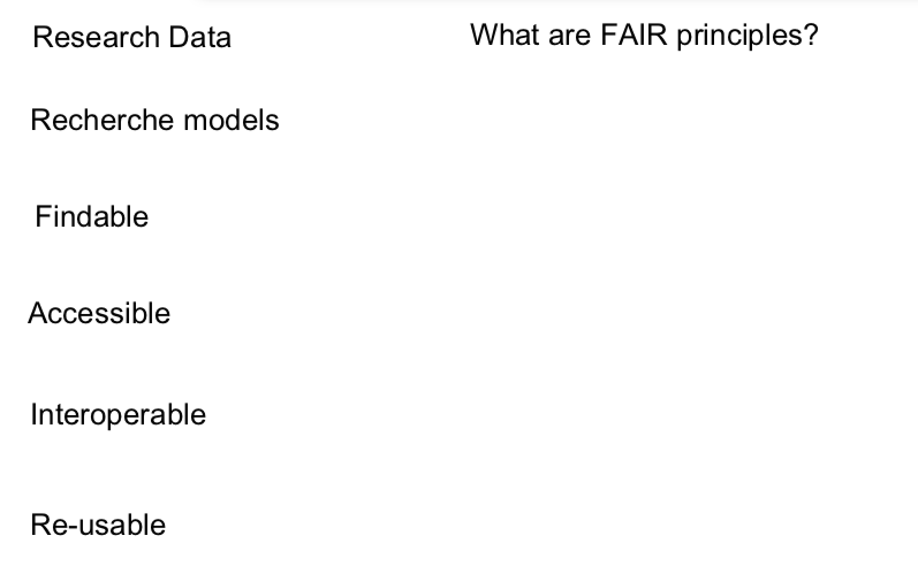
Concept map – FAIR principles
Parking lot Question
Notes:
findable, accessible, interoperable and reusable (Wilkinson et al., 2016)

Slide 8
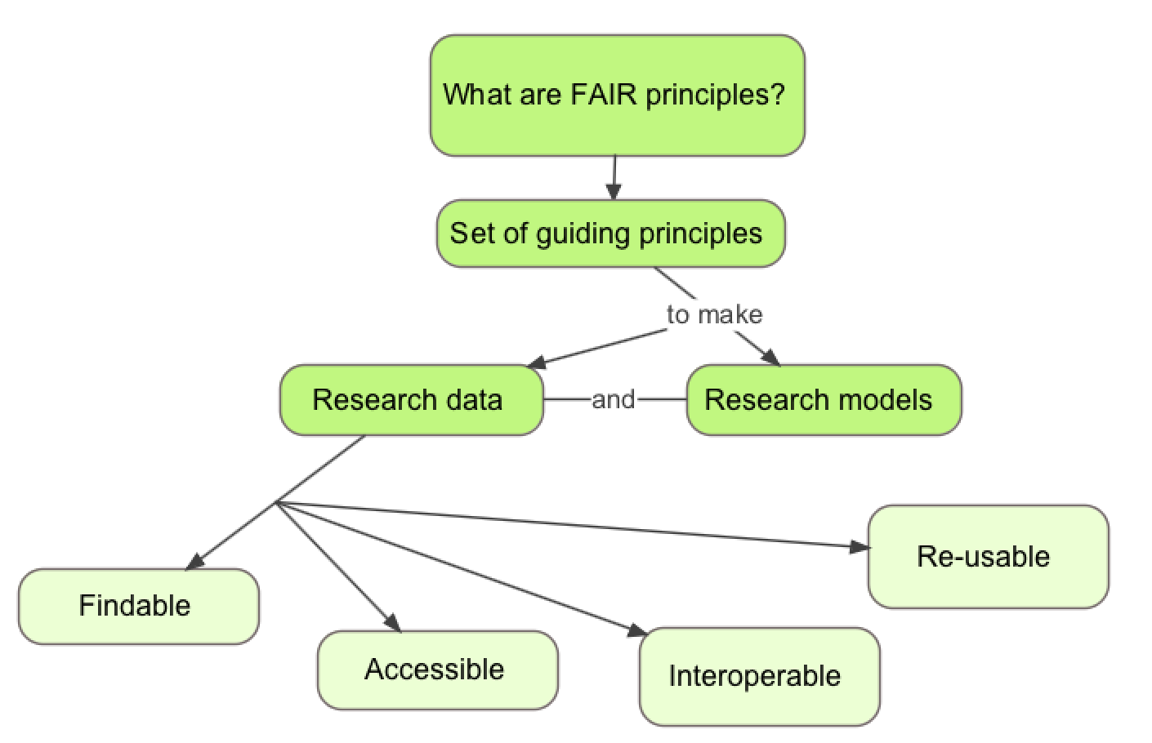
Concept map – FAIR principles

Slide 9
Concept maps – how to use the tool
Concept maps are graphical tools for organizing and representing knowledge
Include concepts and relationships to link concepts
Good to start a concept map with a focus question - context
Help to organize knowledge and to structure it
Good concept maps are built with iterations and feedback
Joseph D. Novak , 1972

Slide 10
Concept maps in curriculum/lesson/session planning
They present key concepts in a highly concise manner
This helps in the teaching plan to measure how much you can cover
The hierarchical organization suggests a sequence to cover material
Further reading http://cmap.ihmc.us/Publications/ResearchPapers/TheoryUnderlyingConceptMaps.pdf

Slide 11
Challenge - Draw a concept map (10 min)
Draw a concept map of your topic of interest, start with a question
Include 7 (+ - 2) concepts
Include relationships and cross-links between these concepts
Arrange it in a hierarchical structure with the key concepts on top
Notes:
When using concept maps to identify the number of items you are going to teach (7+-2 items) you have to COUNTS LINKS AS ITEMS!!!

Slide 12
Challenge - Feedback on concept maps (8 min)
In a group of 2 exchange concept maps. Do not explain the map.
Write one thing you are confused/not sure about the map
Write one thing you like/it is clear about the map
Each person will give and receive two feedbacks:
Positive and Negative on content

Slide 13
Content
Content collection
Appropriate content to the needs and capabilities of your target audience
Content reduction
One of the biggest challenges in designing training courses is the reduction of content to the training format. key points!
Notes:
With Learning Outcomes – the connection to content

Slide 14
Challenge - Delivery planning (3 min)
Think if you want to make your training interactive
Think whether you need or want to use a visual support (images)
Think whether you need to distribute material in advance to the audience
Prepare for your choices
Be creative!

Slide 15
Challenge 5 - Prepare content (15 min)
You have 15 min to prepare the content of your mini-training
The structure of your mini-training should be something like
40 seconds introduction
2 minutes on topic
20 seconds conclusion
Use your concept map and adapt as needed

Slide 16
Challenge 6 - Mini-training practice (20 min)
Split into groups of 3
Each will deliver their 3 minute session to the others
One person delivers the session
One person records on the phone (optional)
One person notes down feedback in real-time
You describe your own feedback (self-feedback) on your delivery
The other two provide feedback to the presenter
Then rotate within the group (and restart from 1)
How to give feedback?

Slide 17
Constructive feedback
 | + | -
Content
Presentation

Slide 18
Discussions / feedback
Listen actively and attentively
Ask for clarification if you are confused
Do not interrupt one another
Challenge one another, but do so respectfully
Critique ideas, not people
Do not offer opinions without supporting evidence
Take responsibility for the quality of the discussion
Build on one another ’s comments; work toward shared understanding.
Do not monopolise discussion.
Speak from your own experience, without generalizing.
If you are offended by anything said during discussion, acknowledge it immediately.
Notes:
Additional suggestions: How to give and recieve feedback

Slide 19
From a 3-min presentation to a lesson/session

Slide 20
Tools for session, course, curriculum design
1. FIVE STEPS for session, course, curriculum design
2. Lesson/session plan
Notes:
These are Nicholls’ five steps for curriculum development

Slide 21
Instruction design in five steps
Select or identify LOs
Select learning experiences (LEs) that will help learners achieve LOs
Select content that is relevant to LOs
1
2
3
Identify/develop assessments to ensure learner is progressing towards LOs
5
Evaluate the effectiveness of the LEs for leading learners to the LOs
4
Nicholls G (2002). Developing teaching and learning in higher education. London, UK: Routledge. Pp 51-75

Slide 22
Lesson/session plan
Time | Activity | Description | Goal

Slide 23
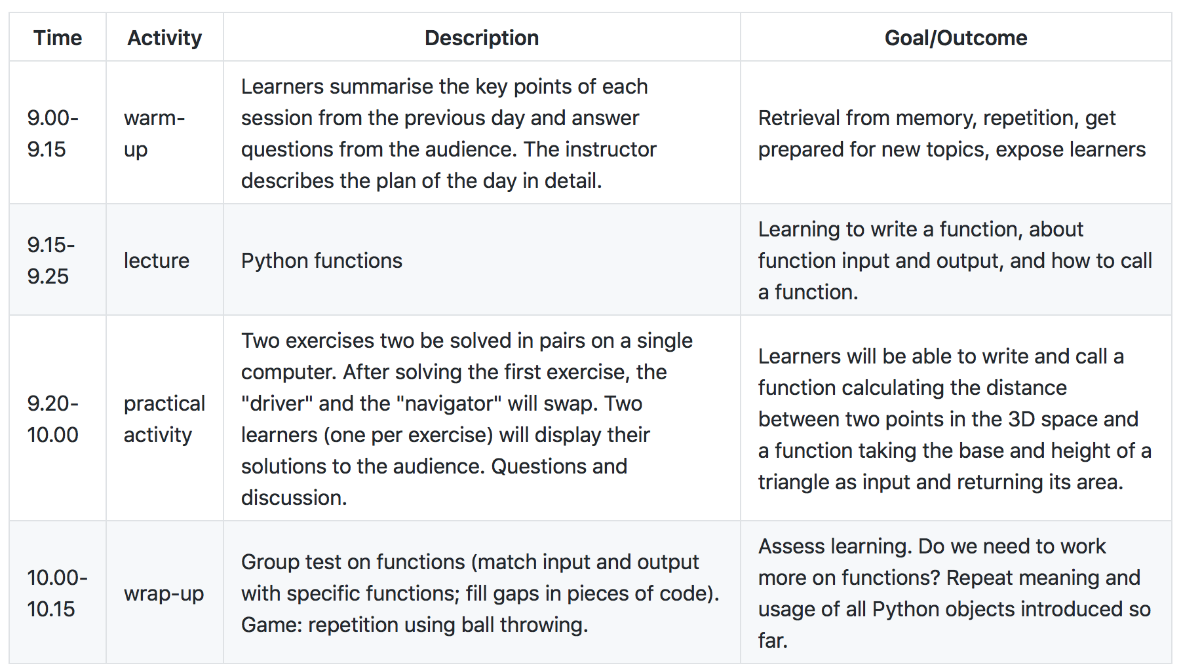
Example: Plan for a 1h15 session

Slide 24
Challenge - Create a lesson plan
In your group…
Take one session idea and expand to a “real” training session
You will need to:
Identify target audience
Set learning objectives and outcomes
Decide learning experiences
Suggest how you will assess trainees progress
Define training session structure/lesson plan (including indicative content, length, breakdown and timings)
Notes:
From 2h to 1 week or more. It is up to you.
Connected to the content!

Slide 25
From a lesson/session to a course

Slide 26
Delivery planning
Is it part of an extended curricula?
Is the training a requirement, or optional career development?
Format: workshop, seminar, lecture, online training or mix online/in-person?
Timing: what is the content and depth of the training?
Do you need to invite any other external experts?
What sort of venue/equipment do you need for this format?

Slide 27
From session to course – defining the aim
Combine the who, what and why requirements into a course aim
Who: write clear trainee specifications;
e.g. undergraduate biologists with basic knowledge of Unix and R
What & why: describe what trainees will learn, and the benefit of that
Consider the where and when requirements (i.e. the logistics)
How much can you do in the time available (including tests, feedback)
Resources limitations (space, equipment, assistants)
We quote Chris Taylor – Earlham Institute - https://www.mygoblet.org/training-portal/materials/train-trainer-course-materials

Slide 28
From learning outcomes to a course outline
A well-written course aim will guide the generation of LOs
LOs should then be instantiated as activities and quality checks
Learning activities: scripts, slides, exercises, tutorials, …
Assessment tools: creative activities, written tests, …
Feedback tools: observation, interaction, forms, …
Learning activities (LAs) should be tightly-linked to quality checks
This is not ‘teaching to the test’ because it’s training not education
When all the LOs are expanded, you have your course outline
LO #1
Learning Activities
Course Aim
LO #2
Assessment Tools
LO #3
Feedback Tools
We quote Chris Taylor – Earlham Institute - https://www.mygoblet.org/training-portal/materials/train-trainer-course-materials

Slide 29
Reproducibility of compute environments
Different courses, different compute requirements: Unix, R, Python, metagenomics, long read sequencing
Installation process time-consuming and technically challenging
Every computer should have an identical installation setup and sufficient hardware (power and memory) to run the tools
Virtual machines, cloud computing, containers, software images

Slide 30
Training rooms for bioinformatics
Physical environment
Room geometry: seats’ quality, the lighting, the room temperature control, the stability of power and network connections
Functionality : video, audio, drawing surfaces (whiteboard, flipchart paper), a corkboard to pin materials
Hardware needs: power suppliers, network connections with a good quality wifi access

Slide 31
Training materials: sharing and making re-use possible

Slide 32
Learning outcome: Be able to identify training materials that exist already, and develop a routine of sharing training materials.

Slide 33
FAIR principles
Data and models are:
Findable - can be searched for by the community after publication
Accessible - can be read/downloaded by other researchers
Interoperable - can be understood clearly in the context of the original experiment
Re-usable - can be used by other researchers

Slide 34
FAIR principles – in the training context
Training course materials: slides, exercises, datasets
Findable - can be searched and found by the trainers community
Accessible - can be read/downloaded by other trainers
Interoperable - can be understood clearly in the context of the original course
Re-usable - can be used by other trainers

Slide 35
Training materials repositories and resources
GOBLET – http://mygoblet.org/training-portal
TeSS - https://tess.elixir-europe.org/
GitHub - https://github.com
Jupiter - http://jupyter.org/
Other?

Slide 36
Resources
Design: ftp://gtpb.igc.gulbenkian.pt/bicourses/posters/Calix_March2013.pdf
Training materials: https://www.mygoblet.org/training-portal
TeSS: https://tess.elixir-europe.org/
https://www.clinton.edu/curriculumcommittee/listofmeasurableverbs.cxml
Adopt collaborative platforms to support training activities

Slide 37
Challenge 9 - Apply (5 min)
Articulate a goal of good teaching practice that you are ready to apply for your next training

Slide 38
Wrapping up
What did you learn in this session?
- One person a time, no repetition

Slide 39
Time to relax!

