Slide 1
Training techniques to enhance learner participation and
engagement

Slide 2
Mazur's video on Peer Instruction for Active Learning

Slide 3
Instruction design in five steps
Select or identify LOs
Select learning experiences (LEs) that will help learners achieve LOs
Select content that is relevant to LOs
1
2
3
Evaluate the effectiveness of the LEs for leading learners to the LOs
Identify/develop assessments to ensure learner is progressing towards LOs
4
5

Slide 4
Aims
Reflect on your experiences in training
Reflect on the 7 principles of learning
Show strategies to enhance learning
Practice good training strategies, and connect strategies to prior knowledge
Learning Outcomes
Identify learning strategy facilitating active, interactive and collaborative learning
Describe what makes training effective
Describe what makes an effective trainer
List motivation and demotivation factors

Slide 5
Challenge 1
Recall concrete examples of past trainings and list your thoughts (3 min)
Effective training | Weak training

Slide 6
Challenge 2
In pairs (3 min)
What makes a good trainer ?
Associate some characteristics and describe them

Slide 7
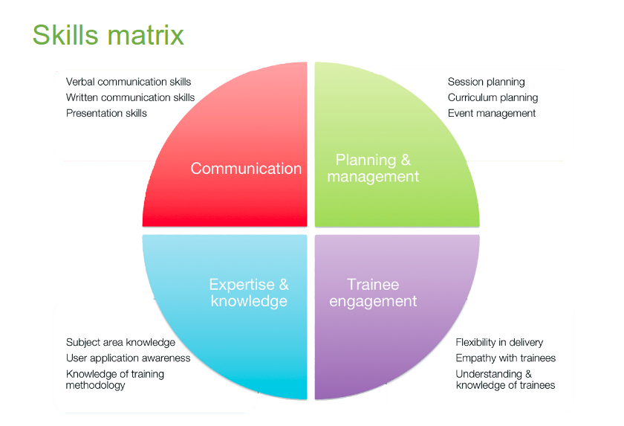
Example - GOBLET trainer skill matrix
Global Organisation for Bioinformatics Learning, Education and Training (GOBLET)
https://www.mygoblet.org/sites/default/files/goblet_events/GOBLET-TTT-061113.pdf

Slide 8
The GOBLET skills matrix for trainers
Challenge
Try to reflect on your current skills and how they fit with this matrix
Communication (C)
Expertise and knowledge (EK)
Planning and Management (PM)
Learner engagement (LE)
Then share your thoughts with us

Slide 9
Challenge - connecting your learning
As a group, retrieve your list of characteristics of good trainers and connect to the four topics
Communication (C)
Expertise and knowledge (EK)
Planning and Management (PM)
Learner engagement (LE)

Slide 10
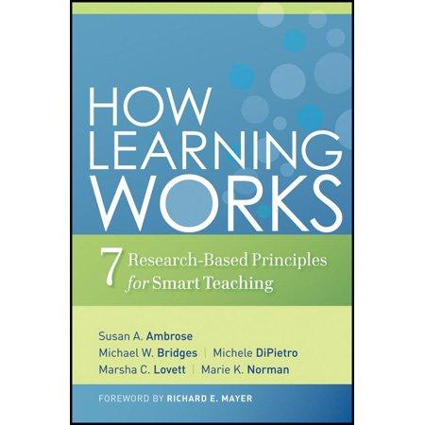
7 Evidence Based Learning Principles
Principle P1: Students' prior knowledge can help or hinder learning.
Principle P2: How students organise knowledge influences how they learn and apply what
they know.
Principle P3: Students motivation determines, directs and sustains what they do learn.
Principle P4: To develop mastery, students must acquire component skills, practice integrating them, and know when to apply what they have learned
Principle P5: Goal-directed practice coupled with targeted feedback enhances the quality of
students' learning
Principle P6: Students' current level of development interacts with the social, emotional, and intellectual climate of the course to impact learning
Principle P7: To become self-directed learners, students must learn to monitor and adjust their approaches to learning.

Slide 11
Challenge
How do you understand principles of learning? (10 min)
Work in groups of three
Carefully read the principles as a group
Pick one principle you like (with no overlapping with the other groups)
Discuss what you would do as a teacher/instructor to facilitate learning according to the principle

Slide 12
Challenge
How do you understand principles of learning? (10 min)
Example
Principle P2: How students organise knowledge influences how they learn and apply what they know.
Possible teaching practices:
Teach learners how to build and use concept maps
Provide learners with a scheme and show them how every new concept/fact fits into the scheme
Every time a new concept/fact is introduced, explain how it fits in the general picture

Slide 13
Motivation and demotivation

Slide 14
Challenge - Motivation
Think about a motivating experience in your life (as a student or as an instructor/teacher) and share it in the GDoc
Notes:
Example:
Don’t you know XYZ???? ( with a surprised tone of voice)
Alternative
Oh you don’t know, that’s alright, I’ve just learned that myself! (Connecting)
Oh let’ me show you how cool is this (Cheerful)
When I’ve learned this it blew my mind! (Positive)

Slide 15
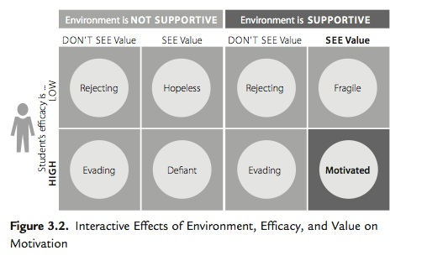
Ambrose, Susan A., et al. How Learning Works, John Wiley & Sons, Incorporated, 2010.

Slide 16
Value
attainment value
satisfaction that one gains from mastery and accomplishment of a goal or task
intrinsic value
the satisfaction that one gains simply from doing the task rather than from a particular outcome of the task
It is the source of intrinsic motivation
instrumental value/extrinsic rewards
praise
public recognition
money
material goods
an interesting career
a high-status job, etc.)

Slide 17
Efficacy
positive outcomes expectancies for success
growth vs fixed mindset
Efficacy expetancies represent the belief that one is capable of identifying, organising, initiating, and executing a course of action that will bring about a desired outcome (Bandura, 1997).
In order to hold a positive expectancy for success, learners must not only believe that doing the assigned work can earn a passing grade (growth mindset), they must also believe that they are capable of doing the work necessary to earn a passing grade

Slide 18
Efficacy
positive outcomes expectancies for success
growth vs fixed mindset
Efficacy expetancies represent the belief that one is capable of identifying, organising, initiating, and executing a course of action that will bring about a desired outcome (Bandura, 1997).
In order to hold a positive expectancy for success, learners must not only believe that doing the assigned work can earn a passing grade (growth mindset), they must also believe that they are capable of doing the work necessary to earn a passing grade

Slide 20
Environment
complex dynamics of the classroom
its tone
the interpersonal forces at play
the nature and structure of communication patterns.
e.g. "The instructor is approachable and several of my classmates seem willing to help me if I run into troubles".
inclusivity

Slide 21
Challenge - What can I do to create a motivating environment?
Think, pair, share
In pairs, think about what you could do to create a motivating environment in your classroom.
Share it with us.

Slide 22
Strategies to motivate learners
Connect the material to students’ interests
Provide authentic, real-world tasks
Show relevance to students’ current academic lives
Demonstrate the relevance of higher-level skills to students’ future professional lives
Identify and reward what you value
Show your own passion and enthusiasm for the discipline
Strategies to build positive expectations
Ensure alignment of objectives, assessments, and instructional strategies
Identify an appropriate level of challenge

Slide 23
Strategies to motivate learners
Connect the material to students’ interests
Provide authentic, real-world tasks/example
Show relevance to students’ current academic lives
Demonstrate the relevance of higher-level skills to students’ future professional lives
Identify and reward what you value
Show your own passion and enthusiasm for the discipline
Strategies to build positive expectations
Ensure alignment of objectives, assessments, and instructional strategies
Identify an appropriate level of challenge

Slide 24
Strategies to motivate learners
Connect the material to students’ interests
Provide authentic, real-world tasks/examples
Show relevance to students’ current academic lives
Demonstrate the relevance of higher-level skills to students’ future professional lives
Identify and reward what you value
Show your own passion and enthusiasm for the discipline
Strategies to build positive expectations
Ensure alignment of objectives, assessments, and instructional strategies
Identify an appropriate level of challenge

Slide 25
Strategies to motivate learners
Connect the material to students’ interests
Provide authentic, real-world tasks/examples
Show relevance to students’ current academic lives
Demonstrate the relevance of higher-level skills to students’ future professional lives
Identify and reward what you value
Show your own passion and enthusiasm for the discipline
Strategies to build positive expectations
Ensure alignment of objectives, assessments, and instructional strategies
Identify an appropriate level of challenge

Slide 26
Strategies to motivate learners
Connect the material to students’ interests
Provide authentic, real-world tasks/examples
Show relevance to students’ current academic lives
Demonstrate the relevance of higher-level skills to students’ future professional lives
Identify and reward what you value
Show your own passion and enthusiasm for the discipline
Strategies to build positive expectations
Ensure alignment of objectives, assessments, and instructional strategies
Identify an appropriate level of challenge

Slide 27
Strategies to motivate learners
Connect the material to students’ interests
Provide authentic, real-world tasks/examples
Show relevance to students’ current academic lives
Demonstrate the relevance of higher-level skills to students’ future professional lives
Identify and reward what you value
Show your own passion and enthusiasm for the discipline
Strategies to build positive expectations
Ensure alignment of objectives, assessments, and instructional strategies
Identify an appropriate level of challenge

Slide 28
Strategies to motivate learners
Connect the material to students’ interests
Provide authentic, real-world tasks/examples
Show relevance to students’ current academic lives
Demonstrate the relevance of higher-level skills to students’ future professional lives
Identify and reward what you value
Show your own passion and enthusiasm for the discipline
Build positive expectations
Ensure alignment of objectives, assessments, and instructional strategies
Identify an appropriate level of challenge

Slide 29
Strategies to motivate learners
Connect the material to students’ interests
Provide authentic, real-world tasks/examples
Show relevance to students’ current academic lives
Demonstrate the relevance of higher-level skills to students’ future professional lives
Identify and reward what you value
Show your own passion and enthusiasm for the discipline
Build positive expectations
Ensure alignment of objectives, assessments, and instructional strategies
Identify an appropriate level of challenge

Slide 30
Strategies to motivate learners
Connect the material to students’ interests
Provide authentic, real-world tasks/example
Show relevance to students’ current academic lives
Demonstrate the relevance of higher-level skills to students’ future professional lives
Identify and reward what you value
Show your own passion and enthusiasm for the discipline
Build positive expectations
Ensure alignment of objectives, assessments, and instructional strategies
Identify an appropriate level of challenge

Slide 31
Strategies to motivate learners
Provide early success opportunities
Articulate your expectations
Provide rubrics
Provide targeted feedback
Be fair
Educate students about the ways we explain success and failure
Describe effective study strategies
Strategies for self-efficacy
Provide flexibility and control
Give students an opportunity to reflect

Slide 32
Strategies to motivate learners
Provide early success opportunities
Articulate your expectations
Provide rubrics
Provide targeted feedback
Be fair
Educate students about the ways we explain success and failure
Describe effective study strategies
Strategies for self-efficacy
Provide flexibility and control
Give students an opportunity to reflect

Slide 33
Strategies to motivate learners
Provide early success opportunities
Articulate your expectations
Provide targeted feedback
Be fair
Educate students about the ways we explain success and failure
Describe effective study strategies
Strategies for self-efficacy
Provide flexibility and control
Give students an opportunity to reflect

Slide 34
Strategies to motivate learners
Provide early success opportunities
Articulate your expectations
Provide targeted feedback
Be fairDescribe effective study strategies
Strategies for self-efficacy
Provide flexibility and control
Give students an opportunity to reflect

Slide 35
Strategies to motivate learners
Provide early success opportunities
Articulate your expectations
Provide targeted feedback
Be fair
Describe effective study strategies
Strategies for self-efficacy
Provide flexibility and control
Give students an opportunity to reflect

Slide 36
Strategies to motivate learners
Provide early success opportunities
Articulate your expectations
Provide targeted feedback
Be fair
Describe effective study strategies
Give students an opportunity to reflect

Slide 37
Strategies to motivate learners
Provide early success opportunities
Articulate your expectations
Provide targeted feedback
Be fair
Describe effective study strategies
Give students an opportunity to reflect

Slide 38
Challenge - Demotivation
Think about a demotivating experience in your life (as a student or as an instructor/teacher) and share it to the GDoc
Notes:
Example:
Don’t you know XYZ???? ( with a surprised tone of voice)
Alternative
Oh you don’t know, that’s alright, I’ve just learned that myself! (Connecting)
Oh let’ me show you how cool is this (Cheerful)
When I’ve learned this it blew my mind! (Positive)

Slide 39
Demotivating
Do not
Dive into complex or detailed technical discussions with one or two people
Pretend to know more than what you do
Use diminishing language "just", "simply", "obviously", "don’t you know?"
Hinder autonomy
Deliver long unidirectional lectures

Slide 40
Strategies for active, interactive, collaborative learning

Slide 41
Active learning
Learners who actively engage with course materials will end up retaining it for much longer than they would have otherwise, and they will be better able to apply their knowledge broadly.
Waldrop, Nature 2015
Strategies for active learning?

Slide 42
Interactive learning
Participatory engagement
Promotes retention
Develops critical thinking
Allows you to assess learners
Learners immediately apply content
Science Education Resource Center at Carleton College (SERC)
https://serc.carleton.edu/sp/library/interactive/

Slide 43
Strategies for active, interactive, collaborative learning
brief question-and-answer sessions
think, pair, share
shared notes
work in groups
peer instruction
discussions (may be integrated into lectures)
brainstorming
impromptu writing assignments
hands-on activities
experiential learning events

Slide 44
Strategies for active, interactive, collaborative learning
Establish teamwork by agreement
Introduce blended multimedia materials
Instant feedback
Let learners do recaps
Introduce physical exercises
Introduce short, relaxing breaks
Assign tasks/problems to groups/pairs give time to present results
Introduce challenges or games

Slide 45
Activities and attitudes the instructor should promote
listening
questions asking
group discussions/brainstorming
peer instruction
participants' interaction/networking
presentations by participants
mode/pace/activity frequent change

Slide 46
Activities and attitudes the instructor should avoid or keep to a minimum
unidirectional lecturing
individual work out with no feedback
providing answers before letting participants doing it
keeping the same pace for long time
using a monotone modality of content delivery (including the tone of the voice)
showing no enthusiasm

Slide 47
Technique - Wrap-up
Allow time for wrap up and feedback

Slide 48
Challenge
On the GDoc
One or more new things that you have learned today and could be useful for your future teaching/training

Slide 49
Challenge - your vote counts
Add a + sign next to the point you agree the most
:D - Great I feel I’m learning new things
:] - I feel neutral, maybe I need more time to reflect
:S - I am more confused then ever

Slide 50
Technique - Short feedback
Sticky notes: red and green
Minute cards: positive and negative (anonymous)
One up, one down: positive and negative (no repetition)

Slide 51
Challenge 7
One up one down
Something you liked about what you did (do this again!)
Something you would like to change (avoid next time)

Slide 52
Time to relax

Slide 53
More resources
https://www.cmu.edu/teaching/
http://www.learningscientists.org/
https://ctl.yale.edu/ActiveLearning
https://www.ncsu.edu/effective_teaching
https://carpentries.github.io/instructor-training/
https://extend.ecampusontario.ca/teacher-for-learning-how-learning-works/

Slide 54
Challenge 6
In pairs ( 10 min)
One person will explain a topic for 90 seconds, while the other person write feedback about presentation and content.
Then you have a minute to go through the feedback.
Then switch and repeat.
As group (10 min )
We will go through the feedback together

Slide 55
“Our curiosity is provoked
when we perceive a problem
that we believe we can solve”
Willingham, 2009

Slide 56
The learning environment
Motivation and demotivation
Mindset

Slide 57
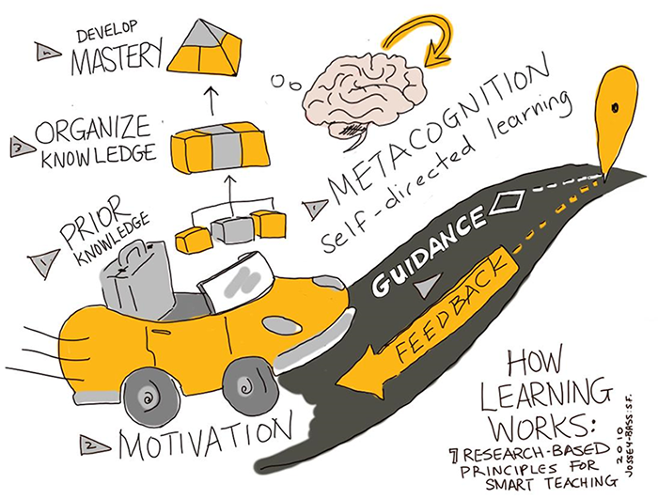
Seven principles of learning
Jossey Bass based on Ambrose, Susan A., et al. How Learning Works https://extend.ecampusontario.ca/teacher-for-learning-how-learning-works/

Slide 58
Seven principles of learning
Prior knowledge
Knowledge organisation
Motivation
Mastery: acquisition, practice integration, application
Goal directed practice with targeted feedback
Environment: social, emotional, and intellectual
Self-directed learners: learn, monitor, adjust
Ambrose, Susan A., et al. How Learning Works, John Wiley & Sons, Incorporated, 2010.

Slide 59
Strategies applied to learning principles
Collect data about students and use it to design instruction (P1,P3)
Be aware and make people aware of diversity in the classroom

Slide 60
Strategies applied to learning principles
Be explicit about learning goals, learning objectives and expectations (P3, P5, P6)
Goals challenging but attainable

Slide 61
Strategies applied to learning principles
Scaffold complex tasks (P2-P7).
Teach and test at the right level, think about your audience

Slide 62
Strategies applied to learning principles
Let learners formulate solutions before moving to work on new problems
Have them reflect on what they learned, and what they will do differently in the future (P2, P4, P7)

Slide 63
Strategies applied to learning principles
Establish a supportive class climate (P3, P6).
Learn and use learners' names and encourage them to interact with you in and outside of the course.
Collect anonymous learner feedback and investigate and respond to any complaints related to class climate.

Slide 64
Exercise - Reading
Let’s take 15 min to read about the seven learning principles from the book
How learning works
https://github.com/TrainTheTrainer/EXCELERATE-TtT/blob/master/docs/Ambrose_RandomThoughts_HowLearningWorks.pdf

