Slide 1
Training techniques to enhance learner participation and
engagement

Slide 2
Teaching objectives and Learning outcomes
Your experiences in training
Motivation and engagement
Strategies to motivate learners
Techniques to enhance learners participation and engagement
Strategies applied to the 7 learning principles
Learning Outcomes:
Reflect on good training strategies and techniques, and connect them to prior knowledge

Slide 3
Challenge 1 – What makes a good or bad training session
Alone: Recall concrete examples of past trainings and list your thoughts (3 min)
Good training | Bad training
Notes:
Trainer

Slide 4
Challenge 2 – what makes a good trainer?
In pairs (3 min)
Discuss with your colleague about some characteristics and write them in the post-its.
One characteristic per post-it.
Notes:
Trainer takes the post-its and organizes them in 4 columns corresponding to the GOBLET Skills matrix: communication, Expertise and knowledge, Planning & Management, Trainee Engagement

Slide 5
According to an experiment described in (Willingham, 2009), effective teachers have two qualities:
they are able to connect personally with students, and
they organise the material in a way that makes it interesting and easy to understand

Slide 6
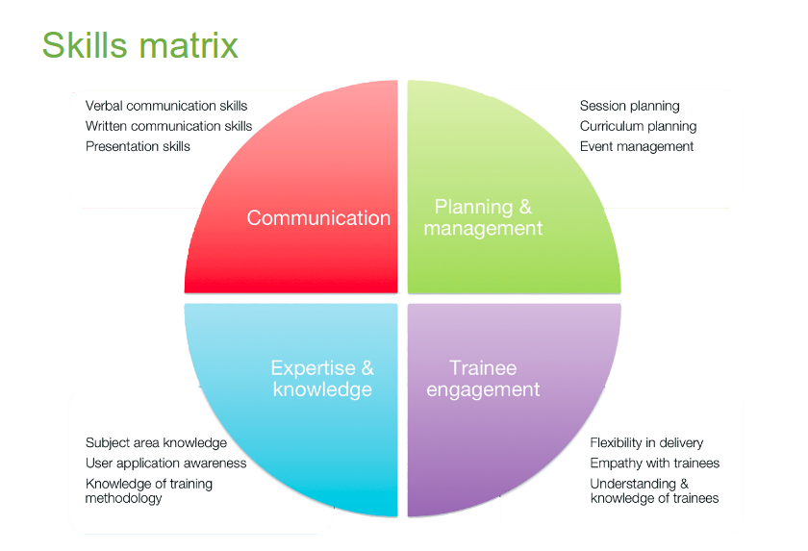
Example - GOBLET trainer skill matrix
Global Organisation for Bioinformatics Learning, Education and Training (GOBLET)
https://www.mygoblet.org/sites/default/files/goblet_events/GOBLET-TTT-061113.pdf

Slide 7
Challenge 3 - connecting your learning
We will see that your list of characteristics of good trainers fall in the four topics
Communication (C)
Expertise and knowledge (EK)
Planning and Management (PM)
Learner engagement (LE)

Slide 8
What makes a good trainer?
Knowledge of subject
Clear aims for session outcomes
Appropriate delivery method
Confidence in delivery
Listens to trainees
Flexible – can change pace / depth if required
Approachable
Engaging

Slide 9
What makes a good trainer?
Knowledge of subject
Clear aims for session outcomes
Appropriate delivery
Confidence in delivery
Listens to trainees
Flexible – can change pace / depth if required
Approachable
Engaging

Slide 10
Motivation and engagement
Motivation is a strong reason that drives someone to act or accomplish something
Principle P3: Students motivation determines, directs and sustains what they do learn.
Engagement refers to the degree of attention, curiosity, interest, optimism, and passion that learners show when they are learning or being taught, which extends to the level of motivation they have to learn and progress in their learning
Motivation
Engagement

Slide 11
Evidence-based methods to motivate learners
Strategies to establish value
Connect the material to students’ interests
Provide authentic, real-world tasks
Show relevance to students’ current academic lives
Demonstrate the relevance of higher-level skills to students’ future professional lives
Identify and reward what you value
Show your own passion and enthusiasm for the discipline
How Learning Works by Susan Ambrose, et al.,
Notes:
How Learning Works by Susan Ambrose, et al., contains this list of evidence-based methods to motivate learners.

Slide 12
Evidence-based methods to motivate learners
Strategies to build positive expectations
Ensure alignment of objectives, assessments, and instructional strategies
Identify an appropriate level of challenge
Create assignments that provide the appropriate level of challenge
Provide early success opportunities
Articulate your expectations
Provide rubrics
Provide targeted feedback
Be fair
Educate students about the ways you explain success and failure
Describe effective study strategies
How Learning Works by Susan Ambrose, et al.,
Notes:
Rubric: a scoring guide used to evaluate the quality of students' constructed responses

Slide 13
Evidence-based methods to motivate learners
Strategies for self-efficacy
Provide strategies for self-efficacy
Provide flexibility and control
Give students an opportunity to reflect
How Learning Works by Susan Ambrose, et al.,

Slide 14
Challenge 4 - your vote counts
Add a + sign next to the point you agree the most
:D - Great I feel I’m learning new things
:] - I feel neutral, maybe I need more time to reflect
:S - I am more confused then ever

Slide 15
Challenge 5 - Motivation
1. Think about any of your courses/ sessions and brainstorm a list of
What’s in it for me? from a student perspective
2. Think about demotivating examples and list them
Then add an alternative to it!
Notes:
Example:
Don’t you know XYZ???? ( with a surprised tone of voice)
Alternative
Oh you don’t know, that’s alright, I’ve just learned that myself! (Connecting)
Oh let’ me show you how cool is this (Cheerful)
When I’ve learned this it blew my mind! (Positive)

Slide 16
Techniques to enhance learner engagement and participation
Interactive training
Participatory engagement
Wrap-up
Short feedback

Slide 17
Technique - Interactive training
Reasons why:
Participatory engagement
Promotes retention
Develops critical thinking
Allows you to assess learners
Learners immediately apply content
Science Education Resource Center at Carleton College (SERC)
https://serc.carleton.edu/sp/library/interactive/

Slide 18
Technique - Interactive training - Tasks
Some examples of tasks
Interpreting graphs
Making calculations and estimations
Making predictions of results – tools/programs
Brainstorming
Tying ideas together
https://serc.carleton.edu/sp/library/interactive/

Slide 19
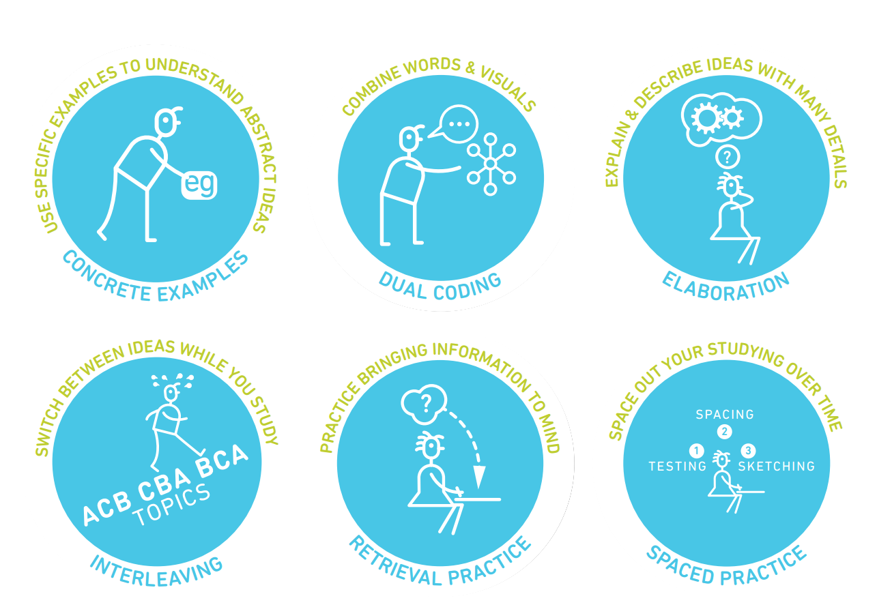
Strategies from learning scientists
teachinghow2s.com/cogsci Six Strategies for Effective Learning by Yana Weinstein, Megan Smith, & Oliver Caviglioli is licensed under a Creative Commons Attribution-NonCommercial-NoDerivatives 4.0 International License. Based on a work at http://www.learningscientists.org

Slide 20
Technique - Participatory engagement
Establish teamwork by agreement
Introduce blended multimedia materials
Instant feedback
Let learners do recaps
Introduce physical exercises
Introduce short, relaxing breaks
Assign tasks/problems to groups/pairs give time to present results
Introduce exercises, challenges or games

Slide 21
Techniques – Warm-up, Wrap-up and short-feedback
Allow time for warm-up, wrap-up and feedback
Short-feedback:
Sticky notes: red and green
Minute cards: positive and negative (anonymous)
One up, one down: positive and negative (no repetition)

Slide 22
Challenge 6
In pairs ( 10 min)
One person will explain a topic for 90 seconds, while the other person write feedback about presentation and content.
Then you have a minute to go through the feedback.
Then switch and repeat.
As group (10 min )
We will go through the feedback together

Slide 23
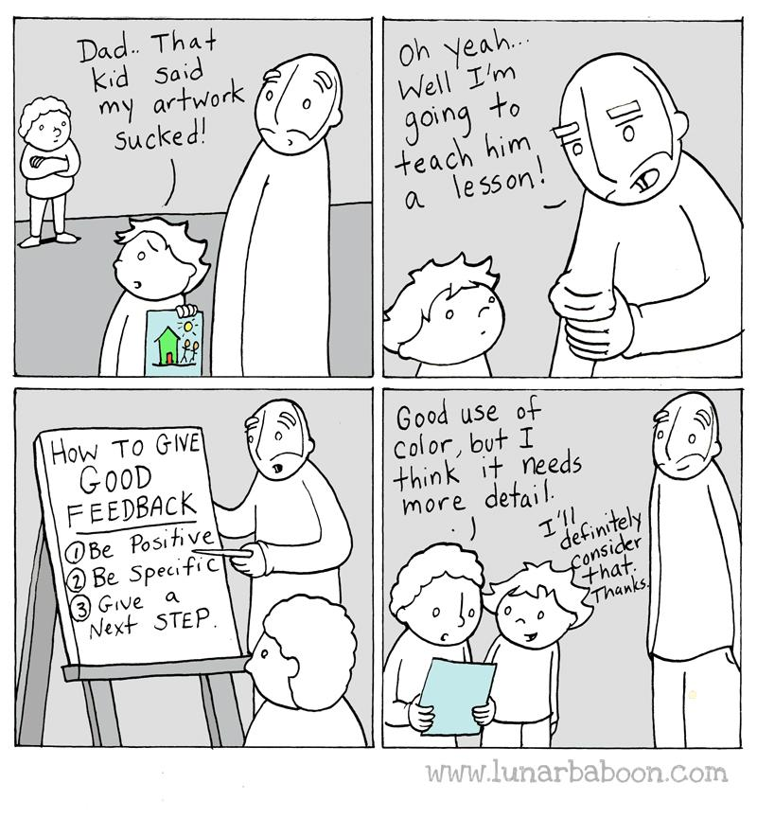
Learn and teach others how to give good feedback

Slide 24
Activities and attitudes the instructor should promote
listening
asking questions
group discussions/brainstorming
peer instruction
participants' interaction/networking
presentations by participants
mode/pace/activity frequent change

Slide 25
Activities and attitudes the instructor should avoid
lecturing
diving into complex or detailed technical discussions with one or two people
providing answers before letting participants doing it
keeping the same pace for long time
using a monotone modality of content delivery (including the tone of the voice)
showing no enthusiasm
pretend to know more than what you do
Use diminishing language "just", "simply", "obviously", "don’t you know?"
Hinder autonomy

Slide 26
Seven principles of learning
Prior knowledge
Knowledge organisation
Motivation
Mastery: acquisition, practice integration, application
Goal directed practice with targeted feedback
Environment: social, emotional, and intellectual
Self-directed learners: learn to monitor and adjust
Ambrose, Susan A., et al. How Learning Works, John Wiley & Sons, Incorporated, 2010.
Notes:
Principle P1: Students' prior knowledge can help or hinder learning.
Principle P2: How students organise knowledge influences how they learn and apply what they know.
Principle P3: Students motivation determines, directs and sustains what they do learn.
Principle P4: To develop mastery, students must acquire component skills, practice integrating them, and know when to apply what they have learned
Principle P5: Goal-directed practice coupled with targeted feedback enhances the quality of students' learning
Principle P6: Students' current level of development interacts with the social, emotional, and intellectual climate of the course to impact learning
Principle P7: To become self-directed learners, students must learn to monitor and adjust their approaches to learning.

Slide 27
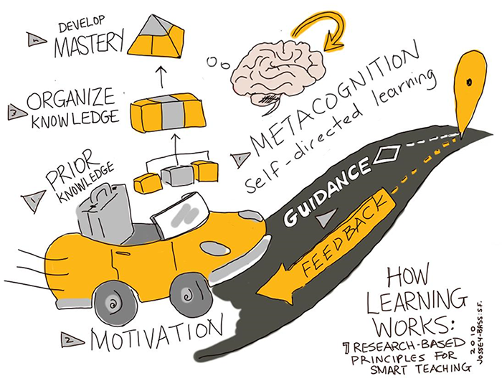
Seven principles of learning
Jossey Bass based on Ambrose, Susan A., et al. How Learning Works https://extend.ecampusontario.ca/teacher-for-learning-how-learning-works/

Slide 28
Strategies applied to learning principles
Collect data about students and use it to design instruction (P1,P3)
Be aware and make people aware of diversity in the classroom

Slide 29
Strategies applied to learning principles
Be explicit about teaching objectives, learning outcomes and expectations (P3, P5, P6)
Goals challenging but attainable

Slide 30
Strategies applied to learning principles
Scaffold complex tasks (P2-P7).
Teach and test at the right level, think about your audience

Slide 31
Strategies applied to learning principles
Let learners formulate solutions before moving to work on new problems
Have them reflect on what they learned, and what they will do differently in the future (P2, P4, P7)

Slide 32
Strategies applied to learning principles
Establish a supportive class climate (P3, P6).
Learn and use learners' names and encourage them to interact with you in and outside of the course.
Collect anonymous learner feedback and investigate and respond to any complaints related to class climate.

Slide 33
Challenge 8
On the etherpad
One new thing that you have learned today and can be useful for your future teaching

Slide 34
Challenge 7
One up one down
Something you liked about what you have learned today (and will use in your next course!)
Something you would like to change (and we should avoid next time)
Notes:
Or One up one down
Something you liked about what you did (do this again!)
Something you would like to change (avoid next time)

Slide 35
More resources
https://www.cmu.edu/teaching/
http://www.learningscientists.org/
https://ctl.yale.edu/ActiveLearning
https://www.ncsu.edu/effective_teaching
https://carpentries.github.io/instructor-training/
https://extend.ecampusontario.ca/teacher-for-learning-how-learning-works/

Slide 36
Thank you

