Slide 1
Design and plan
session, course, materials

Slide 2
Warm-up (5’)
Alone:
Think of 2 take-home messages from yesterday

Slide 3
Teaching objectives of the session
Work on defining
Defining audience
Defining content
Making delivery plan
Content
Targeted feedback

Slide 4
Learning outcomes
Design the content of a minitraining
Prepare and plan for deliver training
Revise feedback then adjust/improve/modify (according to feedback) for a 3 minute presentation

Slide 5
Training requirements
What is the training topic?
Who are you training?
Where will the training be delivered?
When will the training take place?
Why are you training them?
We quote Chris Taylor – Earlham Institute - https://www.mygoblet.org/training-portal/materials/train-trainer-course-materials

Slide 6
Design of a three-minute training
Choose a topic to demonstrate your training in three minutes.
how to make an origami bird
introduction to biochemistry
how bats recognise the presence of obstacles
the second law of Newton
how to draw a comic strip

Slide 7
Challenge 1 - define the audience, goal and outcomes (7 min)
Identify the target audience and prerequisites
Teaching objectives describe the goals and intentions of the instructor
Learning outcomes, think about what learners will be able to do by the end of instruction/session/workshop
https://www.clinton.edu/curriculumcommittee/listofmeasurableverbs.cxml

Slide 8
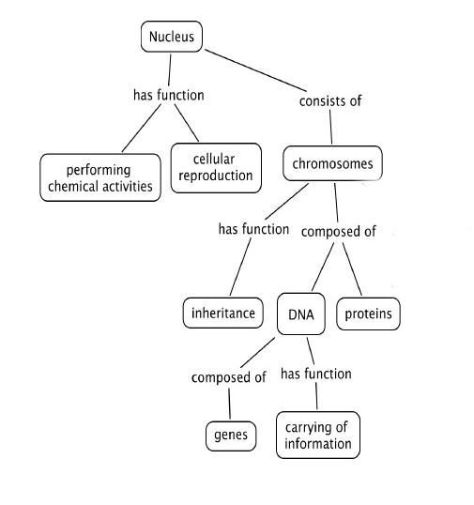
Concept map

Slide 9
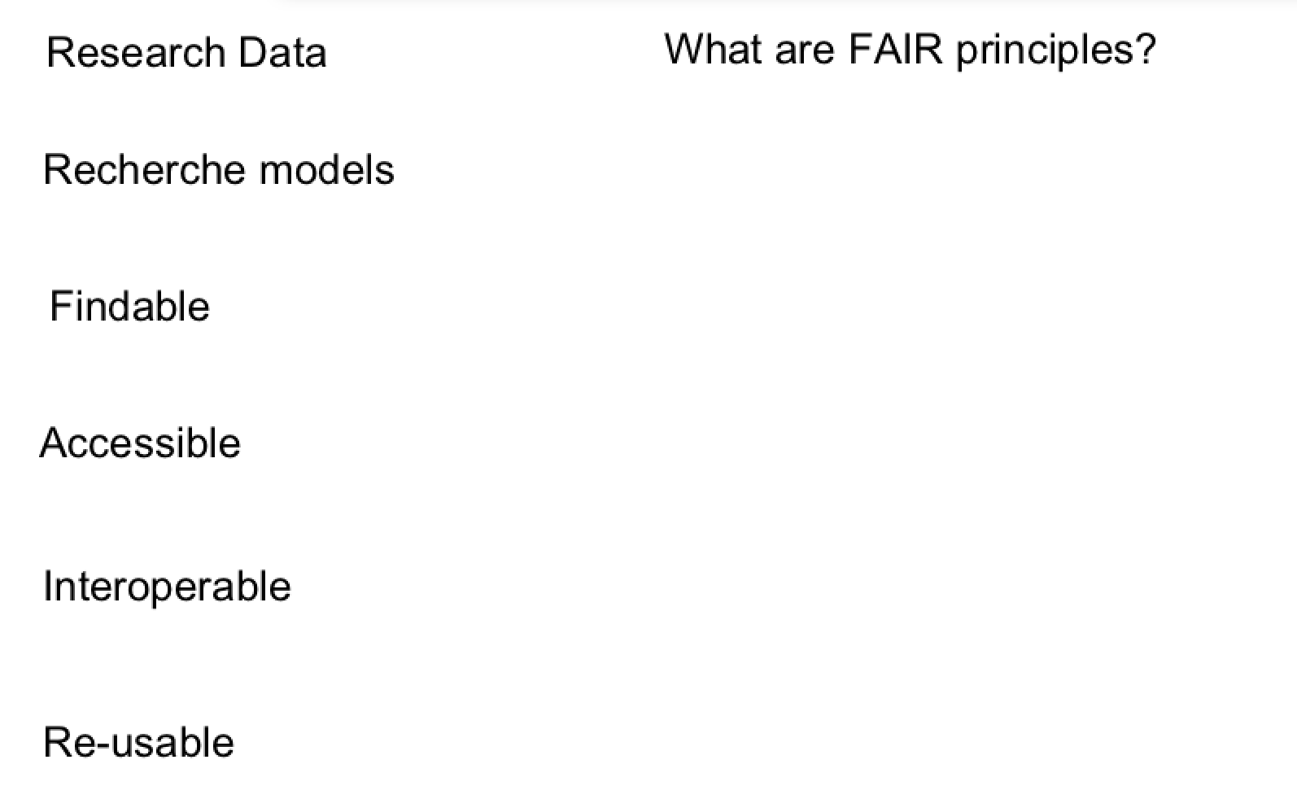
Concept map – FAIR principles

Slide 10
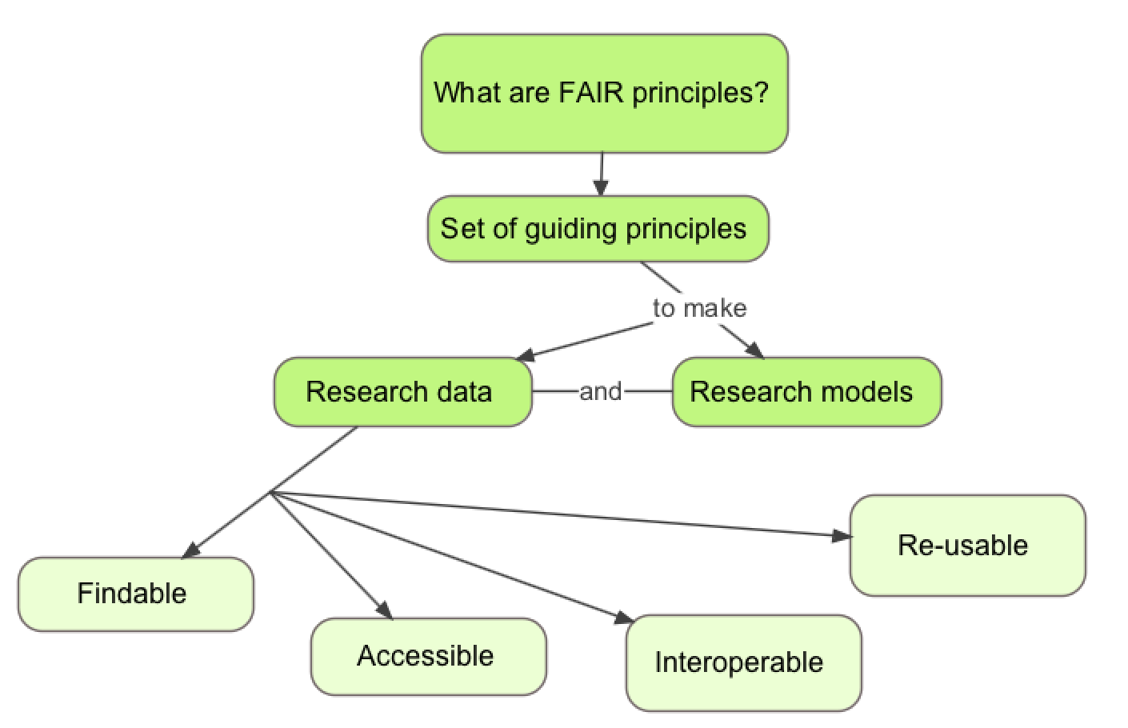
Concept map – FAIR principles

Slide 11
Concept maps
Concept maps are graphical tools for organizing and representing knowledge
Include concepts and relationships to link concepts
Good to start a concept map with a focus question - context
Help to organize knowledge and to structure it
Good concept maps are built with iterations and feedback
Joseph D. Novak , 1972

Slide 12
Challenge 2 (10 min)
Draw a concept map of your topic of interest, start with a question
Include 7 (+ - 2) concepts
Include relationships and cross-links between these concepts
Arrange it in a hierarchical structure with the key concepts on top

Slide 13
Challenge 3 (8 min)
In pairs exchange concept maps. Do not explain the map.
Write one thing you are confused/not sure about the map
Write one thing you like/it is clear about the map
Each person will give and receive two feedbacks:
Positive and Negative on content

Slide 14
Concept maps in curriculum planning
They present key concepts in a highly concise manner
This helps in the teaching plan to measure how much you can cover
The hierarchical organization suggests a sequence to cover material
Further reading http://cmap.ihmc.us/Publications/ResearchPapers/TheoryUnderlyingConceptMaps.pdf

Slide 15
Delivery planning
Is it part of an extended curricula?
Is the training a requirement, or optional career development?
Format: workshop, seminar, lecture, online training or mix online/in-person?
Timing: what is the content and depth of the training?
Do you need to invite any other external experts?
What sort of venue/equipment do you need for this format?
Share your comments!

Slide 16
Challenge 4 - Delivery planning (2 min)
Think if you want to make your training interactive
Think whether you need or want to use a visual support (images)
Think whether you need to distribute material in advance to the audience
Prepare for your choices
Be creative!

Slide 17
A Word about Content
Content collection
Appropriate content to the needs and capabilities of your target audience
Content reduction
One of the biggest challenges in designing training courses is the reduction of content to the training format. Keep only key points!

Slide 18
Training session - design and plan
Iterative and circular process:
Define the overall AIM
Define SMART learning outcome(s) related to the concepts, knowledge and skills you want the learners to develop (see concept maps).
Define the pre-requirements (what they bring, what you need to provide)
Define an evaluation (measure achieved learning outcomes), and the concepts/competencies/skills needed to succeed the evaluation.
Describe and create the course session activities, content, the process of the session (instructions), and any materials needed.
This is an iterative process and can/should be revised several times!
Notes:
Specific – precise outcome
Measurable – a definied element to demonstrate the outcome
Achievable – realistic given the contstraints (frame) of time resources
Relevant – Directly linked to a goal
Timely – Oncludes when the outcomes would be achieved

Slide 19
Challenge 5 - Prepare content (15 min)
You have 15 min to prepare the content of your mini-training
The structure of your mini-training should be something like
40 seconds introduction
2 minutes on topic
20 seconds conclusion
Use your concept map and adapt as needed

Slide 20
Discussions / feedback
Listen actively and attentively
Ask for clarification if you are confused
Do not interrupt one another
Challenge one another, but do so respectfully
Critique ideas, not people
Do not offer opinions without supporting evidence
Take responsibility for the quality of the discussion
Build on one another ’s comments; work toward shared understanding.
Do not monopolise discussion.
Speak from your own experience, without generalizing.
If you are offended by anything said during discussion, acknowledge it immediately.

Slide 21
Challenge 6 - Mini-training practice (15 min)
Split into groups of 3 or 2
Each will deliver their 3 minute session to the others
One person delivers the session
One person records on the phone (optional)
One person notes down comments real-time
You describe your own comments on your delivery
The other two provide feedback to the presenter
Then rotate within the group (and restart from 1)

Slide 22
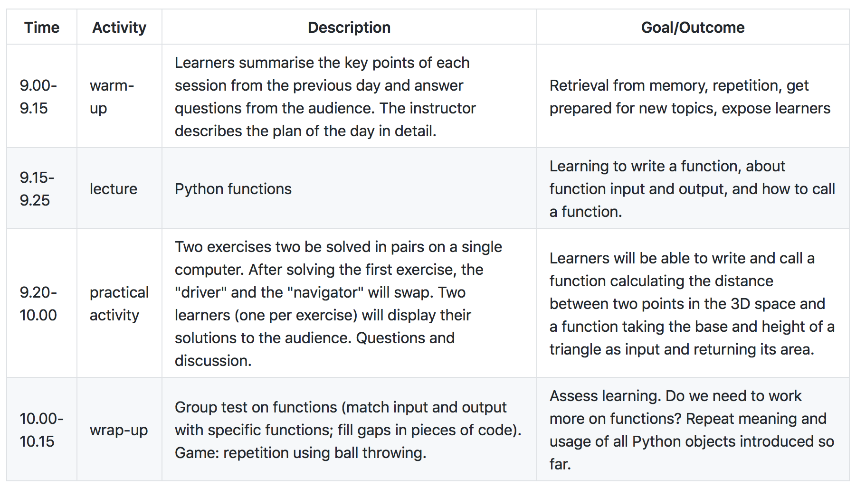
Example: Plan for a 1h15 session

Slide 23
Challenge 7 - Mini-training adjust (5 min)
You then have time to revise your session, before delivering to the group again

Slide 24
Training materials repositories and resources
GOBLET – http://mygoblet.org/training-portal
TeSS - https://tess.elixir-europe.org/
GitHub - https://github.com
Jupiter - http://jupyter.org/
Other?

Slide 25
Sharing and reusing training materials FAIR principles
Data and models are:
Findable - can be searched for by the community after publication
Accessible - can be read/downloaded by other researchers
Interoperable - can be understood clearly in the context of the original experiment
Re-usable - can be used by other researchers

Slide 26
Sharing and reusing training materials FAIR principles – in the training context
Training course materials: slides, exercises, datasets
Findable - can be searched and found by the trainers community
Accessible - can be read/downloaded by other trainers
Interoperable - can be understood clearly in the context of the original course
Re-usable - can be used by other trainers

Slide 27
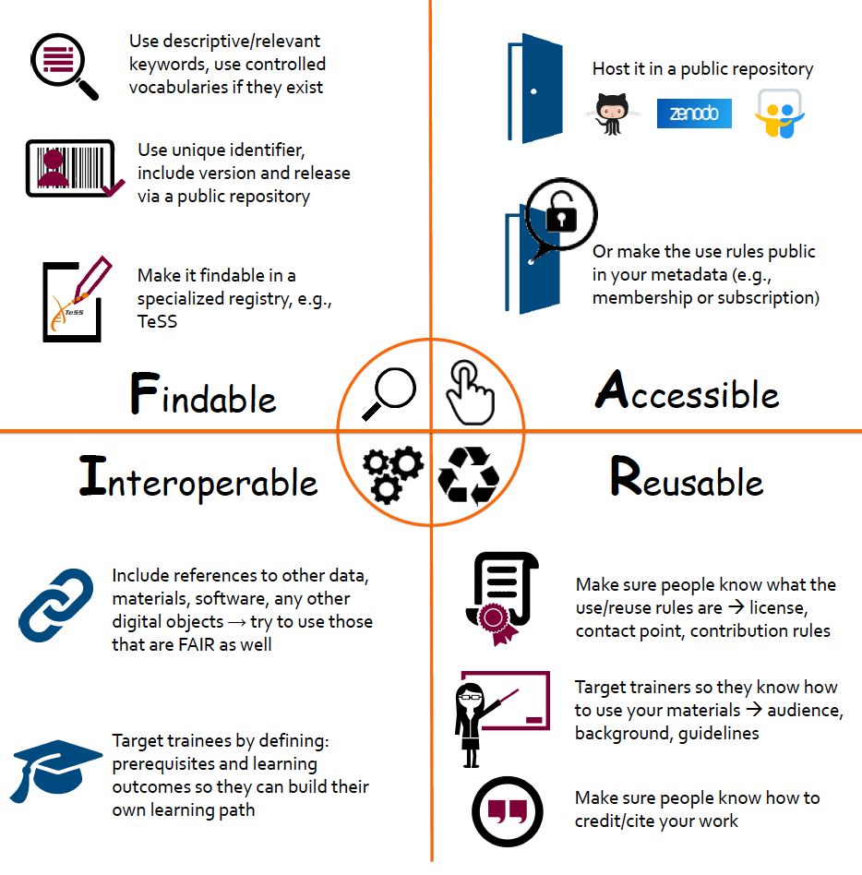
10 recommendations to make training materials FAIRer
https://f1000research.com/posters/8-856

Slide 28
Reproducibility of compute environments
Different courses, different compute requirements: Unix, R, Python, metagenomics, long read sequencing
Installation process time-consuming and technically challenging
Every computer should have an identical installation setup and sufficient hardware (power and memory) to run the tools
Virtual machines, cloud computing, containers, software images

Slide 29
Training rooms for bioinformatics
Physical environment
Room geometry: seats’ quality, the lighting, the room temperature control, the stability of power and network connections
Functionality : video, audio, drawing surfaces (whiteboard, flipchart paper), a corkboard to pin materials
Hardware needs: power suppliers, network connections with a good quality wifi access

Slide 30
Wrap-up (10 min)
Articulate a goal of good teaching practice that you are ready to apply for your next training
- One person a time, no repetition

Slide 31
Summarizing
Using Concept Maps to develop courses and sessions
Training session design and plan
Training materials: sharing and making re-use possible
Training materials repositories and resources: GOBLET, TeSS, GitHub, etc.
Reproducibility of compute environments
Training rooms for bioinformatics

