Slide 1
Assessment and feedback in training

Slide 2
Context of this session
LO #1
Learning Activities
Course Aim
LO #2
Assessment Tools
LO #3
Feedback Tools

Slide 3
Teaching objective
Develop an understanding of different types of feedback,
when to give and receive feedback, and for which purpose.

Slide 4
Challenge 1: (10 min)
what kind of feedback/assessment do you know as a learner
or use as a trainer?
What type of assessment did you undertake as a learner and/or trainer?
What was its purpose in your opinion?
Was it useful to your learning or teaching?
When did the assessment happen?
Write down at least one example and discuss it with us.

Slide 5
Q: what are the different ways we can categorise assessment?

Slide 6
Assessment timeline - when and why to assess
Pre-course assessment (before the course) - verify the target audience of the course
Preventive assessment (beginning of the course) - final adjustments of the course to the reality of the participants
Formative assessment (during the course) - pilot in real time if learning is taking place
Summative assessment (right after the course) - measure and evaluate the knowledge and skills acquired
Strategic evaluation (after the course, long time after the course) - measure the adequacy, quality and impact of the course

Slide 7
Pre-course assessment - Diagnostic questionnaires
Anonymous questionnaires allow to have an idea of the level of knowledge of the whole group of learners.
Non-anonymous and personal questionnaires allow to find out if the learner has a necessary pre-required knowledge, and in the negative case indicate an appropriate teaching choice to palliate this lack.

Slide 8
Challenge 2 (5 min)
Have a look at the example pre workshop questionnaire.
What is the role of this questionnaire?

Slide 9
MCQs: Multiple Choice Questions
A note on how to make feedback questions

Slide 10
Challenge 3: MCQ (10 min)
Q: what is 27 + 15 ?
a) 42
b) 32
c) 312
d) 33
Pick one wrong answer and explain misconception associated with it.

Slide 11
Design of MCQs with distractors
Versatility: written to assess various levels of LO, from basic recall to application, analysis, and evaluation
Reliability: degree to which a test consistently measures a LO
Validity: degree to which a test measures the LO it purports to measure.

Slide 12
Challenge 4: MCQs (10 min)
Write one MCQ (in your field of teaching). Pick one :
a knowledge gap ("what")
a weakness in a practical skill ("why, when, how")
a misconception
Discuss with your partner(s).

Slide 13
Summative and formative assessment
Summative assessment: An exam or a test at the end of a course is an example of summative assessment. Summative assessment is aimed at evaluating learners' performance at the end of teaching (this could be at the end of a topic, a session, or at the end of the entire course). This is the most frequent type of assessment occurring in schools and universities and usually includes grading. It is less frequent in training.

Slide 14
Summative and formative assessment
Formative assessment takes place during teaching and learning. Its purpose is to help both instructors and learners to become aware of what the focus should be.
Formative Classroom assessments’ purpose is to improve the quality of student learning, not to provide evidence for evaluating or grading students.

Slide 15
Challenge 5 (10 min)
Think of different kinds of formative assessment
Write down on the post it.
Discuss it with your partner(s).

Slide 16
Formative assessment can be done in many different ways:
Asking questions to learners and getting responses orally;
Asking them to describe the strategy they would adopt to solve a problem;
Asking them to solve a problem in groups, or individually but in front of the class;
Using brainstorming and discussions;
Providing diagnostic questionnaires;
Providing MCQs with distractors.

Slide 17
Formative assessment
can be used to collect information about learners':
prior knowledge
> which knowledge gaps need to be filled before moving on

Slide 18
Formative assessment
can be used to collect information about learners':
mental models
> whether their mental models are correct

Slide 19
Formative assessment
can be used to collect information about learners':
goals and objectives
> if learners goals and objectives are aligned to the course's goals and objectives

Slide 20
Formative assessment
can be used to collect information about learners':
frequent mistakes
> which types of mistakes need special attention

Slide 21
Formative Assesment can be used to:
Activate and explore prior knowledge:
activate prior knowledge
reveal accurate but insufficient prior knowledge
recognise inappropriate prior knowledge
highlight inaccurate prior knowledge

Slide 22
Peer instructions (2+3 min)
Watch the video.
Discuss with your partner(s).

Slide 23
Feedback from learners
Assessing learner reactions to:
teachers and teaching thus providing context-specific feedback that can improve teaching within a particular course;
class activities, assignments, and materials thus giving instructors information that will help them improve their course materials and assignments;
course organisational aspects, thus providing the organiser information that will help him or her to improve the course organisation;

Slide 24
Systematic immediate feedback
When?
Ideally at natural breakpoints such as ending an exercise, shifting to a different subject and right after a wrap-up session.
How?
It should be very focused and expedite in execution. The instructor should think of a clearly stated question that has a binary (Yes/no) or garaded (0-5) response.
This is Instant Feedback.

Slide 25
methods for Instant Feedback (involving technology)
Clickers
Socrative
MentiMeter
Learning Catalytics

Slide 26
Challenge 6: benefits of Instant Feedback (10 min)
What are the benefits of instant feedback:
for learners
for trainers
write them down, one benefit per post-it

Slide 27
Short term feedback assessment of training quality,
participant and instructor performance
It happens immediately at the end of the course – to measure the trainees’ perception of:
quality of the training and its organisation aspects
trainer’s capacity to teach (performance)
adequacy of the training to their expectations
strengths and weaknesses of course

Slide 28
Challenge 7
Look at Feedback Questionnaires used in ELIXIR workshops.
Common shared questions used by most of the ELIXIR Nodes (countries):

Slide 29
Long term post-course feedback
The assessment of impacts that endure.
Long term assessments (over 6 months after a course) are rather difficult.

Slide 30
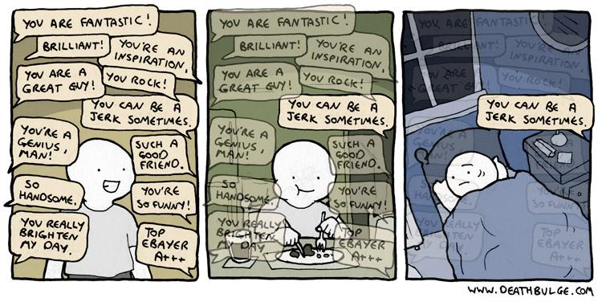
Feedback is hard

Slide 31
Dealing with (bad) feedback
Trainees feedback should be considered along other forms of quality evidence:
Review what they have effectively learned (in exams)
Consider your own experience of teaching
Discuss with colleagues and friends
Look at the feedback from past sessions of the same course
Look at the response rates
Look at the counter examples (contradictions)
Look at the repetitive patterns(not at only one single answer)

Slide 32
Dealing with (bad) feedback
Breath deeply
Humans focus more on negative feedback than on positive (you are not alone)
Try to see the point in the criticism, learn from it
Don’t take it personally (easier said than done). Try to focus on what they say about what you do (not who you are)

Slide 33
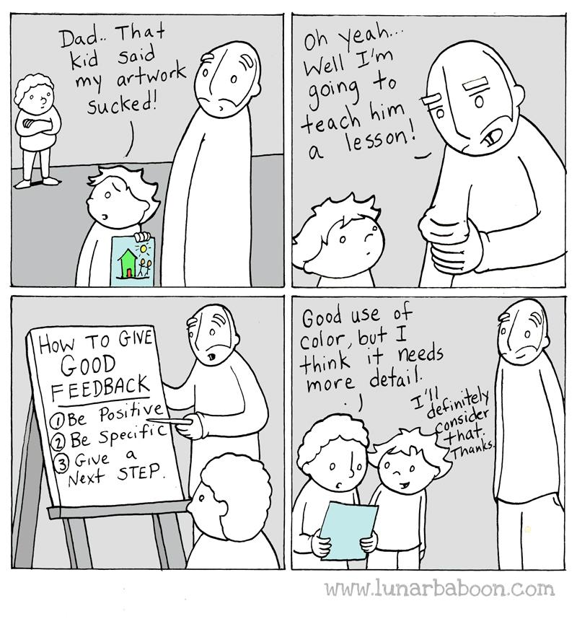
Learn and teach others how to give good feedback

