Slide 1
Training techniques to enhance learner participation and
engagement

Slide 2



Patricia Palagi
Biologist/Computer scientist/Cognitive Sciences
Bioinformatician
Training coordinator
Team Leader, SIB Training
Training Coordinator for ELIXIR Switzerland
Co-Leader ELIXIR Training Platform
patricia.palagi@sib.swiss
@P_Palagi ppalagi

Slide 3
Teaching objectives and Learning outcomes
Your experiences in training
Strategies to establish value
Strategies to enhance learning
Interactive training
Participatory engagement
Motivation
Wrap up and feedback
7 principles of learning
Learning Outcomes:
Apply good training strategies, and connect strategies to prior knowledge

Slide 4
Challenge 1 – What makes a good or bad training session
Recall concrete examples of past trainings and list your thoughts (3 min)
Good training | Bad training

Slide 5
Challenge 2 – what makes a good trainer?
In pairs (3 min)
Associate some characteristics and describe them

Slide 6
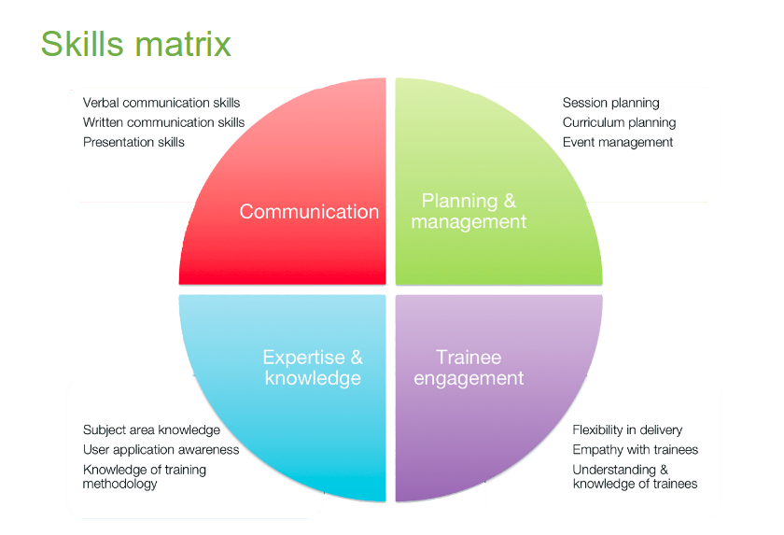
Example - GOBLET trainer skill matrix
Global Organisation for Bioinformatics Learning, Education and Training (GOBLET)
https://www.mygoblet.org/sites/default/files/goblet_events/GOBLET-TTT-061113.pdf

Slide 7
Challenge 3 - connecting your learning
As a group
Retrieve your list of characteristics of good trainers and connect to the four topics
Communication (C)
Expertise and knowledge (EK)
Planning and Management (PM)
Learner engagement (LE)

Slide 8
What makes a good trainer?
Knowledge of subject
Clear aims for session outcomes
Confidence in delivery
Appropriate delivery
Listens to trainees
Flexible – can change pace / depth if required
Approachable
Engaging

Slide 9
According to experiment described in (Willingham, 2009), effective teachers have two qualities:
they are able to connect personally with students, and
they organise the material in a way that makes it interesting and easy to understand (the class is well organised).

Slide 10
Strategies to establish value
Connect the material to students’ interests
Provide authentic, real-world tasks
Show relevance to students’ current academic lives
Demonstrate the relevance of higher-level skills to students’ future professional lives
Identify and reward what you value
Show your own passion and enthusiasm for the discipline
Strategies to build positive expectations
Ensure alignment of objectives, assessments, and instructional strategies
Identify an appropriate level of challenge

Slide 11
Strategies to establish value
Create assignments that provide the appropriate level of challenge
Provide early success opportunities
Articulate your expectations
Provide rubrics
Provide targeted feedback
Be fair
Educate students about the ways we explain success and failure
Describe effective study strategies
Provide strategies for self-efficacy
Provide flexibility and control
Give students an opportunity to reflect
Notes:
Rubric: a scoring guide used to evaluate the quality of students' constructed responses

Slide 12
Challenge 4 - your vote counts
Add a + sign next to the point you agree the most
:D - Great I feel I’m learning new things
:] - I feel neutral, maybe I need more time to reflect
:S - I am more confused then ever

Slide 13
Technique - Interactive training
Participatory engagement
Promotes retention
Develops critical thinking
Allows you to assess learners
Learners immediately apply content
Science Education Resource Center at Carleton College (SERC)
https://serc.carleton.edu/sp/library/interactive/

Slide 14
Technique – Tasks for interactive training
Some examples
Interpreting graphs
Making calculations and estimations
Making predictions of results – tools/programs
Brainstorming
Tying ideas together
https://serc.carleton.edu/sp/library/interactive/

Slide 15
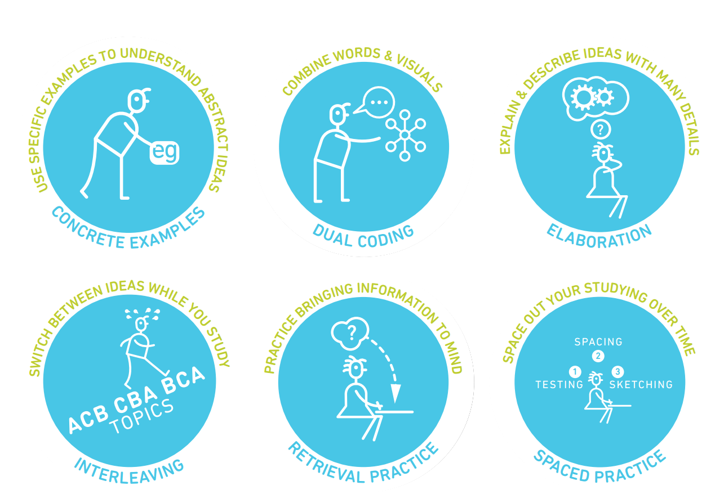
Strategies from learning scientists
teachinghow2s.com/cogsci Six Strategies for Effective Learning by Yana Weinstein, Megan Smith, & Oliver Caviglioli is licensed under a Creative Commons Attribution-NonCommercial-NoDerivatives 4.0 International License. Based on a work at http://www.learningscientists.org

Slide 16
Technique - Motivation
Start with level of the audience
What could grab their interest?
The techniques that can be used to keep motivation up in an audience are called engagement

Slide 17
Technique - Participatory engagement
Establish teamwork by agreement
Introduce blended multimedia materials
Instant feedback
Let learners do recaps
Introduce physical exercises
Introduce short, relaxing breaks
Assign tasks/problems to groups/pairs give time to present results
Introduce challenges or games

Slide 18
Activities and attitudes the instructor should promote
listening
asking questions
group discussions/brainstorming
peer instruction
participants' interaction/networking
presentations by participants
mode/pace/activity frequent change

Slide 19
Activities and attitudes the instructor should avoid
lecturing
individual work out
providing answers before letting participants doing it
keeping the same pace for long time
using a monotone modality of content delivery (including the tone of the voice)
showing no enthusiasm

Slide 20
Challenge 5 - Motivation
1. Think about any of your courses/ sessions and brainstorm a list of
What’s in it for me? from a student perspective
2. Think about demotivating examples and list them
Then add an alternative to it!
Notes:
Example:
Don’t you know XYZ???? ( with a surprised tone of voice)
Alternative
Oh you don’t know, that’s alright, I’ve just learned that myself! (Connecting)
Oh let’ me show you how cool is this (Cheerful)
When I’ve learned this it blew my mind! (Positive)

Slide 21
Example - Demotivating
Do not
Dive into complex or detailed technical discussions with one or two people
Pretend to know more than what you do
Use diminishing language "just", "simply", "obviously", "don’t you know?"
Hinder autonomy
Long unidirectional lecturing

Slide 22
Exercise - Reading
Let’s take 15 min to read about the seven learning principles from the book
How learning works
https://github.com/TrainTheTrainer/EXCELERATE-TtT/blob/master/docs/Ambrose_RandomThoughts_HowLearningWorks.pdf

Slide 23
Seven principles of learning
Prior knowledge
Knowledge organisation
Motivation
Mastery: acquisition, practice integration, application
Goal directed practice with targeted feedback
Environment: social, emotional, and intellectual
Self-directed learners: learn to monitor and adjust
Ambrose, Susan A., et al. How Learning Works, John Wiley & Sons, Incorporated, 2010.
Notes:
Principle P1: Students' prior knowledge can help or hinder learning.
Principle P2: How students organise knowledge influences how they learn and apply what they know.
Principle P3: Students motivation determines, directs and sustains what they do learn.
Principle P4: To develop mastery, students must acquire component skills, practice integrating them, and know when to apply what they have learned
Principle P5: Goal-directed practice coupled with targeted feedback enhances the quality of students' learning
Principle P6: Students' current level of development interacts with the social, emotional, and intellectual climate of the course to impact learning
Principle P7: To become self-directed learners, students must learn to monitor and adjust their approaches to learning.

Slide 24
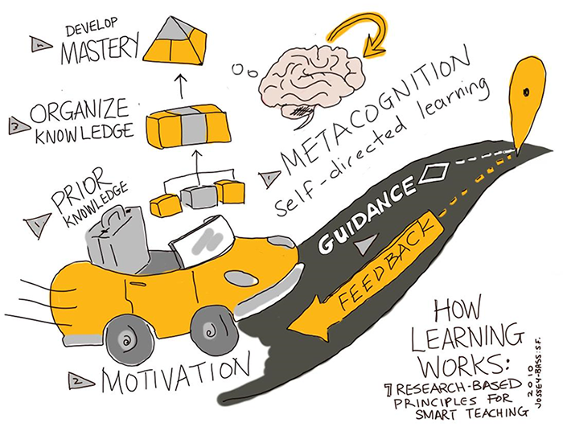
Seven principles of learning
Jossey Bass based on Ambrose, Susan A., et al. How Learning Works https://extend.ecampusontario.ca/teacher-for-learning-how-learning-works/

Slide 25
Strategies applied to learning principles
Collect data about students and use it to design instruction (P1,P3)
Be aware and make people aware of diversity in the classroom

Slide 26
Strategies applied to learning principles
Be explicit about learning goals, learning objectives and expectations (P3, P5, P6)
Goals challenging but attainable

Slide 27
Strategies applied to learning principles
Scaffold complex tasks (P2-P7).
Teach and test at the right level, think about your audience

Slide 28
Strategies applied to learning principles
Let learners formulate solutions before moving to work on new problems
Have them reflect on what they learned, and what they will do differently in the future (P2, P4, P7)

Slide 29
Strategies applied to learning principles
Establish a supportive class climate (P3, P6).
Learn and use learners' names and encourage them to interact with you in and outside of the course.
Collect anonymous learner feedback and investigate and respond to any complaints related to class climate.

Slide 30
Challenge 6
In pairs ( 10 min)
One person will explain a topic for 90 seconds, while the other person write feedback about presentation and content.
Then you have a minute to go through the feedback.
Then switch and repeat.
As group (10 min )
We will go through the feedback together

Slide 31
Challenge 8
On the etherpad
One new thing that you have learned today and can be useful for your future teaching

Slide 32
Technique - Wrap-up
Allow time for wrap up and feedback

Slide 33
Technique - Short feedback
Sticky notes: red and green
Minute cards: positive and negative (anonymous)
One up, one down: positive and negative (no repetition)

Slide 34
Challenge 7
One up one down
Something you liked about what you did (do this again!)
Something you would like to change (avoid next time)

Slide 35
More resources
https://www.cmu.edu/teaching/
http://www.learningscientists.org/
https://ctl.yale.edu/ActiveLearning
https://www.ncsu.edu/effective_teaching
https://carpentries.github.io/instructor-training/
https://extend.ecampusontario.ca/teacher-for-learning-how-learning-works/

Slide 36
Time for lunch (and relax)

