Slide 1
OpenGL moved pyramid animation with keyboard control
Esti Kurniasari
Complete source code available On GITHUB

Slide 2
About open GL
OpenGL is a software interface for graphics hardware. It renders multidimensional objects (two-and three-dimensional objects) into a framebuffer.
These objects are described as sequences of vertices (that define geometric objects) or pixels (that define images)
OpenGL is Designed for use by C/C++ programmers.

Slide 3
???
How to build animated object that can be moved by using keyboard arrow keys as its control

Slide 4
Problem definition
Start with “What software do I use to make this project?”
Problem1 : How to make 3D object
Problem2 : How to make the object move
Problem3 : How to get input from the keyboard
Problem4 : How to set the color of the background and the object

Slide 5
Solution
Problem1 : Decide what kind of object.
In this case my object is a PYRAMID
To make 3D object I need to know about the function in OpenGL.
Problem2 : I use rotation animation so I need to know about how to change the angle of the object by using the function.
Problem3 : Make a function to get the input key from keyboard.
Problem4 : For the color I use RGBA format

Slide 6
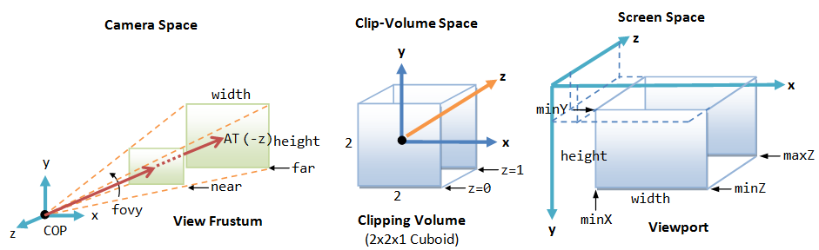
Solution Description
Software I use to build this moved pyramid animation is Visual Studio 2013
Object that I build is 3D pyramid, these pyramid consist from 6 triangles
Knowledge about geometry is needed to build 3D object, also the knowledge about projection
Projection Example
For animation, angle of the object is saved in a variable, then this value changes in certain time interval. This rotation use library function called glRotatef().
For Keyboard Control also use variable to store the value. Every time the key is pressed, the value in variable increase by 0.05 or decrease by 0.05.

Slide 7
Plan
Day 1 : Get to know about OpenGL
How to install OpenGL in Visual Studio 2013, download the library, learn about OpenGL, and setting up the environment in VS 2013
Day 2 : Build 3D Object and to choose the color
Learn about Vertex
First, practice to build 2D object, after get knowing about how things work, start to build 3D Object.
Learn about how to build pyramid and implement these in a code.
Learn about how to change and setting up the color for object and background and implement these in a code.
Day 3 : Apply the animation on object
Day 4 : Add keyboard control movement to the object
Day 5 : Make presentation + Upload

Slide 8

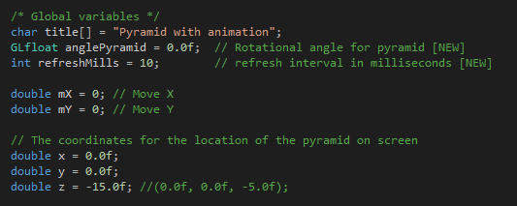
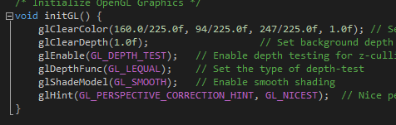
Implementation
Library
OpenGL Graphic Initialization
Global Variable

Slide 9
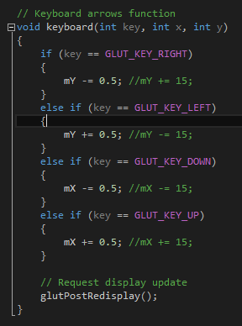
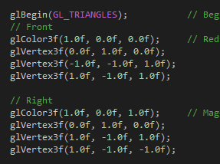
Build 3D Pyramid, the pyramid is made of 6 triangles. 4 triangles for its sides and it needs 2 triangle for the bottom, these triangles form a square. Different color is needed so we can see the different sides easily.
Keyboard Function

Slide 10
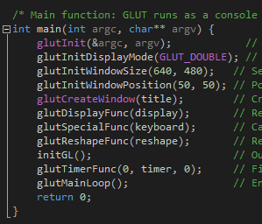
Complete source code available on GITHUB
Main Program

Slide 11
Conclusion
OpenGL is easy to use because a lot of function is available.
These function increase time efficiency
Documentation really helping to get the project done.
Knowledge about basic programming in OpenGL is similar with other programming language makes someone who new in programming using OpenGL can adapt well
This project implements the function that available, the function for displaying, resetting, rotating etc.

Slide 12
Reference
https://stackoverflow.com/questions/46524896/understanding-glclearcolor-values
https://developer.mozilla.org/en-US/docs/Web/CSS/CSS_Colors/Color_picker_tool
https://en.wikipedia.org/wiki/RGBA_color_space
https://docs.microsoft.com/en-us/windows/desktop/opengl/gl-functions
https://en.wikibooks.org/wiki/OpenGL_Programming/Basics/Color
https://cs.lmu.edu/~ray/notes/openglexamples/
http://www.ntu.edu.sg/home/ehchua/programming/opengl/CG_examples.html
https://www.linuxjournal.com/content/introduction-opengl-programming

Slide 13
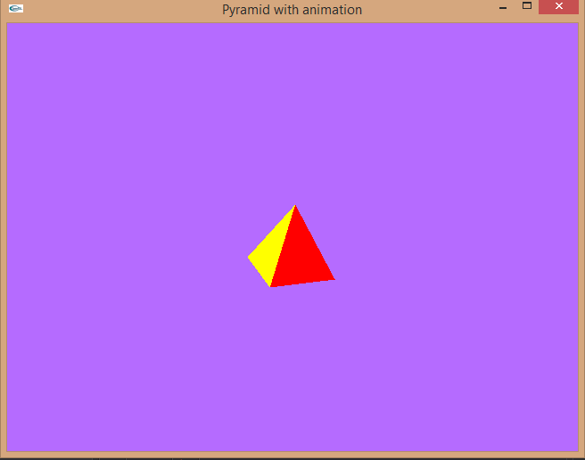
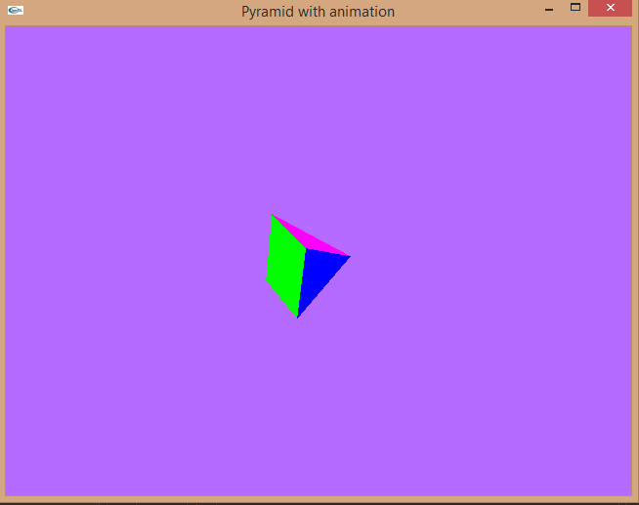
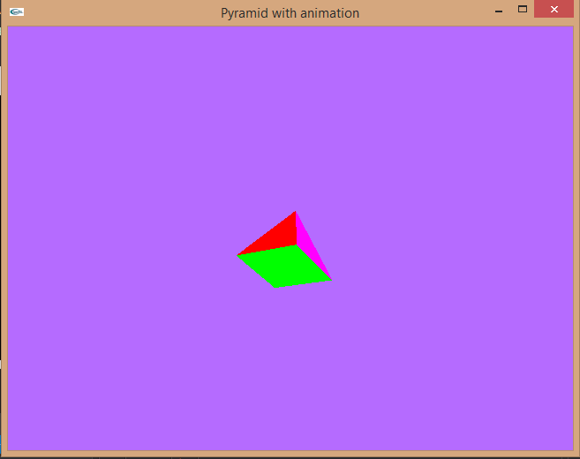
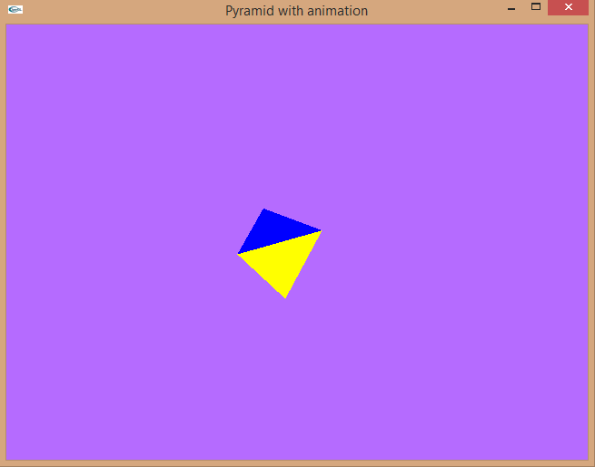
Screen shoot & Video
Video is available
https://youtu.be/SZ0qy6vqGg4

Slide 14
Terimakasih…

