Slide 1
Balanced Scorecard (BSC) Templates for Presentation
Balanced Scorecard Templates
License note: you may NOT distribute the document on your own. If necessary provide link to the home page of the document.

Slide 2
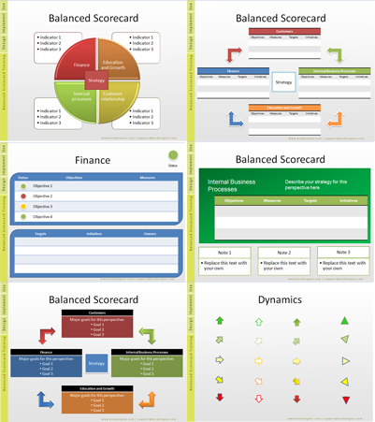
Professional BSC Templates
More than 40 professional PowerPoint template slides for Balanced Scorecard
All slides are easily to edit and customize
Learn more:
balancedscorecardtemplates.com

Slide 3
Balanced Scorecard
Finance
Indicator 1
Education and Growth
Indicator 1
Customer relationship
Indicator 1
Internal processes
Indicator 1
Indicator 2
Indicator 3
Indicator 2
Indicator 3
Indicator 2
Indicator 3
Indicator 2
Indicator 3
Strategy

Slide 4
Balanced Scorecard
Customer
Objectives
Measures
Targets
Initiatives
Finance
Objectives
Measures
Targets
Initiatives
Internal
Objectives
Measures
Targets
Initiatives
Strategy
Education
Objectives
Measures
Targets
Initiatives

Slide 5
Balanced Scorecard
Customer
Objectives
Measures
Targets
Initiatives
Finance
Objectives
Measures
Targets
Initiatives
Internal
Objectives
Measures
Targets
Initiatives
Strategy
Education
Objectives
Measures
Targets
Initiatives

Slide 6
Balanced Scorecard
Customer
Indicator | Description
Finance
Indicator | Description
Internal
Indicator | Description
Strategy
Education
Indicator | Description

Slide 7
Professional BSC Templates
More than 40 professional PowerPoint template slides for Balanced Scorecard
All slides are easily to edit and customize
Learn more:
balancedscorecardtemplates.com

Slide 8
Excel Template for BSC and KPI
Balanced Scorecard Templates

Slide 9
Excel Balanced Scorecard
Perspective | Indicator | Weight | Description | Value
Financial Perspective
 | New indicator 1
 | New indicator 2
 | New indicator 3
Total Performance in group |  |  | Financial Perspective
Customer Perspective
 | New indicator 1
 | New indicator 2
 | New indicator 3
Total Performance in group |  |  | Customer Perspective
Internal Processes Perspective
 | New indicator 1
 | New indicator 2
 | New indicator 3
Total Performance in group |  |  | Internal Processes Perspective
Education and Growth Perspective
 | New indicator 1
 | New indicator 2
 | New indicator 3
Total Performance in group |  |  | Education and Growth Perspective

Slide 10
Templates for KPI (Key Performance Indicators)
Balanced Scorecard Templates

Slide 11
Financial Indicators
Finance
Objectives | Objective 1 | Objective 2 | Objective 3
Measures
Targets
Initiatives

Slide 12
Customer Indicators
Finance
Objectives | Objective 1 | Objective 2 | Objective 3
Measures
Targets
Initiatives

Slide 13
Internal Indicators
Finance
Objectives | Objective 1 | Objective 2 | Objective 3
Measures
Targets
Initiatives

Slide 14
Education Indicators
Finance
Objectives | Objective 1 | Objective 2 | Objective 3
Measures
Targets
Initiatives

Slide 15
Design Template with Balanced Scorecard Designer software
Balanced Scorecard Templates

Slide 16
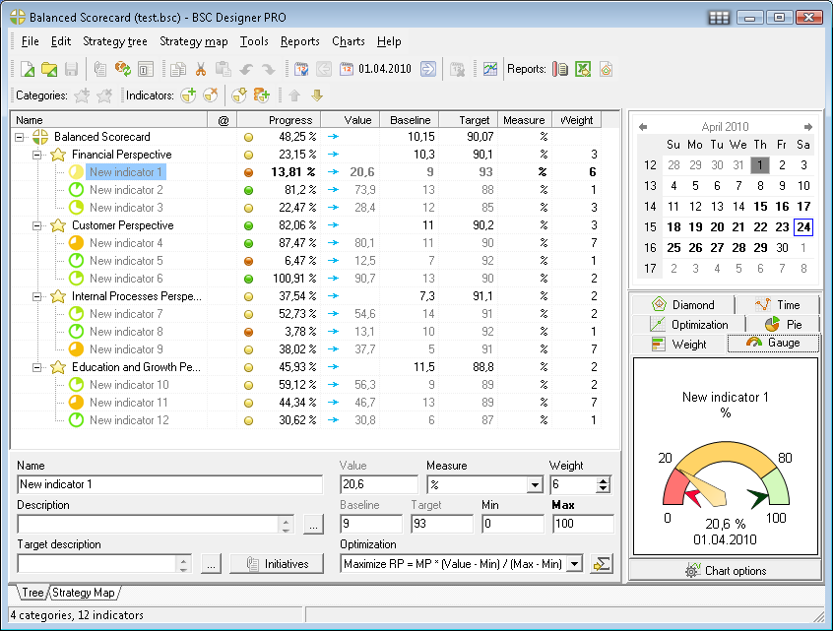
BSC Designer Software

Slide 17
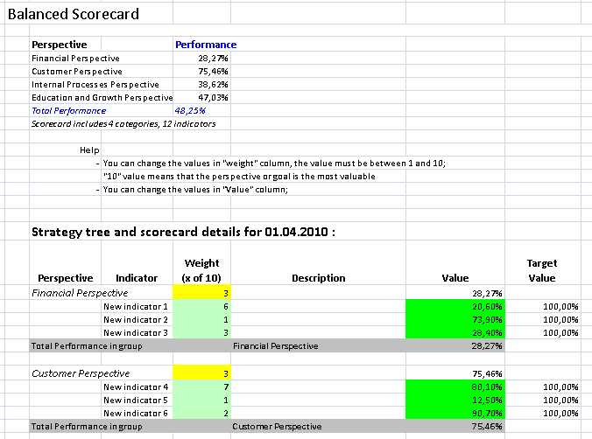
Excel BSC with BSC Designer

Slide 18
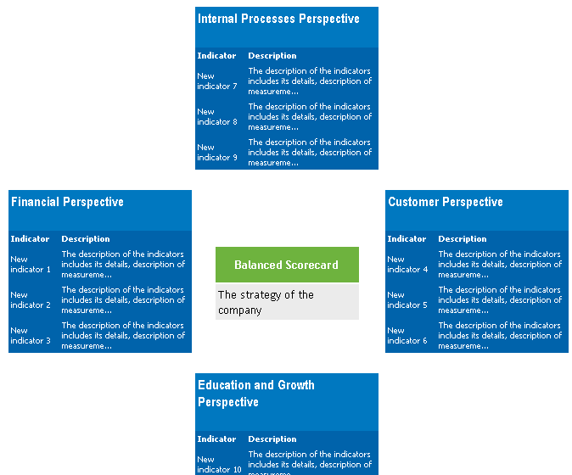
Overview Report in BSC Designer

Slide 19
More about BSC Designer
BSC Designer is a powerful easy to use Balanced Scorecard design software;
The software provides HTML, Excel and PowerPoint reports;
The software provides strategy maps and cascading of balanced scorecards;
Learn more about BSC Designer on www.bscdesigner.com

Slide 20
Professional BSC Templates
More than 40 professional PowerPoint template slides for Balanced Scorecard
All slides are easily to edit and customize
Learn more:
balancedscorecardtemplates.com

