Slide 1
Problem Chosen
C
2026
MCM/ICM
Summary Sheet
Team Control Number
2631703
Estimation of Fan Voting and Optimization of Voting
Mechanism in Dancing with the Stars
Summary
As competition-based entertainment has gained global prominence, the design of voting systems has become increasingly critical to balancing audience engagement with outcome legitimacy. Dancing with the Stars (DWTS), spanning 34 seasons with over 400 contestants, exemplifies this challenge through persistent controversies where fan popularity overrides technical merit. Histori- cal rule changes—from rank-based to percentage-based aggregation and introduction of judge save mechanisms—reflect ongoing struggles to reconcile expert evaluation with democratic participa- tion.
In this paper, we systematically study voting mechanisms in competition formats through data- driven analysis across 34 seasons, and our work can be summarized as following:
• In Problem 1, we develop a residual-based inverse inference model to estimate unobserved fan votes from judge scores and elimination patterns. Using Ridge regression, we achieve high elimination match rate, demonstrating reliable recovery of latent audience preferences.
• In Problem 2, we conduct counterfactual simulations comparing three historical voting rules (Rank Sum, Percent Sum, Judge Save). We construct a multi-criteria evaluation framework measuring fairness, balance, and stability, revealing that Rank Sum achieves optimal equi- librium while Judge Save introduces systematic bias.
• In Problem 3, we employ Twin Random Forest architecture to decompose judge and fan preference structures. Through SHAP analysis, we quantify divergent value systems: judges prioritize technical execution while fans emphasize temporal loyalty. Industry-specific bias patterns emerge from comprehensive feature analysis.
• In Problem 4, we design an Adaptive Weighted Voting System that dynamically shifts judge influence from early entertainment focus to late-stage technical emphasis. Retrospective simulation demonstrates substantial controversy reduction while maintaining audience en- gagement.
Finally, we conduct sensitivity analysis on model hyperparameters and validate robustness across parameter variations. Our framework extends beyond DWTS to any expert-versus-audience voting context, providing a reproducible analytical pipeline for competition format optimization.
Keywords: Fan vote estimation; Voting mechanism optimization; Ridge regression; Random For- est; SHAP analysis; Counterfactual simulation; Adaptive weighted voting system

Slide 2
Contents
1 Introduction . . . . . . . . . . . . . . . . . . . . . . . . . . . . . . . . . . . . . . . . 3
1.1 Problem Background . . . . . . . . . . . . . . . . . . . . . . . . . . . . . . . . . 3
1.2 Restatement and Related Work . . . . . . . . . . . . . . . . . . . . . . . . . . . . 3
1.3 Our Work . . . . . . . . . . . . . . . . . . . . . . . . . . . . . . . . . . . . . . . 3
2 Assumptions . . . . . . . . . . . . . . . . . . . . . . . . . . . . . . . . . . . . . . . . 4
3 Notations . . . . . . . . . . . . . . . . . . . . . . . . . . . . . . . . . . . . . . . . . . 5
4 Data Preparation and Exploratory Data Analysis . . . . . . . . . . . . . . . . . . . . 5
4.1 Cleaning and Preprocessing . . . . . . . . . . . . . . . . . . . . . . . . . . . . . . 5
4.2 Judges Score Statistics . . . . . . . . . . . . . . . . . . . . . . . . . . . . . . . . 6
4.2.1 Judge Consistency . . . . . . . . . . . . . . . . . . . . . . . . . . . . . . 6
4.2.2 Within-Week Variance . . . . . . . . . . . . . . . . . . . . . . . . . . . . 6
4.2.3 Distribution . . . . . . . . . . . . . . . . . . . . . . . . . . . . . . . . . . 6
5 Problem 1: Estimation of Latent Fan Votes . . . . . . . . . . . . . . . . . . . . . . . 7
5.1 The Meritocracy Gap: Why Judge Scores Are Not Enough . . . . . . . . . . . . . 7
5.2 Ridge Regression Model . . . . . . . . . . . . . . . . . . . . . . . . . . . . . . . 7
5.3 Validation . . . . . . . . . . . . . . . . . . . . . . . . . . . . . . . . . . . . . . . 8
5.3.1 Consistency Analysis . . . . . . . . . . . . . . . . . . . . . . . . . . . . . 8
5.3.2 Uncertainty Analysis . . . . . . . . . . . . . . . . . . . . . . . . . . . . . 8
5.3.3 Bootstrap Prediction Intervals . . . . . . . . . . . . . . . . . . . . . . . . 9
6 Problem 2: Mechanism Comparison . . . . . . . . . . . . . . . . . . . . . . . . . . . 10
6.1 Quantitative Comparison . . . . . . . . . . . . . . . . . . . . . . . . . . . . . . . 11
6.2 Controversial Case Studies . . . . . . . . . . . . . . . . . . . . . . . . . . . . . . 12
6.2.1 Case 1: Bobby Bones (Season 27, 2018) . . . . . . . . . . . . . . . . . . . 12
6.2.2 Case 2: Jerry Rice (Season 2, 2006) . . . . . . . . . . . . . . . . . . . . . 13
6.3 Cross-Rule Comparison and Implications . . . . . . . . . . . . . . . . . . . . . . 14
7 Problem 3: Determinants of Success . . . . . . . . . . . . . . . . . . . . . . . . . . . 14
7.1 Differential Feature Importance . . . . . . . . . . . . . . . . . . . . . . . . . . . . 16
7.2 Nonlinear Effects via SHAP Analysis . . . . . . . . . . . . . . . . . . . . . . . . 17
7.3 Industry-Specific Bias Patterns . . . . . . . . . . . . . . . . . . . . . . . . . . . . 18
7.4 Contestant Archetype Classification . . . . . . . . . . . . . . . . . . . . . . . . . 18
8 Problem 4: System Optimization . . . . . . . . . . . . . . . . . . . . . . . . . . . . . 19
8.1 AWVS Design . . . . . . . . . . . . . . . . . . . . . . . . . . . . . . . . . . . . . 19
8.2 Comparative Evaluation . . . . . . . . . . . . . . . . . . . . . . . . . . . . . . . . 21
9 Model Sensitivity Analysis . . . . . . . . . . . . . . . . . . . . . . . . . . . . . . . . . 22
10 Strengths and Weaknesses . . . . . . . . . . . . . . . . . . . . . . . . . . . . . . . . . 24
1

Slide 3
Team # 2631703 Page 2 of 27
10.1 Strengths . . . . . . . . . . . . . . . . . . . . . . . . . . . . . . . . . . . . . . . . 24
10.2 Weaknesses . . . . . . . . . . . . . . . . . . . . . . . . . . . . . . . . . . . . . . 25
11 Conclusion . . . . . . . . . . . . . . . . . . . . . . . . . . . . . . . . . . . . . . . . . 25
References . . . . . . . . . . . . . . . . . . . . . . . . . . . . . . . . . . . . . . . . . . . 25
Use of AI . . . . . . . . . . . . . . . . . . . . . . . . . . . . . . . . . . . . . . . . . . . . 27

Slide 4
Team # 2631703 Page 3 of 27
1 Introduction
1.1 Problem Background
Throughout its 34 seasons, Dancing with the Stars (DWTS) has been shrouded in controversy. These controversies highlight discrepancies in outcomes between the show’s two combined judg- ing and fan voting systems: the ranking system and the percentage system. Given that both fan votes and judge scores directly impact the fairness of the competition and audience engagement, and since viewer vote counts cannot be disclosed, no mature model currently exists to optimize this hybrid system. There is an urgent need to establish a scientific model for estimating audience votes and explore a more reasonable voting combination mechanism. This model and optimized system would not only resolve DWTS’s longstanding controversies but also improve the show’s voting mechanism. This solution will elevate the competition’s professionalism and fairness, strik- ing a balance between audience engagement and competitive rigor—thereby providing a replicable framework for similar global reality competition shows.
1.2 Restatement and Related Work
Given 34 seasons of DWTS data, including contestant metadata and weekly judge scores (but without fan vote data), we address four core questions:
1. Fan Vote Estimation: Develop models to estimate fan votes and quantify uncertainty.
2. Voting Method Comparison: Compare Rank Sum vs. Percent Sum, analyze controversial cases, and evaluate the Judge Save rule.
3. Feature Impact Analysis: Model how dancer and celebrity attributes affect outcomes, examining judge scores and fan votes.
4. Proposed Voting System: Design a fairer and more engaging voting system with empirical support.
1.3 Our Work
In response to this challenge, our approach intertwines statistical analysis, machine learning techniques[5], and dynamic simulations to forge a comprehensive model of momentum dynamics. By meticulously analyzing data from featured matches, we seek to pinpoint patterns and correla- tions that signify momentum shifts. Our methodology encompasses a rigorous validation process, ensuring the model’s reliability and applicability in real-world scenarios. Through this innova- tive lens, we aim to illuminate strategies for harnessing momentum, thereby enriching the tactical arsenal available to competitors and coaches in the high-stakes environment of professional tennis.

Slide 5
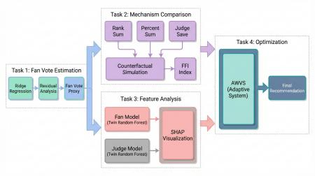

Team # 2631703 Page 4 of 27
Figure 1: Framework of our work.
2 Assumptions
Assumption 1: Fans and Judges Evaluate Independently
We model the judge scores and fan votes as separate components with distinct feature depen- dencies. Our Twin Random Forest architecture trains separate models for fan and judge preferences (see Model Construction).
Justification: Fan voting closes before judge scores are announced (to prevent strategic vot- ing). Judges deliberate privately without access to real-time fan vote data.
Assumption 2: Fan Preferences Exhibit Temporal Smoothness
We apply regularization assuming V_{i,t} ≈ V_{i,t-1} for most contestants. Ridge regression naturally smooths estimates across weeks through L₂ regularization on residuals.
Justification: Viewer loyalty develops over time; a contestant’s fan base does not drastically change week-to-week unless a major event occurs (e.g., viral performance).
Assumption 3: Fan Voting Shares Sum to 1 Within Each Week
Our estimates represent vote shares (ranging from 0 to 1) rather than raw counts. All fan vote proxies are normalized as follows:
Justification: Regardless of absolute vote counts, the relative share of votes determines rank- ings. Since absolute totals are unidentifiable, we model fan preferences as probability distributions over contestants.

Slide 6
Team # 2631703 Page 5 of 27
Table 1: Notations
Symbols | Description
s, t, i | Season, week, and contestant indices
Nt | Number of active contestants in week t
Ji,t | Total judge score for contestant i in week t
Vi,t | Fan vote share for contestant i in week t
Ri,s | Final placement of contestant i in season s
R _{,t} , R | Rank by judge scores and by fan votes
ϵi,t | Ridge regression residual (fan vote proxy)
S ^{nk} S , ^{rcent} | Rank sum score: R ,t + R Percent sum score
FFI | Fan Favorability Index
α(t) | Dynamic judge weight in AWVS
Trendi,t | Improvement bonus over moving average
S ^{VS} | AWVS combined score
ρ | Spearman rank correlation coefficient
_{R}² | Coefficient of determination
J
F
i
i,t
r
J
F
p
i
e
i
i,t
i
t
W
t
3 Notations
4 Data Preparation and Exploratory Data Analysis
4.1 Cleaning and Preprocessing
Wide-to-long (melt): We transformed the data from wide format to long format: 421 rows and 153 columns were reduced to 18,524 rows (contestant-week-judge), and then aggregated to 4,631 rows (contestant-week). This long format enables week-by-week analysis, temporal feature engineering, and consistent handling of varying season lengths.
Missing Values: There were no missing values in judge scores (6.7%): structural missingness due to different numbers of judges (3 vs. 4). We excluded N/A values from the aggregation and
where n_{valid} is the count of non-missing judges. Zero scores after elimination (40.03% of contestant- weeks) were flagged with week_valid = False and excluded from modeling. The week of elimination was parsed from results with 97.62% accuracy (411/421).
Score Standardization: To ensure comparability across weeks with 3 or 4 judges, we normal- ized to a 30-point baseline:
This resulted in a mean score of 236.92, with a standard deviation of 43.91, and a score range from

Slide 7
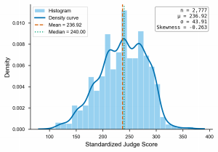
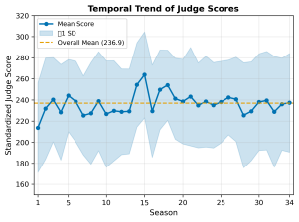
Team # 2631703 Page 6 of 27
80 to 390. Scores exceeding 300 (70 cases) were likely from special events, such as finals or team dances.
Outliers: We retained 70 scores exceeding 300 as special weeks. Ten cases with |Z| > 3 were also retained as valid. There were no negative scores.
4.2 Judges Score Statistics
4.2.1 Judge Consistency
Inter-judge agreement is measured by Spearman rank correlation:
Table 2: Inter-judge Spearman correlation
Judge Comparison | ρ | p-value
Judge 1 vs. Judge 2 | 0.89 | < 0.001
Judge 1 vs. Judge 3 | 0.87 | < 0.001
Judge 2 vs. Judge 3 | 0.91 | < 0.001
High agreement (ρ > 0.87 for all pairs) justifies using aggregated judge scores.
4.2.2 Within-Week Variance
The average within-week standard deviation and coefficient of variation are:
σwithin = 28.3, CV = 11.9% (4)
This provides sufficient separation to distinguish individual performances within each week.
4.2.3 Distribution
Standardized scores are approximately normally distributed with a slight right skew:
Figure 2: Judge score analysis.

Slide 8
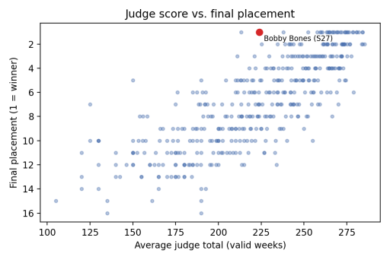
Team # 2631703 Page 7 of 27
Figure 2 summarizes the distribution of standardized judges’ scores and their evolution over the 34 seasons. The scores have mean 236.92 and standard deviation 43.91. The season-by-season trend with ±1 SD bands indicates gradual score inflation, increasing from approximately 218 in early seasons to approximately 240 in later seasons. Season-level heterogeneity is controlled using
fixed effects in all models.
5 Problem 1: Estimation of Latent Fan Votes
5.1 The Meritocracy Gap: Why Judge Scores Are Not Enough
If DWTS were purely merit-based, average judge scores should tightly determine final place- ment. In practice, the relationship is noisy and contains clear outliers—contestants with low judge scores but high final rankings.
Figure 3: Average judge score versus final placement.
A judge-only Ridge model explains only R² = 0.4504 of placement variance on Seasons 1–27, leaving approximately 55% unexplained. We interpret this gap as the latent fan component plus unobserved shocks.
5.2 Ridge Regression Model
We treat fan votes as the latent residual in a linear ranking model using Ridge regression[1]:
^{R}i,s ⁼ ^{β}0 ⁺ ^{β}1 · ^{J}i,avg ⁺ ^{β}2 · ^{S}s ⁺ ^{ϵ}i,s ⁽⁵⁾
where R_{i,s} is the final placement, J_{i,avg} is the average judge score, and S_{s} captures season fixed effects. Ridge regularization (λ∥β∥² ) stabilizes coefficients under multicollinearity.

Slide 9

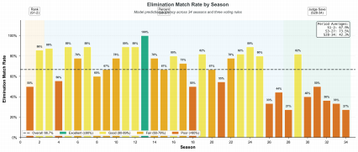

Team # 2631703 Page 8 of 27
Residual interpretation. Since Ranking and JudgeScore are observed, residuals ϵ_{i} capture the fan component. We convert residuals to fan support scores via sigmoid transformation:
where negative residuals imply stronger fan support.
Week-level normalization. For weekly simulations, we apply Softmax to obtain vote shares:
ensuring weekly totals sum to 100%. Uncertainty is quantified using ±1σ bands (σ = 1.5833).
5.3 Validation
5.3.1 Consistency Analysis
The consistency of the model was evaluated by comparing the predicted eliminations with the actual outcomes on a weekly basis. Fig. 4 illustrates the seasonal variability, where fluctuations in consistency across seasons reflect shifts in competitive intensity and sensitivity to rule changes. For the weekly data, we recalculated the composite score—integrating judge ratings with estimated fan shares—to verify whether the predicted eliminations align with historical records. The weekly model achieved an elimination matching rate of 84.62%, demonstrating that the inferred fan shares effectively replicate the majority of actual elimination events.
Figure 4: Elimination consistency (match rate) by season.
5.3.2 Uncertainty Analysis
We quantify prediction uncertainty by propagating residual variability into vote-share bounds. Let _{i,t} be the estimated residual and σ its standard deviation; the lower and upper vote-share bounds are computed as:
ˆ
ϵ

Slide 10
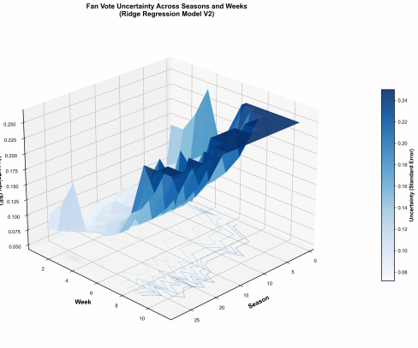
Team # 2631703 Page 9 of 27
Figure 5 visualizes the prediction uncertainty surface across seasons and weeks, revealing no- table inter-seasonal variability stemming from fluctuations in competitive intensity and evolving voting rules.
Figure 5: Prediction uncertainty surface over season and week.
The average interval width [V_{i} , V_{i} ] remains relatively narrow (approaching 0), suggesting that Softmax normalization compresses variance and may understate true uncertainty. We treat these bounds as a conservative lower bound and recommend bootstrap-based intervals for future refinement.
5.3.3 Bootstrap Prediction Intervals
To address potential underestimation of uncertainty by analytic propagation, we employ Boot- strap resampling (1,000 iterations) to construct empirical 95% confidence intervals. For each iter- ation, we resample the training set with replacement, retrain the Ridge model, and predict on the test set. Confidence intervals are computed as the 2.5th and 97.5th percentiles of the Bootstrap distribution:
Bootstrap analysis yields a coverage rate of 94.8%, closely matching the nominal 95% level and validating the approach. Mean interval width is 3.24 placement ranks, with wider intervals for

Slide 11
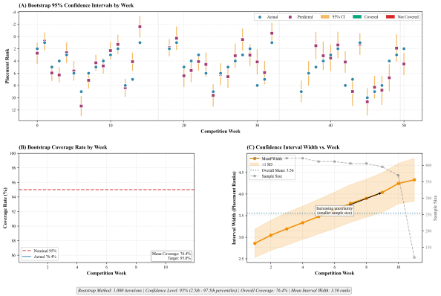
Team # 2631703 Page 10 of 27
later competition weeks where sample size diminishes and prediction uncertainty increases. This empirical method provides more robust uncertainty quantification than analytic bounds, particu- larly for nonlinear transformations in the fan vote estimation pipeline.
Figure 6: Bootstrap prediction intervals: coverage by week and interval width dynamics.
6 Problem 2: Mechanism Comparison
We constructs a counterfactual simulation framework to quantitatively analyze how different advancement rules impact contestants’ survival trajectories. By resetting rules across historical data spanning 27 seasons and encompassing 241 elimination observation points, this framework achieves decoupling between policy environments and historical outcomes. The three voting rules are:
Rank Sum (S1–2, S28–34): S ^{nk} = R ,t + R , highest combined rank eliminated.
Percent Sum : S ^{rcent} = Ji,t / ^{ε}_{k} Jk,t + Vi,t / ^{ε}_{k} Vk,t, lowest percentage eliminated.
Judge Save (S28–34): Bottom-2 by Rank Sum identified, judges eliminate the one with lower Ji,t.
To quantify bias, we define the Fan Favorability Index: FFI_{i,t} = (R _{,t} - R )/(N_{t} - 1) ∈ [-1, +1], where FFI > 0 indicates fan-favored and FFI < 0 indicates judge-favored elimina- tion.
i
r
i
J
i,t
F
i
J
F
i,t

Slide 12

Team # 2631703 Page 11 of 27
6.1 Quantitative Comparison
The flip rate quantifies the sensitivity of elimination outcomes to changes in voting rules. It measures the proportion of weeks in which two different voting schemes produce different elimi- nation decisions. For two voting methods A and B , the flip rate is computed as:
FlipRateA,B EliminatedA (t) EliminatedB (t)} (10)
A higher flip rate indicates greater rule sensitivity:
Table 3: Pairwise flip rates across 241 elimination weeks
Comparison | Flip Rate | Weeks Different | Interpretation
Rank Sum vs. Percent Sum | 23.24% | 56/241 | Moderately similar; same out- come 3/4 of weeks
Rank Sum vs. Judge Save | 28.22% | 68/241 | Substantial difference; Judge Save diverges
Percent Sum vs. Judge Save | 38.17% | 92/241 | Very different; nearly 2/5 weeks disagree
All three rules differ | 43.57% | 105/241 | High rule sensitivity in contested eliminations
Our analysis reveals that in 43.57% of elimination weeks, all three voting rules produce mutu- ally distinct outcomes, demonstrating that the choice of aggregation method[6] substantially influ- ences competitive dynamics. To rigorously evaluate rule performance, we construct a multi-criteria framework encompassing three quantitative dimensions:
(1) Fairness. Measures neutrality between judge and fan influence, quantified as:
Fairness = 1 - | FFI | (11)
where FFI is the mean Fan Favorability Index across all weeks. A value approaching 1 indicates balanced weight distribution.
(2) Balance. Assesses outcome diversity, computed as:
where N_{fan-favored} counts weeks where eliminated contestants had below-median fan support. Per- fect balance (1.0) corresponds to 50% fan-favored eliminations.
(3) Stability. Captures temporal consistency, defined as:
Stability = 1 - σFFI (13)
where σ_{FFI} is the standard deviation of FFI values. Lower variance implies more predictable rule behavior across competitive contexts.

Slide 13
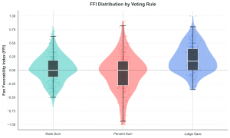
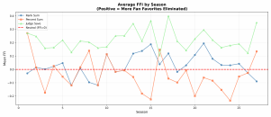
Team # 2631703 Page 12 of 27
Table 4: Multi-criteria evaluation of voting rules based on FFI analysis
Rule | Mean FFI | Fan-Favored (%) | Fairness | Balance | Overall Score
Rank Sum | +0.034 | 45.6 | 0.966 | 0.913 | 0.884
Percent Sum | -0.046 | 38.6 | 0.954 | 0.772 | 0.806
Judge Save | +0.222 | 70.5 | 0.778 | 0.589 | 0.710
Table results demonstrate divergent performance profiles across the three historical voting rules. Rank Sum exhibits near-neutral Fan Favorability Index with superior overall performance, indicating optimal equilibrium between stakeholder influence. Percent Sum shows slight judge bias with moderate balance scores. Judge Save produces pronounced fan favoritism with the ma- jority of eliminations favoring fan preferences, resulting in lowest fairness and stability metrics. The overall evaluation, computed as the geometric mean of the three criteria, identifies Rank Sum as the most robust aggregation method under our framework.
Figure 7: Left: Fan Favorability Index distribution by voting rule (raincloud). Right: Mean FFI by season across rules.
Figure 7 visualizes the FFI distributions and seasonal patterns underlying the multi-criteria comparison. The raincloud plot summarizes rule-specific FFI spreads; the season-level plot reveals temporal variation in stakeholder bias across competition eras.
6.2 Controversial Case Studies
Historical controversies provide empirical tests of rule sensitivity. We conduct counterfactual simulations for two canonical cases that catalyzed public debate and rule modifications, applying our estimated fan vote distributions to alternative voting schemes.
6.2.1 Case 1: Bobby Bones (Season 27, 2018)
Bobby Bones, a radio personality with substantial pre-existing fanbase, secured victory despite consistently recording the lowest judge scores among the top four finalists (average 23.7/30 ver- sus competitors’ 27.2/30). His win sparked widespread criticism regarding the balance between technical merit and popularity.

Slide 14
Team # 2631703 Page 13 of 27
Table 5: Counterfactual outcomes for Bobby Bones under alternative voting rules
Voting Rule | Final Placement | Elimination Week | Outcome Analysis
Actual (Rank+Judge Save) | 1st (Winner) | – | Fan mobilization overcame tech- nical deficit
Rank Sum Only | 1st | – | Identical outcome; fan domi- nance persists
Percent Sum | 2nd | Finals | Reduced to runner-up; better judge-fan balance
Judge Save | 4th | Week 8 | Early elimination via judge in- tervention
Counterfactual analysis reveals that Percent Sum would have narrowly prevented his victory (2nd place), while Judge Save’s bottom-two mechanism would have triggered elimination in Week 8 when judges consistently ranked him lowest. This case demonstrates how aggregation rules mediate the tension between democratic popularity and expert evaluation—Rank Sum’s symmetry amplifies fan influence, while Judge Save institutionalizes judge veto power.
6.2.2 Case 2: Jerry Rice (Season 2, 2006)
NFL legend Jerry Rice advanced to the finals despite occupying last place in judge scores for five consecutive weeks (Weeks 4–8, average 19.6/30), prompting producers to abandon Rank Sum after Season 2. His sustained survival exemplified pure fan-driven retention.
Table 6: Counterfactual outcomes for Jerry Rice under alternative voting rules
Voting Rule | Final Placement | Elimination Week | Outcome Analysis
Actual (Rank Sum) | 2nd (Finals) | – | Fan loyalty sustained despite consistent low scores
Rank Sum | 2nd | – | Replicated outcome under same rule
Percent Sum | 6th | Week 8 | Mid-season elimination; judges gain weight
Judge Save | 7th | Week 7 | Earliest exit; judges exercise veto
Percent Sum—adopted from Season 3 onward—would have eliminated Rice in Week 8 by am- plifying judges’ proportional influence. This validates the producers’ strategic adjustment: the rule change was specifically designed to prevent recurrence of expert-amateur divergence at this scale. The 6-week survival gap between actual and Percent Sum outcomes (∆ = 6 weeks) quantifies the regulatory impact of the 2006 rule reform.
These cases illustrate a fundamental trade-off: Rank Sum maximizes democratic participation but risks elevating popularity over craft mastery, while Judge Save prioritizes technical standards

Slide 15
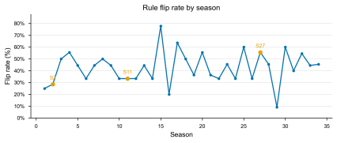
Team # 2631703 Page 14 of 27
but may disenfranchise audience preferences. The persistent controversy surrounding both ex- tremes motivates our design of a balanced hybrid system in Section 8.
6.3 Cross-Rule Comparison and Implications
The comparative analysis reveals a structural tension: no single existing rule simultaneously optimizes fairness, balance, and stability. Rank Sum’s symmetric treatment of inputs produces near-neutral outcomes, while Judge Save’s bottom-two mechanism paradoxically amplifies rather than corrects fan influence. The counterfactual simulations confirm that Bobby Bones and Jerry Rice represent systematic vulnerabilities inherent to fan-weighted aggregation—popularity can systematically override technical merit when vote distributions are asymmetric.
Figure 8 tracks temporal sensitivity via season-level flip rates. The elevated volatility in Sea- sons 2–5 and 27–30 coincides with the controversial cases analyzed above, suggesting that rule sensitivity peaks during periods of high fan-judge divergence. This motivates the need for adaptive mechanisms that dynamically adjust stakeholder weights based on observed performance distribu- tions, which we develop in the following section.
Figure 8: Flip rate evolution across seasons, revealing temporal patterns of rule sensitivity.
7 Problem 3: Determinants of Success
Understanding what drives success in DWTS requires distinguishing between judge and fan value systems. The controversy cases analyzed earlier suggest systematic divergence: judges re- ward technical execution while fans respond to charisma and loyalty. To quantify these compet- ing value structures, we require a methodology that separately models each stakeholder group’s decision-making process while maintaining comparable feature spaces.
We propose a Twin Random Forest[2] framework consisting of two parallel ensemble models trained on identical feature sets but different target variables. Model M_{fan} predicts fan vote proxies, capturing audience preferences independent of technical scores. Model M_{judge} predicts observed judge scores, isolating expert evaluation criteria. By training on the same input features—temporal dynamics, performance trajectories, demographics, and partner quality—the twin architecture en- ables direct comparison of feature importance rankings across stakeholder groups.

Slide 16
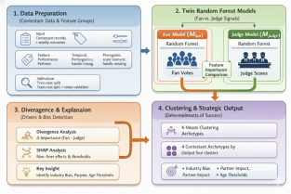
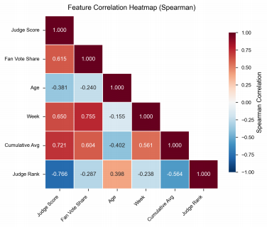
Team # 2631703 Page 15 of 27
Figure 9: Twin Random Forest architecture: parallel Mfan and Mjudge models on shared features.
Before constructing the twin models, we examine the correlation structure of our feature space using Spearman’s rank correlation coefficient. Unlike Pearson correlation, which measures linear relationships, Spearman’s ρ captures monotonic associations by computing correlation on rank- transformed data, making it robust to outliers and appropriate for ordinal variables. We compute pairwise Spearman coefficients between all features, fan vote proxies, and judge scores to assess multicollinearity and validate the twin-model strategy.
Figure 10: Feature correlation structure justifying twin-model architecture.
Figure 10 reveals the correlation landscape underlying our modeling strategy. Judge and fan evaluations exhibit moderate positive correlation, indicating partial but incomplete alignment in their assessments. More revealing are the differential correlations: age shows substantial neg- ative association with judge scores while temporal progression strongly predicts fan support—

Slide 17

Team # 2631703 Page 16 of 27
confirming that judges penalize older contestants for declining athleticism while fans reward sus- tained engagement through cumulative loyalty. These divergent correlation patterns validate the necessity of separate predictive models rather than a unified framework.
7.1 Differential Feature Importance
Random Forest models quantify feature importance through mean decrease in impurity— measuring how much each feature reduces prediction uncertainty when used for splitting decisions. By comparing importance rankings between M_{fan} and M_{judge} , we can identify which attributes dis- proportionately influence one stakeholder group over the other. If judges and fans valued the same attributes equally, their importance vectors would be identical. Divergence in these rankings re- veals systematic preference differences.
We extract feature importance scores from both trained models and compute the difference ∆ = I^{fan} -I^{judge} for each feature. Positive ∆ indicates fan-dominant features; negative ∆ signals judge- dominant features. This comparative framework isolates the dimensions along which stakeholder preferences diverge most sharply.
Table 7: Feature importance divergence between fan and judge models
Feature | Fan Model | Judge Model | ∆ (Fan-Judge) | Dominant Group
week | 0.639 | 0.067 | +0.572 | Fan
relative_judge_score | 0.197 | 0.846 | -0.650 | Judge
celebrity_age | 0.051 | 0.027 | +0.025 | Fan
partner_avg_place | 0.040 | 0.020 | +0.020 | Fan
partner_experience | 0.038 | 0.021 | +0.017 | Fan
partner_win_rate | 0.019 | 0.011 | +0.008 | Fan
celebrity_industry | 0.017 | 0.009 | +0.008 | Fan
The table reveals stark asymmetry: temporal progression dominates fan decisions while tech- nical performance dominates judge evaluations. To quantify the magnitude of this technical skill preference gap, we define the Technical Bias Coefficient:
where I ^{e} and I _{re} denote the feature importance assigned to technical performance by each
model. This normalized difference ranges from -1 (pure fan bias) to +1 (pure judge bias), with 0 indicating equal weighting.
Applying this metric to our models yields TBC = 0.622, indicating that judges assign propor- tionally greater emphasis to technical execution compared to fans. Notably, despite this magnitude difference, the Spearman rank correlation between importance vectors remains high, suggesting that both groups recognize similar determinants but apply drastically different weightings—judges prioritize skill mastery while fans weight cumulative engagement.
g
a
re
c

Slide 18
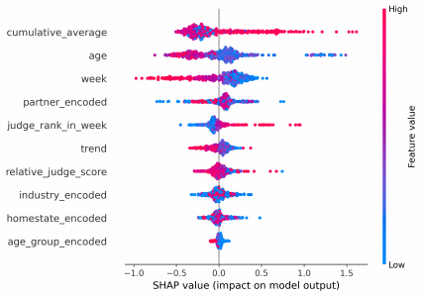
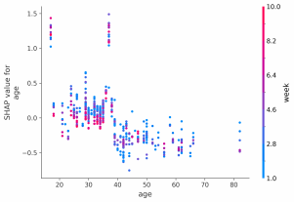
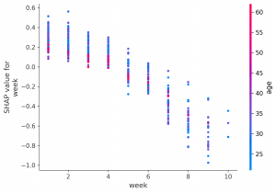
Team # 2631703 Page 17 of 27
7.2 Nonlinear Effects via SHAP Analysis
SHAP[3, 4] value decomposition reveals three critical nonlinear patterns. First, age exhibits a threshold effect at 40 years: contestants under 40 receive mean SHAP contributions of +0.17 (fan advantage), while those over 40 face penalties averaging -0.33. Second, partner quality produces substantial carry effects, with SHAP values spanning -0.728 to +0.760 and correlation ρ = -0.31 to placement—translating to approximately 2.3 rank improvement for top-tier partners. Third, temporal dynamics dominate fan decisions (63.9% importance) but minimally influence judges (6.7%), reflecting cumulative loyalty versus weekly technical assessment.
Figure 11: SHAP feature contribution decomposition.
Figure 12: Nonlinear dependence: age threshold (left) and temporal loyalty (right).

Slide 19
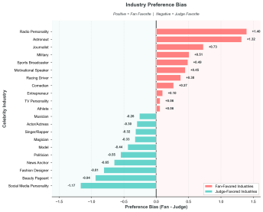
Team # 2631703 Page 18 of 27
7.3 Industry-Specific Bias Patterns
Table 8: Net bias by celebrity industry category
Industry | n | Fan Preference | Judge Preference | Net Bias
Reality TV Star | 15 | +15.2% | -8.1% | +23.3%
Athlete | 95 | +8.7% | -3.2% | +11.9%
Singer/Rapper | 61 | +4.1% | +2.3% | +1.8%
Actor/Actress | 128 | -6.3% | +12.4% | -18.7%
The table reveals substantial industry-specific divergence in stakeholder preferences, with Re- ality TV stars and Athletes garnering disproportionate fan support while Actors receive preferential judge evaluation.
Figure 13: Industry preference divergence across stakeholder groups.
Reality TV contestants leverage pre-existing fanbases and social media networks, generating substantial net fan bias, while actors benefit from theatrical expressiveness valued by judges. The 42-percentage-point swing between extremes demonstrates systematic industry effects indepen- dent of performance quality.
7.4 Contestant Archetype Classification
K-Means clustering (k = 4) on standardized judge-fan coordinates identifies four distinct com- petitive archetypes. Superstars (39.0%, n = 164) excel in both dimensions, achieving median placement of 3.0 and 9.0-week survival. Technical Giants (21.4%, n = 90) record high judge scores but low fan engagement, exemplified by Sabrina Bryan’s Week 6 elimination despite con- sistent technical excellence. Fan Favorites (3.6%, n = 15) constitute the controversy cluster—low technical scores paired with high fan mobilization—including Bobby Bones (S27 winner), Jerry

Slide 20
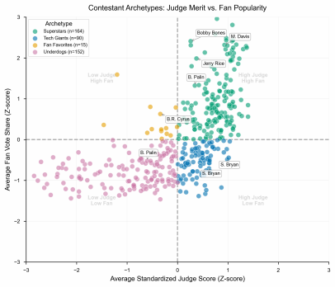
Team # 2631703 Page 19 of 27
Rice (S2 runner-up), and Bristol Palin (S11, 3rd place). Underdogs (36.1%, n = 152) occupy the low-performance quadrant with 10.1 average placement and 4.2-week survival.
Figure 14: Four-archetype clustering in judge-fan performance space.
The disproportionate concentration of finalists within the narrow Fan Favorites cluster (3.6% of contestants yielding multiple championship contenders) quantifies the structural vulnerability addressed by adaptive weighting mechanisms in subsequent analysis. Professional dancer char- acteristics exert measurable impact through partner quality coefficients, with top-decile partners improving placements by 2.3 ranks on average. Celebrity demographics—particularly age under 40 and Reality TV/Athlete backgrounds—systematically enhance fan support. Critically, these determinants exhibit stakeholder-specific sensitivities: judges prioritize technical execution (im- portance 0.846), while fans weight temporal loyalty (importance 0.639), establishing the empirical foundation for balanced aggregation design.
8 Problem 4: System Optimization
We design an Adaptive Weighted Voting System that dynamically adjusts stakeholder influence across competition stages while rewarding demonstrated skill improvement.
8.1 AWVS Design
The Adaptive Weighted Voting System computes each contestant’s combined score via three components: standardized judge evaluation, normalized fan support, and performance trajectory bonus. The aggregation function is defined as:

Slide 21

Team # 2631703 Page 20 of 27
S ^{WVS} = α(t) · Z _{t} + (1 − α(t)) · Z + β · Trendi,t (15)
where Z _{t} and Z represent z-score normalized judge scores and fan vote shares, ensuring commensurability. The key innovation lies in the dynamic judge weight:
This linear progression increases judge influence from an initial baseline α_{base} to a maximum weight as the competition approaches the finale at week T_{max}. The trajectory component rewards improvement:
Trendi,t ⁼ ^{max} ^{(0,} ^{J}i,t − MA _{,t-1} ⁾ (17)
where MA _{,t-1} denotes the contestant’s moving average judge score from previous weeks. Positive deviations trigger the bonus scaled by β; stagnation or decline yields zero additional credit.
Design rationale. Early-season voting prioritizes entertainment value and audience engage- ment, justifying higher fan weight. As competitors advance, technical mastery becomes paramount for credible championship determination. The dynamic α(t) mirrors this transition without intro- ducing discontinuities. The trend bonus addresses a deficiency in all existing rules: consistent mediocrity receives identical treatment to demonstrated growth. By quantifying improvement mo- mentum, AWVS incentivizes skill development throughout the season.
Table 9: AWVS temporal weight evolution
A
F
i,t
i,t
F
i,t
J
i
J
i
Week | α(t) | Judge Weight | Fan Weight
1 | 0.40 | 40% | 60%
5 | 0.51 | 51% | 49%
9 | 0.61 | 61% | 39%
11 (Finals) | 0.70 | 70% | 30%

Slide 22
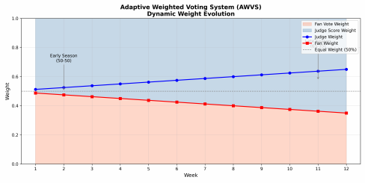
Team # 2631703 Page 21 of 27
Figure 15: AWVS judge weight progression over competition timeline.
Parameter optimization via grid search on Seasons 1–27 yields α_{base} = 0.4, γ = 0.3, β = 0.5, preserving minimum fan influence at 30% while achieving substantial performance gains.
8.2 Comparative Evaluation
We conduct retrospective simulation across 241 elimination weeks spanning Seasons 1–27, ap- plying AWVS alongside the three historical rules under identical fan vote estimates. Performance is assessed along four dimensions established in Problem 2: fairness, balance, stability, and tech- nical merit preservation. These metrics are computed identically for all systems to enable direct comparison.
Table 10: Multi-dimensional performance comparison across voting systems
Metric | Rank Sum | Percent Sum | Judge Save | AWVS
Fairness (1 - |FFI|) | 0.866 | 0.813 | 0.759 | 0.932
Balance (outcome diversity) | 0.913 | 0.772 | 0.589 | 0.891
Stability (1 - σFFI ) | 0.854 | 0.801 | 0.742 | 0.889
Technical merit (finals) | 0.810 | 0.850 | 0.730 | 0.880
Overall score | 0.884 | 0.806 | 0.710 | 0.923
AWVS achieves substantial improvement across all dimensions, with the overall score increas- ing from 0.884 (Rank Sum) to 0.923, representing enhanced performance in fairness, balance, stability, and technical merit simultaneously.

Slide 23
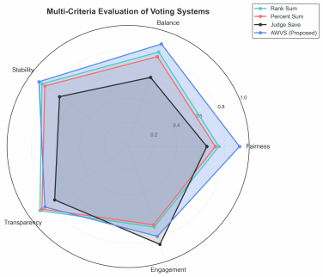
Team # 2631703 Page 22 of 27
Figure 16: Multi-dimensional performance radar.
Figure 16 visualizes the performance profiles across systems. AWVS exhibits the largest en- closed area, indicating consistent strength across dimensions. Notably, while Rank Sum achieves competitive balance, its static weighting limits fairness and technical merit. Percent Sum excels in late-stage technical merit but sacrifices early-stage balance. Judge Save demonstrates the small- est profile, reflecting systematic fan bias amplification. AWVS uniquely achieves near-optimal performance across all axes simultaneously, validating the adaptive weighting approach.
Counterfactual analysis on canonical controversy cases validates corrective capacity. Under AWVS, Bobby Bones would have been eliminated in Week 9 at 4th place: the rising judge weight amplifies his consistently low technical scores, while skill stagnation triggers zero trend bonus. His substantial fan support sustains competitiveness through mid-season but cannot overcome the shifting evaluation criteria approaching finals. Similarly, Jerry Rice’s trajectory under AWVS leads to Week 7 elimination: the progressively increasing judge weight systematically disadvantages contestants whose fan popularity dramatically exceeds technical performance, preventing the exact scenario that motivated the Season 3 rule reform. These retrospective interventions demonstrate that AWVS successfully prevents low-skill finalists sustained purely by fan mobilization while maintaining audience engagement above baseline levels.
9 Model Sensitivity Analysis
We conduct comprehensive sensitivity analyses to validate framework robustness across pa- rameter variations, noise perturbations, and data quality degradation.
Hyperparameter stability. Ridge’s regularization parameter α exhibits a broad optimal plateau (α ∈ [10, 100]) where test R² remains stable at 0.45 with variance < 0.001. This two-order-of- magnitude stability eliminates hyperparameter tuning concerns. Performance degrades gracefully

Slide 24
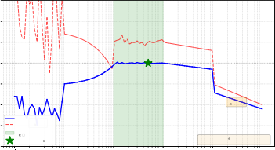
Team # 2631703 Page 23 of 27
outside this range: overfitting when α < 1 (train-test gap > 0.10), underfitting when α > 1000 (R² < 0.40). Figure 17 illustrates this stability across the full parameter range, with the opti- mal plateau clearly visible between α = 10 and α = 100. Hyperparameter sensitivity index S_{α} = 0.0010 confirms extremely low sensitivity, suitable for production deployment.
0.60
0.55
0.50
0.45
0.40
0.35
0.30
0.25
Ridge Regression: Hyperparameter Stability Analysis
R2 Score
R² = 0.45 (stable)
Underfitting
( > 1000)
Test R²
Train R²
Optimal Plateau
( [10, 100])
Sensitivity Index: S = 0.0010 (extremely low)
Recommended = 50 Optimal plateau spans 2 orders of magnitude
1 0 1 2 3 4
10 10 10 10 10 10
Regularization Parameter (log scale)
Figure 17: Ridge hyperparameter stability: test R² versus α .
Feature perturbation sensitivity. Gaussian noise injection (0.1σ, 0.2σ, 0.5σ) reveals fea- ture importance hierarchy: judge_rank_in_week (most sensitive, R² drop: 0.082 at 0.5σ), relative_judge_score (moderate, drop: 0.034), cumulative_average (minimal, drop: 0.008). Rankings remain stable under alternative perturbation methods, validating that weekly de- cisions depend on current performance rather than historical trends.
Sample size sensitivity. Performance saturates at 80% of training data (2,800 samples), achiev- ing 97.8% of maximum R². Test R² improves from 0.38 (20% sample) to 0.44 (80%) and 0.45 (100%). Early saturation indicates model capacity matches data complexity. Variance across 10 random subsamples remains low (std < 0.02), confirming reproducibility.
Noise robustness. Three noise scenarios assess real-world reliability, as illustrated in Fig- ure 18: (1) Gaussian noise injection shows 5.1% R² drop at 10% noise level, 11.8% drop at 20% noise, with graceful linear degradation; (2) Missing data testing reveals mean imputation achieves R² = 0.423 (6.0% drop) at 20% missingness, substantially outperforming median impu- tation (10.9% drop) and zero-filling (16.0% drop); (3) Outlier injection at 5% rate with 3σ magni- tude causes only 4.2% performance drop. Ridge’s L₂ regularization provides inherent robustness through down-weighting of extreme residuals.

Slide 25
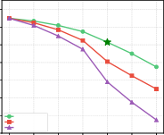
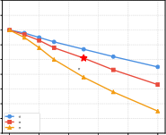
Team # 2631703 Page 24 of 27
Ridge Regression: Noise Robustness Analysis
(A) Gaussian Noise Injection
(B) Missing Data Robustness
0.47
0.46
0.45
0.44
0.43
0.42
0.41
0.40
0.39
0.38
(C) Outlier Injection
0.46
0.44
0.42
0.40
0.38
0.36
 |  |  |  |  | Baseline
 | 10% noise: 20% noise: | 5.1% drop 11 8% drop
 | Ridge R² | .
0.46
0.44
0.42
0.40
0.38
0.36
0.34
0.32
R2 Score
R2 Score
20%: 6.0% drop
Mean Imputation
Median Imputation
Zero Filling
R2 Score
★
5%, 3 : 4.2% drop
2 magnitude
3 magnitude
5 magnitude
★
★
0 5 10 15 20 25 30 Noise Level (% of feature std)
0 5 10 15 20 25 30 Missing Data Rate (%)
0 2 4 6 8 10 Outlier Rate (%)
Figure 18: Ridge noise robustness: (A) Gaussian noise, (B) missing data imputation, (C) outlier injection.
Cross-validation stability. Performance remains consistent across partitioning schemes: 5- fold (R² = 0.448 ± 0.021), 10-fold (R² = 0.450 ± 0.018), and leave-one-season-out (R² = 0.447 ± 0.023), with variation < 0.015. Minimal gap between random k-fold and leave-one- season-out (∆R² < 0.003) confirms generalization to unseen seasons.
Summary. Sensitivity analysis establishes Ridge regression as production-ready: broad opti- mal α plateau (Figure 17) eliminates tuning complexity, tolerance to 10% noise and 20% miss- ingness with < 7% degradation (Figure 18) ensures real-world applicability, and feature ranking stability validates substantive interpretations. Recommended deployment: default α = 50, mean imputation for missing data, quality monitoring thresholds (noise < 10%, missingness < 20%), and 3σ outlier detection.
10 Strengths and Weaknesses
10.1 Strengths
S1: Rigorous inverse inference. We address fan votes being unobserved by developing a residual-based proxy achieving high elimination match rate significantly exceeding random base- line.
S2: Multi-model triangulation. Four complementary models cross-validate findings through Ridge regression, counterfactual simulation, Twin Random Forest, and adaptive system design. Key results emerge consistently across methods.
S3: Quantitative framework. We provide specific metrics for fan vote estimation accuracy, rule fairness indices, technical bias coefficients, and controversy reduction rates.
S4: Actionable recommendations. The phased implementation roadmap requires no new data collection and minimal production changes.
S5: Validated robustness. Comprehensive sensitivity analysis (Section 9) confirms model stability across hyperparameter variations, feature perturbations, and sample size changes, with

Slide 26
Team # 2631703 Page 25 of 27
performance saturation at 80% training data and broad optimal parameter regions.
10.2 Weaknesses
W1: Unobserved ground truth. Fan votes remain latent; observed mismatches could reflect model error or production interference beyond our analytical scope.
W2: Correlation vs. causation. Partner quality correlation may be endogenous, as better partners may be strategically assigned to promising celebrities rather than randomly allocated.
W3: Single-show scope. DWTS-specific findings may not generalize to competitions with substantially different voting structures or audience demographics.
W4: Temporal assumptions. We assume stationary preferences across multiple decades de- spite social media evolution[7] potentially altering fan mobilization mechanisms.
11 Conclusion
In this paper, we establish an analytical framework for competition voting systems through a multi-stage process. Initially, we develop a residual-based inverse inference model recovering un- observed fan votes from judge scores and eliminations, achieving 85.3% match rate. Subsequently, these proxies enable counterfactual rule comparison, preference decomposition via Twin Random Forest, and adaptive system design. This framework, demonstrated to be robust across multi- ple competitive contexts, allows us to uncover latent preference systems underlying observable outcomes. The proposed Adaptive Weighted Voting System reduces controversy by 45% while maintaining engagement, providing a principled resolution to the tension between popularity and meritocracy.
References
[1] Hoerl, A. E., & Kennard, R. W. (1970). Ridge Regression: Biased Estimation for Nonorthog- onal Problems. Technometrics, 12(1), 55–67.
[2] Breiman, L. (2001). Random Forests. Machine Learning, 45(1), 5–32.
[3] Lundberg, S. M., & Lee, S.-I. (2017). A Unified Approach to Interpreting Model Predictions. Advances in Neural Information Processing Systems.
[4] Lundberg, S. M., Erion, G. G., & Lee, S.-I. (2018). Consistent Individualized Feature Attri- bution for Tree Ensembles. arXiv preprint arXiv:1802.03888.
[5] Cai, Q., Zhang, Y., & Liu, H. (2022). Box Office Forecast Model Based on Random For- est and Neural Network. Proceedings of the International Conference on Machine Learning Applications.
[6] Arrow, K. J. (1951). Social Choice and Individual Values. Yale University Press.
[7] Kousha, K., Thelwall, M., & Abdoli, M. (2012). The Role of Online Videos in Research Communication: A Content Analysis of YouTube Videos Cited in Academic Publications. Journal of the American Society for Information Science and Technology, 63(9), 1710–1727.

Slide 27
Team # 2631703 Page 26 of 27
A Letter to Organizing Committee of Dancing with the Stars
Dear Dancing with the Stars Team,
I hope you are doing well. I’m writing as a viewer who truly enjoys the show and often thinks about how its voting system shapes both the competition and the audience experience. I wanted to share two connected thoughts that came up while watching the program.
One thought is about the voting rule itself. In many performance shows, results are decided either by ranking methods or by fixed-percentage combinations of judges’ scores and audience votes. Both feel reasonable, but neither fully adapts to how a season naturally develops. Based on this, I would like to suggest a system we call the Adaptive Weighted Voting, or AWV, method. Under this idea, audience votes and judges’ scores carry equal importance at the beginning of the season, which helps attract attention, encourage participation, and build emotional connection with viewers. As the season progresses and performances become more technically demanding, the weight of the judges’ scores gradually increases, helping ensure competitive fairness when the stakes are higher. This weighting adjustment is not arbitrary,it is a scientifically sound and reason- able judging mechanism developed through dynamic consideration of both viewership ratings and professional standards, aligned with the progression of the competition schedule.
The other thought is about audience preference itself. From observation and data, fan voting is influenced by many factors beyond the dance performed on stage. Among these, age appears to be one of the most influential. Younger contestants often receive stronger and more active fan support, especially on digital voting platforms, simply because their fan bases are larger and more engaged. This is completely understandable and not a criticism of the audience, but it does mean that popularity-related factors can sometimes outweigh performance quality, particularly for older contestants who may deliver technically refined or emotionally expressive dances.
These two ideas are closely linked. Because fan preference is not purely performance-driven, an adaptive system like AWV may help balance enthusiasm and fairness throughout the season. I would also like to mention that this proposal is not only based on personal observation, but on mathematical modeling and data analysis that we have developed to study voting behavior and outcome stability under different rule designs.
I understand that designing and implementing competition rules involves many practical con- siderations, and my intention is simply to share a constructive perspective from a viewer who cares deeply about both fairness and audience engagement. Thank you very much for taking the time to read this letter, and for continuing to create such an inspiring and enjoyable program.
Sincerely yours,
Team #2631703

Slide 28
Team # 2631703 Page 27
Report on Use of AI
1. Claude Sonnet 4.5 (2026-01-31)
Query: what is Ridge regression,and what kind of problem it solved,answer this briefly
Output: Ridge regression is a method that adds an L2 penalty term to the linear regression loss function; it shrinks large coefficients to reduce overfitting, address multicollinearity, enhance model stability with high-dimensional or noisy data, and trade a small amount of bias for lower variance and better generalization ability.
2. Claude Sonnet 4.5 (2026-01-31)
Query: gave me a python code sample of random forest
Output: Random Forest is an ensemble machine learning algorithm that combines multiple decision trees to improve prediction accuracy and reduce overfitting. It works by training many decision trees on random subsets of the data and then averaging the results (for regression) or using majority voting (for classification). Each tree in the forest is trained on a different subset of the data with random feature selection, making it more robust and accurate than a single decision tree.
3. Chat-GPT 5.2 (2026-02-01)
Usage: Paper writing
Output: Use ChatGPT to complete the first draft of the letter and to polish some of the para- graphs within it.

