Slide 1
Advanced Information Systems Development
Human-Computer Interaction (HCI)
Presented by
Franglin

Slide 2
What you will learn
By the end of today, you can:
Say what HCI is and why it matters.
Describe your users and what they need.
Use simple rules to check a design.
Explain why accessibility is important.
Make a simple prototype.
Test a design with a user and find problems.
Advanced Information Systems Development | Human-Computer Interaction
2

Slide 3
How we work today
ASK
Ask a question at any time.
Say: "Please say it again."
TALK
Talk with your friend.
You can think in your own language first.
MENTI
Use your phone for Menti.
Your answers are anonymous.
TRY
Mistakes are OK.
We learn by trying.
Advanced Information Systems Development | Human-Computer Interaction
3

Slide 4
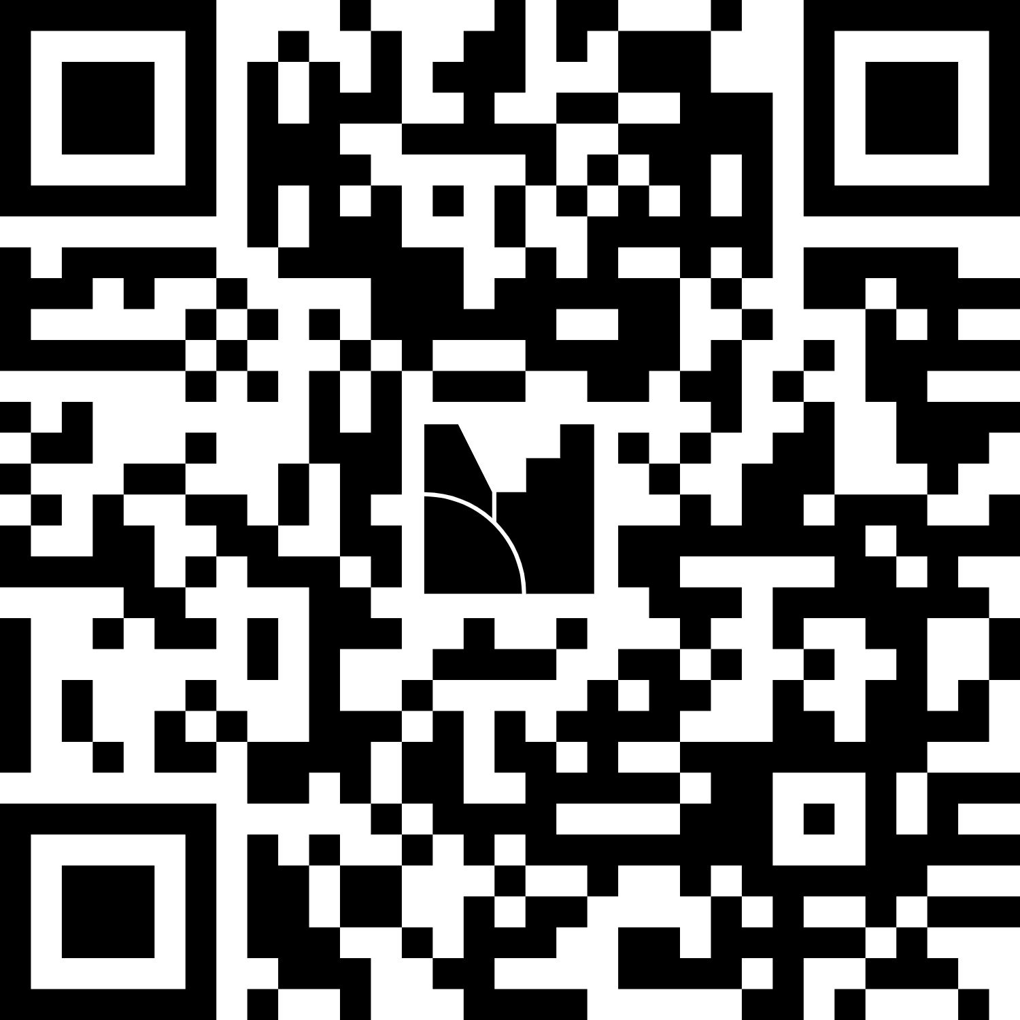
Menti warm-up: join now
1
Open the camera on your phone, or open a web browser.
2
Go to menti.com.
3
Type the code. 1278 4313
4
Answer the question. Write 1-3 words.
MENTI 1 | Word cloud Join: menti.com
Which apps do you use every day? (Write 1- 3 app names)
Advanced Information Systems Development | Human-Computer Interaction
4

Slide 5
What is HCI?

Slide 6
Think, pair, share
PAIR TALK | Talk to your friend sitting next to you
2 min
Think of your phone. Which app do you like? Why?
1
Now think again. Which app is hard to use? Why?
2
MENTI 2 | Open text Join: menti.com
Name one app or website that is hard to use. What is the problem?
Advanced Information Systems Development | Human-Computer Interaction
6

Slide 7
What is HCI?
HCI = Human-Computer Interaction
How people use computers, apps and websites. We want them to be easy, safe and pleasant.
Input
App
touch, type, speak
Output
The user
screen, sound, vibration
The computer
Advanced Information Systems Development | Human-Computer Interaction
7

Slide 8
Key words
User
The person who uses the system.
Interface
What you see and touch: screen, buttons, menus.
Usability
How easy and fast it is to use.
UX
User experience: how the user feels.
Accessibility
Everyone can use it, also people with disabilities.
Advanced Information Systems Development | Human-Computer Interaction
8

Slide 9
Menti check: HCI
Look at the question on your phone. Choose one answer.
Human-Computer Interaction
High Computer Integration
A
B
Home Computer Internet
Human Control Instructions
C
D
MENTI 3 | Multiple choice Join: menti.com
What does HCI mean?
Advanced Information Systems Development | Human-Computer Interaction
9

Slide 10
Why does HCI matter?
Saves time
Users finish tasks faster.
Fewer mistakes
Clear design stops errors.
1
2
Safer systems
In health or banking apps, mistakes can be serious.
Better business
Happy users stay. Support costs go down.
3
4
Advanced Information Systems Development | Human-Computer Interaction
10

Slide 11
Bad message, good message
Hard to understand
Easy to understand
Error
Error 0x80070057: Invalid parameter.
[ OK ]
Could not save
We could not save your file. Please check your internet and try again.
Try again
Good messages use simple words and say what to do next.
Advanced Information Systems Development | Human-Computer Interaction
11

Slide 12
HCI in system development
1 Plan
2 Analyse
3 Design
Who are the users?
What do they need?
What will the screens look like?
4 Build
5 Test
6 Release
Do we follow the design rules?
Can real users do the tasks?
What do users say now?
HCI is in every stage, not only at the end.
Advanced Information Systems Development | Human-Computer Interaction
12

Slide 13
Know your users
Notes:
Start of Part 2 (30 min): users, goals, interviews, personas.

Slide 14
Users are different
Student
Fast, on a phone, always in a hurry.
Older adult
Not sure about technology. Needs big text.
Busy nurse
Uses one hand. No time to read.
Low vision
Needs strong contrast and a screen reader.
Different users have different needs. You are not the user.
Advanced Information Systems Development | Human-Computer Interaction
14

Slide 15
Menti: who is the user?
A bus ticket app is for tourists and older people.
Many bright colours
Big text and simple steps
A
B
Many extra features
Fast animations
C
D
MENTI 4 | Multiple choice Join: menti.com
What is most important for this app?
Advanced Information Systems Development | Human-Computer Interaction
15

Slide 16
Goals, tasks and context
Goal
Task
Context
What the user wants.
The steps they do.
Where and when they use it.
Example:
Buy a bus ticket.
Example:
Choose route. Pay. Show ticket.
Example:
In the rain. In a hurry. One hand.
Design for the goal first.
Advanced Information Systems Development | Human-Computer Interaction
16

Slide 17
How to learn about users
Ask
Interviews and surveys.
Watch
See how people really use things.
1
2
Test
Let users try your design.
Read
Reviews, feedback and data.
3
4
Best: use more than one way.
Advanced Information Systems Development | Human-Computer Interaction
17

Slide 18
Ask good questions
Closed question (weak)
Open question (strong)
"Do you like the app?"
"Is it easy to use?"
The answer is only yes or no.
"Tell me about the last time you booked something online."
"What was difficult?"
"Why?"
Ask "why" and "how". Listen more than you talk.
Advanced Information Systems Development | Human-Computer Interaction
18

Slide 19
Activity 2: interview
ACTIVITY 2 | PAIR WORK
7 min
Topic: How do you order or book things online? (food, taxi, tickets)
1
Partner A asks 3 open questions. Partner B answers. (3 min)
2
A writes short notes.
3
Swap roles. (3 min)
Sentence starters:
Tell me about…
What was hard?
Why?
Advanced Information Systems Development | Human-Computer Interaction
19

Slide 20
Persona: a made-up user
A persona is a made-up person.
It shows a group of real users.
It is based on research.
Use it to remember who you design for.
M
Maria, 68
Retired teacher
Device: Old Android phone
Goal: Book a doctor visit online
Problem: Text is too small. She is afraid to press the wrong button.
"I don't want to break it."
Advanced Information Systems Development | Human-Computer Interaction
20

Slide 21
Activity 3: make a persona
ACTIVITY 3 | GROUP WORK (3–4 people)
7 min
Our project: a study room booking app for students.
Name and age
Device
A quote from your persona
Goal
Problem
Draw a face. Give your persona a name.
Advanced Information Systems Development | Human-Computer Interaction
21

Slide 22
Menti: what do users need?
Think about your persona. Put the most important thing at the top.
Fast
Easy to understand
A
B
Safe (private data)
Looks nice
C
D
MENTI 5 | Ranking Join: menti.com
Rank what is most important for a study room booking app.
Advanced Information Systems Development | Human-Computer Interaction
22

Slide 23
Break
Please come back on time.
10
minutes

Slide 24
Good design rules

Slide 25
Five simple design ideas
Signifier shows what to do. A button looks like a button.
1
Feedback shows what happened. A sound or message.
2
Mapping controls match results. Up arrow moves up.
3
Constraint stops wrong actions. A grey button cannot be pressed.
4
Consistency similar things work the same way.
5
Norman, D.A. (2013) The design of everyday things. Revised and expanded edition. Cambridge, Massachusetts: The MIT Press.
Advanced Information Systems Development | Human-Computer Interaction
25
Notes:
Teach 5 ideas (5 min). Based on Don Norman, 'The Design of Everyday Things'.
Use real objects: a door handle (signifier), a lift light (feedback), a stove (mapping).
Ask students to find one example in the room.

Slide 26
10 usability rules
Rules to check a design (by Jakob Nielsen)
Show what is happening
Show options. No need to remember
1
6
Use words users know
Make it fast for experts
2
7
Let users go back
Keep it simple
3
8
Be consistent
Help users fix errors
4
9
Stop errors early
Give help when needed
5
10
Source Nielsen, J. (1994a) ‘Ten usability heuristics’, in Nielsen, J. and Mack, R.L. (eds.) Usability Inspection Methods. New York: John Wiley & Sons, pp. 25–41. 10 Usability Heuristics for User Interface Design - NN/G
Advanced Information Systems Development | Human-Computer Interaction
26
Notes:
Overview (3 min). These are Jakob Nielsen's 10 usability heuristics, written in simple English.
Heuristic = a simple rule to check a design. Do not read all details now. We look at them in 4 short slides.

Slide 27
Rules 1 to 3
1
Show what is happening
Tell users the system status.
Uploading... 60%
2
Use words users know
No technical words.
Good: "Delete"
Bad: "Terminate record"
3
Let users go back
Give an easy way out.
Undo
Cancel
Back
Advanced Information Systems Development | Human-Computer Interaction
27

Slide 28
Rules 4 to 6
4
Be consistent
Same things look and work the same.
Next
Next
Next
Same word. Same colour.
5
Stop errors early
Ask before a big action.
Delete this file?
Cancel
Delete
6
Show options
Do not make users remember.
Today
Tomorrow
Pick a date
Advanced Information Systems Development | Human-Computer Interaction
28

Slide 29
Rules 7 and 8
7
Make it fast for experts
Shortcuts help people who use it a lot.
Shortcut
Swipe
Voice
8
Keep it simple
Show only what the user needs now.
Too much
Just right
Book
Advanced Information Systems Development | Human-Computer Interaction
29

Slide 30
Rules 9 and 10
9
Help users fix errors
Say what is wrong and how to fix it.
Bad: "Error 500"
Good: "Sorry, we could not find that page. Go to Home."
10
Give help when needed
Make help easy to find.
Search, FAQ, short tips
?
Advanced Information Systems Development | Human-Computer Interaction
30

Slide 31
Menti quiz: which rule?
1. A big file is uploading. The screen shows nothing for 2 minutes.
2. A website says: "Authenticate your credentials."
3. You press Pay by mistake. You cannot cancel.
Show what is happening
Use words users know
A
B
Let users go back
Be consistent
C
D
MENTI 6 | Quiz (3 questions) Join: menti.com
Which rule is broken? Choose on your phone.
Advanced Information Systems Development | Human-Computer Interaction
31

Slide 32
Activity 4: check a website
ACTIVITY 4 | GROUP WORK
10 min
1
Pick one booking website or app.
2
Try to book something for tomorrow. (Do not pay.)
3
Check 3 rules. Fill in the table.
Rule | What did you see? | Score 1–5
Advanced Information Systems Development | Human-Computer Interaction
32

Slide 33
Share your results
Each group: tell us 1 problem you found.
Speak for 30 seconds.
Show what is happening
Keep it simple
A
B
Help users fix errors
Other
C
D
MENTI 7 | Multiple choice Join: menti.com
Which rule did your website break most?
Advanced Information Systems Development | Human-Computer Interaction
33

Slide 34
Design for everyone
Seeing
Strong contrast. Big text. Screen reader.
Hearing
Captions for video and sound.
Moving
Big buttons. Keyboard use.
Thinking and language
Simple words. Clear steps.
Accessible design helps everyone, also in bright sun or on a noisy bus.
Advanced Information Systems Development | Human-Computer Interaction
34

Slide 35
Menti: easy to read?
Book a room
Book a room
Book a room
A
B
C
MENTI 8 | Multiple choice Join: menti.com
Which button is easiest to read?
Advanced Information Systems Development | Human-Computer Interaction
35

Slide 36
Tips for readable design
Contrast Dark text on a light background.
1
Text size Big enough to read on a phone.
2
Not only colour Add text or an icon, not only red or green.
3
Simple words Short sentences. No hard words.
4
Picture text Describe pictures with words (alt text).
5
Advanced Information Systems Development | Human-Computer Interaction
36

Slide 37
Make and test a prototype

Slide 38
What is a prototype?
A prototype is an early model of your design.
We test ideas before we write code.
Real app
with code
Clickable
in a tool
Wireframe
boxes
Sketch
paper
Start simple. Change often. Spend more time as you learn more.
Advanced Information Systems Development | Human-Computer Interaction
38

Slide 39
Parts of a wireframe
1
Header: The page name.
2
Search box: Find things fast.
3
List: Rooms, times or items.
4
Main button: One clear action.
5
Menu bar: Move around the app.
Advanced Information Systems Development | Human-Computer Interaction
39

Slide 40
Screen design tips
One main action on each screen.
1
Big buttons at least 1 cm wide, easy for a thumb.
2
Clear labels short, simple words.
3
Group things that go together.
4
Same place for the same things.
5
Advanced Information Systems Development | Human-Computer Interaction
40

Slide 41
Activity 5: sketch your app
ACTIVITY 5 | GROUP WORK
12 min
1
Look at your persona.
2
Sketch 3 screens.
3
Add short labels.
4
Check with 3 rules.
Find
Time
Confirm
Screens: 1 Find a room, 2 Choose a time, 3 Confirm.
Advanced Information Systems Development | Human-Computer Interaction
41

Slide 42
How to run a usability test
Facilitator
Gives the task. Does not help.
Participant
Tries the task. Says what they think.
Observer
Writes notes. Stays quiet.
Say: "Please say what you think while you work. We test the design, not you."
Advanced Information Systems Development | Human-Computer Interaction
42

Slide 43
Activity 6: test a prototype
ACTIVITY 6 | GROUP WORK
12 min
Task for the user:
"Book a study room for tomorrow at 2 pm."
Round 1: 5 min. Swap. Round 2: 5 min. Share notes: 2 min.
Where did they stop? | What did they say? | Size 1–3
Advanced Information Systems Development | Human-Computer Interaction
43

Slide 44
Menti: how did it go?
Use your notes from the test.
MENTI 9 | Scales Join: menti.com
How easy was the task? 1 = very hard, 5 = very easy.
MENTI 10 | Open text Join: menti.com
What is one thing you will change in your design?
Advanced Information Systems Development | Human-Computer Interaction
44

Slide 45
Fix the big problems first
The user cannot finish the task. Fix first.
High
The user is slow or confused. Fix next.
Medium
A small problem. Fix if there is time.
Low
Advanced Information Systems Development | Human-Computer Interaction
45

Slide 46
Design, test, improve, repeat
Design
Prototype
Improve
Test
Test early. Test often.
Advanced Information Systems Development | Human-Computer Interaction
46

Slide 47
Key points
HCI makes technology work for people.
1
Know your users. Use personas.
2
Use the 10 rules to check a design.
3
Design for everyone. Accessibility matters.
4
Prototype, test, improve. Do it again.
5
Advanced Information Systems Development | Human-Computer Interaction
47

Slide 48
Final Menti quiz
5 questions. 20 seconds each.
Answer on your phone. Do your best!
HCI
Personas
Usability rules
Accessibility
Testing
MENTI 11 | Quiz (5 questions) Join: menti.com
Join with the code on the screen. Choose the best answer.
Advanced Information Systems Development | Human-Computer Interaction
48

Slide 49
Before the next session
Test one app with a friend (10 min). Write 3 problems.
1
Write 3 fixes using the 10 usability rules.
2
Read Nielsen: 10 Usability Heuristics (nngroup.com).
3
Keep your persona and sketches.
4
Advanced Information Systems Development | Human-Computer Interaction
49
Notes:
Homework (2 min). Keep it small and clear. Tell students to keep their persona and sketches. Share the link in the chat or on the VLE.

Slide 50
Menti: exit ticket
MENTI 12 | Open text Join: menti.com
One new thing I learned today.
MENTI 13 | Scales Join: menti.com
I feel confident about HCI. 1 = not at all, 5 = very confident.
Thank you for your answers. They help me to plan the next session.
Advanced Information Systems Development | Human-Computer Interaction
50

Slide 51
Thank you
Questions?

Slide 52
Further reading
Nielsen, J. (2020) 10 usability heuristics for user interface design. Nielsen Norman Group. Available at: https://www.nngroup.com/articles/ten-usability-heuristics/
Norman, D.A. (2013) The design of everyday things. Revised and expanded edn. New York: Basic Books.
W3C (2023) Web Content Accessibility Guidelines (WCAG) 2.2. W3C Recommendation. Available at: https://www.w3.org/TR/WCAG22/
Tools Figma, Canva or PowerPoint for prototypes.
Advanced Information Systems Development | Human-Computer Interaction
52

