Slide 1
RawFileReader
Jim Shofstahl

Slide 2
Thermo Scientific MSFileReader
MSFileReader (and it’s predecessor) are 20 years old
Developed to provide customers the ability to read our RAW files without requiring distribution of C++ include files
Originally developed using OLE/OCX but ported to COM
Originally developed for use in Visual Basic but eventually C++ became the primary programming language
Can be use with Visual Basic, C++, C#, Java, Phyton, LUA

Slide 3
MSFileReader Limitations
COM is old
COM isn’t portable – only runs on Windows computers.
Requires marshalling of data. Therefore extra execution time is required to convert from the internal formats we us into marshalled objects and then from the marshalled objects in formats used in the calling code.
While COM can be used in a multi-threaded application, the underlying library that MSFileReader calls isn’t thread safe.
Hard to debug. MSFileReader is a wrapper around our FileIO.dll.
Not all of the methods in the library work with C#

Slide 4
Thermo Scientific RawFileReader
Released at ASMS 2016 (San Antonio).
Complete re-write of our RAW, SLD, and PMD files reading library in C# (.NET)
Advantage
No more marshalling of data
Faster, direct access to the data without any intermediate layers.
Multi-threaded code
Lockless parallel processing
Better memory management / security (i.e. managed code)
Unit tested (~95% unit test coverage)
Portable (Windows, Linux, MacOS)

Slide 5
RawFileReader Compatibility
.NET 4.5.1, 4.5.2, 4.6, 4.6.1, 4.6.2, 4.7, 4.7.1, 4.7.2 (and 4.8 when released)
Windows
Works with Microsoft Visual Studio 2015 (Update 3), 2017 (15.9), 2019, Visual Studio Code, Jet Brains Rider.
MacOS
Visual Studio for MAC 7.5, 8.1, Xamarin Studio 6.3
Linux
MonoDevelop (18.04, 18.10, 19.04)

Slide 6
RawFileReader components
ThermoFisher.CommonCore.Data.dll
Basic structures/classes used in our data
ThermoFisher.CommonCore.RawFileReader.dll
Methods for reading RAW files
ThermoFisher.CommonCore.BackgroundSubtraction
Background subtraction/averaging methods
ThermoFisher.CommonCore.MassPrecisionEstimator.dll
Mass Precision Estimator methods
Documents describing RawFileReader and using NuGet packages
Example program showing how to use RawFileReader
NuGet Package(s) used to install within Visual Studio for Windows, Linux, and MacOS

Slide 7
Distribution and License
Unlike MSFileReader which required using our installer, the RawFileReader assemblies can be distributed with your application
Included with the NuGet packages, example program, and documents is a copy our license agreement (RawFileReaderLicense.docx) that we ask that you include with our license agreement or have the user accept in your installer.
We will also provide a letter granting developers the right to re-distribute the assemblies

Slide 8
What’s new
Updated version 4.0.107 (last release of the CommonCore 4 branch)
Moving to our CommonCore 5 branch
Compiled against .Net Framework 4.7.1
Supports C# 7
Current build 5.0.7
.Net Standard 2.0 Support – i.e. we have version that supports .Net Core 2.0 / 2.1.

Slide 9
Common Core 5.0 Platform Versions
Because .NET core does not support Windows desktop applications:
Only “non-Windows UI” DLLs are available in the .NET core build.
To provide full compatibility with current apps:
The .NET Framework build will supply the same Windows (Forms, WPF) features.
.NET Framework 4.7.1 build
(Supports Windows .NET Framework or Linux Mono Apps)
GUI
Non-GUI
.NET Standard 2.0 build
(Supports .Net Core 2.x apps running on any OS)

Slide 10
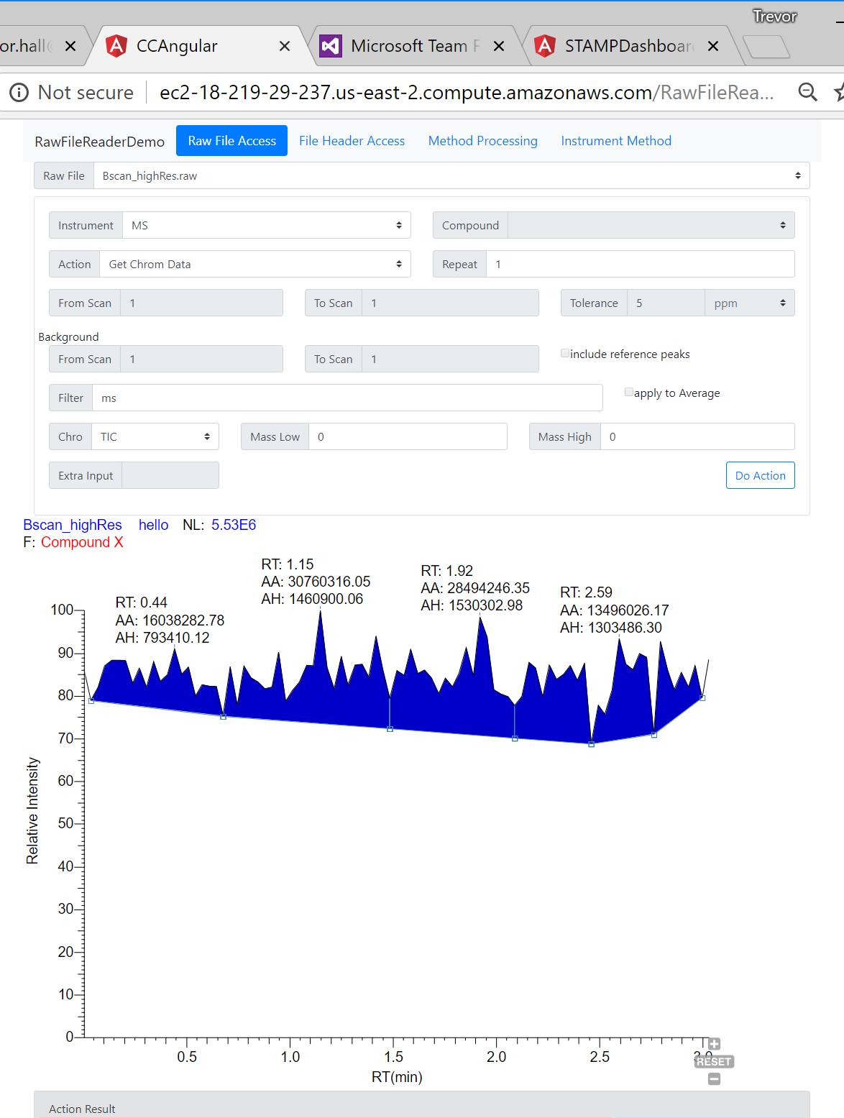
Common Core 5 Status
Targets completed:
.NET Framework 4.7.1
.NET standard 2.0
Evaluated from .NET core 2.1.
Tested with local Linux server.
Tested with Amazon Cloud
Unit tested on Windows and Linux
Cloud Technology Demo:
Based on Raw File Reader Demo
See next slide for technology…

Slide 11
RawFileReader Web Demo Architecture
AWS EC2 Linux instance
Docker Container
PC Browser
.NET Core
Angular SPA with Bootstrap
REST Interface
Tablet Browser
Cell Phone Browser
Demo Business Logic
Common Core Libraries

Slide 12
How to get RawFileReader
The files are available in a OneDrive folder on the Thermo Fisher Scientific Cloud.
Contact me for access – jim.shofstahl@thermofisher.com
We also have information about RawFileReader on the Planet Orbitrap website.

Slide 13
Thermo Scientific Xcalibur XDK
Like MSFileReader, the Xcalibur XDK is rather old.
Will release updated version of the plotting and peak detection libraries later this summer.

Slide 14
Acknowledgements
Trevor Hall, Thomas Ng, Matthew Kump, Anthong Chueng for their work on RawFileReader.

