Slide 1
Beyond MSFileReader
Jim Shofstahl
June 7, 2016
ASMS 2016 San Antonio

Slide 2
MSFileReader History
MSFileReader (and it’s predecessor) are 20 years old
Developed to provide customers the ability to read our RAW files without requiring distribution of C++ include files
Originally developed using OLE/OCX but ported to COM
Originally developed for use in Visual Basic but eventually C++ became the primary programming language
Can be use with Visual Basic, C++, C#, Java, Phyton, LUA
Most popular software package that we provide

Slide 3
MSFileReader Current Version
MSFileReader 3.1 SP2
64 bit version only
In maintenance mode. We will do updates when the Foundation FileIO dll changes.
Downloadable from:
https://thermo.flexnetoperations.com/

Slide 4
MSFileReader Limitations
COM is old
COM isn’t portable – only runs on Windows computers.
Requires marshalling of data. Therefore extra execution time is required to convert from the internal formats we us into marshalled objects and then from the marshalled objects in formats used in the calling code.
While COM can be used in a multi-threaded application, the underlying library that MSFileReader calls isn’t thread safe.
Hard to debug. MSFileReader is a wrapper around our FileIO.dll.
Not all of the methods in the library work with C#

Slide 5
Where are we going?
RawFileReader

Slide 6
What is RawFileReader
Complete re-write of our RAW, SLD, and PMD files reading library in C# (.NET)
Advantage
No more marshalling of data
Faster, direct access to the data without any intermediate layers.
Multi-threaded code
Lockless parallel processing
Better memory management / security (i.e. managed code)
Unit tested (~94% unit test coverage)
Portable

Slide 7
RawFileReader Compatibility
Works with Microsoft Visual Studio 2013 (Update 5) and 2015 (Update 1).
.NET 4.5.1, 4.5.2, 4.6, and 4.6.1
.NET 4.6.2 when it is released

Slide 8
RawFileReader components
ThermoFisher.CommonCore.Data.dll
Basic structures/classes used in our data
ThermoFisher.CommonCore.RawFileReader.dll
Methods for reading RAW files
ThermoFisher.CommonCore.BackgroundSubtraction
Background subtraction/averaging methods
ThermoFisher.CommonCore.MassPrecisionEstimator.dll
Mass Precision Estimator methods
Two documents describing RawFileReader
Example program showing how to use RawFileReader
NuGet Package used to install within Visual Studio

Slide 9
.NET is Portable?
Microsoft, in the post-Ballmer world, has gone “Open”
.NET Foundation was announced in late 2014. Microsoft would port .NET to Linux and OS X for computers and Android and iOS for mobile devices.
http://www.dotnetfoundation.org
The .NET Foundation is an independent organization to foster open development and collaboration around the Microsoft .NET development framework. It serves as a forum for community and commercial developers alike to broaden and strengthen the future of the .NET ecosystem by promoting openness and community participation to encourage innovation
Currently, .NET Foundation supports Linux (Ubuntu, RedHat, Debian, …) and Mac OS X.

Slide 10
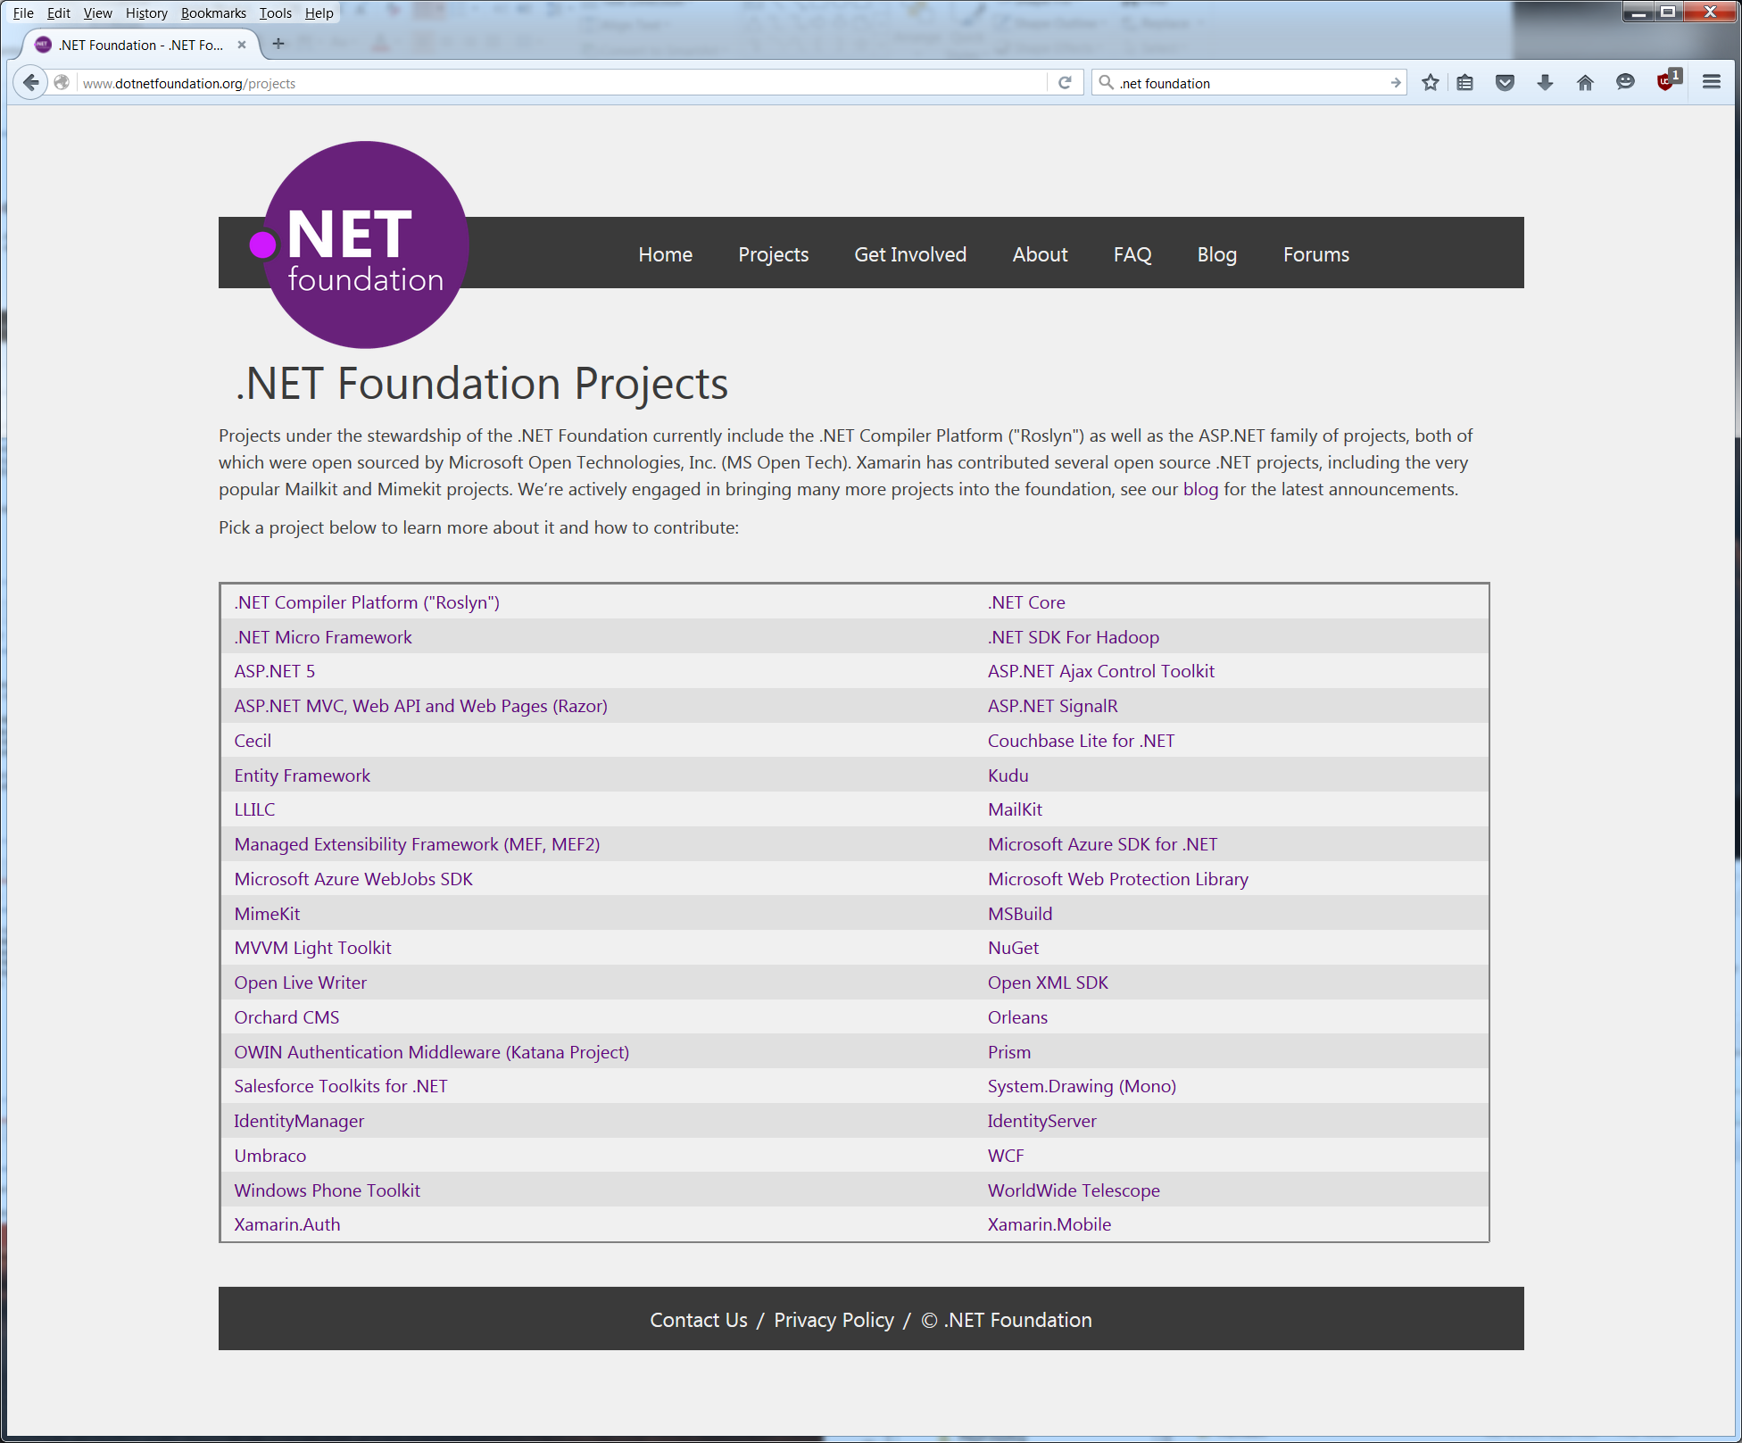
.NET Foundation Projects

Slide 11
Still, Why Linux?
Many customers have asked for the ability to read our RAW files on other platforms (Unix, Linux, OS X)
Our ThermoFisher Cloud software runs on AWS which supports Linux compute nodes.
Being RawFileReader is a pure .Net library for reading our RAW files, porting it to Linux or OS X should be possible.

Slide 12
Initial porting of RawFileReader
Manually copied the CommonCore code to Linux computer.
Removed all of the projects in the Libraries sub-project not related to RawFileReader from the CommonCore solution file.
Changed the .Net Dependency from .Net 4.5.1 to Mono/4.5
Build errors were present but they were rather minor and quick to fix.
As with the step of removing projects from the Libraries sub-project in the CommonCore solution, all of the demo applications except for the RawFileReader demo were removed.
In less than 2 hours, RawFileReader and the demo program were compiling on Linux

Slide 13
So the code compiles, we must be done
Copied a RAW file to the Linux box and attempted to read it – no luck. The code is throwing exceptions.
With another developer’s help we identified some issues in our code that needed fixing:
Linux, like Unix, is case sensitive when it comes to filenames and our code was converting the names to all lower case letters.
Back slashes vs forward slashes in file names.
Issue with creating memory mapped files
After a couple of hours, these issues were corrected and attempted to read a RAW file again. Still no luck. The code was throwing exceptions that seemed odd.

Slide 14
What’s going on?
After investigating on the Linux computer and the web it was discovered that Ubuntu 15.10, while it is the latest release of Ubuntu Linux, is still using an older runtime version of Mono that is more comparable to .Net 3.0 / 4.0 than .Net 4.5.
Updated the Mono and MonoDevelop application to the latest development version of their code. Also installed the Eclipse software which let’s us connect to TFS.
Recompiled the RawFileReader library and demo application and then tried opening the RAW files that could not be opened earlier.

Slide 15
Success – but what does success mean?
Able to open new and old RAW files using RawFileReader demo application. Old RAW files refer to some of RAW files acquired before Xcalibur was developed. These file require some internal conversions that test the libraries more thoroughly than new files.
The demo application provides 55 options for reading sections of our RAW file.
All of these options except for reading the instrument methods worked correctly. Only a couple of the options deal with reading instrument methods.
Our Instrument methods using a structured storage format that requires a Microsoft COM library which hasn’t been ported to Linux. There is an Open Source option to this library that we need to investigate.

Slide 16
Future Work
Currently using Mono, will switch to .Net Core when it is officially release
Investigate/replace the Structured Storage COM library so that we can read the instrument methods on Linux
MAC OS X port

Slide 17
How to get RawFileReader
The files are available in my ShareFile folder on the Thermo ShareFile site.
Current version 3.0.54.
Contact me for access – jim.shofstahl@thermofisher.com.

Slide 18
Acknowledgements
Trevor Hall, Thomas Ng, and Matthew Kump for their work on RawFileReader.

