Slide 1

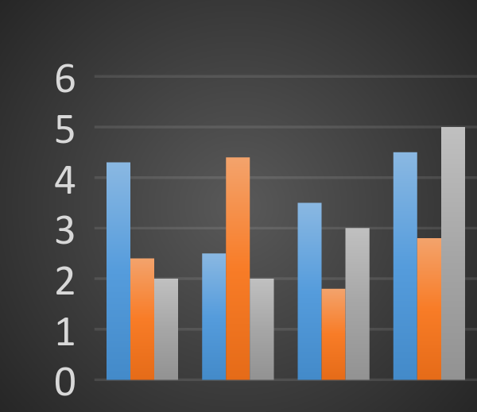
Abstract Title Abstract Title continued Authors’ Names Institution(s)
Background
This is your ePoster template.
Please read the tips carefully. Please remove this text when inserting your own text. We recommend the following presentation structure:
Background
Materials and methods
Results
Conclusions
Please also insert your Abstract Title, Authors, Category and Poster Number
Tips for Excel Charts
Copy and paste your Excel chart. The chart can be stretched to fit as required. If you need to edits parts of the chart, we recommend you edit the original chart in Excel, then re-paste the new chart.
Materials and Methods
Conclusions
Copy and paste your text content here, adjusting the font size to fit. We recommend “Arial” size 10 font. Use the “Symbol” font for Greek characters.
Copy and paste your text content here, adjusting the font size to fit. We recommend “Arial” size 10 font. Use the “Symbol” font for Greek characters.
Results
Copy and paste your text content here, adjusting the font size to fit. We recommend “Arial” size 10 font. Use the “Symbol” font for Greek characters.
References
Journal Article, Name of Journal
Journal Article, Name of Journal
Journal Article, Name of Journal
Journal Article, Name of Journal

