Slide 1

GOPHER AI
Pothole Detection with YOLO11n
Trained model: gopher-ai_v1.pt
Individual Presentation
Eswara Raj M (CB.SC.U4CSE23022)
Faculty Guide
Dr. T. Senthil Kumar, Professor, CSE Department
23CSE473 – Neural Networks and Deep Learning
0 / 18
Notes:
Reference styling and course footer: CB.SC.U4CSE23052-individual.pdf. Presenter identity supplied by the user.

Slide 2
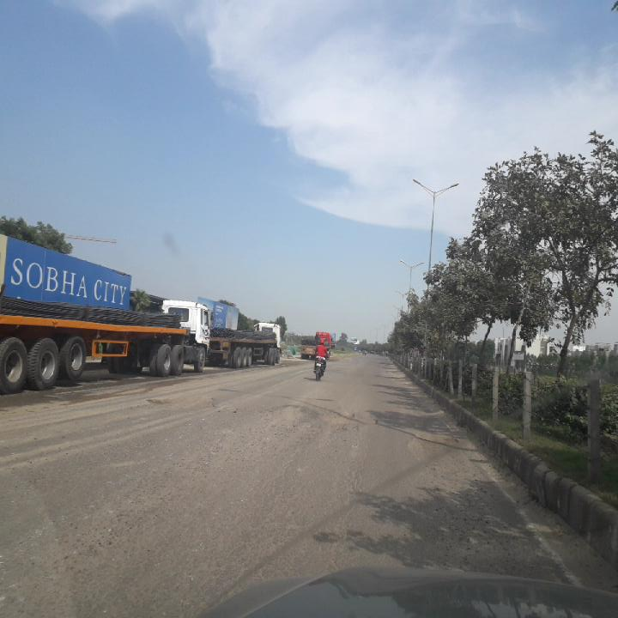
Problem Statement, Introduction & Motivation
Problem
Manual road inspection is slow and inconsistent. Small potholes can blend into shadows, patches and rough road texture.
Objective
Locate potholes in road images or video frames using bounding boxes and confidence scores.
Motivation
A compact detector can support frequent surveys and help reviewers identify road sections that need attention.
The checkpoint predicts five damage classes. The application focuses on class 4: Pothole.
23CSE473 – Neural Networks and Deep Learning
1 / 18
Notes:
Sources: README.md, new_train.py, gopher-ai_v1.pt class names. Application workflow is proposed.

Slide 3
Literature Survey: YOLO11 for Road Damage
Paper / journal | Method and reported result | Relevance to Gopher AI
[1] Li et al., 2025 Applied Sciences RS-YOLOv11n | Lightweight detector for occluded pavement. mAP50 71.49%, recall 64.43%. | Closest architecture: YOLO11n. Study speed, size and occlusion together.
[2] Liu et al., 2025 Computers, Materials & Continua Empowered YOLOv11 | WTConv, multiscale fusion and revised IoU loss. mAP50 86.5%, F1 83.5%. | Feature fusion and localization loss can improve damage detection.
[3] Mi et al., 2026 volume Computers, Materials & Continua Star-YOLO11 | Feature extraction, attention and augmentation. mAP50 90.3%, mAP50–95 62.7%. | Noise and lighting augmentation motivate the proposed denoising study.
2025/2026 journal papers. Journal listings are on SCImago. Results use different datasets and protocols.
23CSE473 – Neural Networks and Deep Learning
2 / 18
Notes:
[1] Li et al. (2025)
A Lightweight YOLOv11n-Based Framework for Highway Pavement Distress Detection Under Occlusion Conditions
Applied Sciences 15(17), 9664
https://doi.org/10.3390/app15179664
[2] Liu et al. (2025)
A YOLOv11 Empowered Road Defect Detection Model
Computers, Materials & Continua 85(1), 1073–1094
https://doi.org/10.32604/cmc.2025.066078
[3] Mi et al. (2026 volume, online 2025)
Pavement Crack Detection Based on Star-YOLO11
Computers, Materials & Continua 86(1), 1–22
https://doi.org/10.32604/cmc.2025.069348
Journal listing evidence: https://www.scimagojr.com/journalrank.php?area=3100&ord=desc&order=tc and https://www.scimagojr.com/diamond/journalrank.php?area=2500&category=2502&country=US&ord=asc&order=cpd&year=2023

Slide 4
Literature Survey: Small Objects & Efficiency
Paper / journal | Method and reported improvement | Relevance and limitation
[4] Zhang et al., 2025 PLOS ONE YOLOv11-ATL | Tiny-object head, attention and lightweight convolutions. mAP50 +3.2 points, mAP50–95 +3.1 points. | Preserving detail may help distant potholes. Study uses an RDD2022 China subset.
[5] Dong et al., 2025 Sensors YOLO11-BD | Lightweight bridge crack detector. mAP50 +3.1 points, mAP50–95 +4.8 points. GFLOPs reduced 19.05%. | Useful nano-model efficiency comparison. Bridge cracks differ from potholes.
Research gap for this project
Test whether controlled image corruption and edge-preserving filtering improve pothole recall without unacceptable latency.
23CSE473 – Neural Networks and Deep Learning
3 / 18
Notes:
[4] Zhang, Deng & Zou (2025)
Automatic road damage recognition based on improved YOLOv11 with multi-scale feature extraction and fusion attention mechanism
PLOS ONE 20(9), e0327387
https://doi.org/10.1371/journal.pone.0327387
[5] Dong, Yuan & Dai (2025)
Study on Lightweight Bridge Crack Detection Algorithm Based on YOLO11
Sensors 25(11), 3276
https://doi.org/10.3390/s25113276
SCImago journal listing evidence: https://www.scimagojr.com/journalrank.php?country=&min=3&min_type=cd&ord=desc&order=titem&year=2024 and https://www.scimagojr.com/journalrank.php?area=3100&ord=desc&order=tc

Slide 5
Overall Application Architecture
Training pipeline
RDD2022
images + labels
Prepare data
resize / augment
Fine-tune
YOLO11n
Validate and save
gopher-ai_v1.pt
Planned application pipeline
Image / video
input
512-pixel input
model inference
Confidence filter
NMS + class 4
Review dashboard
map / report
Optional denoising sits before inference. Location metadata comes from the capture device.
23CSE473 – Neural Networks and Deep Learning
4 / 18
Notes:
Model/training pipeline: new_train.py, resize_images.py, gopher-ai_v1.pt. UI: gopher-ui/src. API, location capture and operational workflow are planned integration components.

Slide 6
Module Details
Module | Input / output | Role
Data preparation | Road images + YOLO labels Prepared train/validation/test splits | Filter unsuitable viewpoints, retain background examples and resize images.
Training | COCO weights + annotated images Fine-tuned checkpoint | Optimize box, class and distribution focal losses.
Inference | Image / frame Boxes, class IDs, confidence | Run YOLO11n, suppress duplicate boxes and expose pothole detections.
Application integration (planned) | Detection + timestamp + optional GPS Reviewable damage record | Connect the model service to map views and a repair review workflow.
Evaluation | Predictions + reference labels P, R, AP and latency | Measure localization, missed potholes and practical inference cost.
23CSE473 – Neural Networks and Deep Learning
5 / 18
Notes:
Sources: new_train.py, resize_images.py, prune_backgrounds.py, Afilter_dash.py, rdd2022/data.yaml and gopher-ui/src. API and geotagged event storage are planned.

Slide 7
Performance Metrics: Formula, Purpose & Suitability
Metric / formula | Purpose for this application | Reported reference
Precision = TP / (TP + FP) | How many reported potholes are correct. Controls unnecessary review or repairs. | [3] Precision: 89.9%
Recall = TP / (TP + FN) | How many real potholes the system finds. Missed road hazards are the key concern. | [1] Recall: 64.43%
F1 = 2PR / (P + R) | Balances missed damage and false alarms. Choose the operating threshold on validation. | [2] F1: 83.5%
IoU = area(B ∩ G) / area(B ∪ G) AP = ∫₀¹ P(R) dR | IoU checks box overlap. AP summarizes the precision–recall curve at a chosen IoU. | [3] mAP50: 90.3%
mAP = (1/C) Σ APc mAP50–95: IoUs 0.50:0.05:0.95 | Average AP across classes. Stricter IoUs reward accurate pothole boundaries. | [3] mAP50–95: 62.7%
TP/FP/FN use one-to-one matching by class and IoU. AP50 is the pothole metric; mAP averages classes.
23CSE473 – Neural Networks and Deep Learning
6 / 18
Notes:
Metric definitions: https://docs.ultralytics.com/guides/yolo-performance-metrics/ . Literature values: [1] doi:10.3390/app15179664; [2] doi:10.32604/cmc.2025.066078; [3] doi:10.32604/cmc.2025.069348. Literature values are study-specific and not directly comparable.

Slide 8
Deep Learning Architecture: YOLO11n
RGB input
512 × 512 × 3
Backbone
Conv + C3k2
Context
SPPF + C2PSA
Neck
Upsample / concat
P3 / stride 8
64 × 64
P4 / stride 16
32 × 32
P5 / stride 32
16 × 16
Decoupled detection heads: box distributions + five class scores
C3k2 extracts features, SPPF expands context, and C2PSA applies attention. No custom blocks in this checkpoint.
23CSE473 – Neural Networks and Deep Learning
7 / 18
Notes:
Architecture read from gopher-ai_v1.pt model.yaml. Nano depth=0.5 and width=0.25. Detect inputs are layers 16,19,22. Sources: installed Ultralytics YOLO11 model definition and https://github.com/ultralytics/ultralytics/blob/main/ultralytics/cfg/models/11/yolo11.yaml

Slide 9
Architecture Novelty & Computational Complexity
Current implementation
Proposed extension
COCO transfer learning with the standard YOLO11n network and a five-class detection head. Project contributions lie in data preparation and application integration.
Noise-aware preprocessing before the detector. Compare baseline, noise augmentation, and augmentation plus filtering in an ablation study.
Aspect | Cost / interpretation
Convolution time | O(Σ Hl Wl kl² Cin,l Cout,l) for standard convolution layers.
Attention and postprocessing | Attention: O(N²d) per attention block. Greedy NMS: O(K²) worst case after confidence filtering.
Model and memory | 2,590,815 parameters. FP32 weights ≈ 9.88 MiB. Training also stores activations, gradients and optimizer states.
Input resolution | 512² / 640² = 0.64 spatial cost ratio. Approx. 4.1 GFLOPs at 512, derived from the 6.4 GFLOPs summary.
23CSE473 – Neural Networks and Deep Learning
8 / 18
Notes:
Measured parameter count from gopher-ai_v1.pt: 2,590,815. Model summary reports about 6.4 GFLOPs at 640, rather than 512. FP32 parameter memory is parameter_count*4 / 2^20 MiB. The FLOPs estimate scales spatial work by (512/640)^2 and is approximate.

Slide 10
Algorithm Procedure: Mathematical Steps
Step | Operation / mathematical form
1. Prepare | x = letterbox(I, 512) / 255. Transform box labels with the same resize and padding.
2. Extract features | Fl = SiLU(BN(Wl * Fl−1)). Fuse backbone features at strides 8, 16 and 32.
3. Predict and assign | For each location, predict class scores and four distance distributions. Match candidate locations to ground-truth boxes with task-aligned assignment.
4. Minimize loss | L = 7.5 Lbox + 0.5 Lcls + 1.5 LDFL. Lbox uses CIoU, Lcls uses BCE, and DFL learns bounding-box distance bins.
5. Update parameters | AdamW: θt+1 = (1 − ηtλ)θt − ηt m̂t / (√v̂t + ε). Validate each epoch and retain the checkpoint with best fitness.
6. Infer and filter | Decode boxes, retain scores ≥ 0.25, apply NMS and select class ID 4. Return box coordinates and confidence to the application.
23CSE473 – Neural Networks and Deep Learning
9 / 18
Notes:
Training settings: gopher-ai_v1.pt train_args. YOLO11 loss and inference: installed Ultralytics implementation. Equation simplifies minibatch reduction and assignment weighting. DFL models distance-bin distributions, not a scalar objectness loss.

Slide 11
Hyperparameter Details with Justification
Hyperparameter | Actual value | Justification
Initialization / input | YOLO11n COCO / 512 px | Transfer visual features at lower input cost.
Epochs / patience | 100 maximum / 10 | Allow convergence with early stopping.
Batch / workers | 16 / 3 | Fit the GTX 1650 setup and feed batches.
Optimizer / initial LR | AdamW / 0.0015 | Adaptive updates for stable fine-tuning.
Weight decay / warmup | 0.0005 / 3 epochs | Regularize weights and ease initial updates.
AMP / cache | False / True | Use FP32 and reduce repeated disk access.
Mosaic / close_mosaic | 1.0 / final 10 epochs | Vary object context, then simplify batches.
Horizontal / vertical flip | 0.5 / 0; rotation 0° | Retain plausible road viewpoints.
HSV / scale | 0.015, 0.7, 0.4 / 0.5 | Vary lighting, colour and object size.
23CSE473 – Neural Networks and Deep Learning
10 / 18
Notes:
Actual settings from gopher-ai_v1.pt train_args and new_train.py. The configured maximum is 100 epochs. Saved checkpoint corresponds to epoch 79. Justifications are engineering interpretations, not proven optimal settings.

Slide 12
Denosing Approach
Proposed experiment: synthetic noise augmentation and edge-preserving filtering
Stage | How the method works
Add noise to training copies | With probability 0.5, choose Gaussian or impulse noise. Gaussian: I˜ = clip(I + ε, 0, 1), ε ~ N(0, σ²), σ ∈ [0.01, 0.05].
Simulate pixel corruption | Impulse noise: set a random 0.5–1.0% of pixels to 0 or 1. Keep original images and bounding-box labels unchanged.
Denoise while retaining edges | Apply a 3 × 3 median filter for impulse noise. Use a bilateral filter for Gaussian noise to preserve pothole boundaries.
Train and compare | Mix clean and processed copies. Compare baseline, noisy training, and noisy training + filtering at matched training settings.
Evaluation: pothole AP50, recall and added latency on clean and fixed-noise validation sets.
23CSE473 – Neural Networks and Deep Learning
11 / 18
Notes:
PROPOSED METHOD, not used to train gopher-ai_v1.pt. Synthetic noise design supplied as an illustrative experiment at the user’s request. No measured gain is claimed. Keep validation/test originals unchanged and create separate deterministic corrupted copies for robustness evaluation.

Slide 13
Results: Saved Checkpoint & Learning Curve
Checkpoint metric | Value
Precision | 55.68%
Recall | 48.72%
mAP@50 | 50.43%
mAP@50–95 | 25.66%
The checkpoint is from epoch 79. The run log continues to epoch 80.
The gap between AP50 and stricter IoU scores indicates that precise localization still needs work.
23CSE473 – Neural Networks and Deep Learning
12 / 18
Notes:
Source: gopher-ai_v1.pt train_metrics and train_results. Saved zero-based epoch 78 is epoch 79. Metrics are validation aggregates across all five classes, not pothole-only accuracy. Chart uses selected epochs from the checkpoint history.

Slide 14
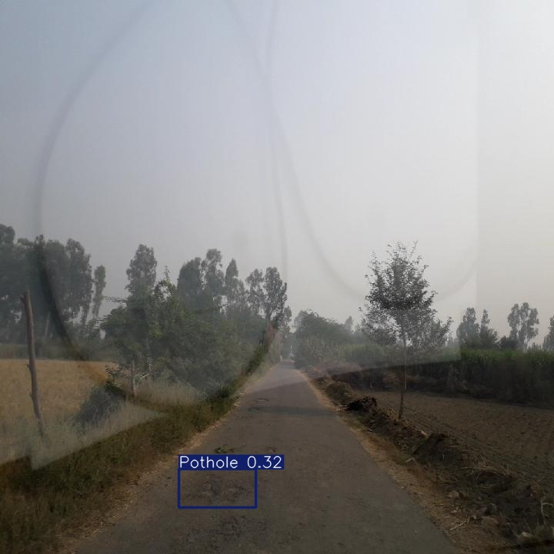
Results: Pothole Detection & Discussion
Fresh full validation
5,113 images at 512 px
Overall mAP50: 50.41%
Overall mAP50–95: 25.66%
Pothole: AP50 35.97%
Precision 52.56% Recall 31.36%
Pothole recall is the main weakness. Small and low-contrast damage needs further study.
Inference: 4.4 ms/image on GTX 1650, batch 16.
Annotated example from the local test split. Bounding boxes indicate 2-D image extent, not pothole depth.
23CSE473 – Neural Networks and Deep Learning
13 / 18
Notes:
Fresh inference: gopher-ai_v1.pt on rdd2022/RDD_SPLIT/test/images/India_001684.jpg, imgsz=512, conf=0.25. Confidence=0.32417. This single example is not a test-set accuracy estimate. If available, validation.json reports a fresh run on the complete local validation split.

Slide 15
Dataset Chosen & Proposed Data Novelty
Local split | Images | Pothole boxes | Background images
Train | 16,726 | 4,406 | 1,000
Validation | 5,113 | 912 | 1,837
Test | 5,076 | 905 | 1,790
RDD2022 subset: five local classes, including Pothole and “other corruption”.
Training scripts filter China drone/motorbike views and keep 1,000 training backgrounds.
Proposed novelty: matched clean/noisy pairs with fixed corruption seeds, evaluated by scene and noise level.
IEEE DataPort related benchmark (not used in training):
https://ieee-dataport.org/documents/road-surface-damages
23CSE473 – Neural Networks and Deep Learning
14 / 18
Notes:
Local counts audited from image files and label text on 14 October 2026. Official RDD2022: https://figshare.com/articles/dataset/RDD2022_-_The_multi-national_Road_Damage_Dataset_released_through_CRDDC_2022/21431547 . Local downloaded conversion: https://www.kaggle.com/datasets/aliabdelmenam/rdd-2022 . Five local classes differ from the four standard RDD2022 damage categories. IEEE DataPort related benchmark: https://ieee-dataport.org/documents/road-surface-damages, supported by https://www.mdpi.com/2224-2708/11/1/15. Not the dataset used to train this checkpoint.

Slide 16
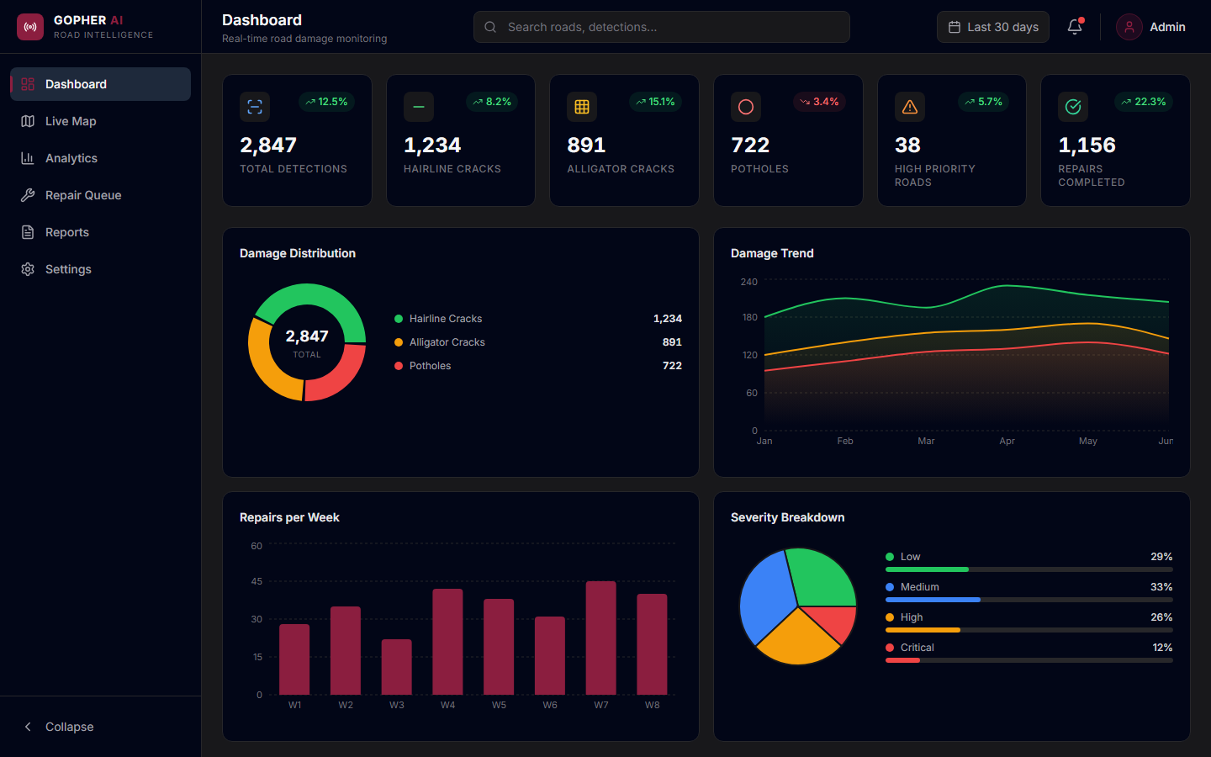
UI Screens Planned for the Application
Existing prototype
Dashboard, live map, damage analytics, repair priority and reports.
Planned integration
Upload images or video, show detections, adjust confidence and confirm damage records.
Prototype screens contain sample data. The model-to-dashboard service is a planned integration.
23CSE473 – Neural Networks and Deep Learning
15 / 18
Notes:
Source: gopher-ui/src/pages and local development screenshot. Existing interface uses sample data. Model API integration, GPS ingestion and reviewer confirmation remain planned. Screenshot is a prototype, not measured operational results.

Slide 17
Standard Paper Chosen & Justification
A Lightweight YOLOv11n-Based Framework for Highway Pavement Distress Detection Under Occlusion Conditions
Li et al. (2025), Applied Sciences 15(17), 9664
DOI: 10.3390/app15179664
Why this paper
Reference result
It uses the same nano YOLO11 family and evaluates pavement damage under occlusion, a relevant source of missed potholes.
RS-YOLOv11n reports mAP50 71.49%, 2.04 M parameters and 5.20 GFLOPs on RDD2022_Mix.
Adaptation: keep the verified YOLO11n baseline and evaluate the denoising proposal through controlled ablations.
23CSE473 – Neural Networks and Deep Learning
16 / 18
Notes:
[1] Li et al. (2025)
A Lightweight YOLOv11n-Based Framework for Highway Pavement Distress Detection Under Occlusion Conditions
Applied Sciences 15(17), 9664
https://doi.org/10.3390/app15179664
Table 4 is the source for the comparator numbers. Do not treat the paper result as a target achieved by the local checkpoint.

Slide 18
References: Journal Papers
[1] Li et al. (2025) — Applied Sciences 15(17), 9664
A Lightweight YOLOv11n-Based Framework for Highway Pavement Distress Detection Under Occlusion Conditions
https://doi.org/10.3390/app15179664
[2] Liu et al. (2025) — Computers, Materials & Continua 85(1), 1073–1094
A YOLOv11 Empowered Road Defect Detection Model
https://doi.org/10.32604/cmc.2025.066078
[3] Mi et al. (2026 volume, online 2025) — Computers, Materials & Continua 86(1), 1–22
Pavement Crack Detection Based on Star-YOLO11
https://doi.org/10.32604/cmc.2025.069348
23CSE473 – Neural Networks and Deep Learning
17 / 18
Notes:
All URLs were selected from publisher sources or local project evidence. SCImago listings establish journal presence, not a claimed 2026 quartile.

Slide 19
References: Journal Papers & Project Evidence
[4] Zhang, Deng & Zou (2025) — PLOS ONE 20(9), e0327387
Automatic road damage recognition based on improved YOLOv11 with multi-scale feature extraction and fusion attention mechanism
https://doi.org/10.1371/journal.pone.0327387
[5] Dong, Yuan & Dai (2025) — Sensors 25(11), 3276
Study on Lightweight Bridge Crack Detection Algorithm Based on YOLO11
https://doi.org/10.3390/s25113276
Model and dataset evidence
gopher-ai_v1.pt, train-10/results.csv, train-10/args.yaml and rdd2022/data.yaml
Ultralytics YOLO11: https://docs.ultralytics.com/models/yolo11/
RDD2022 official archive: https://doi.org/10.6084/m9.figshare.21431547
23CSE473 – Neural Networks and Deep Learning
18 / 18
Notes:
All URLs were selected from publisher sources or local project evidence. SCImago listings establish journal presence, not a claimed 2026 quartile.

