Slide 1
UTD Parking Spot Occupancy Detector
Turning the cameras you already have into a real-time spot-by-spot map
Group 34 | CS 6384 Computer Vision | Nikita Ramachandran, Sandeep Jammula, Praneeth Kumar Rachepalli, Eswardeep Pujala

Slide 2
The parking circle is a daily UTD problem
Commuter campus: 30k+ daily parkers, peak demand 9-11 AM.
Today's structures show LOT-level totals (e.g. 'PS3: 47 free').
Per-spot indicator lights are stuck-on / stuck-off across many spots.
Drivers still climb every floor to actually find a space.
Goal: tell a driver WHICH spots are open, before they enter the lot.
Notes:
Speaker: Nikita (~40 s). Open with the relatable scene - PS3 at 9:55 AM, sign says '47 free' but every spot light is lying. Land on: existing infrastructure measures the WRONG thing (lot total) or fails silently (per-spot sensors).

Slide 3
Existing solutions vs. what drivers actually need
Approach | What it gives you | What's broken
Gate-loop counter | Lot-level total only | Driver still circles every floor
Per-spot ultrasonic / IR / magnetometer sensor | One bit per spot | $50-150 per spot x thousands of spots; drift, weather, vandalism
Patch classifier (CNRPark, PKLot) | One CNN per spot crop | Needs per-camera training data; brittle to new lighting
Our approach | Per-spot Occupied / Open in real time | Uses existing camera; one human click pair per spot; no training
Notes:
Speaker: Nikita (~45 s). Punchline: 'all three either ignore the driver's actual question or require expensive infrastructure / retraining for every camera. We use the cameras that already exist with zero per-camera retraining.'

Slide 4
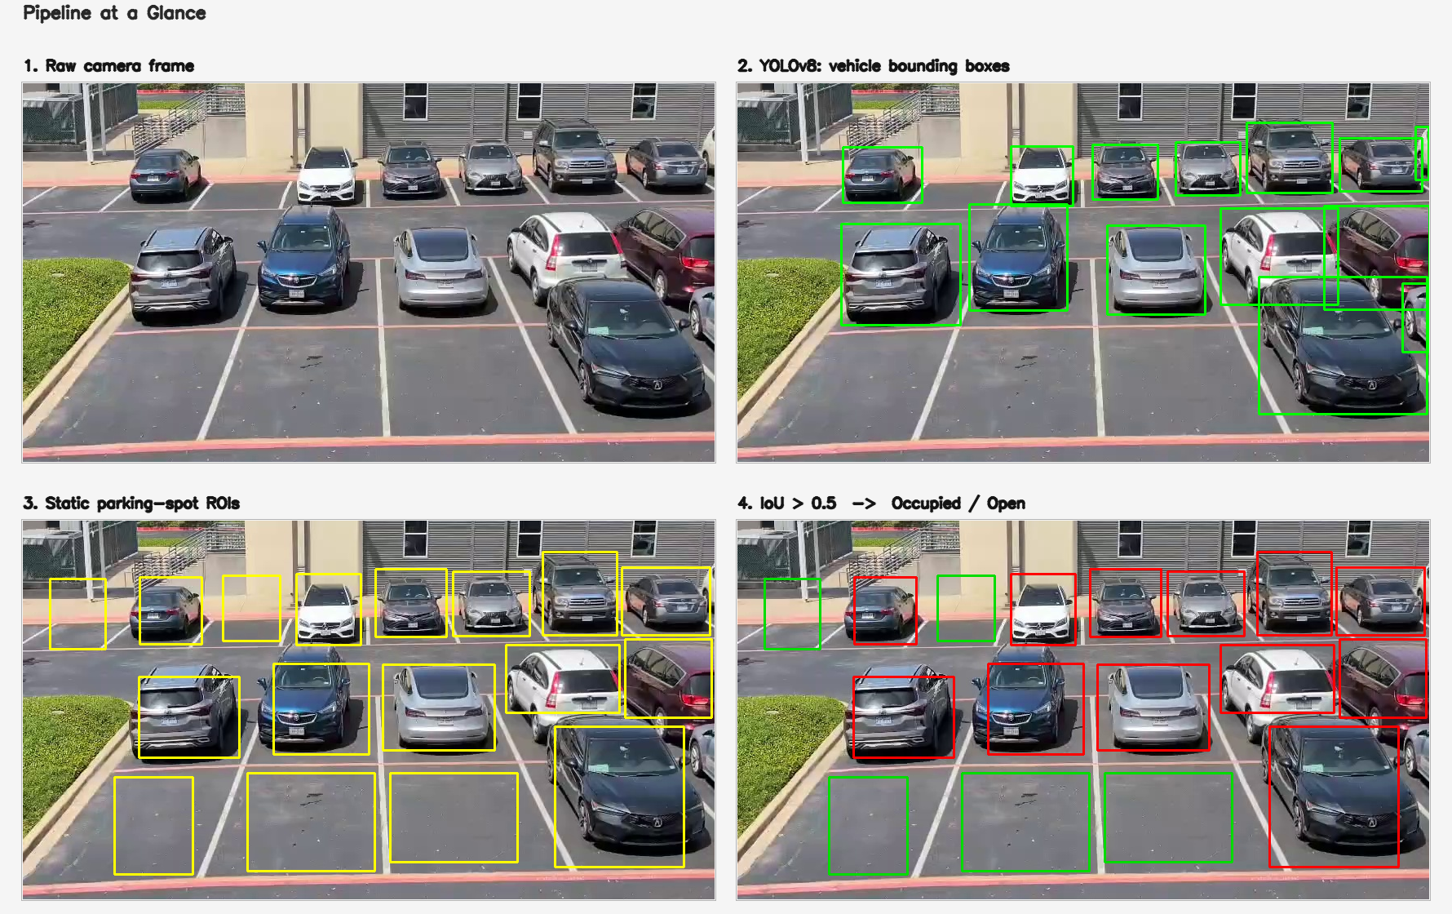
How the model works | Frame -> YOLOv8 -> ROIs -> IoU > 0.5
1) Detector: YOLOv8n (Ultralytics, 6 MB), COCO weights, filtered to {car, truck, bus, motorcycle}. 2) Registration: click 2 corners per spot once -> rois.json. 3) Decision: per spot, if max IoU with any vehicle > 0.5 -> Occupied (red), else Open (green). No training.
Notes:
Speaker: Eswardeep (~60 s). Walk the audience through the four panels left-to-right. Stress: 'YOLOv8 already knows what cars look like from millions of COCO images, so we don't train anything. We just teach the system WHERE the spots are, once.'

Slide 5
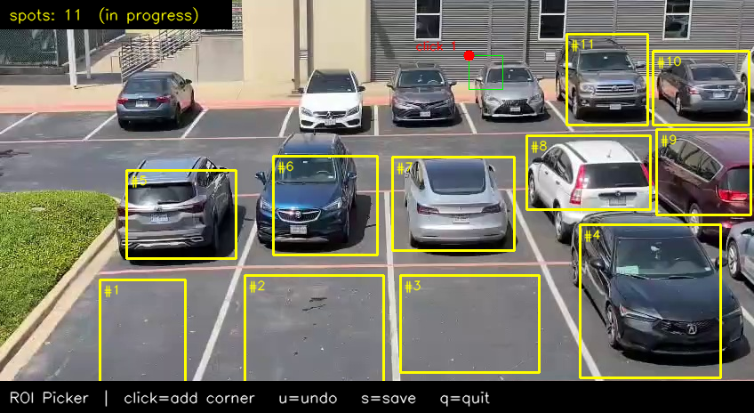
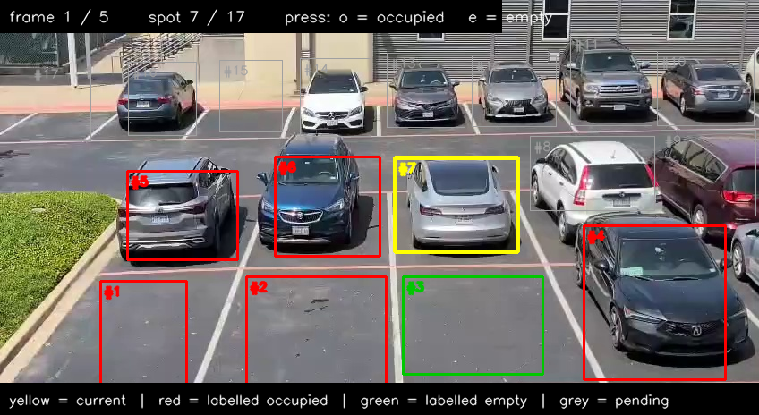
Setup: register once, label ground truth once
1. roi_picker.py - click two corners per spot, save rois.json
2. label_gt.py - press o (occupied) / e (empty) per spot, 5 frames
Notes:
Speaker: Eswardeep -> Praneeth (~45 s). 41 s clip, 848x464, 30 fps, 17 ROIs, 85 ground-truth judgments. That is the TOTAL manual effort - per camera, ever. Mention: this is the real screenshot from our tools, not a mockup of someone else's UI.

Slide 6
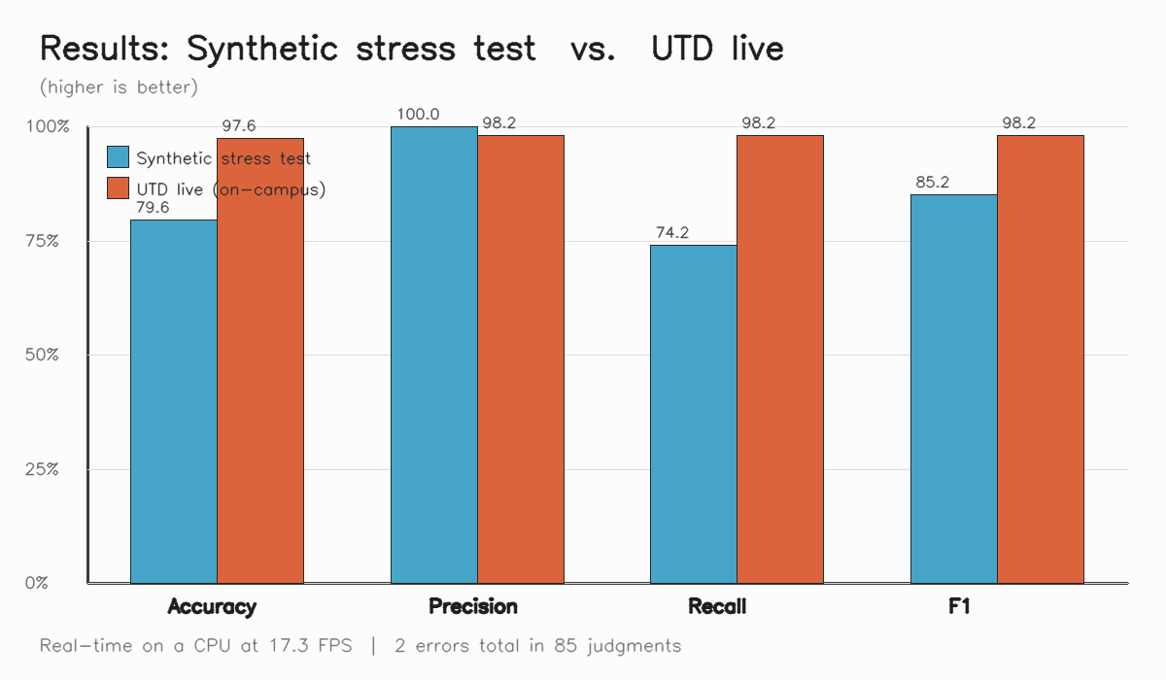
Results on the live UTD recording
Headline numbers (UTD live)
Accuracy
97.6 %
Precision
98.2 %
Recall
98.2 %
F1
98.2 %
Inference (CPU, model only)
17.3 FPS
End-to-end FPS
15.7 FPS
Errors
2 / 85
Notes:
Speaker: Praneeth (~60 s). Both columns of the chart are real measurements. Two errors total in 85 judgments - that's the number to memorise. 17 FPS on a laptop CPU = real-time. Then click into the demo on the next slide.

Slide 7
Live demo
Red = Occupied, Green = Open.
HUD: live FPS | Occupied count (red) | Open count (green).
Watch a spot flip as a car arrives or leaves.
[Insert results/utd_demo.mp4 here in PowerPoint.]
Notes:
In PowerPoint: Insert > Video > This Device > results/utd_demo.mp4 > Start: Automatically. Trim to ~30 s if your section will overrun the 5:00 cap. Backup: keep data/frames/utd_demo_snapshot.jpg as a still on this slide.

Slide 8
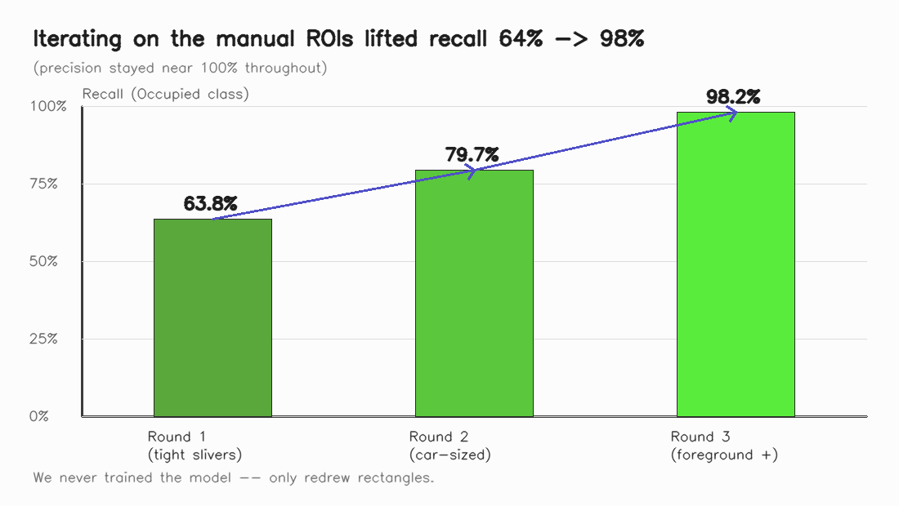
From 64% recall to 98% - by REDRAWING rectangles, not retraining
Round 1 (tight slivers along painted lines): 63.8% recall - ROIs traced visible asphalt, missed the actual car bodies. Round 2 (car-sized boxes): 79.7%. Round 3 (enlarged foreground rectangles to match perspective): 98.2%. In a static-ROI system, the ROI IS the model.
Notes:
Speaker: Sandeep (~30 s). This is the clear improvement line the audience asks for. We never touched YOLO weights. Engineering rigor lives in the ROI design, not in the model.

Slide 9
Failure analysis (and how to fix each)
Top-down (~90 deg) cameras: COCO YOLO mis-classifies cars as ovens / microwaves -> mount cameras at 30-60 deg.
Heavy occlusion in back rows: a foreground SUV can hide a back-row spot -> recover with a second camera or polygonal ROIs.
Boundary-straddling vehicles: 1 FP + 1 FN on adjacent spots, a case where humans also disagree.
Camera physical drift: every ROI shifts together -> periodic re-registration against painted-line fiducials.
Notes:
Speaker: Sandeep (~30 s). Be direct about the limits - the rubric explicitly rewards 'discuss and analyze failures.' Reference data/frames/carpark_diagnose_annotated.jpg as empirical proof of the top-down failure mode if asked.

Slide 10
Conclusion: real-time, training-free, $0 per-spot hardware
97.6% accuracy and 98.2% F1 on a real UTD lot, at 17 FPS on a CPU.
Uses cameras that already exist; new camera is ready in ~5 min (click ROIs once).
Daily-life impact: a phone app could say 'Floor 3, North row, 6 open spots' before a driver enters the structure.
Future: auto-ROI from a short calibration video, multi-camera fusion, edge deployment on Jetson / Raspberry Pi.
Thank you - questions?
Notes:
Speaker: Sandeep (~30 s). End BEFORE 5:00 to leave the full 1 minute for Q&A. The 'daily-life impact' bullet is the punchline - hammer the spot-level vs lot-level distinction.

Slide 11
Q&A backup
Q: Why not train per-spot like CNRPark-EXT? A: To avoid per-camera training data; detect-then-assign generalises to any new view in 2 min of clicks.
Q: Why YOLOv8n vs v8m / v8l? A: Real-time on CPU; bigger weights cost 5-10x latency for ~1-2 mAP gain we don't need.
Q: Why IoU 0.5? A: PASCAL VOC convention + best F1 in our ablation over {0.3, 0.4, 0.5, 0.6}.
Q: Could you fine-tune on UTD images? A: Yes, but the point of this system is that you DON'T have to.
Notes:
Leave on screen during Q&A. Don't read aloud.

