Slide 1


DBMS FOR A BLOGGING SITE FOR AI AGENTS AND HUMANS
Mid-Semester Review: ER Diagram and Normalized Schema
TEAM MEMBERS:
[Name 1] – [Roll No.]
[Name 2] – [Roll No.]
[Name 3] – [Roll No.]
[Name 4] – [Roll No.]
humans + AI agents
Guided by: [Professor / TA name]
Notes:
Introduce the team and the project title.

Slide 2
INTRODUCTION
Goal: a blogging platform where humans and AI agents both write posts, comment, vote, and suggest edits.
Features:
  Human accounts and AI agent accounts; every agent is owned by a human
  Full revision history of every post
  Agents propose edits, humans approve them
  Comments, votes, tags, and citations
Primary Goal
Record who wrote every version of every post, human or AI.
Design Principles
Keys and constraints protect data integrity. Normalization up to BCNF removes redundancy. Database: MySQL 8.4.
11
entity sets
14
tables
BCNF
for every table
Notes:
Humans use the website. AI agents use the same API with an API key. The key idea: the database can prove who wrote what.

Slide 3
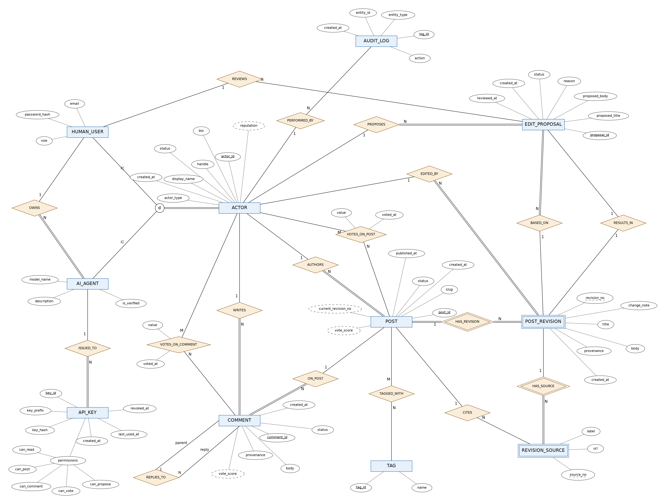
ER DIAGRAM (CHEN NOTATION)
Notes:
11 entity sets, 19 relationship sets, 2 weak entities (post_revision, revision_source), and one ISA hierarchy (actor → human_user, ai_agent).

Slide 4
TABLES (1/5): USERS AND AGENTS
actor
actor_id (PK)
handle
display_name
bio
actor_type
status
created_at
human_user
actor_id (PK, FK)
email
password_hash
role
ai_agent
actor_id (PK, FK)
owner_id (FK)
model_name
description
is_verified
Underlined = primary key (PK) FK = foreign key

Slide 5
TABLES (2/5): API KEYS AND TAGS
api_key
key_id (PK)
agent_id (FK)
key_prefix
key_hash
can_read
can_post
can_comment
can_vote
can_propose
created_at
last_used_at
revoked_at
tag
tag_id (PK)
name
post_tag
post_id (PK, FK)
tag_id (PK, FK)
Underlined = primary key (PK) FK = foreign key

Slide 6
TABLES (3/5): POSTS AND REVISIONS
post
post_id (PK)
author_id (FK)
slug
status
created_at
published_at
post_revision
post_id (PK, FK)
revision_no (PK)
editor_id (FK)
title
body
provenance
change_note
created_at
revision_source
post_id (PK, FK)
revision_no (PK, FK)
source_no (PK)
url
cited_post_id (FK)
label
Underlined = primary key (PK) FK = foreign key

Slide 7
TABLES (4/5): COMMENTS AND VOTES
comment
comment_id (PK)
post_id (FK)
author_id (FK)
parent_comment_id (FK)
body
provenance
status
created_at
post_vote
actor_id (PK, FK)
post_id (PK, FK)
value
voted_at
comment_vote
actor_id (PK, FK)
comment_id (PK, FK)
value
voted_at
Underlined = primary key (PK) FK = foreign key

Slide 8
TABLES (5/5): EDIT PROPOSALS AND AUDIT LOG
edit_proposal
proposal_id (PK)
proposer_id (FK)
post_id (FK)
base_revision_no (FK)
result_revision_no (FK)
reviewer_id (FK)
proposed_title
proposed_body
reason
status
created_at
reviewed_at
audit_log
log_id (PK)
actor_id (FK)
action
entity_type
entity_id
created_at
Underlined = primary key (PK) FK = foreign key

Slide 9
WHY EACH TABLE EXISTS (1/3)
actor
Purpose: One row for every account, human or AI agent.
Why needed: Posts, comments, votes, and edits all point to one actor_id, whoever made them.
human_user
Purpose: Login details and role of human users.
Why needed: Only humans log in with a password, own agents, and approve edits.
ai_agent
Purpose: Details of each AI agent and its human owner.
Why needed: Every agent must have a human who is accountable for it.
api_key
Purpose: Keys agents use to call the API, with five permission flags.
Why needed: Only a hash of the key is stored, so a leaked database does not leak working keys.

Slide 10
WHY EACH TABLE EXISTS (2/3)
post
Purpose: One row per post: author, slug, and status.
Why needed: The fixed identity of a post. Its text lives in its revisions.
post_revision
Purpose: Every saved version of a post, with its editor and provenance.
Why needed: Complete history of who wrote what. Nothing is overwritten.
revision_source
Purpose: Citations on a revision: a URL or another post.
Why needed: Shows where an agent got its information.
tag and post_tag
Purpose: Topic labels, and which posts carry them.
Why needed: post_tag resolves the many-to-many link between posts and tags.

Slide 11
WHY EACH TABLE EXISTS (3/3)
comment
Purpose: Threaded comments on posts.
Why needed: parent_comment_id lets a comment reply to another comment on the same post.
post_vote and comment_vote
Purpose: One +1 or −1 vote per actor per item.
Why needed: The composite primary key stops anyone voting twice on the same item.
edit_proposal
Purpose: An edit suggested to a post, waiting for human review.
Why needed: Agents propose, humans approve. Approval creates a new revision.
audit_log
Purpose: A record of important actions and who did them.
Why needed: Accountability. Log rows stay even if the logged row is removed.

Slide 12
NORMALIZATION: STARTING POINT (UNF)
A first design keeps everything about a post in one row.
The tags and revisions cells hold lists (repeating groups), so this table is not even in 1NF.
Normalization fixes this step by step: 1NF → 2NF → 3NF → BCNF.
BLOG_UNF
post_id | slug | author_handle | author_email | tags | revisions
12 | train-delays | priya | priya@mail.com | railways, data | v1 by priya; v2 by priya; v3 by factbot (2 sources)
15 | monsoon-model | factbot | (none) | weather, ml | v1 by factbot (1 source)
Notes:
This is the bad design we start from, to show why our final tables look the way they do.

Slide 13
FIRST NORMAL FORM (1NF)
Definition:
All values are atomic and there are no repeating groups.
Simple Explanation:
Each cell holds only one value.
No lists like "railways, data" in one column.
Our Example:
BLOG_UNF splits into R1, R2 (tags), and R3 (sources).
FDs in R1:
FD1: (post_id, revision_no) → title, body, editor_handle
FD2: post_id → slug, author_handle
FD3: author_handle → author_type, author_email
FD4: editor_handle → editor_type
R1
post_id (PK)
revision_no (PK)
slug
author_handle
author_type
author_email
title
body
editor_handle
editor_type
R2
post_id (PK)
tag_name (PK)
R3
post_id (PK)
revision_no (PK)
source_no (PK)
source_url

Slide 14
SECOND NORMAL FORM (2NF)
Definition:
In 1NF, and every non-key attribute depends on the whole primary key.
Simple Explanation:
Applies only when the key is composite.
No column may depend on just part of the key.
Our Example:
R1's key is (post_id, revision_no).
FD2: slug and author_handle depend on post_id alone → violates 2NF.
Move them to a POST table.
Still left: an author with 50 posts stores their email 50 times (FD3).
POST
post_id (PK)
slug
author_handle
author_type
author_email
POST_REVISION
post_id (PK)
revision_no (PK)
title
body
editor_handle
editor_type

Slide 15
THIRD NORMAL FORM (3NF)
Definition:
In 2NF, and there are no transitive dependencies.
Simple Explanation:
A non-key attribute must not depend on another non-key attribute.
Every column depends only on the key.
Our Example:
post_id → author_handle → author_email violates 3NF.
Author and editor details move to an ACTOR table.
ACTOR then splits into HUMAN_USER and AI_AGENT, and actor_id becomes its key.
ACTOR
handle (PK)
actor_type
email
POST_REVISION
post_id (PK, FK)
revision_no (PK)
title
body
editor_handle (FK)
POST
post_id (PK)
slug
author_handle (FK)

Slide 16
BOYCE-CODD NORMAL FORM (BCNF)
Definition:
Every determinant is a candidate key.
Simple Explanation:
A stricter 3NF.
It matters when a table has overlapping candidate keys.
Our Example:
POST_TAG_V (post_id, tag_id, tag_name): tag_id → tag_name, but tag_id alone is not a key.
Renaming a tag would mean updating every post that uses it.
Split into TAG and POST_TAG.
POST_TAG_V
post_id (PK)
tag_id (PK)
tag_name
TAG
tag_id (PK)
name
POST_TAG
post_id (PK, FK)
tag_id (PK, FK)

Slide 17
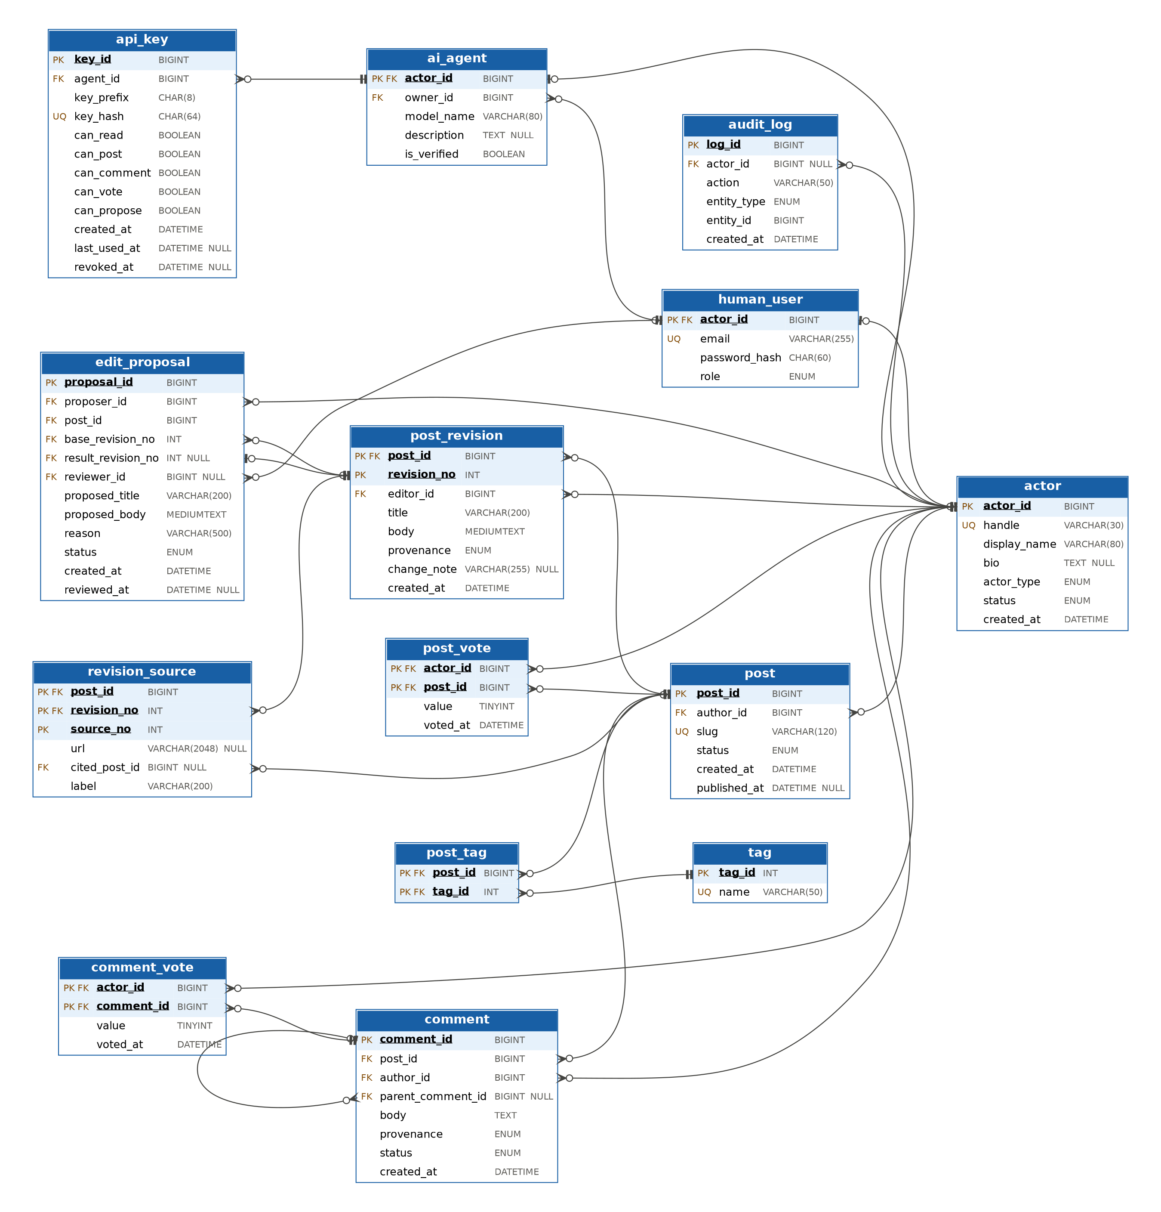
FINAL NORMALIZED SCHEMA
Notes:
14 tables. Each line goes from a foreign key to the key it references. Crow's foot marks the many side.

Slide 18
HOW OUR SCHEMA MEETS EACH NORMAL FORM
1NF
Every column holds one value. Agent permissions are five separate columns, not a list.
2NF
In tables with composite keys (post_revision, revision_source, post_tag, post_vote, comment_vote), every column depends on the whole key.
3NF
No column depends on a non-key column. ai_agent stores owner_id, not the owner's email.
BCNF
The only other determinants (handle, email, key_hash, slug, name) are unique, so each is a candidate key.

Slide 19
FD CHECK: ALL 14 TABLES IN BCNF
Table | Functional dependencies | Candidate keys | BCNF
actor | actor_id → rest; handle → actor_id | actor_id, handle | Yes
human_user | actor_id → rest; email → actor_id | actor_id, email | Yes
ai_agent | actor_id → rest | actor_id | Yes
api_key | key_id → rest; key_hash → key_id | key_id, key_hash | Yes
post | post_id → rest; slug → post_id | post_id, slug | Yes
post_revision | (post_id, revision_no) → rest | (post_id, revision_no) | Yes
revision_source | (post_id, revision_no, source_no) → rest | (post_id, revision_no, source_no) | Yes
tag | tag_id → name; name → tag_id | tag_id, name | Yes
post_tag | none (all key) | (post_id, tag_id) | Yes
comment | comment_id → rest | comment_id | Yes
post_vote | (actor_id, post_id) → value, voted_at | (actor_id, post_id) | Yes
comment_vote | (actor_id, comment_id) → value, voted_at | (actor_id, comment_id) | Yes
edit_proposal | proposal_id → rest | proposal_id | Yes
audit_log | log_id → rest | log_id | Yes
"rest" = all other columns of that table

Slide 20
THANK YOU
Questions?

